Slide 1



Securing a Control System: Experiences from ISO 27001 Implementation
National Superconducting Cyclotron Laboratory
Vasu Vuppala, Ph.D., PMP
John Vincent, Ph.D.
Jay Kusler
Kelly Davidson
{vuppala,vincent,kusler,davidson}@nscl.msu.edu
National Superconducting Cyclotron Laboratory,
East Lansing, Michigan, USA.

Slide 2
Overview
“”
Background
Argus the ISMS: Overall Approach
Risk Assessment
Asset Classification
Documentation
Project Statistics
Current Status
FRIB Data Security
Lessons Learnt
Conclusion

Slide 3
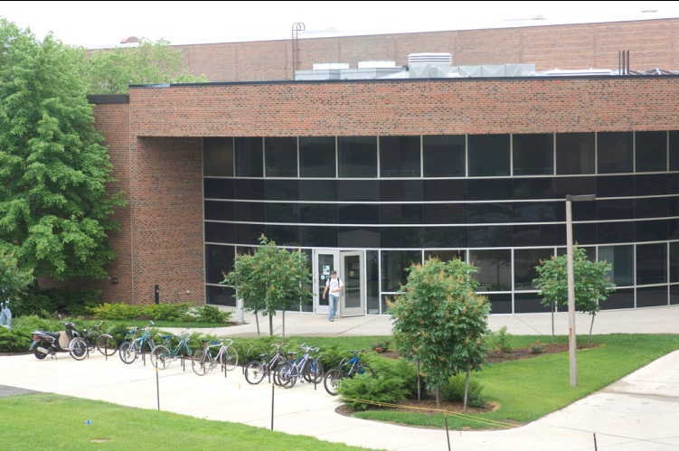
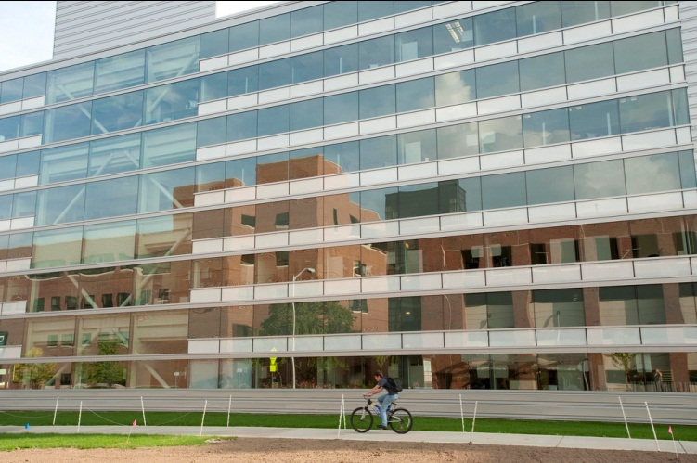
Background: NSCL
“”
Rare Isotope Research
Two Superconducting Cyclotrons
Located on Campus of Michigan State University, USA
About 400 Employees
Building the Facility for Rare Isotope Beam (FRIB)

Slide 4
Background: The Initial Problem
“”
Restrict Traffic to Control Network
Reduce Inadvertent Disruptions to Experiments
Group Based Access Control to EPICS Channels
Ability to Reserve/Release Devices (Their Channels)

Slide 5
Information Security (IS)
“.”
Information Assets (IA)
IA Containers
Technology
Physical
Human
IS Security: Protection of IA from threats for business continuity, minimize risk
Achieved by Implementing a Set of Controls
What are Controls?
Means of Managing Risk
Policy, Procedure, Organization Structure, Software/Hardware Functions

Slide 6
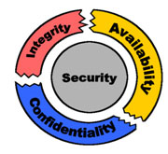
Information Security
“.”
Requirements
Assessing Risks to the Organization
Legal, Regulatory, Contractual Compliance
Organization’s objectives for Information Processing
Principles
Confidentiality
Integrity
Availability

Slide 7
ISO/IEC 27000 Series Standards
“.”
27000 – Overview
27001 – Specification
27002 – Code of Practice (Controls)
27003 – Implementation Guidance
27004 – Information Security Management Measurement
27005 – Information Security Risk Management
27006 – Certification/Registration Process

Slide 8
ISO/IEC 27001
“.”
The Specification
Process Approach: Plan-Do-Check-Act (PDCA) Model
Defines ISMS Requirements
Establish, Implement and Operate, Monitor and Review, Maintain and Improve
Documentation Requirements
Management Responsibilities
Commitment, Resources, Training, Awareness
Internal Audits
Management Review
ISMS Improvement
Corrective and Preventive Actions
Plan
Do
Check
Act

Slide 9
ISO/IEC 27002
“.”
A Code of Practice: Annex to 27001
Security Clauses (11)
Main Security Categories (39)
Security Objective
Security Controls
11 Security Clauses
Security Policy
Information Security Organization
Asset Management
HR Security
Physical Security
Communication and Operations Management
Access Control
Information Systems
Information Security Incident Management
Business Continuity Management
Compliance

Slide 10
Argus The ISMS
“.”

Slide 11
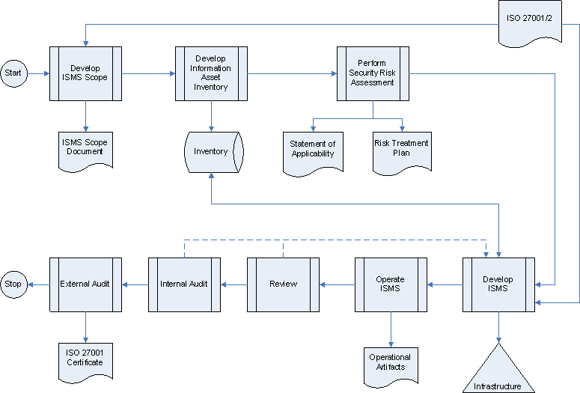
Argus Roadmap
“.”

Slide 12
Argus: Lifecycle I
“.”
Plan
Define Scope and ISMS Policy
Develop Approach to Identify, Evaluate, and Treat Risks
Identify and Analyze Risks
Evaluate Risk Treatment Options
Select Controls to Treat Risks: Statement of Applicability
Do
Develop Risk Treatment Plan (RTP)
Implement RTP
Measure Effectiveness of Controls
Manage Information Security Incidents
Implement Training and Awareness Programs

Slide 13
Argus: Lifecycle II
“.”
Check
Monitor and Review Argus
Conduct Internal Audits
Measure Argus’ Effectiveness Based on Audits, Incidents, Feedback etc
Review Risk Assessment
Act
Identify Improvements Based on Reviews/Audits
Identify and Implement Corrective and Preventive Actions

Slide 14
Risk Assessment Method Based on OCTAVE Allegro
“.”
Establish Risk Measurement Criteria: Identify and Prioritize Impact Areas:
Employee Safety & Health, Quality Objective, Reputation, Productiity, Financial, Legal
Identify Information Assets
Identify Information Asset Containers: Technical, Physical, Human
Identify Areas of Concern: Conditions that can affect IA
Identify Threat Scenarios: Actors, Means, Motives, Outcomes
Evaluate Impact of Each Threat
Identify Risks: Threat + Impact
Analyze Risks

Slide 15
Risk Assessment Method: Example
“.”
Impact | Value
No Impact | 0
Low | 1
Medium | 2
High | 3

Slide 16
Argus: Asset and Risk Profiles
“”

Slide 17
Documentation
“.”
Argus Handbook: Informal Overview
Argus ISMS Policy: Formal Policy for ISMS
Argus ISMS Procedure: PDCA Steps
Argus Documentation Policy
Argus Document Procedure
Management Responsibilities
Internal Audits Procedure
Management Review Policy
Argus Corrective and Preventive Action Policy
Argus Controls
Policy, Procedures, Guidelines etc from ISO/IEC 27002
Policies
Procedures
Guidelines, Checklists, Templates, Standards

Slide 18
Information Security Organization
“”
EEDH
ISB
ISM
IAT
ITG
HRM
PSM
EE Department Head (EEDH)
Information Security Board (ISB)
Information Security Manager (ISM)
Physical Security Manager (PSM)
Human Resource Security Manager (HRSM)
Internal Audit Team (IAT)
IT Management Group (ITG)

Slide 19
Information Asset Classification
“”

Slide 20
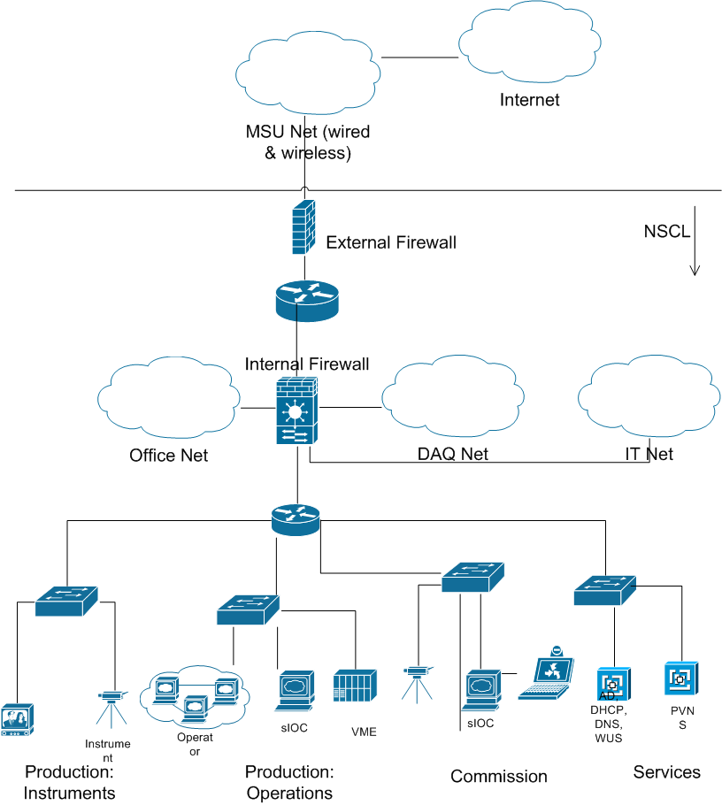
NSCL Networks
“”

Slide 21
Access Control Matrix
“”

Slide 22
Physical & HR Controls
“”
Physical
Outer Perimeter
Magnetic Card and PIN
Time Based
Front-desk
Accelerator Facility
Magnetic Card
HR
Pre-Employment
Background Criminal Check
Post-Employment
Account, Entry Card Revocation
Assets Transfer

Slide 23
Business Continuity (BC)
“”
Disaster Recovery (DR)
Backup Tapes Transported Offsite: Weekly
Offsite Live Backup (almost done)
Restoration Logs
Redundancy
BC Procedures
Not Tested
To Be Hosted Offsite

Slide 24
Communication and Ops Controls
“”
Operating Procedures
Change Management
Segregation of Duties
Separation of Development, Test, and Operational Facilities
Shutdowns
Networks to be Segregated
Malicious and Mobile Code
Backups
Network Controls
Removable Media: Handling, Disposal
Information Exchange
Monitoring: Access Logs, Fault Logs, Clock Sync (NTP)

Slide 25
Other Controls
“”
Software Development, Maintenance, Acquisition
Authentication
No Clear Text Passwords
No Passwords in Code
Design and Code Reviews
IS Incident Management
Trouble Report System
Compliance:
Legal, Intellectual Property, Regulatory
Limited IS Requirements

Slide 26
System Support
“”
Document Management System
Incident Reporting/Management System
Training System

Slide 27
Current Status
“”
Completed
Risk Assessment
Statement of Applicability
Initial Set of Documentation
Selection of Registrar
Ongoing
Vetting of Policies and Procedures (Documentation)
Initial Stages of Implementation
Expected
Internal Audit: Nov 2011
External Audits: Dec 2011
Certification: Early 2012

Slide 28
Project Statistics
“”
Scope: NSCL Electronics Department
Time:
Start: August 2009
Expected End: Jan 2012
Effort (in Person Hours)
Planned: ~1000
Current: ~800
Cost :
Audit: Approximately 30,000.00 USD
Pre-Assessment
Stage I & II External Audits
Two Post-certification Audits (Yearly)

Slide 29
Challenges
“”
Research and Education Environment
More Open
Resources
Organizational Changes
Implementing Secure Software Development Practices
Interest Level: Non-technical and Mundane Work
Infrastructure Changes
Technical
Control Net: No Encryption, Authentication, Authorization
Cabling
Password Aging
Employee Agreements

Slide 30
Lessons Learnt
“”
Start Small. Implement. Expand.
Not Necessary to Include the Whole of IT
Use Existing Processes. Do Not Make Drastic Changes
Use Small Iterations
Leverage Existing Management Systems
ISO 9001, 14001, 18001,…
Reserve Resources, If Possible
Management Support is Crucial
Don’t Lose Focus or Morale
Needs Support From Every Unit in the Organization

Slide 31
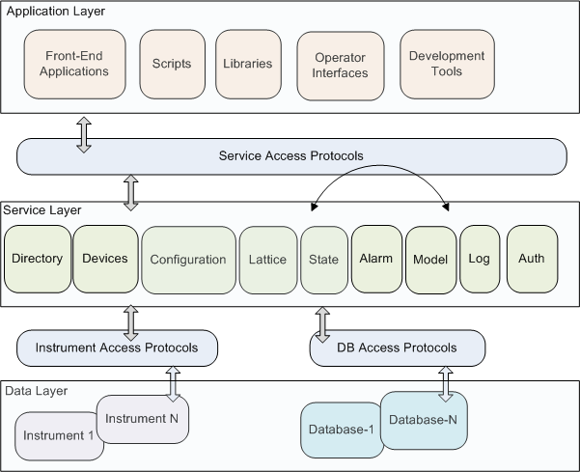
Control System Information Architecture
“”

Slide 32
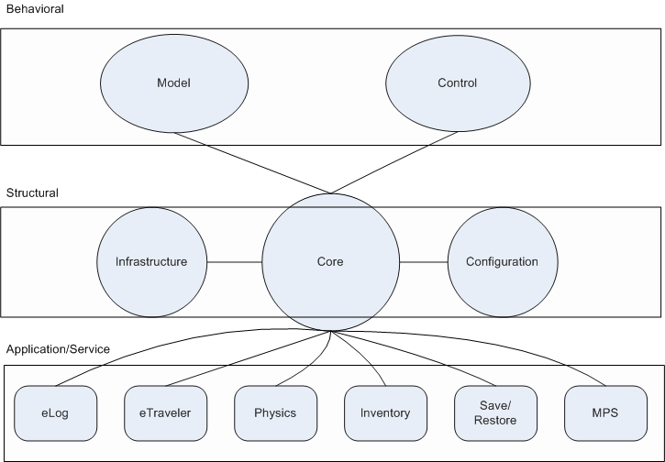
FRIB Database Architecture
“”
Security

Slide 33
FRIB Data Security
“”
Structural
Who Can Modify Attributes of a Cavity?
Area Based Component Hierarchy
Access Control on Areas
Behavioral
Who Can Modify the Voltage (PV) on a Power Supply?
Operations Based Component Hierarchy
Access Control on the Operations Elements
Standalone ‘Reserve/Release’ Application
Not Very Clear How to Implement it on EPICS
Modify IOC db Files. IOCs Reload db Files
Application
Who Can Write to Operations LogBook?

Slide 34
Conclusions
“.”
Started as a Small Technical Problem
Grew to ISO/IEC 27001
Developed Argus
Risk Assessment Approach and Results
Information Assets and Classification
Controls: Access, Operations, Physical, HR, BC etc
References
ISO/IEC 27001
ISO/IEC 27002
ISO 27k Toolkit

Slide 35
Thank you!
“.”

