Slide 1



Quark: A Dynamic SDLC Methodology
National Superconducting Cyclotron Laboratory
Vasu Vuppala, Ph.D., PMP
John Vincent, Ph.D.
{vuppala,vincent}@nscl.msu.edu
National Superconducting Cyclotron Laboratory,
East Lansing, Michigan, USA.

Slide 2
Overview
“If you can't describe what you are doing as a process, you don't know what you're doing”
Background
Software Crisis
SDLC Models
NSCL EE Department Requirements
The Quark Software Process Model
Implementation
Results
Conclusion

Slide 3
Software Crisis
“Real programmers can write assembly code in any language. -Larry Wall”
Software Crisis
Software Projects Behind Schedule
Over Budget
Low Quality
Difficult to Maintain
Inefficient
Software Process Models, SDLC Methodologies
Waterfall, V-Model, Spiral, RUP, Agile (Scrum, XP, FDD,DSDM etc)
Frameworks
CMMI, ISO 9000-3, PMBOK
Quality Management Systems
TQM, Six Sigma, Lean Software Development

Slide 4
Software Engineering
“We adore chaos because we love to produce order. -M. C. Escher”
Four Decades and Still No Light
Software Development: Art, Science, or Black Magic?
Engineering Discipline Futile for Software Development?
Humanist Management
Multi-disciplinary: Psychology, Sociology, Organizational Theory
Personality Types and Roles
Creativity vs Efficiency
Chaos and Creativity
Predictive vs Adaptive

Slide 5
NSCL Requirements
“You can always tell a physicist, but you can't tell him much.”
Transparent
Predictive
Un-bureaucratic
Low Overhead
Minimal Customer Interaction
Must Not Stifle Creativity
Single Model

Slide 6
SDLC Model Selection
“Three virtues of a programmer: laziness, impatience, and hubris. -Larry Wall.”
 | Waterfall | RUP | Agile | V-Model
Requirements Volatility | Low | High | High | Low
Requirements Clarity | High | Medium | Low | High
Development | Custom | Custom | Custom/Product | Custom/Product
Customer Availability | Low | High | High | Low
Criticality | Low | High | Medium | Medium
Complexity | Low | High | High | Medium
Size | Low | High | Medium | Medium
Customer Involvement | Low | High | High | Low

Slide 7
Quark Model: Elements
“All science is either physics or stamp collecting. -Ernest Rutherford.”
Iterations
Parameterized: Quark Parameters (QMPs)
Projects
Qualified: Project Characteristics (PCTs)
Project Management
Integrated

Slide 8
Quark Model: QMPs
“Remember that there is no code faster than no code.”
Duration
Change Control Specification
Planning Detail
Documentation Detail
Communication
Quality Control

Slide 9
Quark Model: Static PCTs
“Brooks Law: Adding manpower to a late software project makes it later!”
Safety and Security Requirements
Quality Requirements
Timeline Constraints
Customer Availability
Bespoke or off-the-shelf
Contract Type
Team Location

Slide 10
Quark Model: Dynamic PCTs
“Brooks Law: Adding manpower to a late software project makes it later!”
Requirements Clarity
Customer Requirements Clarity
Size
Technology Expertise
Complexity
Estimate Confidence Level

Slide 11
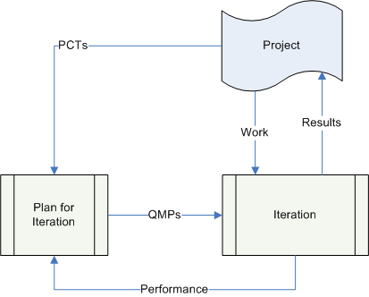
Quark Model
“The perfect project plan is possible if one first documents a list of all the unknowns.”

Slide 12
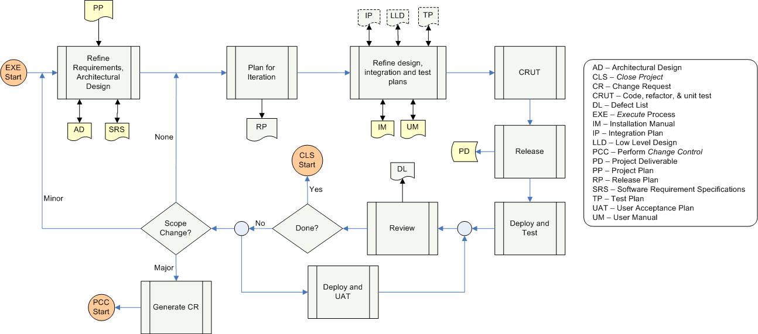
Development Process
“If at first you don't succeed, call it version 1.0”

Slide 13
Development Process
“You cannot teach beginners top-down programming, because they don't know which end is up. -Hoare.”
Refine Requirements and Architecture
Plan for iteration or release (PFI)
Refine design and test plans
Code, Refactor, Unit Test (CRUT)
Release
Deploy and Test
Review
Perform User Acceptance Test (UAT)

Slide 14
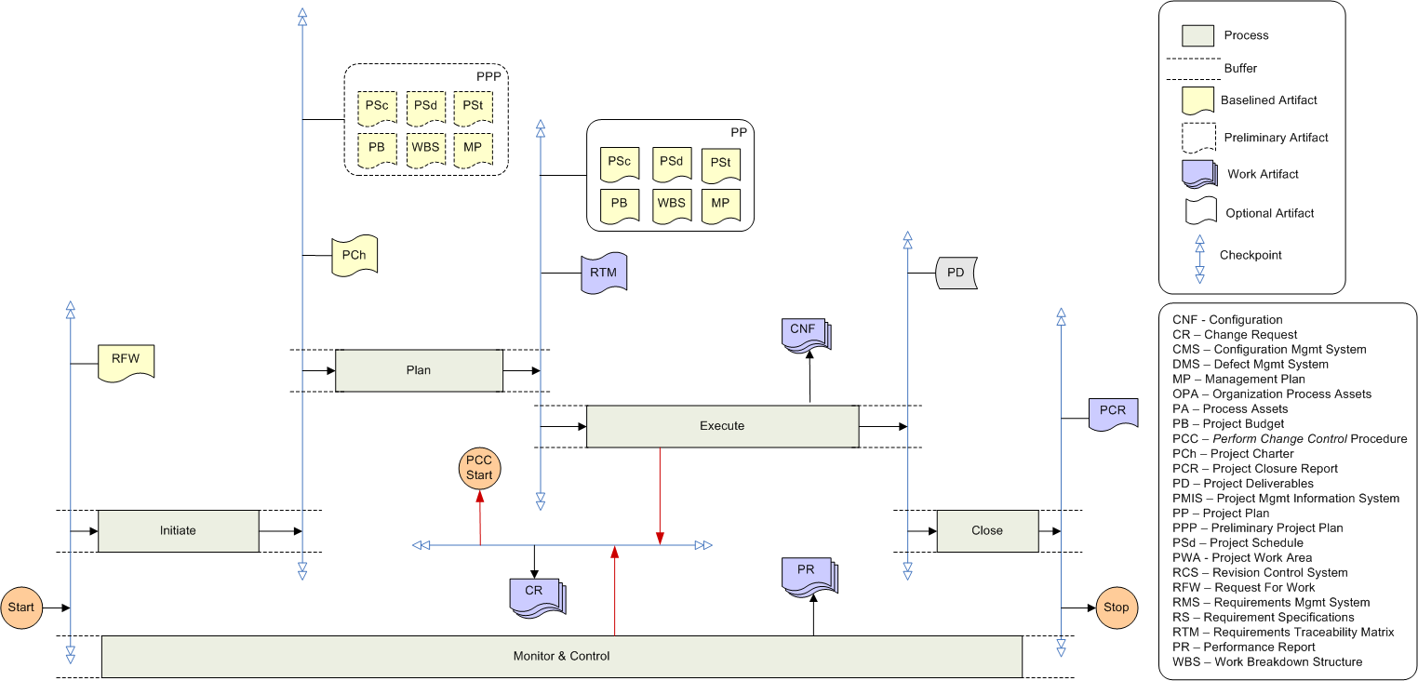
PM Processes
“I have always found that plans are useless, but planning is indispensable -Eisenhower.”

Slide 15
Performance Measurement
“Wirth's law: Software gets slower faster than hardware gets faster.”
Earned Value Management (EVM)
Planned Value (PV): Work Scheduled
Earned Value (EV): Work Completed
Actual Cost (AC): Cost Incurred
Cost Performance Index (CPI) = EV/AC
Schedule Performance Index (SPI) = EV/PV
Performance Measured Periodically (Weekly)

Slide 16
Documentation
“If the code and the comments disagree, then both are probably wrong.”
Refined Iteratively
QMPs Dictate the Detail Level
SRS and AD Kept in Sync with CRUT of Last Iteration
Essential Documents
Requirement Specifications, Architecture Document
Installation Manual, Release Notes, User Manual
Project Plan, Project Closure Report

Slide 17
Implemenation: SPI
“In theory, there is no difference between theory and practice. But, in practice, there is.”
Software Process Infrastructure (SPI)
Policies
Procedures
Guidelines, Checklists, Templates, Standards

Slide 18
Implementation
“Nine people can’t make a baby in a month. - Brooks”
Quark SPI
Hosted on the Web
Policies Based on CMMI-Dev 1.2
Procedures Based on QM, PMBOK-4
Templates
LEMA
Project Plan, SRS, AD, PSR, EVM, PQM, PCR

Slide 19
Implementation: Quark Model
“Simplicity is prerequisite for reliability. -Edsger W.Dijkstra.”

Slide 20
Preliminary Results
“Better train people and risk they leave - than do nothing and risk they stay.”
All Projects In EE Department Follow QM
PM Processes Being Utilized By Other Groups
First Software Projects:
Channel Access Protocol on Rabbit CoreModule
LINAC Emittance Measurement Application (LEMA)
Currently 5 Software And About 15 Hardware Projects Using QM

Slide 21
Results: LEMA
“Measuring programming progress by lines of code is like measuring aircraft building progress by weight.”
Under Budget
Slight Schedule Slippage Due to Customer Surveys
Customer Satisfaction Survey: 8.4/9

Slide 22
Silver Bullet?
“For every complex problem there is an answer that is clear, simple, and wrong.”
Have We Killed The Beast?
Too Early to Say?
Far From It….
Subjective Measurement Of QMPs And PCTs
EVM May Not Be Suitable For All Types Of Projects
Heavier-weight Model (Due To PM)

Slide 23
Conclusions
“The software isn't finished until the last user is dead.”
In Less Than a Year We Have Moved From Almost No Processes to Mature Processes
Management vs Development
Quark’s Processes Are Still Being Evaluated
Resource Utilization
Current Work
Objective Measurement Of PCTs And QMPs
EVM For QM
Tailoring Integration
Requirements Traceability
Project/Release Performance

Slide 24
Thank you!
“Software and cathedrals are much the same - first we build them, then we pray.”

