Slide 1

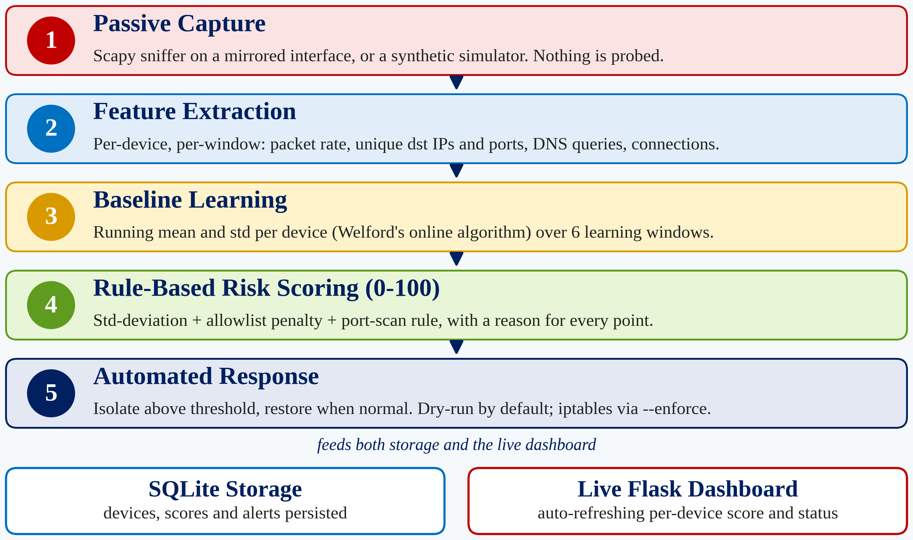
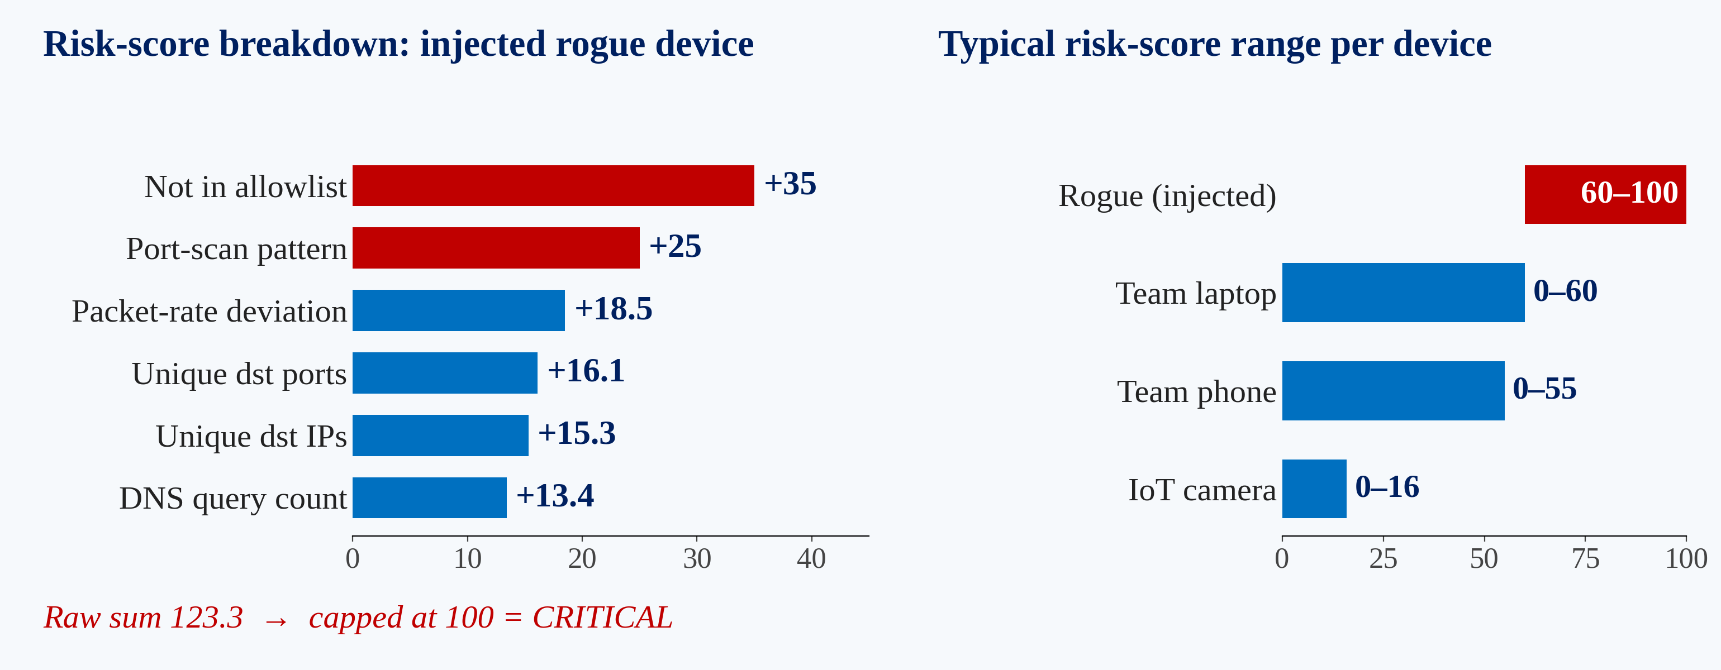
Rogue Device Detection Using Passive Network Traffic
COHORT
INNOVATION
RESEARCH
IMPACT
Network Security, IoT and Behavioral Analytics
Per-Device Risk Scoring with Self-Healing Response
Signature-Based IDS Misses Behavioral Drift
Campus LAN, IoT Gateway and SOC-Assist Protection
Abstract
Proposed Methodology
Home and campus LANs now host laptops, phones and IoT devices, and a single compromised or rogue device can move through the network long before anyone notices. Signature-based IDS and static firewall rules catch only known patterns, miss gradual behavioral drift, and need manual intervention once a threat is flagged. This project presents a behavior-driven, self-healing network security system built on passive monitoring. A per-device behavioral baseline (packet rate, unique destination IPs and ports, DNS queries, connection counts) is learned online with Welford's algorithm, and a rule-based 0-100 risk score quantifies each device's deviation, with a human-readable reason for every point added. When the score crosses a threshold the device is isolated, then re-evaluated and restored once its behavior normalizes. In a reproducible 90-second simulation, an injected rogue device reached a critical score of 100 and triggered an isolation action (logged in dry-run mode), while known devices mostly stayed in the normal range; 8/8 unit tests pass. A short baseline window causes some false positives, which motivates a robust estimator and an ML anomaly layer.
Objectives
Experimental Results
Design a passive traffic-monitoring module that builds a per-device behavioral baseline (packet rate, connections, DNS, ports).
Develop a rule-based 0-100 risk score for deviation from baseline, to be layered with an ML anomaly-scoring component.
Implement automated response: isolate a high-risk device, then re-evaluate and restore access once behavior normalizes.
Build a live dashboard showing per-device risk score, status and response history.
8/8
pytest unit tests passing
90 s
reproducible simulation run
100
rogue-device risk score (critical)
1/1
injected rogue detected in demo
Research Gap and Novelty
Gap 1: device-fingerprinting work (passive 802.11, IoT behavioral, DNS-based) stops at identification and classification.
Gap 2: self-healing SDN and cloud frameworks target infrastructure faults, not per-device behavior.
Gap 3: none of the surveyed sources fuses per-device behavioral risk scoring with automated isolation and recovery.
Novelty: a continuous 0-100 score tied to an isolate, re-evaluate, restore loop; interpretable rules now, ML layer planned.
Limitations and Future Work
Comparison with N-BaIoT Baseline
Baseline noise: only 6 learning windows, so the simulated laptop sometimes scored suspicious/high-risk (a false positive). Fix: more windows or a robust MAD estimator.
Real-network test: run live_capture.py on a controlled LAN with a mirrored or monitor-mode interface.
ML layer: add anomaly scoring as a second signal beside the interpretable rule engine.
Evaluation: no accuracy, precision/recall or F1 is claimed yet; repeated attack and benign runs will report detection rate, false-positive rate and latency.
Aspect | N-BaIoT (2018) | This project
Detection | Deep autoencoder, 115 statistical features | Lightweight rule-based scoring, interpretable features
Output | Binary / 10-class attack label | Continuous 0-100 risk score + reasons
Data source | Fixed offline dataset | Live passive capture or simulator
Response | Stops at classification | Automated isolate / restore
Baseline | Global model, no per-device baseline | Per-device Welford mean / std
Adaptation | Needs offline retraining | Baseline adapts online
Conclusion
A working end-to-end prototype: passive capture, per-device baselining, 0-100 risk scoring, isolation logging and a live dashboard.
The injected rogue device reached a critical score of 100 while known devices mostly stayed normal; baseline noise is the main limitation.
References
Neumann, Heen, Onno (2014). An empirical study of passive 802.11 device fingerprinting. arXiv:1404.6457.
Prasad, Biju, Somani, Mitra (2023). Context-aware behavioral fingerprinting of IoT devices via network traffic analysis. SECRYPT 2023.
Meidan et al. (2018). N-BaIoT: network-based detection of IoT botnet attacks using deep autoencoders. IEEE Pervasive Computing.
SecuNet-4D: a comprehensive framework for distributed SDN security and resilience (2025). Scientific Reports.
US Patent 10,320,825: fingerprint merging and risk-level evaluation for network anomaly detection.
Welford, B. P. (1962). Note on a method for calculating corrected sums of squares and products. Technometrics, 4(3).
Team Details
Team No. 14 | Engineering Capstone Project - I
Guide: Dr. K. Swanthana, Associate Professor, Dept. of CSE
2320030400 – Venkata Vasudeva Reddy Yeddula
2320030412 – Shivarathri Pradeep
Department of Computer Science and Engineering

