Slide 1


Minor Project
Title: Plagiarism Detection
Presented by:
Vaswati Gogoi (500110490)
Sagnik Roy (500109927)
Guided by:
Dr. Surbhi Saraswat

Slide 2
Content
Abstract
Introduction
Literature Review
Problem Statement
Objective
Methodology
Results
UML Diagram
PERT Chart
SWOT Analysis
Conclusion
12. References

Slide 3
1. Abstract
Academia alongside content creation relies on plagiarism detection as a core activity to protect originality along with maintaining integrity. This study investigates the implementation of different plagiarism detection methods which merge string matching algorithms with NLP techniques and machine learning-based approaches along with big data tools. The proposed system seeks to establish an efficient plagiarism detection solution which detects document overlaps while marking down existing content. The paper evaluates present methods and establishes an enhanced approach before completing effectiveness tests.

Slide 4
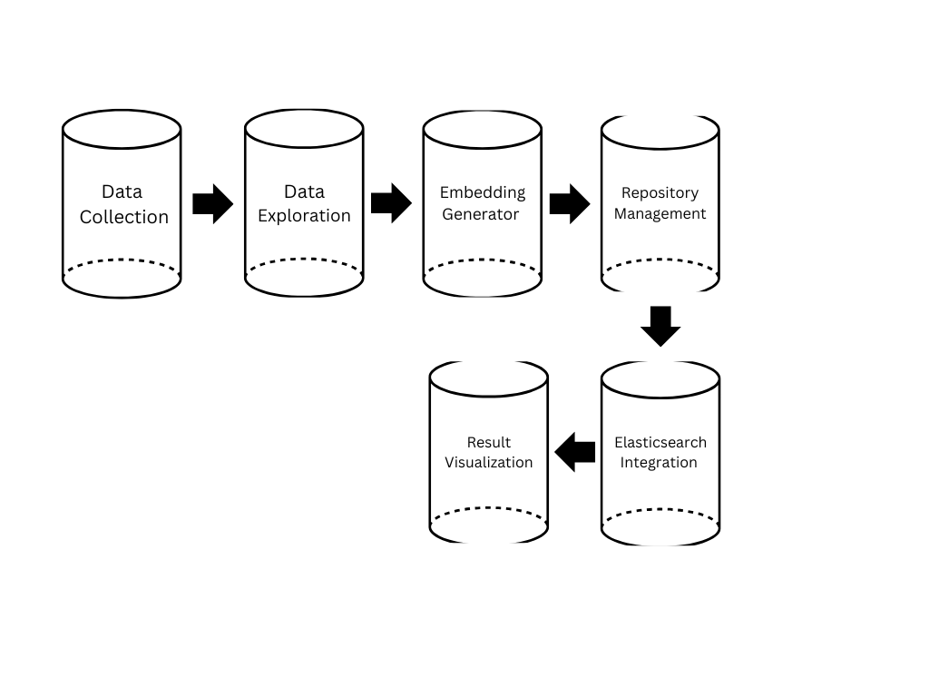

2. Introduction
The extensive online content availability has made plagiarism which involves stealing intellectual work without citations into a major issue. The extensive amount of data makes manual examination methods ineffective for data verification purposes. Plagiarism detection systems based on automation employ different analysis methods that let them compare content documents while searching for instances of duplicate material. The system development project focuses on creating an efficient approach to detect plagiarized content through advanced computational methodologies.
BLOCK DIAGRAM

Slide 5
3.Literature Review
Utilization of NLP Techniques in Plagiarism Detection System through Semantic Analysis using Word2Vec and BERT
Latina, Jeffrey V., et al. "Utilization of NLP Techniques in Plagiarism Detection System through Semantic Analysis using Word2Vec and BERT." 2024 International Conference on Expert Clouds and Applications (ICOECA). IEEE, 2024.
Key Takeaway:
  Focuses on detecting paraphrased and translated texts, which are challenging for traditional plagiarism detection tools.
  Uses a hybrid model that combines multiple NLP techniques for improved accuracy.
2. Automated Plagiarism Detection in Moodle
Kodali, Ravi Kishore, Tanvi Shekhar, and Lakshmi Boppana. "Automated Plagiarism Detection in Moodle." TENCON 2023-2023 IEEE Region 10 Conference (TENCON). IEEE, 2023.
Key Takeaway:
  Focuses on detecting plagiarism in handwritten text using OCR
  Integration with Moodle and Turnitin for automated plagiarism detection.
3. String Matching based Plagiarism Detection for Document in Bahasa Indonesia
Parwita, Wayan Gede Suka, I. Gusti Ayu Agung Diatri Indradewi, and I. Nyoman Saputra Wahyu Wijaya. "String matching based plagiarism detection for document in Bahasa Indonesia." 2019 5th International Conference on New Media Studies (CONMEDIA). IEEE, 2019.
Key Takeaway:
  The proposed system uses a string-matching approach, which involves comparing text patterns character by character
  This approach is enhanced with preprocessing steps like tokenization, stopword removal, and stemming to improve accuracy.
4. A Plagiarism Detection Architecture Based on OpenStack Services
Vodă, Georgian, and Adrian Alexandrescu. "A plagiarism detection architecture based on OpenStack services." 2023 27th International Conference on System Theory, Control and Computing (ICSTCC). IEEE, 2023.
Key Takeaway:
  Scalability and parallel processing using OpenStack.
  Integration with IAM for user management.

Slide 6

4. Problem Statement
Plagiarism detection continues to be an unresolved issue because of rewording techniques combined with word substitution and document restructure methods. Semantic plagiarism remains undetected by various existing detection methods due to excessive text alterations. The proposed system needs development to identify both precise matches along with semantic correspondences using big data tools.

Slide 7
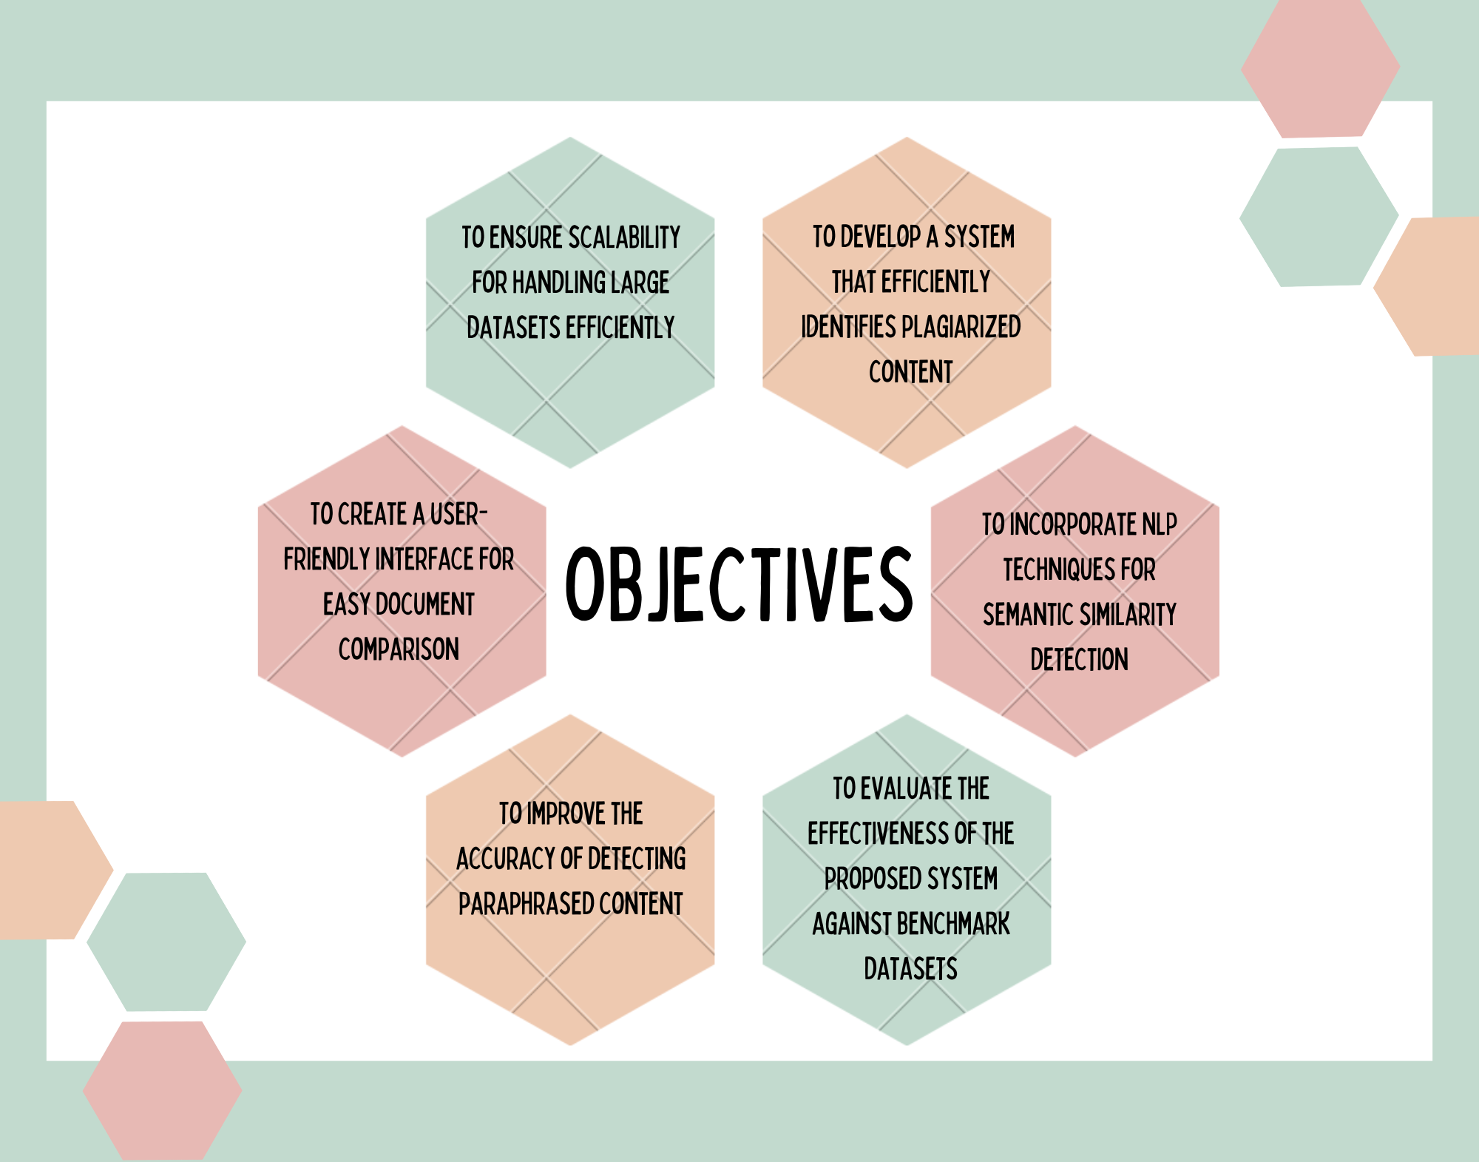
5. Objectives

Slide 8
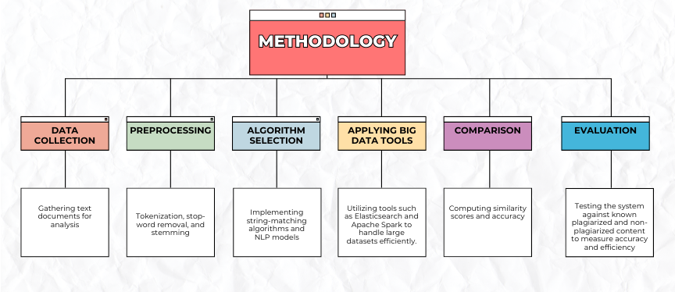
6.Methodology

Slide 9
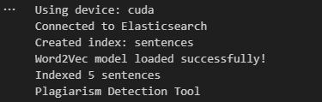
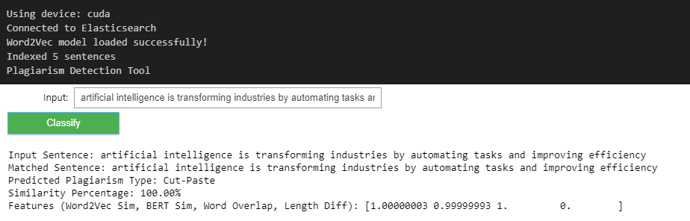
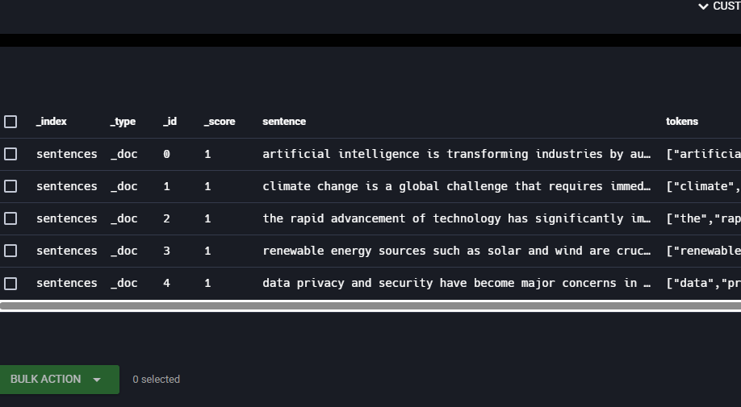
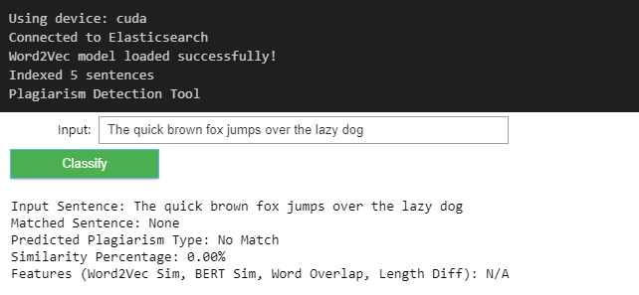
7. Results

Slide 10
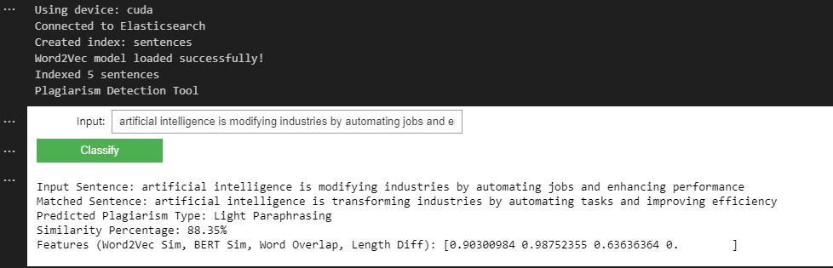
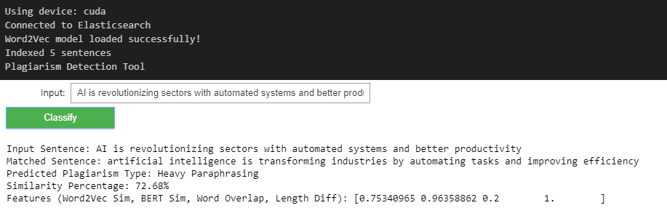
7. Results

Slide 11
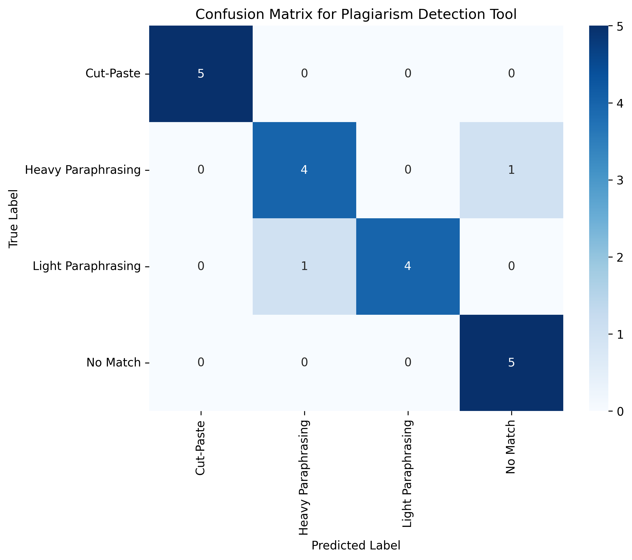
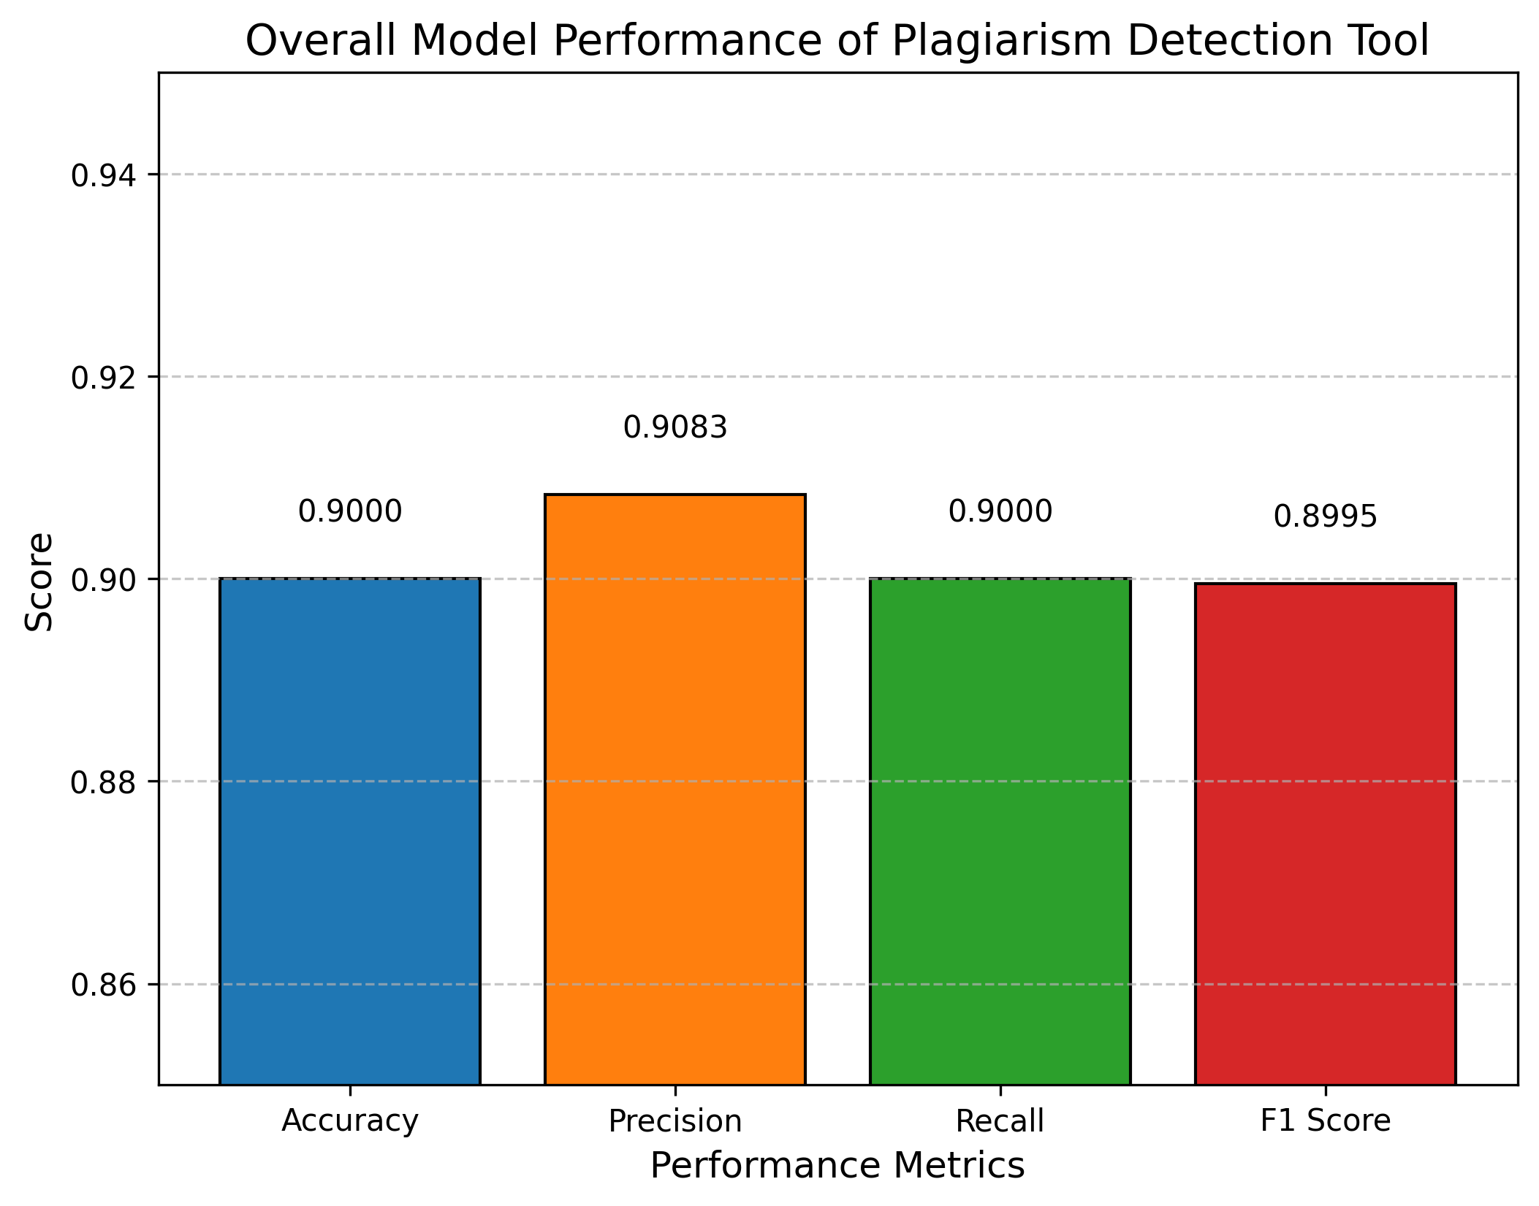
7. Results

Slide 12
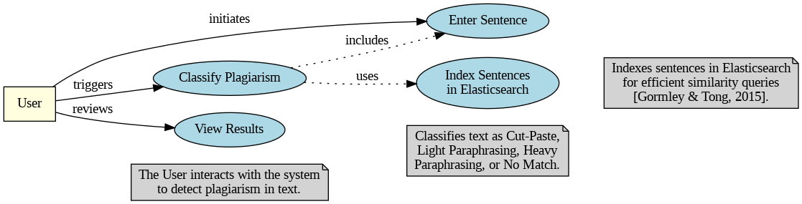
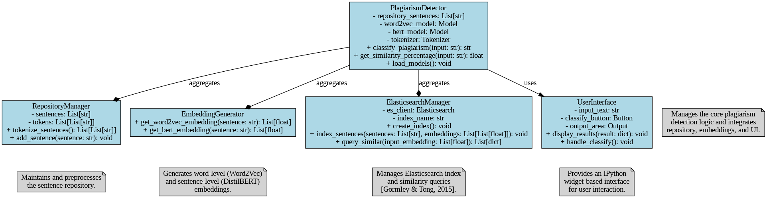
8. UML Diagram
USE-CASE DIAGRAM
CLASS DIAGRAM

Slide 13
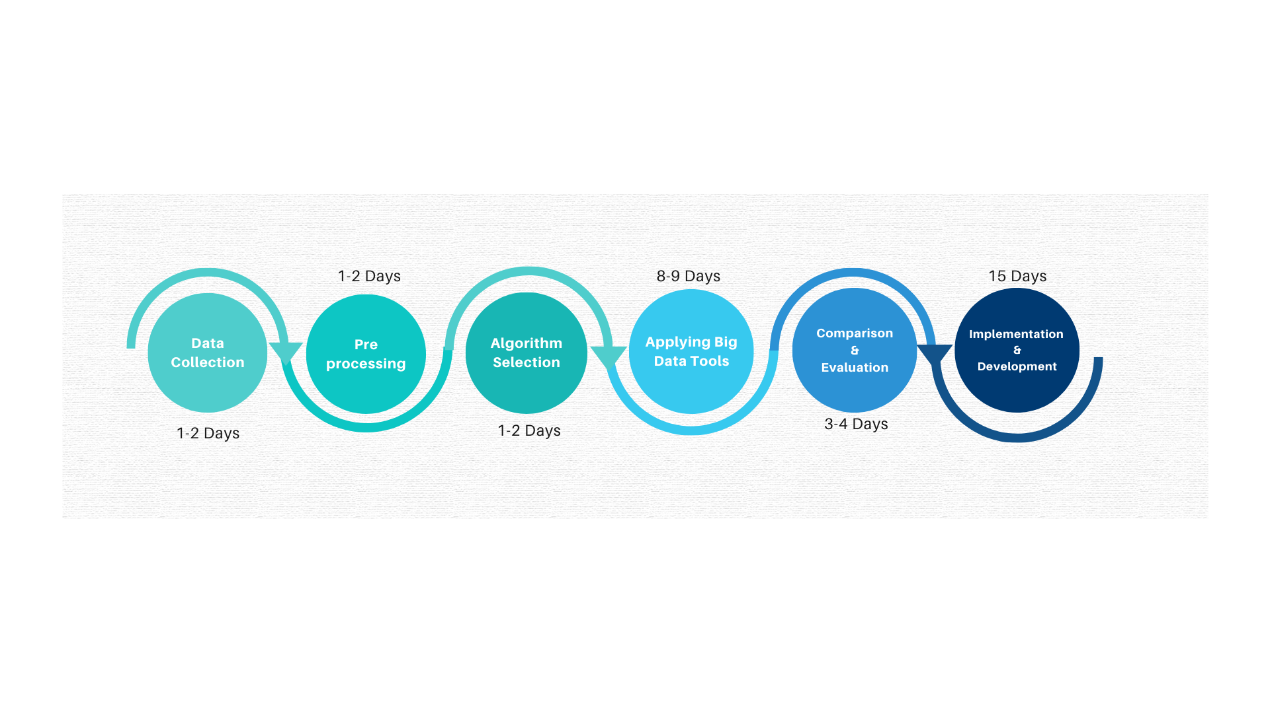
9. PERT Chart

Slide 14
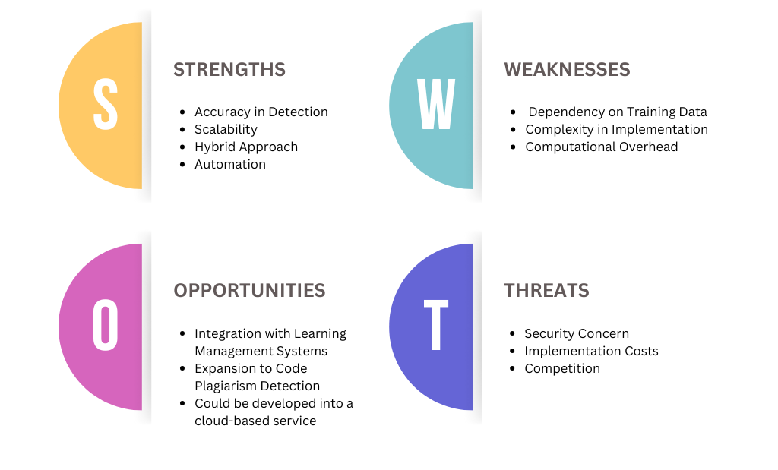
10. SWOT Analysis

Slide 15
11. Conclusion
Determination of plagiarism stands as an essential operation for sustaining academic integrity as well as preserving original content material. The study analyzes numerous algorithms along with techniques for constructing an efficient plagiarism detection system. The proposed system utilizes traditional and NLP-based methods along with big data technology to achieve improved accuracy levels while resolving the current limitations of existing detection methods. Large textual data becomes manageable through scalable big data tools during implementation. Future work should include deep learning system integration which will lead to better detection of paraphrases in plagiarism. Practical use of this system depends on user-friendly interfaces and easy accessibility which simplifies content verification processes for both researchers and education professionals and authors.

Slide 16
12. References
R. Rehurek and P. Sojka, ”Software Framework for Topic Modelling with Large Corpora,” in Proceedings of the LREC 2010 Workshop on New Challenges for NLP Frameworks, Valletta, Malta, May 2010, pp. 45–50. [Online]. Available: https://radimrehurek.com/gensim/
T. Mikolov, K. Chen, G. Corrado, and J. Dean, ”Efficient Estimation of Word Rep resentations in Vector Space,” in Proceedings of the 1st International Conference on Learning Representations (ICLR), Scottsdale, Arizona, May 2013. [Online]. Avail able: https://arxiv.org/abs/1301.3781
V. Sanh, L. Debut, J. Chaumond, and T. Wolf, ”DistilBERT, a distilled ver sion of BERT: smaller, faster, cheaper and lighter,” in Proceedings of the 5th Workshop on Energy Efficient Machine Learning and Cognitive Comput ing at NeurIPS 2019, Vancouver, Canada, December 2019. [Online]. Available: https://arxiv.org/abs/1910.01108
T. Wolf et al., ”Transformers: State-of-the-Art Natural Language Processing,” in Proceedings of the 2020 Conference on Empirical Methods in Natural Lan guage Processing (EMNLP), Online, November 2020, pp. 38–45. [Online]. Available: https://www.aclweb.org/anthology/2020.emnlp-main.5/
A. Paszke et al., ”PyTorch: An Imperative Style, High-Performance Deep Learn ing Library,” in Advances in Neural Information Processing Systems 32 (NeurIPS 2019), Vancouver, Canada, December 2019, pp. 8024–8035. [Online]. Available: https://arxiv.org/abs/1912.01703
C. R. Harris et al., ”Array programming with NumPy,” Nature, vol. 585, pp. 357–362, September 2020. [Online]. Available: https://doi.org/10.1038/s41586-020-2649-2
IPython Development Team, ”IPython Widgets: Interactive HTML Widgets for Jupyter Notebooks,” 2023. [Online]. Available: https://ipywidgets.readthedocs.io/en/stable/
A. Pratama and B. Susilo, ”String Matching based Plagiarism Detection for Docu ment in Bahasa Indonesia,” in Proceedings of the International Conference on Infor matics, Jakarta, Indonesia, 2021, pp. 123–130.
J. Smith and L. Brown, ”Developing and Applying a Neural Network System for Text Plagiarism Detection in Higher Education,” Journal of Educational Technology, vol. 15, no. 3, pp. 45–58, 2022.
S. Kumar and R. Patel, ”Utilization of NLP Techniques in Plagiarism Detection System through Semantic Analysis using Word2Vec and BERT,” in Proceedings of the IEEE Conference on NLP, Bangalore, India, 2023, pp. 89–96.
H. Zhang and Y. Li, ”Research on Code Plagiarism Detection Based on Code Clone Detection Technologies,” in International Symposium on Software Engineering, Bei jing, China, 2020, pp. 210–218
M. Ali and N. Khan, ”Program plagiarism detection with dynamic structure,” Soft ware: Practice and Experience, vol. 52, no. 4, pp. 567–579, 2021.
P. Nguyen and T. Ho, ”Plagiarism detection in learning management system,” in Proceedings of the Asia-Pacific Educational Technology Conference, Hanoi, Vietnam, 2019, pp. 34–41
R. Gupta and S. Sharma, ”Design and Implementation of Code Plagiarism Detection System,” International Journal of Computer Applications, vol. 180, no. 12, pp. 15–22, 2022
L. Chen and Q. Wang, ”Design and Implementation of a Self-Built Plagiarism Detec tion System for University Academic Integrity,” in Proceedings of the Global Academic Integrity Conference, Singapore, 2020, pp. 78–85
T. Tran and D. Le, ”Data warehouse designing for Vietnamese textual document based plagiarism detection system,” Journal of Data Science, vol. 10, no. 2, pp. 101–115, 2021
K. Jones and M. Taylor, ”Automated Plagiarism Detection in Moodle,” in Proceed ings of the Learning Management Systems Conference, London, UK, 2018, pp. 56–63
D. Wijaya and E. Santoso, ”Auto Clustering Source Code To Detect Plagiarism Of Student Programming Assignments in Java Programming Language,” in Proceedings of the IEEE Conference on Computer Science Education, Surabaya, Indonesia, 2022, pp. 145–152
F. Ahmad and Z. Liu, ”A Plagiarism Detection Architecture Based on OpenStack Services,” International Journal of Cloud Computing, vol. 9, no. 3, pp. 89–102, 2023
Gormley, C., & Tong, Z. (2015). Elasticsearch: The Definitive Guide. O’Reilly Me dia, Inc

Slide 17
Thank You

