Slide 1
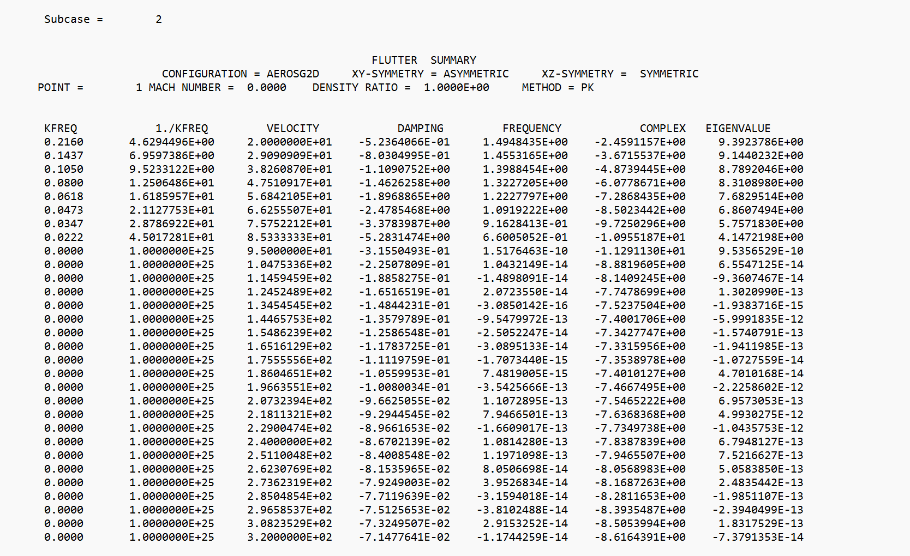
Velocity, Mach Number and Density ratio defined in the FLFACT entries
Method of Flutter analysis
Each analysis point corresponds to a different eigenmode
Reduced Frequency
Inverse Reduced Frequency
Velocity, Damping and Frequency are calculated form the complex eigenvalues
Real and imaginary components of the Eigenvalue analysis

Slide 2
1 | 2 | 3 | 4 | 5 | 6 | 7 | 8 | 9 | 10
PCOMP | PID | Z0 | NSM | SB | FT | TREF | GE | LAM | +
 | MID1 | T1 | THETA1 | SOUT1 | MID2 | T2 | THETA2 | SOUT2 | +
 | MID3 | T3 | THETA3 | SOUT3 | Etc.

