Slide 1
JavaScript INTRO
By Vasyl Dziuba

Slide 2
Agenda
Agenda
Language concept and history
ECMA Standard Editions and changes from ES1 to ES2019
Platforms and API
Environment Setup: Transpiling, Linting

Slide 3
History
JavaScript - A high-level scripting programming language built into the browser that allows you to create the functionality of web pages / applications. Note that JavaScript is also available on other software platforms such as Node.Js
JavaScript was created by Brendan Eich in 1995 during his time at Netscape Communications. Netscape, for a time, made the best browser in the world and enjoyed market dominance. Netscape Communications Corporation had a strong presence in the young web. Netscape was founded by the very same people that took part in the development of Mosaic during the early 90s, and now, with money and independence, they had the necessary freedom to seek further ways to expand the web. And that is precisely what gave birth to JavaScript.

Slide 4
It was Mocha and then LiveScript. And then in early December, Netscape and Sun did a license agreement and it became JavaScript.
JavaScript and Java have almost nothing in common. The name JavaScript came from Netscape’s support of Java applets within its browser. Many say it was also a marketing tactic to divert some attention from Java, which was the most buzzed-about language at the time. To run Java programs, the code must be first compiled into an executable form. On the other hand, JavaScript was created to be interpreted at run time, making it much more dynamic.

Slide 5
JavaScript ≠ Java Java is complex which requires declarations, compiling, and servers.
JavaScript is unrelated to Java,
except that: both use C syntax
JavaScript looks like Java, but is easier for less technical users to program.
JavaScript uses many Java names and naming conventions

Slide 6
Capabilities
Scripting language easy to use and learn
Runtime, not compiled
Primarily client side, but also server side snippets interacts with HTML and DOM browser control form validation, formatting rollover’s, etc.
Interacts with HTML and DOM
Browser control
Form validation, formatting rollover’s, etc.
Adds client side application support

Slide 7
Related languages
ECMAScript standardized version of JavaScript
Jscript Microsoft version of JavaScript
VBScript only works with Microsoft products
DHTML combination of CSS and Javascript

Slide 8
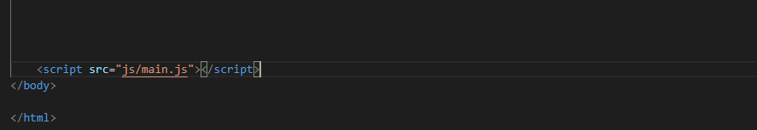
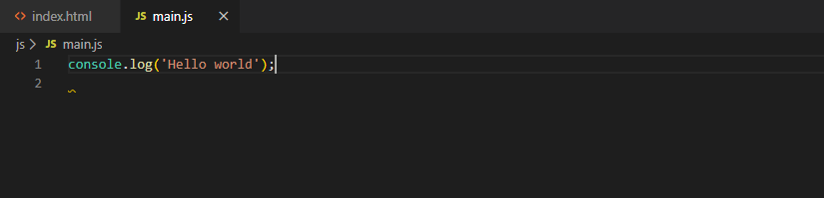
Get started with JavaScript
Create .js file
Аttach file
Write some code

Slide 9
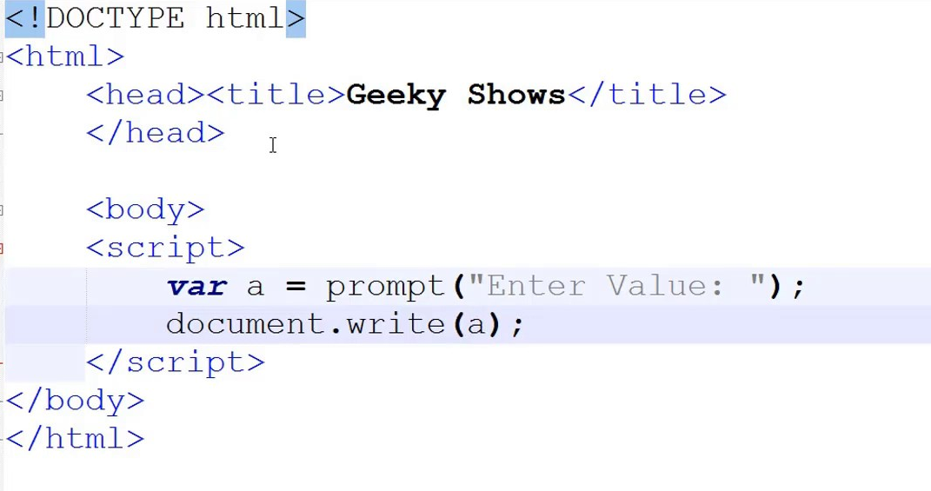

Slide 10
BASICS
JS Statements - http://www.w3schools.com/JS/js_statements.asp
JS Comments - http://www.w3schools.com/JS/js_comments.asp
JS Variables - http://www.w3schools.com/JS/js_variables.asp
JS Operators - http://www.w3schools.com/JS/js_operators.asp
JS Comparisons - http://www.w3schools.com/JS/js_comparisons.asp
JS If...Else - http://www.w3schools.com/JS/js_if_else.asp
JS Switch - http://www.w3schools.com/JS/js_switch.asp
JS Popup Boxes - http://www.w3schools.com/JS/js_popup.asp
JS Functions - http://www.w3schools.com/JS/js_functions.asp
JS For Loop - http://www.w3schools.com/JS/js_loop_for.asp
JS While Loop - http://www.w3schools.com/JS/js_loop_while.asp
JS Break Loops - http://www.w3schools.com/JS/js_break.asp
JS For...In - http://www.w3schools.com/JS/js_loop_for_in.asp
JS Events - http://www.w3schools.com/JS/js_events.asp
JS Try...Catch - http://www.w3schools.com/JS/js_try_catch.asp
JS Throw - http://www.w3schools.com/JS/js_throw.asp
JS Special Text - http://www.w3schools.com/JS/js_special_characters.asp
JS Guidelines - http://www.w3schools.com/JS/js_guidelines.asp

Slide 11
BASICS
JS objects
JS String‐ http://www.w3schools.com/JS/js_obj_string.asp
JS Date‐http://www.w3schools.com/JS/js_obj_date.asp
JS Array‐ http://www.w3schools.com/JS/js_obj_array.asp
JS Boolean‐ http://www.w3schools.com/JS/js_obj_boolean.asp
JS Math‐ http://www.w3schools.com/JS/js_obj_math.asp
JS HTML DOM‐ http://www.w3schools.com/JS/js_obj_htmldom.asp
JS Advanced
JS Browser‐ http://www.w3schools.com/JS/js_browser.asp
JS Cookies‐ http://www.w3schools.com/JS/js_cookies.asp
JS Validation‐ http://www.w3schools.com/JS/js_form_validation.asp
JS Animation‐ http://www.w3schools.com/JS/js_animation.asp
JS Image Maps‐ http://www.w3schools.com/JS/js_image_maps.asp
JS Timing‐ http://www.w3schools.com/JS/js_timing.asp
JS Create Object‐ http://www.w3schools.com/JS/js_objects.asp

Slide 12
15 JavaScript concepts that every JavaScript Programmer must know.
JavaScript Prototype
JavaScript(ES6) Class
IIFE (Immediately Invoked Function Expression)
Scope(Global Scope Local Scope)
JavaScript Closures
The Module Pattern
Hoisting
Promises
Async & Await
Currying(is a technique of evaluating the function with multiple arguments, into a sequence of function with a single argument.)
Memoization
The apply, call, and bind methods
Polymorphism
Asynchronous Js
Callback Function

Slide 13
What is ECMAScript?
JavaScript was created as a scripting language for Netscape. After which he was sent to ECMA International for standardization (ECMA is an association whose activities are dedicated to the standardization of information and communication technologies). This led to the emergence of a new locale known as ECMAScript.
Subsequent versions of JavaScript were already based on the ECMAScript standard. Simply put, ECMAScript is the standard, and JavaScript is the most popular implementation of this standard.

Slide 14
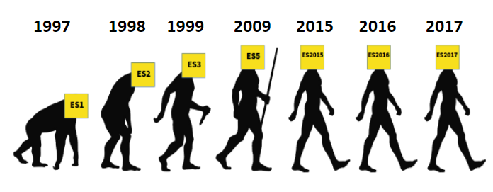
Version History
There are 8 versions of ECMAScript in total. ES1 was released in June 1997, ES2 in June 1998, ES3 in December 1999, and ES4 was never adopted, ES5 was released in December 2009, The ES6 / ES2015 version was released in June 2015, ES2016 (ES7) was released in June 2016. After another year, ES2017 (ES8) is released.

Slide 15
ES5
ES6 / ES2015
added destructuring assignment ;
arrow functions added ;
in pattern strings, you can declare strings using `(backquotes). Template strings can be multi-line, can also be interpolated;
let and const- alternatives var for declaring variables. Added "temporary dead zone";
the iterator and the iteration protocol now determine how to iterate over any object, not just arrays. Symbol used to assign an iterator to any object;
Promises added.
support for strict mode;
accessors getters and setters;
the ability to use reserved words as property keys and put commas at the end of the array;
multiline string literals;
New functionality in the standard library
JSON support.

Slide 16
ES2016 (ES7)
exponentiation operator **;
a method Array.prototype.includes that checks if the passed argument is contained in an array.
ES2017 (ES8)
asynchrony is now officially supported ( async/ await);
“Hanging” commas in function parameters. Added the ability to put commas at the end of the list of function arguments;
Added two new methods for working with strings: padStart()and padEnd(). The method padStart()substitutes additional characters on the left, before the beginning of the line. And padEnd(), in turn, on the right, after the end of the line;
added a function Object.getOwnPropertyDescriptors()that returns an array with descriptors of all the object’s own properties;
added memory sharing and object Atomics

Slide 17
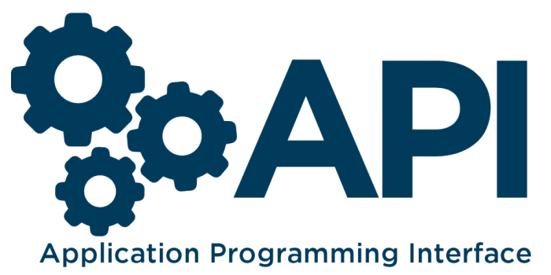
What is an API?
Application Programming Interfaces (APIs) are pre-built programming language constructs that allow a developer to build complex functionality with less effort. They "hide" more complex code from the programmer, providing ease of use. For client-side JavaScript, in particular, there are many APIs. They are not part of the language, but are built using the built-in JavaScript functions in order to increase your ability to write code.
They can be divided into two categories:
Browser APIs
Third-party APIs

Slide 18
Browser APIs
Third-party APIs
Third-party APIs are not embedded in the browser by default. Such APIs and information about them usually need to be searched on the Internet. For example, the Twitter API allows you to post the latest tweets on your website. This API defines a set of constructs that make requests to Twitter services and return certain data and ther are Twitter API , Google Maps API , YouTube API etc.
Browser APIs are built into the web browser and are able to use browser and computer environment data to perform more complex operations with this data. For example, the Geolocation API provides easy-to-use JavaScript constructs for working with location data, so you can, let's say, mark your location on a Google Map. In fact, the browser executes complex low-level code (for example, in C ++) to connect to a GPS device (or any other geolocation device), receive data and transmit it to the browser for processing by your program, but, as mentioned above, these details are hidden thanks to the API.

Slide 19
JavaScript Libraries - Usually one or more files containing custom functions . Such files can be attached to a web page to speed up or provide tools for writing common functionality. Examples: jQuery, Mootools, and React.
JavaScript frameworks - The next step in the development of development after libraries. JavaScript frameworks (such as Angular and Ember) strive to be a set of HTML, CSS, JavaScript and other technologies, after which you can "write" a web application from scratch. The main difference between frameworks and libraries is “Inversion of Control”. The method is called from the library at the request of the developer. When using the framework, on the contrary, the framework calls the developer code.

Slide 20
What are the APIs capable of?
API for working with documents uploaded to the browser.
APIs that receive data from the server are often used to update small parts of a web page.
APIs for working with graphics are widely supported by browsers, the most popular: Canvas and WebGL
The Audio and Video APIs.
Device APIs - basically, an API for processing and reading data from modern devices in a way convenient for web applications.
APIs for storing data on the user side are becoming more widespread in web browsers - the ability to store information on the client side is very useful when you need to create an application that will maintain its state between page reloads, or even work when the device is offline.

Slide 21
How does the API work?
Different JavaScript APIs work a little different, but basically they have similar functions and how they work.
They are based on objects.
Interaction with the API in the code occurs through one or more JavaScript objects that serve as containers for the information that the API works with (contained in the properties of the object) and implement the functionality that the API provides (contained in the methods of the object).

Slide 22
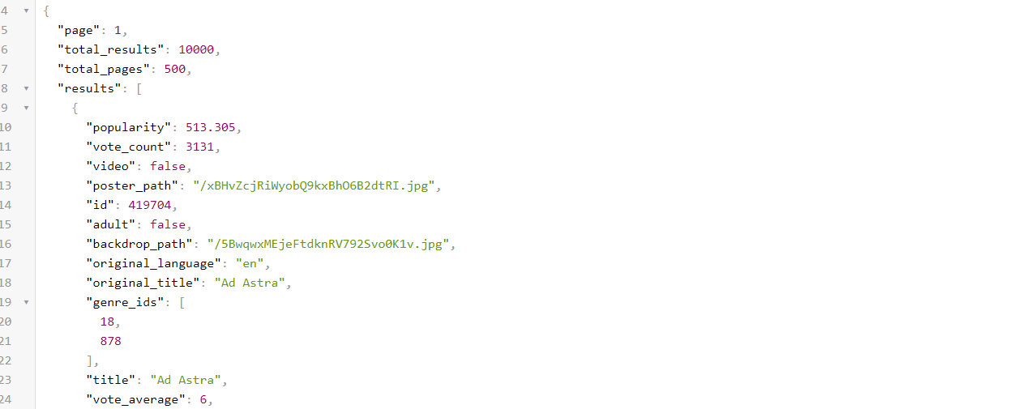
Get started with API

Slide 23
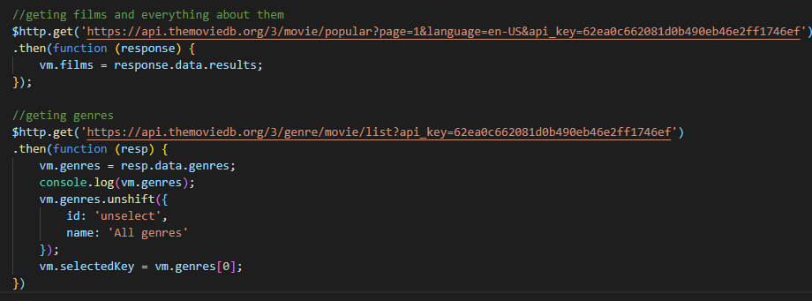
Get started with API

Slide 24
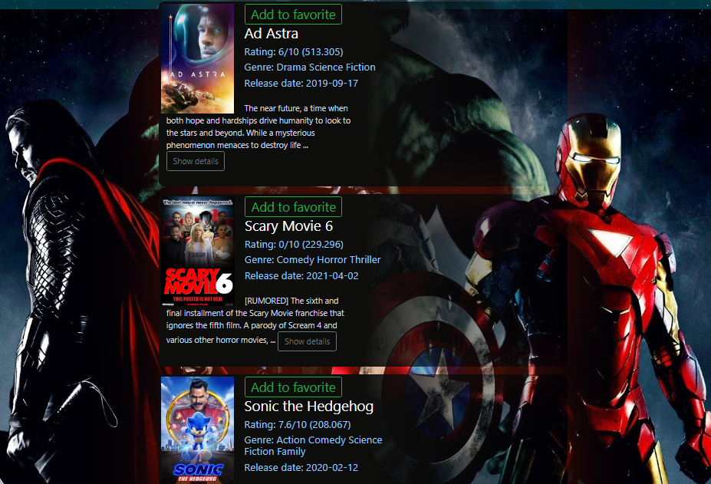
Result

Slide 25
Transpilation
Transpilation is defined as source-to-source compilation. Tools have been written to do this and they are called transpilers. Transpilers take the source code and convert it into another language. Transpilers are important for two reasons. First, not every browser supports every new syntax in ES6, and second, many developers use programming languages based off of JavaScript, such as CoffeeScript or TypeScript.
Transpilers also allow us to develop web or server side applications in other programming languages. Languages such as TypeScript and CoffeeScript may not run natively in the browser; however, with a transpiler, we are able to build a full application in these languages and translate them into JavaScript for server or browser execution.
Some examples of transpilers:
Emscripten: Transpiles C/C++ to JavaScript
Babel: Transpiles ES6+ code to ES5 (ES6 and ES5 are different versions or generations of the JavaScript language)

Slide 26

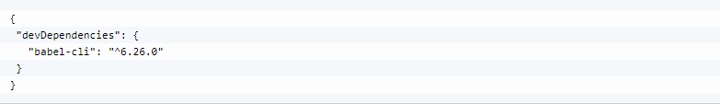
One of the most popular transpilers for JavaScript is Babel. Babel is a tool that was created to aid in the transpilation between different versions of JavaScript. Babel can be installed through the node package manager (npm). First, open your terminal and path to the folder containing your JavaScript project.
If there is no package.json file in this directory, we must create it. This can be done with the npm init command. The command-line interface will ask you for several entries so that you can fill out the defaults of the package.json file. You can enter the values or simply press the return key and accept the default values.
To install the Babel command-line interface, use the following command: npm install --save-dev babel-cli. After that has concluded, the babel-cli field will have been added to the devDependencies object in the package.json file.

Slide 27
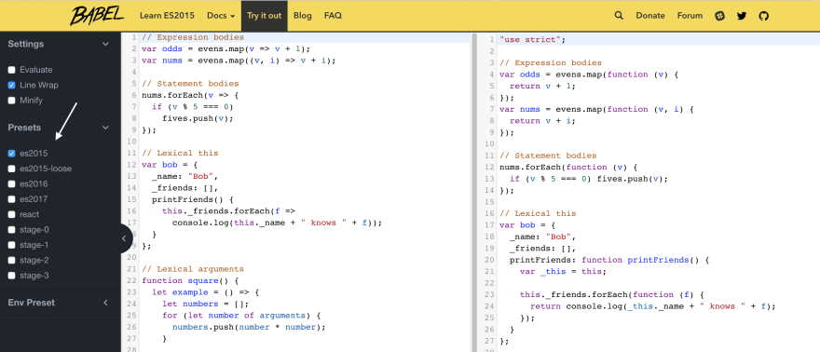

Slide 28
Linting
Linting is the process of running a program that analyzes your code for programmatic and stylistic errors. A linting tool, or a linter, marks or flags any potential errors in your code such as syntax errors or incorrectly spelled variable names. This can save time and help you write better code.
Linters will go through your code, and highlight:
formatting discrepancy
non-adherence to coding standards and conventions
pinpointing possible logical errors in your program
Running a linter on your code makes sure it follows best practices, is readable and easy to maintain. Linters can be installed using npm or another package manager. Linters can be used from the command line by passing in files. Linters are also available as plugins for tools and sometimes they are directly integrated into editors.

Slide 29
Linting
Here are some popular JavaScript Linters:
JSLint 24, JSHint 4, JSCS 3, ESLint 22
Linters for Editors :
Visual Code : To Install the eslint extension, open command palette (View -> Command Palette… or cmd+shift+p ) and execute command: ext install eslint
Tools and Plugins
Prettier 5

Slide 30
REFERENCES
https://2ality.com/2011/03/javascript-how-it-all-began.html
https://www.quora.com/What-is-the-history-of-JavaScript
https://www.springboard.com/blog/history-of-javascript/
https://medium.com/@benastontweet/lesson-1a-the-history-of-javascript-8c1ce3bffb17
https://medium.com/@madasamy/15-javascript-concepts-that-every-nodejs-programmer-must-to-know-6894f5157cb7
https://tproger.ru/translations/wtf-is-ecmascript/
https://developer.mozilla.org/ru/docs/Learn/JavaScript/Client-side_web_APIs/Introduction

Slide 31


