Slide 1
Object methods, built-in objects
By Vasyl Dziuba

Slide 2
Object
An object is a collection of properties, and each property consists of a name and a value associated with that name. The property value can be a function that can be called an object method . In addition to the objects built into the browser, you can define your own objects. Іn JavaScript, an object is an independent unit that has properties and a specific type. Compare, for example, with a cup. A cup has a color, shape, weight, material from which it is made, etc. Similarly, JavaScript objects have properties that define their characteristics.

Slide 3
Object
In JavaScript, an object has properties associated with it. The property of an object can be understood as a variable assigned to an object. The properties of an object are essentially the same JavaScript variables, except that they are attached to the object. The properties of an object determine its characteristics.

Slide 4
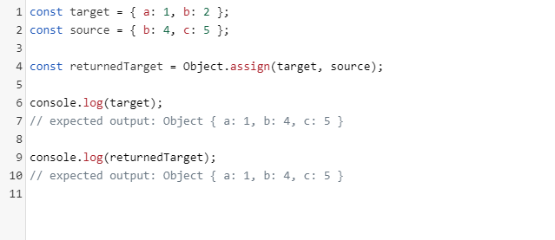
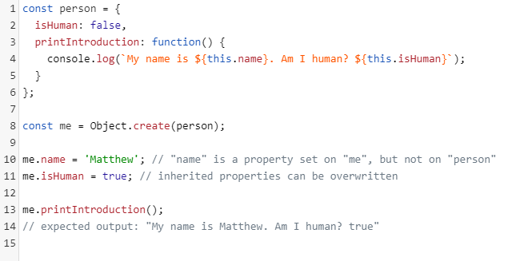
Object methods
Object.assign()
The method is Object.assign()designed to copy to the target object all personal (not inherited) listed properties of one or more objects. The method returns the target object.
Object.create()
creates a new object using the existing object as a prototype for the newly created object.

Slide 5
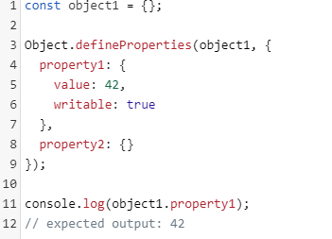
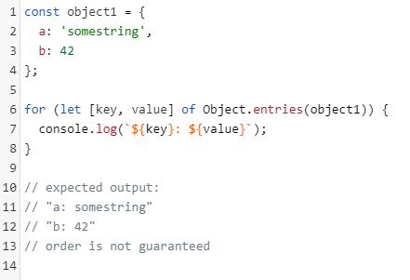
Object methods
Object.defineProperties()
The method Object.defineProperties() determines new or modifies existing properties directly on the object, returning that object.
Object.entries()
The method Object.entries()returns an array of key-value pairs of personal, enumerated, string properties of the given object, in the same order in which they are provided by the loop for...in.

Slide 6
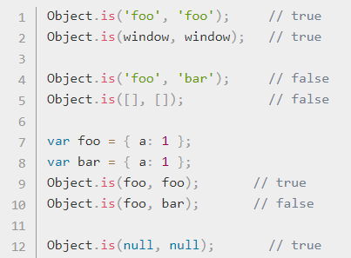
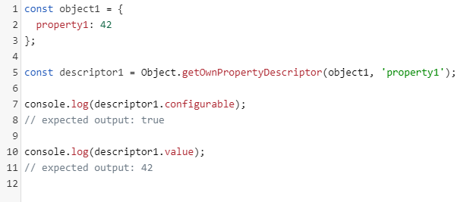
Object methods
Object.getOwnPropertyDescriptor() returns a property descriptor for the personal property (such that it is present directly on the object and not in the chain of its prototypes) of the given object.
Object.is()
finds out if two arguments have the same meaning .

Slide 7
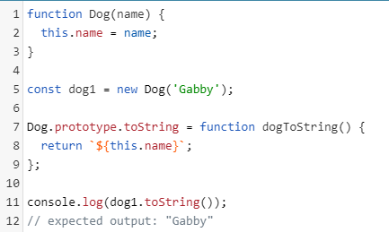
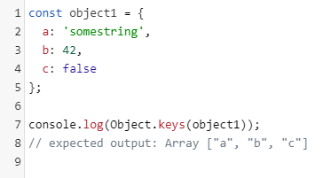
Object methods
Object.keys()
returns an array of names of the personal enumerated properties of the passed object in the same order as it is returned by a normal loop.
toString()
returns a string that displays the object.

Slide 8
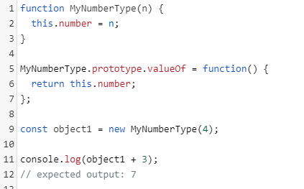
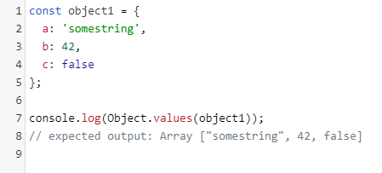
Object methods
valueOf()
returns a simple value of the specified object
Object.values()
returns an array of values ​​of all personal (not inherited) listed properties of the transferred object.

Slide 9
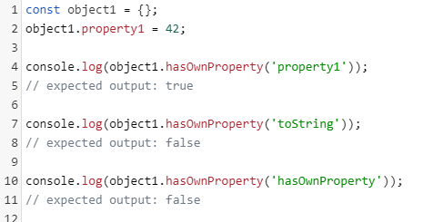
Object methods
Object.freeze()
The frozen object cannot be changed; Freezing prevents adding new properties, deleting existing properties, changing the availability of existing properties for listing, configuring, and writing, and changing the values ​​of existing properties
hasOwnProperty()
returns a Boolean value that indicates whether the specified property is a personal property of the object

Slide 10
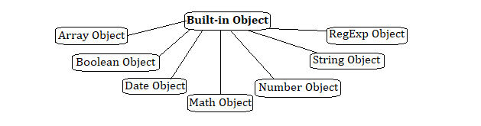
BUILT-IN OBJECTS

Slide 11
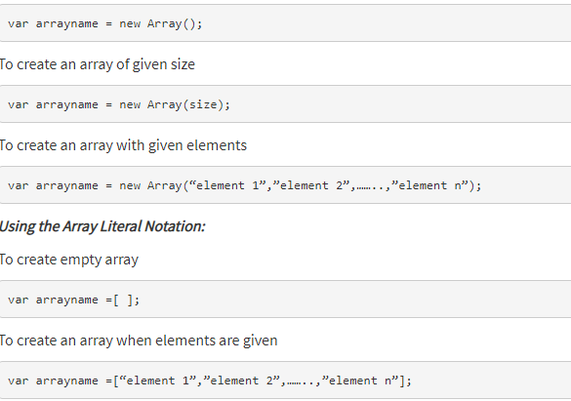
Array Object
Multiple values are stored in a single variable using the Array object.
In JavaScript, an array can hold different types of data types in a single slot, which implies that an array can have a string, a number or an object in a single slot.

Slide 12
Array methods/properties
Properties of the Array object
Length - Returns the number of elements in the array.
Constructor - Returns the function that created the Array object.
Prototype - Add properties and methods to an object.
Methods of the Array object
reverse() - Reverses the array elements
concat() - Joins two or more arrays
sort() - Sort the elements of an array
push() - Appends one or more elements at the end of an array
pop() - Removes and returns the last element
shift() - Removes and returns the first element
unshift(), join(), indexOf(), lastIndexOf(), slice(startindex, endindex) are some of the methods used in Array object.

Slide 13
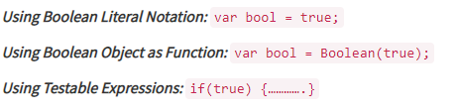
Boolean Object
The Boolean object is wrapper class and member of global objects.
It is used to convert a non-Boolean value to a Boolean value (true or false).
If the Boolean object has no initial value or if it is 0, -0, null, "", false, undefined, or NaN, the object is set to false. Otherwise it is true (even with the string "false")!

Slide 14
Boolean Object methods/properties
Properties of the Boolean object
Constructor - Returns the function that created the Boolean object.
Prototype - Add properties and methods to an object.
Methods of the Boolean object
toSource() - Returns a string containing the source of the Boolean object; you can use this string to create an equivalent object.
toString() - Returns a string of either "true" or "false" depending upon the value of the object.
valueOf() - Returns the primitive value of the Boolean object

Slide 15
Date Object
At times when user need to access the current date and time and also past and future date and times. JavaScript provides support for working with dates and time through the Date object.
The Date object provides a system-independent abstraction of dates and times.
Date object can be created as : var today = new Date( );
Dates may be constructed from a year, month, day of the month, hour, minute, and second, and those six components, as well as the day of the week, may be extracted from a date.
Dates may also be compared and converted to a readable string form. A Date is represented to a precision of one millisecond.

Slide 16
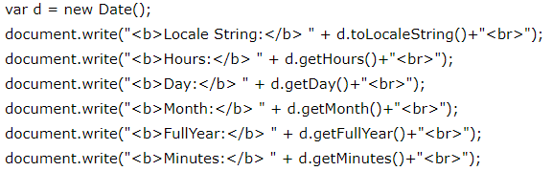
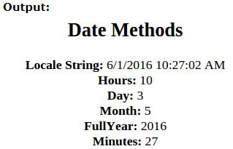
Date Object
Properties of Date object:
Constructor - Returns the function that created the Date object.
Prototype - Add properties and methods to an object.
Methods of Date object:
Date() - Returns today's date and time
getDate() - Returns the day of the month for the specified date
getDay() - Returns the day of the week for the specified date
getFullYear() - Returns the year of the specified date
getHours() - Returns the hour in the specified date according to local time.
getMilliseconds() - Returns the milliseconds in the specified date according to local time.
getMinute(), getMonth(), getTime(), getTimezoneOffset(), setDate(), setFullYear(), setHours(), setMilliseconds(), setMinutes(), setMonth(), setSeconds(), setTime() are some of the methods used in Date object.

Slide 17
Math Object
The Math object is used to perform simple and complex arithmetic operations.
The Math object provides a number of properties and methods to work with Number values
The Math object does not have any constructors. All of its methods and properties are static; that is, they are member functions of the Math object itself. There is no way to create an instance of the Math object.

Slide 18
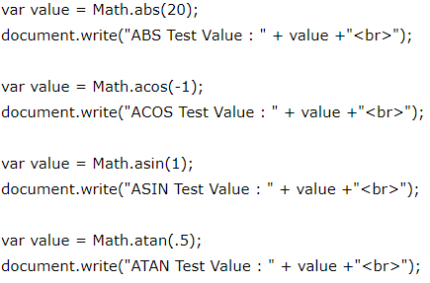
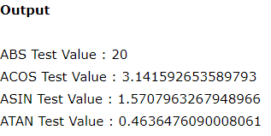
Math Object methods
Properties of Math object
PI - The value of Pi
E - The base of natural logarithm e
LN2 - Natural logarithm of 2
LN10 - Natural logarithm of 10
LOG2E - Base 2 logarithm of e
LOG10E - Base 10 logarithm of e
SQRT2 - Square root of 2
SQRT1_2 - Square root of ½
Methods of Math object
max(a,b) - Returns largest of a and b
min(a,b) - Returns least of a and b
round(a) - Returns nearest integer
ceil(a) - Rounds up. Returns the smallest integer greater than or equal to a
floor(a) - Rounds down. Returns the largest integer smaller than or equal to a
pow(a,b) - Returns ab
abs(a) - Returns absolute value of a
random() - Returns a pseudo random number between 0 and 1
sqrt(a) - Returns square root of a
sin(a) - Returns sin of a (a is in radians)
cos(a) - Returns cos of a (a is in radians)

Slide 19
Number Object
The Number objects represents numerical date, either integers or floating-point numbers.
A Number objects are created using the Number() constructor var num = new number(value);

Slide 20
Number Object methods/properties
Properties of Number object
Constructor - Returns the function that created the Number object.
MAX VALUE - Returns maximum numerical value possible in JavaScript.
MIN VALUE - Returns minimum numerical value possible in JavaScript.
NEGATIVE INFINITY - Represent the value of negative infinity.
POSITIVE INFINITY - Represent the value of infinity.
Prototype - Add properties and methods to an object.
Methods of Number object
toExponential() - Converts a number into exponential notation.
toFixed() - Formats a number with a specific number of digits to the right of the decimal.
toLocaleString() - Returns a string value version of the current number in a format that may vary according to a browser's locale settings.
toPrecision() - Defines how many total digits to display of a number.
toString() - Returns the string representation of the number's value.
valueOf() - Returns the number's value.

Slide 21
String Object
in JavaScript, all strings are represented as instances of the String object.
The String object is wrapper class and member of global objects.
String object used to perform operations on the stored text, such as finding the length of the string, searching for occurrence of certain characters within string, extracting a substring etc.
A String is created by using literals. A string literal is either enclosed within single quotes(‘ ‘) or double quotes(“ “) var string1= “ Ques10“ ;

Slide 22
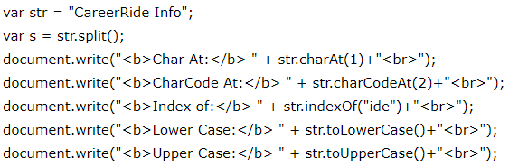
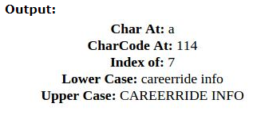
String Object methods/properties
Properties of String object
Length - Returns the length of string.
Constructor - Returns the function that created the String object
Prototype - Add properties and methods to an object
Methods of String object
charAt() - Returns the character at a specified position.
concat() - Combines two or more strings.
toLowerString() - Converts a string to lowercase.
toUpperString() - Converts a string to uppercase.
indexOf(searchtext, index) - Searches for the specified string from the beginning of the string.
lastIndexof(searchtext, index) - Searches for the specified string from the end of the string

Slide 23

RegExp Object
RegExp object used to validate the pattern of characters.
RegExp define methods that use regular expressions to perform powerful pattern-matching and search and replace functions on text.
Regular expressions can be defined by using following ways

Slide 24
RegExp Object methods/properties
Properties of RegExp object
Constructor - Returns the function that created the RegExp object
Global - Checks whether the "g" modifier is set
ignoreCase - Checks whether the "i" modifier is set
lastIndex - Specifies the index at which to start the next match
multiline - Checks whether the "m" modifier is set
source - Returns the text of the RegExp pattern
Methods of RegExp object
exec() - Tests for a match in a string. Returns the first match.
test() - Tests for a match in a string. Returns true or false.
toString() - Returns the string value of the regular expression.
toSource() - Returns an object literal representing the specified object

Slide 25
Useful links
https://developer.mozilla.org/uk/docs/Web/JavaScript/Reference/Global_Objects/Array
https://developer.mozilla.org/uk/docs/Web/JavaScript/Reference/Global_Objects/Object/values
https://www.tutorialride.com/javascript/javascript-built-in-objects.htm
https://developer.mozilla.org/uk/docs/Web/JavaScript/Reference/Global_Objects/Object/valueOf

Slide 26


Slide 27


