Slide 1
WELCOME TO THE FUTURE

Slide 2
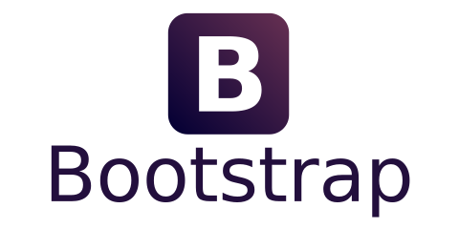
INTRODUCTION TO BOOTSTRAP
Bootstrap - is a free, open source toolkit designed to build websites and web applications that contains CSS and HTML templates for typography, forms, buttons, navigation and other interface components, as well as additional JavaScript extensions . It simplifies the development of dynamic websites and web applications. Bootstrap (originally called Twitter Blueprint ) was developed by Mark Otto and Jacob Thornton as a framework to ensure the consistency of Twitter's
internal tools .

Slide 3
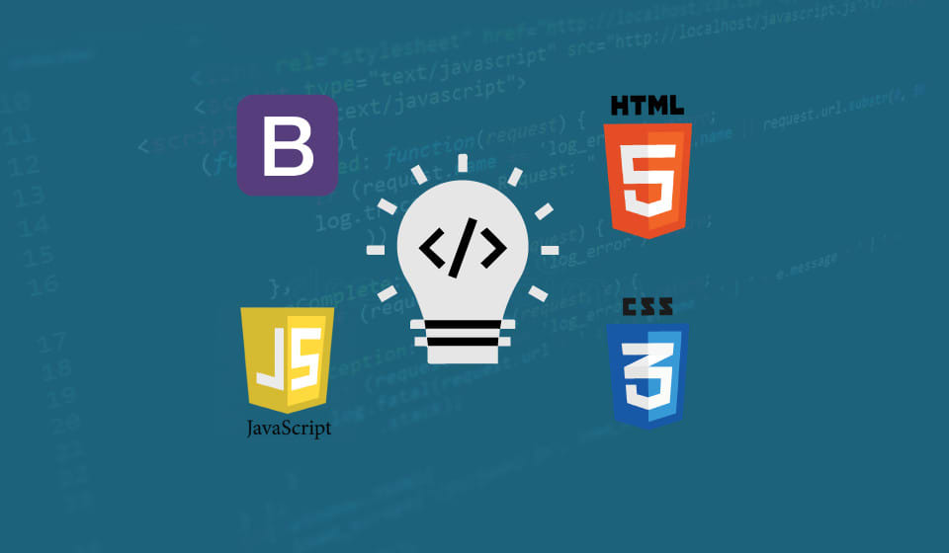
INTRODUCTION TO BOOTSTRAP

Slide 4
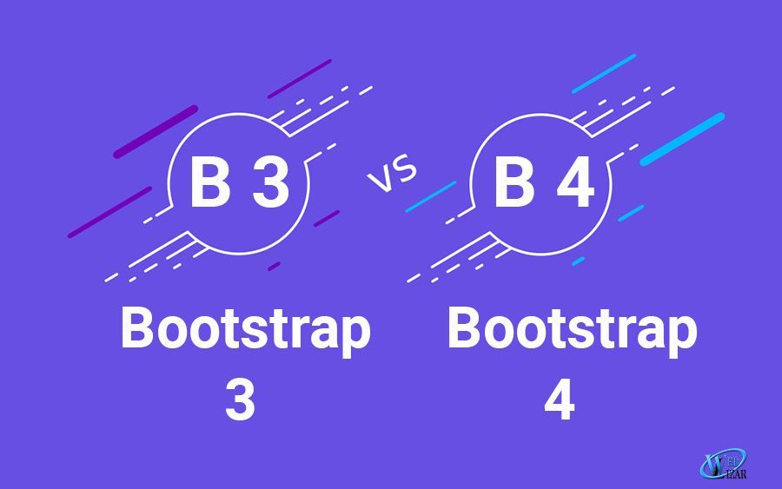
INTRODUCTION TO BOOTSTRAP

Slide 5
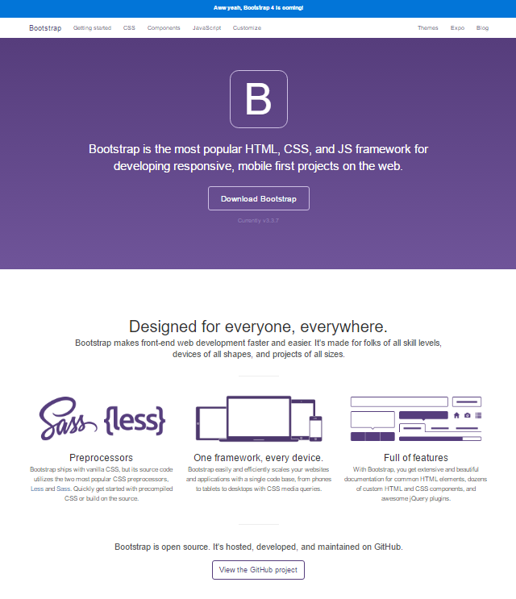
Bootstrap 4
used Sass syntax instead of Less ;
Improved layout, including block structure;
added support for flexbox , an HTML5 component ;
sizes are specified in rem and em instead of pixels, which enhances the mobile appearance of the framework;
all JavaScript plugins have been updated ;
updated pop-ups and tooltips;

Slide 6
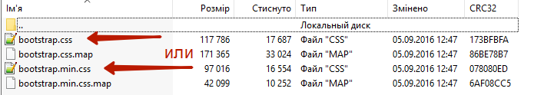
HOW TO USE?
<link rel="stylesheet" href=“./bootstrap.min.css">
or

Slide 7
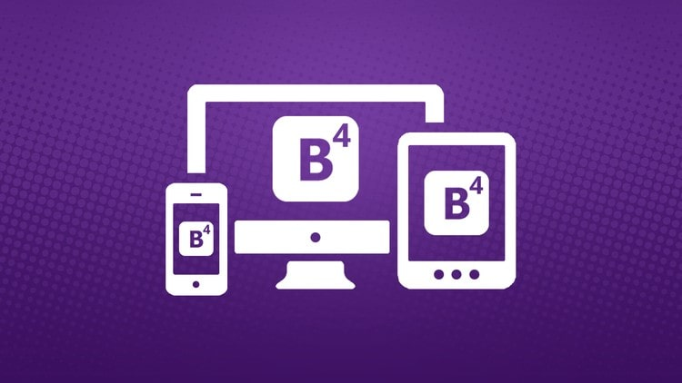
BOOTSTRAP STRUCTURE AND FUNCTIONS
Grids are preset, ready to use columns
Templates - Fixed or responsive page templates
Typography - Description and definition of classes for fonts, such as fonts for code, citations, etc.
Media - media for image and video management
Tables (table) - means of registration of tables which in particular provide sorting
Forms - classes for designing forms and certain events
Navigation (nav, navbar) - classes for the design of tabs, pages, menus and navigation bars
Alerts are classes for designing dialog boxes, prompts, and pop-ups
font (icon font) - a set of icons in a font, consists of nearly 500 components

Slide 8
WHAT IS BOOTSTRAP.js?
In addition to styles, the framework also contains functional components that are built on js using jQuery
Transitions - smooth changes, the plugin is used to configure the latest components of the framework.
Modal - Modal windows, both pop-up and embedded in the page.
Dropdown - Random lists built without a tag select.
Scrollspy is a plugin that automatically changes an active menu item depending on the page's scroll position.
Tab - Tabs, commonly used for stylized navigation.

Slide 9
OTHER FEATURES OF BOOTSTRAP.js
Tooltip - tooltips, text items that appear next to a given object after hovering.
Popover is an analog of pop-up tips, but with more features. You can add a header to the tooltip, and the block appears after clicking on the object.
Alert - information messages that are created by the class .alertbut can be closed.
Button is a plugin for controlling button states. Plugin methods allow you to change the status and type of a button, as well as create elements that behave as checkboxor radio buttonbut are normal block elements.
Carousel is a multimedia image gallery.

Slide 10
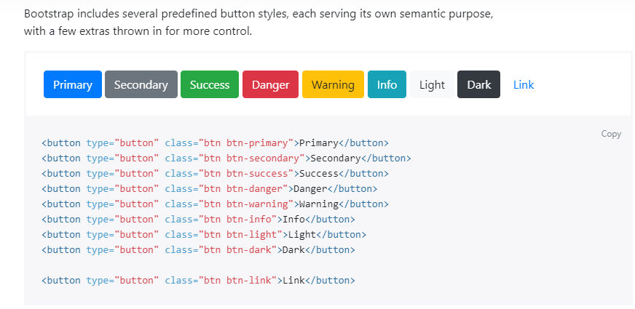
BOTSTRAP BUTTONS EXAMPLE

Slide 11
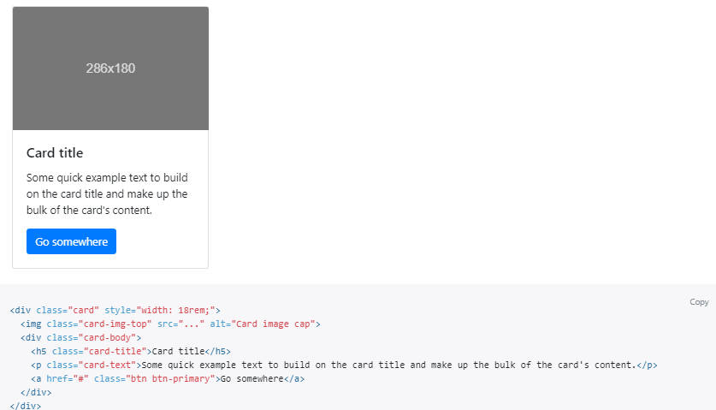
BOOTRSTRAP CARDS

Slide 12
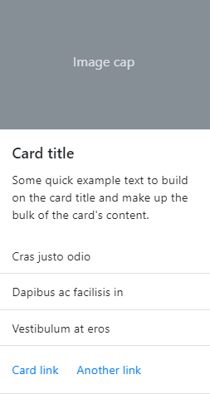
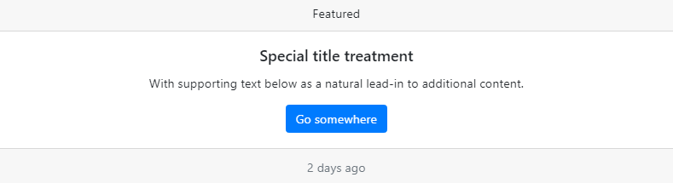
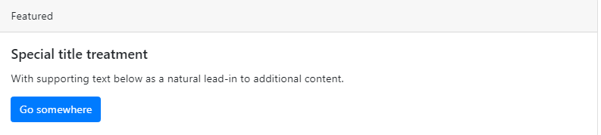
OTHER CARDS EXAMPLE

Slide 13
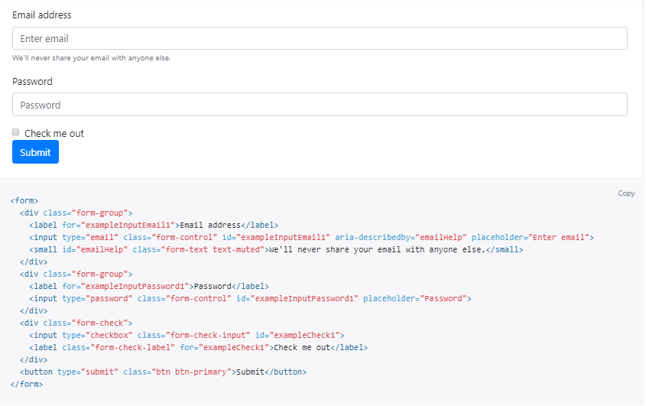
BOOTSTRAP FORMS

Slide 14
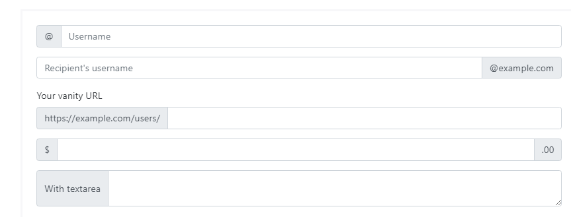
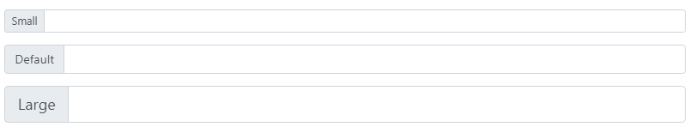
INPUT GROUP

Slide 15
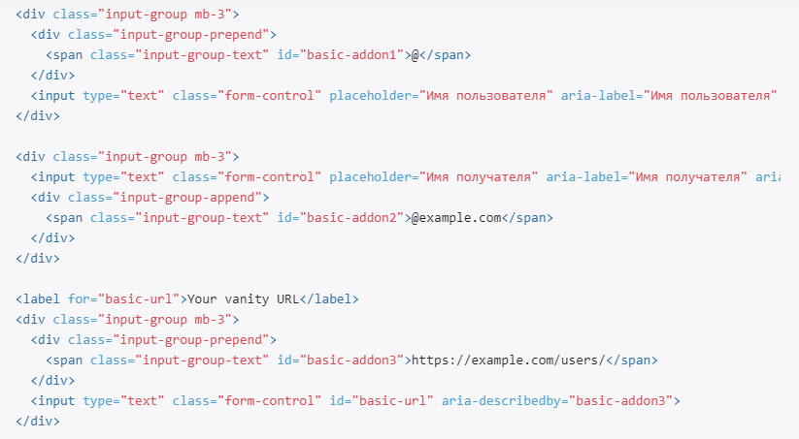
INPUT GROUP CODE EXAMPLE

Slide 16
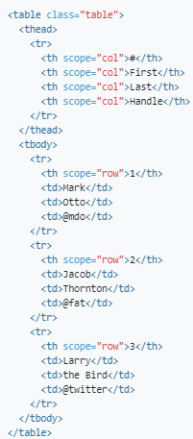
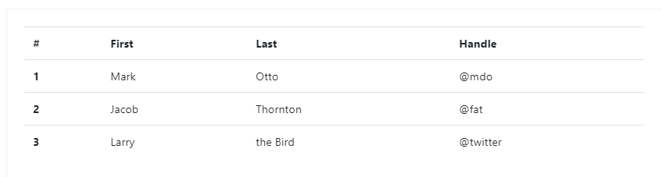
TABLES

Slide 17
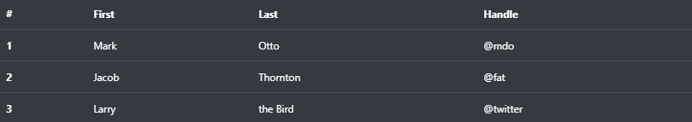
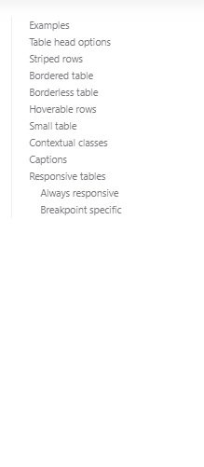
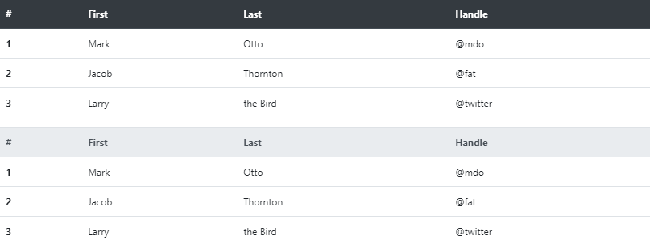
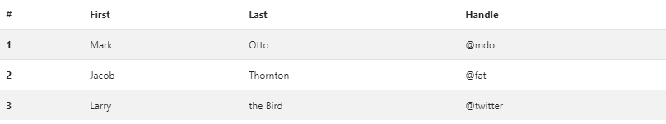
TABLES

Slide 18
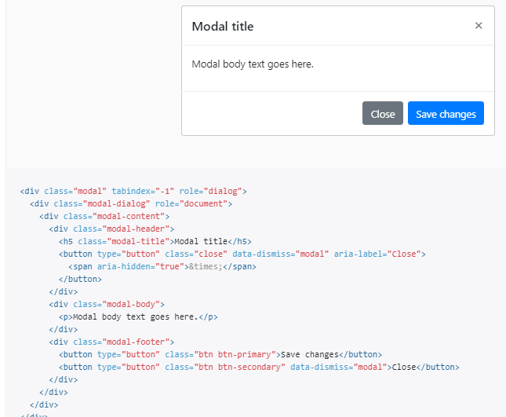
BOOTSTRAP MODAL WINDOW

Slide 19
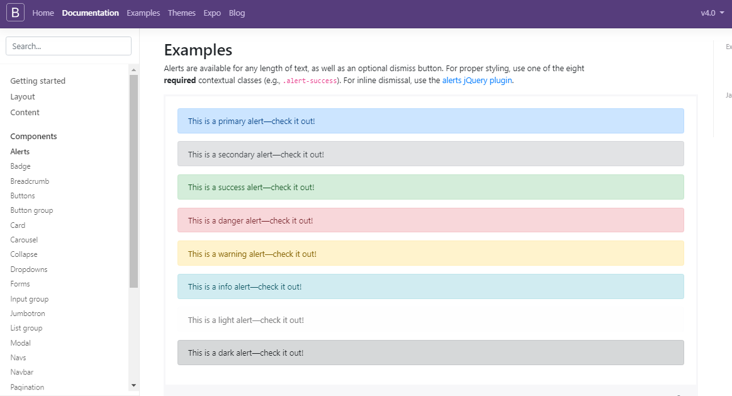
ALERTS

Slide 20
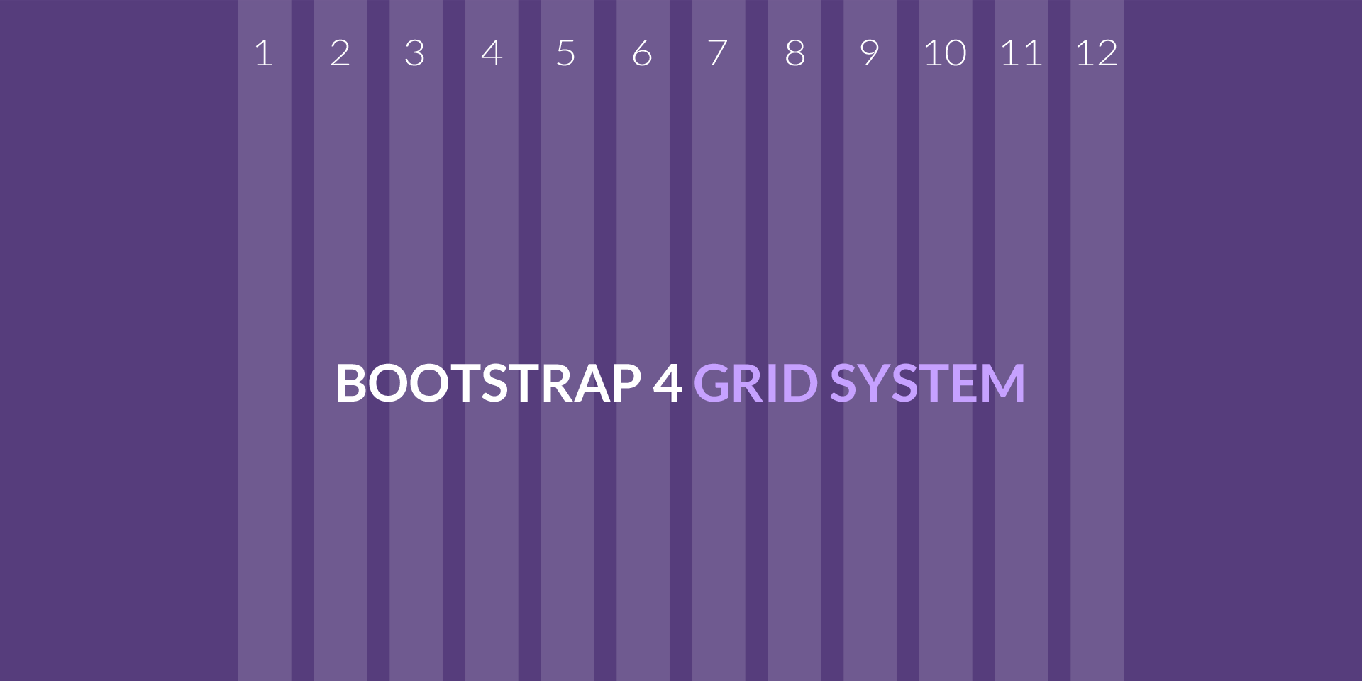

Slide 21
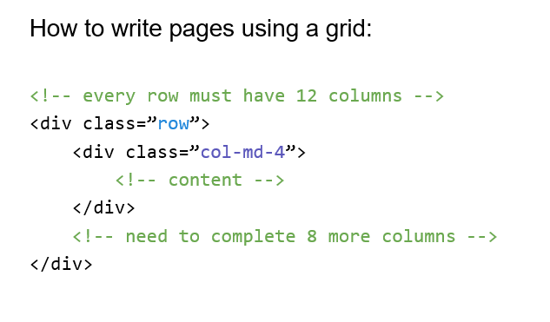
NOTE THIS!

Slide 22
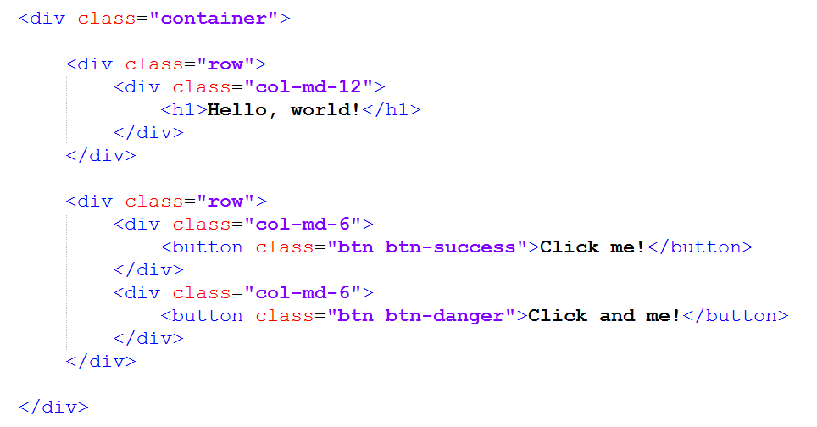
TRY THIS

Slide 23
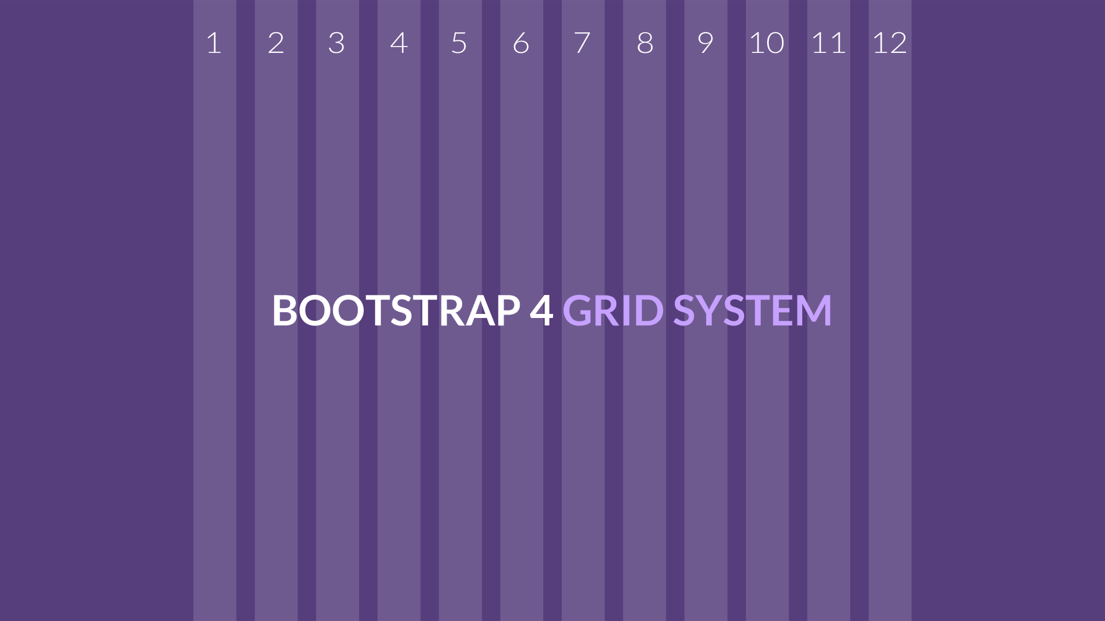
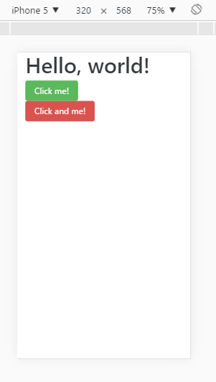
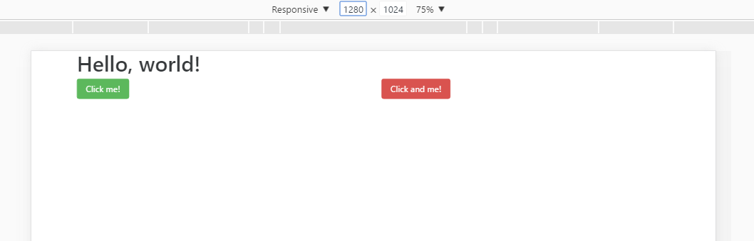

Slide 24
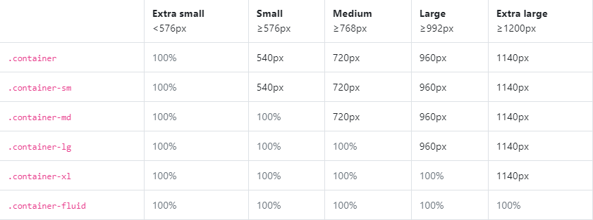
BOOTRSTRAP Container examples

Slide 25
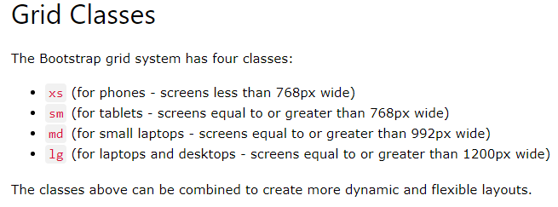
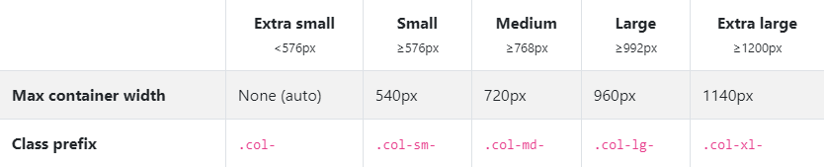
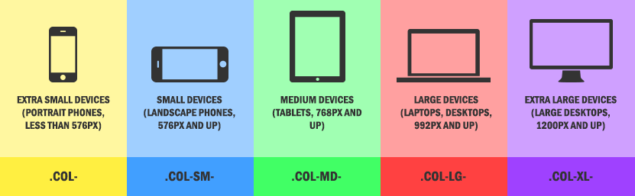
WHAT IS xs, sm, md, lg ?

Slide 26
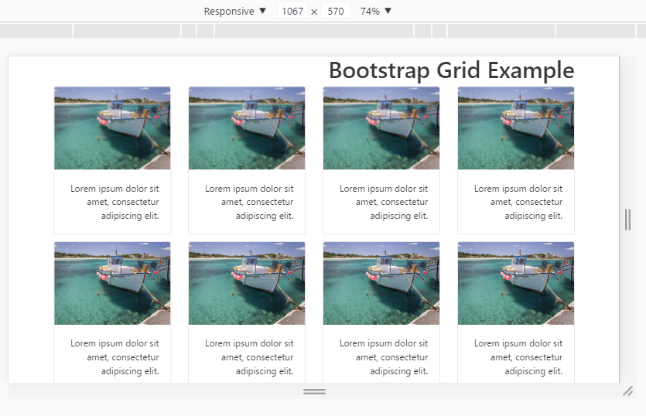
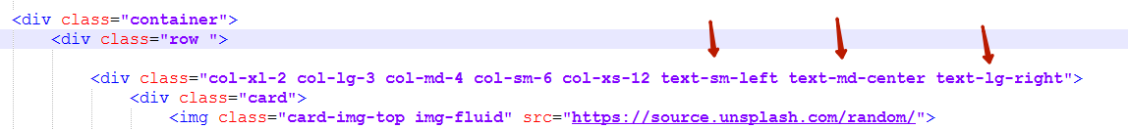

HOW IT WORKS?

Slide 27

ADVANTAGES AND DISADVANTAGES

Slide 28
BENEFITS OF BOOTSTRAP
Reduce development time
Easy to use and quick to learn
Traditionally, the use of frameworks and libraries greatly facilitates the work of developers and allows you to develop projects faster.
Bootstrap is easy to use in development, easy to understand.
Clear code
Adaptability
Bootstrap allows you to write high-quality and understandable code that is easily understood by another developer.
Bootstrap allows you to create responsive sites. The site design will be correctly displayed on the screens of devices of different sizes.
Unity of styles
Cross browser
Bootstrap elements look harmonious with each other and allow you to create pages and sites in a single style.
Sites made using Bootstrap will render equally in all modern browsers.

Slide 29
DISADVANTAGES OF BOOTSTRAP
Pattern
Lack of flexibility
Sites developed using Bootstrap are similar to each other: the same structure, navigation, buttons. Each new site looks like many already created - and this is not very good. You can solve the problem - you must abandon the use of ready-made solutions and change the template as much as possible depending on the wishes of the customer and the ideas of the designers. For this reason, it is important to understand all the tools offered by Bootstrap in order to maximize their use in development.
Despite all the advantages, Bootstrap is a tool that has its limitations. Therefore, Bootstrap may not be suitable for the implementation of some projects.

Slide 30



Slide 31


