Slide 1
JavaScript PART 2
By Vasyl Dziuba

Slide 2
Agenda
Agenda
CALL BIND APPLY
IIFE
CLOSURES
PRE-DEFINED FUNCTIONS

Slide 3
CALL, BIND, APPLY
In JavaScript, functions are objects, as you should already know. And as objects, functions have their own methods, including such effective ones as apply(), call()and bind(). We can say that Apply() they are Call() literally identical to each other and are often used in JavaScript in order to borrow methods and expose values this. We also use Apply()for functions with a large number of variables and arguments.

Slide 4
Bind () method
Basically, we use a method bind() to call a function with a value this. And in other words, bind() it allows us to easily set exactly which object will be attached to this at the moment of calling the function or method.
This may seem relatively trivial, but often this value in methods and functions must be set explicitly when you need to bind a specific object to the value of this function itself. Usually, we need bind() it when we use the method this and call the method itself from the receiving object. The bind() method creates a new function that, when called, has its this keyword set to the provided value.

Slide 5
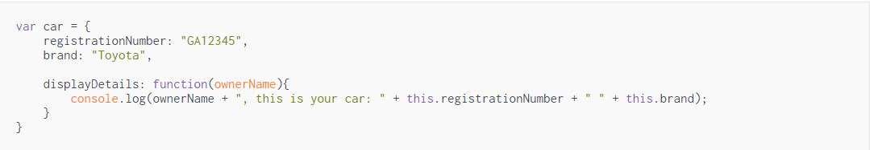
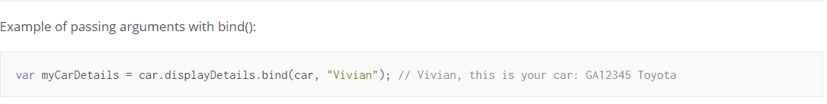
It let’s us explicitly define the value of this when calling a function.

Slide 6
When we use the bind() method:
.bind() is used when you need to pass a callback (e.g. some sort of function reference), but you want the caller to call your function with a specific this value. This is most common when your function is actually a method and you want the this value set to be the a specific object so the method will operate on that specific object ..

Slide 7
call(), apply()
call and apply are very similar—they invoke a function with a specified this context, and optional arguments. The only difference between call and apply is that call requires the arguments to be passed in one-by-one, and apply takes the arguments as an array.

Slide 8
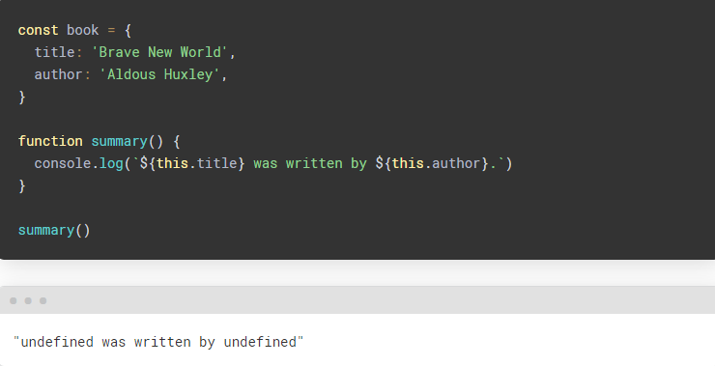
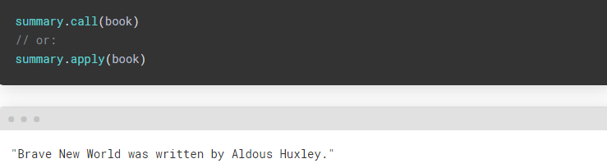
Using ‘this’ instead of call, apply

Slide 9
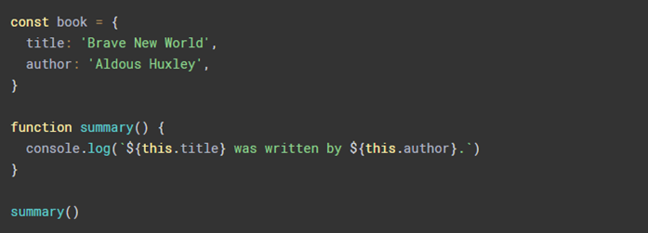
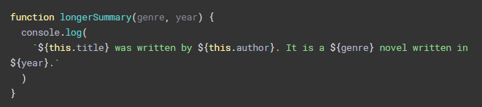
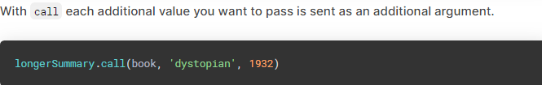

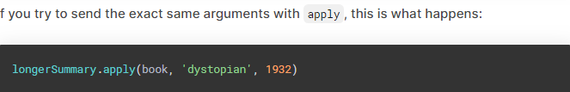
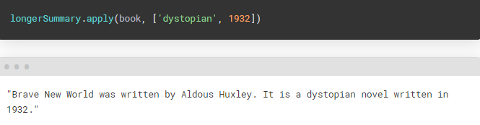

Slide 10
IIFE
Usually, the definition of a function is separated from its call: first we define the function, and then we call it. But this is optional. We can also create functions that will be called immediately upon definition. Such functions are also called Immediately Invoked Function Expression (IIFE). The Immediately Invoked Function Expression function in JavaScript is a construct that allows you to call a function immediately after it is defined.

Slide 11
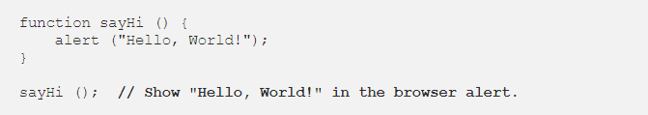

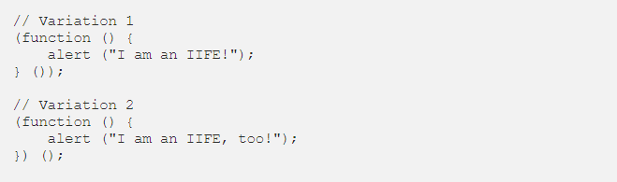
Declaring a function in a natural way
Declaring a function in a IIFE way

Slide 12

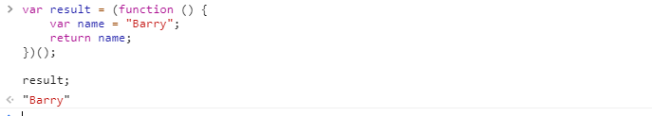
A variable inside an expression is not available outside it.
Assigning an IIFE to a variable stores the value returned by the function, not the function definition itself.

Slide 13
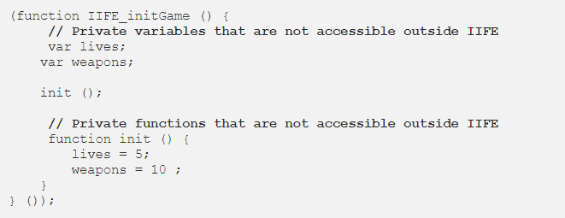
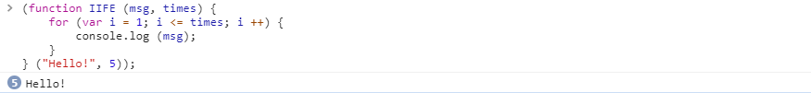
Any variables inside IIFE are not visible to the outside world. declared two variables inside IIFE and here they are private, only for IIFE itself. No one outside IIFE has access to it
IIFE with parameters

Slide 14
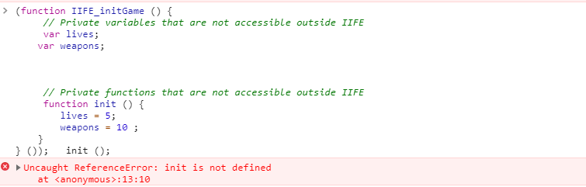

Slide 15
Closures
Closures are a fundamental concept in Javascript that any experienced developer knows and applies. Closures are an extremely functional thing implemented in Javascript and in most other languages. Closures are functions that reference independent (free) variables. In other words, the function defined in the closure “remembers” the environment in which it was created.

Slide 16
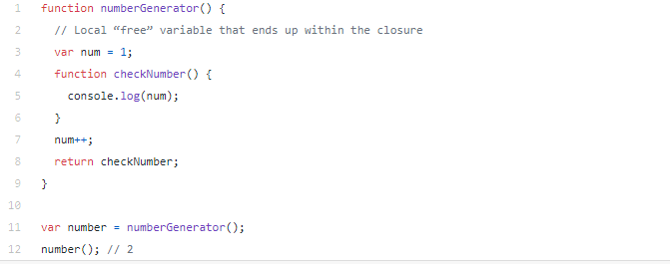
EXAMPLE 1

Slide 17
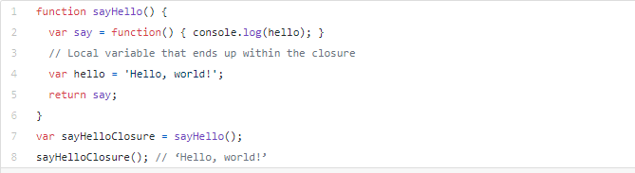
EXAMPLE 2

Slide 18
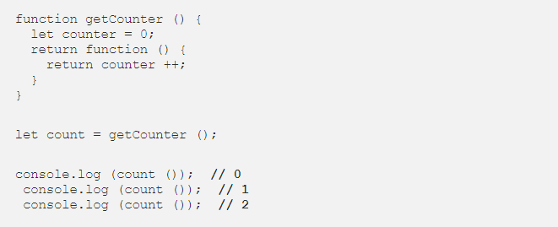
EXAMPLE 3

Slide 19
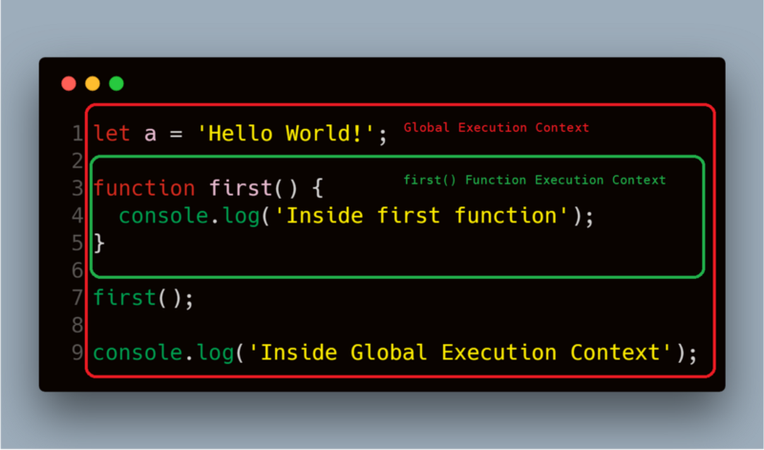
Execution context
The execution context is an abstract concept in which the Javascript specification, known as ECMAScript, explains the code execution model after run. The context can be either global, from which the execution of the script begins, or the context of the call, which begins from the moment the body.
During the execution of this code, the JavaScript engine creates a global call context, in order to execute the global code and when it comes to the function call first(), it creates a new execution context for this function and puts it on the top of the call stack.

Slide 20
SUMMARY
A closure is a function that has access to its external function in scope, even after the external function has stopped. This suggests that the closure can remember and access the variables and arguments of its external function, even after it stops executing.

Slide 21
Predefined JavaScript functions
Javascript has many pre-defined functions and functions which are used extensively are Conversion and Comparison – Functions used for data conversion and comparison:
escape(string) – Encodes a string from ASCII into an ISO Latin-1 (ISO 8859-1) character set for HTML processing. It is passed the string to be encoded, and returns the encoded string.
unescape – Converts an ISO8859-1 character set to ASCII.
eval()– Converts a string to integer or float value. Expression is evaluated, and if the result is not a string, the result is returned.
isNaN(value) – If the value passed is a not a number, the boolean value of true is returned, if it is a number, it returns false.
parseFloat() – Returns floating point numbers the same as the parseInt function, but looks for floating point qualified strings and returns their value as a float.
parseInt()– Converts a string to an integer returning the first integer encountered which is contained in the string. If no integer value are found such as in the string “abcd”, then a value of 0 is returned.
typeof operator – This operator returns the type of the object it operates on.
Values returned are string values and may be one of “undefined”, “object”, “function”, “number”, “Boolean”, or “string”

Slide 22
Predefined JavaScript functions
Methods that belong to all objects:
toString() – Converts an object to a string.
Object.create() method - is used to create a new object and link it to the prototype of an existing object.
Object.keys() creates an array containing the keys of an object.
Object.values() creates an array containing the values of an object.
Object.entries() creates a nested array of the key/value pairs of an object.
Object.assign() is used to copy values from one object to another.
Dialog Boxes
alert(message) – Displays an alert box with a message defined by the string message.
confirm(message) – When called, it will display the message and two boxes. One box is “OK” and the other is “Cancel”.
prompt(message) – Displays a box with the message passed to the function displayed. The user can then enter text in the prompt field, and choose OK or Cancel. If the user chooses Cancel, a NULL value is returned. If the user chooses OK, the string value entered in the field is returned.

Slide 23
REFERENCES
https://www.vskills.in/certification/tutorial/dhtml-and-javascript/predefined-javascript-functions/
https://developer.mozilla.org/uk/docs/Web/JavaScript/Closures
https://developer.mozilla.org/ru/docs/%D0%A1%D0%BB%D0%BE%D0%B2%D0%B0%D1%80%D1%8C/IIFE
https://coderoad.ru/21781551/JavaScript-IIFE
https://habr.com/ru/company/ruvds/blog/494868/

Slide 24


