Slide 1
F.prototype, prototypal inheritance, prototype chain, constructing objects
By Vasyl Dziuba

Slide 2
Functional Prototype
When it comes to imitation, JavaScript has only one construction: objects. Each object contains as a hidden property a reference to another object, which is called a prototype of this. This prototype in turn has its own prototype , and so on until we reach the object whose prototype is null. By definition, null it has no prototype and serves as the final value in this chain of prototypes .
Almost all objects in JavaScript are instances Object, which stands at the top of the prototype chain.
The prototype model of inheritance is often considered as one of the weaknesses of JavaScript, but in fact it is more powerful than the classical one. The classic model, for example, is quite easy to build on the basis of the prototype.

Slide 3
F.prototype
New objects can be created using the constructor function new F().
If F.prototypean object is contained in , the operator ‘new’ sets it as the quality [[Prototype]] for the new object. But earlier, in the old days, there was no direct access to the prototype of the object. Only "prototype"the constructor function property was used in many scripts.

Slide 4
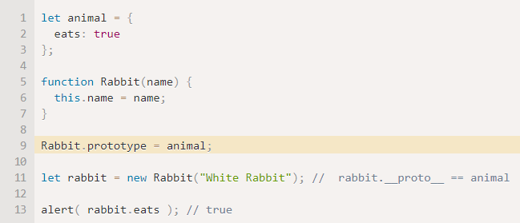
F.prototype
Setting Rabbit.prototype = animal literally tells the interpreter the following: "When creating an object through new Rabbit (), write animal to it in [[Prototype]]".

Slide 5
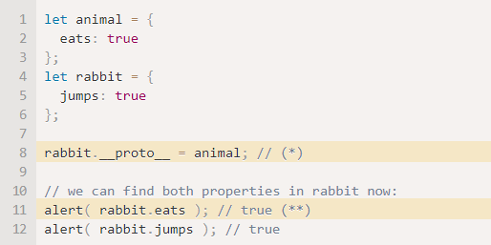
Prototype inheritance
Prototype inheritance: a prototype is an instance of a working object. Objects are inherited directly from other objects.
Instances can consist of many different source objects, which provides easy selective inheritance and a flat [[prototype]] hierarchy of delegation. Typically, instances are created using so-called factory functions, object literals, or Object.create().
This is the prototype that you get when you attach Constructor.prototype and instantiate it with the `new` statement. You can also use Object.create () for this purpose and even mix this technique with concatenation to smooth multiple prototypes to a single delegate or expand an instance of an object after creation.

Slide 6
Prototype Inheritance
All JavaScript objects inherit properties and methods from a prototype:
Date objects inherit from Date.prototype
Array objects inherit from Array.prototype
Person objects inherit from Person.prototype
The Object.prototype is on the top of the prototype inheritance chain:
Date objects, Array objects, and Person objects inherit from Object.prototype.

Slide 7
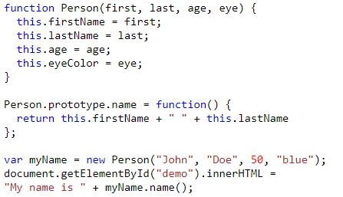
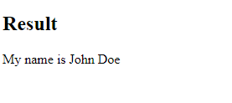
The JavaScript prototype property allows you to add new properties to object constructors

Slide 8
Prototype chaining
Nearly all objects in JavaScript are instances of Object. That means all the objects in JavaScript inherit the properties and methods from Object.prototype. This is called Prototype chaining. This is a very powerful and potentially dangerous mechanism to override or extend object behavior.
Objects created using the new keyword inherit from a prototype called Object.prototype.
For example: If a date object [new Date()] is created with the new keyword, then it inherits the Date.prototype.
We have Date, Array, Function, RegExp in the list for the same. All these objects inherit from the Object.prototype.

Slide 9
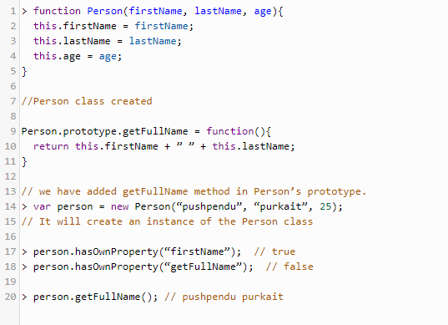
Prototype chaining
As the getFullName() method was not there in the object but still we were able to use it. We should not forget that we added the method in class Person’s prototype. The method went to the object through prototype chaining. It means the class had the method in its prototype, which went to its instance (person object) through prototype chaining. To prove that we will check it in the object.
Whenever we create an instance of any class, the prototype of the class is created in object as well. We have to check it in __proto__ property. This property contains the prototype of its class.
__proto__ has the getFullName() method, which is taken from class Person.
When was used hasOwnProperty() method to check whether we have getFullName method as a property of the object. It returned false, that means there is no such property. But, when we used getFullName method, it returned the actual full name but the property was not there.

Slide 10
Prototype chaining
The advantage of prototypical inheritance. We can add methods to our class without modifying the class definition, letting the chain handle property inheritance. Creating methods and inheriting using the prototype chain may seem tedious as compared to the sugary class implementation. Short chains equal better performance.

Slide 11
Constructing objects
Using functions as class:
One of the easiest way to instantiate an object in JavaScript. We define a classical JavaScript function and create an object of the function using new keyword. The properties and methods of function are created using the this keyword.
Using object literals:
Literals are smaller and simpler ways to define objects.
Singleton using a function:
The third way is a combination of the other two that we already saw. We can use a function to define a singleton object.

Slide 12
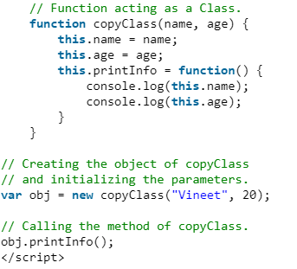

Using functions as class

Slide 13
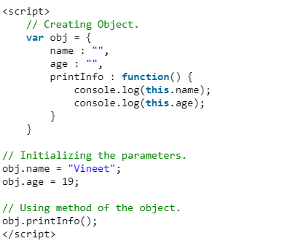
Using object literals

Slide 14
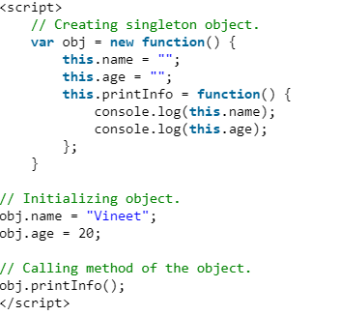
Singleton using a function
use the function structure to declare a object.

Slide 15
Useful links
https://medium.com/@toastui/javascripts-prototype-chain-made-easy-adbcd5a76e75
https://ui.dev/javascript-inheritance-and-the-prototype-chain/
https://community.risingstack.com/javascript-prototype-chain-inheritance/
https://medium.com/@toastui/javascripts-prototype-chain

Slide 16


