Slide 1
JavaScript Unit Testing
By Vasyl Dziuba

Slide 2
Agenda
Agenda
WHAT IS JAVASCRIPT UNIT TESTING?
JASMINE
MOCHA
ISTANBUL
TDD
BDD

Slide 3
WHAT IS UNIT TESTING
A unit test runs some code over a segment of your program checking the input and output. These tests allow developers to check individual areas of a program to see where(and why) errors occur.
This comes with an inherent understanding of what you’re trying to test for and how the code should function. Checking for bugs and errors can only be useful when you know exactly what you’re looking for.

Slide 4
There’s no need to unit test for HTML/CSS because they’re not function-based languages. JavaScript is true scripting and with new resources like Node.js and TypeScript it’s becoming much more powerful.
Simple JS unit testing will take a function, monitor output and return its behavior.
Not every JS project will need a unit test. But many developers prefer to be safe rather than sorry, and it’s always good to double-check work.
Every unit test is made to check against an individual unit in JavaScript, which typically breaks down to a function or library. The goal is to check every aspect of the function to make sure it all works properly for all cases.

Slide 5
JASMINE
Jasmine is a BDD framework (Behavior-Driven Development)
Jasmine does not depend on any other JavaScript framework.
Jasmine does not require any DOM.
All the syntax used in Jasmine framework is clean and obvious.
Jasmine is an open-source framework and easily available in different versions like stand-alone, ruby gem, Node.js, etc.

Slide 6

Install Jasmine
Download is the standalone library files from the official website https://jasmine.github.io/
Unzip downloaded file into your project folder.

Slide 7
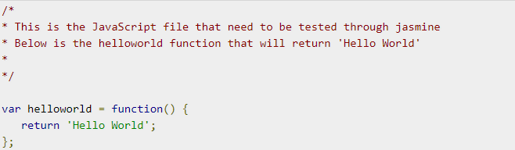
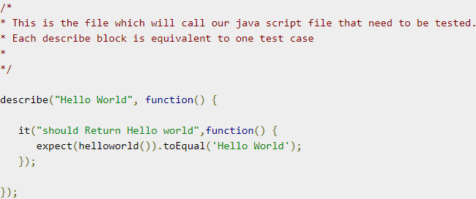
Related languages
Create simple function in Js file
Test your function in other Js file using Jasmine test functions

Slide 8
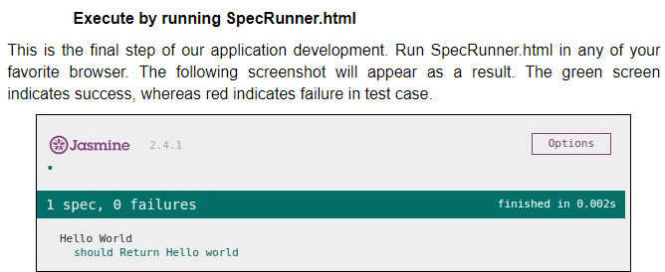
Run your application

Slide 9
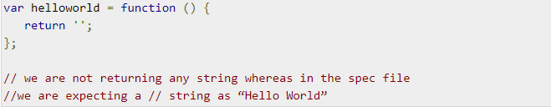
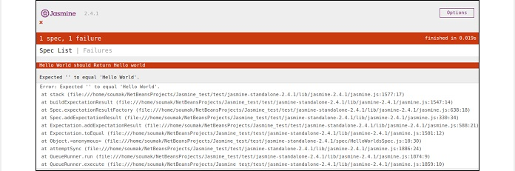
Understand the failure case

Slide 10
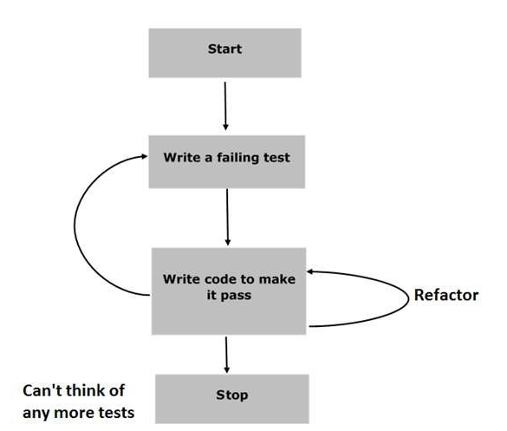
Phases of BDD framework
Step 1 − Start
Step 2 − Write a failing test
Step 3 − Write a code to make it pass
Step 4 − Refactor
Step 5 − Stop

Slide 11
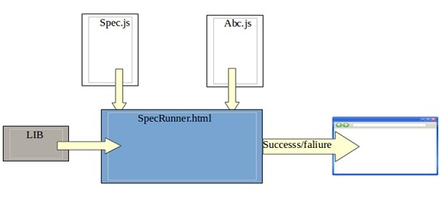
Phases of BDD framework example 2
Lib
Spec.js(Test case file)
Abc.js(File to be tested)
SpecRunner.html

Slide 12
Building blocks of test by Jasmine
Suite Block:
Jasmine is a testing framework for JavaScript.
Suite is the basic building block of Jasmine framework. The collection of similar type test cases written for a specific file or function is known as one suite. It contains two other blocks, one is “Describe()” and another one is “It()”.
One Suite block can have only two parameters, one “name of that suite” and another “Function declaration” that actually makes a call to our unit functionality that is to be tested.

Slide 13
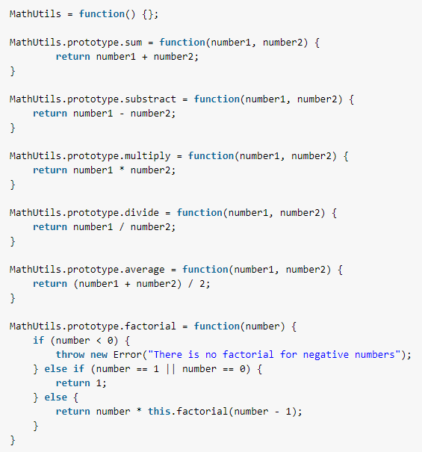
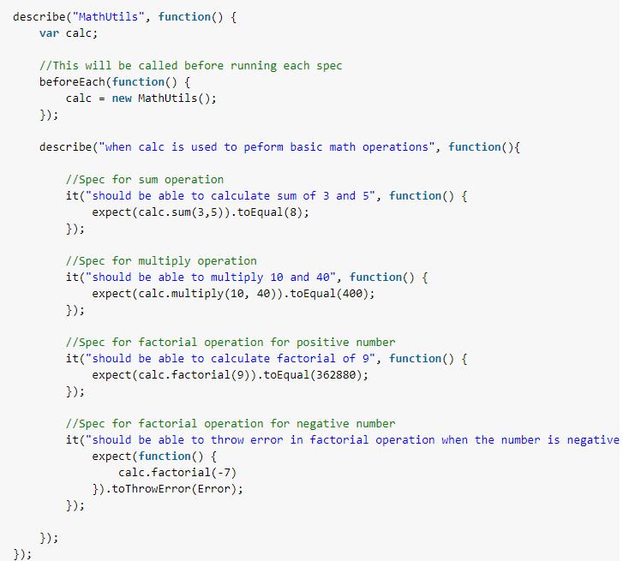
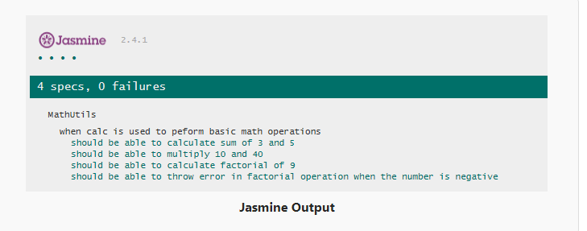

Slide 14
beforeEach() afterEach()
For setup and tear down purpose, Jasmine provides two global functions at suite level i.e. beforeEach() and afterEach().
1. beforeEach()
The beforeEach function is called once before each spec in the describe() in which it is called.
2. afterEach()
The afterEach function is called once after each spec.
In practice, spec variables (is any) are defined at the top-level scope — the describe block — and initialization code is moved into a beforeEach function. The afterEach function resets the variable before continuing. This helps the developers in not to repeat setup and finalization code for each spec.

Slide 15
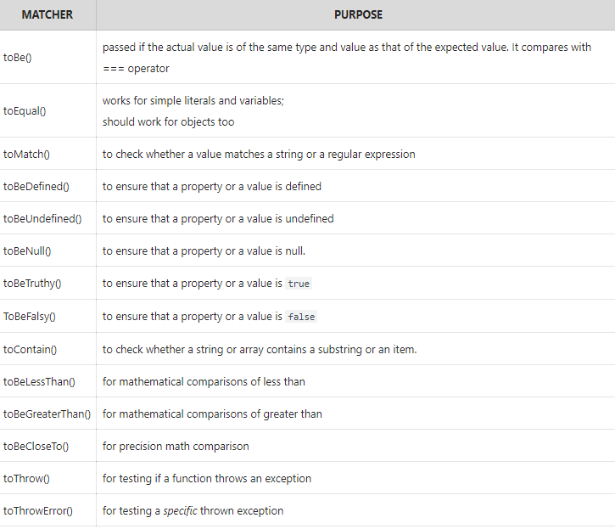
Jasmine Matchers

Slide 16
Mocha
Mocha is a testing library for Node.js, created to be a simple, extensible, and fast. It’s used for unit and integration testing, and it’s a great candidate for BDD (Behavior Driven Development).
- npm install --save mocha chai
--save option to automatically save these dependencies in our package.json file
-npm test
Run test command

Slide 17
Mocha does not discriminate whatever assertion library you choose to use. If you are using Mocha in a Node.js environment, you can use the built-in assert module as your assertion library. However, there are more extensive assertion libraries you can make use of such as Chai, Expect.js, Should.js. Using Assert libraries is not necessary, but they make testing much easier. Mocha allows us to use any library.
- npm i --save-dev chai

Slide 18
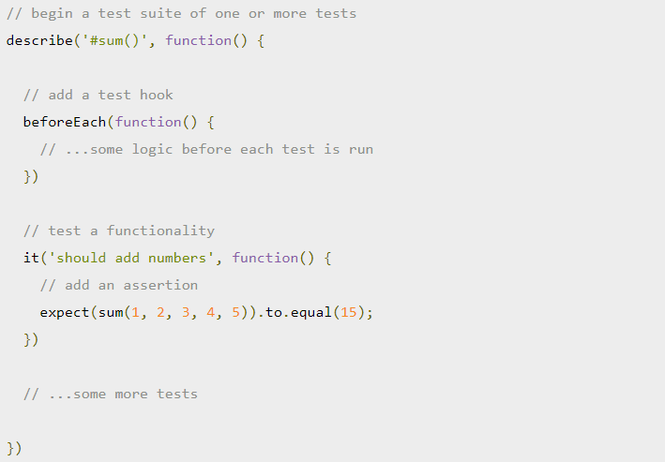
Mocha interfaces
Mocha provides a variety of interfaces for defining test suites, hooks and individual tests, namely: BDD, TDD, Exports, QUnit and Require.
However, you can check the comparison between the available Mocha style-interfaces in this documentation.
Mocha - This library contains common functions for testing, including describeand it.
Chai - The library supports a variety of functions for checks. There are different "styles" of checking the results, which we will meet later, for the moment we will use only assert.equal.

Slide 19
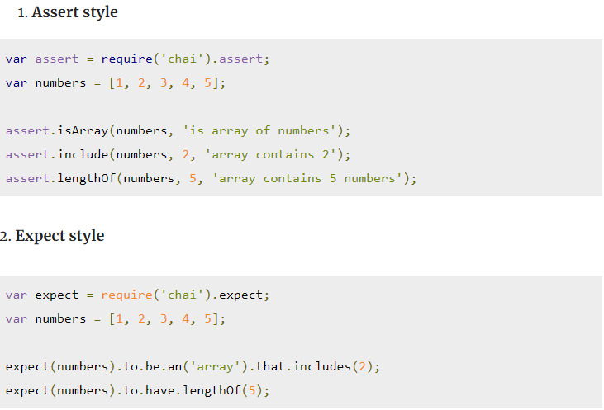
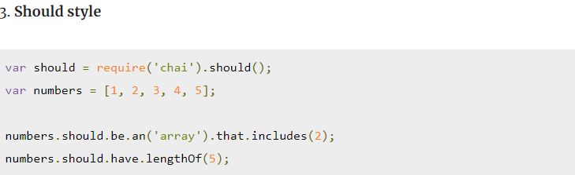
Chai provides the following assertion styles:

Slide 20
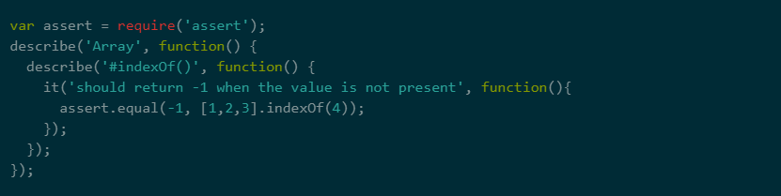
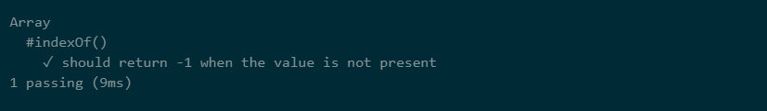
We describe what we want to verify using describe().
it()used to describe what will be tested in this block of code.
npm test

Slide 21
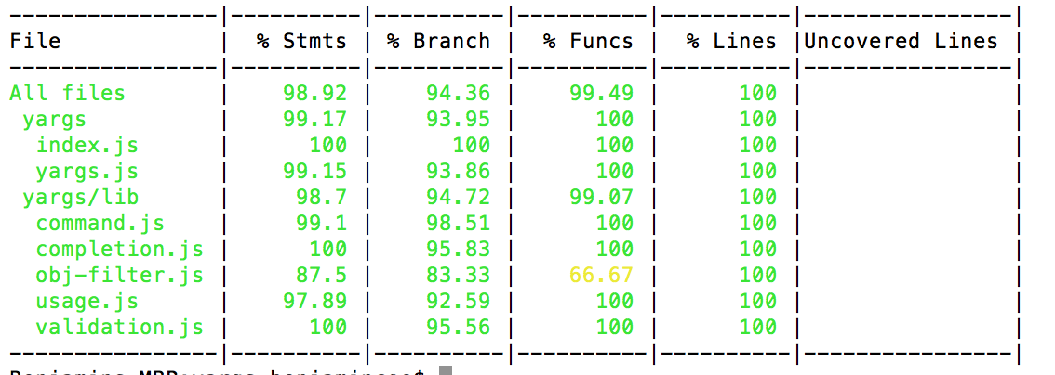
ISTANBUL
Istanbul tool allows you to analyze code coverage with unit tests. He displays detailed reports, focusing on which you can get an accurate idea of ​​what has not yet been tested in the project, and evaluate the amount of work needed to improve the situation. Istanbul instruments your ES6 and ES2015+ JavaScript code with line counters, so that you can track how well your unit-tests exercise your codebase.

Slide 22
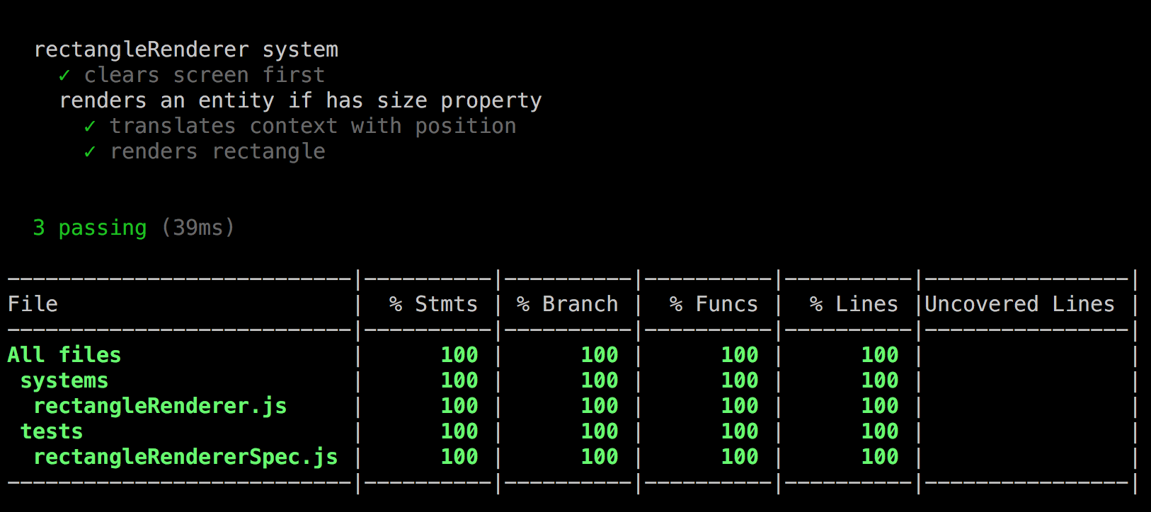
Istanbul install and Run
npm i nyc --save-dev
After installing as a development dependency, only thing left is to edit test script in package.json file.
"scripts": {
"test": "nyc mocha"
}
3. npm run test
So, Istanbul.js is essential tool to work in tandem with mocha to give us more insight about the tests and code we write.

Slide 23
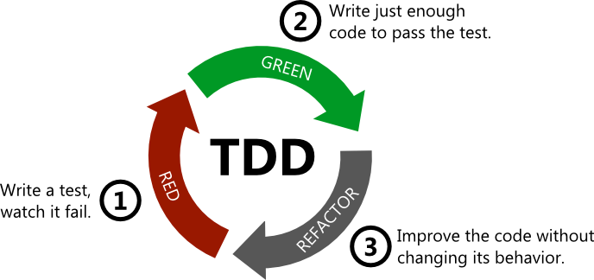
TDD (Test Driven Development)
TDD (Test Driven Development) is one of the software development methods. The concept is that you write a test before you implement a function.
The steps of TDD are as follows:
Write failing test: write tests according to the logic of the function.
Make the test pass: write code to make the test pass and confirm it passes all the other tests.
Refactor the implementation: update and rewrite the code to increase the quality of the product. Also, make sure it passes the new test and passed tests.
Thanks to TDD, you can immediately confirm test coverage. TDD also forces us to subdivide the function and decide what expected result is for each section. That helps us to understand more about the function before you implement.

Slide 24
BDD (Behavior Driven Development)
BDD is another software development method. That designs tests and expresses behavior (required specification). In BDD, the test is thought as the first customer of the products and requires some specifications in words of a human. That is why testing frameworks provide us functions which allow us to write as you write a sentence.

Slide 25
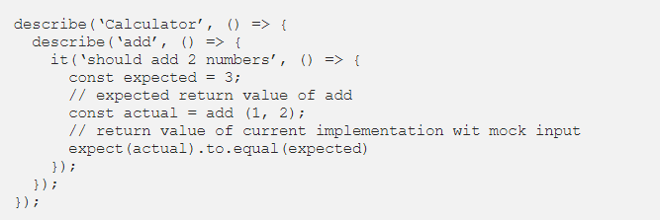
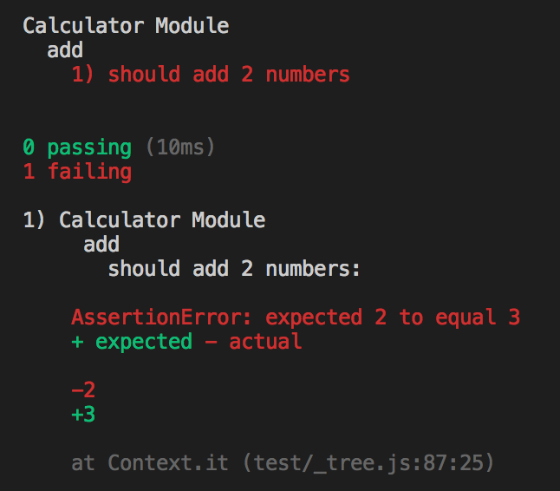
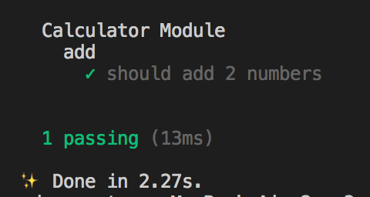
Test it
Suppose that there is a module called Calculator and it has add function as a part of it.
const add = (x, y) => {
return x + y;
}
If it is failed:
If it is passed:
Like above BDD structurally displays the result of the test. That helps us to find which module/function is failed immediately.

Slide 26
SUMMARY
TDD and BDD is very useful method. It makes your product more manageable and increase the its quality. And also there are a lot of support tools. The key difference is the scope. TDD is a development practice while BDD is a team methodology. In TDD, the developers write the tests while in BDD the automated specifications are created by users or testers (with developers wiring them to the code under test.)

Slide 27
Other test libraries/frameworks
Jsdom
Karma
Unexpected
Sinon.JS
Testdouble.js
Wallaby
Cucumber
Jest
Ava
Cypress
Puppeteer
Tape
Selenium
Appium
Protractor
WebdriverIO
Nightwatch
TestCafe
PhantomJS
Nightmare
Casper
CodeceptJS

Slide 28
REFERENCES
https://designmodo.com/test-javascript-unit/
https://howtodoinjava.com/javascript/jasmine-unit-testing-tutorial/
https://www.tutorialspoint.com/jasminejs/jasminejs_building_blocks_of_test.htm
https://habr.com/ru/company/ruvds/blog/349452/
https://github.com/dwyl/learn-istanbul

Slide 29


