Slide 1
NODE JS INTRODUCTION
By Vasyl Dziuba

Slide 2

Agenda
Agenda
Why Node.jS?
What is Node.js?
Architecture of Node.js
Node.js Event Loop
Where to use Node JS?

Slide 3
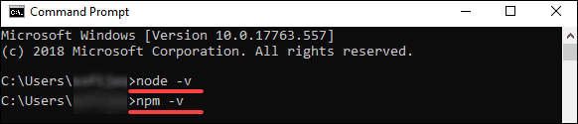
Agenda
Installation
navigate to https://nodejs.org/en/download/. Click the Windows Installer button to download the latest default version. The Node.js installer includes the NPM package manager.
Verify Installation:

Slide 4
Agenda
NPM
npm is the default package manager for Node.js.
It manages dependencies for an application.
It also allows users to install Node.js applications that are available on the npm registry.

Slide 5

What is a Node.JS?
What is a Node.JS? 4
Server Side JavaScript
Platform built on Chrome’s JavaScript runtime i.e. V8 script engine
Lightweight and Efficient
Event-Driven, works on the Non-Blocking Model
Can Handle Thousands of Concurrent Connections with Minimal Overhead on a Single Process.

Slide 6
Why Node.JS?
Provide Easy Way to Build Scalable Network Programs.
A Node.js app is run in a single process, without creating a new thread for every request.
Node.js provides a set of asynchronous I/O primitives in its standard library that prevent JavaScript code from blocking and generally, libraries in Node.js are written using non-blocking paradigms, making blocking behavior the exception rather than the norm.
When Node.js needs to perform an I/O operation, like reading from the network, accessing a database or the filesystem, instead of blocking the thread and wasting CPU cycles waiting, Node.js will resume the operations when the response comes back.

Slide 7
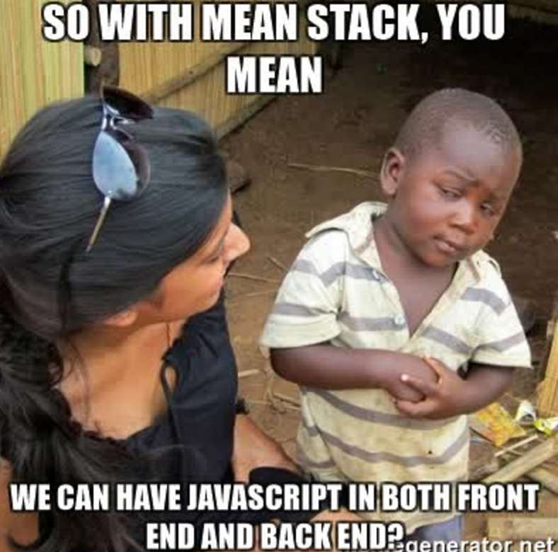
Run JavaScript on Server Side
Allows to run Javascript code in the backend,
outside a browser.
Using Google’s V8 Engine
Has Runtime environments and NPM library.

Slide 8

NodeJs works on
Node.js runs the V8 JavaScript engine, the core of Google Chrome, outside of the browser. This allows Node.js to be very performant.

Slide 9
Synchronous vs Asynchronous
Synchronous Asynchronous
Waits for each operation to complete, after that executes next operation. | Never waits each operation to complete, executes all at one time. Results handled as available.
Step by Step execution | Callbacks used to handle results

Slide 10
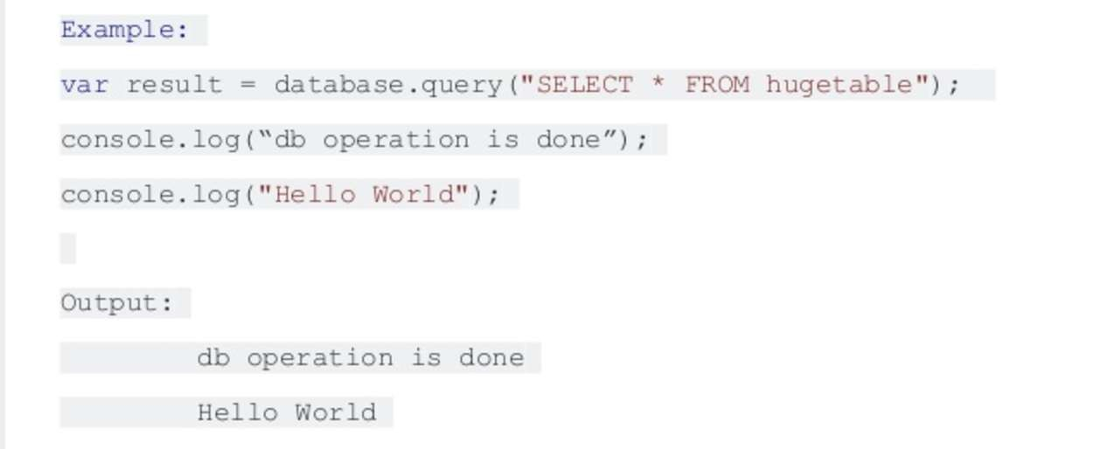
Synchronous Example

Slide 11
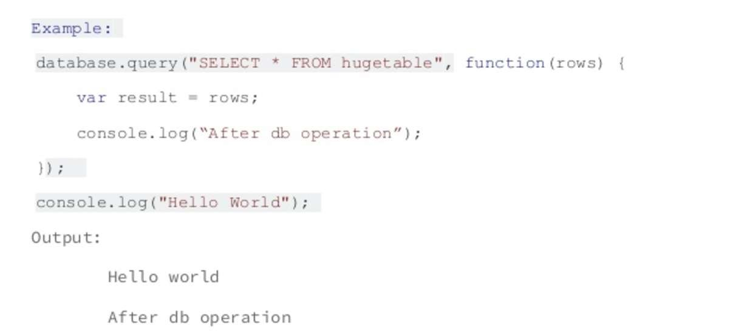
Asynchronous Example

Slide 12
The importance of good architecture
Having a good starting point when it comes to our project architecture is vital for the life of the project itself and how you will be able to tackle changing needs in the future. A bad, messy project architecture often leads to:
Unreadable and messy code, making the development process longer and the product itself harder to test
Useless repetition, making code harder to maintain and manage
Difficulty implementing new features. Since the structure can become a total mess, adding a new feature without messing up existing code can become a real problem

Slide 13
How to prevent it
We can all agree that our project architecture is extremely important, and we can also declare a few points that can help us determine what this architecture must help us do:
Achieve clean and readable code
Achieve reusable pieces of code across our application
Help us to avoid repetitions
Make life easier when adding a new feature into our application

Slide 14
Node.js Event Loop
The Event Loop is one of the most important aspects to understand about Node.js.
Why is this so important? Because it explains how Node.js can be asynchronous and have non-blocking I/O, and so it explains basically the "killer app" of Node.js, the thing that made it this successful.
The Node.js JavaScript code runs on a single thread. There is just one thing happening at a time.
Just pay attention to how you write your code and avoid anything that could block the thread, like synchronous network calls or infinite loops.
You mainly need to be concerned that your code will run on a single event loop, and write code with this thing in mind to avoid blocking it.

Slide 15
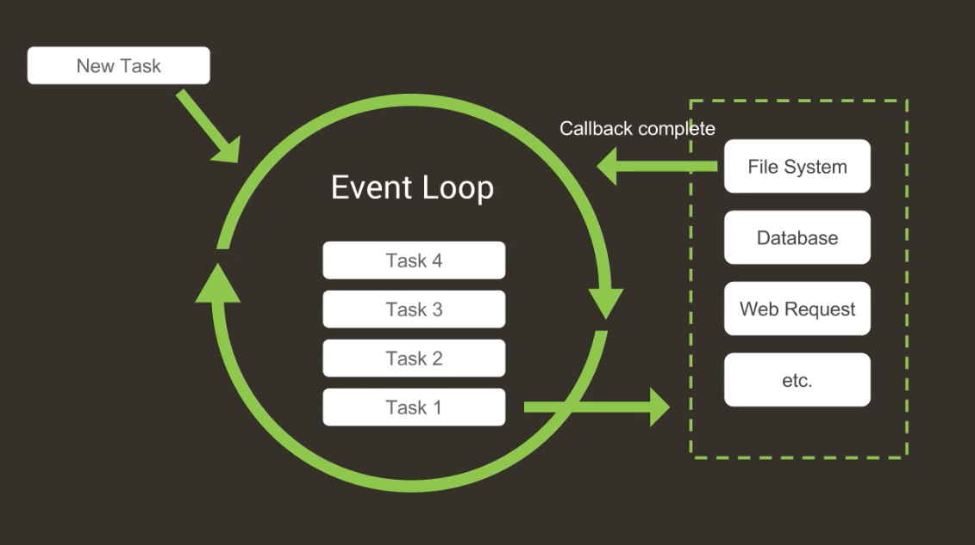
Summary

Slide 16

Blocking I/O in JavaScript
When a thread invokes a read() or write() operation, that thread is blocked until there is some data to read, or the data is fully written.
The thread can do nothing else in the meantime. Some operations, e.g. reading a file, used to be single threaded operations, and the operation had to be completed before another could be executed.

Slide 17
Non-Blocking I/O in JavaScript
Non-Blocking I/O enables a thread to request reading data from a channel, or in the case of front-end technologies from "the Event Loop," gets what is currently available, or nothing at all if no data is available.
Rather than remain blocked until data becomes available for reading, the thread can go on with something else. Revolutionary: speeding up processing time and read/write time quite dramatically, with improved error handling.
That is, a single thread can now manage multiple requests of input and output. Blocking methods execute synchronously (at once — the full process from start to finish) and non-blocking methods execute asynchronously — sending and receiving "call-backs" as tokens to and from where their operations are performed.

Slide 18
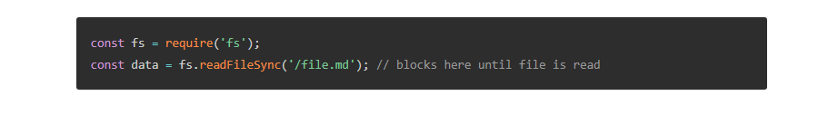
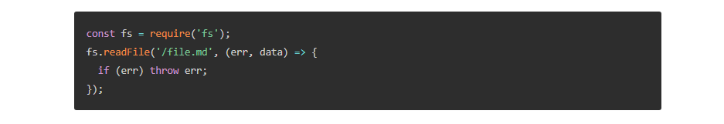
Synchronous/Asynchronous file read
Using the File System module as an example, this is a synchronous file read
And here is an equivalent asynchronous example:

Slide 19




Where to Use Node.JS?
Few CPU Cycles
I/O Operations
Chat/ messaging
Real – Time Applications
Communication Hubs
High Concurrency Applications
Destructuring lets us streamline this code:
is equivalent to

Slide 20
Benefits
Multi-Platform (Linux, Mac, Windows)
One development language JS on client and server side
Open source technology
Many NPM packages available on npmjs.org
Short learning curve (Event loop theory, JavaScript, Evented programming)

Slide 21

Where You Cannot Use Node.JS?
Heavy Computation
Large and Complicated Web Applications

Slide 22

Who Uses Node.Js?

Slide 23

REFERENCES
https://nodejs.dev/the-nodejs-event-loop
https://nodejs.org/en/docs/guides/blocking-vs-non-blocking/
https://blog.logrocket.com/the-perfect-architecture-flow-for-your-next-node-js-project/

Slide 24


