Slide 1
REACT INTRO
By Vasyl Dziuba

Slide 2

In this presentation
Introduction to React
Function component
Destructuring props

Slide 3

What is React?
React is a JavaScript framework that aims to simplify the development of visual interfaces.
Developed on Facebook and released in 2013, it has become one of the most common code examples in the world, driving Facebook and Instagram, as well as many other companies.
React is used to create one-page web applications, like many other libraries and frameworks that were available before React came out.

Slide 4
Why is React so popular?
Not as complicated as other alternatives
At the time React was announced, Ember.js and Angular 1.x were the main choice, like frameworks. Both of them imposed too many conventions in the code, making porting existing applications completely inconvenient.
Perfect timing
Switching from Angular 1 to 2 was like switching to a completely new framework, so because of this, along with the speed improvements that React promised, it made many developers look forward to trying React.
Facebook support
Support for Facebook certainly benefited the project if it became successful, but this is not a guarantee, as you can see from many unsuccessful open source projects, for the world, both from Facebook and from Google.

Slide 5


Famous React Projects
Facebook - it uses React partially, but also in the PC version, and in the mobile application.
Instagram - in such a popular application, the reaction plays a huge role. Starting with the ability to determine the geolocation and ending with the accuracy of the search functionality, these things are often done on React.
The Netflix - most actively involved on the Gibbon platform.
Yahoo! Mail Address - thanks to Facebook, these services have become streamlined in terms of architecture.
WhatsApp - specialists of this service decided to use React to create user interfaces
Dropbox - In the wake of the popularity of the library, it began to be used for this site.

Slide 6
Core Concept
JSX
Components
Unidirectional Data Flow
Virtual DOM

Slide 7
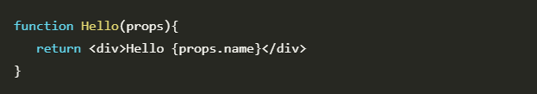
What Is Functional Component?
There are two main types of components in React.
Class Components and Functional Components. The difference is pretty obvious. Class components are ES6 classes and Functional Components are functions. The only constraint for a functional component is to accept props as an argument and return valid JSX.
The key thing that makes this type of component different from a class component is the lack of state and lifecycle methods. This is why functional components are also commonly referred to as stateless components.

Slide 8
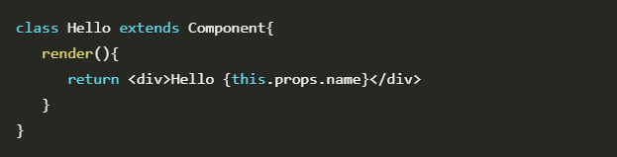
Simple Example Of Class Component
This snippet is a contradiction to the most basic rule. If you ever have a class component with only a render method – you should always make it a functional component.

Slide 9
Why to use Functional Component
Functional components are easy to reason about
One of the main benefits of functional components is that they make your code easier to read and understand. If you’re working on a project by yourself, you might not think this is a big deal.
Functional components are easy to test
It’s easier to test functional components because you don’t have to worry about hidden state or side effects. For every input (props), functional components have exactly one output.
Functional components are easy to debug
Functional components depend only on the props they are given to produce an output which in turn makes debugging easier.

Slide 10


When NOT to use Functional Components
The general heuristic I use is to always start with a functional component. If you find out you need lifecycle methods or it makes sense to have a small piece component level state, it’s trivial to refactor to a class component.

Slide 11
Summary
A Functional component is a function that takes props and returns JSX
They do not have state or lifecycle methods.
Functional components are easier to read, debug, and test. They offer performance benefits, decreased coupling, and greater reusability.
They with a few downsides … but the benefits strongly outweigh these. Use them whenever you can.
Functional components are built into React. You can get started adding them (and refactoring unnecessary class components) to your existing projects right away!

Slide 12
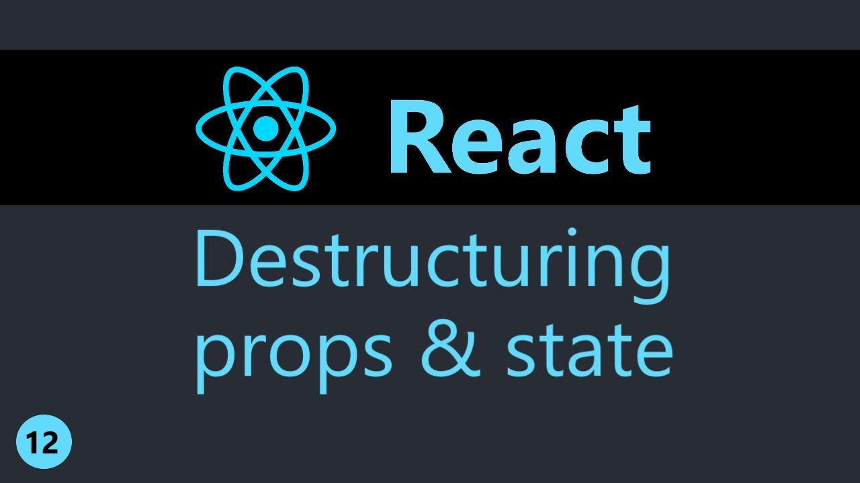
Destructuring props
Destructuring was introduced in ES6. It’s a JavaScript feature that allows us to extract multiple pieces of data from an array or object and assign them to their own variables.

Slide 13
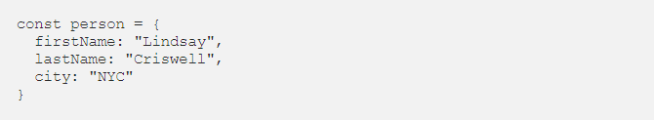
Destructuring props
Destructuring was introduced in ES6. It’s a JavaScript feature that allows us to extract multiple pieces of data from an array or object and assign them to their own variables.
Imagine you have a person object with the following properties:

Slide 14



Before ES6, you had to access each property individually:
Destructuring lets us streamline this code:
is equivalent to

Slide 15

Reasons to destructure
Improves readability
This is a huge upside in React when you’re passing down props. Once you take the time to destructure your props, you can get rid of props / this.props in front of each prop.
Shorter lines of code
It’s long, clunky, and takes way too many lines of code. With destructuring, your code becomes much more clear.

Slide 16

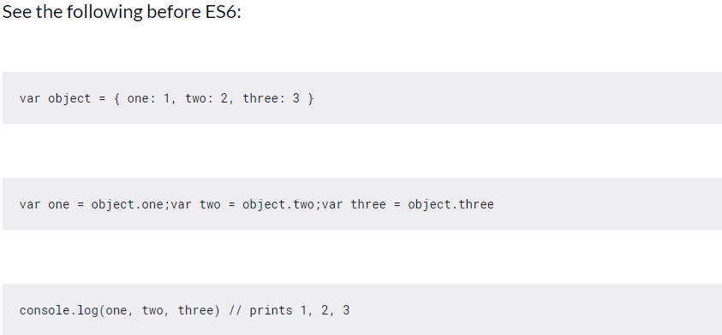

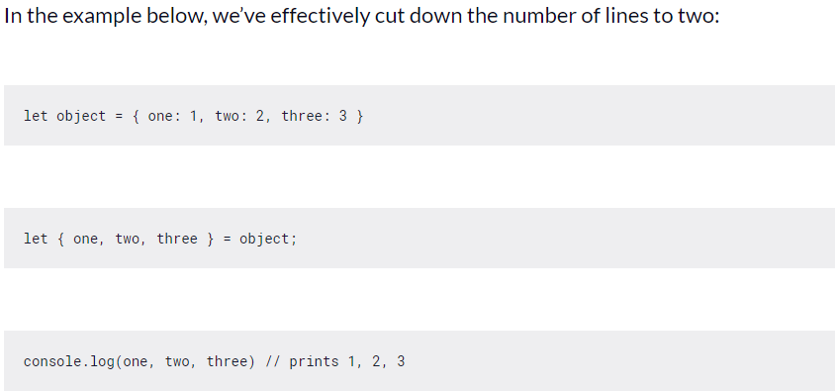

Slide 17

Advantages Of Using Destructuring
The first one is that your code more readable. If you destructure an object at the top of a function or code block, it is clear to the reader what variables you are going to use.
The second plus is performance. Destructuring encourages programmers to put object properties in local variables before using them, which can improve application performance. Especially if you are accessing those variables multiple times, maybe in a loop, it is more efficiënt if the variables are locally defined.

Slide 18



Summary
The code is more readable and in larger render functions the advantages will become more evident. If you are coding ES6 in your project, try destructuring out!

Slide 19
Useful Links
https://programmingwithmosh.com/react/react-functional-components/
https://wecodetheweb.com/2015/05/25/es6-destructuring/
https://www.freecodecamp.org/news/the-basics-of-destructuring-props-in-react-a196696f5477/

Slide 20


