Slide 1
JavaScript Meta Programming
By Vasyl Dziuba

Slide 2
Agenda
Agenda
SYMBOLS
PROXY
REFLECT
TAGGED TEMPLATE LITERALS

Slide 3
METAPROGRAMMING
Metaprogrammig is a programming technique in which computer programs have the ability to treat programs as their data. It meane that a program can be designed to read, generate, analyse or transform other programs or itself while running.

Slide 4
SYMBOL
The symbol type is a new primitive type of value introduced in ES6 and it is both immutable and unique, which means that, differently from other primitives, a symbol will never be equal another one (just as it happens with objects). This behavior very useful. The Symbol object is a globally available object which acts as a wrapper around the symbol primitive data type

Slide 5
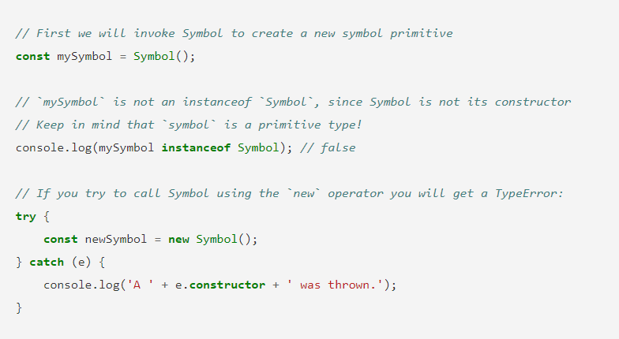
SYMBOL
To create a new symbol you just need to invoke the Symbol function, if you use the new operator a TypeError will be thrown.

Slide 6
Symbols are often used to identify object properties. Often to avoid name clashing between properties, since no symbol is equal to another. Or to add properties that the user cannot overwrite, intentionally or without realizing. Symbols are not enumerated, which means that they do not get included in a for..of or for..in loop ran upon an object. Symbols are not part of the Object.keys() or Object.getOwnPropertyNames() result. You can access all the symbols assigned to an object using the Object.getOwnPropertySymbols() method.

Slide 7
Why to use Symbol():
Name Clashes: when you wanted to prevent collisions with keys in objects
Privacy: when you don’t want your object properties to be enumerable
Symbols in Javascript can provide access level uniqueness to objects. It's worthwhile for all developer to have a basic understanding of them and their various use-cases.

Slide 8
Proxy
An object Proxy"wraps" around another object and can intercept (and, if desired, independently process) various actions with it, for example, reading / writing properties and others. Further we will call such objects "proxies".
Proxies are used in many libraries and some browser frameworks. In this chapter we will see many cases of using proxies in solving real problems.

Slide 9
PROXY
Syntax:
let proxy = new Proxy(target, handler);
target - this is the object for which you need to make a proxy, it can be anything, including functions.
handler - proxy configuration: an object with “traps”: methods that intercept various operations, for example, a trap get for reading properties from target, a trap setfor writing properties to target and so on.

Slide 10
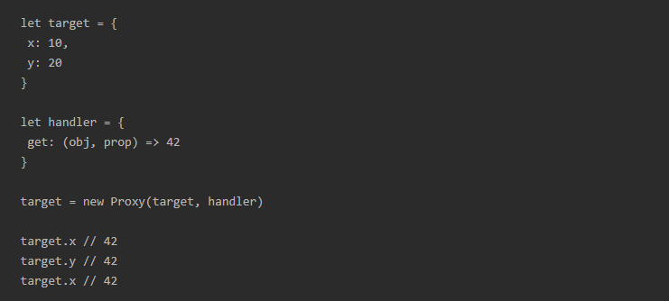
PROXY
A proxy is created using a constructor new Proxythat takes two required arguments: the target object and the handler .
The simplest example of a working Proxy is one with one trap, in this case a trap getthat always returns “42”.

Slide 11
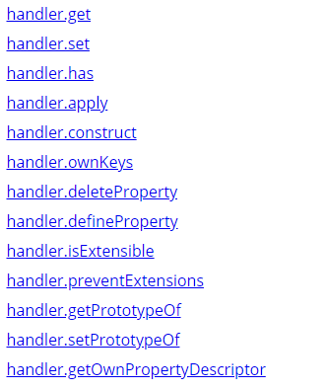
PROXY METHODS

Slide 12
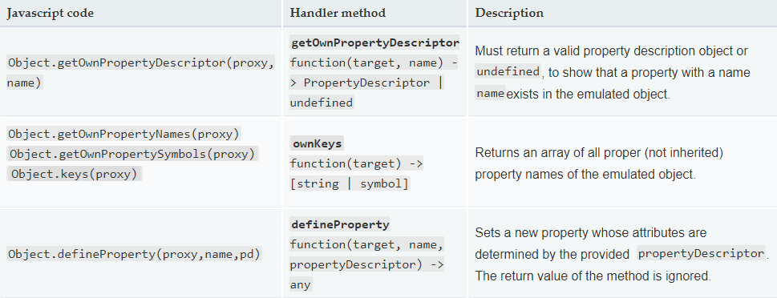
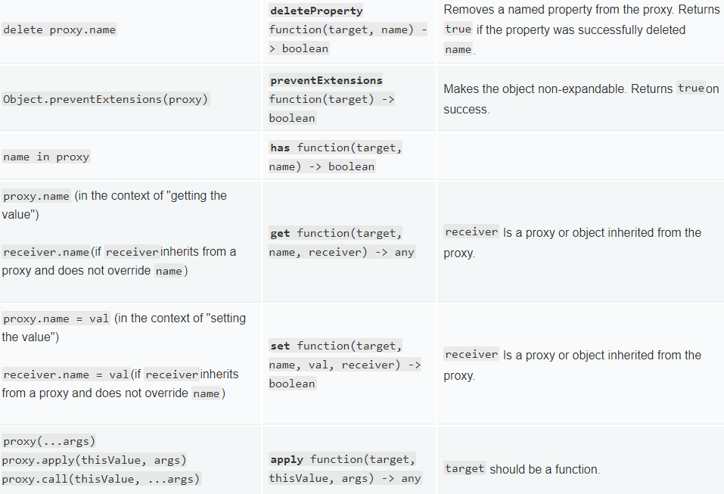

Slide 13
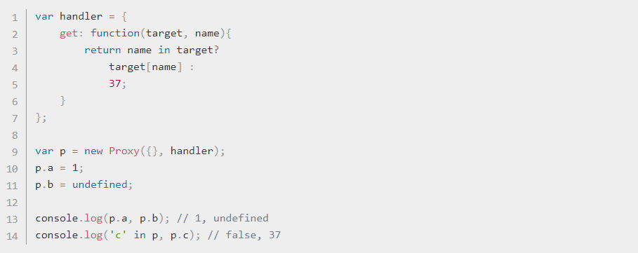
An object that returns 37 if there is no property with the specified name:

Slide 14
Reflect
Reflect is a built-in object that provides methods for intercepting JavaScript operations. These methods are similar to proxy handler`s methods . Reflect- it is not functional, but a simple object, it is not designed.
Unlike most global objects, Reflectthis is not a constructor. You cannot use it with new operator or call Reflect, as a function. All properties and methods of the object Reflectare static (the same as for the object Math).

Slide 15
Reflect.apply()
Calls the objective function with the arguments passed in the parameter args. See also Function.prototype.apply().
Reflect.construct()
The operator new as a function. Similarly new target(...args). Also provides the ability to define another prototype.
Reflect.defineProperty()
Looks like Object.defineProperty(). Returns Boolean.
Reflect.deleteProperty()
The operator delete as a function. Similarly delete target[name].
Reflect.enumerate()
It looks like a loop for...in. Returns an iterator with its own enumerated and inherited properties of the target.

Slide 16
Reflect.ownKeys()
Returns an array of strings with the names of their own (non-inherited) properties.
Reflect.preventExtensions()
Similarly Object.preventExtensions(). Returns Boolean.
Reflect.set()
A function that assigns values ​​to properties. Returns Booleanvalue true on success.
Reflect.setPrototypeOf()
A function that assigns a prototype to a target.
Reflect.get()
A function that returns the value of properties.
Reflect.getOwnPropertyDescriptor()
Similarly Object.getOwnPropertyDescriptor(). Returns the handle of the specified property if present in the object, otherwise undefined.
Reflect.getPrototypeOf()
Similarly Object.getPrototypeOf().
Reflect.has()
The operator in as a function. Returns a value Booleandepending on the fact of having its own or inherited property.
Reflect.isExtensible()
Similarly Object.isExtensible().

Slide 17
What is the difference between Reflect and Proxy?
Reflect is a set of useful methods for working with objects, half of which are rewritten existing from Object. This was done in order to improve semantics and restore order, since Object is a base class, but it contains a lot of methods that should not be in it. Also, if you create an object with an empty prototype, then your reflection methods disappear (below I will show with an example what this means). Proxy is a class that always creates a new object with handlers installed to intercept access. It allows you to catch any actions with the object and modify them. Reflect is often used to implement various logic. Below with examples, this will be clearly visible.

Slide 18
REFLECT
Also added a few new methods:
Reflect.construct is a more convenient alternative to Object.create , which allows not only to create an object with the specified prototype, but also to immediately initialize it
Reflect.ownKeys - returns an array of properties belonging to the specified object (and not to objects in the prototype chain).

Slide 19
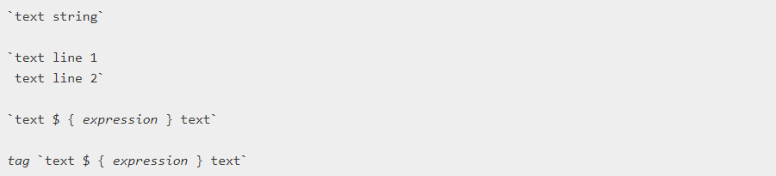
Tagged Template Litterals
Pattern literals are string literals that allow the use of built-in expressions. With them, you can use multi-line notation and line interpolation tools.
In previous versions of the ES2015 specification, they were called "template strings".

Slide 20
Tagged Template Litterals
Pattern literals are enclosed in quotation marks (``) ( gravis ) instead of double or single quotation marks.
Template literals may contain placeholders. They are denoted by a dollar sign and parentheses ( ${expression}). Expressions in placeholders and text between quotation marks (``) are passed to the function.
A simple function simply combines several parts into a single line. If the template is preceded by an expression (tag), it is called a tagged template . In this case, the tag expression (usually a function) is called along with the template literal, and you can manipulate it before returning.

Slide 21

Execution context
Instead of:
console.log ('text string 1 \ n' +
'text line 2');
// "text string 1
// text line 2 “
Do this:
console.log (`text line 1
text line 2`);
// "text string 1
// text line 2 "
Instead of:
let a = 5;
flight b = 10;
console.log ('Fifteen is' + (a + b) + ', and \ nnot' + (2 * a + b) + '.');
// "Fifteen is 15, and
// not 20. “
Do this:
let a = 5;
flight b = 10;
console.log (`Fifteen is $ {a + b}, and
not $ {2 * a + b} .`);
// "Fifteen is 15, and
// not 20. "

Slide 22
REFERENCES
https://habr.com/ru/company/tuturu/blog/334546/
https://habr.com/ru/company/docsvision/blog/417097/#4-reflect-api
https://developer.mozilla.org/uk/docs/Web/JavaScript/Reference/Template_literals
https://developer.mozilla.org/ru/docs/Web/JavaScript/Guide/Meta_programming

Slide 23


