Slide 1
Think like architect
How the architecture changed my mindset?
Ilya Ryabukhin
Application Consultant @ IBM CZ

Slide 2
Agenda
High-level overview
Top-5 archiecture errors
What’s architectural thinking?
Architecture vs Design
Architecture in development
Architecture artifacts

Slide 3
Architecture

Slide 4
Architecture
No single definition
IBM: an engineering discipline that studies methods of designing IT systems that provide a solution to a business problem. The solution must satisfy functional and non-functional requirements in a way that best balances competing stakeholders’ concerns and must take constraints into account
TOGAF: A formal description of a system, or a detailed plan of the system at component level, to guide its implementation
Gartner: the overall design of a computing system and the logical and physical interrelationships between its components. The architecture specifies the hardware, software, access methods and protocols used throughout the system

Slide 5
Architecture
Defines system structure and definition
Exists in each system
Impacts on system implementation and team skillset
Defines system roadmap
Manages and balances expecations

Slide 6

Top-5 erorrs
We’re building MVP, architecture is not required
I was thinking like that
There exists MVA (minimum viable architecture) aka “just enough architecture”
Detailed architecture description is no required
That would lead to multiple solution fixes huge time waste
We’re agile, architecture is not required
PaaS is used, architecture is not required
There’s a slight change, architecture should stay the same
$$→$$

Slide 7
Types of Enterprise Architecture (EA)
Business architecture
Reflects business strategy and defines all processes
Clarifies goals and indicators for achieving the goals
Information architecture
Defines logical and physical data model
Describes the usage of data entity between business services and functions
Application architecture (I was thinking the only one)
Shows application deployment and links to existing business processes
IT architecture
States the logical and physical ability to deploy the service
Includes infrastucture and middleware

Slide 8
Architectural thinking
Ability to iterate
Architecture adapts to the business requirements
Non-linearity
Some business processes may change or include multiple inputs
Usage of previous experience
Reference architectures (more on that later)
Inputs for architectural thinking
What’s the problem we’re trying to solve?
What system should do and how should it work?
What can be reused from previous expreience?

Slide 9
Architecture vs Design
Both are the stages of solution development
Architecture is about HOW
Each component is black box
Focus on integrity
Difficult to change
Design is about WHAT
Each component is properly described
Focus on details
Easier to change

Slide 10
Agenda
High-level overview
Architecture in development
Role in the software development processes
View vs Viewpoint
4+1 Views Model
Architecture artifacts

Slide 11
Development

Slide 12
Development phases
Analysis
Includes Architecture and Design
Architecture dominates here
Creation
Development and Testing
Reference architectures analysis
Architecture is presented here
Operations
Validation of functional and non-functional requirements
Most project artifacts can become a reference

Slide 13
View vs Viewpoint
Viewpoint
Point of view linked with some of roles for architecture creation
Each viewpoint produces its own view
View
Vision of overall system with the perspective of limited amount of objective
The more views are considered – better architecture is built

Slide 14

4+1 Views Model
Development
View
Logical View
Use-cases
Process View
Physical View

Slide 15
4+1 Views Model
Logical
Objects model
Development
Core software systems, component reusage
Process
Scalability, efficiency, ability to integrate
Physical
Mapping between software and infrastructure
Use-cases
Set of scenarios that describe system behaviour

Slide 16
Agenda
High-level overview
Architecture in development
Architecture artifacts
Requirements
Architecture principles and decisions
Reference architectures and pattens
Component Diagrams
Deployment Diagram
Architecture Validation

Slide 17
Artifacts

Slide 18
Requirements
Functional
About WHAT should system do
Describes actual needs
Non-functional
About HOW should system do
Describes details about functionality usage

Slide 19
Architectural principles and decisions
Principles
Set of statements that are used to achieve one or more company goal
Depends on company’s IT landscape, strategy, market trends etc.
Not changed for multiple projects
Part of Enterprise Architecture
Goal: connect mutiple solutions on the enterprise level
Decisions
Set of statements that are used to fix the choice of some solution in the system
May change between some projects
Part of Solution Architecture
Goal: connect multiple components on the solution level

Slide 20
Reference architecture and patterns
Reference architecture
Best practice from perspective of either technology or industry
More about approach
Pattern
Best practice from perspective of specific problem
More about implementation

Slide 21
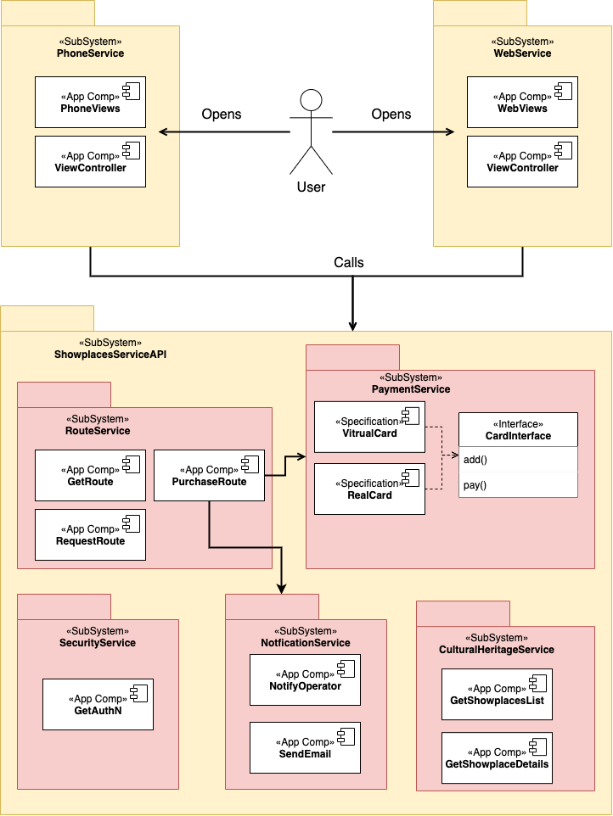
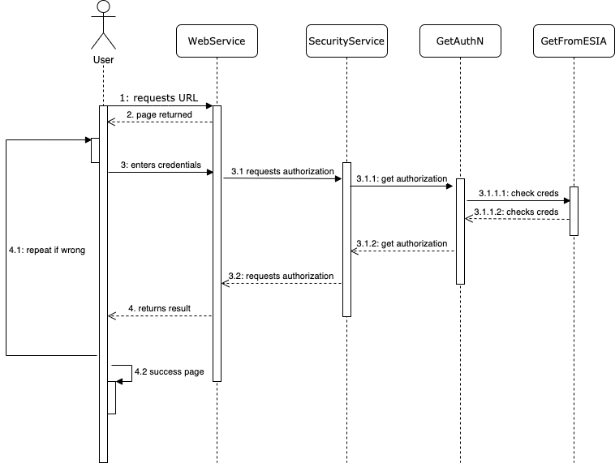
Component Diagrams
Component Relationship
Component Interaction

Slide 22
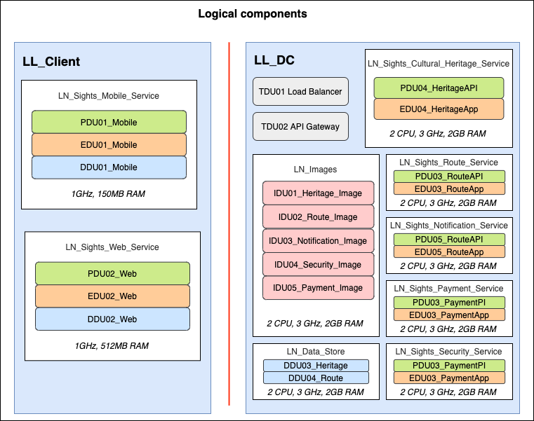
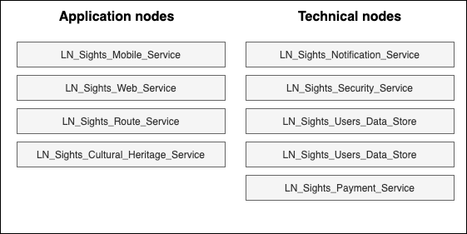
Component Diagrams
Nodes

Slide 23
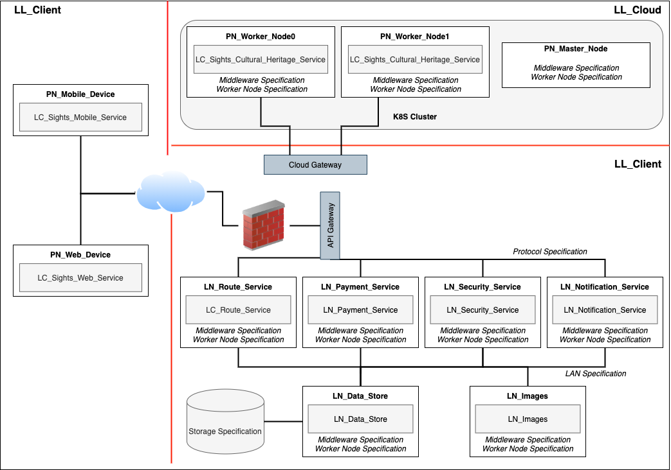
Operations Diagram

Slide 24
Validation
Based on architecture principles
Implementation is scored using principles
Functional requirements are considered
Assessment of functionality feasibility
Check if some functional requirement can be assigned to one or more component
Compliance with non-functional requirements
Operations model is assessed through requirements

Slide 25
Wrap it up
Architecture is important
Main management and coordination tool
Allows to better plan process of solution creation
Architecture is about HOW, not WHAT
Less details – more integrity
Always iterate and use output as a future input
Multiple artifacts should be created
Each artifact’s output used as input to the next one

Slide 26
Think like architect
How the architecture changed my mindset?
Ilya Ryabukhin
Application Consultant @ IBM CZ

