Slide 1

FOOD DEMAND FORECASTING
Team Details: Group 7
RITESH KUMAR
YASHARTH SRIVASTAVA
VATAN KUMAR
AMAN SINGH
SANJAY KUMAR GUPTA

Slide 2
Problem Definition
Define the technology and business problem you have solved
Food Demand forecasting for upcoming weeks of a meal delivery company
Tool :- Python
Library used :- NumPy, Pandas, Seaborn, MatplotLib ,Sklearn, Scipy, Jupyter Notebook.
Why it is important problem
A food delivery service has to deal with a lot of perishable raw materials which makes it all the more important for such a company to accurately forecast daily and weekly demand
What are the value additions you planned
Extracted new features like Discount which may give insights for future orders.
Providing insights into the data in order to optimize inventory which would lead to cost minimisation and thus increase a better resource planning of man and material.
Increased customer satisfaction by timely fulfilling their expectations and requirements

Slide 3
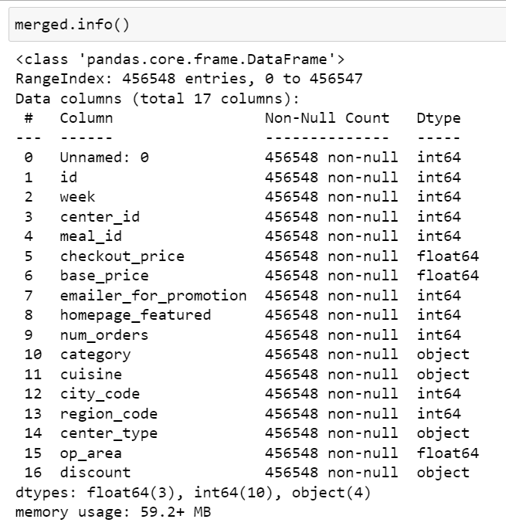
Data Set
Food Demand Forecasting (analyticsvidhya.com)

Slide 4
Supervised Learning Regression(SLR) Steps:
Aggregation of Data
Descriptive Statistics
Univariate Analysis- Numerical & Categorical Variable
Bivariate Analysis- Numerical & Categorical Variable
Missing Value
Outlier Analysis
Data Encoding
Train Test Split
Data Scaling
Statistical Testing for Significant Variables
Building Base Model
Checking The SLR Assumptions
Improving Base Model
Applying Other Models Like Random Forest, Decision Tree etc.
Improving Best Model Using Grid Search CV
Final Results on the basis of RMSE( Root Mean Squared Error) and R-Square.

Slide 5
Aggregation of Data using Python
There were total 3 datasets in the project which were combined into a single dataset . The 3 dataset were as follow:-
Weekly Demand data (train.csv)
Fulfilment_center_info.csv
Meal_info.csv

Slide 6
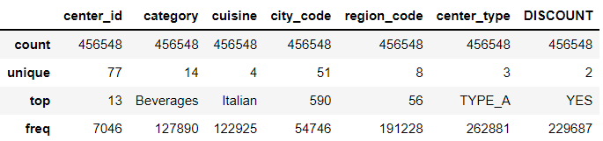
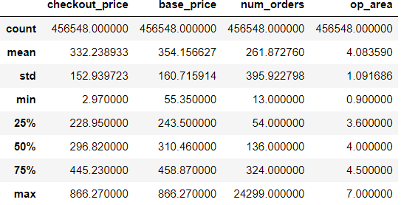
DESCRIPTIVE STATISTICS
For Categorical Data types:-
For Numerical Data types:-

Slide 7
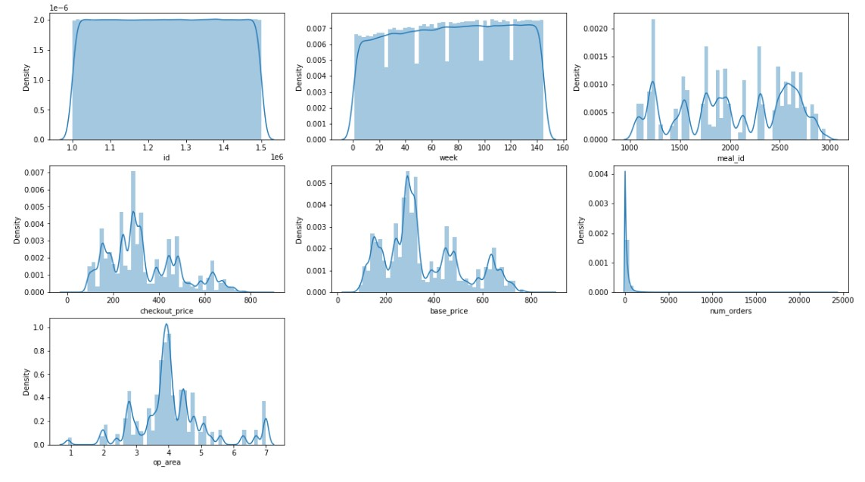
Univariate Analysis- Numerical Variables
Most of the orders having base price range in between 200 to 400.
Checkout price ranges varies similar to base price with a little discount.
Maximum orders placed from restaurant are having operation area within 3.5 to 4.5 SqKm.

Slide 8
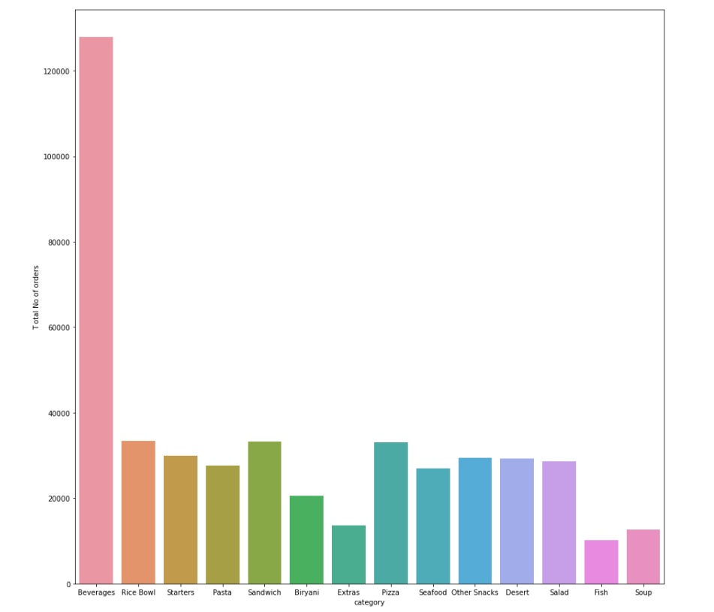
Univariate Analysis- Categorical Variables

Slide 9
Univariate Analysis- Categorical Variables
Beverages and Rice Bowl are the food category which has the highest number of orders and Soup and Fish are the food category with least number of orders.
In specific Cuisine-Food Category has the highest number of orders.In that Food Category we could see that Indian-Rice Bowl has the highest number of orders and Indian-Biriyani has the least no of orders.

Slide 10
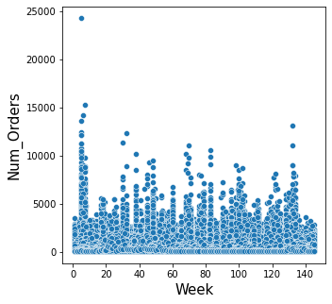
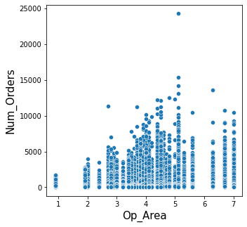
Bivariate Analysis: No. of Orders(Target) vs Week and Operation Area (Numerical)
We can see that No. of Orders remain constant across the week. This Shows a steady Demand for the Service Provider.
Most Number of Orders have been Placed from Service Centers with 3 to 5 square km Operation Area.

Slide 11
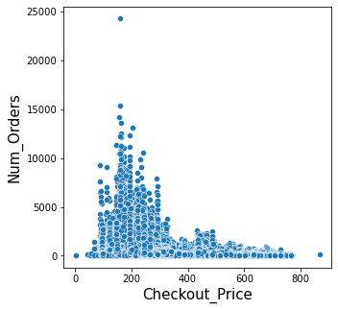
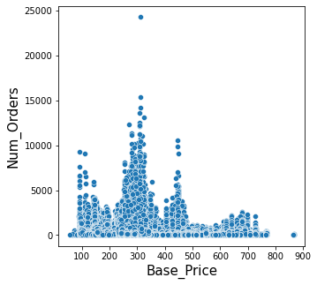
No. of Orders vs Checkout_Price and Base_Price
Most of the Orders have Checkout_Price in range from 100 to 300. It shows that there are less bulk orders.
Most of the Orders have Base Price less than 500. It shows customers are ordering for 1 or 2 people only at once.

Slide 12
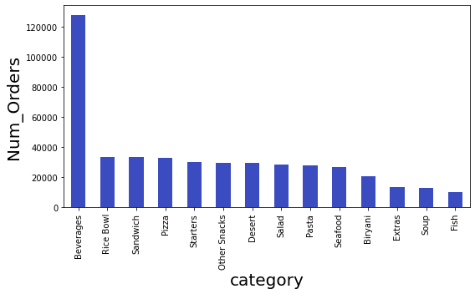
Bivariate Analysis: No. of Orders vs Category (Categorical)
Beverages are the Most Ordered Item.
While Biryani, Soup, Fish are the Least Orderd Dishes.

Slide 13
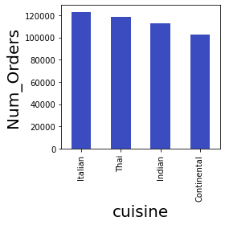
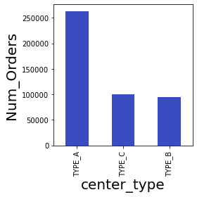
Bivariate Analysis : Number of Orders VS Cuisine and Center_Type
Italian is the Most Ordered Cuisine, followed by Thai and Indian.
Type_A Centers are catering to most of the Orders, while Type_B center deals with the Lowest no. of orders.

Slide 14
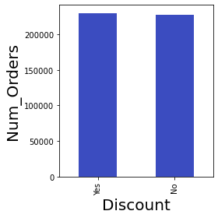
Bivariate Analysis: No. of Orders vs Discount
The Number of Orders having Discounted Products and not having Discounted Products is almost the same.
This Shows present Discount Scheme is not working.

Slide 15
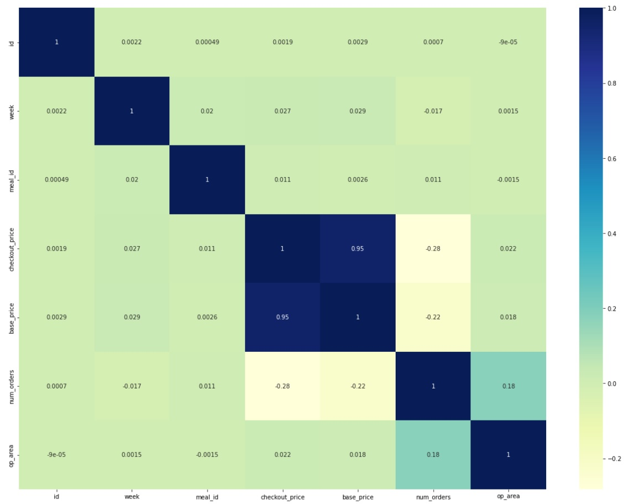
Multivariate analysis
The correlation between the variable with each order is very low so we believe that the multicollinearity is also low in them.
But base_price & checkout_price shows high correlation.

Slide 16
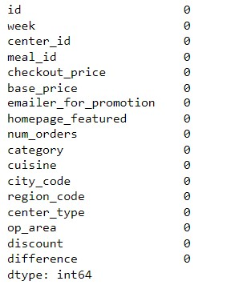
Missing Value
There are no missing value in the Data set
Details are given on right side

Slide 17
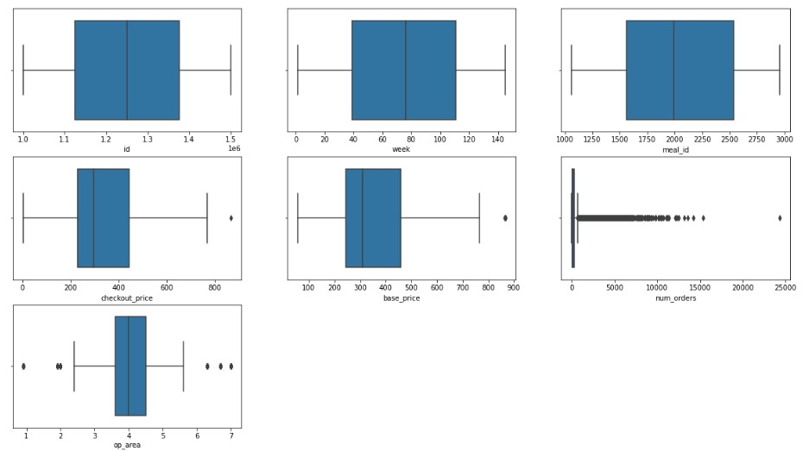
Outlier Analysis
We have seen few outlier in the checkout_price , op_area & base_price .
Num_orders is the target variable. It has many outlier .
We have used Capping to remove the Outliers

Slide 18
Data Encoding & Scaling
ENCODING
We would be using frequency encoding for categorical columns . As the frequency encoding would prevent explosion of columns, which is the case in DUMMY ENCODING or ONE-HOT ENCODING.
STANDARDSCALER
We would be using the STANDARDSCALER for scaling the numerical columns. Data is Scaled after the Splitting the Data into Train Set and Test Set.

Slide 19
Train Test Split
Data has been Split into 70:30 ratio of Train and Test set.
Train Test Split Function from sklearn library has been used for the same.

Slide 20
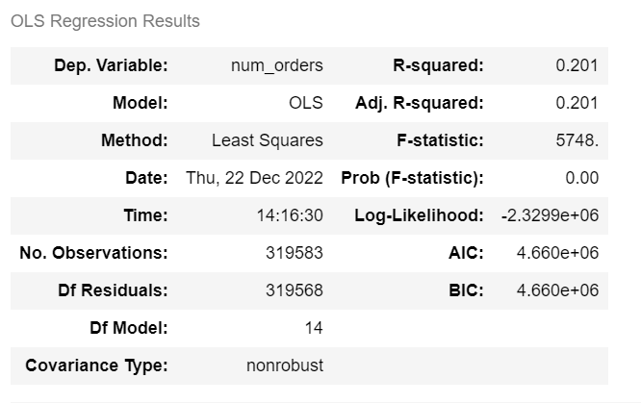
Base Model
It is the Ordinary Least Square Linear Regression Model from Statsmodel Library.
R-Squared is 20.1%, which means that the all the Independent Variables explain 20.1% Variation in the Dependent Variable.
P-Value of F-Statistic is Zero, showing the Model is Significant.

Slide 21
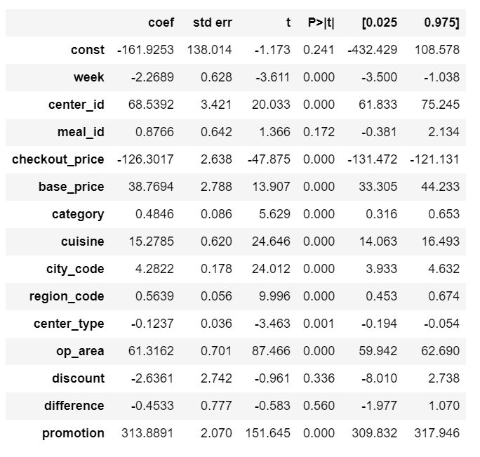
Base Model Summary-2
All Variables are Significant apart from Meal_ID, Discount and Difference.

Slide 22
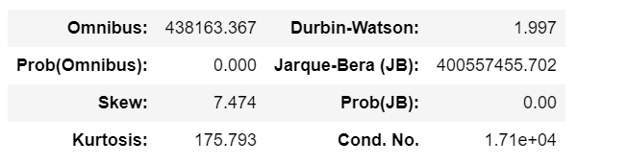
Base Model Summary-3
DW statistic is close to 2, which means there is no Auto-Correlation.
The Condition number is Greater than 1000, which means there is High Multicollinearity.
P value of Jarque Bera Test indicates that the Data is Not Normal.

Slide 23
Statistical Tests to find Significant Columns
Numerical Features: We have used Mann-Whitney U Test which is a Non-Parametric Test.
Hypothesis for Mann-Whitney U Test is:
Ho: Two Populations are equal.
Ha: Two Populations are not equal.
Decision to accept or reject Ho was made on the basis of P-Value @ 5% level of Significance.
Significant Features: ‘ Week’, ‘Check_Out Price’ , ‘Base Price’, ‘Op_Area’, ‘Meal_ID’
P-Value was less than 0.05 for these Features.

Slide 24
Statistical Tests to find Significant Columns
Categorical Features: We have used Anova or Analysis of Variance to determine the significant Columns.
Hypothesis for Anova:
Ho: Beta is Zero or Feature is Insignificant
Ha: Beta is not equal to Zero or Feature is Significant
The Decision was made on the basis of P-Value @ 5% level f significance.
All Categorical Columns had a P-Value around Zero, which indicates that the Variables are Significant.
'center_id', 'emailer_for_promotion', 'homepage_featured', 'category', 'cuisine', 'city_code', 'region_code', 'center_type'

Slide 25
Statistical Tests to test the Assumption of Base Model
Before Model Assumptions:
Dependent Variable or Target Variable shall be Numeric.
No Multicollinearity
After Model Assumptions:
Linearity
No Autocorrelation
Heteroskedasticity
Normality of Residuals

Slide 26
Before Model Assumptions:
Dependent Variable or Target Variable shall be Numeric :
Dependent Variable in this Analysis is Number of Orders.
It is Continuous Numerical Variable.
No Multicollinearity: The Presence of Strong Correlation among Independent Variables is Called Multicolliearity.
It was checked by Heatmap and VIF Analysis.

Slide 27
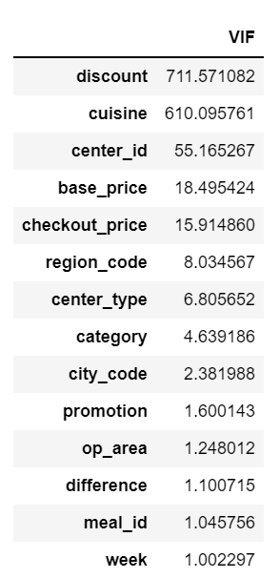
VIF Analysis for Multicollinearity :
No Multicollinearity:
VIF Analysis: Variance Inflation Factor Analysis was conducted.
We can see that discount, cuisine, center_id, base_price, Check_out Price have VIF greater than 10.
This means these variables contribute to Multicollinearity.
Another model is run leaving out these Variables.

Slide 28
After Model Assumptions: Linearity
Linearity: Multiple linear regression requires the relationship between the independent and dependent variables to be linear, i.e. it should be linear in the parameters.
The linearity assumption can best be tested with scatterplots.
The independent variables must have a linear relationship with the dependent variable.
As seen in the Bi-Variate Analysis, the Scatter Plot between independent Variable and Dependent Variable doesn’t show any specific pattern.
Hence, we may conclude that the variables are linearly related to the dependent variable.

Slide 29
After Model Assumptions:
No AutoCorrelation
No Autocorrelation: Durbin Watson Test
If the Durbin-Watson test statistic is near to 2: No autocorrelation
If the Durbin-Watson test statistic is between 0 and 2: positive autocorrelation
If the Durbin-Watson test statistic is between 2 and 4: negative autocorrelation
DW Statistic for Base Model is 1.997, showing there is no Auto -Correlation.

Slide 30
After Model Assumptions:
No Heteroskedasticity
Heteroskedasticity: Breusch Pagan Test
Ho: Homoscedasticity is Present
Ha: Heteroscedasticity is Present
P-Value for Breusch Pagan Test is Zero for Base Model, showing presence of Heteroscedasticity.
Note: In real life it might not be possible to meet all the assumptions of linear regression.

Slide 31
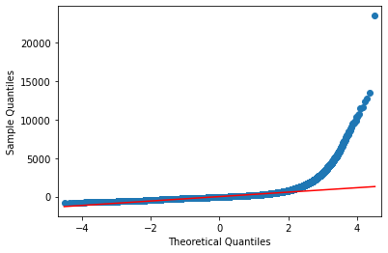
After Model Assumptions:
Normality of Residuals : Checked Using Shapiro Test
Ho: Residual are Normally Distributed
Ha: Residual are not Normally Distributed
P-Value of Shapiro Test is Zero, showing Residuals are not normally Distributed. Same can be seen from Q-Q Plot.

Slide 32
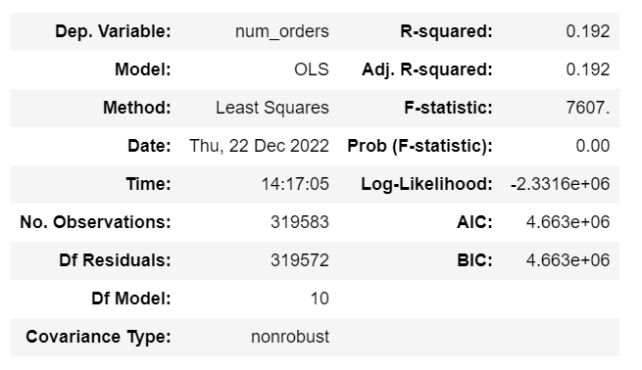
Base Model using results of VIF Analysis.
R_Squared is 19.2%, Showing Independent Variables explain 19.2% of the variation in Dependent Variables.
P-Value of the Model is Zero, showing that the Model is Significant.

Slide 33
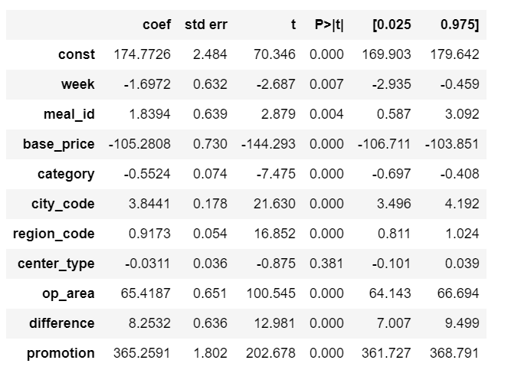
All the Variables barring Center_Type are Significant.
Base Model using results of VIF Analysis-2

Slide 34
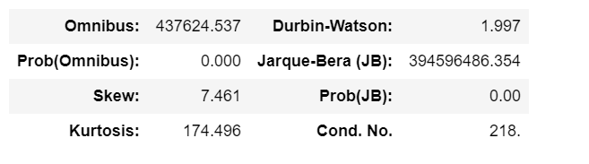
Base Model using results of VIF Analysis-3
The Condition number has reduced showing there is no Multicollinearity in the Model
We see that DW statistic is close to 2, which means there is no Auto-Correlation.
P value of Jarque Bera Test indicates that the Data is Not Normal.

Slide 35
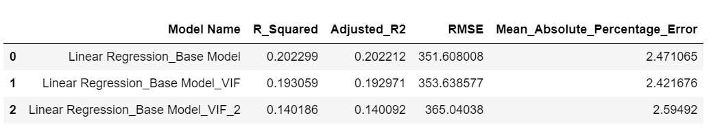
Comparing Regression Results of Base Models.
Model Evaluation is done on the basis of R_Squared, Adjusted_R_Squared, Root Mean Squared Error.
We can see that Base Model having all the features has the Largest R_Squared Value and Lowest RMSE Value.
Further, we have used different Regularization Models from SK Learn library like Ridge,Lasso, Enet
Other Advanced Models Like Decision Tree and Random Forest has also been Used.

Slide 36
Intermediate Models: Decision Tree, Random Forest, XG-Boost
Decision Tree: Decision tree regression observes features of an object and trains a model in the structure of a tree to predict data in the future to produce meaningful continuous output. Continuous output means that the output/result is not discrete, i.e., it is not represented just by a discrete, known set of numbers or values.
Random Forest Regressor: A random forest is an Ensemble Model. It is a meta estimator that fits a number of classifying decision trees on various sub-samples of the dataset and uses averaging to improve the predictive accuracy and control over-fitting.
XG-Boost Regressor:
Gradient boosting refers to a class of ensemble machine learning algorithms that can be used for classification or regression predictive modeling problems. Ensembles are constructed from decision tree models.
Trees are added one at a time to the ensemble and fit to correct the prediction errors made by prior models. This is a type of ensemble machine learning model referred to as boosting.
Models are fit using any arbitrary differentiable loss function and gradient descent optimization algorithm. This gives the technique its name, “gradient boosting,” as the loss gradient is minimized as the model is fit, much like a neural network.
XG-Boost is Extreme Gradient Boosting.

Slide 37
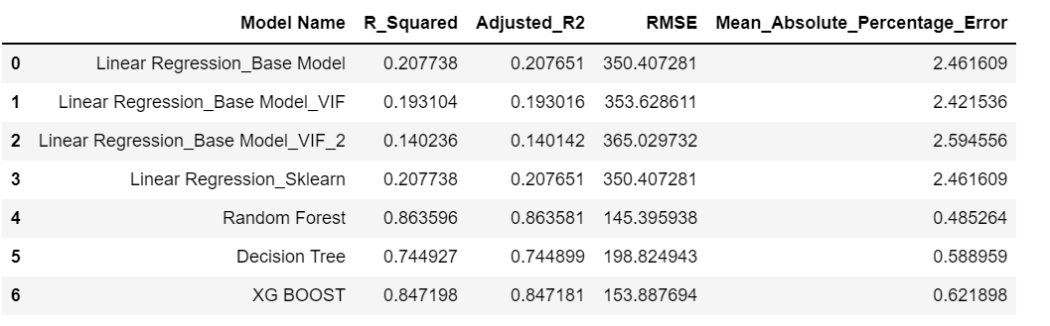
Comparing Results of Models
We can see that Advanced Ensemble Model of Random Forest is Performing better than Base Model
Random Forest has the Highest R_Squared Value (86.35%) and Lowest RMSE value ( 145.35) followed by XG Boost and Decision Tree.
As Random Forest is the best performing Model, we will do the Hyperparameter Tuning to get the Best Parameters.

Slide 38
Hyper Parameter Tuning using Grid Search CV
Grid Search uses a different combination of all the specified hyperparameters and their values and calculates the performance for each combination and selects the best value for the hyperparameters.
In GridSearchCV, along with Grid Search, cross-validation is also performed.
This makes the processing time-consuming and expensive based on the number of hyperparameters involved.
In the Model, Parameters of Random Forest Regressor have been Tuned. Specifically, no. of estimators and Maximum Features have been Tuned.

Slide 39
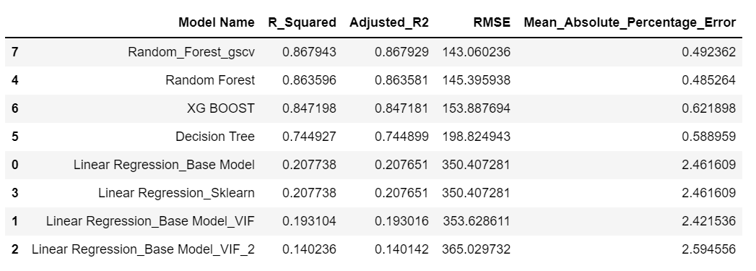
Final Results including Random Forest with Grid Search CV
Random Forest Model with Optimised Hyperparameters using Grid Search CV is showing the Lowest value of RMSE and highest value of R_Squared.
It is followed by normal Random Forest Model and XG BOOST Model.

Slide 40
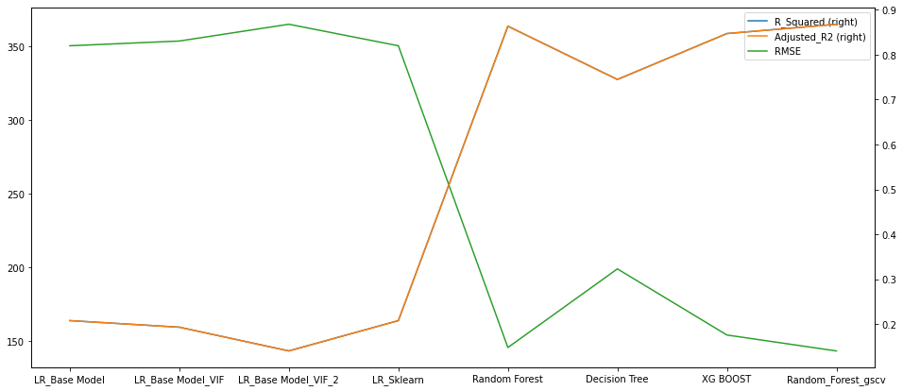
Graphical Representation of Result

Slide 41
Final Remarks
The graph shows the performance metrics root mean squared error, R-squared and Adjusted R-squared of the models implemented.
The plot gives a clear picture of the inverse relation of R squared values and the RMSE value, the better the R-squared value naturally the lesser is the RMSE value.
Findings suggest that the Random Forest algorithm optimized by GSCV has the highest accuracy with lowest RMSE.
Finally, it can be concluded that the Random Forest can be used by Meal Delivery Company to predict Food Demand for the Upcoming Weeks.

Slide 42
Thanks!

