Slide 1
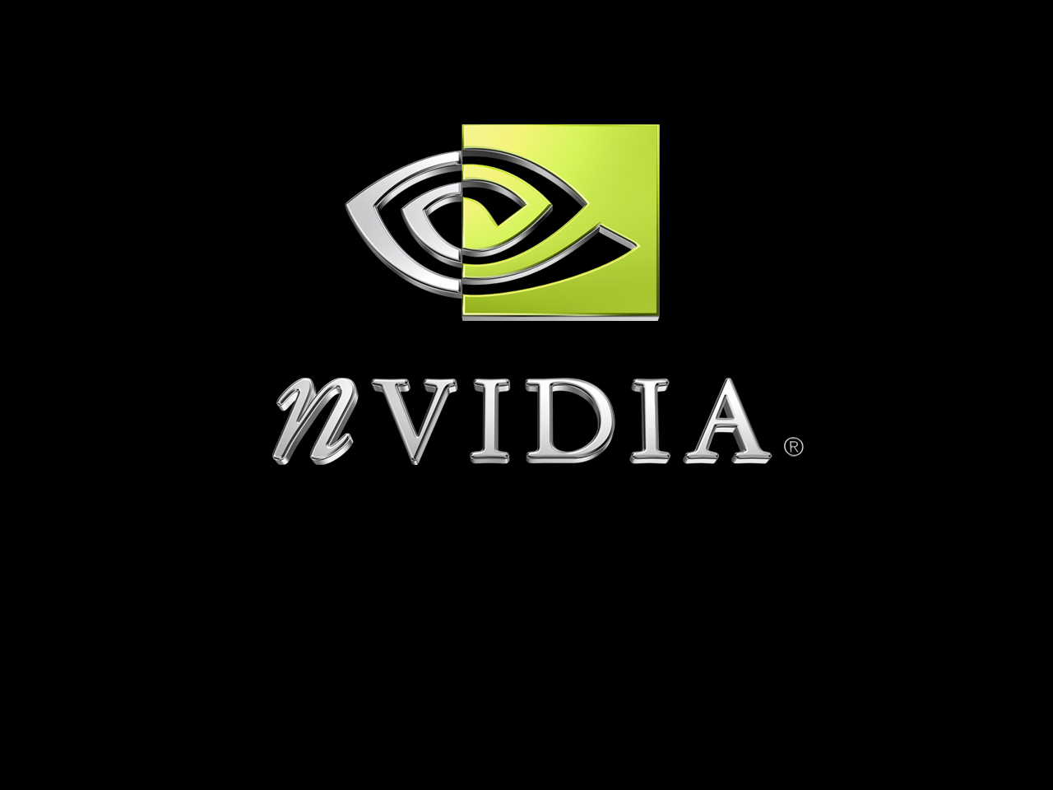
Variance Shadow Maps
Andrew Lauritzen, RapidMind

Slide 2
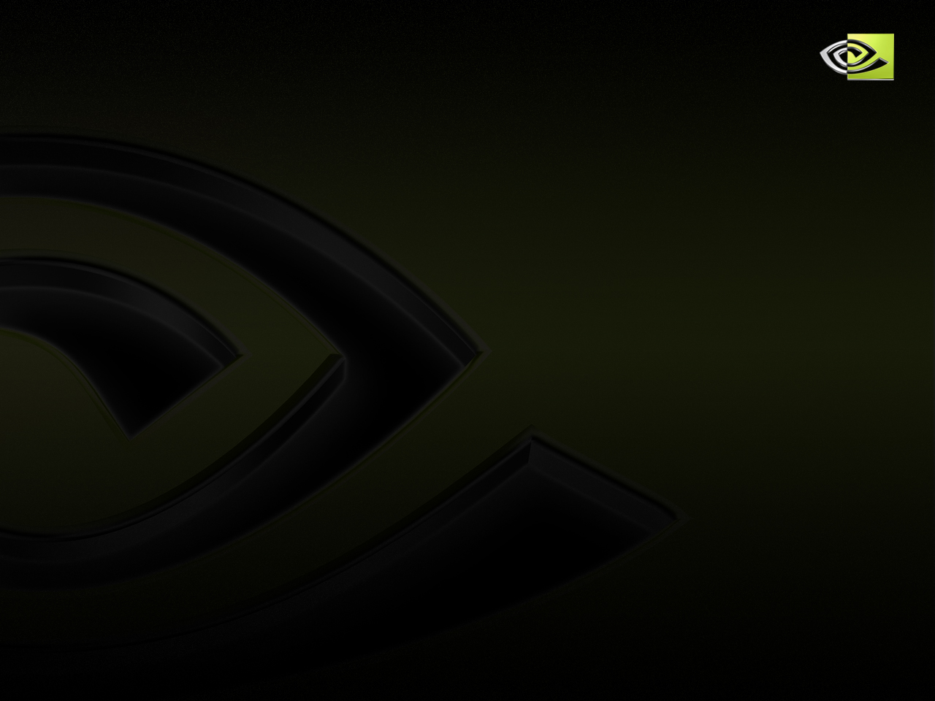

Overview of Shadow Mapping
Introduced by Williams in 1978
Advantages compared to shadow volumes:
  Cost less sensitive to geometric complexity
  Can be queried at arbitrary locations
  Often easier to implement
Disadvantages:
  Aliasing
Notes:
Don’t need to worry as much about special cases, capping geometry, etc.

Slide 3
Shadow Mapping Algorithm
Render scene from light’s point of view
  Store depth of each pixel
When shading a surface:
  Transform surface point into light coordinates
  Compare current surface depth to stored depth
  If depth > stored depth, the pixel is in shadow; otherwise the pixel is lit

Slide 4
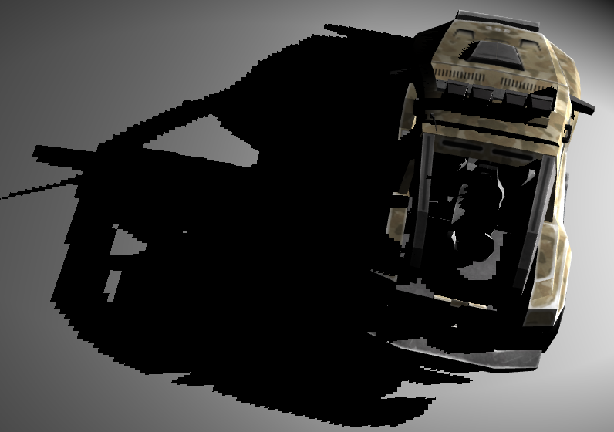

Aliasing Artifacts
Magnification artifacts
Notes:
Can be addressed to some extent by increasing shadow map resolution. However maximum texture size limits are reached quickly, and are still inadequate (and needlessly expensive) for a large scene.
This is a 512x512 shadow map.

Slide 5
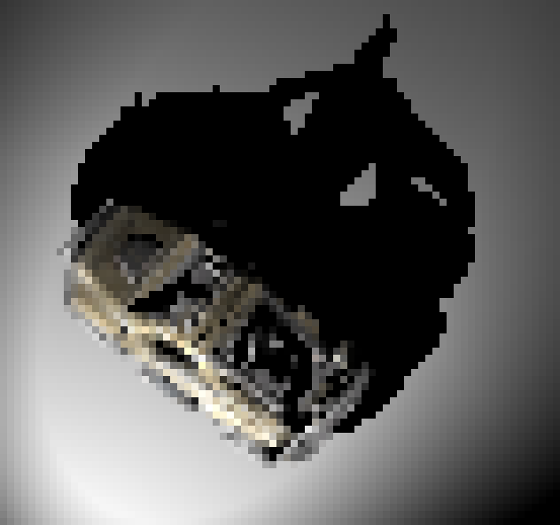
Aliasing Artifacts
Minification artifacts
  Typically encountered when viewed from a distance
  Produces ugly and distracting “swimming” effect along shadow edges

Slide 6
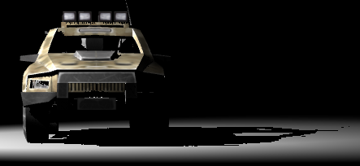
Aliasing Artifacts
Anisotropic artifacts
  A mix of minification and magnification
  Encountered at shallow angles

Slide 7
Solutions?
Also encountered with colour textures
Reduce aliasing by hardware filtering
  Magnification artifacts => linear interpolation
  Minification artifacts => trilinear, mipmapping
  Anisotropic artifacts => anisotropic filtering

Slide 8
Solutions?
Can we apply these to shadow maps?
  Not at the moment
Interpolating depths is incorrect
  Gives depth < average(occluder_depth)
  Want average(depth < occluder_depth)
Notes:
Occluder depth is stored in the shadow map.

Slide 9
Percentage Closer Filtering
Proposed by Reeves et al. in 1987
Filter result of the depth comparison
  Sample surrounding shadow map pixels
  Do a depth comparison for each pixel
  Percentage lit is the percentage of pixels that pass the depth comparison (i.e. are “closer” than the nearest occluder)
NVIDIA hardware support for bilinear PCF
Good results, but can be expensive!
Notes:
For example, combining PCF with mipmapping would require a comparison with *every* pixel in the shadow map in the worst case.

Slide 10
Occluder Distribution
Really want a cumulative distribution function (CDF) of a set of depths
  F(t) = P(x≤t)
  F(t) is the probability that a fragment at distance “t” from the light is in shadow
1
f(t)
F(t)
0
t
t
Notes:
Cumulative distribution function allows us to compute the probability that a fragment is in shadow directly.
Example probability density function and associated cumulative distribution function is shown. For shadows, the example could be something like participating media with higher particle density in the interior of the “cloud”.

Slide 11
Deep Shadow Maps
Lokovic and Veach, in 2000
Per-pixel piecewise linear function
No hardware filtering
Complex reconstruction
Notes:
Deep shadow maps can handle complex high-frequency geometry and volumetric effects, but require variable storage per-pixel, making the reconstruction and evaluation expensive.
Don’t utilize the filtering and antialiasing hardware that we have available on GPUs.

Slide 12
Occluder Distribution
A representation that filters linearly?
  Allows us to utilize hardware filtering
Idea: Moments of distribution function!
  E(x) is the mean, E(x²), E(x³), etc.
  Linear in distribution

Slide 13
Variance Shadow Maps
Store depth squared as well as depth
  Gives E(x) and E(x²) where x is the depth of the nearest occluder
  Use the moments to approximate the fraction of the distribution that is more distant than the surface point being shaded
Notes:
When linearly filtered, we get the average of whatever components we store.

Slide 14
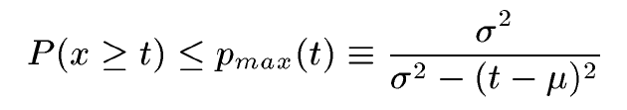
Variance Shadow Maps
We want to find P(x≥t)
We have the mean, and can find variance:
  μ = E(x)
  σ² = E(x²) – E(x)²
Cannot compute CDF exactly
Chebyshev’s Inequality states:
Notes:
Recall x is a random variable representing the occluder depth distribution function, and t is the current fragment depth. Thus P(x>=t) is precisely the percentage of fragments over the filter region that are more distant than the current fragment, i.e. the percentage of fragments that are lit.
Note: this version of Chebyshev’s inequality is valid when t > mu.

Slide 15
Variance Shadow Maps
Inequality only gives an upper bound
  Becomes equality in the case of single planar occluder and receiver
  In a small neighbourhood, an occluder and receiver will have constant depth and thus p_{max} will provide a close approximation to p
So just use p_{max} for rendering

Slide 16
Implementation
// Call the parent light shader
light_contrib & dir_to_light & dist_to_light & n_dot_l =
spot_light_shader(surf_position, surf_normal);
// Transform the surface position into light space and project
ShAttrib4f surf_light = light_view_projection | surface_position;
ShTexCoord2f tex_coord = 0.5 * surf_light(0,1)/surf_light(3) + 0.5;
// Query the shadow map
ShAttrib2f moments = shadow_map(tex_coord);
// Standard shadow map comparison
ShAttrib1f lit_factor = (dist_to_light <= moments(0));
// Variance shadow mapping
ShAttrib1f E_x2 = moments(1);
ShAttrib1f Ex_2 = moments(0) * moments(0);
ShAttrib1f variance = E_x2 - Ex_2;
ShAttrib1f m_d = moments(0) - dist_to_light;
ShAttrib1f p_max = variance / (variance + m_d * m_d);
// Attenuate the light contribution as necessary
light_contrib *= max(lit_factor, p_max);
Notes:
Uses Sh. See http://www.rapidmind.net and http://libsh.org.
So when t <= mu, contrib is always 1 (i.e. full light contribution). When t > mu, contrib = p_{max}.

Slide 17
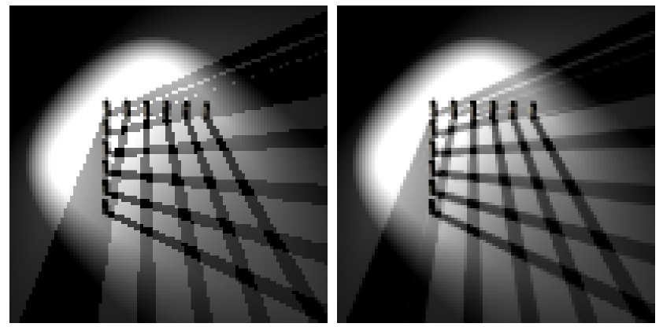
Mipmapping Results
Shadow Map
Variance Shadow Map

Slide 18
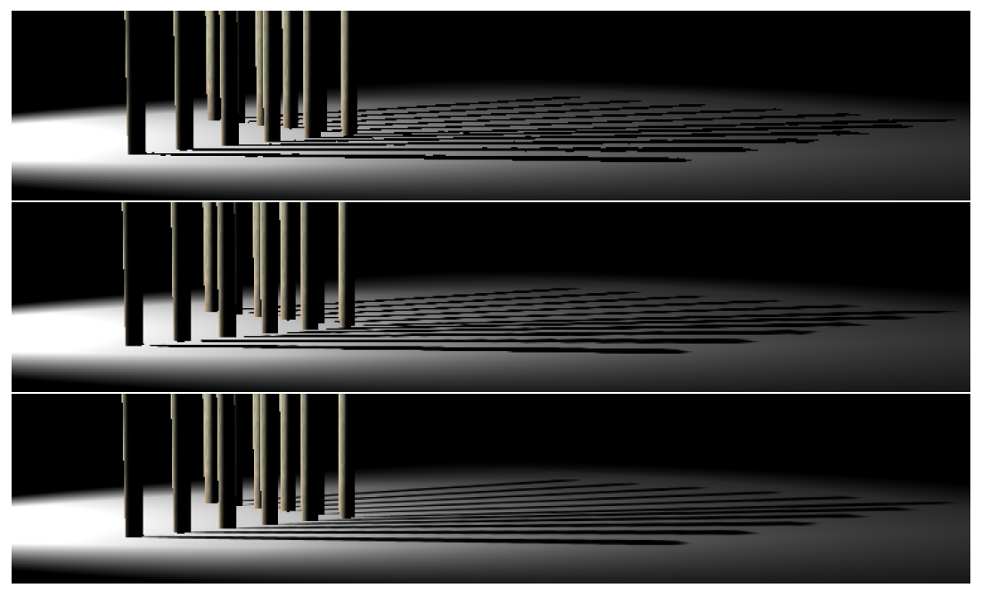
Anisotropic Filtering Results
Shadow Map
Bilinear PCF
Variance Shadow Map
Notes:
Top is standard shadow mapping.
Middle is bilinear percentage closer filtering.
Bottom is variance shadow maps with hardware anisotropic filtering.

Slide 19
Variance Shadow Maps
Can we do more?
  Our shadow maps can be arbitrarily filtered now
Pre-filter shadow map using a Gaussian blur
  Equivalent to percentage closer filtering
  Separable convolution => O(n) on kernel size
  Much faster than PCF complexity of O(n²)

Slide 20
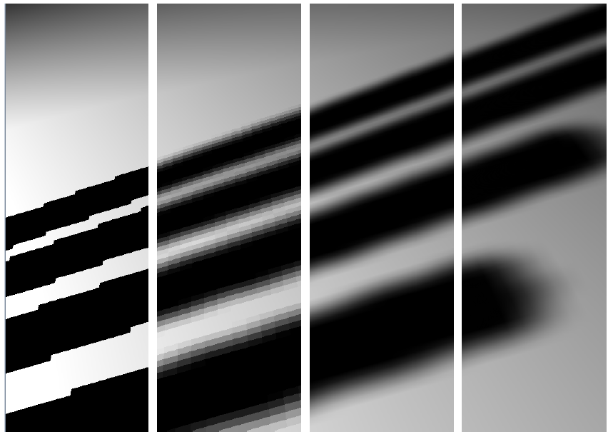
Gaussian Blur Results
SM
PCF 5x5
Bil.PCF 5x5
VSM
Notes:
Left to right:
Standard shadow mapping.
5x5 percentage closer filtering.
5x5 bilinear percentage closer filtering.
Variance shadow mapping with 5x5 gaussian blur.

Slide 21
Super-sampling
Generate more samples and filter
  Render large shadow map and down-sample
  Or simply use texture LOD bias
Tiled rendering of a huge shadow map
  Render 4 tiles at 4096x4096 each
  Down-sample to a single texture
  Gives an anti-aliased 4096x4096 shadow map

Slide 22
Multi-sampling
Simply enable multi-sampling while rendering the shadow map
Support is dependent on chosen texture format
  More of this later…
Notes on gamma correction
  Hardware might “gamma correct” the samples
  This is incorrect for non-colour data!
  Ideally we want to turn this “feature” off…
Notes:
Some hardware doesn’t enable gamma correction for floating point render targets. This works well for us here.

Slide 23
Other Fun Stuff
Orthogonal to projection-warping techniques
  Perspective shadow maps (PSM)
  Trapezoidal shadow maps (TSM)
Notes:
2-component 16-bit fixed point formats that can be filtered available.
Can be combined trivially with trapezoidal or perspective shadow maps.

Slide 24
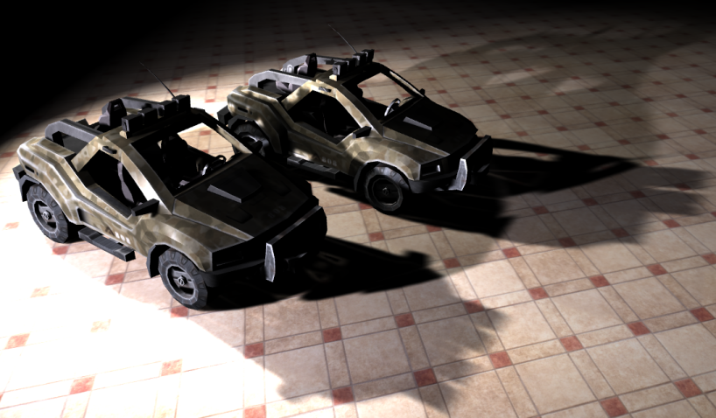
Demo

Slide 25
Texture Formats
Ideal texture format:
  Renderable
  Two components
  High precision
  Supports filtering (anisotropic, mipmapping)
  Supports multisampling

Slide 26
Depth and Shadow Formats
+/- Indirectly renderable
- Single-component
- Often highly non-uniform precision
- Do not support arbitrary linear filtering
  Mipmapping, trilinear, anisotropic, etc.
- Do not support multisampling
Not the way to go…
Notes:
Really want to just output some value and save it. We need more than a simple depth buffer here.

Slide 27
Floating-point Formats
No renderable two-component formats!
4x fp16
  + NVIDIA GeForce 6/7 supports filtering!
  +/- Average precision
  +/- Some hardware supports multisampling
4x fp32
  + Great precision
  - No filtering on current hardware
  - No multisampling on current hardware
Probably the best current options

Slide 28
Fixed-point Formats
8-bit formats?
  - Poor precision makes these unusable
2x 16-bit (i.e. G16R16)
  + Two component
  + Often supports filtering
  +/- Renderable on some hardware
  +/- Acceptable precision (at least as good as fp16)
  +/- Some hardware supports multisampling
Dreaming:
  2x 32-bit filterable fixed point format?

Slide 29
Texture Format Summary
Floating-point formats probably the best
  Ideally we want filterable fp32
16-bit fixed-point formats could work too
  Dependent on what hardware supports

Slide 30
Numerical Stability
Recall the computation of variance:
  σ² = E(x²) – E(x)²
Highly numerically unstable!
Recall Chebyshev’s Inequality:
Can be a problem when fragment is near occluder
Need a high-precision texture format

Slide 31
Ways to Improve Stability
Can use any distance metric that we want
  Post-projection “depth” (z) is a bad choice
  Use a linear metric, ex. distance to camera
When using floating-point formats
  Rescale the numeric range to fall in [-1, 1]
  Gets an extra bit of precision from the sign
Notes:
Since our model is probabilistic, all we need is a strictly ordered depth metric.
Standard depth buffer value is fine for comparison, but bad for math. As soon as we get even a small ways from the near clip plane, precision drops off drastically.

Slide 32
Ways to Improve Stability
Four-component floating-point formats
  Store extra precision in extra components
  Must still filter linearly!!!
Example encoding:
Example decoding:
ShAttrib2f moments = (...);
ShOutputAttrib4f output;
const float factor = 64.0f; // Try to gain 6 more bits
output(0,1) = frac(moments * factor) / factor;
output(2,3) = moments - output(0,1);
ShAttrib4f input = shadow_map(tex_coord);
ShAttrib2f moments = input(0,1) + input(2,3);
Notes:
Recall that we can’t render to two-component floating point formats, so let’s put those other two components to *some* use!
Even with this trick, still don’t get nearly as much precision as fp32.

Slide 33
Ways to Improve Stability
Use a 32-bit per component floating-point texture!
We’ve had no precision problems with fp32

Slide 34
Notes on Shadow Bias
Biasing depth comparison usually required
  Proportional to slope of polygon (glPolygonOffset)
  Scene dependent and error-prone
Not required for variance shadow maps!
  If (t – μ) ~ 0 then p_{max} ~ 1
May want to bias variance very slightly
  For numeric stability reasons
  This is neither slope nor scene dependent!
Notes:
P_{max} becomes sigma^2 / sigma^2 (i.e. variance over variance) ~ 1.

Slide 35
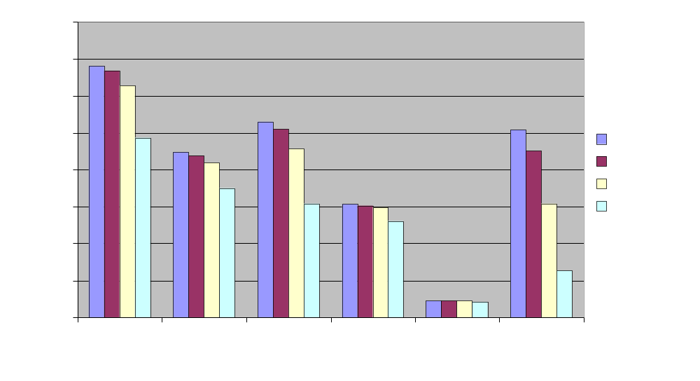
How Fast?
GeForce 6800GT @ 1024x768
Notes:
Note that these techniques are not all comparable in quality.
Vanilla variance shadow maps are slightly slower than shadow mapping, and about the same speed as bilinear PCF.
For larger PCF/blur kernels, variance shadow maps will ultimately win due to their separable convolution filter and single texture read per framebuffer fragment.

Slide 36
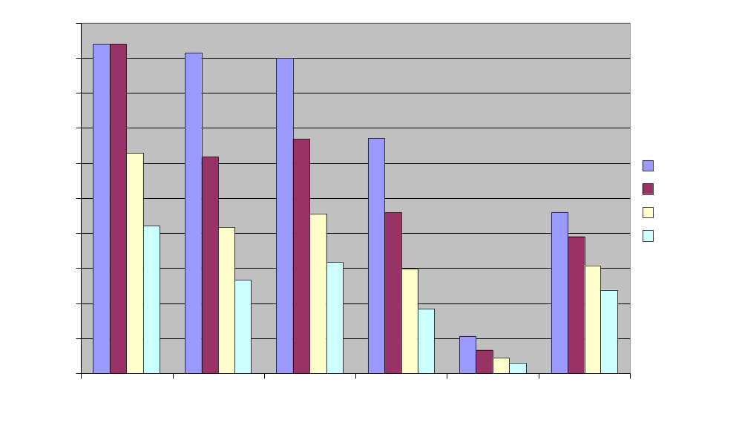
How Fast?
Fix shadow map at 512x512
Notes:
Percentage closer filtering is done per lit fragment, and so it scales with framebuffer resolution.
Pre-filtering variance shadow maps is done once before rendering, and so scales only with shadow map size.

Slide 37
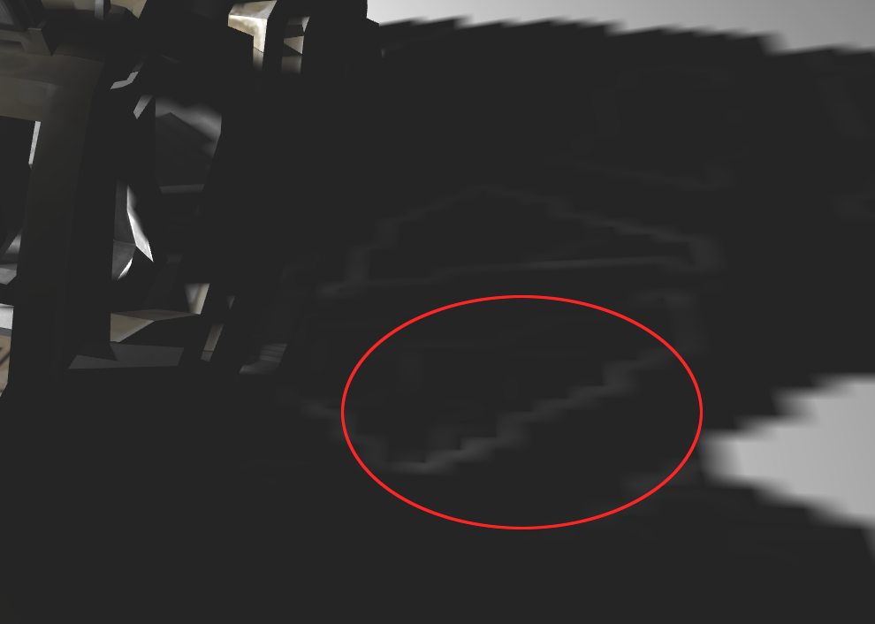
Light Bleeding
p_{max} works in many situations, but not all
When σ² is large, can get “light bleeding” :
Notes:
I’ve adjusted the contrast in the image to make the error more visible.

Slide 38
Ways to Reduce Light Bleeding
Lower depth complexity in light space
  Ex. Use variance shadow maps for the sun, not headlights
  Construct scenes with this artifact in mind
  Control attenuation ranges carefully
Use ambient or multiple lights
  Contrast will be lessened
Use static lights
  Moving lights makes the projection obvious
Use smaller filter regions
  Artifact is only as large as the filter region
Notes:
Light bleeding is potentially worse with large filter kernels.

Slide 39
Ultimate Solutions
Find a higher-order inequality?
Fast, programmable hardware filtering?
Combine with percentage closer soft shadows
  Randima Fernando (NVIDIA), 2005
  Cheap, perceptually-correct soft shadows?
Lots of potentially fruitful hybrid techniques!
Notes:
Light bleeding is potentially worse with large filter kernels.

Slide 40
Conclusion
Introduced a simple solution to many forms of shadow map aliasing
Implemented easily on modern hardware
Compares favourably in both performance and quality to existing techniques

Slide 41
For More Information…
Donnelly and Lauritzen, Variance Shadow Maps, ACM Symposium on Interactive 3D Graphics and Games 2006
http://www.punkuser.net/vsm/
Questions?

Slide 42

The Source for GPU Programming

