Slide 1



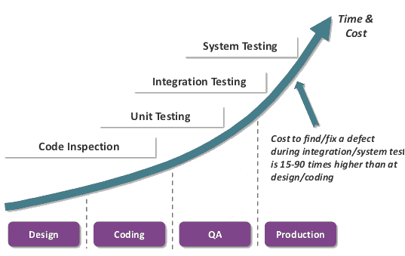


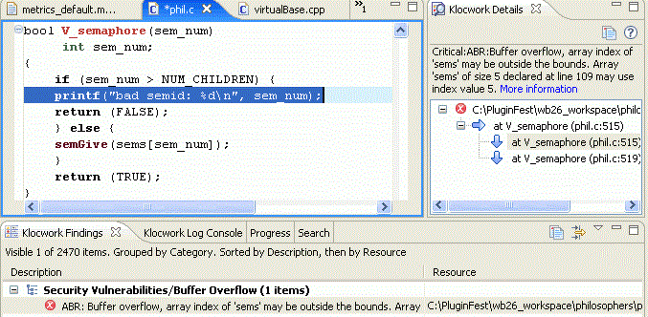
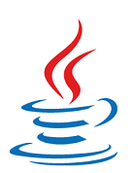
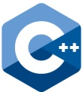


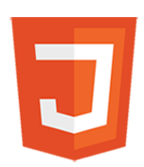

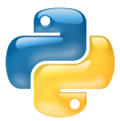


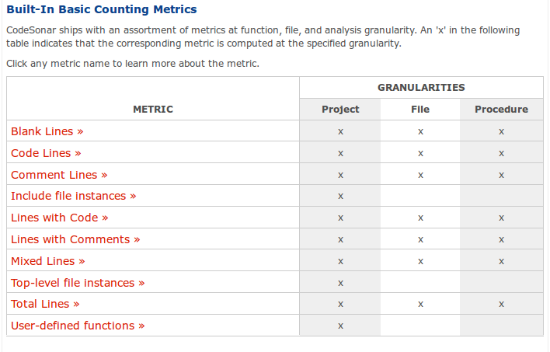

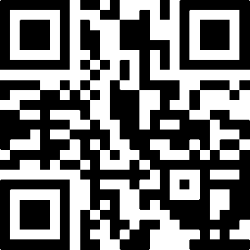
KEEP CALM AND SECURE CODE ON
Aniqua Z. Baset, Srivathsava Nelaturi and Raviteja Srigiriraju
Contrast
Cppeclipse
Codescan
Klockwork-solo
Crypto-assistant
CxSuite
JSLint
CodeDX
PVS-studio
ASIDE
Klocwork
Parasoft dotTEST
LAPSE+
SSVChecker
SecureAssist
CodeSonar
Tern
SonarLint
WHY
Major vulnerabilities come from common coding errors
Security checking while coding can save money and time!
WHAT WE DID?
IDE supports that check and give feedback while coding
Vulnerability checks, languages, platforms
Feedback style, ease of install, correctness
SQL injectionx
Cross-site scripting
Cross-Site request forgery
URL redirect
Unvalidated user input
Cookie poisoning
Buffer overflow
Memory/resource leak
Hardcoded credentials
Hardcoded keys
Use of weak crypto
Broken authentication
 | Eclipse | Eclipse, MVS | Eclipse | Eclipse | Eclipse | Eclipse | Eclipse | Eclipse, MVS | Notepad++ | Eclipse, MVS, IntelliJ | Eclipse | MVS | MVS | Eclipse, IntelliJ, Netbeans | Eclipse,MVS, Springsource | Eclipse, MVS | Eclipse | Eclipse, MVS, Sublime, Emacs, Vim
Source:
EXAMPLE OUTPUT
WHAT WE GOT?
Many plug-in are available to check common web application vulnerabilities
Not much support for crypto related issues and mobile platforms
Support for 10 among top 25 CWE software error list
Example of Klocwork detecting Buffer Overflow
QR code
Example of Klocwork detecting Buffer Overflow

