Slide 1
Feedback-stabilization of an arbitrary pure state of a two-level atom
Python Project
Special Topics and Quantum Industry
Srivathsan S
MSc Quantum Technologies

Slide 2


Abstract
Unit-efficiency homodyne detection of the resonance fluorescence of a two-level atom collapses the quantum state of the atom to a stochastically moving point on the Bloch sphere. Recently, Hofmann, Mahler, and Hess showed that by making part of the coherent driving proportional to the homodyne photocurrent one can stabilize the state to any point on the bottom-half of the sphere. Here we reanalyze their proposal using the technique of stochastic master equations, allowing their results to be generalized in two ways. First, we show that any point on the upper- or lower-half, but not the equator, of the sphere may be stabilized. Second, we consider nonunit-efficiency detection, and quantify the effectiveness of the feedback by calculating the maximal purity obtainable in any particular direction in Bloch space.
https://github.com/vathzen/qmsc-python-project
https://arxiv.org/abs/quant-ph/0008003

Slide 3
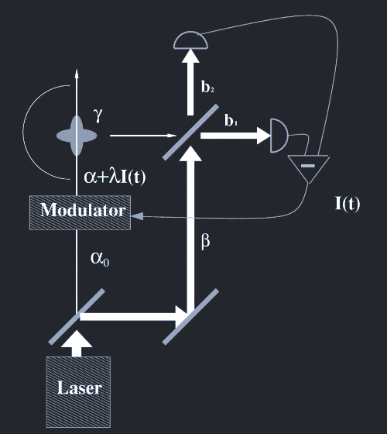
Experimental Setup

Slide 4
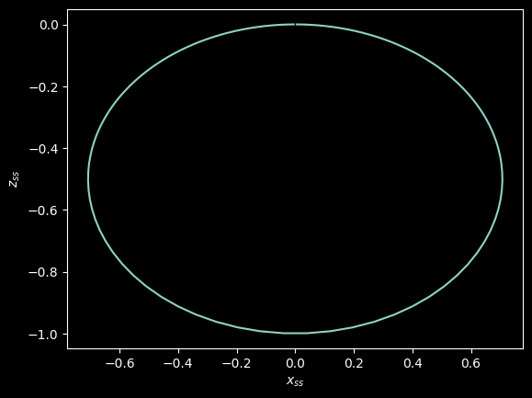
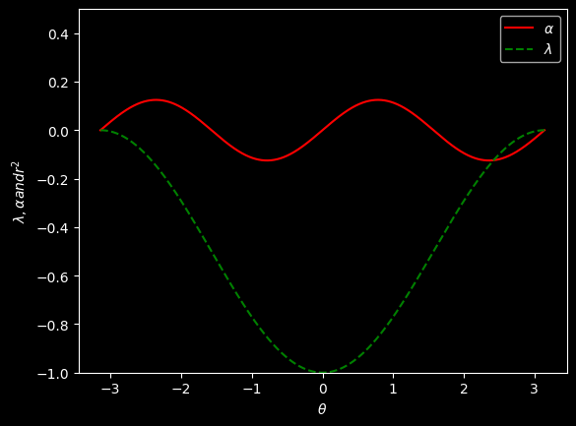
Results
Locus of solutions with driving only
Optimal Driving and Feedback to get Pure State θ

Slide 5
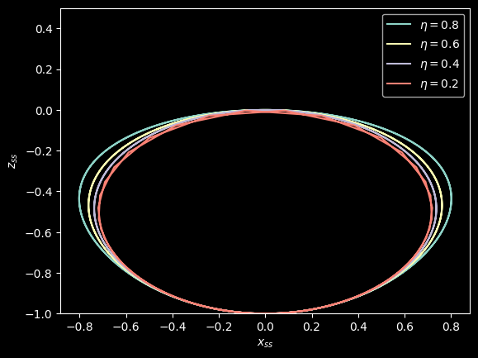
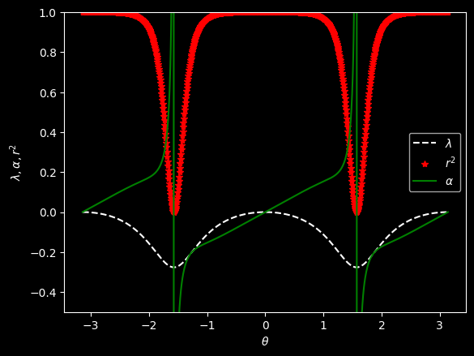
Results
Optimal Driving and Feedback for n = 0.8
Locus of solutions with non unit detector efficiency

Slide 6
Questions?

