Slide 1
WELCOME TO OUR PRESENTATION
Project Name
BUBT VEHICLE PARKING SYSTEM

Slide 2


GROUP NUMBER 8
We Have Two Members In our Group
Md Mohibbullah
Md Rakibur Rahman

Slide 3
REPORT OF BUBT VEHICLE PARKING SYSTEM
Introduction
The BUBT vehicle parking system has been developed to override the problems prevailing
in the practicing manual system. This software is supported to eliminate and, in some cases,
reduce the hardships faced by this existing system. Moreover, this system is designed for the need of the Bubt to carry out operation in a smooth and effective manner.

Slide 4
MODULES OF BUBT PARKING SYSTEM PROJECT
Staff records
It helps to provide details of staff that uses the Vehicle parking management System. It provides the descriptions of staffs like:-Staff first, middle and last name-Address-Contact Number-Gender.
User Records
This record helps for the authorization for using Vehicle Parking Management System. It Provides the Username and Password for the User(staff).It also includes the level of authority that means it separates the normal users and administrator.
Vehicle Records
This most important record which focuses on our Vehicle Parking Management System. It stores the essential Vehicle records like: -Vehicle Number-Vehicle Type-Vehicle Entry Time-Vehicle Exit Time.

Slide 5
TOOLS
#Software
Os(Windows 11)
Netbeans 12.6
XAMPP
#Programing Language
Java
MySQL

Slide 6
HARDWARE AND SOFTWARE REQUIREMENT
Processor
SYSTEM RAM
Operating System
Pentium IV or above for optimum performance
1.00GB RAM
WINDOWS 7,8,10,11

Slide 7
PROCESS MODEL
Iterative Model
The iterative process starts with a simple implementation of a subset of the software
requirements
and iteratively enhances the evolving versions until the full system is implemented.
At each iteration,
design modifications are made, and new functional capabilities are added.

Slide 8
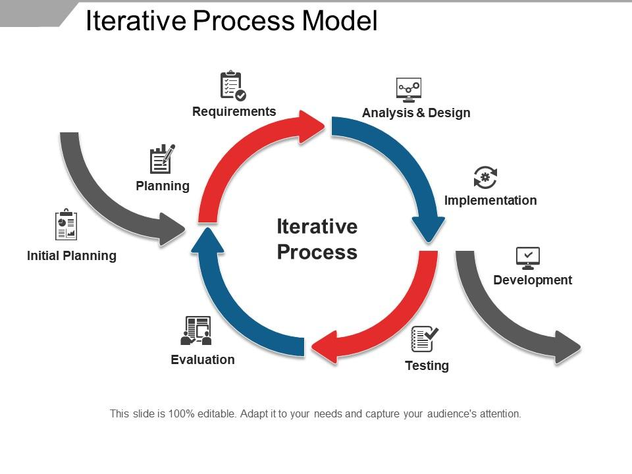

Slide 9


Responsibilities of the members
Plan,Design,Testing
Develop,Design,Analyze,Testing

Slide 10
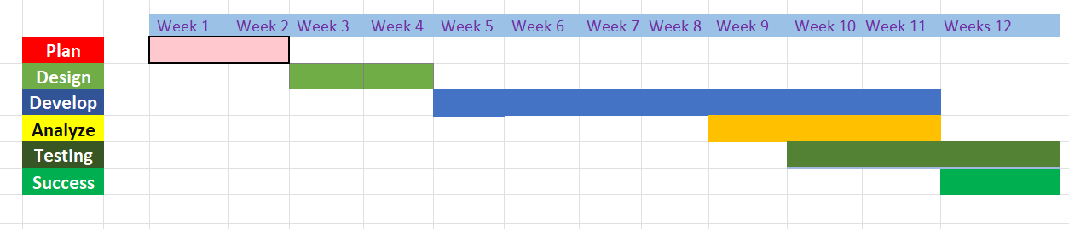
GANTT CHART

Slide 11
WEEKS TASK SUMMARY
1
Plan
5
Develop/Analyze
9
Develop/ Testing
Program Planning
Analyze and develop
Improve and Testing
2
Design
6
Develop/Analyze
10
Develop/ Fix
Project Design
Testing and database analyze
Testing and bug fixing
3
Database Design
7
Develop/Analyze
11
Testing/Bug Fixing
MySQL Database Design
Testing and database analyze
Develop
4
Start Coding Develop
8
Testing and database analyze
12
Complete the Project
Develop/Analyze
Success

Slide 12
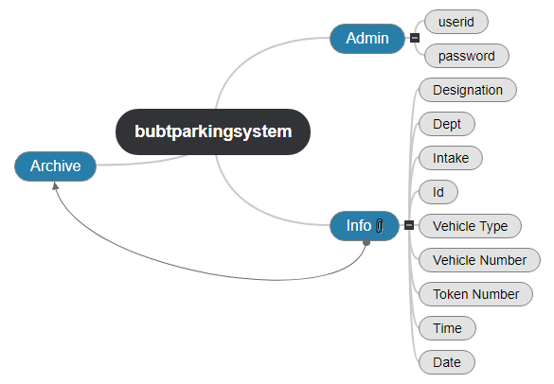
DATABASE MODULE

Slide 13
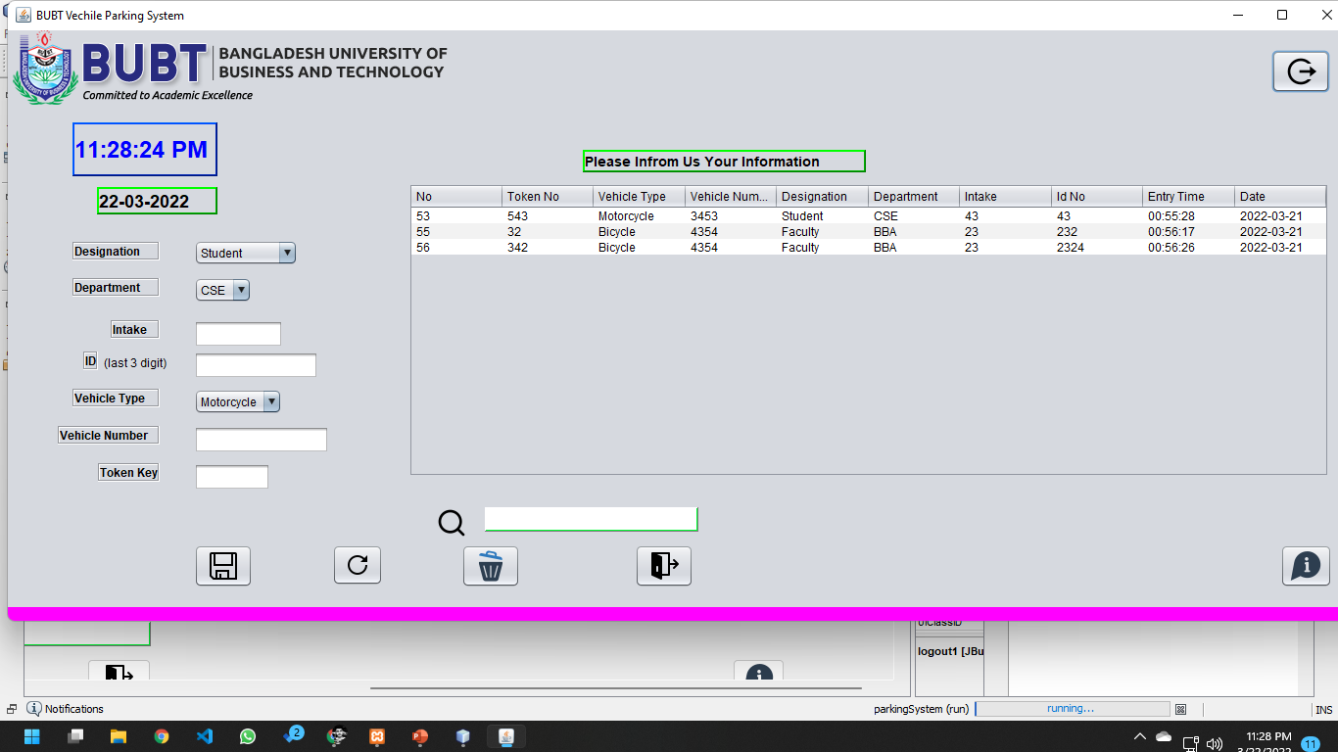
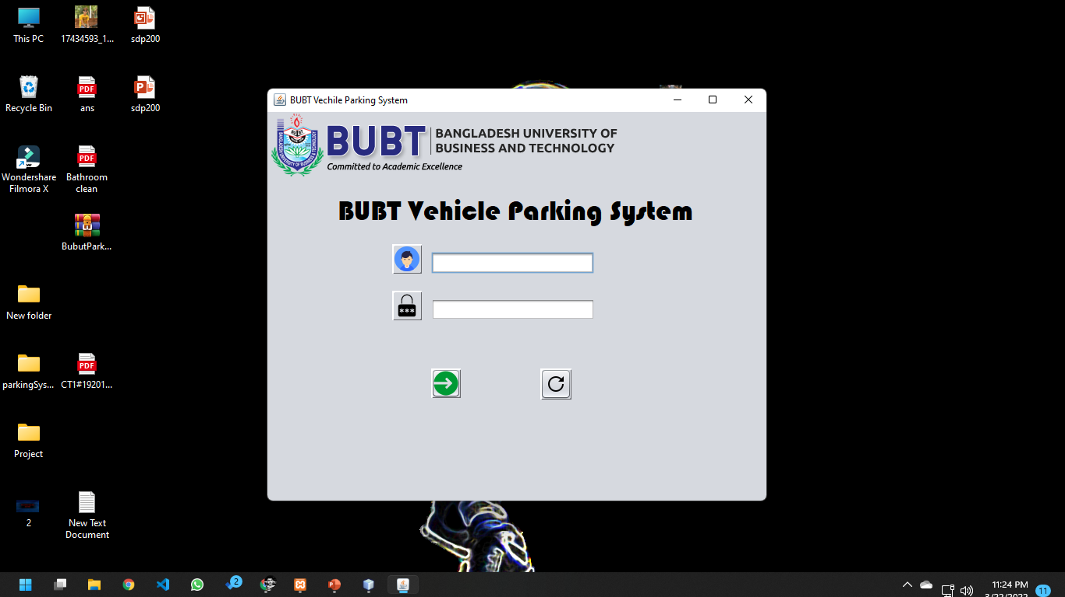
Software Img
LogIn Page
Home Page

Slide 14
THANKS

