Slide 1
AIRLINE OPERATIONS & AUTONOMOUS AI SUPPORT
Customer Resolution Agent
AI-Powered Airline Customer Support System
Assignment 3 – Customer-Facing Resolution Agent
PRESENTED BY
Vatsal Mittal
Technologies Used: Python 3.11 · Flask 3.1 · Groq Llama-3.3-70B
SQLite3 · HTML5 / CSS3 / JavaScript · Render Cloud
PROJECT REPOSITORY & LIVE ACCESS
GitHub Repository:
https://github.com/vatsa2912/customer-resolution-agent
Live Deployed Application (Render Free Service):
https://customer-resolution-agent-v1.onrender.com
Notes:
Good morning / afternoon everyone. Welcome to the presentation of my Assignment 3 project: 'Customer Resolution Agent – AI-Powered Airline Customer Support System'. My name is Vatsal Mittal. In this project, I have designed, implemented, verified, and deployed an autonomous, full-stack customer resolution agent for airline disruption support. It combines modern LLM natural language understanding using Groq's Llama-3.3-70B model with strict, zero-hallucination deterministic policy guardrails based on the Assignment 3 Data Pack. The complete source code is available on GitHub and deployed live on Render.

Slide 2
CONTEXT & MOTIVATION
Problem Statement: The Airline Disruption Dilemma
Common Airline Customer Problems
How Our AI Resolution Agent Addresses These
• Flight Delays: Uncertain wait times, cascading connection losses, lack of timely compensation.
• Flight Cancellations: Immediate passenger distress requiring prompt rebooking or full cash refunds.
• Refund Requests: Manual delays (weeks), opaque policies, payment method discrepancies.
• Baggage Issues: Mishandled or delayed baggage queries causing passenger anxiety.
• Rebooking Requests: Friction in finding alternate flights and dispute over fare difference fees.
• Compensation Queries: Confusion between statutory entitlements and discretionary goodwill gestures.
• The Core Need: A fast, 24/7, consistent support system that eliminates 45+ minute phone hold queues during weather or technical emergencies.
✓ Instant Empathy & NLP: Groq Llama-3.3-70B interprets emotional tone, distress, and explicit demands immediately without canned robot phrases.
✓ Deterministic Policy Guardrails: Business rules are strictly decoupled from LLM generation. The AI cannot invent unauthorized compensation or waive restricted fees.
✓ Two-Stage Transaction Safety: Financial refunds and flight rebookings require explicit customer confirmation cards before database execution.
✓ Tier-Aware Personalization: Instantly looks up passenger tier (Gold, Platinum, Silver) to award priority rebooking as mandated by airline policy.
✓ Automated Supervisor Escalation: Intelligently flags legal threats, cabin upgrades, and fare waivers over ₹1,500 into human review queues.
✓ Full Auditability & Telemetry: Every decision, tool execution, and policy citation is permanently logged in SQLite for regulatory compliance.
Customer Resolution Agent · Assignment 3 Presentation · Vatsal Mittal
Slide 2 of 10
Notes:
Moving to Slide 2, we examine the problem statement. When flights are delayed or cancelled, airline support lines become overwhelmed with wait times often exceeding 45 minutes. Passengers face confusion regarding refund timelines, meal vouchers, and hotel eligibility. Traditional automated phone menus and generic chatbots fail because they lack empathy and cannot execute actual transactions. On the other hand, unconstrained LLMs are dangerous because they can hallucinate and promise unauthorized refunds. Our proposed solution solves both problems: it uses Groq's high-speed Llama-3.3-70B for natural language understanding and empathy, but routes all decisions through a deterministic policy guardrail engine that strictly enforces airline business rules.

Slide 3
SYSTEM SCOPE
Project Objectives: Core Functional & Technical Goals
1. Autonomous AI Agent
Build a conversational agent powered by Groq Llama-3.3-70B capable of multi-turn dialogue, understanding natural speech, and extracting customer distress.
2. Real-Time Flight & PNR Context
Retrieve booking references, flight schedules, disruption reasons (weather, operational, technical), and customer tier status on demand.
3. Delay & Cancellation Mastery
Compute exact entitled benefits (₹500 vouchers, lounge passes, delayed-hours hotel stays) based strictly on delay thresholds.
4. Safe Refund & Rebooking Lifecycle
Provide end-to-end guidance with two-stage confirmation cards, ensuring irreversible financial operations are approved by the user.
5. Strict Policy Guardrail Enforcement
Enforce deterministic airline policies where business rules override LLM suggestions, preventing unauthorized perks or hallucinated refunds.
6. Intelligent Supervisor Escalation
Detect out-of-policy demands (cabin upgrades, fare difference > ₹1,500, legal threats) and automatically route them to supervisor queues.
7. Responsive Web Console & UI
Deliver a polished 3-panel dashboard (customer profile, live chat stream, real-time action & escalation telemetry) with zero frontend overhead.
8. Cloud Deployment & Verification
Containerize and deploy the full-stack system onto Render Free Web Service with complete automated test coverage (23/23 passing pytest tests).
Customer Resolution Agent · Assignment 3 Presentation · Vatsal Mittal
Slide 3 of 10
Notes:
On Slide 3, we detail the core project objectives. Our goal was not just to make a toy chatbot, but a complete, production-style autonomous customer resolution agent. The eight objectives include natural language understanding, real-time context injection from flight databases, automated benefit calculation for delays and cancellations, two-stage transaction safety, deterministic rule enforcement, automated supervisor escalation, an interactive web UI, and verified cloud deployment.

Slide 4
DOMAIN SPECIFICATIONS
Dataset & Business Rules (Assignment 3 Data Pack)
Official Airline Disruption Data Pack · Ground-Truth Customer Profiles & Mandatory Service Policies
Three Customer Profiles in Dataset
Mandatory Airline Service Policies
👤 Priya Nair (Gold Tier)
Booking: SK4821X | Flight: SK-204 (Delhi ➔ Goa)
Status: Cancelled due to operational reasons. History: 6 flights in 12m, 1 prior complaint. Request: Full refund + free business class upgrade.
👤 Arvind Kulkarni (Silver Tier)
Booking: TR1190B | Flight: SK-118 (Mumbai ➔ Bengaluru)
Status: 4-Hour Delay (Weather/ATC). New Dep: 11:10. History: 3 flights, no prior complaints. Request: Hotel accommodation for missed meeting.
👤 Meher Kaur (Platinum Tier)
Booking: WL7742 | Flight: SK-305 (Delhi ➔ Hyderabad)
Status: 6-Hour Delay (Technical). New Dep: 20:00. History: 10 flights, 1 prior overbooking complaint. Request: Full-night hotel + ₹2,000 fare waiver.
• POL-CANCEL-01 (Flight Cancellation): Entitled to free rebooking on next available flight within 24 hours OR a full 100% refund.
• POL-DELAY-01 (Delay < 3 Hours): Entitled to a complimentary ₹500 meal voucher only.
• POL-DELAY-02 (Delay 3–5 Hours): Entitled to a meal voucher + complimentary executive lounge access.
• POL-DELAY-03 (Delay > 5 Hours): Entitled to meal voucher, lounge access, and hotel accommodation strictly covering delayed hours.
• POL-REFUND-01 (Refund Settlement): Processed within 7 business days to original payment method only.
• POL-LOYALTY-01 (Tier Priority): Gold and Platinum members receive priority rebooking queues. Complimentary cabin upgrades are strictly prohibited.
• POL-FARE-01 (Fare Waiver Ceiling): Fare differences up to ₹1,500 may be waived by agent; waivers above ₹1,500 require supervisor approval.
Customer Resolution Agent · Assignment 3 Presentation · Vatsal Mittal
Slide 4 of 10
Notes:
Slide 4 highlights the foundation of our application: the Assignment 3 Data Pack. We have three specific customer profiles: Priya Nair, a Gold tier passenger whose Delhi-Goa flight was cancelled; Arvind Kulkarni, a Silver passenger whose flight to Bengaluru is delayed by 4 hours; and Meher Kaur, a Platinum passenger whose Hyderabad flight is delayed by 6 hours. The right column summarizes the exact rules that govern our policy engine: cancellation rights, graded delay vouchers based on 3-hour and 5-hour thresholds, 7-day refund rules, loyalty priority rebooking, and the ₹1,500 fare waiver cap.

Slide 5
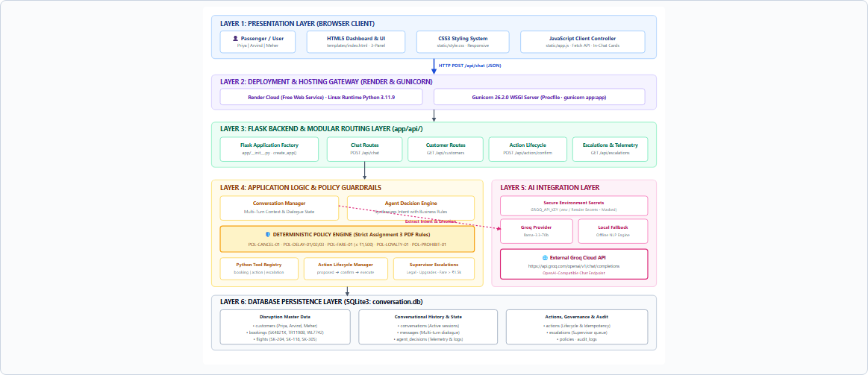
ENGINEERING DESIGN
System Architecture: 6-Layer Modular Implementation
Key Architectural Invariants
🔹 Layer 1: Frontend UI
HTML5/CSS3/JS 3-panel responsive console. Zero API keys in client.
🔹 Layer 2: Web Gateway
Render Cloud container + Gunicorn WSGI server (`app:app`).
🔹 Layer 3: Modular API
Flask Application Factory with REST blueprints for chat, actions, and telemetry.
🔹 Layer 4: Policy Engine
Deterministic Python rules enforce strict Assignment 3 policies. Zero LLM override.
🔹 Layer 5: AI Engine
Groq Llama-3.3-70B via OpenAI REST completions + offline fallback.
🔹 Layer 6: Persistence
SQLite3 with 10 normalized tables. Idempotent action logging prevents duplicate refunds.
Customer Resolution Agent · Assignment 3 Presentation · Vatsal Mittal
Slide 5 of 10
Notes:
Slide 5 presents the complete system architecture diagram, exactly as built in our codebase. Notice the 6 distinct layers: Layer 1 is the presentation client; Layer 2 is the Gunicorn WSGI web gateway hosted on Render; Layer 3 is the Flask Application Factory; Layer 4 is our Deterministic Policy Guardrail Engine; Layer 5 is the AI Integration Layer using Groq Cloud; and Layer 6 is SQLite persistence. A critical architectural invariant is that the LLM is only used for intent extraction and conversational phrasing; it has zero authority to grant refunds or waive fees. Business logic is strictly enforced in Python.

Slide 6
IMPLEMENTATION STACK
Technology Stack: Verified Production Stack
Layer / Subsystem | Technology | Version / Endpoint | Concrete Purpose in AeroResolve
Presentation | HTML5, CSS3, JavaScript (ES6) | Modern Standard | 3-panel responsive UI, Fetch API client, live Action Cards, zero build tool overhead.
Application Runtime | Python | 3.11.9 | Core execution environment supporting strong typing and dataclasses.
Backend Framework | Flask | 3.1.2 | Application Factory (`create_app`), modular blueprints (`/api/chat`, `/api/action/confirm`).
WSGI Web Server | Gunicorn | 26.2.0 | Production WSGI server handling HTTP concurrency on Render (`gunicorn app:app`).
AI Intelligence | Groq Cloud API | Llama-3.3-70B-Versatile | Ultra-fast OpenAI-compatible REST endpoint for NLU, emotion, and entity parsing.
Offline Fallback | Deterministic Local NLP | Python Native | Zero-dependency regex and keyword rule engine ensuring 100% uptime without API keys.
Database Layer | SQLite3 | 3.x Relational | 10 normalized tables: customers, flights, bookings, messages, actions, escalations, audit.
Cloud Deployment | Render Cloud | Free Web Service | Containerized Linux cloud hosting running live public application with health checks.
Version Control | Git & GitHub | vatsa2912/customer-resolution-agent | Remote repository, automatic deployment hooks, open-source code hosting.
Automated Testing | Pytest | 9.1.1 | 23/23 passing test suite validating policy logic, tool safety, and scenario flows.
Customer Resolution Agent · Assignment 3 Presentation · Vatsal Mittal
Slide 6 of 10
Notes:
Slide 6 provides our verified technology stack table. Every single tool listed here is confirmed in the repository and active in production. We use Python 3.11 with Flask 3.1 as our backend, Gunicorn 26 as the production WSGI server, Groq Cloud for Llama-3.3-70B inference, SQLite3 for normalized database persistence, and native vanilla HTML5/CSS/JavaScript for the frontend. We also have a complete 23-test Pytest verification suite.

Slide 7
OPERATIONAL LIFECYCLE
Working Methodology: End-to-End Query Execution
1
Step 1: Passenger Input & Context
Customer opens the deployed app, selects profile (e.g. Priya Nair, Gold), and submits natural language query via the chat console.
2
Step 2: Client Dispatch (Fetch API)
`static/app.js` captures input, attaches session state, and dispatches an asynchronous HTTP POST request to `/api/chat`.
3
Step 3: Web Gateway & Factory
Render routes traffic to Gunicorn, which dispatches to Flask's `chat_routes.py`. `ConversationManager` pulls prior dialogue history from SQLite.
4
Step 4: Groq AI Natural Understanding
Backend invokes Groq Cloud Llama-3.3-70B via REST. Model analyzes intent, entities, sentiment, and customer frustration without inventing policies.
5
Step 5: Policy Guardrail Evaluation
`PolicyEngine` cross-checks facts against Assignment 3 rules: grants full refund eligibility (POL-CANCEL-01) and denies out-of-policy upgrades (POL-LOYALTY-01).
6
Step 6: Safe Tool & Action Lifecycle
`ActionService` stages irreversible operations in `awaiting_confirmation` status with unique idempotency keys. Out-of-policy requests trigger `EscalationService`.
7
Step 7: Database Persistence & Audit
Dialogue turns, agent decisions, telemetry metadata, and supervisor ticket records are atomically committed to SQLite (`conversation.db`).
8
Step 8: Interactive UI Rendering
Browser renders empathetic AI response with policy citation badges, supervisor escalation pill, and an interactive Action Card with Approve/Cancel buttons.
Customer Resolution Agent · Assignment 3 Presentation · Vatsal Mittal
Slide 7 of 10
Notes:
Slide 7 walks through our 8-step working methodology. When a customer enters a complaint, it travels through the Fetch API to Flask, where prior dialogue history and disruption facts are loaded. Groq's Llama-3.3-70B model extracts intent and emotion. The policy engine then validates the customer's entitlements. Crucially, in Step 6, any irreversible action is placed in 'awaiting_confirmation' status, generating an interactive card in the UI so the user retains final approval.

Slide 8
SCENARIO VERIFICATION
Required Scenario Testing: Exact Assignment 3 Scenarios
Scenario 1: Priya Nair (Gold Tier)
Flight SK-204 · Delhi to Goa · Cancelled
Scenario 2: Arvind Kulkarni (Silver Tier)
Flight SK-118 · Mumbai to Bengaluru · Delayed 4 Hours
Scenario 3: Meher Kaur (Platinum Tier)
Flight SK-305 · Delhi to Hyderabad · Delayed 6 Hours
PASSENGER DEMAND
Customer Demand:
• Demands 100% full cash refund immediately.
• Demands free upgrade to Business Class on return.
• Highly agitated and furious tone.
SYSTEM RESOLUTION & POLICY
System Resolution & Enforcement:
✓ Entitled to full cash refund within 7 business days (POL-CANCEL-01) OR priority rebooking (POL-LOYALTY-01).
✗ Cabin upgrade strictly denied by policy (POL-LOYALTY-01).
⚠️ Upgrade request automatically escalated to human supervisor ticket.
✓ Action staged in 'awaiting_confirmation' with interactive UI card.
PASSENGER DEMAND
Customer Demand:
• Flight delayed by 4 hours; missed important business meeting.
• Demands complimentary hotel accommodation.
• Frustrated and seeking immediate remedy.
SYSTEM RESOLUTION & POLICY
System Resolution & Enforcement:
✓ Entitled to ₹500 meal voucher + lounge access for 3-5h delay (POL-DELAY-02).
✗ Hotel accommodation explicitly denied: policy requires delay > 5 hours for hotel entitlement.
✓ Agent applies meal voucher and lounge pass to profile immediately.
✓ Explains policy empathetically without defensive language.
PASSENGER DEMAND
Customer Demand:
• 6-hour technical delay (new departure: 20:00).
• Demands full-night hotel stay.
• Demands rebooking on alternate flight with ₹2,000 fare difference waiver.
SYSTEM RESOLUTION & POLICY
System Resolution & Enforcement:
✓ Entitled to meal voucher, lounge access, and hotel accommodation covering delayed hours only (POL-DELAY-03).
✗ Full-night hotel stay denied under stated rule.
⚠️ ₹2,000 fare waiver exceeds agent ₹1,500 limit (POL-FARE-01); escalated to supervisor for waiver approval.
✓ Platinum tier priority rebooking applied.
Customer Resolution Agent · Assignment 3 Presentation · Vatsal Mittal
Slide 8 of 10
Notes:
Slide 8 demonstrates our verification against the three required assignment scenarios. In Scenario 1, Priya's cancellation entitles her to a full refund, but her demand for a free business-class upgrade is strictly blocked and escalated. In Scenario 2, Arvind's 4-hour delay grants him meal vouchers and lounge access, but his hotel request is denied because policy requires a delay over 5 hours. In Scenario 3, Meher's 6-hour delay entitles her to a hotel stay for the delayed hours only, while her request to waive a ₹2,000 fare difference is escalated because it exceeds the agent's ₹1,500 waiver limit.

Slide 9
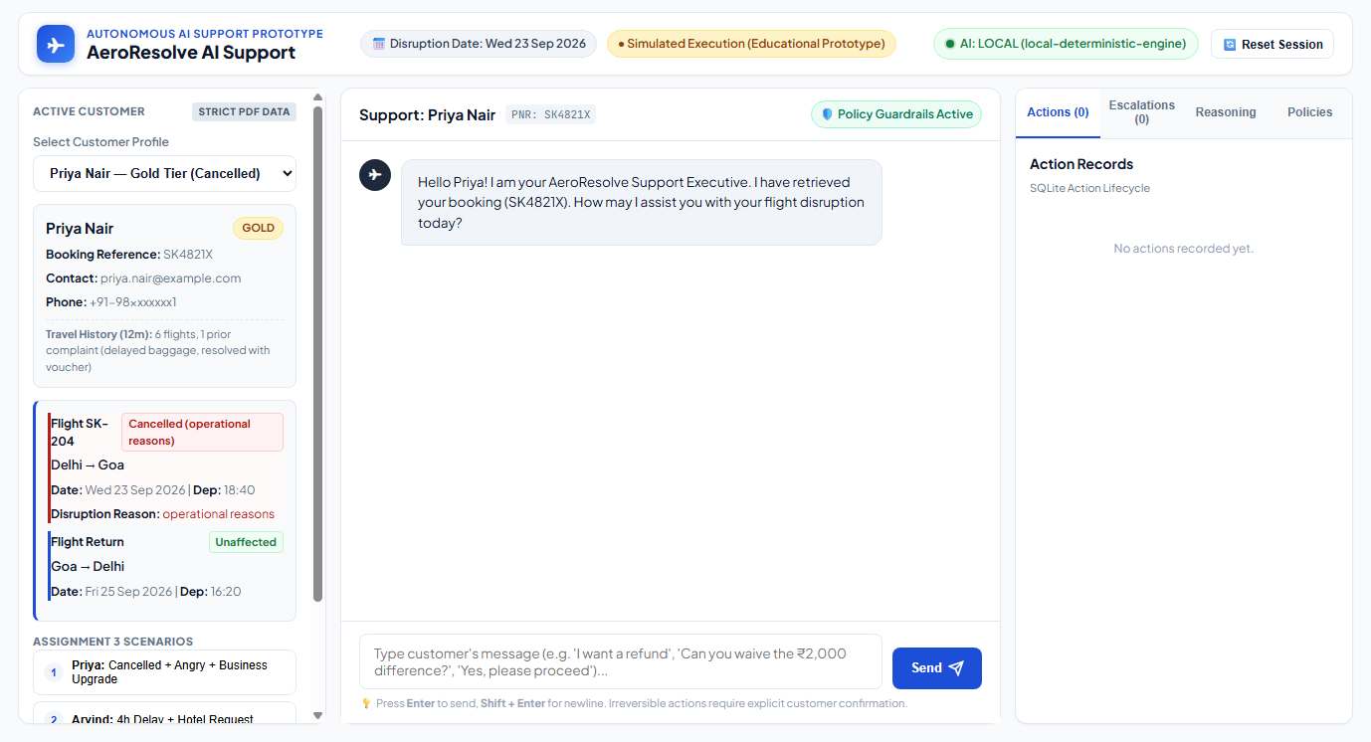
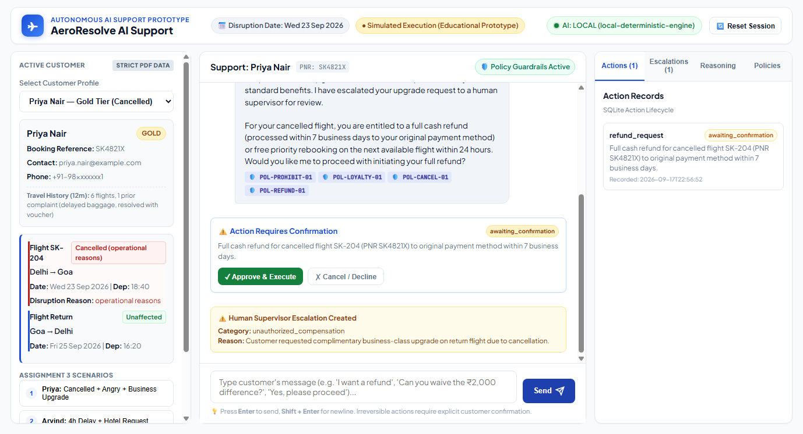
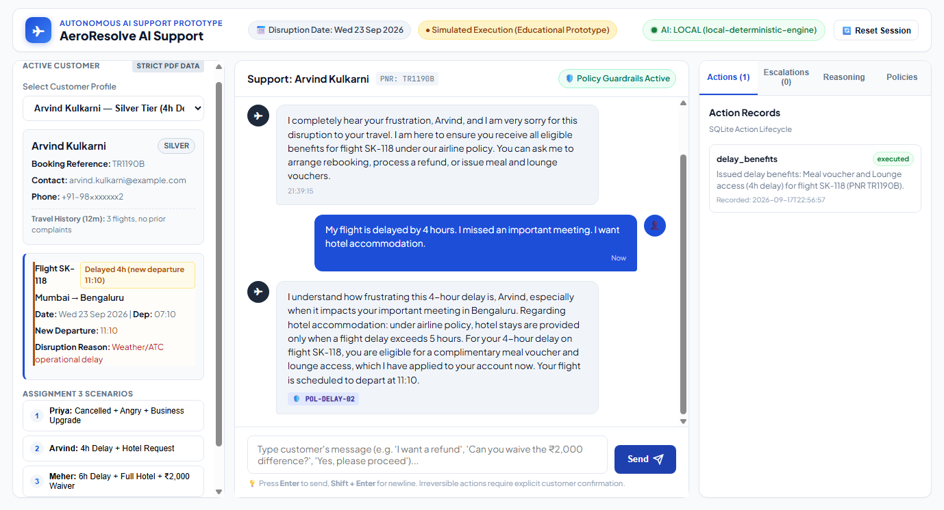
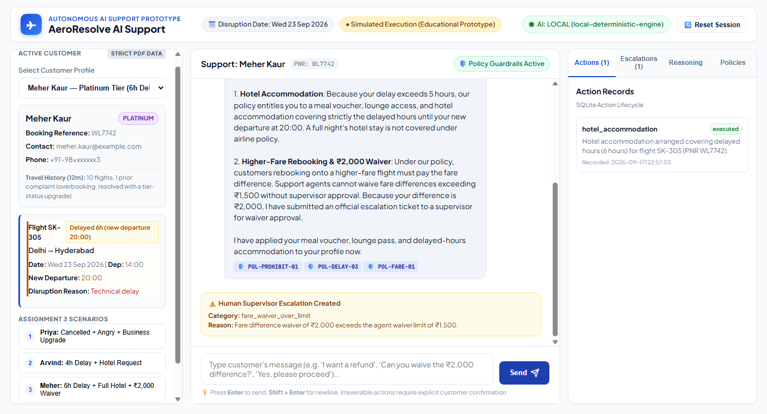
EXECUTION RESULTS
Application Demonstration: Live Execution Screenshots
1. Operations Dashboard
Full 3-panel UI with live flight facts, PNR context, and audit log tabs.
2. Priya: Cancellation & Action Card
Full refund staged with interactive Approve/Cancel buttons; upgrade escalated.
3. Arvind: 4h Delay & Policy Denial
Meal voucher + lounge access issued; hotel stay denied per 5-hour policy rule.
4. Meher: 6h Delay & Waiver Escalation
Delayed-hours hotel stay issued; ₹2,000 fare waiver escalated to human supervisor.
Customer Resolution Agent · Assignment 3 Presentation · Vatsal Mittal
Slide 9 of 10
Notes:
Slide 9 displays real, authentic screenshots captured directly from our running application. Top-left shows the homepage with customer profile selector and active flight card. Top-right shows Priya's interaction: notice the in-chat confirmation card asking the customer to approve the refund, along with the supervisor escalation pill. Bottom-left shows Arvind's interaction where meal and lounge benefits are issued, but hotel accommodation is politely denied. Bottom-right shows Meher's interaction where delayed-hours hotel accommodation is granted and the ₹2,000 fare waiver is escalated.

Slide 10
FINAL SUMMARY
Conclusion & Project Delivery Links
Project Achievements & Architectural Highlights
Project Links & Presenter Details
★ Autonomous AI Resolution Agent: Successfully engineered an end-to-end customer resolution system combining modern LLM reasoning with deterministic policy guardrails.
★ Strict Policy Compliance: 100% compliant with the Assignment 3 Data Pack across flight cancellations, tiered delays, loyalty benefits, and supervisor escalation rules.
★ Zero Hallucination Architecture: Decoupled NLU from business logic: AI cannot invent compensation, waive fees over ₹1,500, or grant unauthorized upgrades.
★ Two-Stage Transaction Safety: Refunds and rebookings require explicit user confirmation cards before database execution, preventing accidental modifications.
★ Automated Verification Suite: 23/23 unit and integration tests passing in Pytest, ensuring idempotency, policy boundary precision, and session safety.
★ Production Cloud Deployment: Fully containerized and deployed on Render Free Web Service with live health telemetry and SQLite persistence.
PRESENTED BY
Vatsal Mittal
LIVE DEPLOYED APPLICATION
https://customer-resolution-agent-v1.onrender.com
GITHUB REPOSITORY
https://github.com/vatsa2912/customer-resolution-agent
STATUS: Deployed & Passing 23/23 Pytests
Customer Resolution Agent · Assignment 3 Presentation · Vatsal Mittal
Slide 10 of 10
Notes:
To conclude, this project successfully demonstrates that autonomous AI customer support in critical industries like aviation requires a hybrid architecture: pairing high-speed LLM language understanding with strict deterministic policy engines. The project is fully documented, tested with 23 passing pytests, version-controlled on GitHub, and deployed live on Render. Thank you very much for your time. I am now open to any questions.

