Slide 1
Morphological
Image Processing
INTRUDUCTION TO

Slide 2
Introduction
The word morphology commonly denotes a branch of biology that deals with the form and structure of animals and plants.
Therefore, morphological operations are intended to affect the shape of the object

Slide 3
We use mathematical morphology as a tool for extracting image components that are useful in the representation and description of region shape, such as
boundaries extraction
skeletons
convex hull
morphological filtering
thinning
pruning

Slide 4
Sets in mathematic morphology represent
objects in an image:
binary image (0 = black, 1 = white) :
the element of the set is the coordinates (x,y) of pixel belong to the object Z²
gray-scaled image :
the element of the set is the coordinates (x,y) of pixel belong to the object and the gray levels Z³

Slide 5
A is a set in Z² ,
a=(a1,a2) an element of A, a∈A If not, then a∉A
∅: null (empty) set
A subset of B: A⊆B
Union of A and B: C=A∪B
Intersection of A and B: D=A∩B
Disjoint sets: A∩B= ∅
Complement of A: A^{c} = {x|x∉A}
Difference of A and B:
A-B = {x|x∈A, x ∉ B} = A∩B^{c}

Slide 6
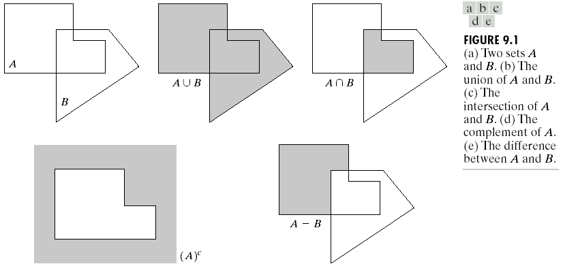
Operators by examples:

Slide 7

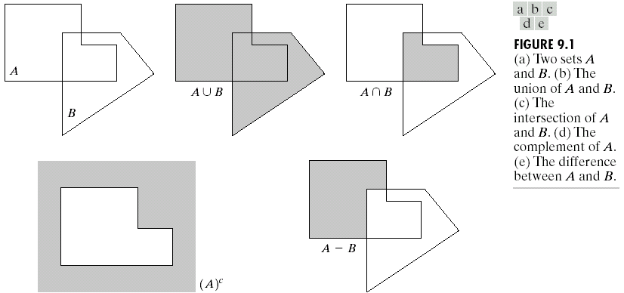
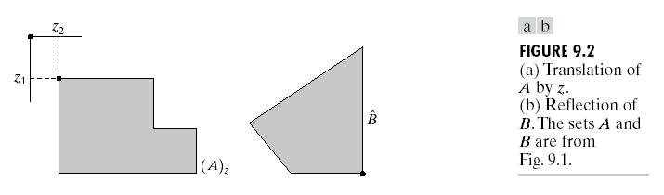
Reflection and Translation by examples:
Need for a reference point.
Reflection of B:
= {x|x=-b, for b∈B}
Translation of A by x=(x₁,x₂), denoted by (A)_{x} is defined as:
(A)_{x} = {c| c=a+x, for a∈A}
Reference point

Slide 8
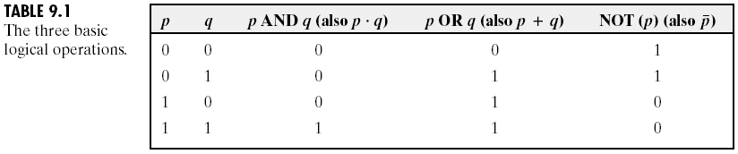
Basic Logic Operations:

Slide 9
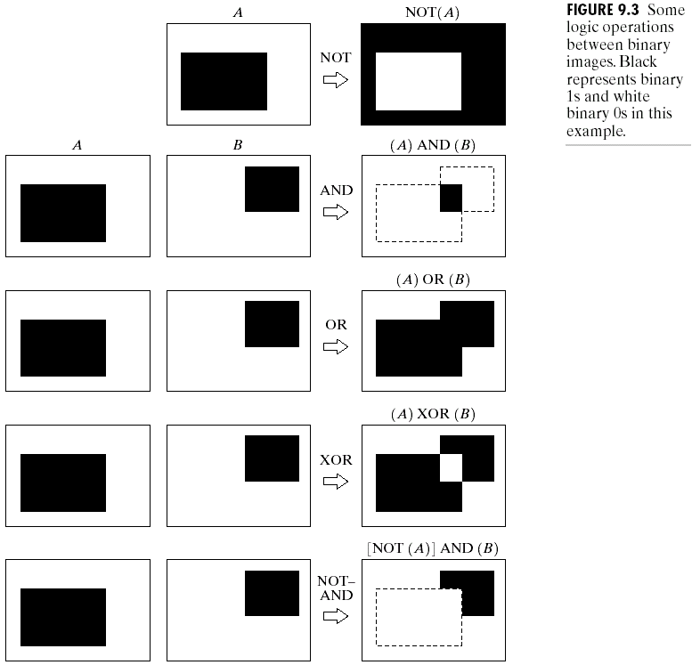

Slide 10

Two Fundamental Morphological Operators:
Dilation:
  Obtaining the reflection of B about its origin and then shifting this reflection by x
  The dilation of A by B then is the set of all x displacements such that and A overlap by at least one nonzero element…
(B is the structuring element in dilation)
    Relation to Convolution mask:
      - Flipping
      Overlapping
  Dilation is typically applied to binary image, but there are versions that work on gray scale image.

Slide 11
Suppose that X is the set of coordinates corresponding to the input binary image, and that K is the set of coordinates for the structuring element.
Let Kx denote the translation of K so that its origin is at x.
Then the dilation of X by K is simply the set of all points x such that the intersection of Kx with X is non-empty.

Slide 12
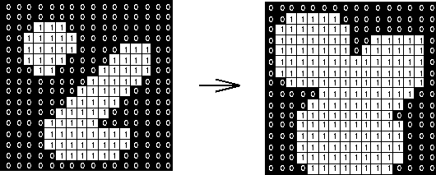
Suppose that the structuring element is a 3×3 square .
Note that in subsequent diagrams, foreground pixels are represented by 1's and background pixels by 0's.
To compute the dilation of a binary input image by this structuring element, we superimpose the structuring element on top of the input image so that the origin of the structuring element coincides with the input pixel position.
If the center pixel in the structuring element coincides with a foreground pixel in the image underneath, then the input pixel is set to the foreground value.
1
1
1
1
1
1
1
1
1
Structuring element

Slide 13
  MATLAB CODE:
clear all;
B=zeros(256,256); % create 256x256 image
for i=128:160
for j=128:160 B(i,j)=1;
end
end
for i=20:25
for j=30:190 B(i,j)=1;
end
end
i=1;
while i<40 % generate 40 random pixels
x=uint8(rand*255); y=uint8(rand*255);
B(x,y)=1;i=i+1;
end
imshow(B); title('Original image');
K3=ones(3); K5=ones(5); K7=ones(7); K9=ones(9); % create kernels
B3=imdilate(B,K3); B5=imdilate(B,K5); % apply dilation
B7=imdilate(B,K7); B9=imdilate(B,K9);
figure; imshow(B3); title('Dilated image with 3 by 3');
figure; imshow(B5); title('Dilated image with 5 by 5');
figure; imshow(B7); title('Dilated image with 7 by 7');
figure, imshow(B9); title('Dilated image with 9 by 9');

Slide 14
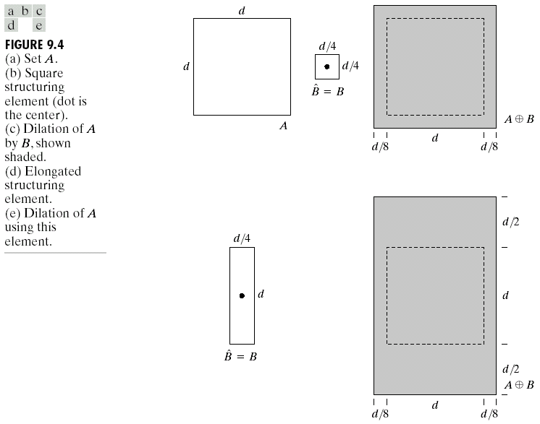
Dilation by example:

Slide 15
  Dilation is typically applied to binary image, but there are versions that work on gray scale image.
  The basic effect of the operator on a binary image is to gradually enlarge the boundaries of regions of foreground pixels (i.e. white pixels, typically).
  Thus areas of foreground pixels grow in size while holes within those regions become smaller.

Slide 16
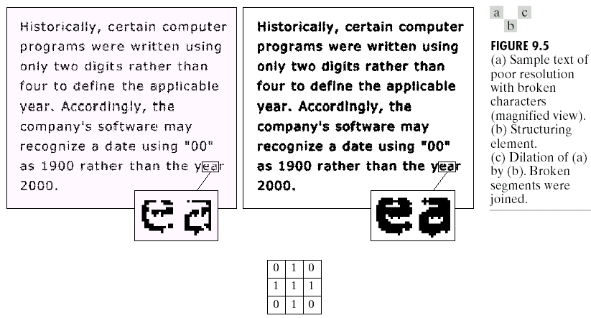
  The basic effect of the operator on a binary image is to gradually enlarge the boundaries of regions of foreground pixels (i.e. white pixels, typically).

Slide 17
  Summary effects of dilation:
    Expand/enlarge objects in the image
    Fill gaps or bays of insufficient width
    Fill small holes of sufficiently small size
    Connects objects separated by a distance less than the size of the window

Slide 18

Erosion:
  i.e. the erosion of A by B is the set of all points x
  such that B, translated by x, is contained in A.
  It is typically applied to binary image, but there are versions that work on gray scale image.
  The basic effect of the operator on a binary image is to erode away the boundaries of regions of foreground pixels (i.e. white pixels, typically).
  Thus areas of foreground pixels shrink in size, and holes within those areas become larger.

Slide 19
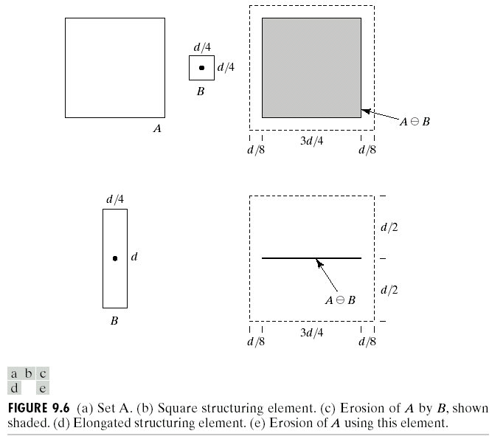

Slide 20

Suppose that the structuring element is a 3×3 square .
Note that in subsequent diagrams, foreground pixels are represented by 1's and background pixels by 0's.
The structuring element is now superimposed over each foreground pixel ( input pixel ) in the image. If all the pixels below the structuring element are foreground pixels then the input pixel retains it’s value. But if any of the pixels is a background pixel then the input pixel gets the background pixel value.
1
1
1
1
1
1
1
1
1
Structuring element

Slide 21
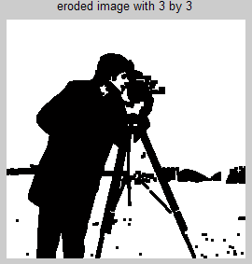
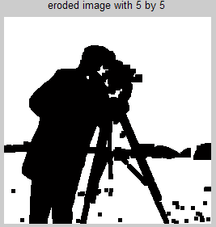

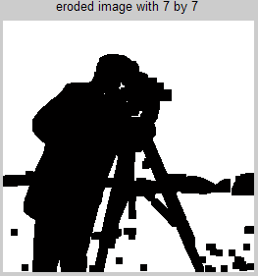
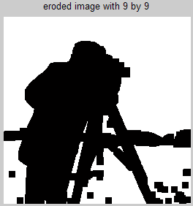
Another example:
MATLAB CODE
% read image
I=imread('cameraman.tif');
% convert to binary image
B=im2bw(I,0.3);
% create kernels
K3=ones(3);
K5=ones(5);
K7=ones(7);
K9=ones(9);
% apply erosion
B3=imerode(B,K3);
B5=imerode(B,K5);
B7=imerode(B,K7);
B9=imerode(B,K9);
% display images
imshow(B);title('original image');
figure, imshow(B3);title('eroded image with 3 by 3');
figure, imshow(B5);title('eroded image with 5 by 5');
figure, imshow(B7);title('eroded image with 7 by 7');
figure, imshow(B9);title('eroded image with 9 by 9');

Slide 22
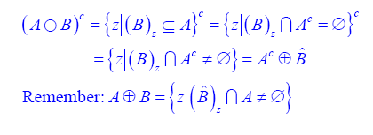
Dilation-Erosion Duality:

Slide 23
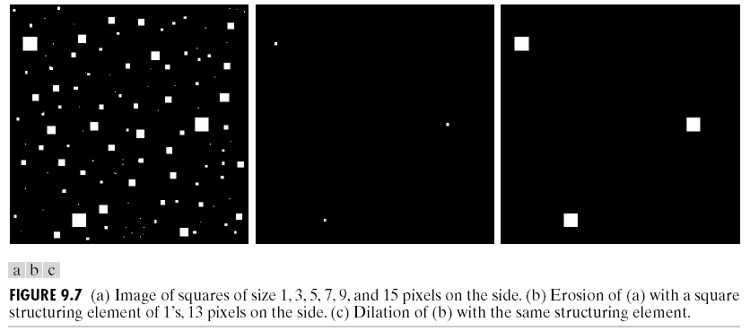

Slide 24

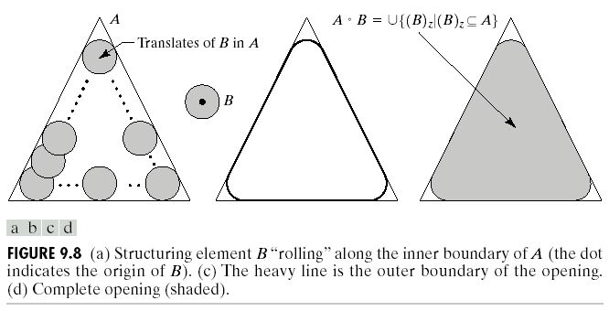
Opening and Closing:
Dilation expands and Erosion shrinks.
  Opening:
  An erosion followed by a dilation using the same structuring element for both operations.
    Smooth contour
    Break narrow isthmuses
    Remove thin protrusion

Slide 25
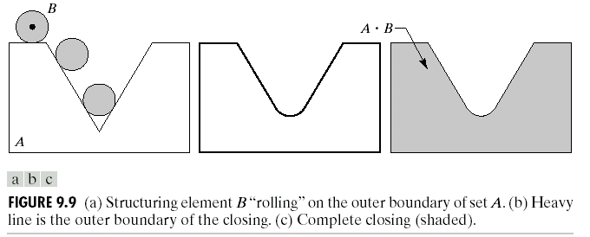
  Closing:
    A Dilation followed by a erosion using the same
structuring element for both operations.
    Smooth contour
    Fuse narrow breaks, and long thin gulfs.
    Remove small holes, and fill gaps.

Slide 26
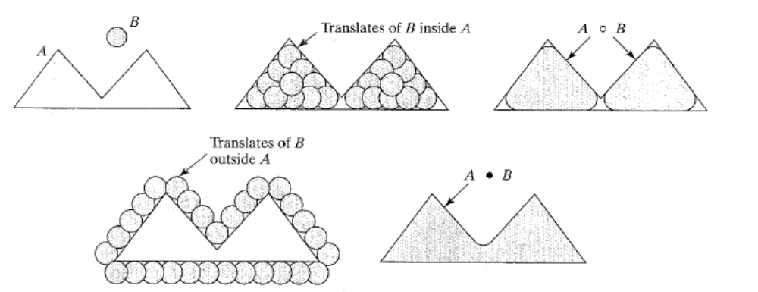

Slide 27
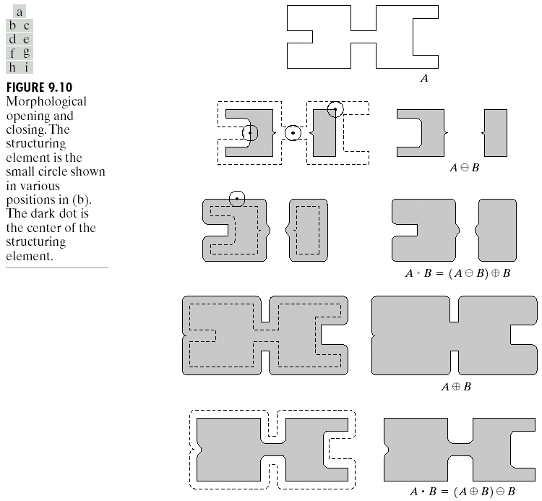

Slide 28
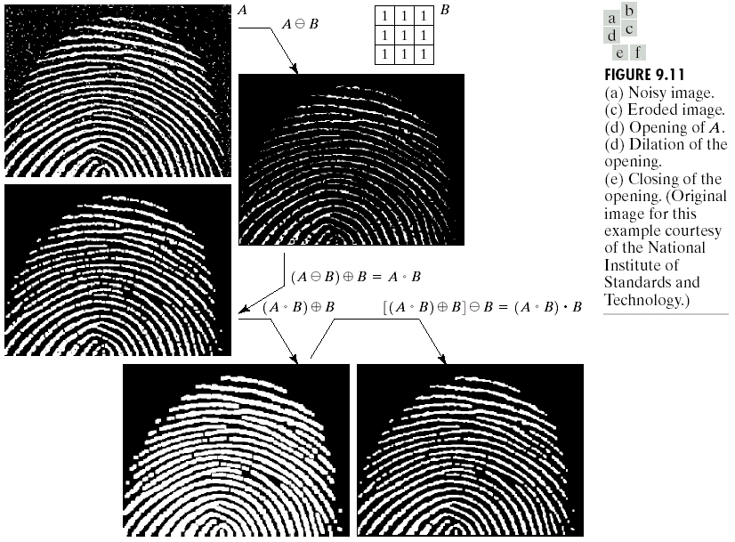

Slide 29
Hit-or-Miss Transform
The hit-or-miss transform is a general binary morphological operation that can be used to look for particular patterns of foreground and background pixels in an image.
The hit-and-miss transform is a basic tool for shape detection.
Concept: To detect a shape:
  Hit object
  Miss background

Slide 30
Hit-or-Miss Transform
  The structural elements used for Hit-or-miss transforms are an extension to the ones used with dilation, erosion etc.
  The structural elements can contain both foreground and background pixels, rather than just foreground pixels, i.e. both ones and zeros.
  The structuring element is superimposed over each pixel in the input image, and if an exact match is found between the foreground and background pixels in the structuring element and the image, the input pixel lying below the origin of the structuring element is set to the foreground pixel value. If it does not match, the input pixel is replaced by the boundary pixel value.

Slide 31
The hit-or-miss transform is defined as:
Let B ={B1, B2}, where B1 is the set formed from elements of B associated with an object and B2 is the set of elements of B associated with the corresponding background, where B1 and B2 are disjoint.

Slide 32
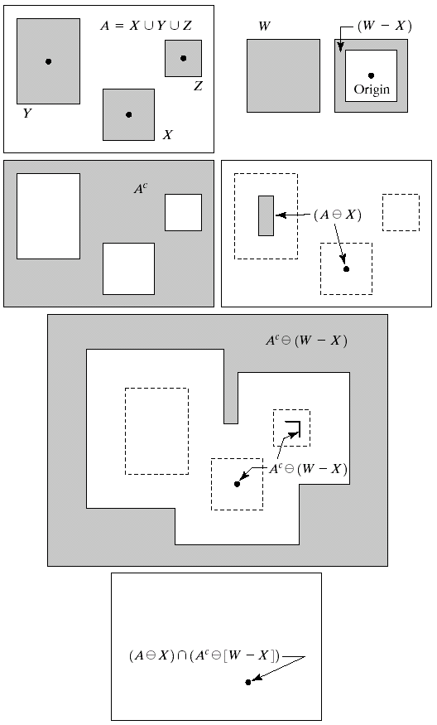
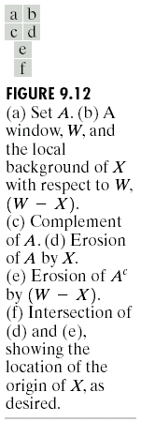

Hit-and-Miss Transform
B1: Object related
B2: Background related

Slide 33

Applications
  Boundary Extraction
    The boundary of a set X is obtained by first eroding X by structuring element K and then taking the set difference of X and it’s erosion.
    The resultant image after subtracting the eroded image from the original image has the boundary of the objects extracted. The thickness of the boundary depends on the size of the structuring element.

Slide 34
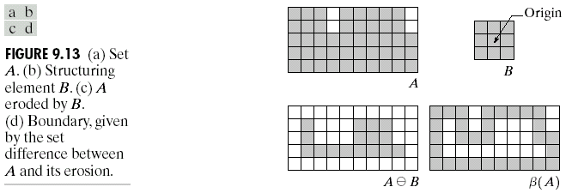
Boundary Extraction

Slide 35
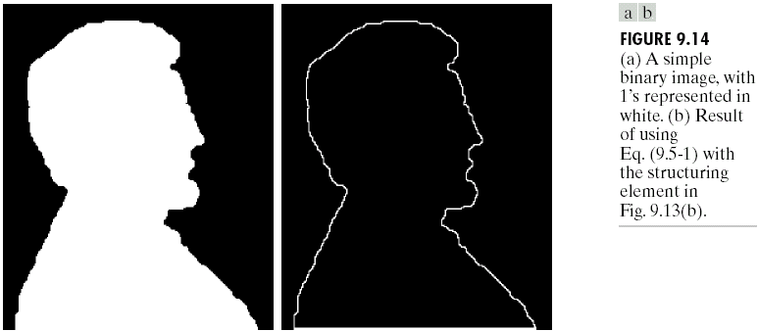


Slide 36
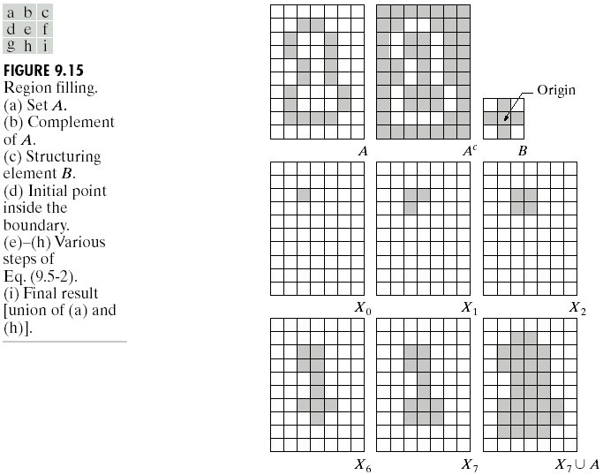
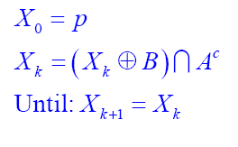
Applications
  Region/Hole Filling:
    Start form p inside boundary.

Slide 37
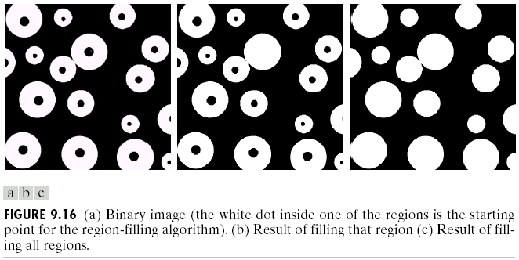
Semi-automated to cancel reflection effect

Slide 38
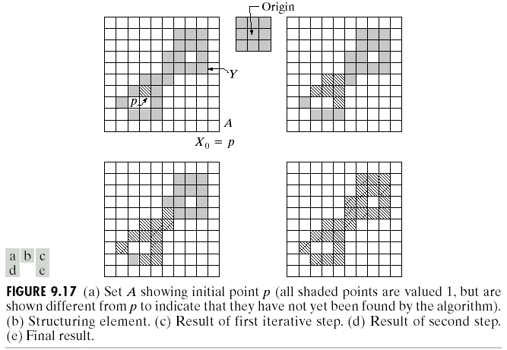
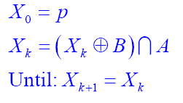
8
Applications
  Connected components Extraction:
Start from p belong to desired region.

Slide 39
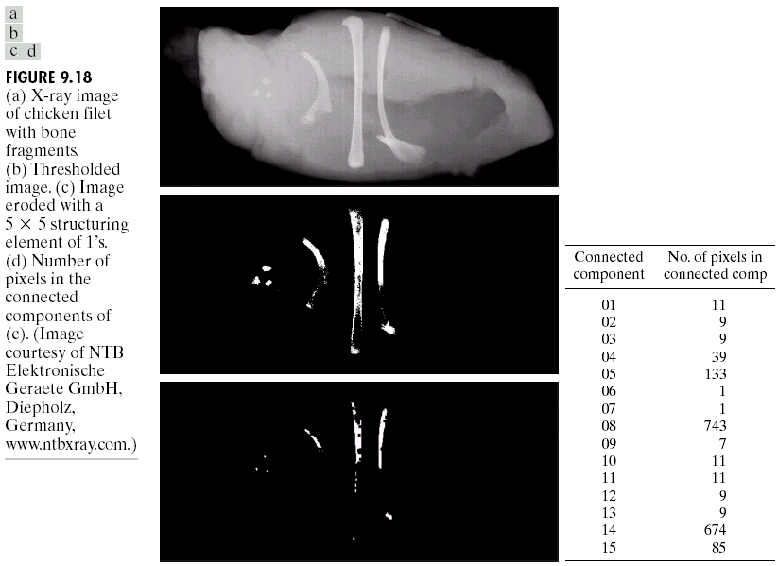

Slide 40
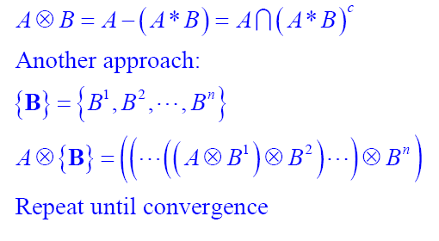
Applications
  Thinning:

Slide 41
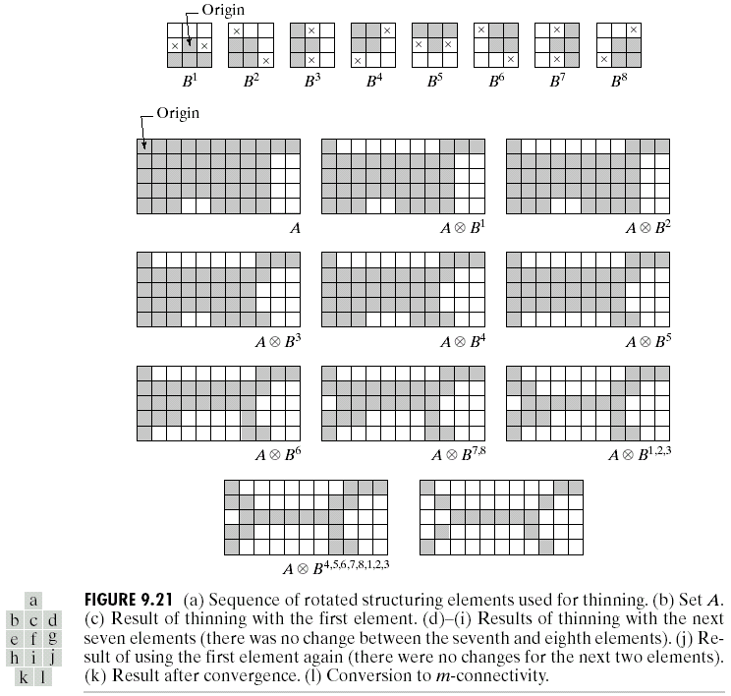
Convert to m-connection

Slide 42
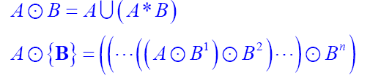

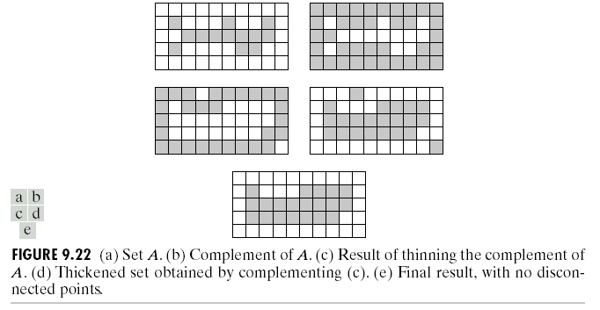
Applications
  Thickening

Slide 43
Applications
  Skeletons A with notation S(A):
    For z belong to S(A) and (D)z, the largest disk
    centered at z and contained in A, one can not find a
    larger disk containing (D)z and included in A.
    Disk (D)z touches the boundary of A at two or
    more different points.

Slide 44
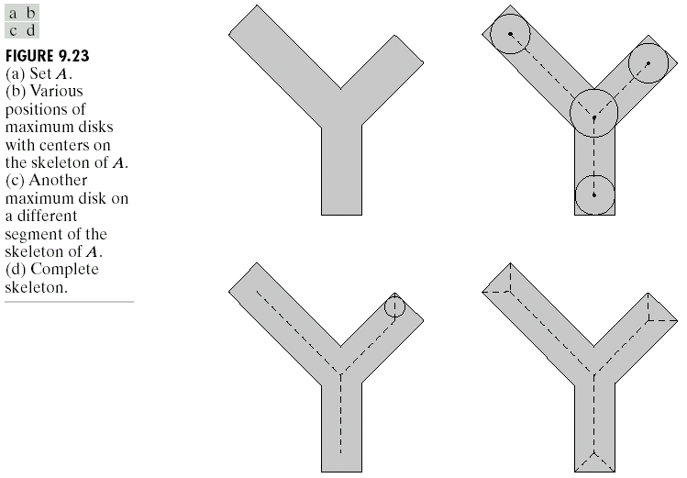

Slide 45
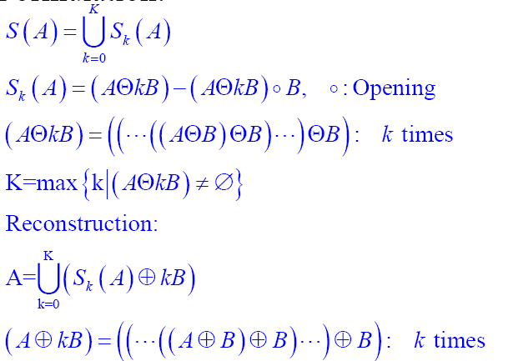
  Skeletons A with notation S(A):

Slide 46
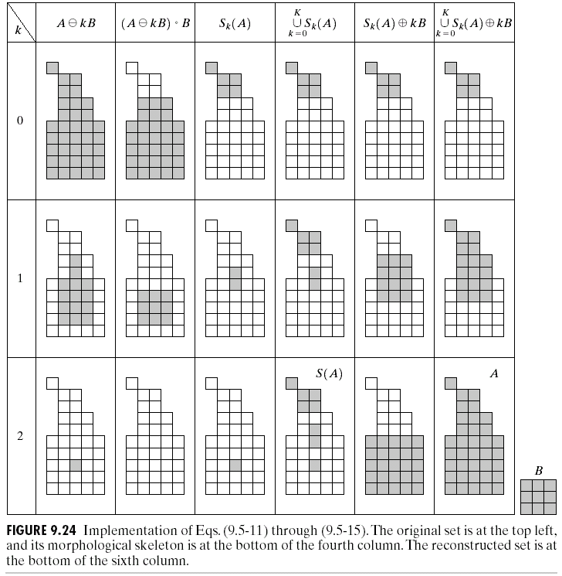
The final skeleton not only thicker it needs to be ,but more important is not connected.

Slide 47


Applications
  Pruning
  Removing parasitic component complement to thinning and skeletonizing by successive elimination its end point.

Slide 48
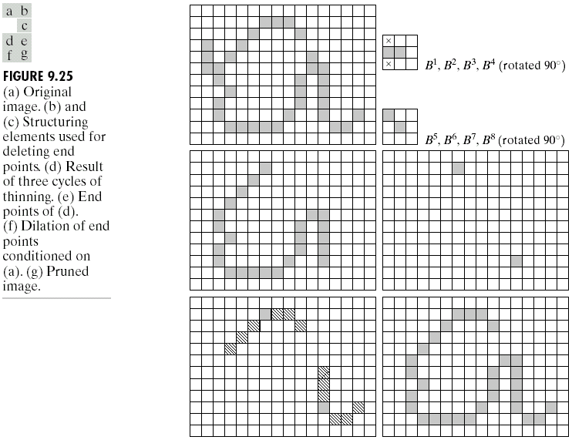

Slide 49
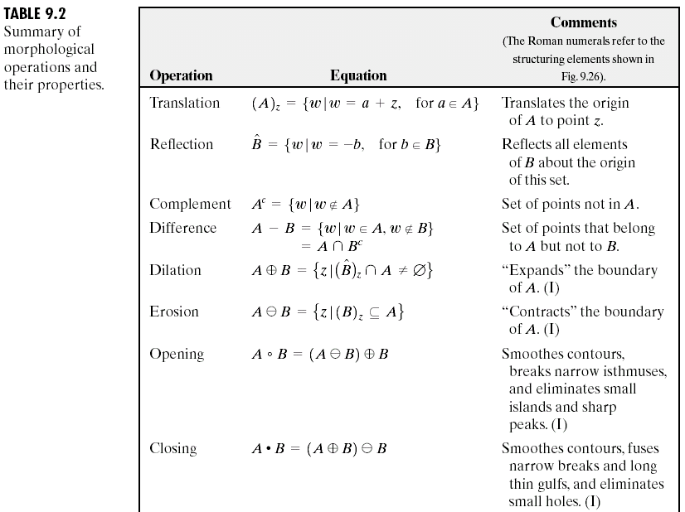

Slide 50
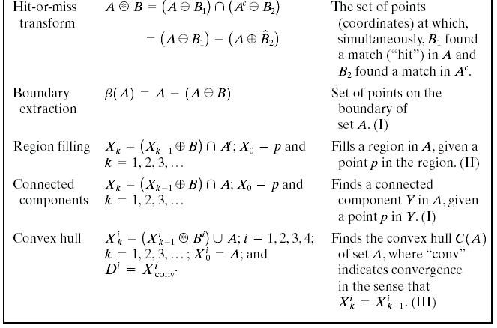
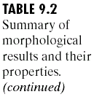

Slide 51
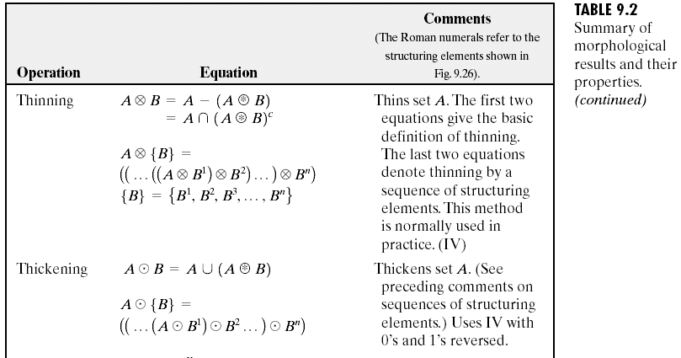

Slide 52
Extension to Gray-Level images:
  f(x,y): the input image
  b(x,y): a structuring element (a subimage function)
  (x,y) are integers.
  f and b are functions that assign a gray-level value (real number or real integer) to each distinct pair of coordinate (x,y)

Slide 53
Extension to Gray-Level images:
  Dilation:
  Df and Db are the domains of f and b, respectively.
  condition (s-x) and (t-y) have to be in the domain of f
  and (x,y) have to be in the domain of b is similar to the
  condition in binary morphological dilation where the
  two sets have to overlap by at least one element

Slide 54
Dilation Similarity with Convolution:
  f(s-x) : f(-x) is simply f(x) mirrored with respect to the original of the x axis. the function f(s-x) moves to the right for positive s, and to the left for negative s.
  Max operation replaces the sums of convolution
  Addition operation replaces with the products of convolution.
• General effect
  If all the values of the structuring element are positive, the output image tends to be brighter than the input
  Dark details either are reduced or eliminated, depending on how their values and shapes relate to the structuring element used for dilation.

Slide 55
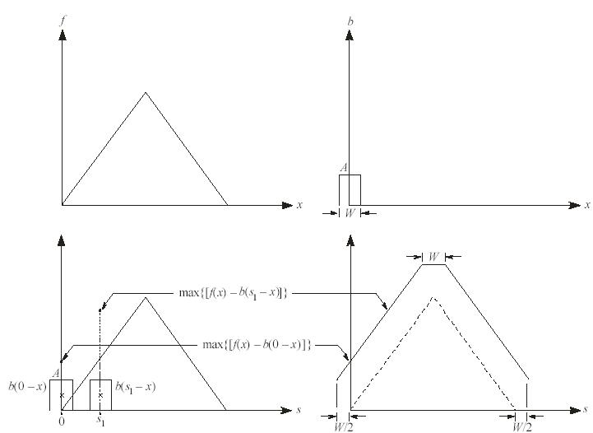
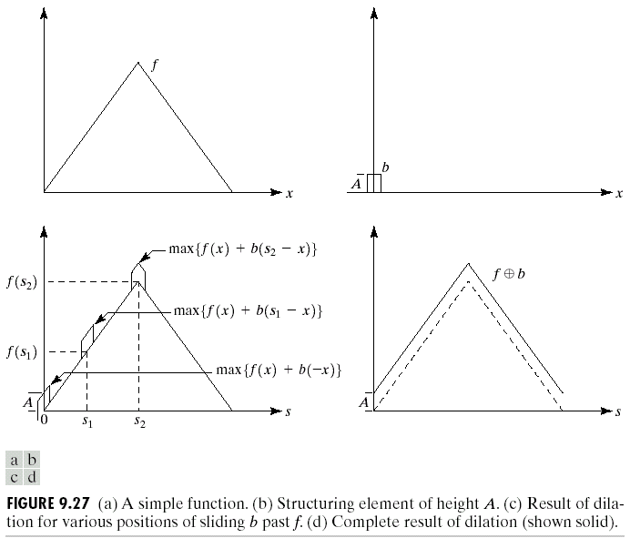

Slide 56
  Erosion:
Condition (s+x) and (t+y) have to be in the domain of f and (x,y) have to be in the domain of b is similar to the condition in binary morphological erosion where the structuring element has to be completely contained by the set being eroded.

Slide 57
Similarity to 2D correlation
  f(s+x) moves to the left for positive s and to the right for negatives.
• General effect
  If all the elements of the structuring element are positive, the output image tends to be darker than the input
  The effect of bright details in the input image that are smaller in area than the structuring element is reduced, with the degree of reduction being determined by the gray-level values surrounding the bright detail and by the shape and amplitude values of the structuring element itself.

Slide 58
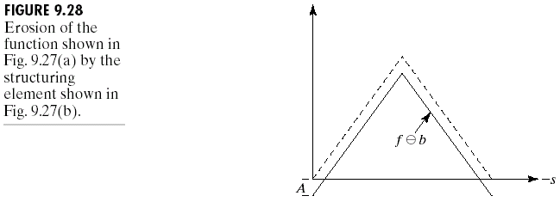


Slide 59
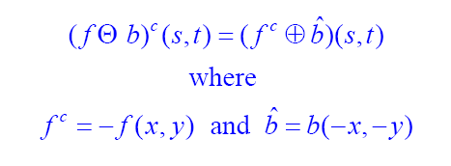
Erosion-Dilation Duality:

Slide 60
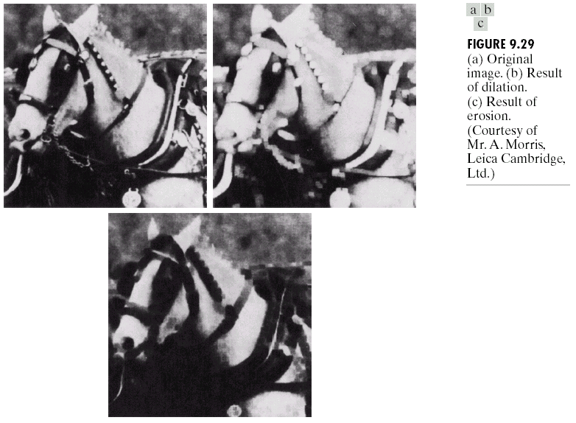

Slide 61
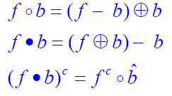
Opening-Closing:
  Same (binary) relation with Dilation-Erosion:

Slide 62
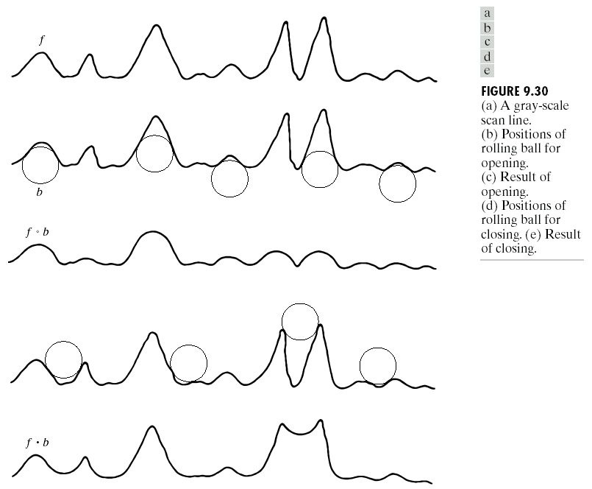

Slide 63
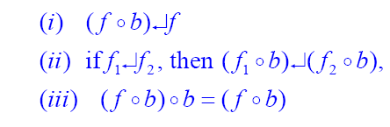

Opening-Closing Properties:
  Opening:
  Closing:
  e↵r indicates that the domain of e is a subset of the domain of r, and also that e(x,y) ≤ r(x,y) for any (x,y) in the domain of e

Slide 64
Opening
  The structuring element is rolled underside the surface of f
  All the peaks that are narrow with respect to the diameter of the structuring element will be reduced in amplitude and sharpness
  So, opening is used to remove small light details, while leaving the overall gray levels and larger bright features relatively undisturbed.
  The initial erosion removes the details, but it also darkens the image.
  The subsequent dilation again increases the overall intensity of the image without reintroducing the details totally removed by erosion.

Slide 65
Closing
  The structuring element is rolled on top of the surface of f
  Peaks essentially are left in their original form (assume that their separation at the narrowest points exceeds the diameter of the structuring element)
  So, closing is used to remove small dark details, while leaving bright features relatively undisturbed.
  The initial dilation removes the dark details and brightens the image
  The subsequent erosion darkens the image without reintroducing the details totally removed by dilation

Slide 66

Opening: Decreased size
of small bright details. No
changes to dark region
Closing: Decreased size
of small dark details. No
changes to bright region

Slide 67


Smoothing

Slide 68


Gradient

Slide 69


Top-hat:
  Enhancing details in presence of shades

Slide 70

Textural segmentation
  Performing closing with successive larger structuring element till removing the small blobs
  Performing Simple opening
  Performing Simple thresholding

Slide 71

Granulometry:
  Used to determine size distribution
  Performing opening operations with structuring elements of increasing size.
  Computing the difference between original image and its opening .
  Normalizing values and constructing particles size distributions

Slide 72
Reference
Digital Image Processing, 2nd ed.
2002 R. C. Gonzalez & R. E. Woods
Hands-on Morphology Image Processing
By Handson

Slide 73
Thank you
for your attention

