Slide 1
Secure data hiding in images using steganography
CAPSTONE PROJECT
Presented By: Patel Vatsal Parimal
Student Name : Patel Vatsal Parimal
College Name : Indus University
Department : Computer Science Engineering

Slide 2
OUTLINE
Problem Statement
Technology used
Wow factor
End users
Result
Conclusion
Git-hub Link
Future scope

Slide 3
Problem Statement
With increasing concerns about data security and privacy, traditional encryption methods often raise suspicion when intercepted. Steganography provides a secure way to hide confidential information inside images, making it undetectable to unauthorized users.
This project aims to develop a Graphical User Interface (GUI) application using Python, OpenCV, and Tkinter that allows users to: Embed a secret message inside an image (Encryption). Retrieve the hidden message using a password (Decryption).

Slide 4
Technology used
Programming Language: Python
Libraries: OpenCV (cv2) for image processing, OS for file handling
Algorithm: Custom Pixel Manipulation encoding for steganography
Platform: Windows
Output Format: Encrypted image (PNG) with hidden message

Slide 5
Wow factors
Seamless Data Hiding – The message is embedded within an image without altering its visual appearance.
Password-Protected Decryption – Ensures only authorized users can retrieve the hidden message.
User-Friendly GUI – Simple and intuitive interface using Tkinter for both encryption and decryption.
Easy & Accessible: Works on any standard image, making secret communication effortless.
Real-World Use Cases – Can be applied for secure communication, digital watermarking, and confidential data storage.

Slide 6
End users
Cybersecurity Enthusiasts & Ethical Hackers – To explore and understand steganography techniques for secure data transmission.
Government & Military – For covert communication and intelligence sharing.
Intelligence Agencies & Law Enforcement – To securely hide and transmit sensitive data for investigations and operations.
Businesses & Corporate Users – To protect confidential business information by embedding it within images.
Developers & Security Professionals – To enhance encryption techniques and develop more secure data transmission applications.

Slide 7
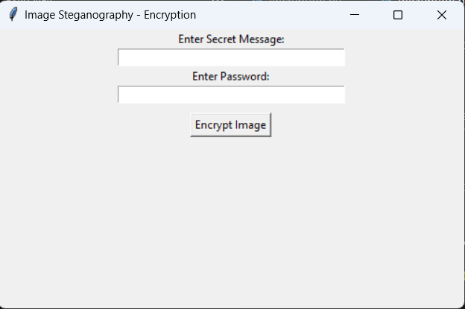
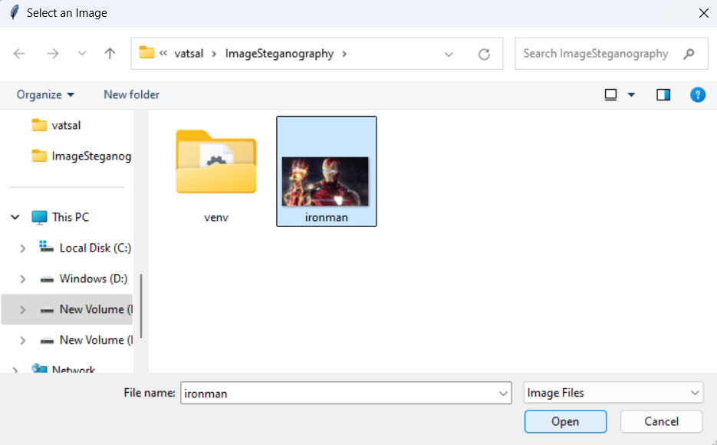
Results

Slide 8
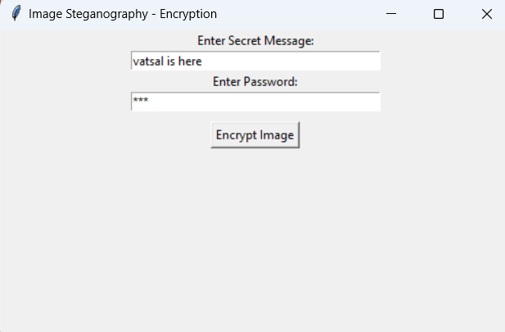
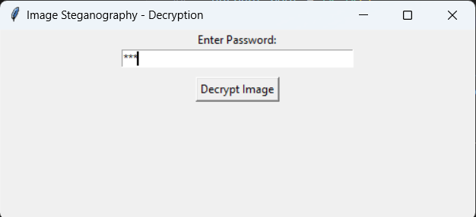
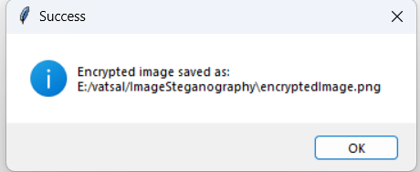
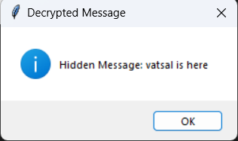
Results

Slide 9
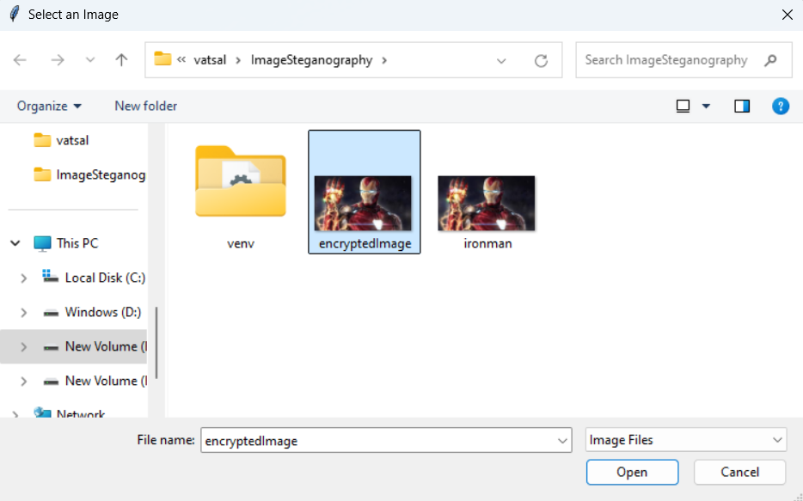
Results

Slide 10
Conclusion
Image Steganography provides a secure and efficient method for hiding sensitive information within images, making it nearly undetectable to unauthorized users. By implementing this technique using Python, OpenCV, and Tkinter, we have created a user-friendly GUI application for encrypting and decrypting hidden messages. This project demonstrates the practical use of steganography in data security, covert communication, and digital watermarking.
With applications in government, military, cybersecurity, and corporate data protection, this technique enhances confidentiality and ensures safe information exchange. As technology advances, integrating steganography with stronger encryption methods can further improve security and broaden its use in various fields.

Slide 11
GitHub Link
https://github.com/vatsal3000/Steganography_Image

Slide 12
Future scope(optional)
Advanced Encryption Techniques – Integrating stronger encryption algorithms like AES or RSA along with steganography for enhanced security.
AI & Machine Learning Integration – Using AI to optimize message embedding and detection, making steganography more efficient and undetectable.
Mobile Application Development – Creating Android and iOS apps for on-the-go secure message hiding and retrieval.
Real-Time Communication Security – Applying steganography in secure messaging apps for encrypted real-time communication.
Cloud-Based Steganography – Implementing a secure online platform where users can encrypt and decrypt messages remotely.

Slide 13
THANK YOU

