Slide 1
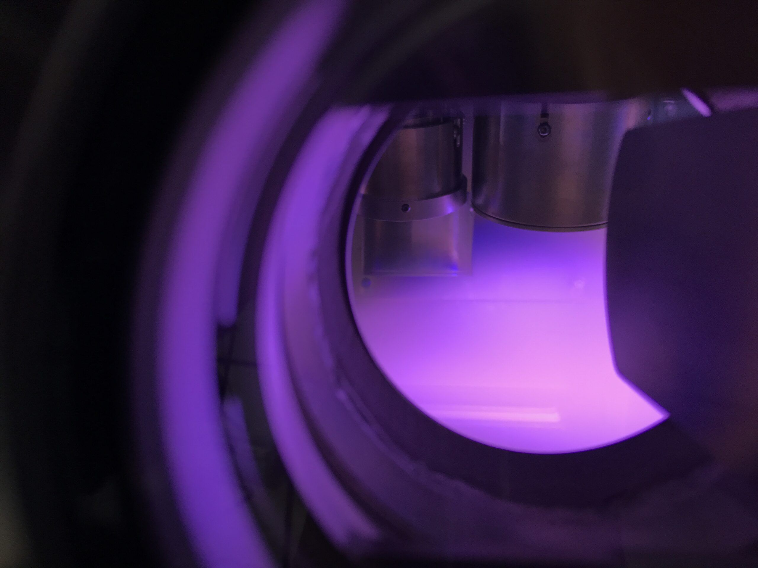
A RAG-BASED
GENERATIVE AI FRAMEWORK
FOR SPUTTERING PARAMETER EXTRACTION
Vatsal Kumar · IIT Kanpur
Under the guidance of Prof. Shikhar Misra
Dept. of Material Science & Engineering, IIT Kanpur
Undergraduate Project · 2025-26 Even Semester
MAGNETRON
SPUTTERING
RAG · LLM · ChromaDB · Gemini · Pandas · Streamlit

Slide 2
PRESENTATION ROADMAP
01
02
03
Problem Statement
Proposed Architecture
ETL Data Pipeline
Literature bottleneck & AI shortcomings
Dual-storage hybrid RAG system
GROBID → Gemini → ChromaDB
04
05
06
Dashboard (Macro View)
Dashboard (Micro View)
Results & Impact
Statistical consensus engine
RAG chatbot with guardrails
5,293 papers

Slide 3

THE RESEARCH BOTTLENECK
Why manual literature review is broken
🔒
Locked in PDFs
HUNDREDS
Decades of critical sputtering parameters (Power, Pressure, Temperature) buried in unstructured PDF papers
of hours wasted on
🔀
Semantic Inconsistency
manual
literature review
"ZnO" vs "Zinc Oxide" vs "Zn0" — fragmented naming makes cross-paper analysis nearly impossible
per material system
🤖
AI Hallucination
Standard LLMs hallucinate when computing strict engineering metrics like Mean, Median, and Mode
📄
📄
📄
😓
🔗
No Unified Platform
No tool bridges Macro-level statistical baselines with Micro-level paper-specific Q&A

Slide 4
PHASE CONTEXT
MAGNETRON SPUTTERING
The physics problem we're solving
MAGNETRON SPUTTERING CHAMBER
Critical Parameters
Target Power
TARGET (e.g., ZnO)
50 – 400 W
Ar+
Ar+
Ar+
Ar+
Working Pressure
0.1 – 10 Pa
Ar gas bombardment
↓ ↓ ↓ ↓ ↓
Base Pressure
Sputtered atoms deposit on substrate
< 10⁻⁴ Pa
SUBSTRATE (e.g., Glass, Si)
Substrate Temp.
→ THIN FILM DEPOSITED
RT – 600 °C
Substrate Material
Glass, Si, etc.

Slide 5




SOLUTION OVERVIEW
THE PROPOSED SOLUTION
An end-to-end automated intelligence platform
📄
→
→
→
→
Raw PDFs
(5,636+)
GROBID
Parser
Gemini
LLM
ChromaDB
+ CSV
Streamlit
Dashboard
📈 MACRO VIEW — Statistical Consensus
💬 MICRO VIEW — RAG Chatbot
Pandas calculates guaranteed Mean, Median & Mode for Target Power, Temperature, and Pressure across thousands of papers. Zero hallucination.
ChromaDB retrieves the top-10 most relevant paper chunks. Gemini answers with strict guardrails and automated source traceability.

Slide 6


PHASE 2 · PIPELINE
THE TECH STACK
Modern data engineering tools powering the system
Python
GROBID
Gemini LLM
CORE LANGUAGE
PDF PARSER
AI ENGINE
Fault-tolerant pipeline scripting with automated API key rotation
Converts rigid PDFs into structured XML/JSON isolating key text blocks
Targeted parameter extraction + semantic alias grouping
ChromaDB
Pandas
Streamlit
VECTOR STORE
MATH ENGINE
UI FRAMEWORK
High-dimensional embeddings for semantic paper retrieval
Deterministic Mean, Median, Mode — mathematically guaranteed
Rapid ML-focused Python web app, zero HTML/CSS required

Slide 7
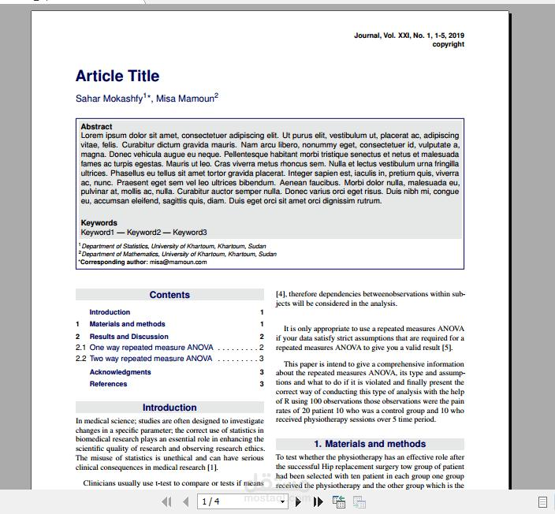
ETL · PHASE 1+2
PDF PARSING WITH GROBID
From unstructured visual chaos to clean machine-readable text
BEFORE
AFTER
{ "title": "ZnO Thin Films via RF...",
"abstract": "In this work...",
"methodology": {
→
GROBID
"target_power": "150 W",
"pressure": "0.5 Pa",
"temperature": "300 °C",
"substrate": "Glass"
}
}
Two-column PDF
(rigid, unstructured)
Structured JSON output
(machine-readable)

Slide 8
ETL · PHASE 3
AI-DRIVEN PARAMETER EXTRACTION
Gemini LLM as a targeted scientific reader
PROMPT ENGINEERING
OUTPUT SCHEMA (per paper)
SYSTEM: You are an expert physicist...
{ "paper_id": "XYZ123",
Extract ONLY from the text below.
"material": "ZnO",
"target_power": 150,
"pressure": 0.5,
Extract these 10 parameters:
"temperature": 300,
• target_power (unit: W)
"substrate": "Glass" }
• working_pressure (unit: Pa)
⚡ FAULT TOLERANCE
• base_pressure (unit: Pa)
Automated API key rotation ensures
continuous extraction across 5,000+ papers
• substrate_temperature (°C)
• substrate_material
If not found → return "NaN"
5,939
10
NEVER guess. NEVER hallucinate.
Papers Sourced
Parameters
Extracted

Slide 9
ETL · PHASE 4
DATA NORMALIZATION & CLEANING
Transforming noisy extraction into a pristine dataset
5,939 Raw Papers Sourced
▼
Sputtering Filter Applied (remove CVD, ALD, Sol-Gel...)
▼
5,293 Purified Sputtering Papers
Unit Standardization
Data Coercion
String Normalization
Enforced uniform units:
• Watts (W) for Power
• Celsius (°C) for Temperature
• Pascals (Pa) for Pressure
Text artifacts like "Not specified", "N/A" converted to NaN (Null) values for safe mathematical operations
Standardized capitalization + stripped whitespace to merge fragmented aliases: "glass" = "Glass" = "GLASS"

Slide 10
DUAL-STORAGE HYBRID RAG SYSTEM
Separating semantic reasoning from deterministic mathematics
CHROMADB
PANDAS CSV
Vector Semantic Store
Structured Statistical Engine
Maps queries into high-dimensional vector space
Stores all extracted parameters as clean CSV rows
Retrieves top-50 contextually relevant paper chunks
Calculates Mean, Median, Mode with 100% accuracy
VS
Enables semantic similarity (ZnO ≈ Zinc Oxide)
Handles outlier detection via 98th percentile
Powers the Micro-View RAG chatbot
Powers the Macro-View statistical dashboard
Semantic Search Engine → MICRO VIEW
Mathematical Engine → MACRO VIEW

Slide 11
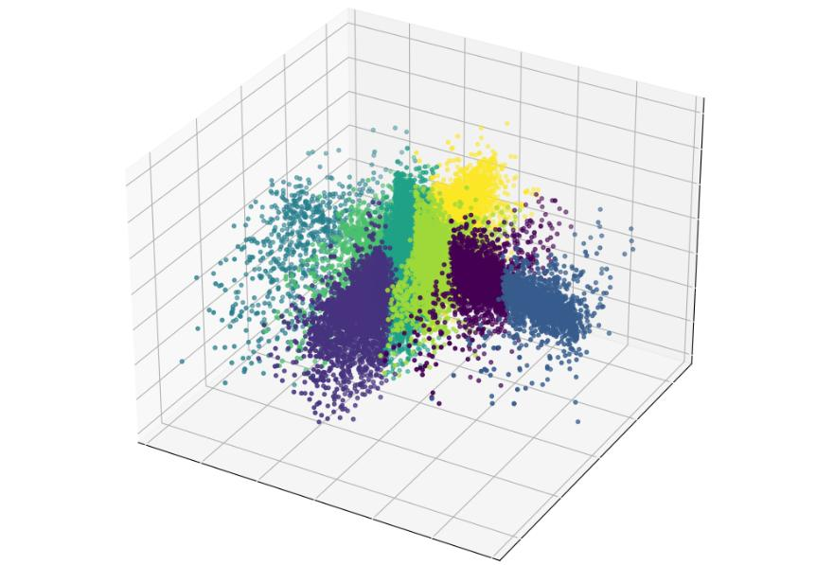
ARCHITECTURE · CHROMADB
BUILDING THE VECTOR BRAIN
ChromaDB: Converting text into mathematical meaning
How Embeddings Work
1
Text → Embedding
Each paper chunk is converted into a 768-dimensional vector by the embedding model
Query
ZnO papers
TiO₂ papers
2
Storage in Vector Space
Semantically similar chunks cluster together in high-dimensional space
3
Query Matching
User query "ZnO" converts to vector, finds nearest neighbors in < 50ms
VECTOR SPACE VISUALIZATION

Slide 12
DASHBOARD · MAO VIEW
STATISTICAL CONSENSUS ENGINE
The Macro View: industry-standard parameter baselines
User enters
material (e.g. ZnO)
Gemini groups
chemical aliases
ChromaDB retrieves
top-50 papers
Pandas calculates
consensus metrics
Dashboard
displays results
→
→
→
→
AI Alias Grouping:
"ZnO", "Zinc Oxide", "ZnO:Ga", "Ga-doped ZnO", "Zn0" → all grouped as ZnO family (291 papers found)
100 W
25 °C
1.20 Pa
Glass
Median Target Power
Mode Temperature
Median Working Pressure
Most Common Substrate

Slide 13
DASHBOARD · DISTRIBIONS
VISUAL PARAMETER DISTRIBUTIONS
Histograms reveal industry consensus at a glance
Smart Outlier Handling:
Raw data preserved (e.g., 4000°C errors remain in CSV). Histograms clip to 98th percentile for readable distributions. Box-and-whisker plots expose full range including statistical extremes.

Slide 14
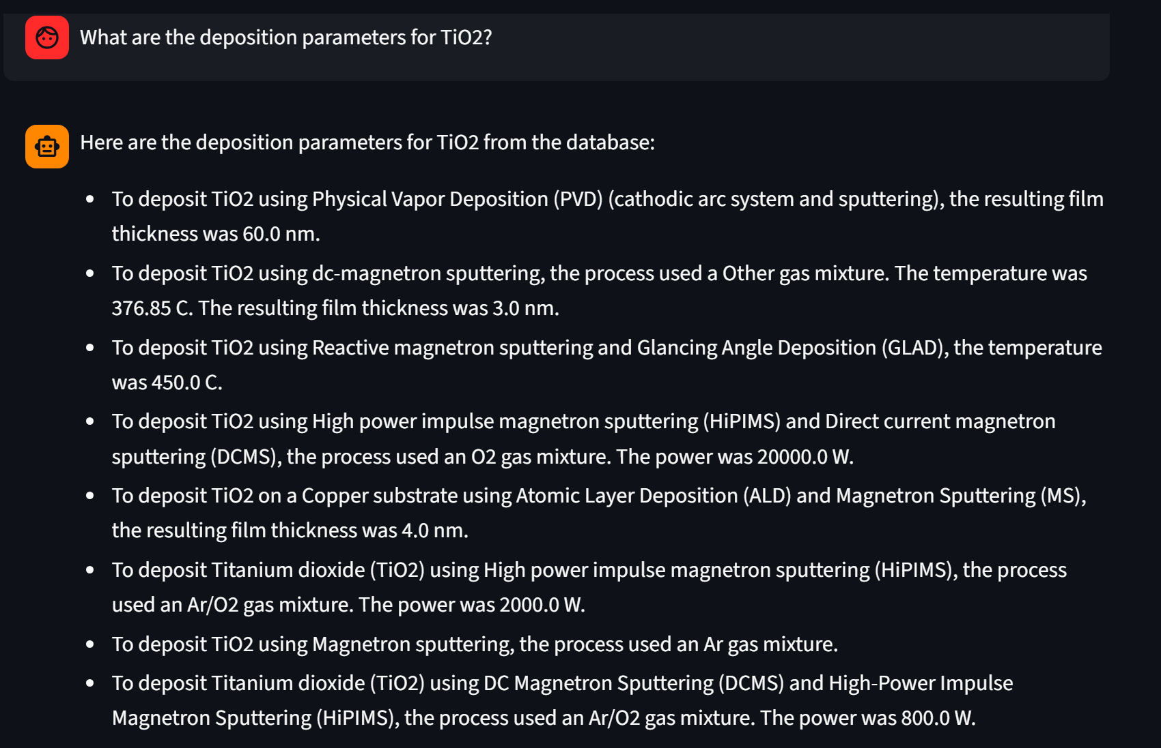
DASHBOARD · MICRO VIEW
MICRO-RAG CHATBOT
Hallucination-free Q&A with automated source traceability
🔒 STRICT PROMPT GUARDRAILS
1
User Query
✓ Absolute Grounding:
If not in context: "I cannot find this in the database"
"What were the sputtering parameters used for ZnO in paper XYZ?"
✓ Data Omission Rule:
"Not specified" / NaN values auto-filtered from output
✓ Anti-Hallucination:
2
ChromaDB Retrieval
Statistical queries redirected to Tab 1 (Macro View)
Top 10 most relevant paper chunks injected into LLM context window
💬 EXAMPLE INTERACTION
3
Gemini Generation
Answers ONLY from injected context. Cannot access internet or training data.
User: How many papers used silicon substrate?
4
Source Traceability
AI: Statistical counts are best handled by the Statistical Overview (Tab 1). Would you like specific parameters from a particular paper instead?
Paper IDs + Material Names auto-appended to every response

Slide 15
DEPLOYMENT
DASHBOARD DEPLOYMENT
Production-ready Streamlit web application
EXECUTION FLOW
User Input
Route: Tab 1 or 2?
Pandas Engine
(Math)
RAG Pipeline
(Chat)
Streamlit UI
Real-time Update
→
→
→
→
⚡ Why Streamlit?
🔗 Backend Integrations
• Rapid prototyping for ML & data science
• Zero HTML/CSS required
• Native Plotly / Pandas integration
• Instant deployment to cloud
• Gemini API — real-time inference & entity resolution
• ChromaDB — zero-latency local vector retrieval
• Pandas — instant statistical calculations
• Plotly — interactive chart rendering
🌐 Live Dashboard
📂 GitHub Repository
sputtering-rag-ai.streamlit.app
github.com/vatsal3512/sputtering-rag-ai
5293
2
< 2s
Live
Papers in DB
Dashboard Tabs
Query Response
Deployment Status

Slide 16
PHASE 4 · REUTS
KEY RESULTS & ACHIEVEMENTS
Quantifiable outcomes of the engineering pipeline
✓ End-to-End Automation
5,293
Fully automated GROBID + Gemini ETL pipeline eliminates hundreds of hours of manual literature review per study
Sputtering Papers
Processed
✓ Production Deployed
✓ Solved AI Hallucination
Live Streamlit dashboard accessible worldwide, processing real queries against the 5,293-paper database in under 2 seconds
Hybrid RAG architecture strictly separates LLM reasoning from Pandas math — provably correct consensus metrics every time
✓ Semantic Alias Resolution
Gemini dynamically unifies chemical aliases across all papers, solving the data fragmentation problem that made cross-paper analysis impossible

Slide 17



CONCLUSIO & FUTURE SCOPE
CONCLUSION & FUTURE SCOPE
What We Built
End-to-End ETL Pipeline
Hybrid RAG Architecture
Production Dashboard
Future Scope
Database Expansion
Open-Source Release
Scale to 10,000+ papers. Add CVD (Chemical Vapor Deposition) and ALD deposition methods.
Publish the cleaned structured CSV and ChromaDB vector store to the academic community on GitHub.
Lab Integration
Fine-Tuned Model
Direct IoT integration with sputtering equipment for real-time parameter logging and comparison.
Train a domain-specific model on the extracted dataset to improve extraction accuracy beyond 99.6%.

Slide 18
THANK YOU
🌐 Live Dashboard
sputtering-rag-ai.streamlit.app
📂 GitHub
github.com/vatsal3512/sputtering-rag-ai

