Slide 1
MVC
8866080550 www.trinfotips.com
Vatsal Thakkar

Slide 2
ASP.NET - 1.0 - 4.0
print(lost)
Drag 'n drop GUI Programming
Data Controls - GridView,FormView,DetailsView,ListView,DataPager
Data Access Controls –
SqlDataSource,ObjectDataSource
Login control , Navigation control
Masterpages
Themes-Skins
Code behind
LINQ
8866080550 www.trinfotips.com

Slide 3
ASP.NET
When we generally talk about ASP.NET applications built on a tiered architecture they are divided in four parts:
UI (ASPX pages)
Code-behind (ASPX.CS pages)
Middle tier (.NET classes)
Data layer.
8866080550 www.trinfotips.com

Slide 4
ASP.NET | MVC
Asp.Net Web Form follow a traditional event driven development model. | Asp.Net MVC is a lightweight and follow MVC (Model, View, Controller) pattern based development model.
Asp.Net Web Form has server controls. | Asp.Net MVC has html helpers.
Asp.Net Web Form supports view state for state management at client side. | Asp.Net MVC does not support view state.
Asp.Net Web Form has file-based URLs means file name exist in the URLs must have its physically existence. | Asp.Net MVC has route-based URLs means URLs are divided into controllers and actions and moreover it is based on controller not on physical file.
Asp.Net Web Form follows Web Forms Syntax | Asp.Net MVC follow customizable syntax (Razor as default)
8866080550 www.trinfotips.com

Slide 5
ASP.NET | MVC
Asp.Net MVC has Layouts for consistent look and feels. Asp.Net Web Form has User Controls for code re-usability. | Asp.Net MVC is lightweight, provide full control over markup and support many features that allow fast & agile development.
Asp.Net Web Form has Master Pages for consistent look and feels. | Asp.Net MVC has Layouts for consistent look and feels. Asp.Net Web Form has User Controls for code re-usability.
In Asp.Net Web Form, Web Forms(ASPX) i.e. views are tightly coupled to Code behind(ASPX.CS) i.e. logic. | In Asp.Net MVC, Views and logic are kept separately.
8866080550 www.trinfotips.com

Slide 6
Update panel vs MVC
Rendering is still there

Slide 7
Good For
It’s good for small scale applications with limited team size.
Less knowledge HTML, CSS , JavaScript.
ASP.NET WebForms is Rapid Application Development approach.
8866080550 www.trinfotips.com

Slide 8
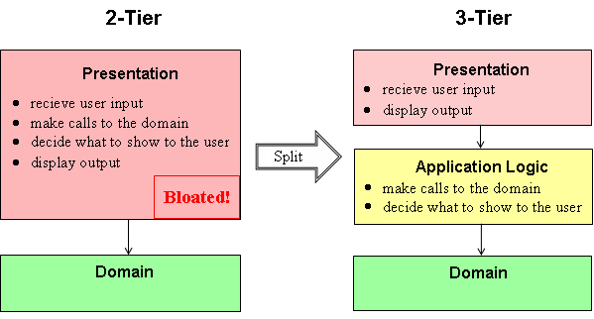
2 tier and 3 tier

Slide 9



Today’s IT Company
We are professional software developer and we build complex, large scale websites with a team of developers
8866080550 www.trinfotips.com

Slide 10
MVC
Model View Controller
Model–view–controller (MVC) is a software pattern for implementing user interfaces.
8866080550 www.trinfotips.com

Slide 11
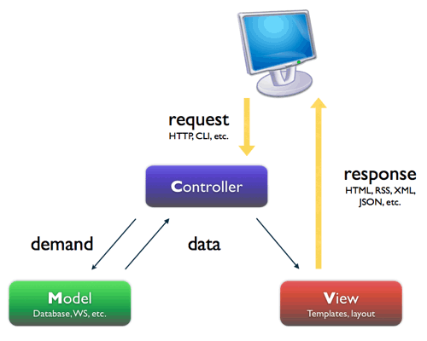
MVC
8866080550 www.trinfotips.com

Slide 12
MVC
Model
Implement the logic of the application
Classes that represent the data of the application and that use validation logic to enforce business rules for that data.
It's like our normal classes with getter/setter properties.
Classes that represent the data of the application and that use validation logic to enforce business rules for that data.
8866080550 www.trinfotips.com

Slide 13
MVC
Views
Display data and present the UI
Template files that your application uses to dynamically generate HTML responses.
.cshtml coding file.
8866080550 www.trinfotips.com

Slide 14
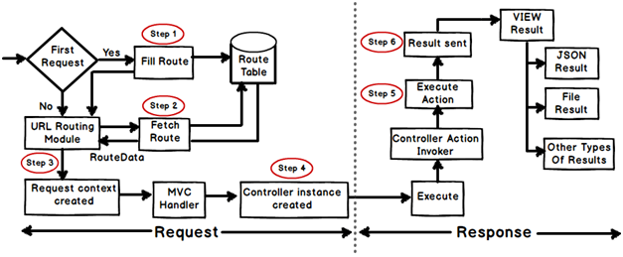
Life Cycle

Slide 15
Life Cycle
Asp.net Routing is the first step in MVC request cycle.
Basically it is a pattern matching system that matches the request’s URL against the registered URL patterns in the Route Table.
When a matching pattern found in the Route Table, the Routing engine forwards the request to the corresponding IRouteHandler for that request.
The default one calls the MvcHandler. The routing engine returns a 404 HTTP status code against that request if the patterns is not found in the Route Table

Slide 16
Step 1 : Fill Route
MVC requests are mapped to route tables which in turn specify which controller and action to be invoked.
So if the request is the first request the first thing is to fill the route table with routes collection.
This filling of route table happens in the global.asax file.

Slide 17
Step 2 : Fetch Route
Depending on the URL sent “UrlRoutingModule” searches the route table to create “RouteData” object which has the details of which controller and action to invoke.

Slide 18
Step 3: Request Context Created
The “RouteData” object is used to create the “RequestContext” object.

Slide 19
Step 3: Controller instance Created
This request object is sent to “MvcHandler” instance to create the controller class instance. Once the controller class object is created it calls the “Execute” method of the controller class.

Slide 20
Step 5: Creating Response Object
This phase has two steps executing the action and finally sending the response as a result to the view.

Slide 21
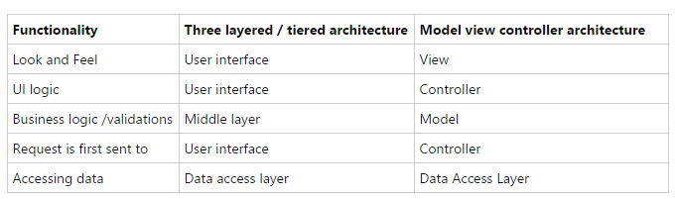
Is MVC different from a three layered architecture?

Slide 22
New in MVC 6?
ASP.NET MVC and Web API has been merged in to one.
Dependency injection is inbuilt and part of MVC.
Side by side - deploy the runtime and framework with your application
Everything packaged with NuGet, Including the .NET runtime itself.
New JSON based project structure.
No need to recompile for every change. Just hit save and refresh the browser.
Compilation done with the new Roslyn real-time compiler.
vNext is Open Source via the .NET Foundation and is taking public contributions.
vNext (and Rosyln) also runs on Mono, on both Mac and Linux today.

Slide 23
MVC
Controllers
It's like main function() of C language where coding execution will start according to event raised.
Classes that handle incoming browser requests, retrieve model data, and then specify view templates that return a response to the browser.
Handle user interactions, work with models and select next view to display
8866080550 www.trinfotips.com

Slide 24
How Call done?
The user enters in the browser some URL that is sent to the server, e.g., http://localhost/Product/List.
The user request is analyzed by the framework in order to determine what controller should be called.
The Controller takes the parameters that the user has sent, calls the model to fetch some data, and loads the model object that should be displayed.
The Controller passes the model object to the view.
The View gets data from the model, puts it into the HTML template, and sends the response back to the user browser.
The browser shows the HTML that is received from the server.

Slide 25
View Engine
The view engine is responsible for creating HTML from your views.
Like ASP.NET .aspx <% %>
Views are usually some kind of mix-up of HTML and a programming language.
Razor
ASPX
Spark
NHaml
NDjango
Brail
Hasic
8866080550 www.trinfotips.com

Slide 26
Razor - View Engine
MVC 3.
It’s not a programming language but uses C# syntax for embedding code in a page without the ASP.NET delimiters: <%= %>.
Razor using an @
Cshtml , vbhtml
8866080550 www.trinfotips.com

Slide 27
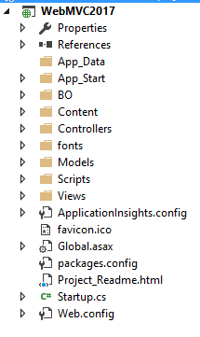
Folders

Slide 28
App_Data
App_Data folder is for storing application data.

Slide 29
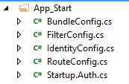
App_Start
This folder contains all the files which are needed during the application load.

Slide 30
App_Start
BundleConfig.cs
This is used to create and register bundles for CSS and JS files.
By default, various bundles are added in this files including jQuery, jQueryUI, jQuery validation, Modernizr, and Site CSS.
Difference between minified and uncompressed?
RouteConfig.cs
This is used to register various route patterns for your ASP.NET MVC application.
By default, one route is registered here named as Default Route.

Slide 31
App_Start
FilterConfig.cs
Our own logic
IdentifyConfig.cs
By default, one route is registered here named as Default Route.

Slide 32
App_Start
Startup.Auth.cs
By default, one route is registered here named as Default Route.

Slide 33
Razor – Syntax Rule
Razor code blocks are enclosed in @{ ... }
Inline expressions (variables and functions) start with @
Code statements end with semicolon
Variables are declared with the var keyword
Strings are enclosed with quotation marks
8866080550 www.trinfotips.com

Slide 34

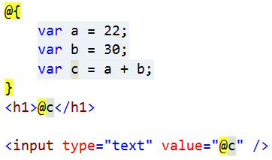
Razor – Coding Syntax
8866080550 www.trinfotips.com

Slide 35
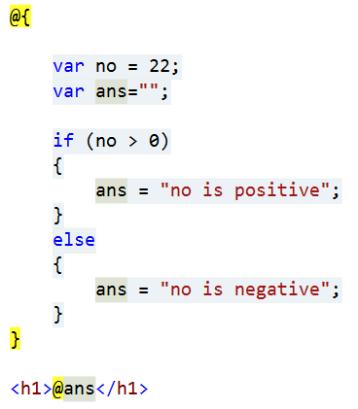
Razor – Coding Syntax
8866080550 www.trinfotips.com

Slide 36
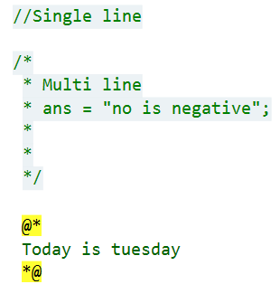
Razor – Coding Syntax
8866080550 www.trinfotips.com

Slide 37
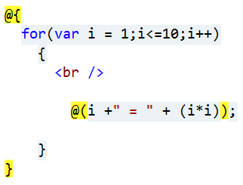
Razor – Coding Syntax
8866080550 www.trinfotips.com

Slide 38
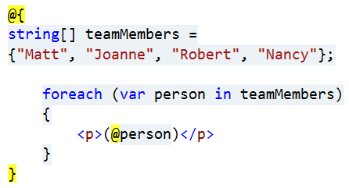
Razor – Coding Syntax
8866080550 www.trinfotips.com

Slide 39
Razor – Coding Syntax
Content
@:
<text></text>
8866080550 www.trinfotips.com

Slide 40
Steps
Step 1: Create New WebApplication –Select MVC – Add new Control
Step 2: Now Give Name
Step 3: Add HelloWolrd Contoller
public String About()
{
return "Hello World";
}

Slide 41
Now create Controller
Add Three Views Index, About ,Contact
Create module
Student module
public int StudentId { get; set; }
public String LastName { get; set; }
public String FirstName { get; set; }
public int Fees { get; set; }

Slide 42
Create object in Index
Create object and set properties and
return View(s1);

Slide 43
Create object in Index.cshtml
@model WebApplication1Practise.Models.Student
@model ProjectName.Models.Classname
<h3>@Model.FirstName</h3>
<h3>@Model.LastName</h3>
<h3>@Model.Fees</h3>
<h3>@Model.StudentId</h3>

Slide 44
List control
List<Student> iListStudent = new List<Student>();
iListStudent.Add(s1);
iListStudent.Add(s2);
iListStudent.Add(s3);
iListStudent.Add(s4);
return View(iListStudent);

Slide 45
Now sending List from Controller
List<Student> iListStudent = new List<Student>();
iListStudent.Add(s1);
iListStudent.Add(s2);
iListStudent.Add(s3);
iListStudent.Add(s4);
return View(iListStudent);

Slide 46
Getting List in View
@model IEnumerable<WebApplication1Practise.Models.Student>
<table border='2'><tr><td>Id</td><td>Name</td><td>Fees</td></tr>
@foreach(var item in Model)
{
<tr><td>@item.StudentId</td><td>@item.FirstName </td><td>@item.Fees </td></tr>
}
</table>

Slide 47
Sharing Data
As a strongly typed model object.
As a dynamic type - @model dynamic
ViewData
ViewBag
TempData

Slide 48
ViewData
ViewData is a Dictionary object that is derived from ViewDataDictionary Class.
ViewData is used to pass data from controller to corresponding view.
It allows an object to have properties dynamically added to it.
It's life is only during the current request.
It requires typecasting for complex data and check for null values to avoid error.
ViewData is derived from the ViewDataDictionary class and we can use the traditional "key-value" syntax
ViewData is a dictionary object in which we can store the data. The data then will be accessed from the view.

Slide 49
ViewData- Syntax
ViewData[“A"]=”Ram“;
string name = ViewData["A"].ToString();

Slide 50
ViewData in Controller
public ActionResult GetViewData()
{
ViewData["Fname"] = "Ram Patel";
ViewData["CurrentData"] = System.DateTime.Now;
return View();
}

Slide 51
ViewData in View
@{
var name = ViewData["Fname"];
}
<h2>GetViewData</h2>
<h1>@name</h1>
<h2>@ViewData["CurrentData"]</h2>

Slide 52
ViewData in Controller
public ActionResult GetViewData3()
{
Student s1 = new Student();
s1.StudentId = 5;
s1.FirstName = "Alax";
s1.LastName = "Patel";
s1.Fees = 21000;
ViewData["CurrentDate"] =System.DateTime.Now;
ViewData["MSg"] = "Welcome !!!!";
ViewData["Stu"] = s1;
return View();
}

Slide 53
ViewData in View
@{
ViewBag.Title = "GetViewData3";
var student = ViewData["Stu"] as WebApplication1Practise.Models.Student;
}
<h2>GetViewData3</h2>
<h2>Name @ViewData["CurrentDate"]</h2>
<h2>@student.StudentId </h2>
<h2>@student.FirstName </h2>
<h2>@student.LastName </h2>
<h2>@student.Fees</h2>

Slide 54
ViewBag
ViewBag.Uname = “SomeData“;
Uname was not a property of ViewBag object. It is added dynamically to it.
ViewBag is a property of ControllerBase class.
It’s life also lies only during the current request.
If redirection occurs then it’s value becomes null.
It doesn’t required typecasting for getting data.

Slide 55
ViewBag in View
ViewBag.Countries = new List<String>()
{
"India","UK","USA","Canda"
};

Slide 56
ViewBag in Controller
<h2>GetViewBag</h2>
<ul>
@foreach (string strCounty in ViewBag.Countries)
{
<li>@strCounty</li>
}
</ul>

Slide 57
ViewBag in View
ViewData["Countries"] = new List<String>()
{
"India","UK","USA","Canda"
};
return View();

Slide 58
ViewBag in Controller
<ul>@foreach(string strCountry in (List<String>)ViewData["Countries"])
{
<li>@strCountry</li>
}
</ul>

Slide 59
DrawBacks
Please note that to pass data from Controller to View, It’s always a good practice to use strongly typed view models instead of using ViewBag & ViewData.
The major advantage is that it provides Compile time error checking.

Slide 60
TempData
TempData is a property of ControllerBase class.
TempData is used to pass data from current request to subsequent request (means redirecting from one page to another).
It’s life is very short and lies only till the target view is fully loaded.
It’s required typecasting for getting data and check for null values to avoid error.
It is used to store only one time messages like error messages, validation messages.

Slide 61
TempData
public ActionResult StudentSet()
{
var obj=new Student()
{
FirstName="Lalita",
Fees =21000,
LastName="Patel"
};
TempData["Stu"] = obj;
return RedirectToAction("StudentDetails");
}
public ActionResult StudentDetails()
{
var model = TempData["Stu"];
return View(model);
}

Slide 62
WebGrid
Automatically sets up an HTML table to display data
Supports different options for formatting
Supports paging through data
Supports Sorting by clicking on column headings

Slide 63
Model - CategoryDetailsModel
public CategoryDetailsModel()
{
_lstctg = new List<CategoryDetailsModel>();
}
public int CatID { get; set; }
public string CatName { get; set; }
public bool? IsDisplay { get; set; }
public bool? Gender { get; set; }
public List<CategoryDetailsModel> _lstctg { get; set; }

Slide 64
Index
public ActionResult Index()
{
CategoryDetailsModel ctgModel = new CategoryDetailsModel();
var getCat = (from t in _dbEntities.Categories select t).ToList();
foreach(var item in getCat)
{
CategoryDetailsModel ctg = new CategoryDetailsModel();
ctg.CatID = item.CatId;
ctg.CatName = item.CatName;
ctg.Gender = item.Gender;
ctg.IsDisplay = item.IsDisplay;
ctgModel._lstctg.Add(ctg);
}
return View(ctgModel);
}

Slide 65
WebGrid
Source – Where your data comes from. Usually the model passed by the controller action.
DefaultSort – Here you can define how the data will be sorted. Just provide the column name here.
RowsPerPage – Number of records that will be shown on table.
CanPage – Allows paging.
CanSort – Allows sorting by clicking on column title.
SelectedFieldName - Gets full name of the query-string field that is used to specify the selected row of theWebGrid instance.

Slide 66
WebGrid
@model MVC2014.Areas.Admin.Models.CategoryDetailsModel
@{
ViewBag.Title = "Index";
WebGrid wg = new WebGrid(source: Model._lstctg);
}

Slide 67
File upload
var file = Request.Files["file"];
Product model = new Product();
string path = Server.MapPath("~/proimg/");
file.SaveAs(path + file.FileName);
model.ProImg = file.FileName;
===============================================
string path = Server.MapPath("~/proimg/");
if (file.FileName!="")
{
file.SaveAs(path+file.FileName);
getproduct.ProImg = file.FileName;
}

Slide 68
File upload
grid.Column("ProImg", "Product Image", @<text><img src="@Url.Content("~/proimg/")@item.ProImg" height="80px" width="80px" /></text>),

