Slide 1
Twitter Sentiment Analysis
Presented by : Vatsala

Slide 2
Introduction
This project concerns with the analysis of tweets collected using the twitter tweepy API.
Any tweets with the work ”Ukraine” were collected using the Tweepy API.
The tweets were analyzed to know how majority of the people felt when they heard the word “Ukraine”.

Slide 3






Procedure

Slide 4
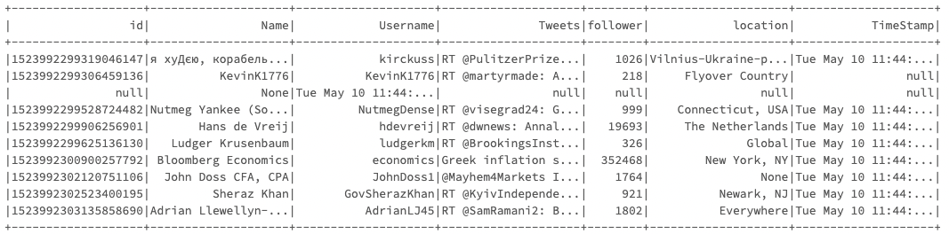
Dataset :
The dataset collected had the following information.

Slide 5
Tweets cleaning / Data cleaning - preprocessing
The tweets are cleaned using regex.
Tweet Cleaning using regex is done by removing :
Links (anything contained with http\)
RT (retweet tag); Any retweets can be removed or grouped as they lead to duplication
The tweets are brought to lowercase.
Any thing with @ sign is replaced with blank.
# are replaced with ‘’.
Tweets are trimmed.

Slide 6
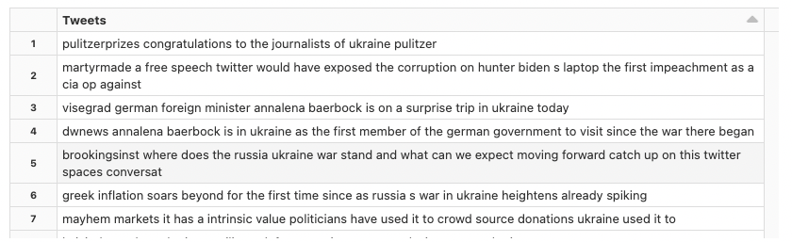
Result of data cleaning

Slide 7
Labelling tweets using TextBlob
The sentiment of the tweets is labelled using textblob.
This process is done for the ML algorithm to learn from the labelled tweets.
After that, in order to help the learning algorithm to analyze our tweets, the data is cleaned using Tokenizer, StopWordsRemover, CountVectorizer, HashingTF, StringIndexer

Slide 8

Fitting the model and testing it
Logistic Regression is used to learn from the data and predict the output from the test set.

Slide 9
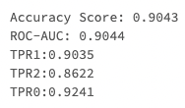
Model Evaluation
To evaluate how the model performs on our test set, the metrics that have been used are accuracy, ROI and true positive rate (TPR).

Slide 10
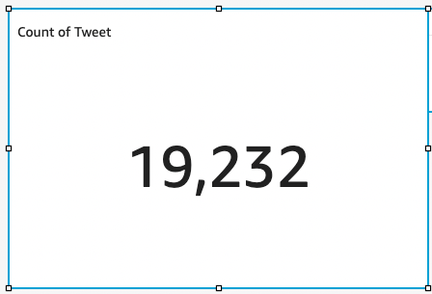
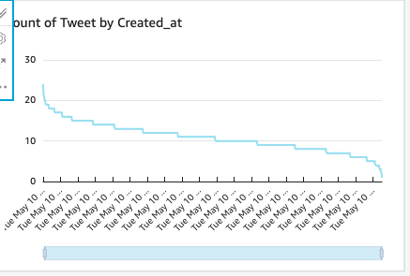
Results on Quicksight dashboard

Slide 11
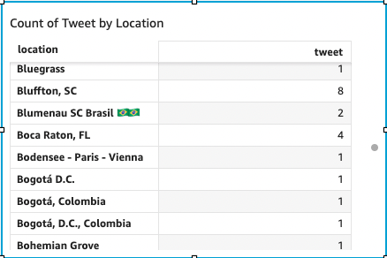
Results contd.
Count of Tweets by Location

Slide 12
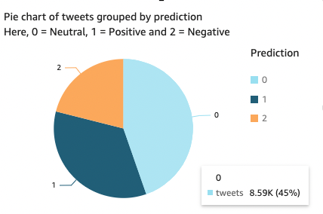
Results Contd.
From the datasets
On the full dataset, the sentiment analysis is carried out.
It is seen that majority of the tweets are neutral in state.
These tweets might contain facts, latest news or no stance on the war.
34% tweets are labelled with a positive sentiment.
21% tweets are labelled as negative

Slide 13
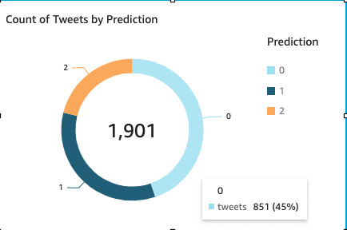
Results Contd.
From the predictions from the Logistic Regression model, 1901 tweets had these predictions

Slide 14
Summary
The tweets containing “Ukraine” were collected using the Tweepy API and analyzed using SparkML.
The order in which the sentiment regarding Ukraine appared on twitter were : Neutral, Positive and Negative
High accuracy was achieved with the LR model.
It is interesting to see how the number of tweets depended on the geographical location of the user.

