Slide 1
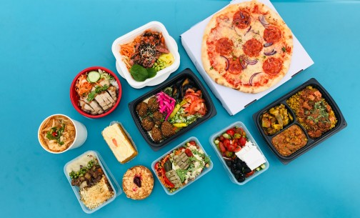

Restaurant Management System

Slide 2
Group Members
ROLL NO.​ | NAME​ | GR NO​
223060​ | Sohan Shinde​ | 21911133​
223064​ | Swaleha Kittur​ | 21911155​
223066​ | Aakanksha Thokare​ | 21910700​
223068​ | Vatsal Arya​ | 21911193​

Slide 3

CONTENTS
Objectives
Introduction/Theory
Conclusions
Future scope
References

Slide 4

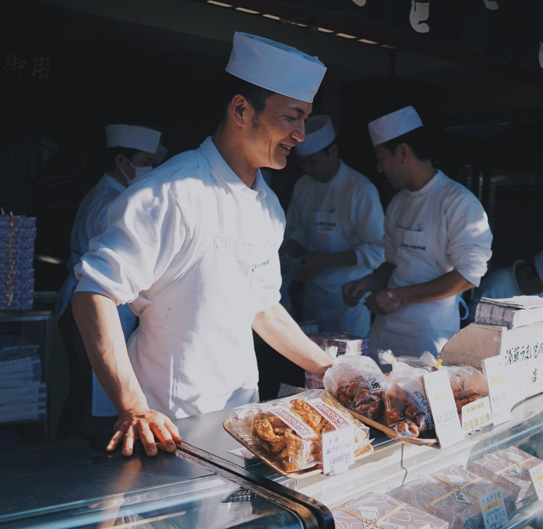
OBJECTIVES
Efficient food management system.
Using Python and MySql

Slide 5

Introduction/Theory
An increasing interest in online ordering has been witnessed and therefore
Restaurants need to have good management system
Requirement of rank-ordering objects
Thus we have made Restaurant management system using :
1)Python 2)MySql

Slide 6
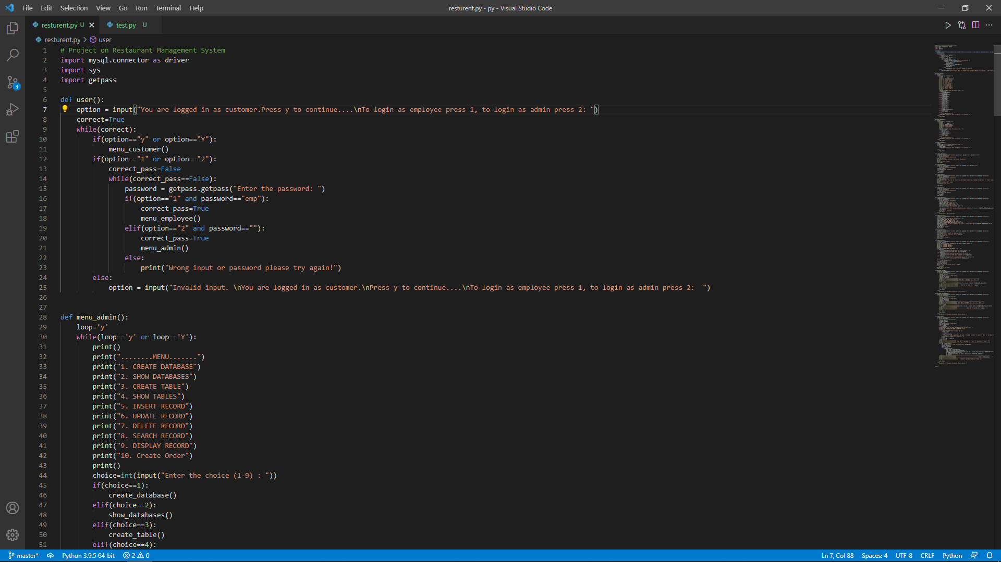

Slide 7
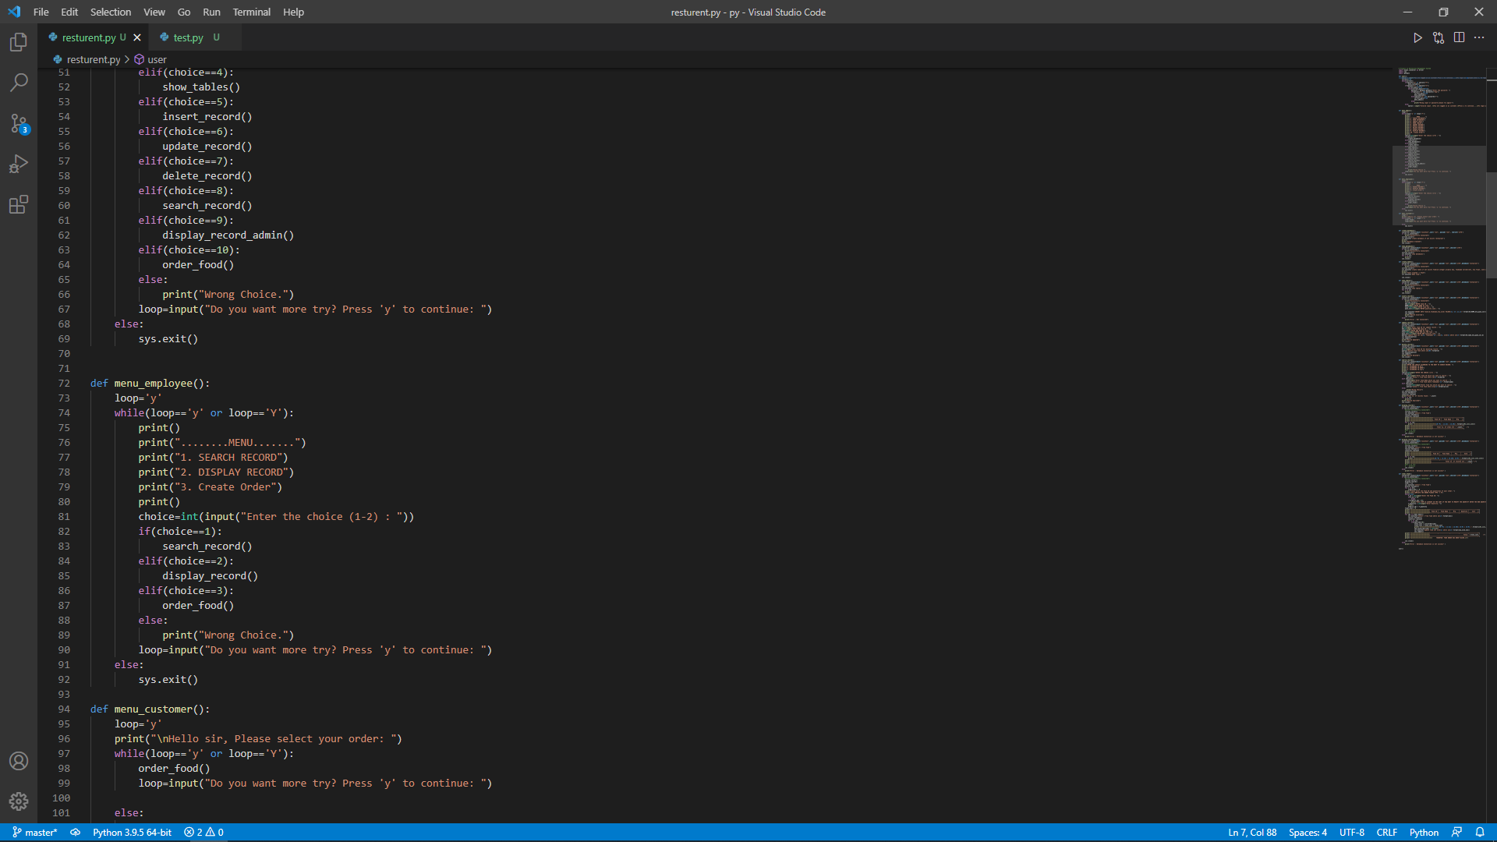

Slide 8
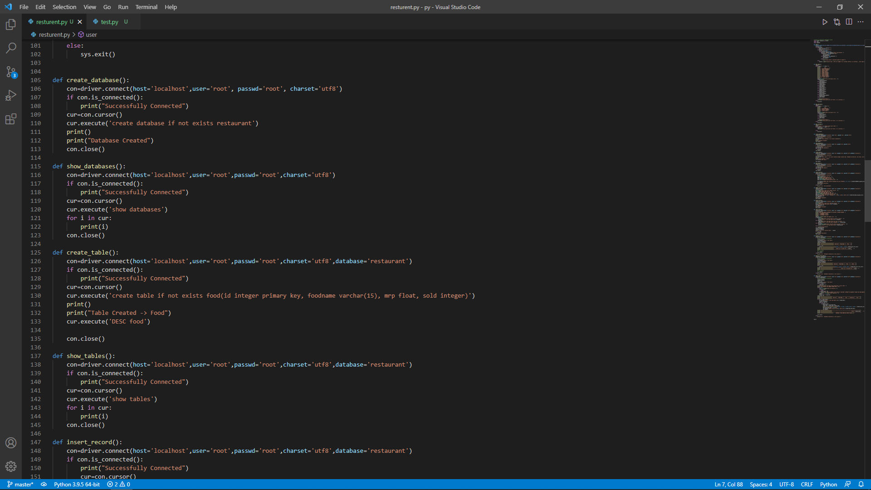

Slide 9
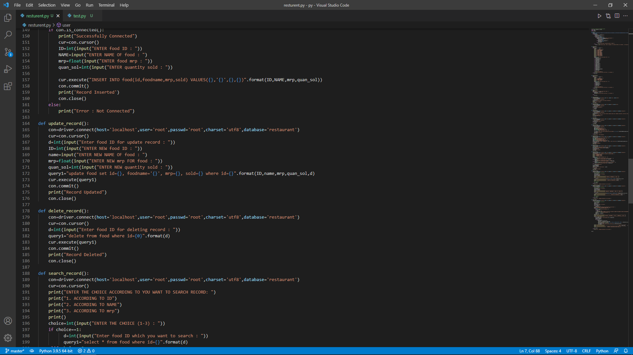

Slide 10
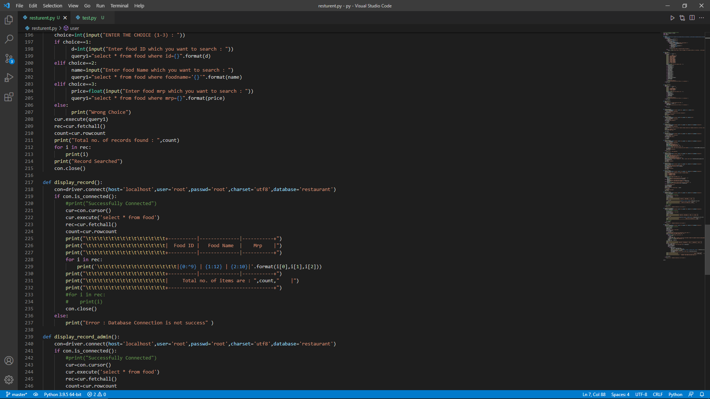

Slide 11
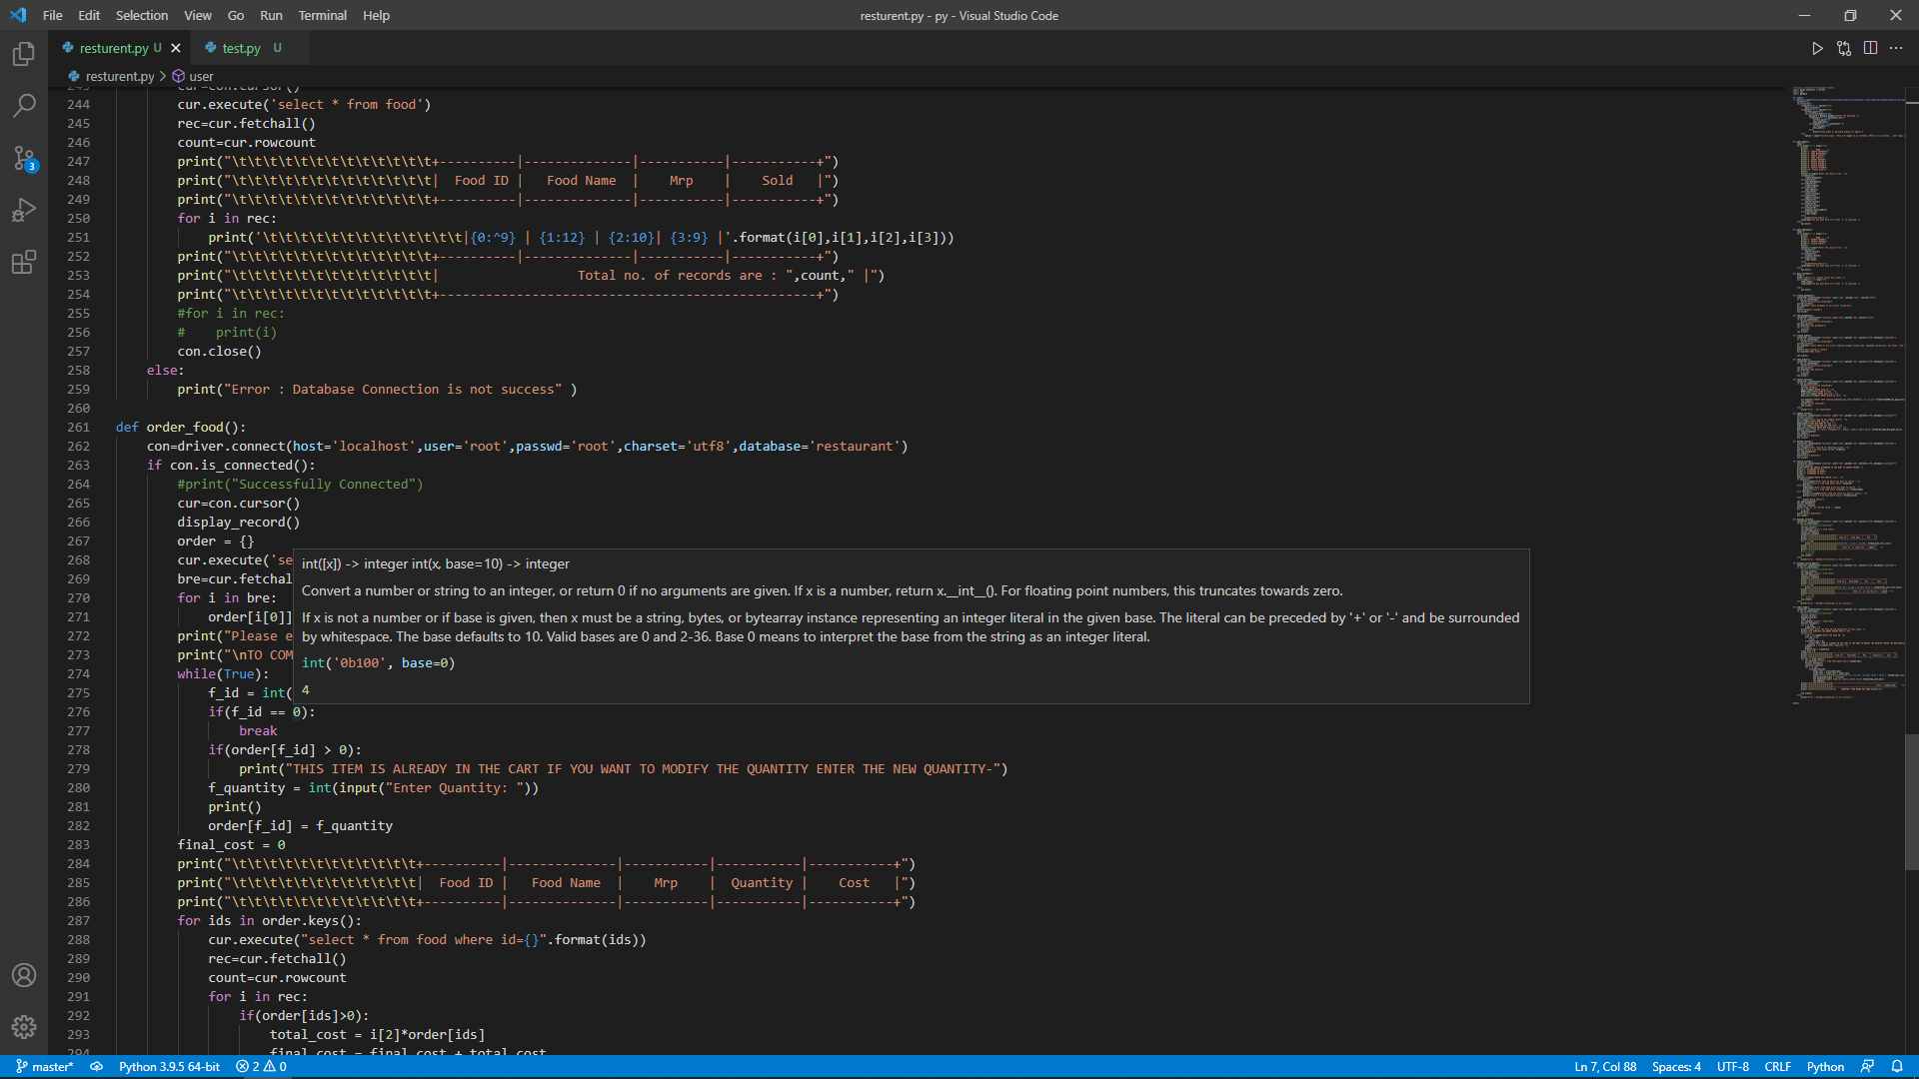

Slide 12
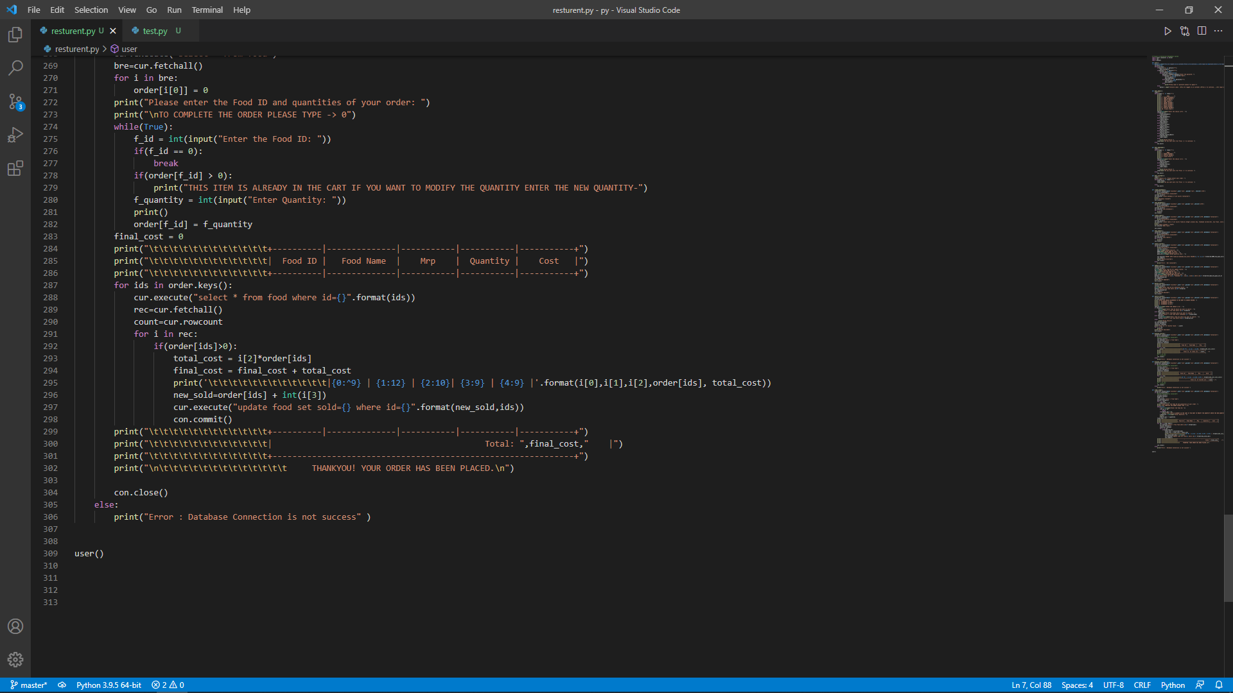

Slide 13
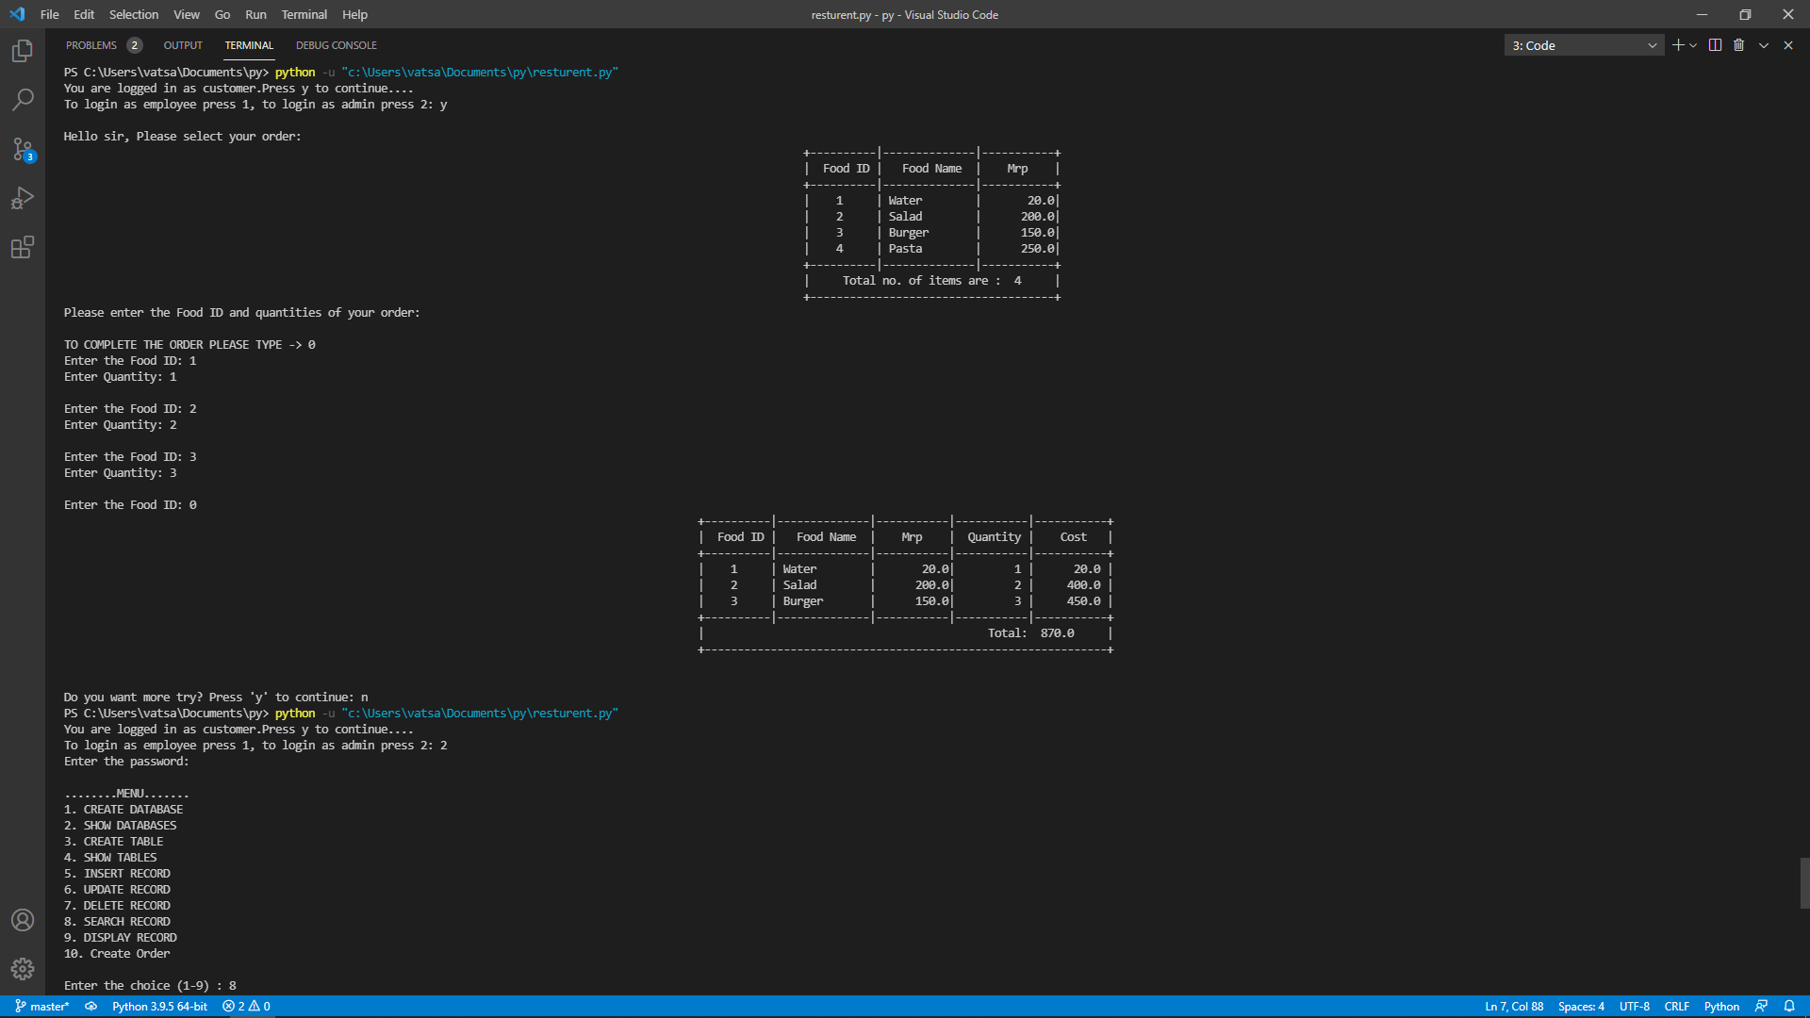

Slide 14
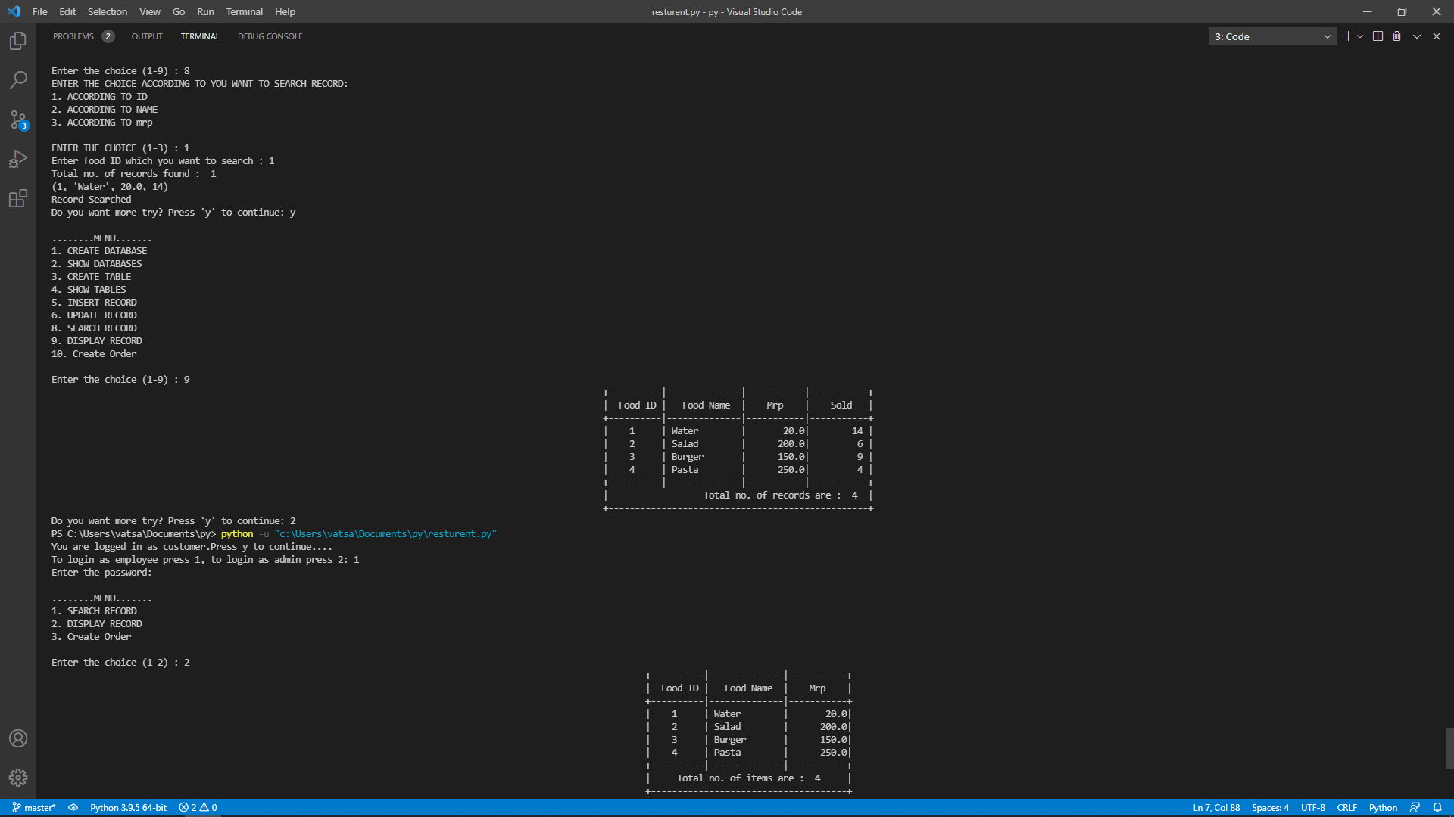

Slide 15
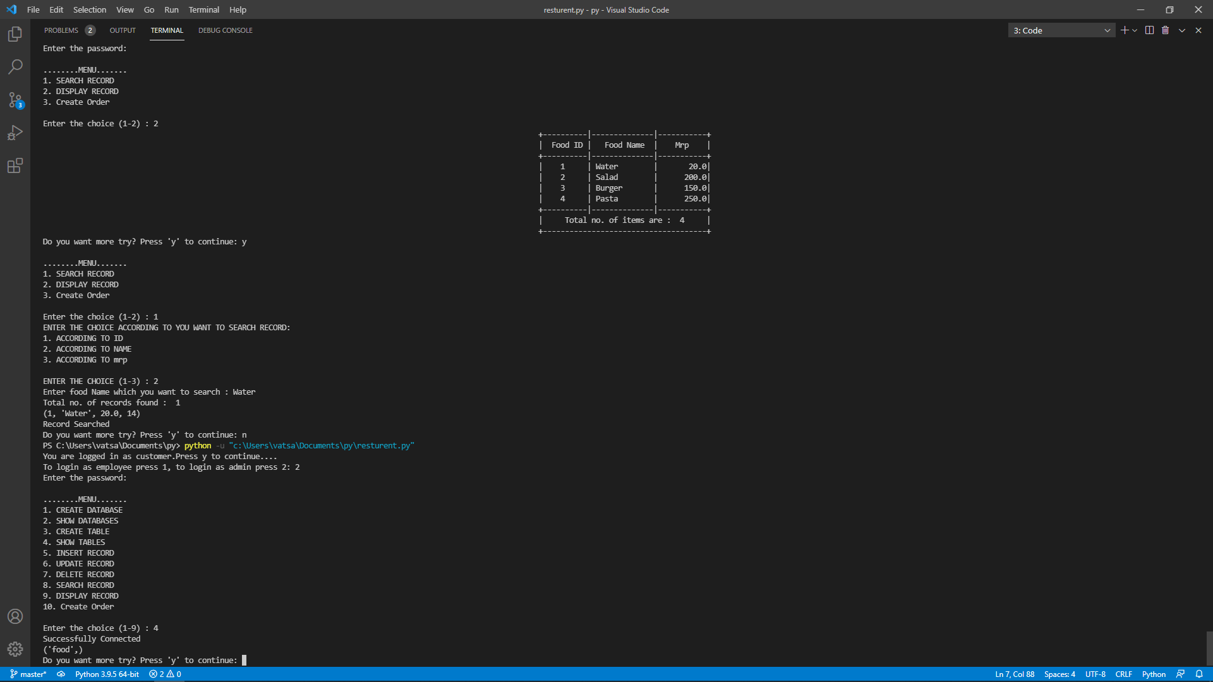

Slide 16
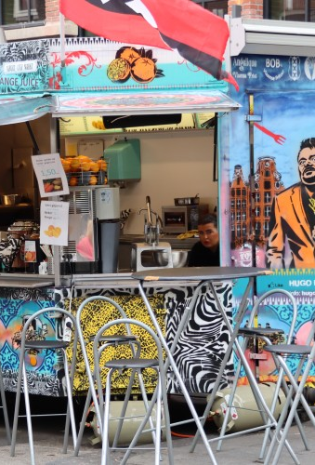
Conclusions
Multi-criteria filtering
Helps restaurants
Fast edit and search
MySql is efficient
Sorted items

Slide 17
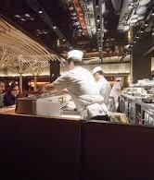
Future scope
Easy to find food
Reduce search for applications
Simple to use
Help all hotel owner

Slide 18
References
https://wcaler.com/event/build-your-first-website-all-on-your-own-3?rcy=1&rce=aa65575473fdww.s
https://www.geeksforgeeks.org/how-to-become-a-web-developer-in-2020-a-complete-guide/amp/
https://youtu.be/uqTxqvqvjC8
https://youtu.be/8pJ7lJNiGkA
https://www.kaggle.com/gspmoreira/recommender-systems-in-python-101
https://youtu.be/2Y2lcVnMkZI
https://www.youtube.com/watch?v=EkZBLuIfwzo
https://www.youtube.com/watch?v=PGlJFy7oinw&t=196s
https://support.wix.com/en/article/embedding-custom-code-to-your-site
https://youtu.be/YWA-xbsJrVg
https://youtu.be/tuu0D1izrUU
https://datasetsearch.research.google.com/ search?query=Food%20recommendation%20dataset%20&docid=SAejiTSs5Z1eDiSUAAAAAA%3D%3D

Slide 19
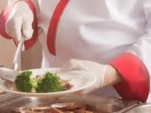
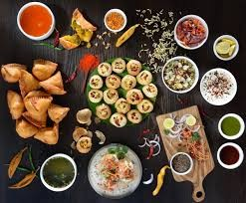
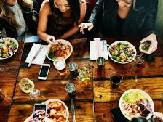
Thank You !!!

