Slide 1
EEG-based Biometric Authentication
using Deep Learning
Guide: Prof. Kriti Srivastava
Palash Rathod | 60004170076
Parag Vaid | 60004170077
Siddharth Sanghavi | 60004170108

Slide 2
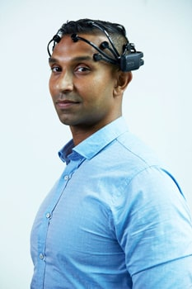
What is EEG?
An Electroencephalogram (EEG) is the electrical activity of your brain.
Each person has a unique combination of biological brain structure and involuntary memory.
This makes EEG unique, universal, secure and reliable for every individual.

Slide 3
Problem Statement
Our project aims at creating a Biometric Recognition Framework for individuals based on their EEG signals.
We aim to tackle two problems:
If Biometrics are forged/stolen, then how to generate multiple unique Biometrics.
Limited availability of labelled data for training a neural network.

Slide 4
Pros of EEG over Existing Biometrics
Once the Biometric such as a fingerprint, an iris or a face is stolen, it simply becomes useless.
EEG-based Biometrics can be used again and again to generate infinitely unique Biometric for different stimuli.

Slide 5
Comparison with Existing Biometrics
 | Signature | Fingerprint | Face | Iris | EEG
Unique | M | H | M | H | H
Universal | L | M | H | H | H
Secure | L | H | M | M | H
Reliable | M | H | M | H | H
Permanent | M | H | M | H | H
Performance | M | M | L | H | H

Slide 6
One-Shot Learning
Existing implementations use a traditional ML/DL classification model for identifying/authenticating a person.
Current approaches do not solve the One-Shot Learning problem.

Slide 7
One-Shot Learning
ML/DL Classification algorithms require training on hundreds or thousands of samples/images and very large datasets.
One-shot Learning aims to learn information about object categories from one, or only a few, training samples/images.

Slide 8
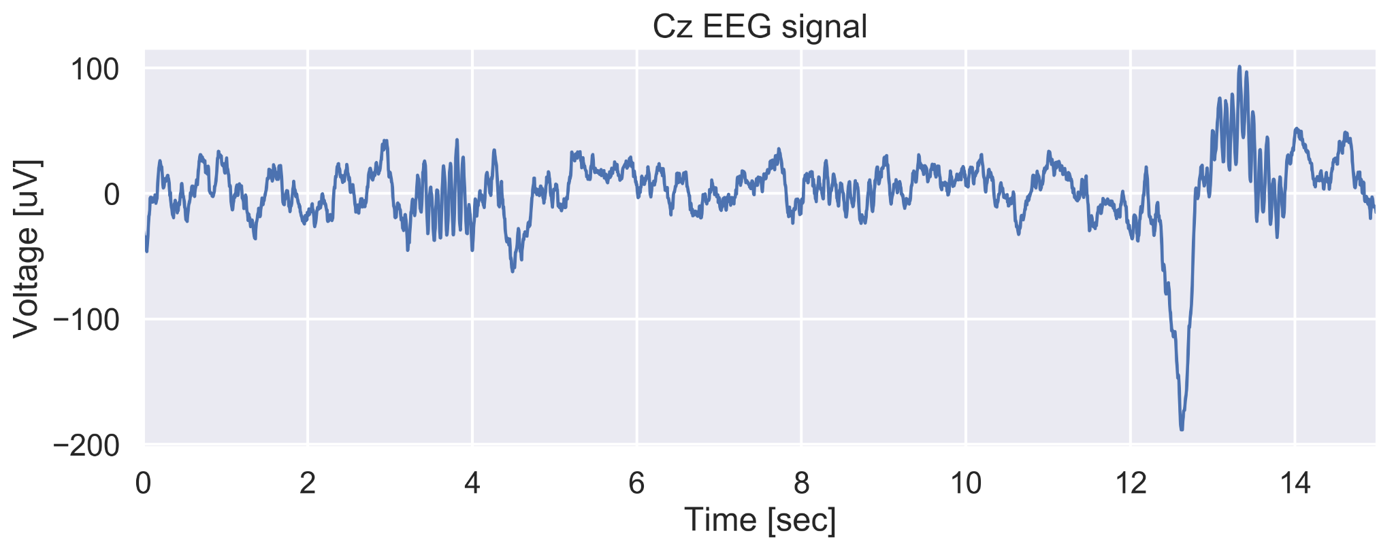
Representing EEG data with Spectrograms

Slide 9
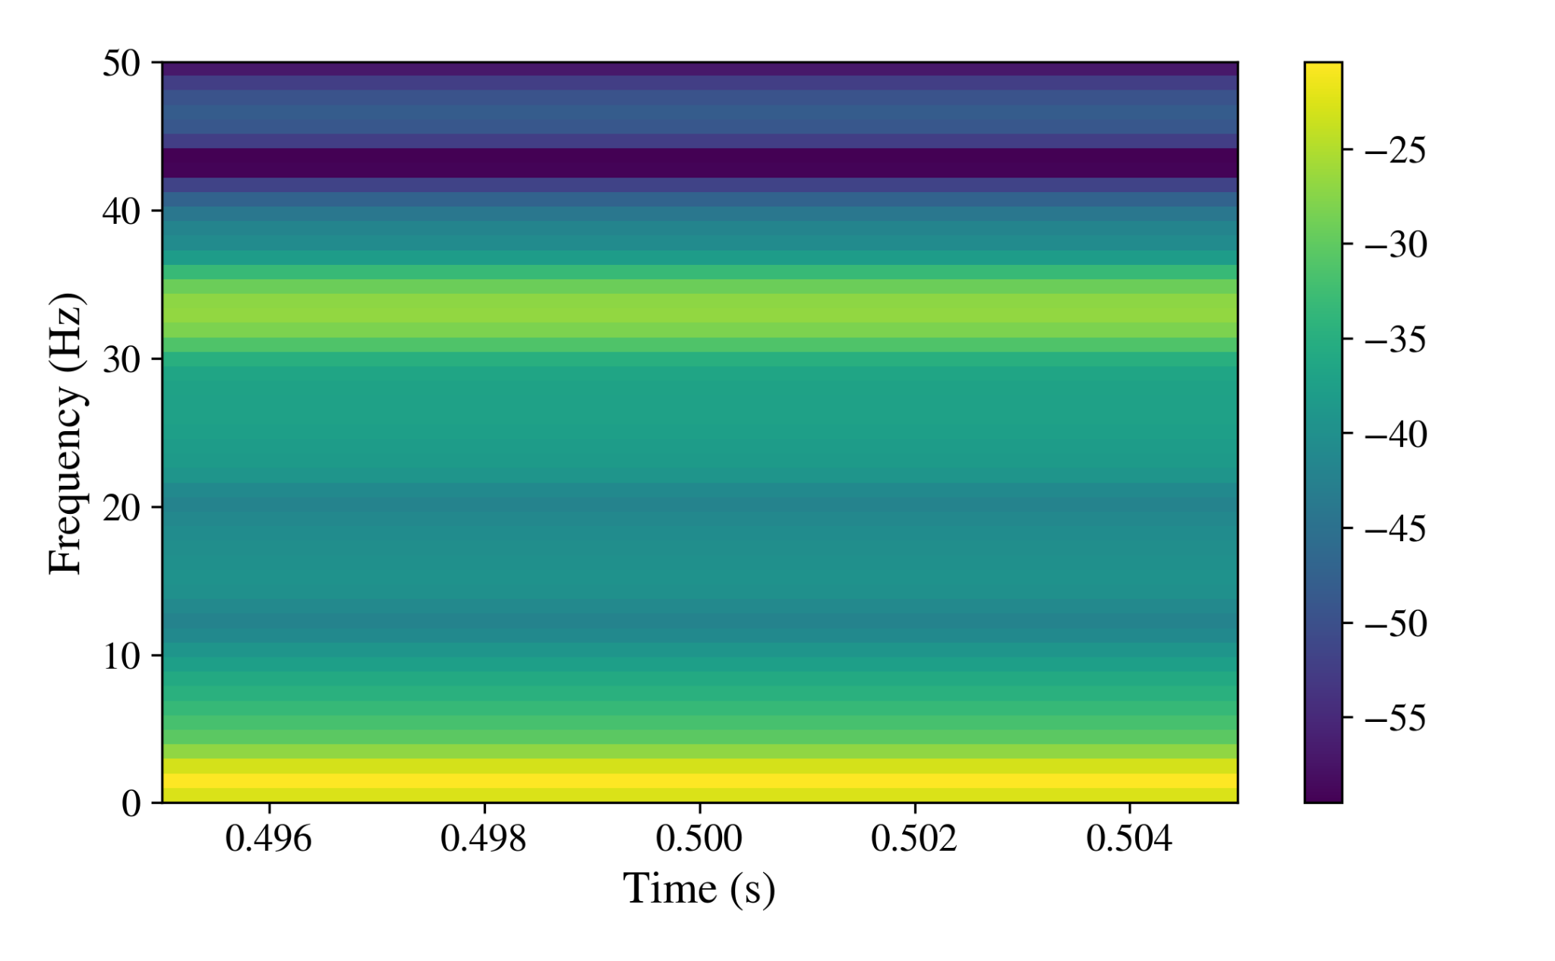
Representing EEG data with Spectrograms
A spectrogram is a visual way of representing the loudness/strength of a signal over time at various frequencies.
X-axis represents time
Y-axis represents frequency
3rd dimension is amplitude which is color coded.

Slide 10
Dataset Description
The dataset used in this project is the publicly available PhysioNet EEG Motor Movement/Imagery Database (EEGMMIDB).
The BCI2000 system was used to record 64-channel EEG recordings of 109 subjects, with each subject recording 14 experimental runs.

Slide 11
Dataset Description
The following mental task must be completed by the subject:
A target can be found at the top or bottom of the screen.
If the target is on top, the subject imagines opening and closing both fists.
If the target is on the bottom, the subject imagines opening and closing both feet, until the target vanishes.
The subject then begins to relax.

Slide 12
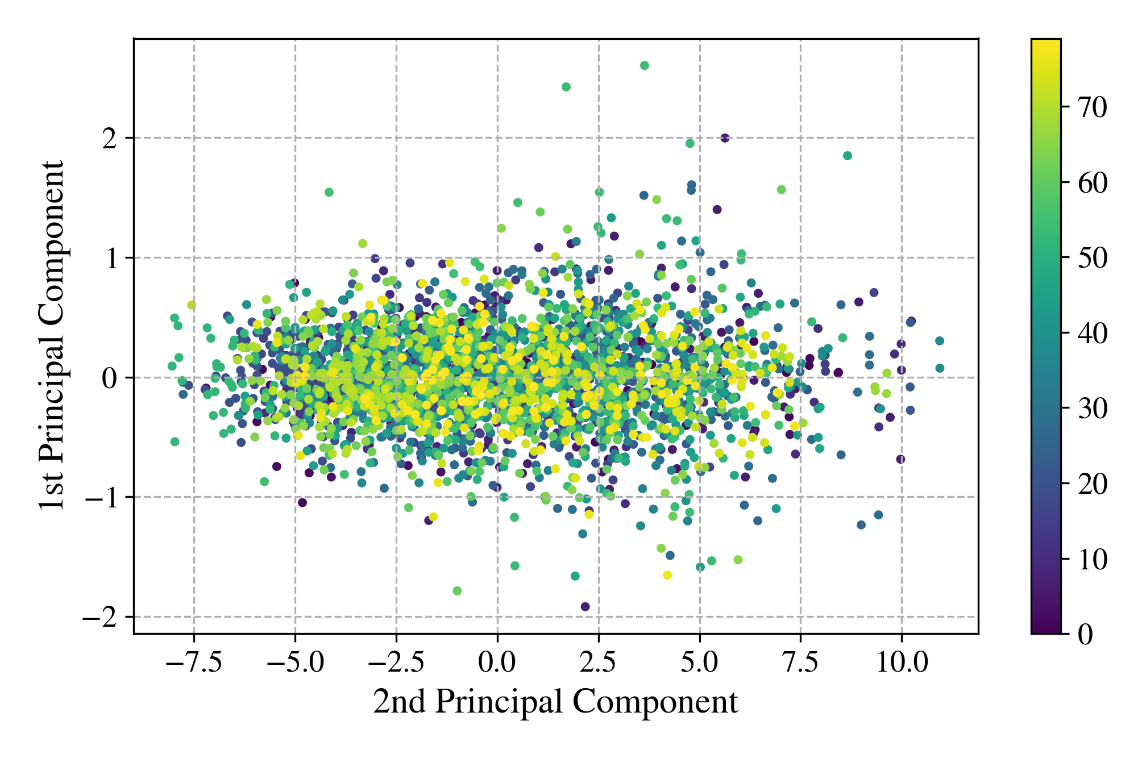
Dataset Visualization

Slide 13
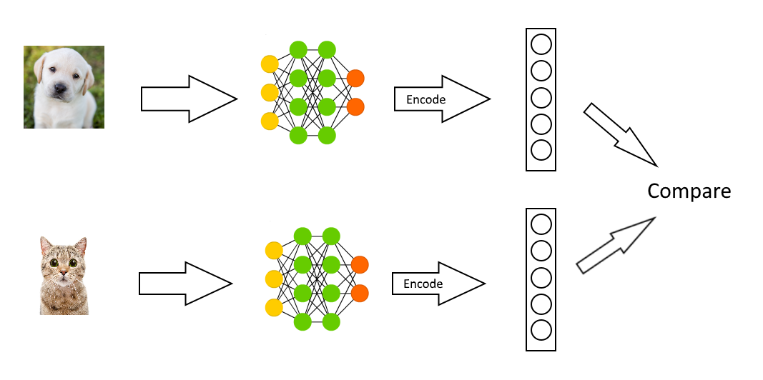
Siamese Neural Networks

Slide 14
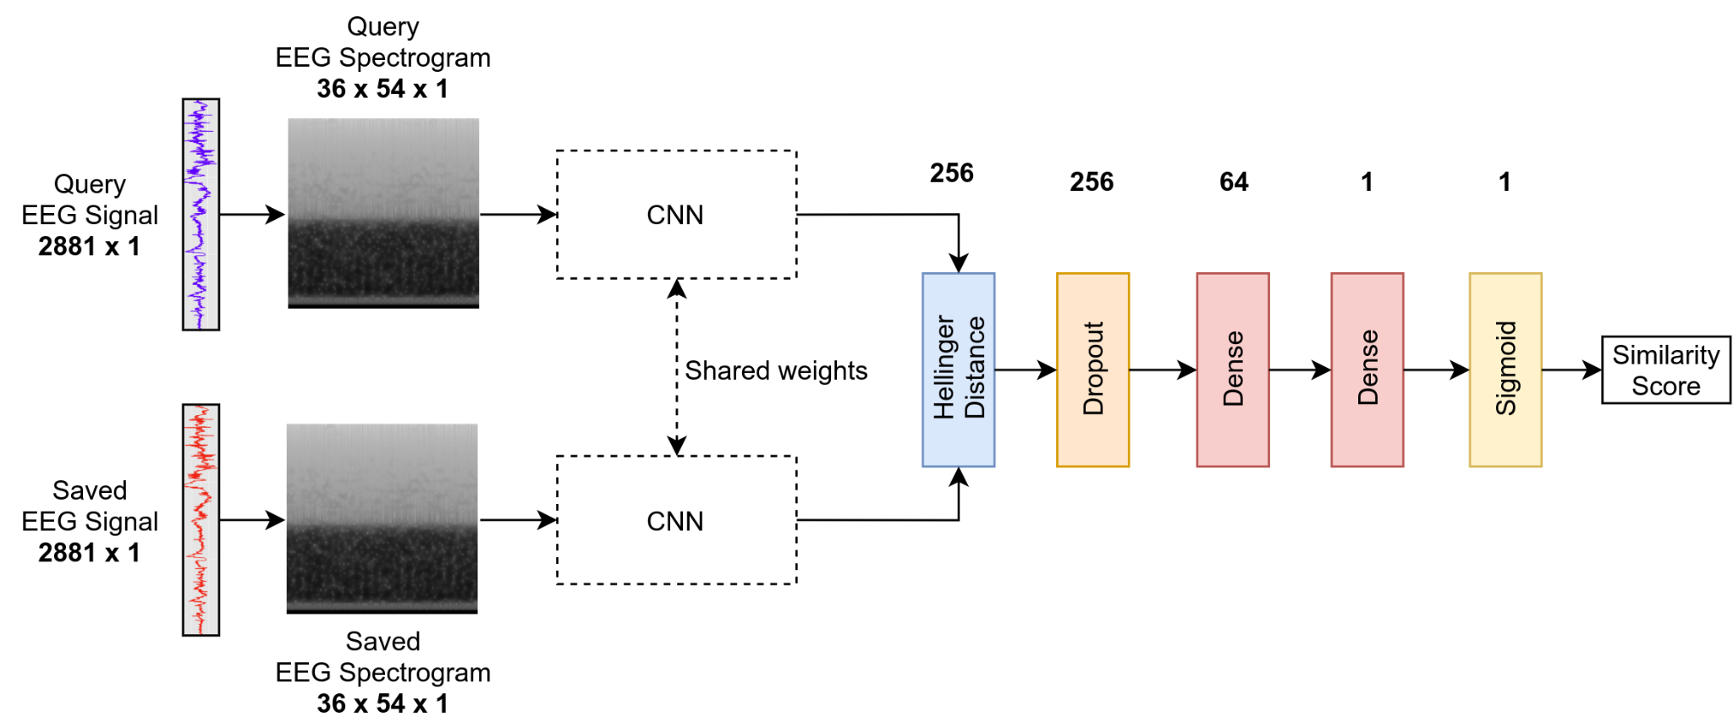
Proposed Model: SiamEEGNet

Slide 15
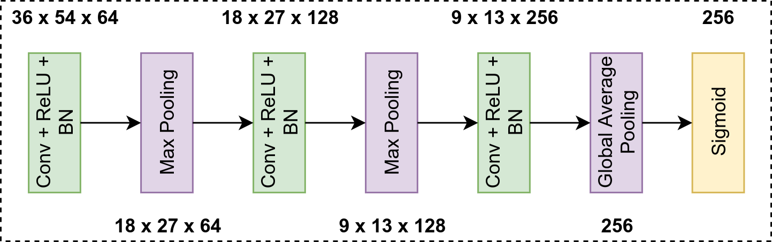
SiamEEGNet CNN Subnetwork

Slide 16
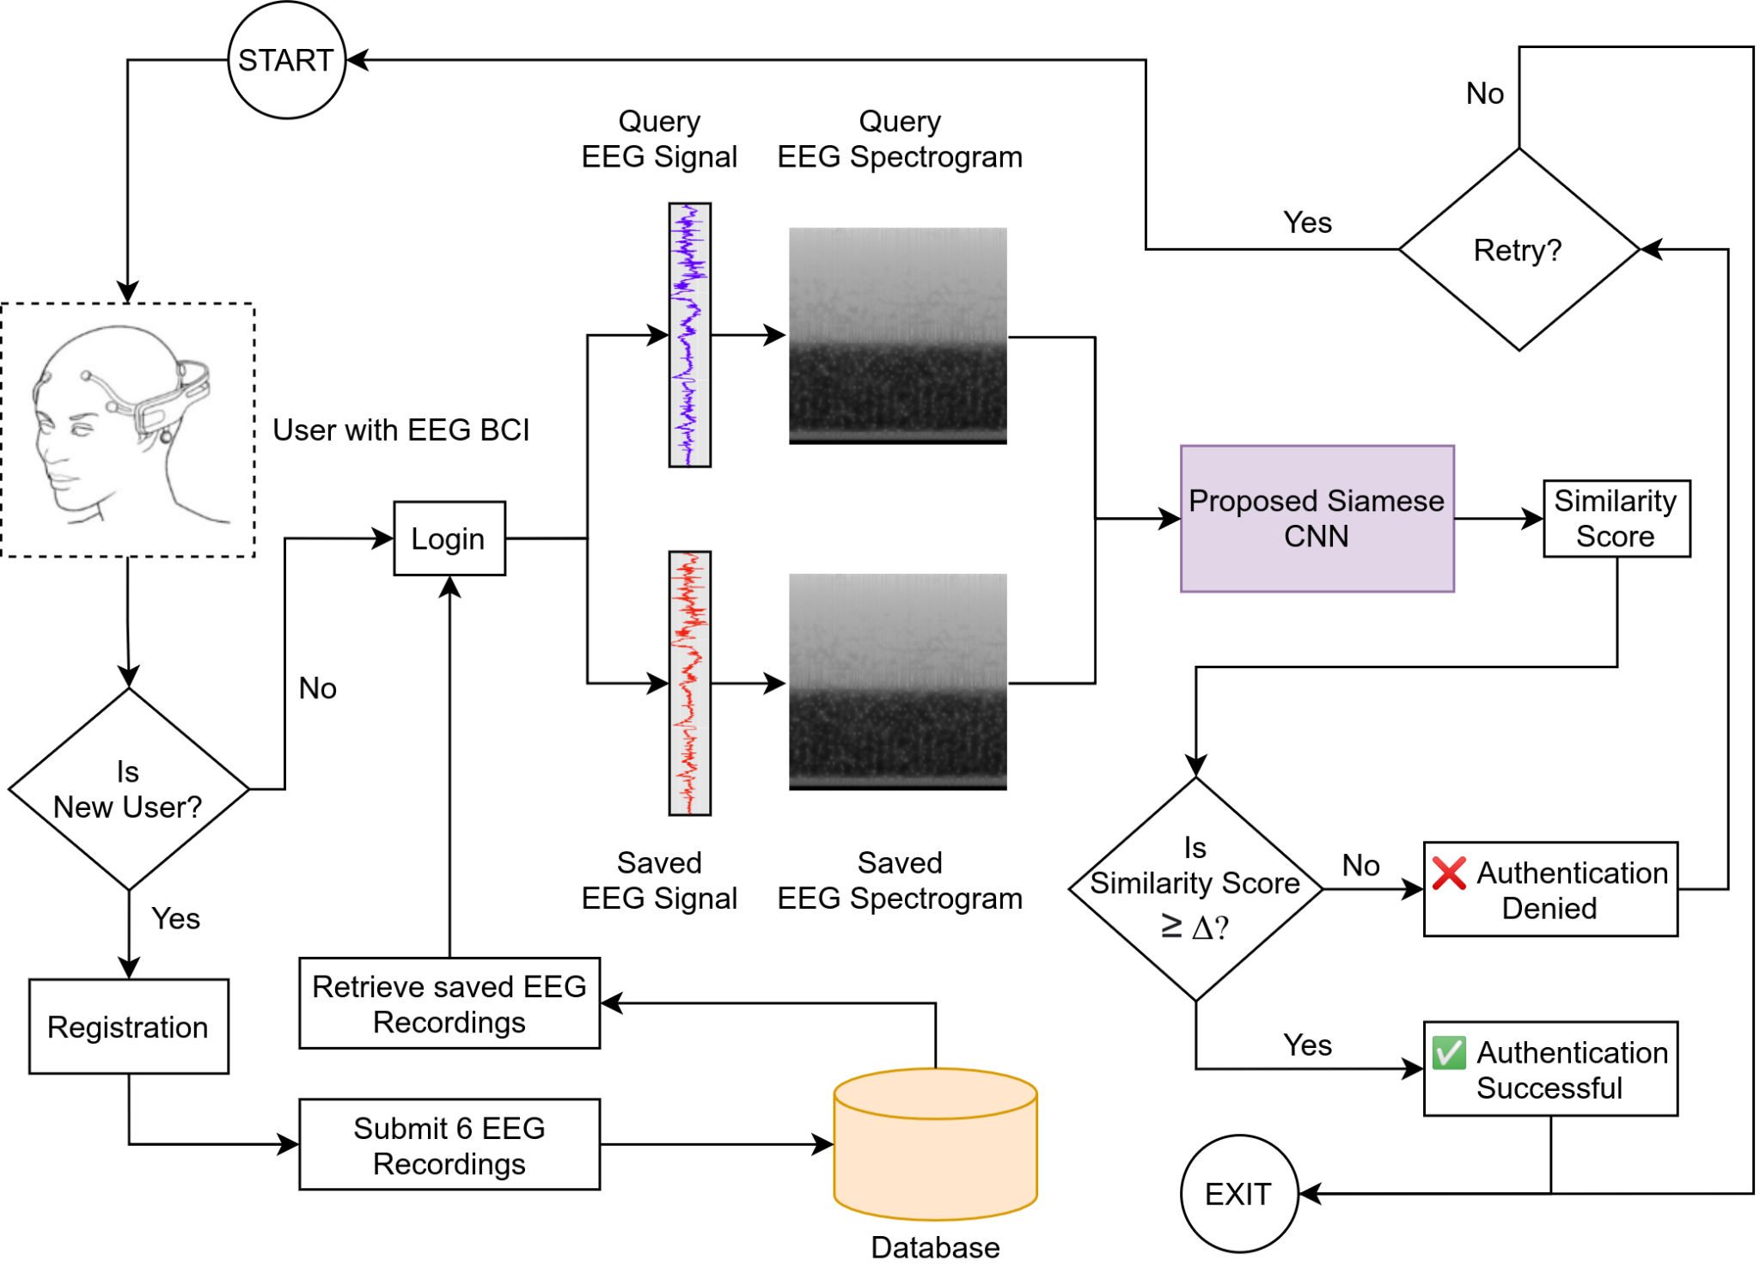
System Architecture

Slide 17
Biometric Tasks
Biometric Verification | Biometric Identification
Authenticating a user’s identity by matching a submitted biometric to see if it matches a specific database template. | Locating an unknown person’s name by comparing his or her live biometric samples with all templates previously stored in a system’s database.
1:1 matching | 1:N matching

Slide 18
Results: Classification Report
 | Precision | Recall | F1-score
Class Similar | 0.97 | 0.97 | 0.97
Class Dissimilar | 0.97 | 0.97 | 0.97
Accuracy | - | - | 0.97
Macro avg. | 0.97 | 0.97 | 0.97
Weighted Avg. | 0.97 | 0.97 | 0.97

Slide 19
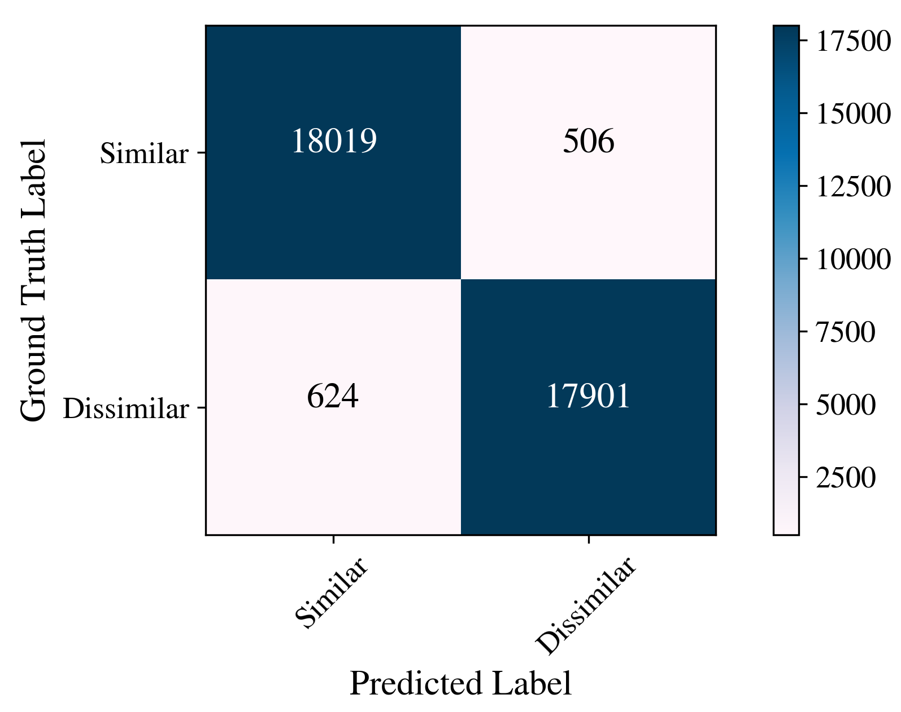
Results: Confusion Matrix

Slide 20
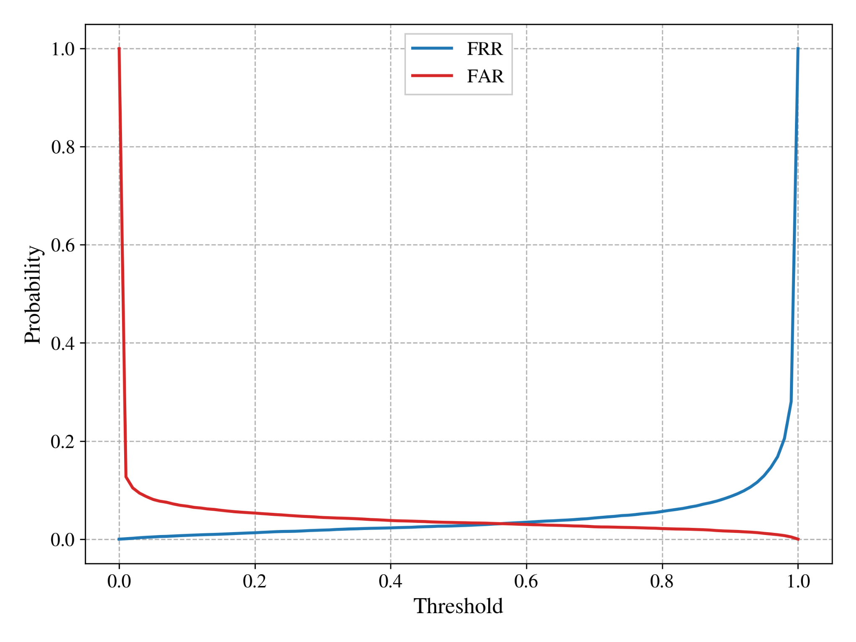


Results: FAR, FRR vs. Threshold
FA: no. of false acceptances
IA: no. of attempts by an impostor
FR: no. of false rejections
AA: no. of authorized attempts

Slide 21

Results: EER
FAR: False Acceptance Rate
FRR: False Rejection Rate
More the EER is near to 0, better is the performance of the Biometric system.
SiamEEGNet is able to obtain an EER of 0.0314 at a corresponding threshold of 0.552.

Slide 22
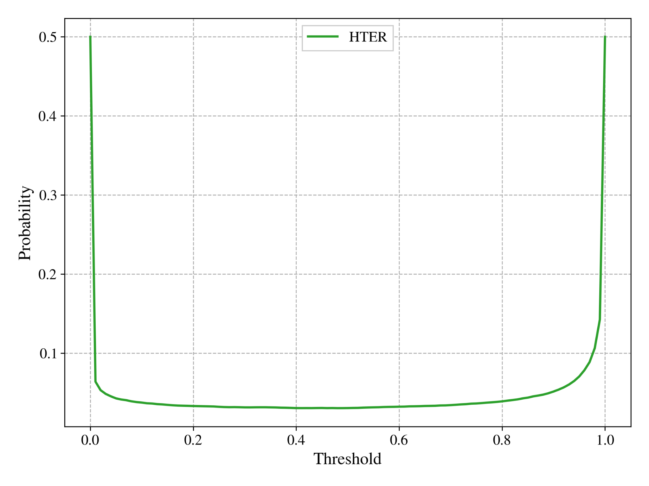

Results: HTER vs. Threshold
FAR: False Acceptance Rate
FRR: False Rejection Rate

Slide 23
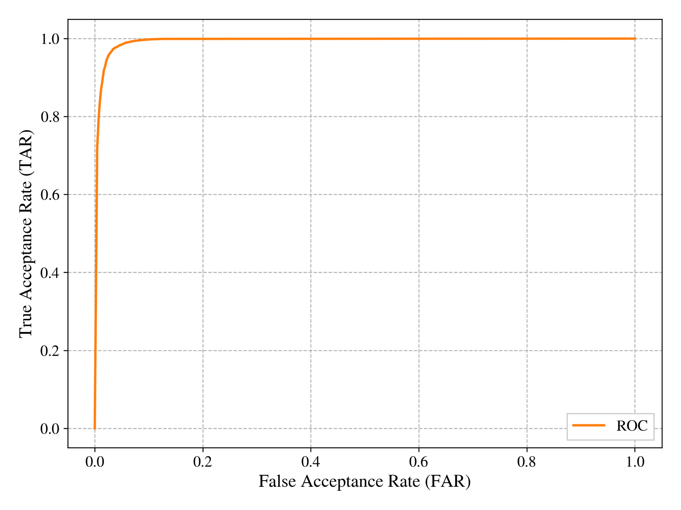
Results: ROC Curve
TAR = 1 - FRR
FRR: False Rejection Rate

Slide 24
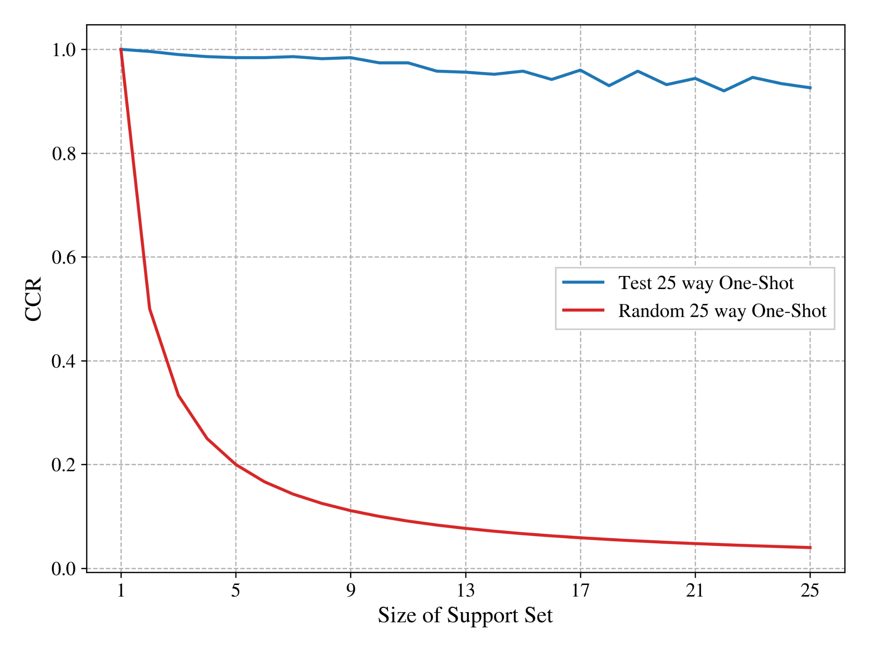
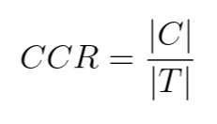
Results: Average CCR for 450 runs
C: No. of correct classification decisions
T: No. of trials

Slide 25
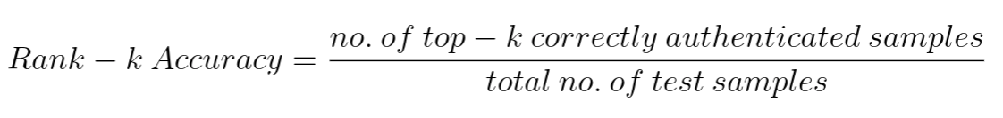
Results: Rank-k Accuracy
For 25 Subjects | Rank-1 | Rank-5
Mean | 0.972 | 1.0
Standard Deviation | 0.062 | 0.0

Slide 26
Conclusion
The project formulates the Biometric Recognition problem as a One-Shot Learning task allowing the proposed approach to be applied to novel data categories in the EEG domain without further training the model on new data which might be sparsely available or costly to annotate manually.
The entire Deep Learning pipeline was successfully executed and tested. Based on an extensive literature survey, no previous work known to the best of the authors’ knowledge has adopted a One-Shot Learning approach for EEG-based Biometric Recognition.

Slide 27
Future Scope
The Contrastive loss emphasizes on more absolute similarity values and hence gives less attention to inter-class and intra-class variations. Instead we could use the Triplet loss and the Triplet network proposed by Schroff et al. and Ye et al. respectively.
The EEG output of an individual is affected by factors such as emotional stress, alcohol consumption and BCI sensor/device noise. Such scenarios can be considered and further experimentation can be done.

Slide 28
Publications
Siddharth Sanghavi, Parag Vaid, Palash Rathod & Kriti Srivastava, "SpatioTemporalNet: Improving Automated Sleep Stage Scoring with Stacked Generalization", 2nd International Conference on Electronics and Sustainable Communication Systems (ICESC 2021). (Accepted)

Slide 29
References
Gui, Qiong & Jin, Zhanpeng & Xu, Wenyao. (2015). Exploring EEG­based biometrics for user identification and authentication. 2014 IEEE Signal Processing in Medicine and Biology Symposium, IEEE SPMB 2014 ­ Proceedings. 10.1109/SPMB.2014.7002950
Koch, Gregory R.. “Siamese Neural Networks for One­Shot Image Recognition.” (2015).
Hadsell, Raia & Chopra, Sumit & Lecun, Yann. (2006). Dimensionality Reduction by Learn­ing an Invariant Mapping. 1735 ­ 1742. 10.1109/CVPR.2006.100.
Rui, Zhang. (2018). A Survey on Biometric Authentication: Toward Secure and Privacy­ Preserving Identification. IEEE Access. PP. 1­1.10.1109/ACCESS.2018.2889996.
Nieves, Orlando & Manian, Vidya. (2016). Automatic person authentication using fewer chan­nel EEG motor imagery. 1­6. 10.1109/WAC.2016.7582945.
Chan, H., Kuo, P., Cheng, C., & Chen, Y. (2018). Challenges and Future Perspectives on Electroencephalogram­Based Biometrics in Person Recognition. Frontiers in Neuroinformat­ics,

Slide 30
Thank You

