Slide 1
AI powered Real-Time Social Distance Monitoring System with Immutable Data Storage

Slide 2
1. Following social distancing is a necessity to curb the spread of COVID-19
Problem Statement

Slide 3
2. It is not feasible to ensure that people are following social distancing by placing officials everywhere

Slide 4
3. Current social distancing detector systems lack consistency, privacy and dependable data

Slide 5
Proposed Solution
A data integrity validation tool to enable the use of AI for physical distancing detection by mitigating concerns related to privacy and tampering through a hybrid on and off-chain system.

Slide 6
Benefits of Using Blockchain
Preserves data integrity
Removes risk of data tampering or corruption
Transparency on what is happening
These benefits are essential to consistently enforcing social-distancing guidelines and slowing the spread of COVID-19.

Slide 7
HOW IT WORKS
Build Computer Vision Detector
Incorporate Blockchain Storage
Deploy and Monitor Social Distancing
Implement a YOLO v3 detection model to accurately and consistently identify individuals not following social-distancing guidelines
The use of blockchain ledgers and smart contracts preserve the integrity of the data and allows for easy analysis of social distancing practices throughout different locations
Deploying the detection model to video feed of webcams and record social distancing. The detections made by the model are flowing through the blockchain and good/bad distancing are recorded

Slide 8
Details of Hash Process
Event ID, location, timestamp, and number of violations are combined and hashed with SHA256 and stored On-Chain through a smart contract.
Hashes are easily computable given event data, but hashes are not easily reversible. This mitigates privacy concerns about distancing data and ensures integrity.
Data can be easily verifiable by computing and verifying hash with event logistics and ID in Off-Chain database.

Slide 9
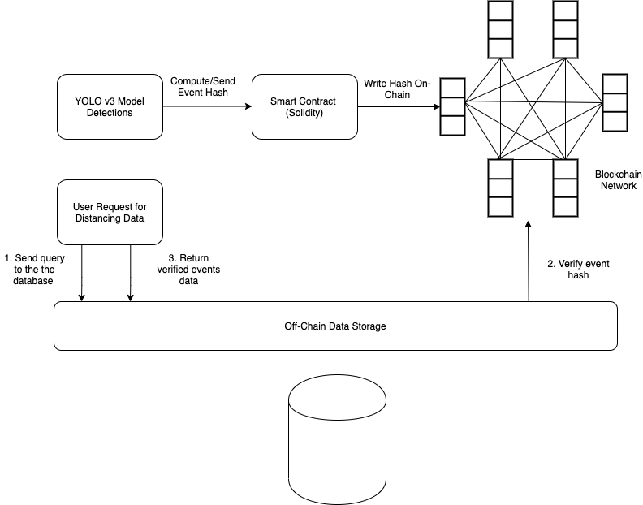
Application Diagram

Slide 10
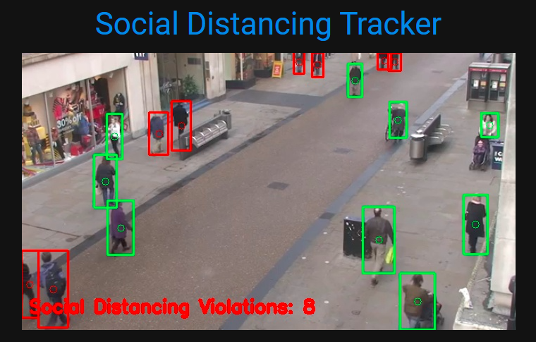
Place your screenshot here
Main View
Shows real time if people on camera are following social distancing measures

Slide 11
Thank You

