Slide 1
Coca-Cola Stock Analysis & Prediction
Machine Learning | Data Analysis | Live Forecast | Dashboard

Slide 2
Problem Statement
The goal is to analyze Coca-Cola's stock trends using historical data, financial features, and apply machine learning to predict stock price movement. A dashboard and live prediction system are also built for interaction and updates.

Slide 3
Datasets Used
- Historical stock data (CSV): Open, High, Low, Close, Volume, Dividends, etc.
- Company info (Excel): Meta information about Coca-Cola
- Live stock data: Fetched via yfinance (Yahoo Finance API)

Slide 4
Feature Engineering
- Moving Averages: MA20, MA50
- Daily Return (% change)
- Volatility (20-day rolling std dev)
- Target: Next-day price direction (Up/Down)

Slide 5
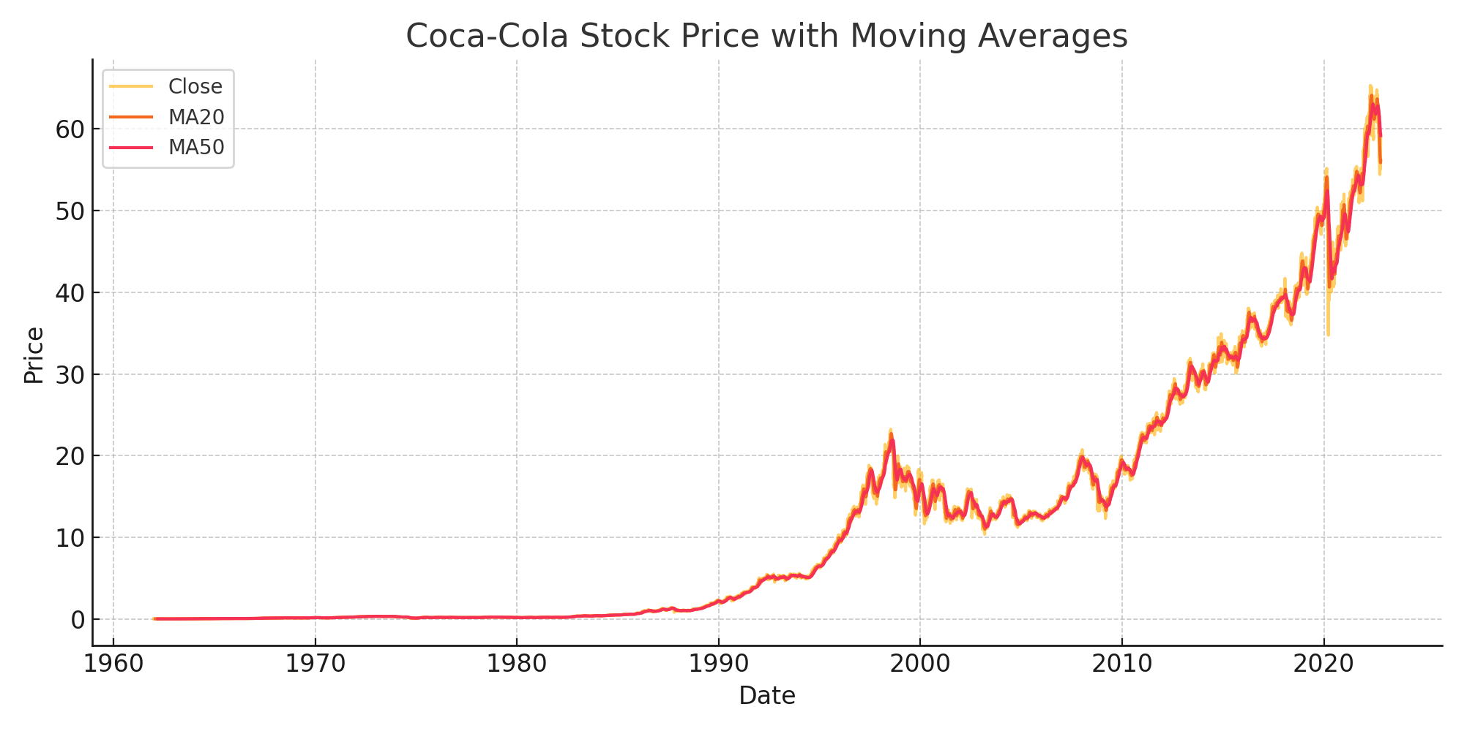
Stock Price with Moving Averages

Slide 6
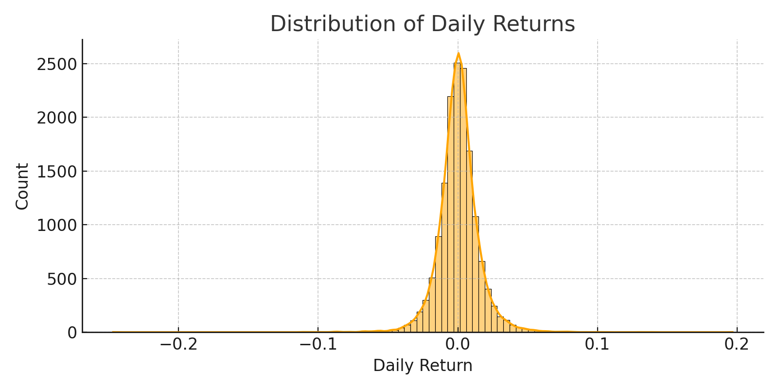
Distribution of Daily Returns

Slide 7
Machine Learning Model
- Model: Random Forest Classifier
- Features: Price + Engineered indicators
- Output: Predicts if stock will rise next day
- Accuracy ~47% with class imbalance

Slide 8
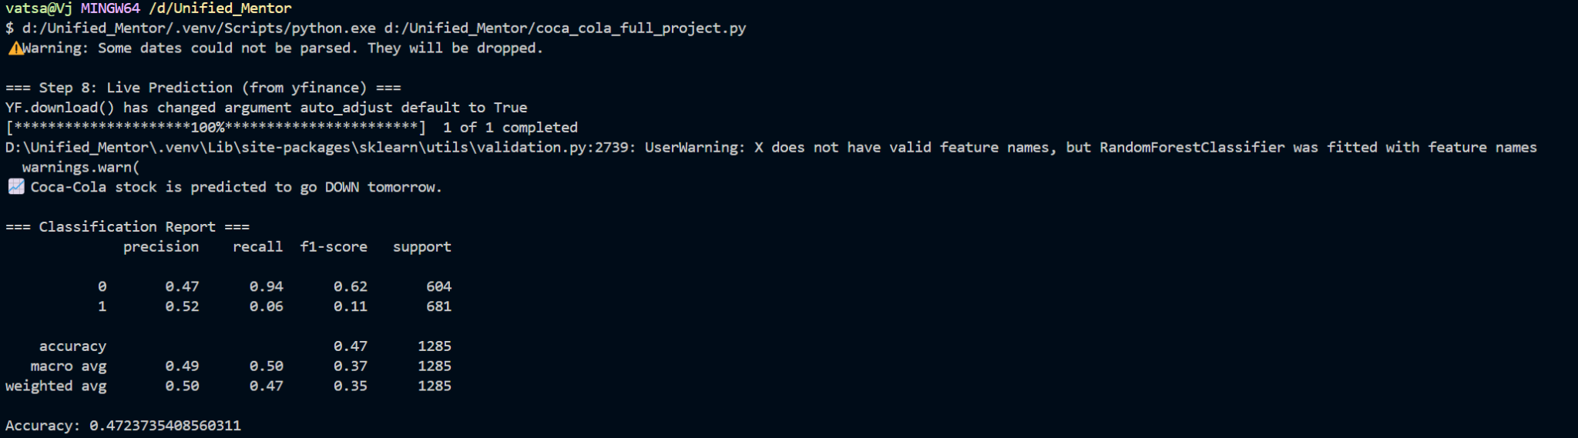
Live Prediction Terminal Output

Slide 9
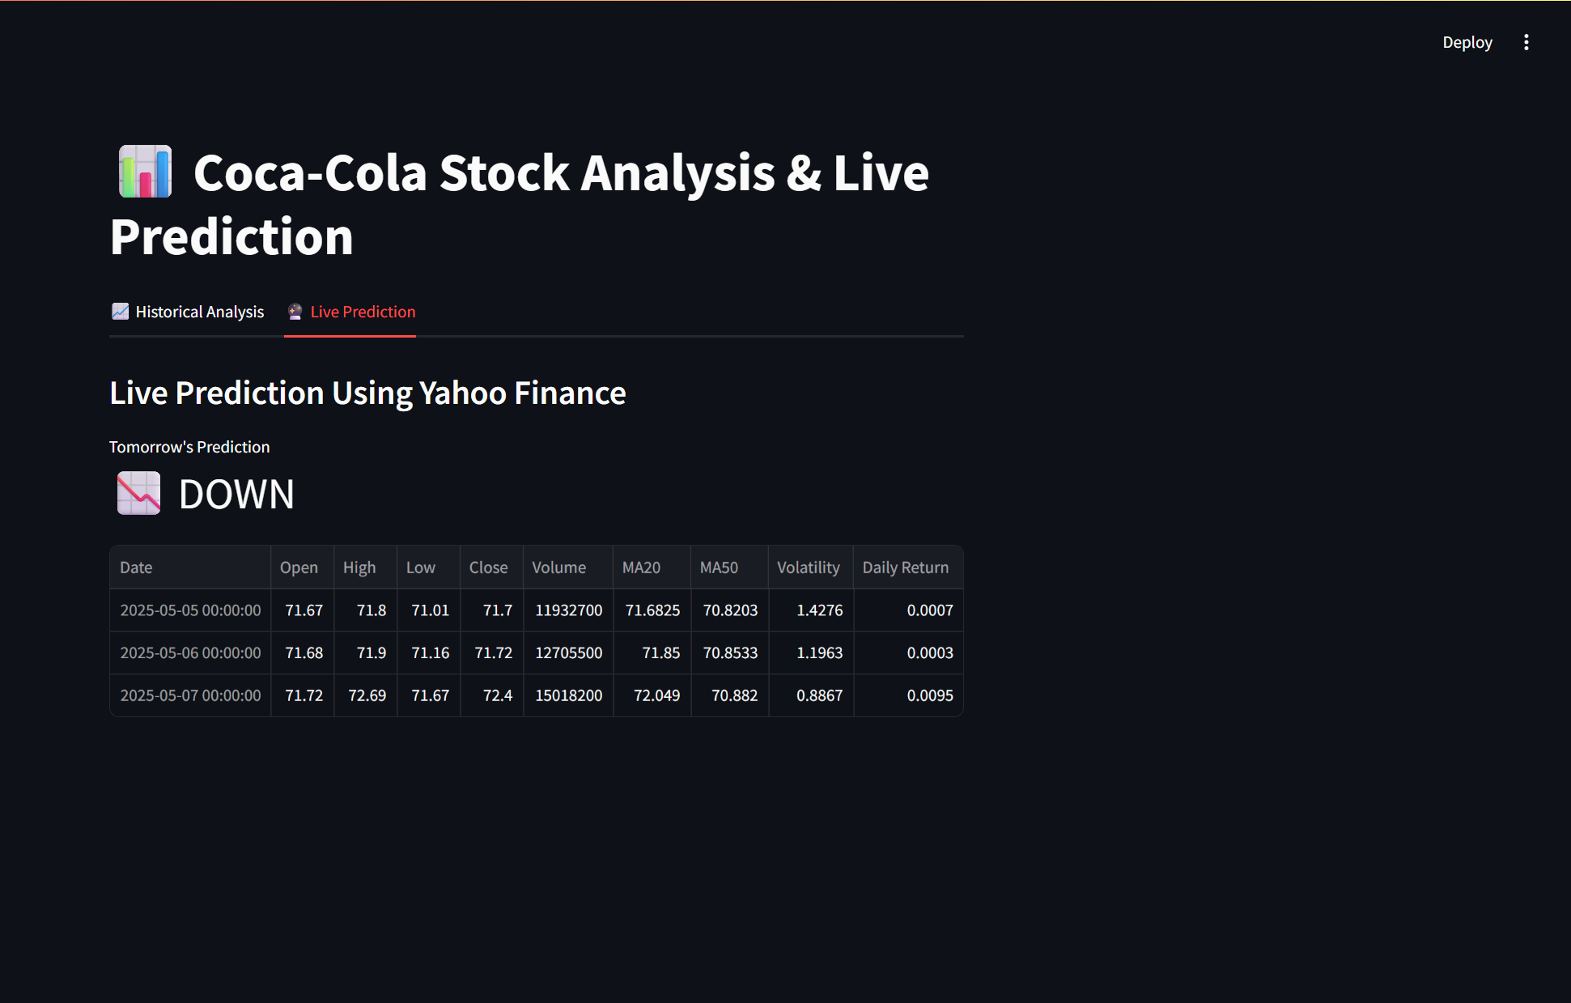
Streamlit Live Prediction Tab

Slide 10
Conclusion
- End-to-end Coca-Cola stock analysis pipeline complete
- Live prediction system functional
- Dashboard for visualization and usability
- Ready for enhancement or deployment

