Slide 1
Olympics Data Analysis & Medal Prediction
Summer Olympics (1976–2008)
Using Python, ML, and Streamlit

Slide 2
Project Overview
• Analyze Olympic medal trends from 1976 to 2008
• Explore gender participation, top athletes and countries
• Build a predictive ML model for medal outcome
• Visualize and deploy with Streamlit dashboard

Slide 3
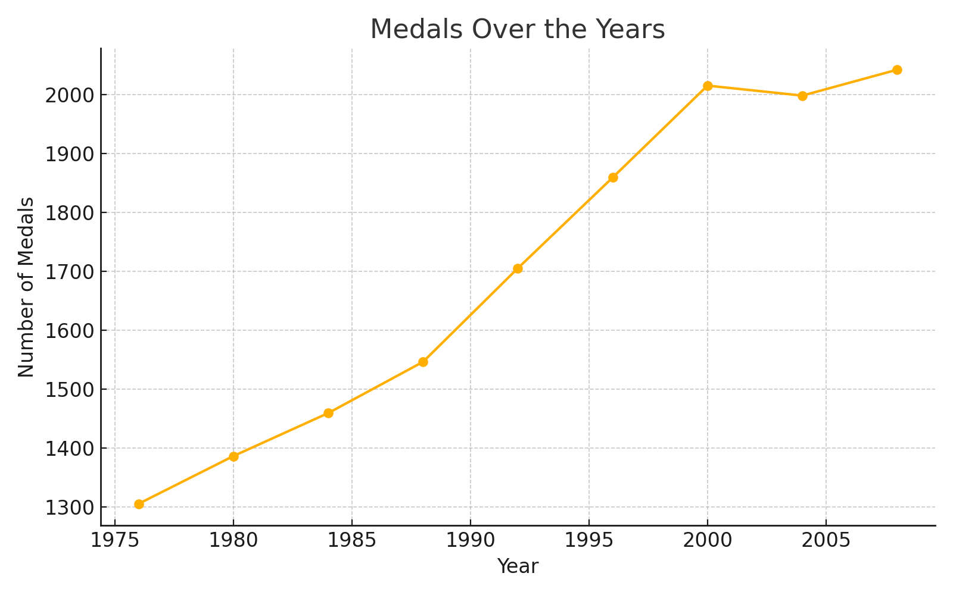
Medals Over the Years

Slide 4
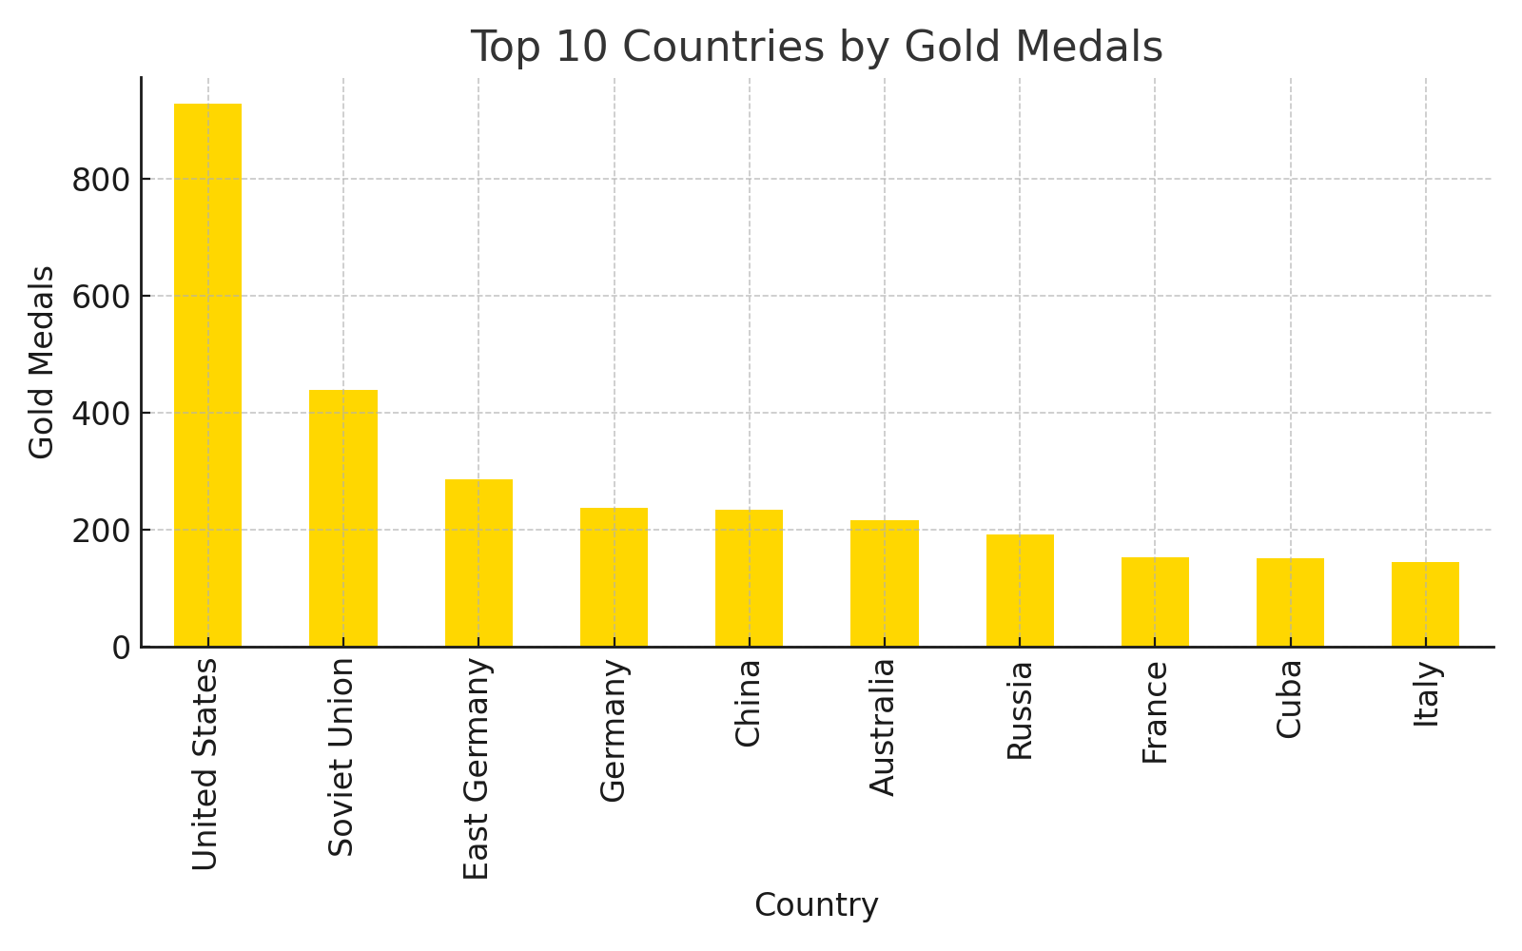
Top 10 Countries by Gold Medals

Slide 5
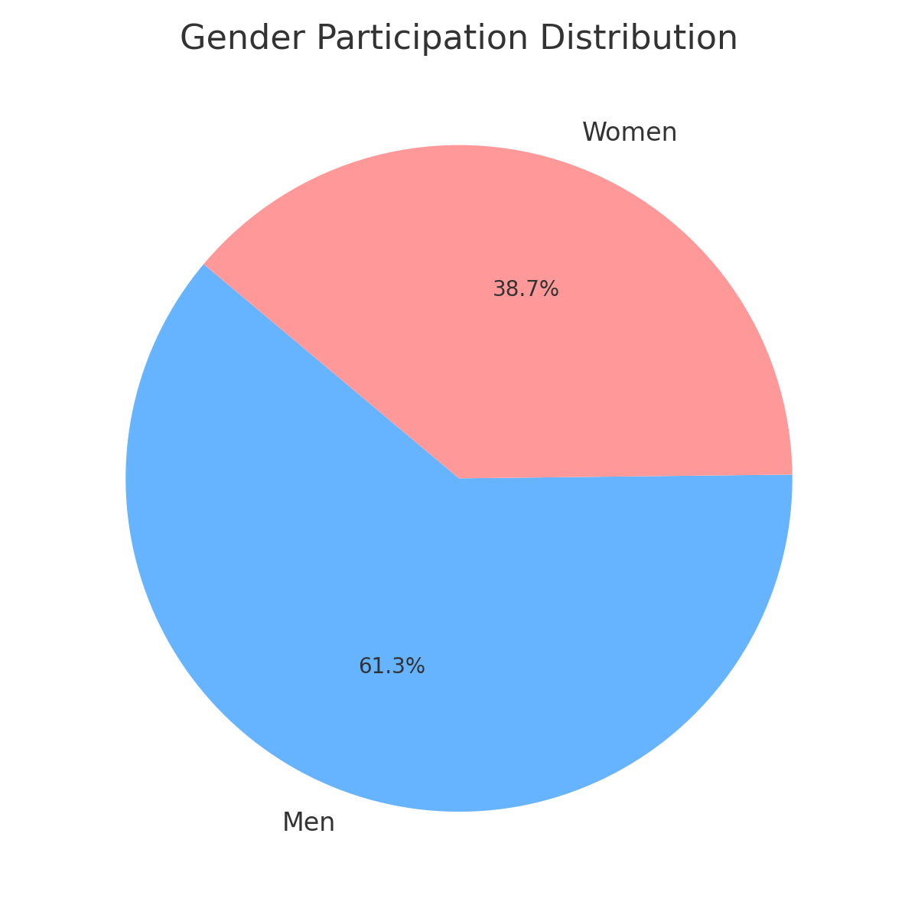
Gender Participation Distribution

Slide 6
Machine Learning Model
• Random Forest Classifier trained on Country, Sport, Year
• Labels: Medal type (Gold, Silver, Bronze)
• Accuracy measured with classification report
• Streamlit interface allows medal prediction

Slide 7
Conclusion & Insights
• USA and Russia dominated the Olympics during this period
• Gender disparity observed in certain sports/events
• ML model provides good accuracy for predicting medal outcomes
• Streamlit enhances interactivity and user experience

