Slide 1
Simulation of Rods undergoing twist and analyzing resulting Plectonemes
Vatsal Jain

Slide 2
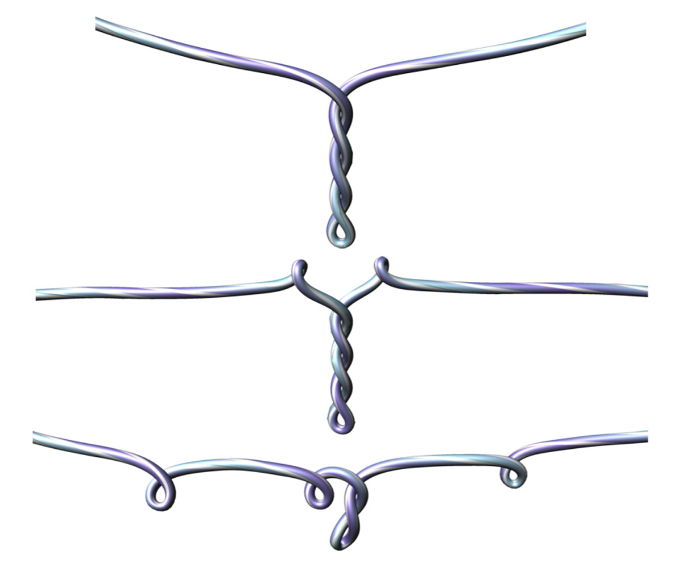
Plectonemes
Results from a rod undergoing significant amount of twist, causing buckling

Slide 3
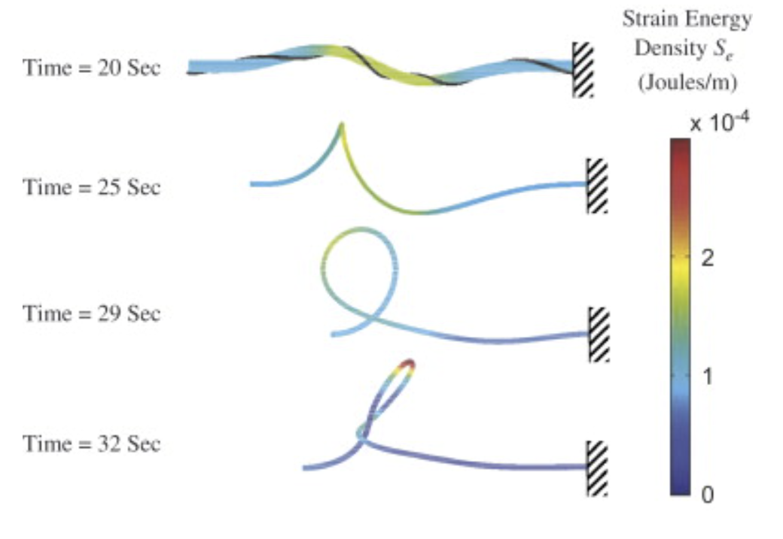
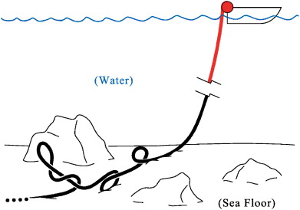
Previous Works
Analyzed the plectonemes in underwater marine cables (fixed on one end)
Since these tangles can cause significant issues, including damage and signal transmission interruptions
[Goyal 2007]
Transition from a buckled helical form to an intertwined form

Slide 4
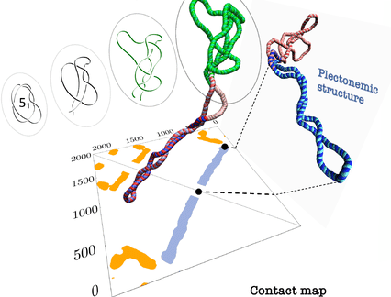
Previous Works
Plectonemes applied to organic structures: DNA
DNA modeled as an elastic rod to observe the appearance of plectonemes in the process of DNA supercoiling
[Yang 1993]

Slide 5
Previous Works
Analyzed the plectonemes in an electrically charged rod
Since Plectonemes are self-contact phenomena
Repulsion introduces a new set of plectonemes as the rod will have repulsive force when making self-contact
These vary depending on the charge of the rod, charge of solvent, etc.
Example in life of electrically charged rod/ plate: ribbons
[Lim 2010]

Slide 6
Simulation of Plectonemes
An elastic rod fixed from both ends, and applying twisting on both ends
Want to observe the twisting energies especially during any sudden buckling/ jumps
Several variables to see what is interesting
Radius of rod
Length of rod
Speed of twisting
Material
Viscosity

Slide 7
Methodology
Discrete Elastic Rods algorithms
using time parallel reference frame

