Slide 1
Medical Web Platform Presentation
Appointments | Medicine Store | Hospital Locator | Cognitive Tests

Slide 2
Problem Statement
Patients face difficulty accessing healthcare services efficiently.
- Booking appointments
- Finding hospitals
- Buying medicines
- Monitoring cognitive health
A unified platform is needed to simplify and centralize these services.

Slide 3
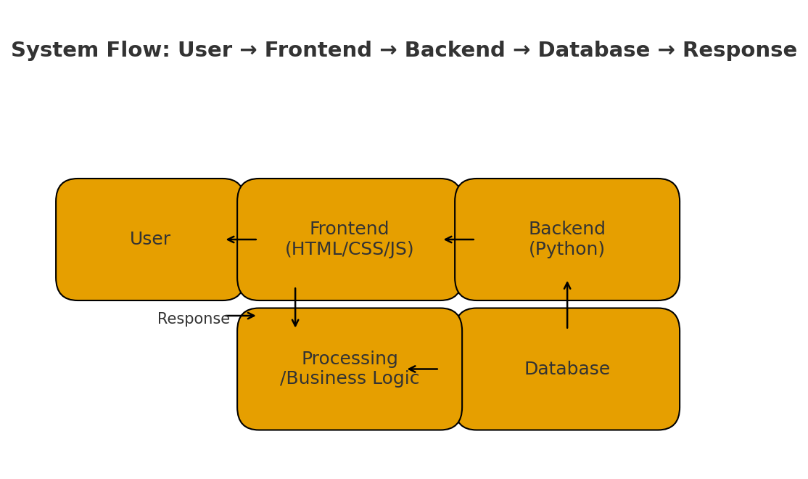
System Flow Diagram
User →
Frontend (HTML) →
Backend (Python) →
Database →
Response to User

Slide 4
Key Features
• Book medical appointments
• Buy medicines online
• Locate nearby hospitals
• Perform cognitive tests
• Secure login and responsive UI

Slide 5
Live Demo
Demonstration Steps:
1. Appointment booking
2. Medicine store navigation
3. Hospital locator
4. Cognitive test example

Slide 6
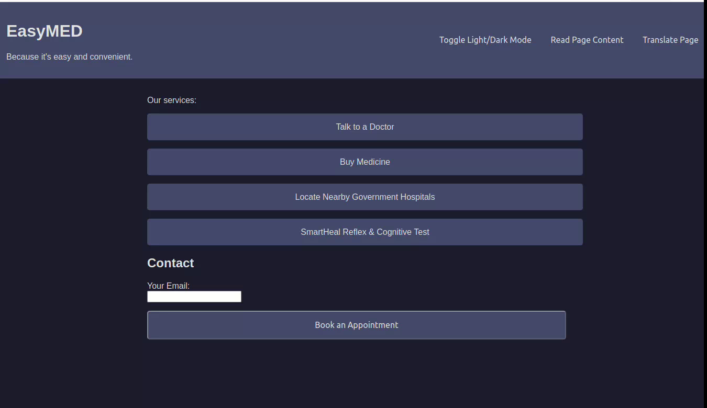

Slide 7
Conclusion
Our platform streamlines healthcare access by integrating multiple services.
Designed for simplicity, speed, and user convenience.
Thank you!

