Slide 1
N75E_type3 — Slope Estimation
VGGT reconstruction → Method 1 (ground-distance) → gravity-aligned to ground-truth camera poses
2 flight(s): downhill, uphill

Slide 2
Method
Why the estimate is trustworthy
1. VGGT reconstructs a 3-D point cloud + camera poses from the frames.
2. Method 1 reads the road surface beneath each camera and fits ground elevation vs. along-track distance — the line's tilt is the slope.
3. Gravity alignment (key fix):
VGGT's reconstruction is only defined up to a similarity transform and is exported in camera-0's frame — its vertical axis is NOT gravity.
So the raw slope MAGNITUDE is measured in a tilted frame and can be far off (a true 25° slope can read ~65°).
Fix: align the VGGT camera centres to the ground-truth camera world positions (encoded in each frame's filename), recover the missing rotation, rotate the terrain into a true-vertical frame, then measure slope.
This corrects both the magnitude and the sign from one physical anchor. A small alignment residual (align_resid_m) confirms the fit is trustworthy.

Slide 3
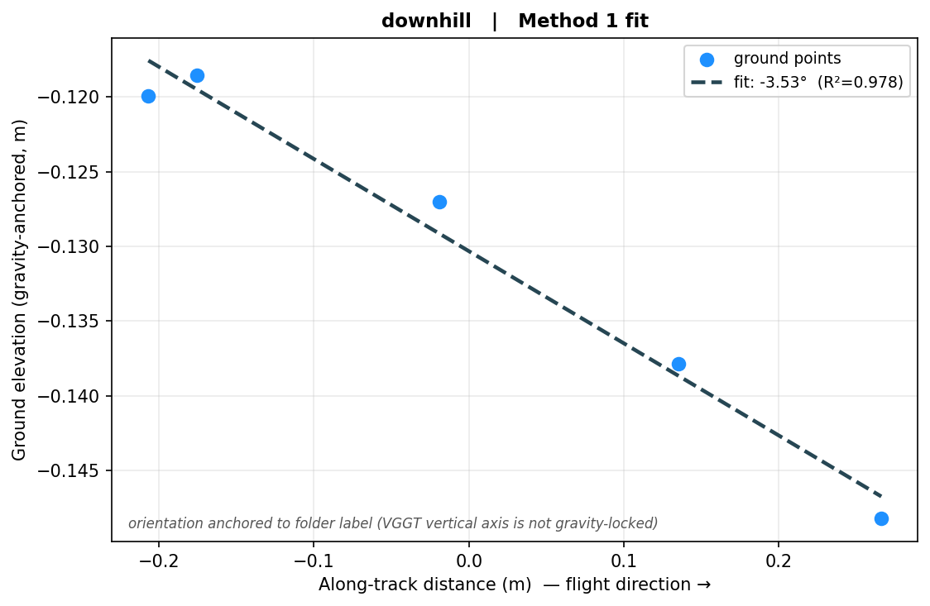
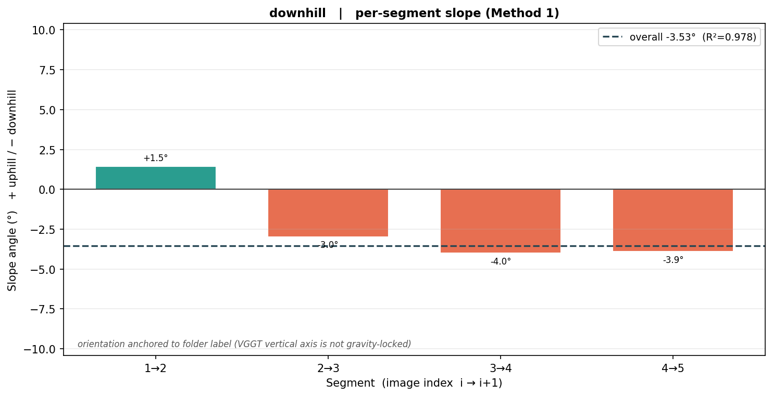
downhill
Final slope -3.53° downhill
Final (gravity-aligned): -3.53° downhill | Method 1 R² = +0.978 | ground points = 5
Gravity alignment NOT applied (degenerate camera geometry (collinear, axis ratio 0.005)). Falling back to: Method 1 magnitude, folder-label sign. Magnitude in VGGT's tilted frame — treat with caution.

Slide 4
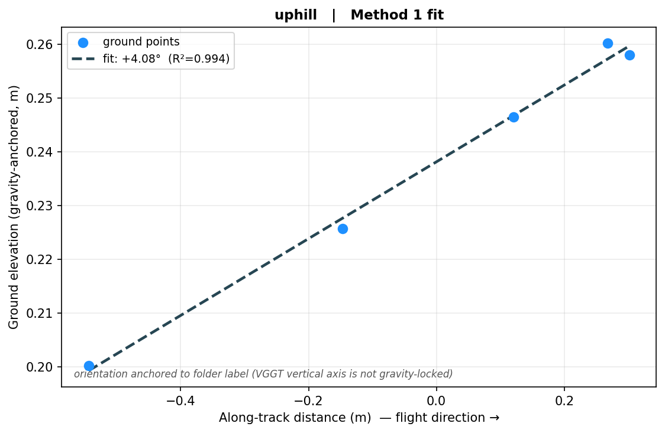
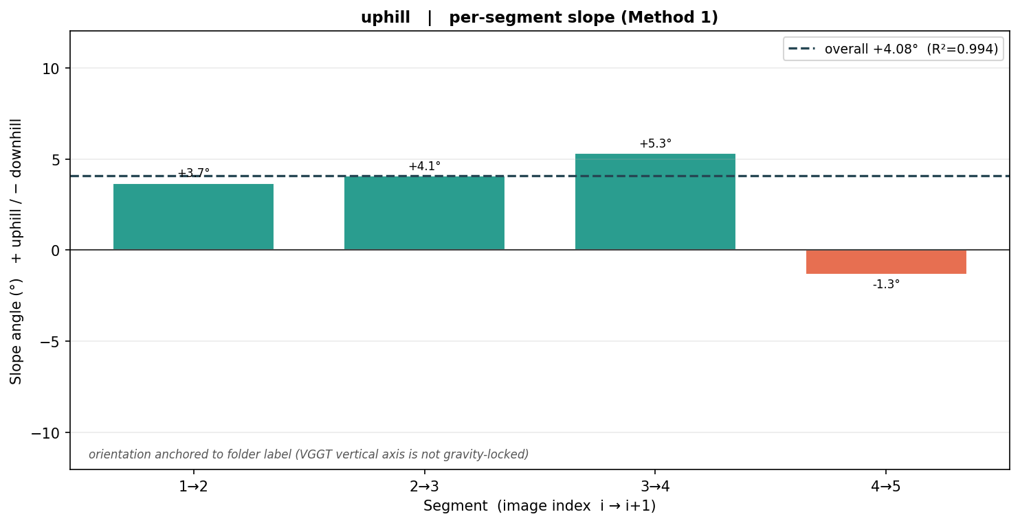
uphill
Final slope +4.08° uphill
Final (gravity-aligned): +4.08° uphill | Method 1 R² = +0.994 | ground points = 5
Gravity alignment NOT applied (degenerate camera geometry (collinear, axis ratio 0.002)). Falling back to: Method 1 magnitude, folder-label sign. Magnitude in VGGT's tilted frame — treat with caution.

Slide 5
Summary
Gravity-aligned vs. raw VGGT-frame
Flight | Final (aligned) | Direction | Raw VGGT | R² | Aligned? | Resid (m)
downhill | -3.53° | downhill | -3.53° | +0.978 | no | None
uphill | +4.08° | uphill | -4.08° | +0.994 | no | None
Final = gravity-aligned Method 1 (magnitude + sign from ground-truth poses). Raw VGGT = pre-alignment value in the tilted reconstruction frame, shown for transparency. A small residual means the pose alignment is reliable.
⚠ No flight in this run was gravity-aligned — numbers are raw VGGT-frame. Re-run with the dataset path + flags so the poses can be read.

