Slide 1
Method 1 (Ground-Distance) Slope Estimation
Cross-application to the Method-2 dataset · per-segment slope analysis · Robinson plan
Drone terrain slope from VGGT reconstructions

Slide 2
What was asked, and the short answer
• The request
– Apply Method 1 to the dataset used by Method 2
– Method 1 is more general — it doesn't assume fixed height above ground
– Process the two Robinson datasets with Method 1
– Report slope with a sign (+ uphill / − downhill); use all images
– Per-segment slope plots; same plots for the previous dataset
– Collect everything into a slide file
• Short answer
– Method 1 transfers to the Method-2 dataset and works well
– Uphill: +3.7° (Method 2: +3.4°) — close agreement, R²=0.99
– Downhill: −7.9° (Method 2: −4.8°) — right direction, steeper
– Method 1 needs the reconstruction to capture vertical relief (terrain-following flights) — level flights rebuild flat
– Robinson uphill: +16.3° uphill (GPS-verified); downhill: −5.65° downhill
– Sign finding: Method 1's up/down sign rides on VGGT's vertical axis, which is NOT gravity-locked — we now anchor the sign to GPS

Slide 3
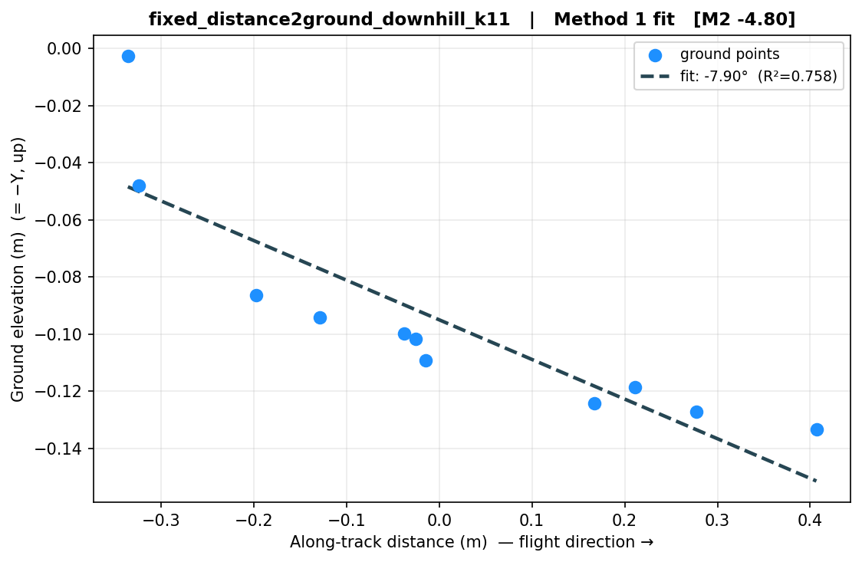
How Method 1 works (ground-distance method)
• Assume the GLB's up-axis (+Y) points along gravity
• For each camera, look straight down and take the road surface beneath it (point cloud)
• Collect those ground points along the whole flight
• Fit a line: ground elevation vs. distance along the path
• The tilt of that line is the slope
• It reads the terrain directly — so it does NOT need the drone to keep a fixed height (that is Method 2's assumption)
The actual fit: ground elevation vs. along-track distance — its tilt is the slope.

Slide 4
Method 1 vs. Method 2 — what each assumes
 | Method 1 — ground-distance | Method 2 — camera-altitude
What it measures | Terrain points beneath the camera | The camera's own up/down motion
Key assumption | Up-axis = gravity | Drone keeps a fixed height above ground
Generality | Works for any flight (if relief is reconstructed) | Only valid for terrain-following flights
Fails when | Reconstruction comes back flat (no vertical parallax) | Drone altitude ≠ terrain (e.g. level flight)
• Shengqing's point is right: Method 1 is the more general of the two — it never relies on the fixed-height assumption.

Slide 5
Sign convention (so + / − is unambiguous)
• All images are used (1, 2, 3, …) — no frames dropped.
• The sign is anchored to image order — the direction the drone actually flew:
– + = terrain goes UPHILL as the flight progresses
– − = terrain goes DOWNHILL as the flight progresses
• Each dataset reports one overall slope (a single line fit over all images) plus a per-segment breakdown between consecutive images.
• R² is shown alongside: high R² = the terrain profile is cleanly reconstructed; near-zero R² = no usable slope signal.

Slide 6
Results — all datasets (Method 1, all images)
Dataset | Method 1 | R² | Method 2 | Verdict
Happy Hollow (original) | -3.92° | 0.994 | — | clean signal
fixed_dist2ground — uphill | +3.69° | 0.989 | +3.44° | clean signal
fixed_dist2ground — downhill | -7.90° | 0.758 | -4.80° | clean signal
fixed_altitude — uphill | +0.25° | 0.004 | -0.12° | no signal (flat rebuild)
fixed_altitude — downhill | -0.11° | 0.003 | -0.11° | no signal (flat rebuild)
Method 2 numbers shown only for the fixed_dist2ground datasets (where Method 2 is valid).

Slide 7
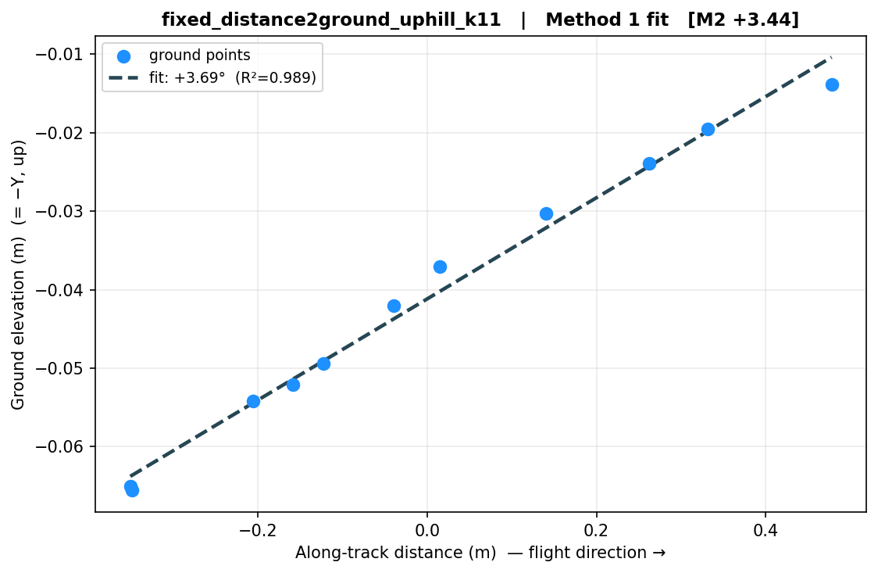
Method 1 on the Method-2 dataset (the main request)
fixed_distance2ground — terrain-following flight
• Uphill +3.69° (R²=0.99) vs Method 2 +3.44° → excellent agreement.
• Downhill −7.90° (R²=0.76) vs Method 2 −4.80° → correct direction, magnitude steeper.
• Takeaway: Method 1 transfers cleanly here because this flight follows the terrain, giving VGGT vertical parallax to reconstruct the slope.

Slide 8
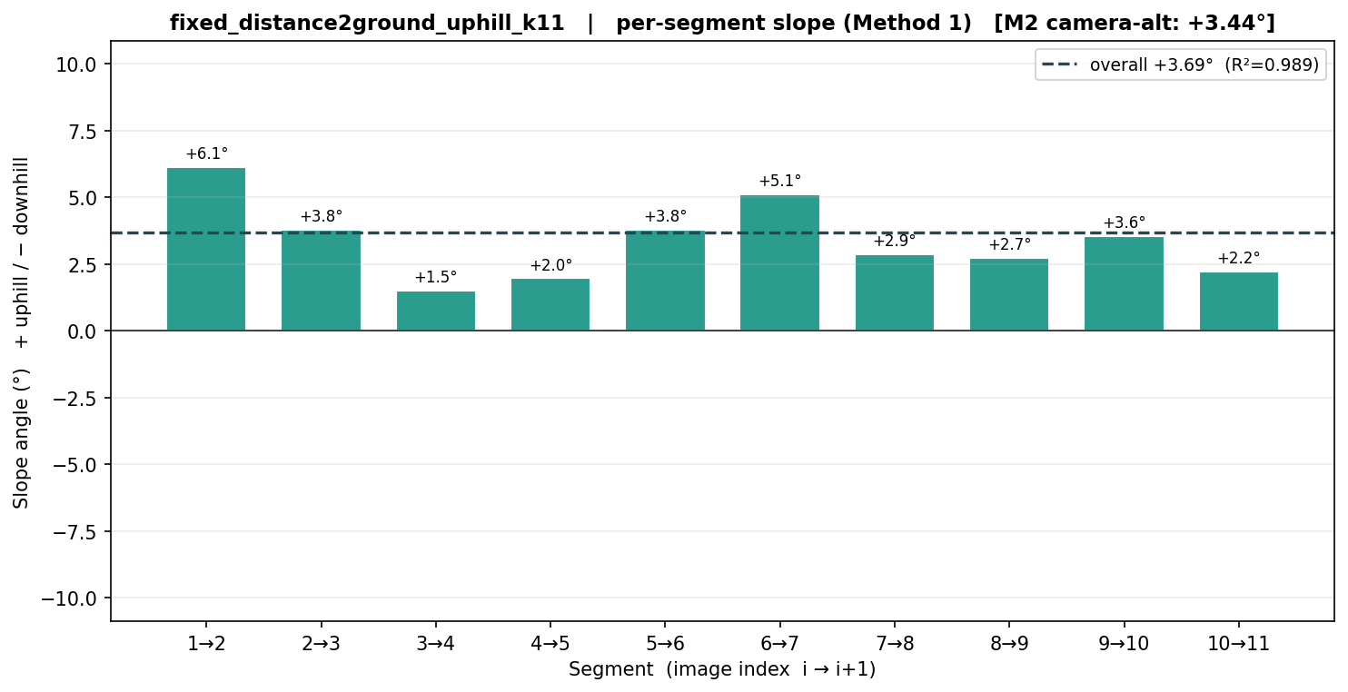
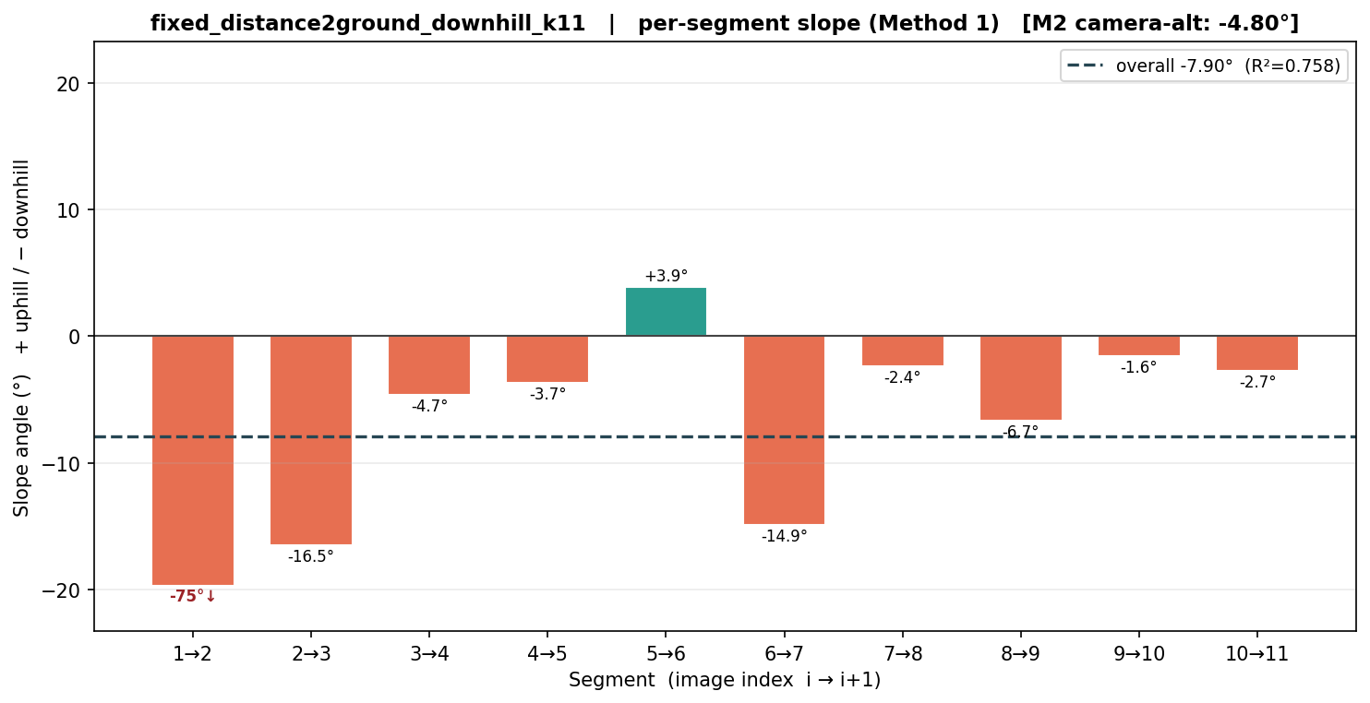
Per-segment slopes — Method-2 dataset (fixed_distance2ground)
x = image-index segment, y = signed slope. Single near-vertical bars (closely-spaced cameras) are capped & flagged.

Slide 9
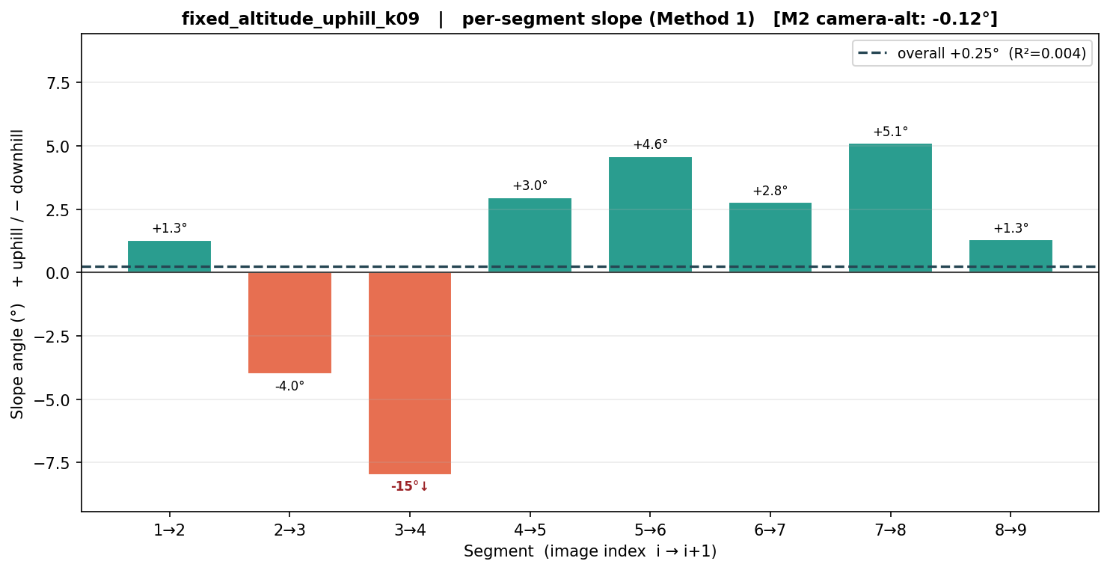
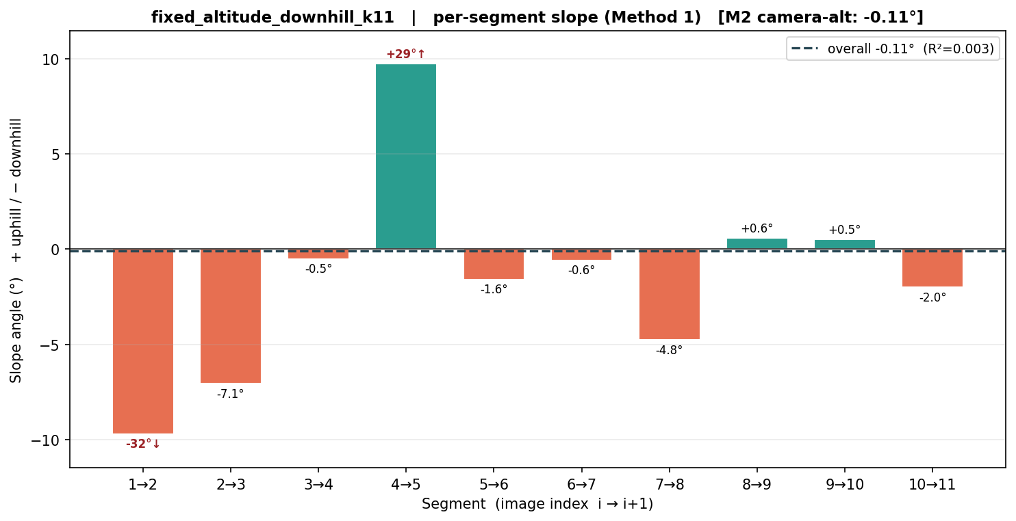
Previous dataset — Method 1 on fixed_altitude (level flight)
• Both come out near 0° with R²≈0.00 — the per-segment slopes are just noise (alternating up/down).
• This is NOT terrain being flat: it is the SAME hill as the fixed_distance2ground flights (matching GPS track).

Slide 10
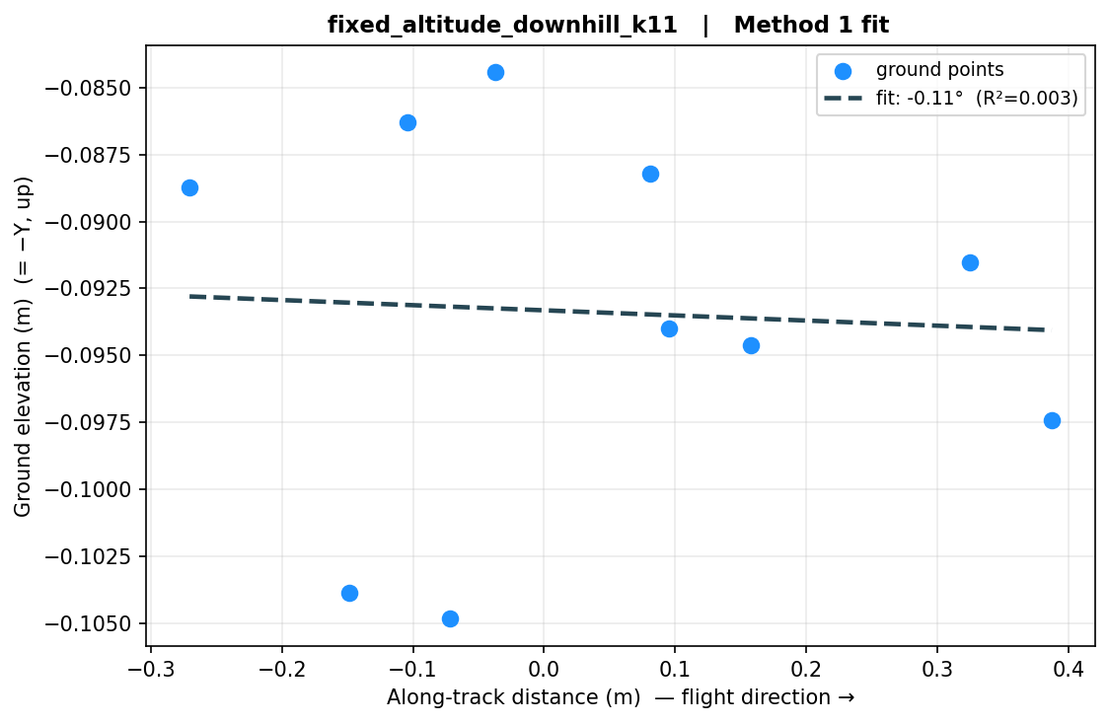
Why: the flight geometry decides whether Method 1 has a signal
Same terrain, same GPS path, two flight styles
• Left (terrain-following): camera moves up/down with the hill → VGGT reconstructs the relief → clean −7.9° fit.
• Right (level / fixed-altitude): camera moves horizontally only → little vertical parallax → ground rebuilds flat → no slope to fit.
• So 'up-axis = gravity' is necessary but not sufficient — the reconstruction must also preserve vertical relief.

Slide 11
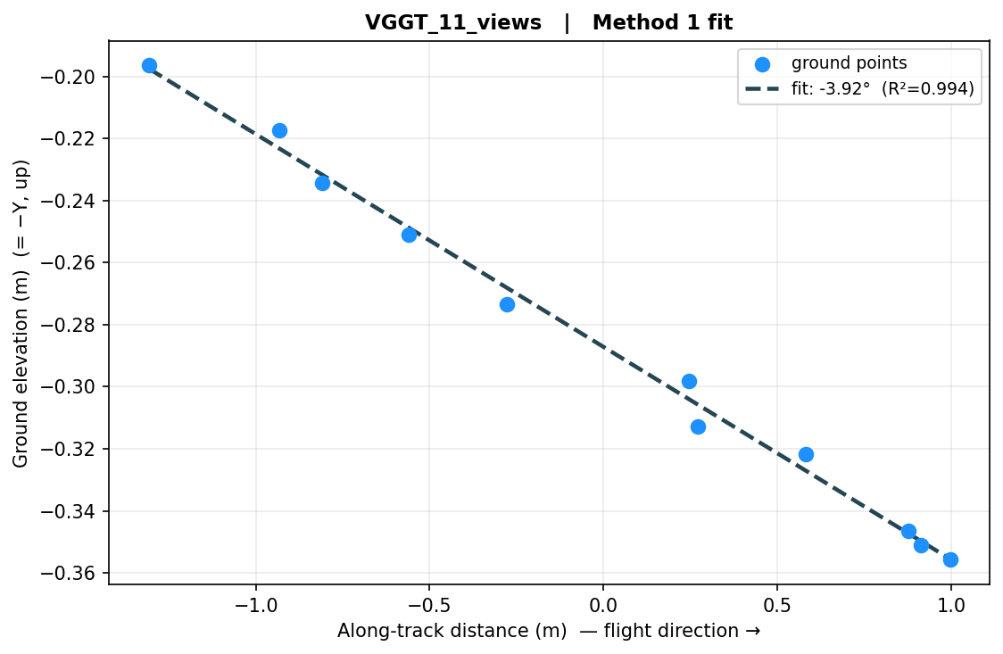
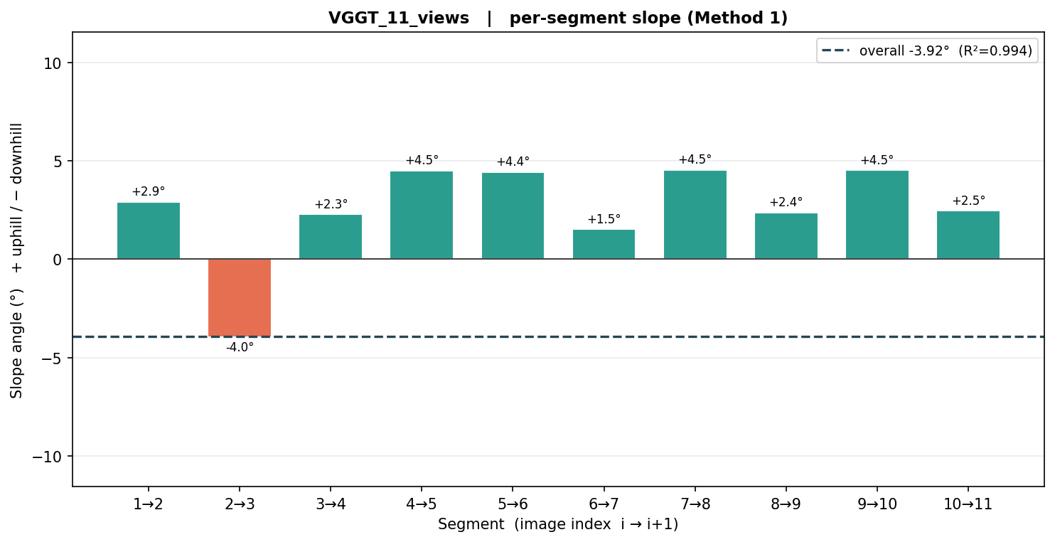
Reference: original Happy Hollow reconstruction (Method 1)
Original 11-view reconstruction: −3.92° downhill, R²=0.99 — Method 1's clean reference case.

Slide 12
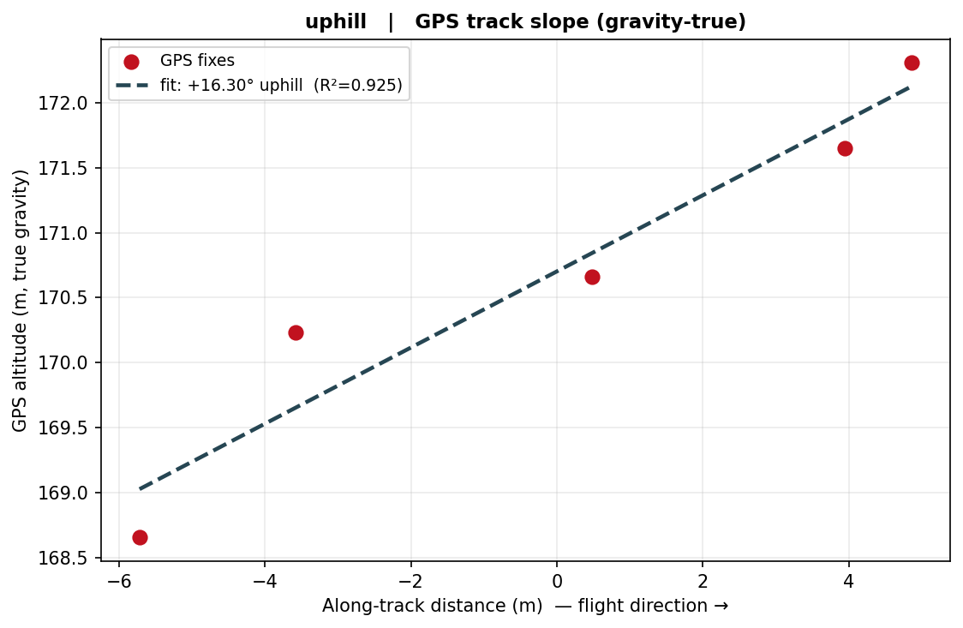
Fixing the up/down sign — anchor to GPS, not VGGT
VGGT has no gravity sensor, so its vertical axis (and the slope sign) is not reliable
• Method 1 reads slope in VGGT's coordinate frame, assuming +Y = gravity.
• VGGT never measures gravity — it picks an arbitrary frame — so the up/down SIGN can come out backwards.
• Proof on Robinson uphill: the photos carry GPS, and the drone climbed 168.7 → 172.3 m (clearly uphill).
– GPS: +16.3° uphill (R²=0.93)
– Method 1: −2.6° downhill (R²=0.29) ✗ wrong sign & noisy
• Fix: when photos carry GPS, take the sign (and a metric slope) from the GPS track. Otherwise fall back to the known flight label.
Robinson uphill: GPS altitude vs. along-track distance — the gravity-true profile.

Slide 13
Robinson datasets — results
all images, signed (+ uphill / − downhill)
Dataset | Imgs | Method 1 (VGGT) | GPS track | FINAL | Sign from
downhill | 5 | +5.65° (R²=1.00) | — | -5.65° downhill | folder label
uphill | 5 | -2.61° (R²=0.29) | +16.30° (R²=0.93) | +16.30° uphill | GPS
• uphill — iPhone 14 with GPS: drone climbed; FINAL +16.3° uphill from the GPS track (Method 1's ground-fit was too noisy here, R²=0.29).
• downhill — DJI, GPS stripped from the files: Method 1's ground-fit is clean (R²≈1.00), so we keep its 5.65° magnitude and take the sign from the folder label → −5.65° downhill.
• To verify downhill independently, we'd need its flight log / original GPS — flagged for follow-up.
FINAL sign source: GPS where available, otherwise the known flight label. Magnitude: GPS when Method 1's R² is low, else Method 1.

Slide 14
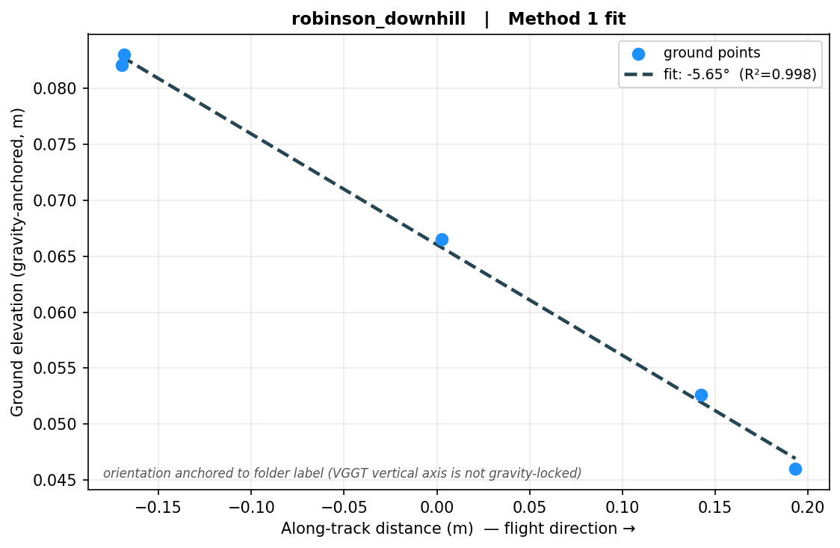
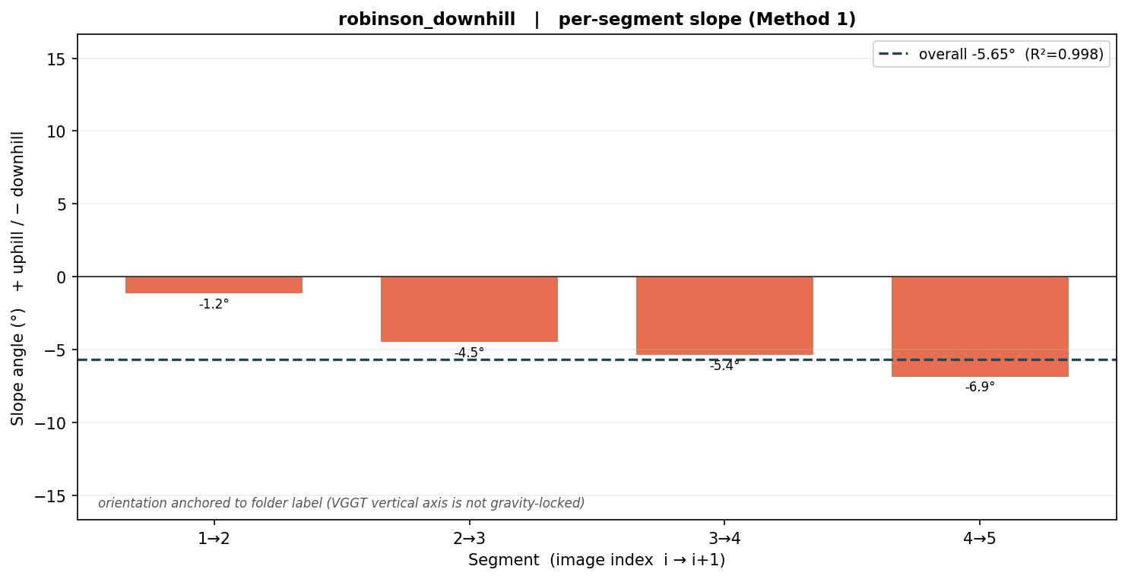
Robinson — downhill
FINAL -5.65° downhill [Method 1 magnitude, folder-label sign] · 5 images
Left: Method 1 ground-elevation fit. Right: Method 1 per-segment slope by image index.

Slide 15
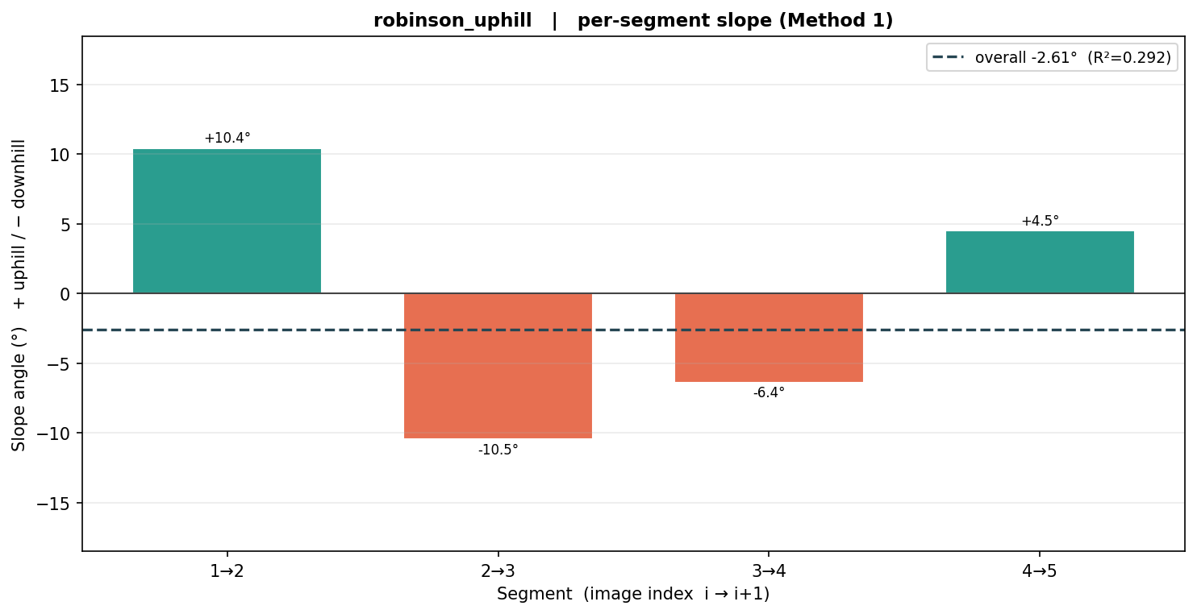
Robinson — uphill
FINAL +16.30° uphill [GPS track] · 5 images
Left: GPS track (gravity-true). Right: Method 1 per-segment slope by image index.

Slide 16
Observations & recommendations
• Method 1 estimates slope MAGNITUDE well when R² is high — but its up/down SIGN is unreliable, because VGGT's vertical axis is not gravity-locked.
• Always anchor the sign to a gravity-true reference: GPS altitude is ideal (we proved it flips the wrong Robinson-uphill sign to the correct +16.3°).
• Capture GPS/flight-log with every dataset — without it, the sign can only be taken from the known flight label, which we can't independently verify (e.g. Robinson downhill).
• Reliability tracks R²: trust the magnitude when R² is high; treat near-zero R² as 'no signal', not 'flat ground'.
• Per-segment slopes are noisy and can spike — read them as a profile, not point values; use all images for the overall fit.
• Prefer flights with vertical parallax (terrain-following / oblique) over level passes.

Slide 17
Files & how to reproduce
• method1_slope.py — Method 1 (all-frames, signed, image-order, adaptive ground-search radius) + plot helpers
• gps_anchor.py — reads EXIF GPS, computes the gravity-true track slope; the sign anchor
• run_robinson.py — A100: reconstruct with VGGT (or --from-glb to skip GPU), then Method 1 + GPS anchor
• run_method1_existing.py — Method 1 on the earlier GLBs → results/ plots + summary.json
• build_slides.py — regenerates this deck from results/
• Re-run order: (A100) run_robinson.py [--from-glb] → build_slides.py

