Slide 1
The Sleeping Teaching Assistant
CMPE 180 C
Design Review
Team Members (Group 4):
Vatsal Makani: 013731614
Jay Parsana: 013779389
Yash Amin : 013006253

Slide 2
What is the Sleeping TA problem?
We have a single Teaching Assistant that is either awake and helping a student, or is asleep when is he is not. The TA can only cater to one student a time, while a maximum of three students can be seated outside the TA’s room waiting to be addressed.
This is classic problem analogous to the critical section problem where Mutex and Semaphores are used to avoid the Race Condition or Data Inconsistency.
The Sleeping TA problem also involves the concepts of POSIX Threads to resolve the Critical Section problem. Here the critical section is the Teaching Assistant office, where only one student can sit and ask the queries.
Notes:
In computing, a data warehouse (DW or DWH), also known as an enterprise data warehouse (EDW), is a system used for reporting and data analysis, and is considered a core component of business intelligence.^{[1]} DWs are central repositories of integrated data from one or more disparate sources. They store current and historical data in one single place^{[2]} that are used for creating analytical reports for workers throughout the enterprise.

Slide 3
DESIGN Flow (Algorithm)
Make student threads and TA thread (initialize)
Each thread is running own thread function (student is programming, TA is sleeping)
Student wakes the TA up after random time, then TA helps the arrived student (change student's semaphore to 1 and wait TA’s semaphore). but if chairs are full, students go to their programming work back and come again after random amount of time.
If TA is done with helping, TA checks the remaining students. if there is(are) student(s) TA attends next student who is waiting on the chair and if not, TA goes to sleeping back (change TA’s semaphore to 1 and wait student's semaphore)
Repeat 3-4 steps.
Notes:
In computing, a data warehouse (DW or DWH), also known as an enterprise data warehouse (EDW), is a system used for reporting and data analysis, and is considered a core component of business intelligence.^{[1]} DWs are central repositories of integrated data from one or more disparate sources. They store current and historical data in one single place^{[2]} that are used for creating analytical reports for workers throughout the enterprise.

Slide 4
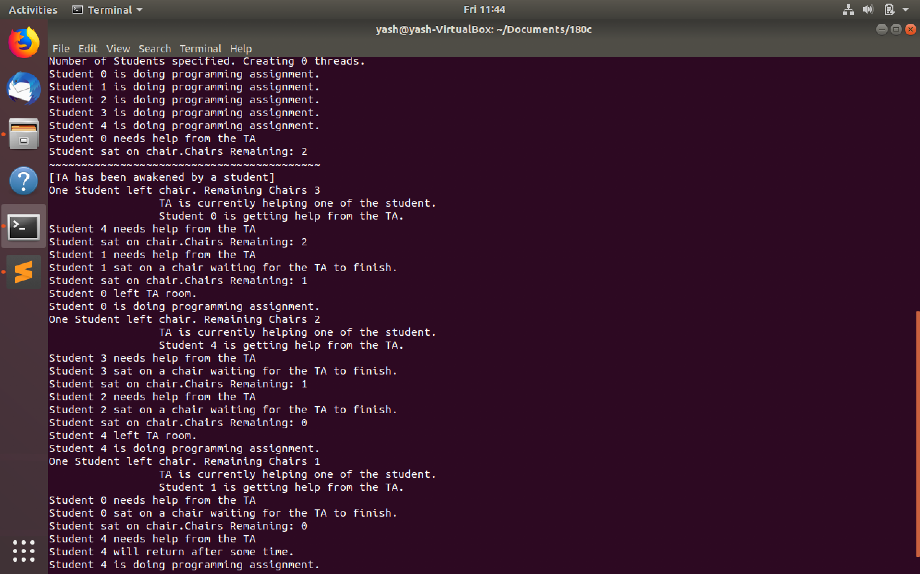
Student 0 left the TA room and continues with his assignment.
Student 3 occupies the position vacated by student 4
Student 1 now enters the TA room. Students enter in FIFO order in TA office.
Since all the chairs are occupied, if any student needs help, it will not be able to enter the queue and resume working.

Slide 5
Thank You.

