Slide 1
Catching protocol deviations before the FDA does

Slide 2
Status Quo vs. Automated Trial Records
Manual
Status Quo Records
Paper logs & siloed EDC entries; discrepancies discovered weeks later during retrospective audits.
High Risk
Lagging Detection
Missed visits, dosage drift, and banned co-meds unflagged until formal regulatory inspection.
Real-Time
Automated Monitor
Instant ingestion & automated GCP classification flag protocol deviations as records occur.
Contrasting retrospective manual audit logs against continuous, audit-ready automated records

Slide 3
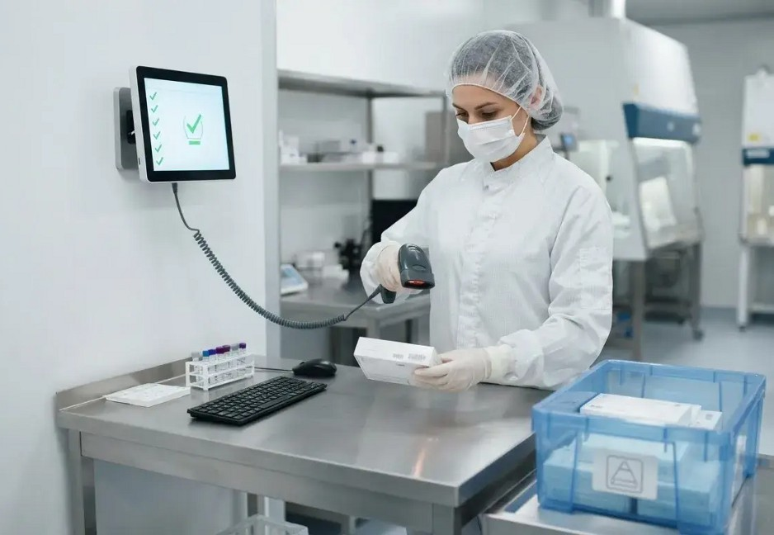
From Raw Patient Data to Audit-Ready Insight
Continuous protocol compliance checking and automated risk prioritization
01
Ingestion & Protocol Rules
Continuously ingests patient visit logs and compares them against digital protocol specs.
02
Detection & GCP Classiﬁer
Automated engine flags breaches and assigns ICH E6 GCP severity (major, minor, administrative).
03
Risk Scoring & CAPA Output
Aggregates site leading indicators into risk scores and auto-generates actionable mitigation reports.

Slide 4
End-to-End System Architecture
Data Ingestion
Ingests visit logs, EHR records, and digital protocol specs.
Comparison Engine
Rule matching & semantic AI check against protocol criteria.
Severity Classiﬁer
Tags deviations into major, mi-nor, or admin GCP classes.
Scalable multi-stage pipeline processing thousands of visit logs across 200+ sites
Site Risk Scoring
Aggregates leading oper-ational & compliance risk per site.
Report Generator
Auto-generates CAPA reports and inspection audit trails.
Engineered for high-throughput clinical data compliance
End-to-End System Architecture

Slide 5
Clinical Deviation Management Features
Real-time notification flags visit window lapses, unauthorized co-medications, or dosage errors.
Instant Deviation Alert
Prominent visual tag prioritizing urgent patient safety concerns over administrative slips.
ICH E6 GCP Badge
Pre-drafted corrective action plan ready for trial manager review and regulatory sign-off.
Mitigation & CAPA Panel

Slide 6
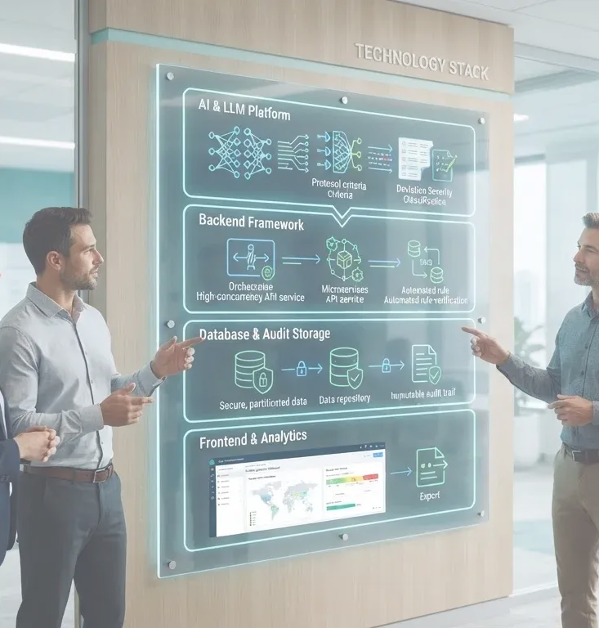
Technologies & Implementation Stack
AI & LLM Platform
Backend Framework
Interprets complex, ambiguous protocol criteria and classifies GCP deviation severity.
High-concurrency API service orchestrating stream ingestion and automated rule verification.
Database & Audit Storage
Frontend & Analytics
Fully partitioned, encrypted data repository maintaining an immutable audit trail.
Clinical operations dashboard delivering site-level risk heatmaps and one-click CAPA export.
Modern enterprise infrastructure built for regulatory compliance and zero-downtime monitoring

Slide 7
Quantiﬁable Regulatory & Operational Impact
X%
Protocol deviations
X
Hours saved
Protocol deviations caught and resolved prior to formal FDA inspection.
Hours saved per week for clinical trial risk managers through automated triage.
200+
Sites monitored
Sites actively monitored simultaneously with real-time risk index calculations.
Zero
Surprise deﬁciencies
Proactive CAPA generation prevents warning letters and inspection holds.
Turning a 6–12 month audit risk into a real-time dashboard metric

Slide 8
Clinical Team Expertise
Regulatory & QA
Vatsal Paghadal
Clinical AI
Lead
Het Barai
Backend Architect
Hrutvijsinh
Jadeja
Full-Stack & UX
Vishwa Darji

