Slide 1
Community Solar
DSCI-D592 Data Science in Practice
Fall 2024
Tyler King
Delia Krueger
Guru Kappa
Vatsal Vinay Parikh
Saransh Kamlesh Singh
Ashlesh Rajesh Upganlawar

Slide 2
Purpose
Project Goal: Refine and evaluate potential Solar data for the existing list of Non-Profit Organizations that could serve as anchors for Community Solar Projects
Key Challenges:
Develop system for cleaning the data, more specifically ensuring better Address Matching
Reduce the Solar Data from Google Solar into a more manageable and useful state
Deliver automatically generated visualizations and reports for stakeholder use

Slide 3
Data Cleaning
Decided on a multi-step approach for cleaning and address matching.
Removed excess google solar data as well as google places data
Used County Data Harvest Parcel Data
Web Scraping County GIS Data
Manual Correction

Slide 4
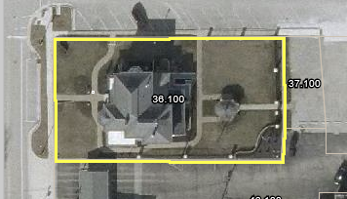
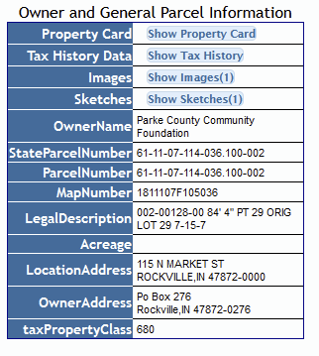
Web Scraping
Developed a Web Scraper for Pulling Parcel owner data out of local county GIS website
Works for all 4 of our counties of record
Not universal for counties that don’t use the same system but should be modifiable if needed.

Slide 5
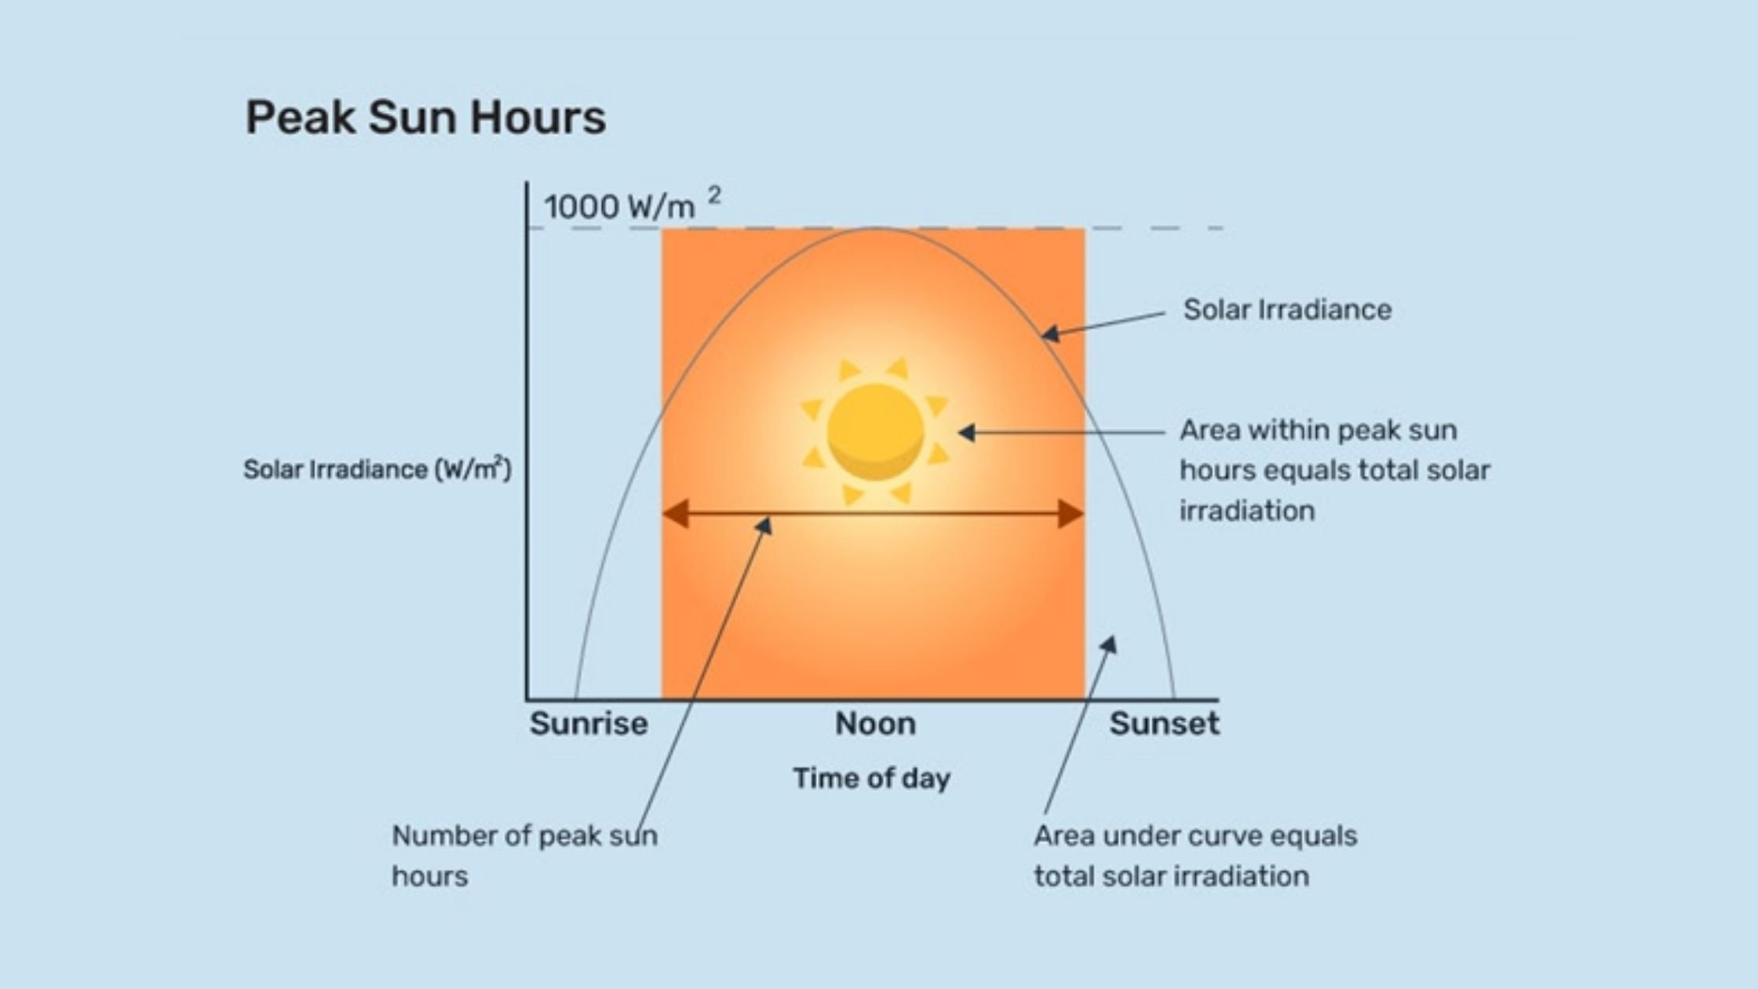
Power and Metric Calculations
Translating Sun Hours to Nominal Power
Assuming a 300 W solar panel
Assuming average house consumption of 10,566 kWh per year
Generated new fields:
Nominal Power (W)
Predicted Mean Annual Power (kWH/year)
Equivalent Houses Powered
Annual CO2 Generation savings (ton)

Slide 6
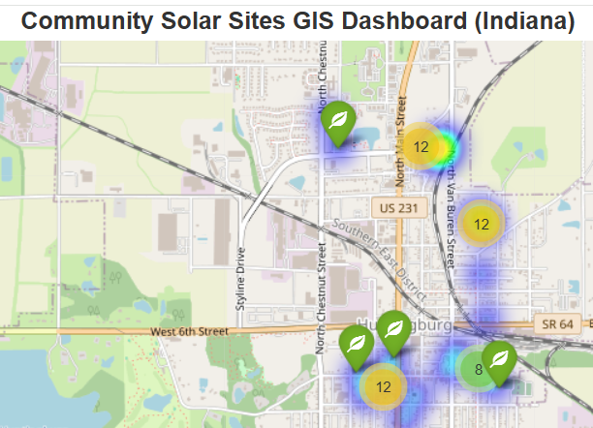
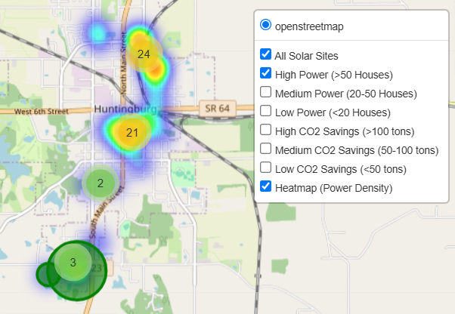
Visualizations
GIS-Enabled Visualizations:
- Interactive map with Marker Clusters, Layer Filters (by power and CO2 savings), allowing users to explore solar sites across Indiana based on various criteria.
- Visualized power density to highlight areas with higher energy generation potential.
- Developed using Python, Folium for interactive mapping, Pandas for data processing, OpenStreetMap for base maps, and Jupyter Notebooks for development and visualization.

Slide 7
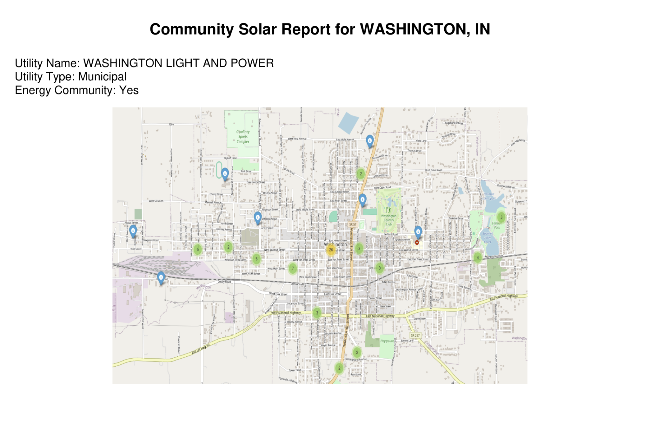
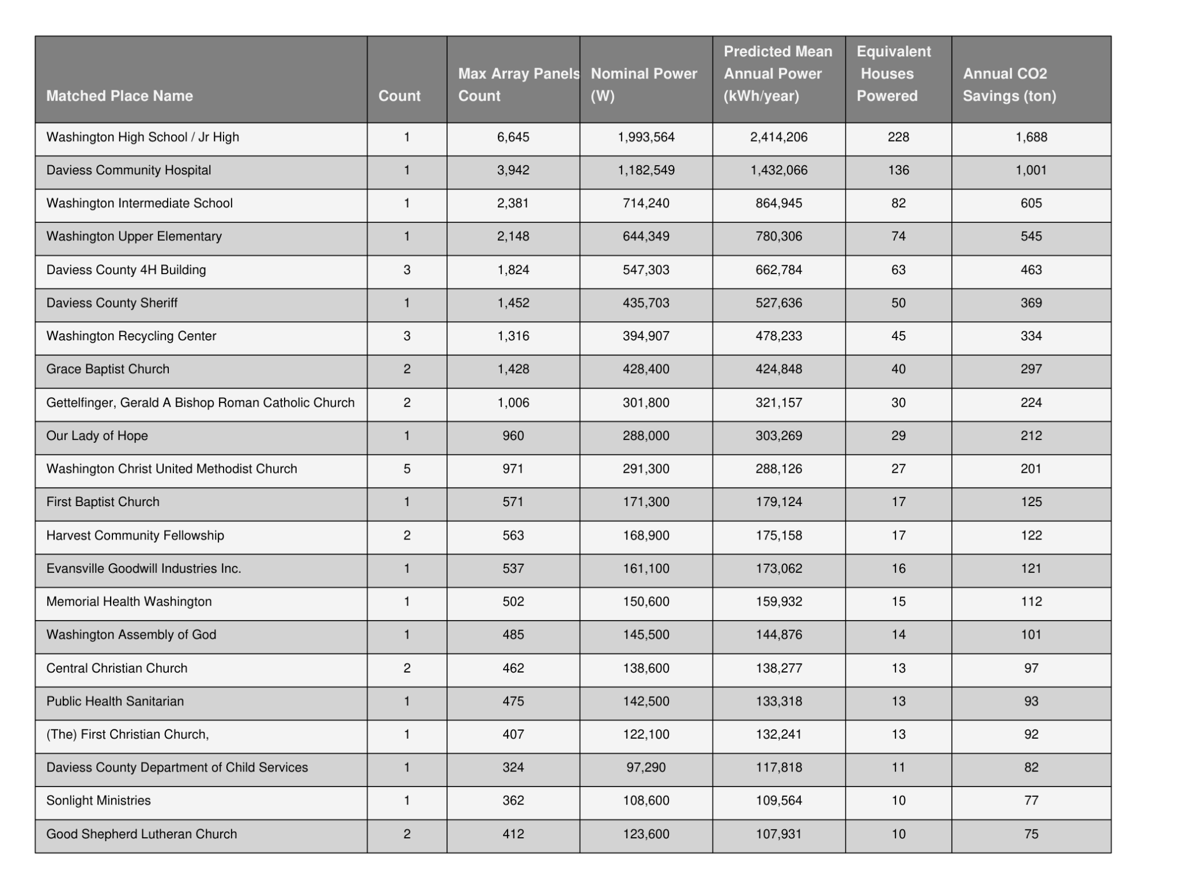
Automated Report Generation
Goal: To create a machine generated report that is easy to read and able to be easily distributed
PDF was chosen as the final file format for ubiquity
Includes:
City Name
Utility name and type
Energy Community Status
Map of sites
Table with data for grouped sites
Graphs visualizing key city metrics

Slide 8
Future Work Ideas
Evaluate similar sites for alternatives to Rooftop Solar
Ground mount
Parking Canopies
Geothermal
Wind
Incorporate Energy Storage Analysis
Assess the potential impact of adding energy storage solutions like batteries to increase the utility of solar energy projects.
Develop tool for assessing the Regulatory framework for community solar projects
Show how local, state, and federal policies affect the feasibility and scalability of community solar projects.
Create a searchable database of all relevant sites statewide with relevant data
Evaluate Sustainability and Environmental impact of these potential Solar Projects

