Slide 1
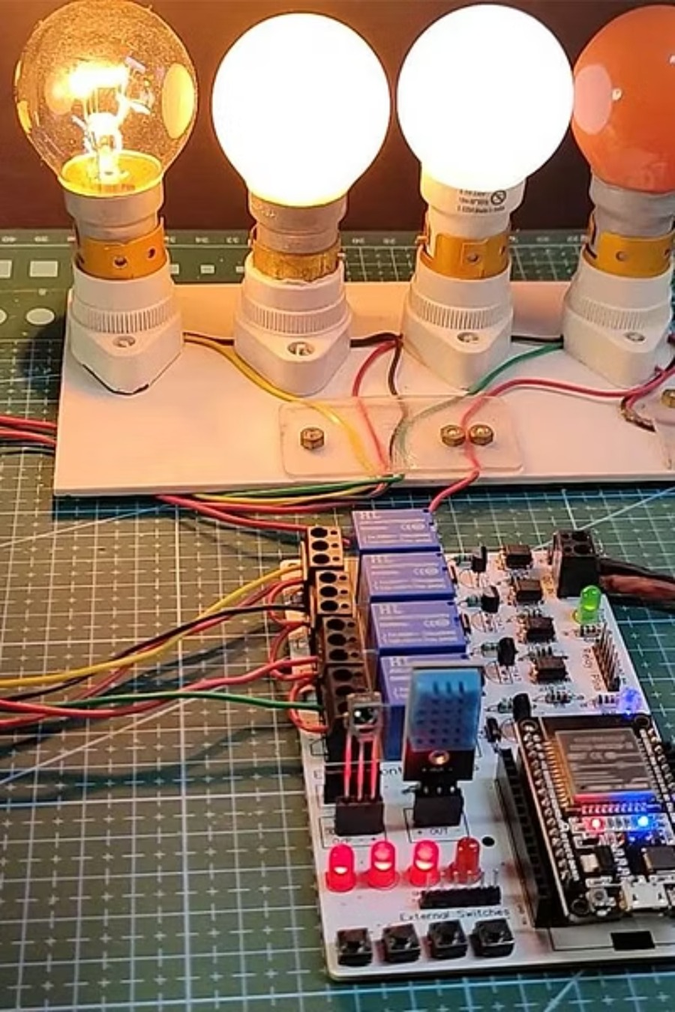

MINOR PROJECT
ESP32 + DHT11 + PIR SENSOR
FLASK + REACT
Smart Home Automation & Energy Monitoring System
IoT-Based Fan & Light Control with Cloud Dashboard — an end-to-end system that senses, decides, and acts in real time to conserve energy and improve home comfort.
Notes:
"Good morning/afternoon everyone. Today I'm presenting my minor project — a Smart Home Automation and Energy Monitoring System. This project combines hardware components like the ESP32 microcontroller, DHT11 temperature sensor, and PIR motion sensor with a full cloud-based web dashboard to create an intelligent, automated home system."

Slide 2

PROBLEM STATEMENT
The Problem We're Solving
Traditional homes are energy-inefficient by design. Lights and fans continue running in unoccupied rooms, driving up electricity bills and carbon footprints — with zero real-time visibility into consumption patterns.
🔌 Energy Waste
Appliances run continuously regardless of occupancy, wasting significant electricity each day.
📊 No Visibility
Homeowners lack real-time data on power consumption, making informed decisions impossible.
🖐 Manual Control
Switching devices on and off manually is inconvenient, error-prone, and unsustainable.
🤖 The Need
An intelligent, automated system that responds to occupancy and temperature — autonomously.
Notes:
Let's start with why this project matters. In most traditional homes, lights and fans keep running even when no one is in the room — which is a direct waste of electricity. There's also no easy way to know how much energy is being consumed in real time. Manual switching is inconvenient and people often forget. Our solution is a system that is smart enough to detect occupancy and temperature, and act on its own — without any human intervention.

Slide 3
PROJECT OVERVIEW
What We Built
The Core Idea
Full-Stack Architecture
An IoT-based Smart Home Automation system that automatically controls a fan and light based on motion detection and room temperature — with all data streamed live to a cloud dashboard and Google Sheets.
Hardware Layer
ESP32 microcontroller + DHT11 + PIR sensor + relay modules
Firmware Layer
The system replaces manual switches with intelligent, sensor-driven decisions, reducing energy waste without sacrificing comfort.
Arduino-based logic for sensing, control, and data transmission
Backend API
Flask (Python) + SQLite + JWT authentication
Frontend UI
React + Vite + Chart.js role-based dashboard
Notes:
"So what exactly did we build? We built a complete IoT-based Smart Home system. The ESP32 microcontroller reads data from sensors and automatically controls a fan and a light. Simultaneously, all this data gets sent to a cloud server and also logged to Google Sheets. On top of that, we built a full web dashboard where users can monitor energy usage, get alerts, and even control devices remotely. It's an end-to-end solution — from hardware all the way to the web."

Slide 4

HARDWARE
Hardware Setup
The physical layer of the system uses affordable, widely available components connected to the ESP32 — a powerful, WiFi-enabled microcontroller that serves as the brain of the entire operation.
Component
Role in the System
ESP32 Microcontroller
WiFi-enabled brain — reads sensors, controls relays, sends HTTP data
DHT11 Sensor
Reads ambient temperature and humidity every 5 seconds
PIR Motion Sensor
Detects human presence and room occupancy in real time
Fan Relay (GPIO 13)
Switches the fan ON/OFF based on firmware logic
Light Relay (GPIO 12)
Switches the light ON/OFF based on motion detection
All components operate at low voltage and are safe for indoor prototyping. The ESP32 handles both sensor reading and WiFi communication simultaneously.
Notes:
"Let me walk you through the hardware. The brain of the system is the ESP32 — a powerful microcontroller with built-in WiFi, which allows it to send data to the internet directly. The DHT11 sensor reads temperature and humidity. The PIR sensor detects motion — basically whether someone is present in the room or not. We then have two relay modules — one controlling the fan on GPIO pin 13, and one controlling the light on GPIO pin 12. These relays act as smart switches that the ESP32 can turn on or off programmatically."

Slide 5

ARCHITECTURE
How It All Connects
Data flows seamlessly from physical sensors to a cloud-hosted dashboard. The ESP32 polls the DHT11 and PIR sensor every 5 seconds, packages the readings into a JSON payload, and transmits it via HTTP POST to both a local Node.js server and Google Sheets simultaneously. The Flask API then processes and stores this data, serving it to the React dashboard where live KPIs, alerts, and analytics are rendered in real time.
Sensors
ESP32
Server & Sheets
API & Dashboard
This dual-path architecture ensures data redundancy — if one logging path fails, the other continues capturing readings. The result is a resilient pipeline from sensor to screen with sub-10-second latency.
Notes:
"Now let me explain how all these pieces connect together. The DHT11 and PIR sensors feed data into the ESP32. Every 5 seconds, the ESP32 packages this data as a JSON message and sends it via HTTP POST to two destinations — our local Node.js server and Google Sheets through a Google Apps Script URL. The Flask backend then serves this data through REST APIs to our React frontend dashboard. So the data flows from physical sensors all the way to a beautiful web interface in real time."

Slide 6
FIRMWARE LOGIC
Smart Control Logic (Arduino Code)
🌡️ Fan Control Rule
⚡ Energy Tracking
The fan turns ON only when temperature ≥ 30°C and motion is detected. This dual-condition logic prevents the fan from running in empty rooms, even during hot conditions — directly reducing wasted energy.
The firmware calculates real-time energy consumption in Watt-hours (Wh) using the formula: Power × Elapsed Time. This running total is transmitted alongside every sensor reading.
📦 Data Payload Sent
💡 Light Control Rule
Temperature (°C)
Humidity (%)
Motion state (active/inactive)
Power draw (Watts)
Cumulative energy (Wh)
The light turns ON whenever motion is detected and turns OFF automatically when the room is empty. No manual intervention required — occupancy is the sole trigger.
Notes:
"This is the core intelligence of the system — the automation logic written in Arduino C++. The fan turns ON only when two conditions are met simultaneously — the temperature is 30 degrees Celsius or above, AND motion is detected in the room. If either condition fails, the fan turns off. The light is simpler — it turns ON whenever motion is detected and turns OFF when the room is empty. We also track energy consumption by calculating power multiplied by time elapsed, giving us energy in watt-hours. All of this runs in a continuous loop every 5 seconds."

Slide 7
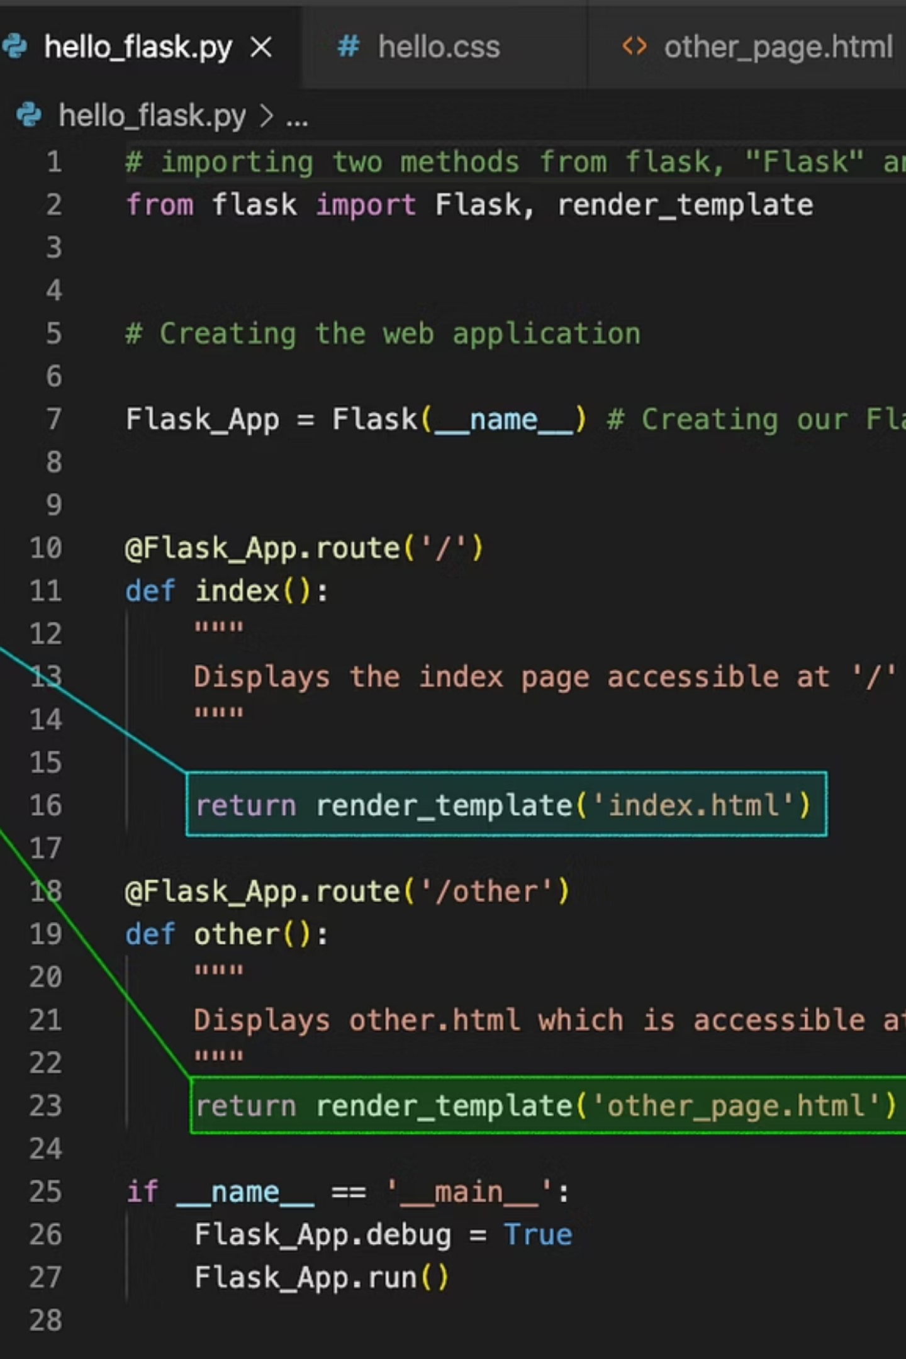
BACKEND
Flask Backend — EnergyIQ Platform
The backend is built with Flask (Python) and SQLite, providing a secure, RESTful API layer between the hardware and the frontend dashboard. JWT-based authentication ensures only authorized users access the system.
🔐 Security
JWT Authentication with two roles: Operator (device control) and Manager (full analytics access). Tokens expire automatically for session security.
🌐 API Endpoints
/api/sensor-data — live readings + alerts + KPIs · /api/device-control — remote toggle · /api/analytics — weekly energy comparison · /api/export-csv — download logs
🚨 Alert System
Critical alerts trigger on power spikes or high temperature. Warning alerts flag voltage anomalies or devices going offline. Alerts appear instantly on the dashboard.
Notes:
"On the software side, the backend is built using Flask in Python with an SQLite database. We implemented JWT-based authentication, which means users must log in with a token to access any data — making the system secure. There are different API endpoints — one for live sensor data with alerts, one for remotely toggling devices, one for analytics, and one for exporting data as a CSV file. The alert system classifies issues into critical alerts like power spikes and high temperature, and warning alerts for things like voltage fluctuations or device going offline."

Slide 8
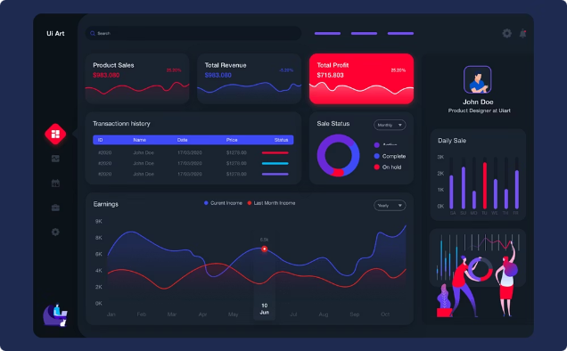
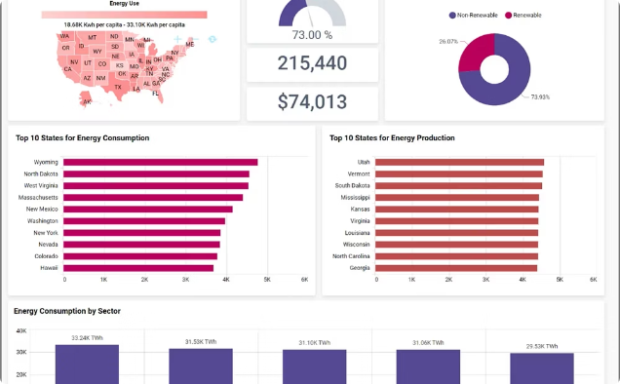
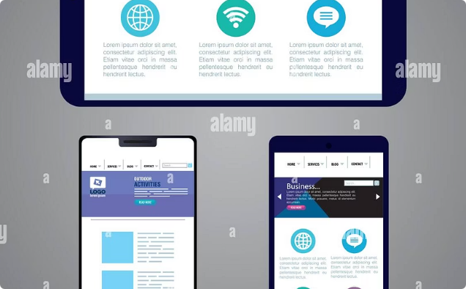
FRONTEND
React Frontend Dashboard
Built with React + Vite + Chart.js, the dashboard delivers a polished, responsive interface that adapts to desktop, tablet, and mobile — with role-based views tailored to each user's responsibilities.
Operator View
Manager View
Role-Based Access
Live sensor readings, device toggle controls, activity log, and real-time alerts — everything needed to monitor and manage devices at a glance.
Advanced analytics including energy timeline (line chart), weekly comparison (bar chart), system health score, and one-click CSV export for reporting.
Operators see the control panel; Managers see full analytics. JWT tokens enforce access levels. Responsive design ensures usability across all screen sizes.
Notes:
"The frontend is built using React with Vite for fast development, and Chart.js for visualizations. We have two different dashboards based on the user's role. The Operator sees live sensor readings, can toggle devices remotely, and views the activity log and alerts. The Manager gets access to advanced analytics — an energy timeline shown as a line chart, a weekly energy comparison bar chart, a system health score, and the ability to export all energy logs as a CSV. The design is fully responsive, so it works on mobile and tablets too."

Slide 9
RESULTS
What the System Achieves ✅
Automatic Control
Real-Time Energy KPIs
Fan and light respond to real occupancy and temperature — zero manual input required.
Live monitoring of kWh today, average power, and device runtime with instant updates.
Dual Cloud Logging
Smart Alerts
Data logged simultaneously to local server and Google Sheets for redundancy and accessibility.
Instant web alerts for power spikes and high temperature thresholds — keeping users informed.
CSV Energy Export
JWT Security
Download complete energy logs for offline analysis, reporting, or further processing.
Role-based dashboard access with secure token authentication for Operators and Managers.
Notes:
"Let me summarize what our system successfully achieves. First, the automation works — the fan and light respond correctly to occupancy and temperature in real time. Second, energy monitoring is live — we can see today's energy in kilowatt-hours, average power, and total runtime on the dashboard. Third, data is backed up to both our server and Google Sheets simultaneously. Fourth, the alert system notifies users of any anomalies like power spikes or high temperature. And finally, managers can export all historical data as a CSV for further analysis."

Slide 10
CONCLUSION & ROADMAP
Conclusion & What's Next
What We Delivered
🔭 Future Scope
We successfully built an end-to-end IoT Smart Home system integrating hardware sensors, ESP32 firmware, a cloud backend, and a real-time web dashboard — demonstrating the practical power of IoT in energy conservation. The system is fully functional, secure, and ready for real-world deployment.
01
Voice Control
Alexa & Google Home integration for hands-free operation
02
Mobile App
Native iOS/Android app for remote monitoring and control
03
ML Optimization
Machine learning for predictive energy usage and anomaly detection
04
More Devices
Support for AC units, water heaters, and smart plugs
05
Solar Integration
Monitor and optimize solar panel energy contribution
Notes:
"To conclude — this project demonstrates how IoT can solve a very real and everyday problem. We successfully integrated hardware sensors, embedded firmware, a REST API backend, and a web-based dashboard into one cohesive system. It's energy-efficient, automated, and remotely accessible. As for future scope — we plan to add voice assistant integration with Alexa or Google Home, build a dedicated mobile app, and explore using machine learning to predict and optimize energy usage patterns. We also want to support more smart devices and eventually integrate solar energy monitoring. Thank you — I'm happy to take any questions."

