Slide 1

Mini Project (BCS- 351)
Mini Project Presentation
On
PDF TO AUDIOBOOK CONVERTER
Submitted by
Ashwani Singh Bhadauriya - 2300971640023
Akash Kumar - 2300971640010
Vatsal Porwal - 2300971640070
Under the Supervision
of
Dr. Narendra Kumar
( Professor)
Galgotias College of Engineering & Technology
Greater Noida, Uttar Pradesh
Mini Project (BCS-351) ODD Semester 2024-25

Slide 2
PDF TO AUDIOBOOK
Converter
Mini Project (BCS-351) ODD Semester 2024-25

Slide 3

WHAT WE ARE?
Welcome to PDF to Audiobook Converter, your go-to website for turning your digital documents into engaging audio experiences. Whether you're on the go, multitasking, or just prefer listening, our easy-to-use platform helps you convert PDFs into high-quality audiobooks in just a few clicks. Simply upload your file and let our advanced AI-driven engine handle the rest. Enhance your learning, leisure, or productivity with audio versions of your favourite documents. Accessible, efficient, and designed with you in mind-unlock the power of audio today!
Mini Project (BCS-351) ODD Semester 2024-25

Slide 4
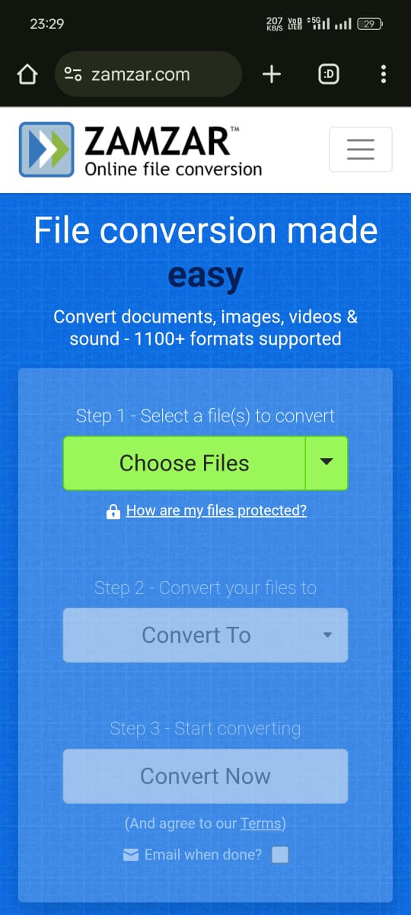
EXISTING SERVICES
Zamzar is an online file converter and compressor, created by brothers Mike and Chris Whyley in England in 2006. It allows users to convert files online, without downloading a software tool, and supports over 1,200 different conversion types.
Mini Project (BCS-351) ODD Semester 2024-25

Slide 5
MOTIVATION
Growing Demand for Audio
Content
Accessibility for Visually
Impaired
Enhanced Learning
Experiences
In today's fast-paced world, audio content is becoming increasingly popular. People are looking for convenient ways to consume information and entertainment while on the go. Audiobooks provide a great solution for individuals who prefer listening over reading, allowing them to learn and be entertained while commuting, exercising, or doing other activities.
Audiobooks provide a unique learning experience, allowing individuals to absorb information passively while engaging in other activities. This is particularly beneficial for students and professionals who are constantly on the go. The ability to listen to academic articles, research papers, and textbooks while commuting or exercising enhances learning efficiency and retention.
Audiobooks are essential for people with visual impairments, enabling them to access written information and enjoy the same literary experiences as sighted individuals. Our PDF to Audio Book Converter aims to bridge the gap in accessibility, ensuring that everyone can enjoy the benefits of reading, regardless of their visual abilities.
Mini Project (BCS-351) ODD Semester 2024-25

Slide 6
OUR OBJECTIVE
The objective of PDF to Audiobook Converter is to provide a seamless and efficient solution for transforming digital text into audio content. Our platform aims to enhance accessibility for users who prefer listening to reading, including those with visual impairments, busy professionals, or multitaskers. By leveraging advanced AI-driven text-to-speech technology, we strive to deliver high-quality, natural-sounding audiobooks from PDFs.
Mini Project (BCS-351) ODD Semester 2024-25

Slide 7
Proposed Idea/Solution
Our proposed solution utilizes an AI-powered text-to-speech (TTS) engine integrated with a sophisticated PDF parsing system and audio production capabilities. This powerful combination ensures accurate conversion, natural-sounding narration, and high-quality audio output.
PDF Parsing
Audio Production
The first step involves parsing the PDF document to extract the text content, preserving the original formatting and layout. This ensures that the audio output accurately reflects the structure and content of the original document.
The final step involves producing the audiobook file, combining the converted speech with any necessary sound effects or music to enhance the listening experience. The tool provides options for different audio formats and quality settings, allowing users to customize the output based on their preferences.
1.
1.
2.
3.
Text-to-Speech Conversion
The extracted text is then fed into the AI-powered TTS engine, which converts the written words into natural-sounding speech. The engine is trained on a vast dataset of human speech, allowing it to produce realistic and expressive audio.
Mini Project (BCS-351) ODD Semester 2024-25

Slide 8
METHODOLOGY
Our methodology involves utilizing advanced text-to-speech (TTS) technology to convert PDF documents into audiobooks. Users simply upload their PDF, select a preferred voice and language, and our AI-powered engine processes the text, transforming it into clear, natural-sounding audio. The platform ensures accuracy in pronunciation and structure, delivering a high-quality listening experience efficiently and reliably.
Mini Project (BCS-351) ODD Semester 2024-25

Slide 9
Our
SERVICE
    Voice Customization
    Multilingual Support
    AI Summarization
    Mobile and Offline Access
Mini Project (BCS-351) ODD Semester 2024-25

Slide 10

SOLUTION ENVIRONMENT
Our PDF to Audio Book Converter will be hosted on a secure and scalable cloud-based platform, ensuring accessibility and availability for users worldwide. This cloud infrastructure allows for flexible scaling to accommodate increasing user demands, guaranteeing a seamless and uninterrupted service. The user interface will be designed with simplicity and intuitiveness in mind, providing a user-friendly experience for individuals of all technical backgrounds.
Scalable Infrastructure
The cloud-based platform ensures that the converter can handle a high volume of users and conversions without experiencing performance issues. This scalability allows us to accommodate growing demand and provide a reliable service for all users.
1.
User-Friendly Interface
2.
The user interface is designed with a focus on simplicity and ease of use, making it accessible to users of all technical backgrounds. Users can easily upload their PDF files, select their preferred voice, and start the conversion process without any complicated steps.
Secure Environment
The cloud platform is secured with industry-standard protocols and practices, ensuring the safety and privacy of user data. All user data is encrypted and protected, providing a secure environment for users to convert their PDF files.
3.
Mini Project (BCS-351) ODD Semester 2024-25

Slide 11


Impact & Benefits: Empowering Users and
Transforming Learning
Provides individuals with visual impairments access to a wider range of information and educational resources.
Enhanced Accessibility
Offers a more engaging and immersive learning experience, catering to diverse learning styles and improving comprehension and retention.
Improved Learning Outcomes
Allows users to consume information and complete tasks more efficiently, freeing up time for other activities.
Increased Productivity
Makes learning more enjoyable and engaging, encouraging users to explore new topics and expand their knowledge base.
Boosted Engagement
Mini Project (BCS-351) ODD Semester 2024-25

Slide 12
SUSTAINABILTY GOAL
To enhance accessibility to information while minimizing paper use and promoting digital consumption by converting PDFs into eco-friendly audiobooks, reducing environmental impact and supporting inclusive education for all."
This goal aligns with both environmental and social sustainability, ensuring access to information without the need for physical resources
Mini Project (BCS-351) ODD Semester 2024-25

Slide 13



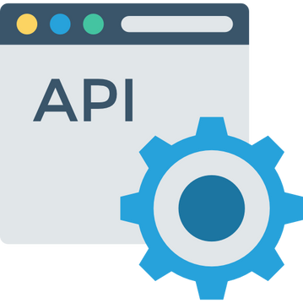
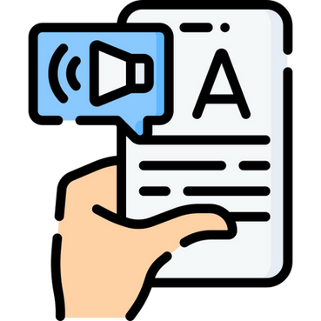
Used
TECHNOLOGY
Mini Project (BCS-351) ODD Semester 2024-25

Slide 14
TECHNOLOGY
THANK YOU!
Mini Project (BCS-351) ODD Semester 2024-25

