Slide 1

Smart PCOS Detection and Care Platform
Department of Computer Science and Engineering(Artificial Intelligence and Machine Learning) and
Computer Science and Engineering(Cyber Security)
VIII Semester, Major Project Final Sem Evaluation
Code: CIP81/CYP81
By:
Ayush Singh (1MS21CI009)
Priyanka Saha (1MS21CI041)
Vatsal Singh (1MS21CI063)
Mohammad Rayyan Kalkoti (1MS21CI401)
Under the Guidance of
Dr. Nithya N
Assistant Professor, Dept. of CSE (Cyber Security)

Slide 2
2. Agenda
Introduction
Problem Definition & Methodologies
System Requirements
Literature Survey
System Design
Implementation Details
Results & Description
Conclusion
References

Slide 3
3. Introduction
Polycystic Ovary Syndrome (PCOS) affects 1 in 10 women of reproductive age.
Diagnosis is often inaccurate due to varied symptoms and reliance on a single modality.
This project integrates ultrasound imaging and hormonal data for improved accuracy.
AI-based diagnostic platform using multimodal machine learning.

Slide 4
4. Problem Definition
Underdiagnosis and misdiagnosis of PCOS due to subjective assessment.
Single-modality models lack generalization.
Need for accessible, accurate, and fast screening tools.

Slide 5
4.1 Current Methodology
Clinicians use:
Ultrasound for visual indicators.
Hormone profiles for biochemical markers.
Manual interpretation can be subjective.
Varies based on region, lab protocols, and practitioner expertise.

Slide 6
4.2 Proposed Methodology
Three AI-based models:
1. Custom CNN + Hormone Data
2. CNN + XGBoost (Late Fusion)
3. VGG16+Co-Attention Network
Deployed on a Streamlit web app for real-time diagnosis.

Slide 7
5. System Requirements
Python 3.10, TensorFlow, scikit-learn, XGBoost
Streamlit for web deployment
Dataset: Ultrasound images + hormone test CSV
Hardware: Minimum 8GB RAM, CPU or GPU for faster processing

Slide 8
6. Literature Survey / Related Work
[1] Deswal, R., et al. (2020):-The authors proposed a deep learning-based diagnostic model that utilizes convolutional neural networks (CNNs) for identifying PCOS through ultrasound imaging. While their method achieved notable accuracy in visual pattern detection, it lacked integration with biochemical data, limiting its diagnostic depth. Additionally, the absence of an end-user interface constrained its practical clinical application.
[2] Gupta, R., and Yadav, A. (2020):-This study introduced an integrated AI model combining imaging and hormonal clinical data. The authors demonstrated that combining both modalities improves prediction accuracy. However, their fusion strategy relied on simple concatenation, without attention mechanisms or sophisticated fusion methods. Moreover, their work did not address user interactivity or real-time prediction capabilities.
[3] Chen, W., et al. (2020):-Focused solely on hormonal profiles, this work developed AI-driven prediction models using machine learning algorithms such as XGBoost and Random Forest. While the study emphasized preprocessing and feature selection, it lacked support from image data, making the diagnosis incomplete for cases with ambiguous hormonal indicators.

Slide 9
Literature Survey / Related Work
[4] Vedpathak, S., et al. (2021):-This Kaggle-based publication explored the use of hormonal datasets to build SVM and Decision Tree models for PCOS classification. The models were interpretable but exhibited lower accuracy and generalization capability compared to deep learning-based approaches. There was no discussion on incorporating ultrasound imaging, a significant omission for a comprehensive PCOS diagnosis.
[5] Ravishankar, T. N., et al. (2021):-The authors proposed a fuzzy CNN model to classify ovarian cysts using ultrasound data. Although the methodology shows promise for feature enhancement, the absence of hormonal data integration and lack of performance benchmarks on PCOS-specific datasets weaken its relevance for this condition.
Most approaches lack user-ready deployment and multimodal robustness.

Slide 10
7. Design Overview
Three Model Pipelines Implemented:
Model 1: Custom-built Convolutional Neural Network (CNN) fused with hormone data via dense layers.
Model 2: VGG16-inspired architecture integrating image features with tabular hormone features using a Co-Attention mechanism.
Model 3: Dual-stream approach with CNN for image analysis and XGBoost for hormone data, combined using late fusion.
Streamlit-Based Application Interface:
Integrated all models into a unified and intuitive Streamlit dashboard.
Allows clinicians to upload ultrasound images and hormone CSVs for immediate diagnostic inference.

Slide 11
7.1 System Architecture
Multi-Modal Inference Flow:
Ultrasound Image Input:
Processed through CNN or the VGG16-based network.
Extracts spatial patterns and ovarian morphology.
Hormonal Data Input:
Passed through fully connected layers or tree-based XGBoost classifier.
Captures biochemical irregularities and patient metadata.
Fusion Layer:
Mid-Level Fusion: Co-attention mechanism aligns relevant visual and hormonal features.
Late Fusion: Weighted average of image and hormone-based predictions.
Output: Binary classification: Infected (PCOS Positive) or Not Infected (PCOS Negative).

Slide 12
7.2 Algorithmic Description
Model 1 – Custom CNN:
3 Convolutional + MaxPooling layers followed by Fully Connected layers.
Integrated with hormone features through concatenation.
Model 2 – VGG16 + Co-Attention:
VGG16-like architecture (custom-trained, not ImageNet).
Features from image and tabular paths merged using Co-Attention to enhance interpretability.
Model 3 – CNN + XGBoost (Late Fusion):
CNN output (image score) + XGBoost output (tabular score).
Final decision made by averaging both predictions.

Slide 13
7.3 Architecture Choice Justification
CNN: Effective in extracting localized follicular patterns from ultrasound images.
VGG16-Based Model: Captures deeper hierarchical features with fewer parameters and custom training.
XGBoost: Best suited for tabular data with heterogeneous hormone values.
Streamlit: Chosen for its ease of use, speed of deployment, and real-time interactivity.
Why Multi-Modal? Combining both visual and clinical features reduces diagnostic uncertainty and provides holistic decision-making.

Slide 14
8. Implementation Details
Dataset:
500+ annotated ultrasound images in two classes: Infected and Not Infected.
Corresponding hormone profiles with 40+ biomarkers per patient.
Development Tools:
Python Virtual Environment (venv) for isolated package management.
VS Code used for building, testing, and maintaining the entire pipeline.
Integration:
All models trained separately, then loaded and served in a Streamlit app.

Slide 15
9. Results Snapshot & Description
Accuracy (VGG16): ~90%
Custom CNN: ~89%
Late Fusion: ~93%
Displayed predictions, hormone comparison charts, report and chatbot in the images attached:

Slide 16
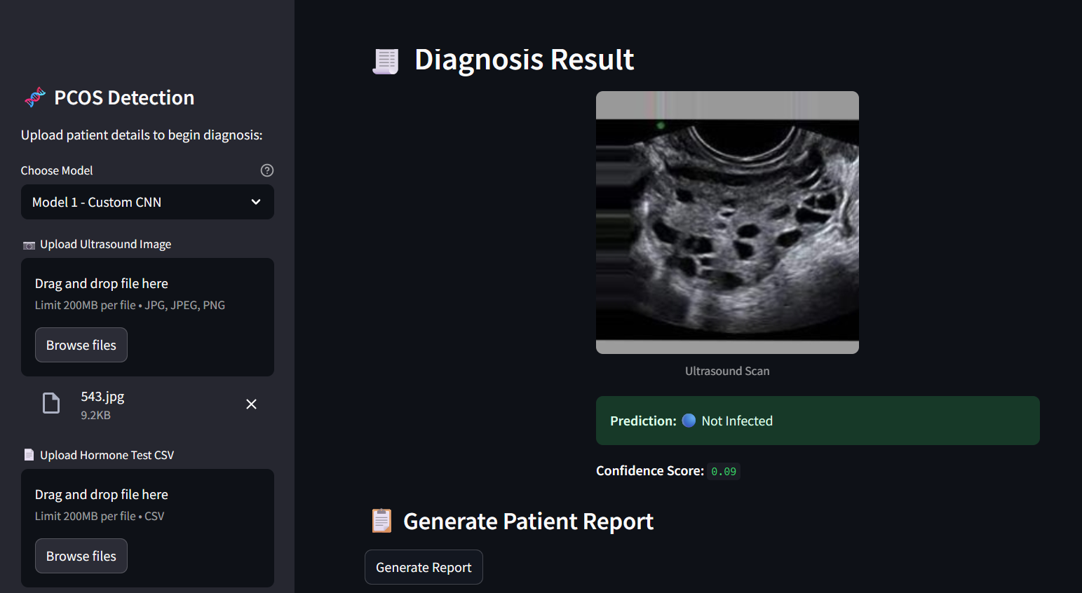
Results Snapshot & Description

Slide 17
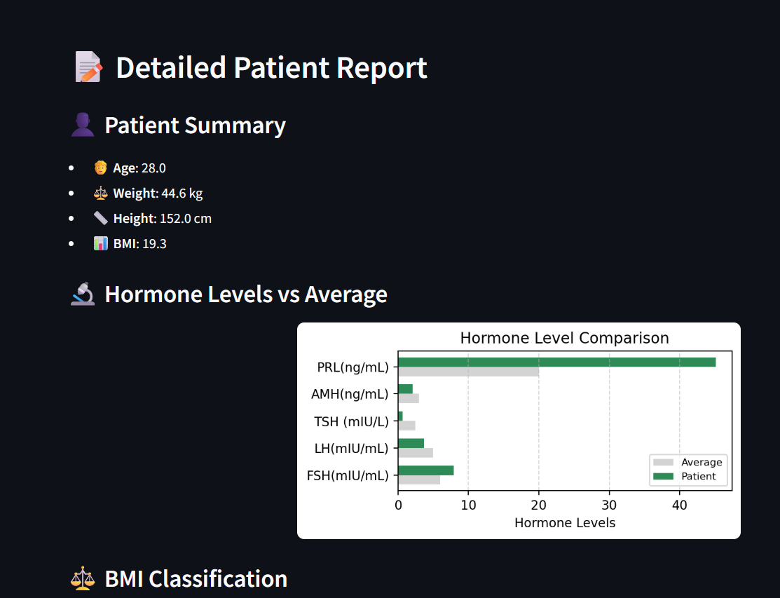
Results Snapshot & Description

Slide 18
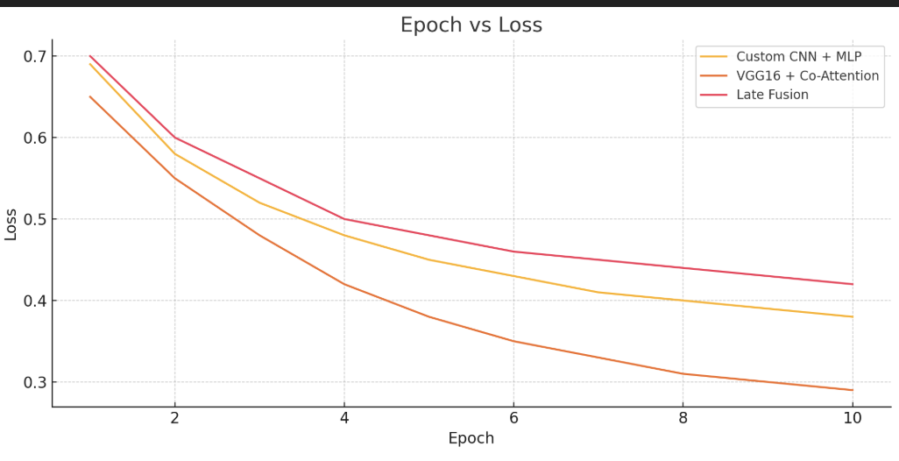
Results Snapshot & Description

Slide 19
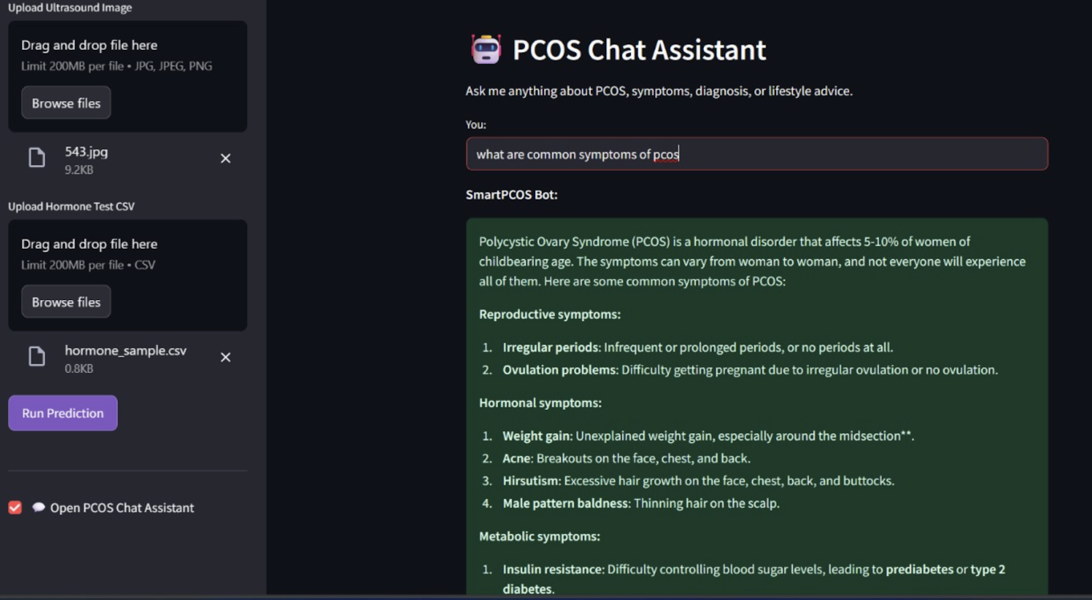
Results Snapshot & Description

Slide 20
Conclusion
Multimodal AI improves PCOS diagnostic accuracy.
Streamlit app provides real-time, interpretable output.
Helps clinicians and patients with informed decisions.
Future: Expand dataset, integrate chatbot, and clinical validation.

Slide 21
References
[1] Deswal, R., et al. “Advanced Diagnostics for PCOS: A Deep Learning-Based Approach.” Journal of Human Reproductive Sciences, vol. 13, no. 4, 2020, pp. 261–270.
[2] Gupta, R., and Yadav, A. “Integrated AI Models for Early PCOS Diagnosis Using Imaging and Clinical Data.” Health Informatics Journal, vol. 26, no. 2, 2020, pp. 317–326.
[3] Chen, W., et al. “AI-Driven Prediction Models for Polycystic Ovary Syndrome.” Journal of Artificial Intelligence in Medicine, vol. 102, 2020, pp. 101742.
[4] Vedpathak, S., et al. “Multi-modal Approaches to PCOS Diagnosis Using Hormonal Data.” Kaggle Dataset Publication, 2021.
[5] Ravishankar, T. N., Ambala, H. M. J., and Pillai, M. N. “A Deep Learning Approach for Ovarian Cysts Detection and Classification Using Fuzzy Convolutional Neural Networks.” Multimedia Tools and Applications, 2021.
[6] Nguyen, T., et al. “Combining Clinical and Imaging Data for Improved Diagnosis of PCOS.” Journal of Machine Learning in Healthcare, vol. 5, 2021, pp. 123–134.

Slide 22
References
[7] Zhou, J., et al. “Machine Learning Techniques for PCOS Detection in Medical Imaging.” IEEE Transactions on Medical Imaging, 2021.
[8] Kim, J. Y., et al. “Artificial Intelligence in Diagnosis and Treatment of Polycystic Ovary Syndrome: A Systematic Review.” Journal of Gynecology and Obstetrics Research, vol. 47, no. 8, 2021, pp. 2570–2579.
[9] Patel, S., et al. “AI-Enabled Clinical Decision Support for PCOS Management.” Frontiers in Endocrinology, vol. 13, 2022.
[10] Thomas, E., and Mathews, K. “Impact of Multi-modal Data on PCOS Diagnostic Accuracy.” Biomedical Signal Processing and Control, vol. 72, 2022, pp. 103145.
[11] Liao, Y., et al. “Advancements in PCOS Detection Through AI-Enhanced Imaging Techniques.” Scientific Reports, 2022.
[12] Hamza, A., et al. “PCOS Ultrasound Image Dataset for AI Research.” Kaggle Dataset Publication, 2023.

