Slide 1
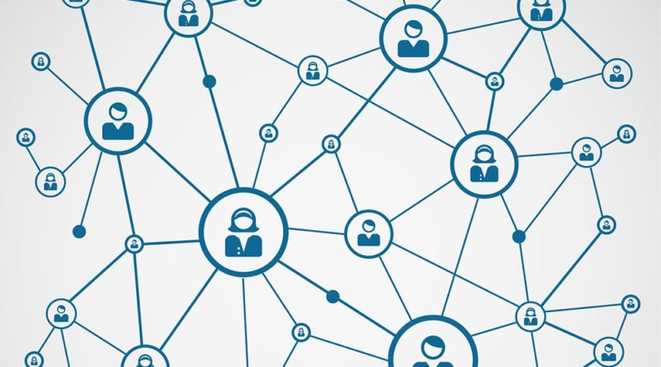
SOCIAL NETWORK implementation using GRAPHS

Slide 2
Social Network
Social Network is a platform that allows people with similar interests to come together and share information, photos and videos.
The most popular social networks are Facebook, Instagram, Snapchat and Twitter.

Slide 3

Example of a Social Network

Slide 4
Implementation:
We have used the Graph data structure to mimic some features of a social network on a small scale.
We used graphs to represent connections between users.
Graphs provide the best way to implement a social network. Also, most of the Social Networks use this data structure as their primary data structure.

