Slide 1


RTR- R2R Training Academy
Leading Practices and Enablers – October 2025

Slide 2

Tower 2
1
Master Data & Governance
2
Close Preparation
3
General Accounting
4
Fixed Assets Accounting
5
Intercompany Accounting
6
Order Creation
7
Balance Sheet Reconciliation
8
Compliance

Slide 3
Master Data & Governance
Source - EYQ

Slide 4
Monthly close calendarized checklist and validations
Pre-close validations
Close all transactions
Confirm cut-off timelines & communicate
Completeness and accuracy validation
Reconcile and confirm interco balances and posting
Review and clear open suspense a/c
Check Assets add, disposal and depreciations settings
Validate exchange rates for revaluation and translation
Four days before due date
Communicate cut-off timelines
Two days before due date
Clear suspense accounts Reconcile bank accounts Balance sheet account reconciliations Sub-ledger to GL reconciliations
On due date
Submit financials to consolidation Review SOX controls Conduct month-end review meetings
2
4
6
START
END
1
3
5
Post-close validations
Review exceptions and anomalies
Confirm reconciliation of bank, GL, sub-ledger
Validate accuracy of financial statements
Compare actuals vs budget and analyze the variance
Ensure timely & accurate submission to grp consolidation
Control execution and documentation for audit trail
Conduct post-close review with stakeholders to discuss issues and improvements
Archive supporting documents and close reports
Five days before due date
Review open items in sub-ledgers Ensure all transactions are posted
Three days before due date
Post accruals and prepayments Perform FX revaluation Run depreciation for fixed assets
One day before due date
Prepare P&L and Balance Sheet reports Variance analysis
High Risk Medium Risk Low Risk

Slide 5
Close Preparation
Source - EYQ

Slide 6






Close Calendar Operating System — Best Practices
Governance & Operating Model
Standardized Work & Checklists
Data, Systems & Automation
Close Owner + Close Council
Policy stack: Close Policy, Close Charter, desk procedures per workstream
RACI & backups per task; escalation paths published
Entity tiering (Tier 1/2/3) — differentiated SLAs, documentation, review rigor
Master WBS: task templates, durations, dependencies, evidence
Pre‑close: GR/IR & suspense clean‑up; recurring JEs; unbilled/unearned review
Close‑day: regional cutoffs, subledger locks, interface monitors, rate/freeze updates
Deploy close orchestration tools integrated with ERP and consolidation systems.
Automate high‑volume recs, IC matching/ elims, recurring JEs, variance alerts.
Standardize COA, entity attributes, calendars with master data governance.
Calendar Design Principles
Controls & Compliance (SOX/COSO/IIA)
Special Situations & Continuous Improvement
Backward schedule from external reporting/board deadlines; derive critical path.
Use wave‑based, follow‑the‑sun scheduling for global teams.
Enforce freeze windows & Late Adjustment Policy with thresholds and approvals.
Strict period management: open/close controls, role‑based posting, dual approvals.
Segregation of duties for JEs, recs, approvals; automate SOD checks.
Centralize evidence repository aligned to PBC and SOX/COSO standards.
For quarter/year‑end, enforce stricter thresholds and enhanced evidence.
For M&A/reorgs, use ring‑fenced calendars and trial consolidations.
For multi‑GAAP/currency, define rate freeze and translation cutoffs early.
KPI Framework & Benchmarks
Operating Rhythm & Communication
Talent, Training & Capacity
ENABLERS

Slide 7

Tiered best‑practice targets — entity‑level vs group‑level close days
Tier
Entity (Local ledger) target
Group consolidation & reporting target
When to use/ Application
Tier 1 – Leader
WD2–3 entity sign‑off
CD ≤5 (or WD3–5) for consolidated FS & management pack
Mature data governance, standardized COA, heavy automation, “move‑left” culture. Anchored to APQC top quartile and EY 6‑WD performers
Tier 2 – Progressing
WD4–5
CD 6–8 (or WD6–8)
Some standardization/automation; a few complex entities or IC frictions
Tier 2
Tier 3
Tier 3 – Baseline
WD6–8
CD 9–12
Fragmented systems, manual reconciliations; use as interim baseline while transforming.
WD – Working Days, CD- Calendar Days

Slide 8

Tiered best‑practice targets — entity‑level vs group‑level close days
Pre‑close (D‑5 to D‑1, rolling)
Daily/weekly reconciliations of cash, AR, AP; auto‑post recurring JEs; subledger hygiene; exception queues triaged.
Lock master data changes; confirm cutoffs with Operations/Procurement; freeze posting calendars per entity.
Complete entity balance sheet recs (risk‑based priority); IC confirmations and auto‑match; FX revaluation for local ledgers; book standard accruals (materiality rules
Entity controller sign‑off; transmit reporting package (mapped to standard COA); IC disputes resolved within defined tolerance windows
Final posting windows close per region/time zone; preliminary TB generated by entity
IC eliminations; minority interests; complex journals; consolidation run; first consolidated TB
Group variance/flux analysis; management commentary drafting in connected reporting workspace
Consolidated management pack released; KPIs updated; issues fed into continuous close backlog
Day 0
Month
end Cutoff
D+1
Entity Focus
D+2
Entity Sign‑off / group prep)
D+3
Group
Consolidation
D+4
Review & Analysis
D+5
Publish
Managing this cadence at scale requires a task/workflow hub (owners, due dates, evidence, approvals, dashboards) and an explicit close calendar object tied to your entity hierarchy.
OUTPUTS
Powered by standardization and automation

Slide 9
Controller‑Led vs. Automated Tasks — Ownership & Coverage
Controller‑Led Tasks
Automated Tasks
Human judgement and involvement
Technology enabled
Policy-driven decisions: Materiality thresholds, accounting estimates, impairment reviews.
Complex journal entries: Non-standard accruals, M&A adjustments, tax provisions.
Variance analysis & commentary: Explaining flux, preparing management narratives.
Control sign-offs: SOX/ICFR certifications, entity-level approvals.
Audit liaison: Providing evidence, responding to queries.
High-volume, rules-based activities:
Account reconciliations (80%+ auto-certification possible).
Intercompany matching & eliminations.
Standard recurring JEs (depreciation, amortization & accruals).
Workflow orchestration:
Task assignment, reminders, escalations.
Real-time dashboards for status visibility.
Data pulls & validations: GL extracts, subledger tie-outs, bank feeds.
Exception handling: Bots flag anomalies; humans review only exceptions.
Task​ | Automation Coverage​
Account Reconciliations​ | High​
Intercompany Matching/Eliminations​ | High​
Recurring Journal Entries​ | High​
Close Orchestration & Reminders​ | High​
Variance Pre-screening & Anomaly Detection​ | Medium​

Slide 10
Task Management Overview
Task Management provides a configurable, web-based command centre where you can manage accounting and finance tasks. Utilising a hierarchical task list, role based workflow, and real-time dashboards, the task management product allows users to track and control a variety of task types, including month end close checklists, PBC lists, tax filings, and more. The key features of this module include:
Central Management of Processes
Task Management provides hierarchical task lists and workflows to control numerous manual processes across accounting and finance.
Cross-product task dependencies, certifications, and email notifications ensure that tasks are established, assigned, communicated, and achieved ahead of deadlines.
Accelerated Accounting Process
Tasks are configurable across BlackLine products and can be linked with reconciliations and journals, guaranteeing the correct sequence, flow, and rollup of related activities.
Milestone tasks can be used to track activity and automatically certify when child tasks are executed.
Real-Time Dashboards
Real-time dashboards and comprehensive reporting capabilities give accounting leaders immediate visibility into completed and outstanding items by task type, geographic location, and due date.
Automatic notifications warn users of pending tasks and notify management of overdue tasks and bottlenecks.
5

Slide 11
BlackLine Task Management – Architecture and Process
BlackLine Tasks module supports centralized web based solution to manage global, regional, corporate and team activities/tasks performed during a financial close cycle.
Reject back to Preparer
Expectations
Move away from manual close processes
Approvals of tasks and milestones to be completed in BlackLine
Workflow
Preparer
Preparer
Approver/Reviewer
Review task details, add comments, add documents
Complete tasks
Review documents, comments and approve
Milestones
Blackline
Administrators
Admin & Data Loads
Manage user security provisioning/authorization
Task profile updates
Template management
Schedule management
Tasks
Control Points
Segregation of duties
Notification for:
Due Dates
Delinquent tasks
Rejections
Role based assignment and access
Visibility into bottlenecks
Metadata (due dates, ownership etc.)
Governance & Reporting
All Users
Auditors
Governance
Auditors
Status reports, dashboards and filters
Centralized
audit and QA
Dashboards and Reporting
(Status Tracking, Analysis, etc)
Centralized
audit and QA
5
6

Slide 12
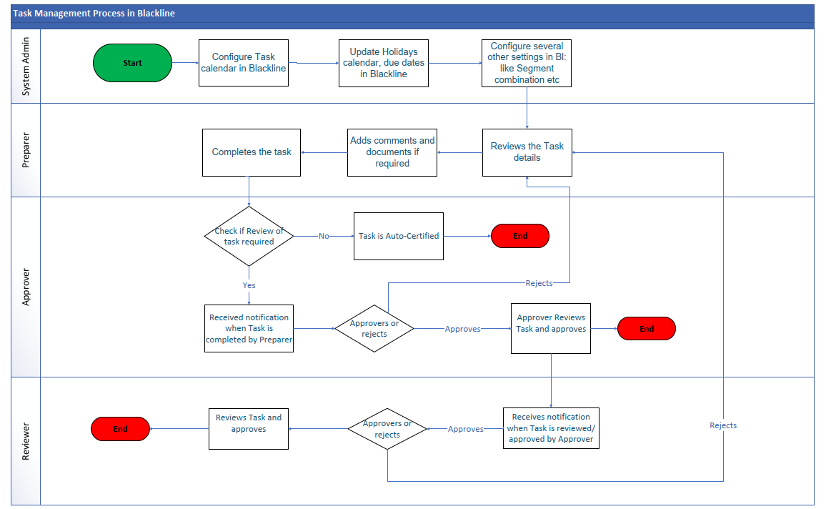
Task Management-Workflow
Blackline Task Management supports a centralized web-based solution to manage month close activities / checklists at Global, Regional, Corporate, Entity and team level during a financial close cycle.
System admin configures the Task calendar in Blackline, update holidays calendar, due dates & configure other settings in Blackline like segment combination, entity structure etc.
Preparer completes the tasks assigned to them, add comments & supporting documents if required & reviews the task details
Approver reviews the tasks assigned to them. An auto certified task doesn’t need approver review. For the tasks assigned to them, an approver looks into the comments & supporting documents attached by preparer and can approve or reject a task.
A task if rejected goes back to the preparer.
A reviewer is an optional additional layer of review that an organization can keep. Once the tasks get assigned to the reviewer, they can either approve or reject the task after looking at the comments of preparer & approver. A task if rejected goes back to the preparer.

Slide 13
Leading practices – Manual journal entries
Policies
Process
Technology
Global policies to be formulated and implemented across organization considering:
Assignment of user access as a Journal Preparer or Approver requires requisite approvals depending upon the nature of posting and impacted teams
Approver rights granted to only those who have formal responsibility for reviewing
Segregation of duties between Preparer and Approver using business rules in the General Ledger system
The level of Chart of Accounts (COA) access assigned to all users
Use of manual adjustment accounts rather than posting directly to reconciliation accounts
Define journal posting thresholds (e.g. no posting below $1k)
Create approval matrix (e.g. one level approval till $10k, additional level approvals for more that $10k)
Implement journal thresholds during period close (WD1 to WD5)
Standardized Templates for JEs, Don’t fit every journal into ONE standard template
GL Accounts should be consistent across the enterprise including field attributes
Add validation rules within the JE template
Integration of journal template and ERP
Leverage automated recurring entries and accruals along with approval workflow
Address and solve Overdue Journals with Journal Entry Automation
Add adequate supporting documentation
Apply materiality thresholds accurately for manual journal entries: Review and confirm whether each manual JE is required separately or there is opportunity to combine entries
Document the process for the specific journal entry posting
Periodic review of manual journal entries to access for automation opportunities
Journal Entries should have status, change history, audit trail and control documented in the system
Maintain and review accuracy tracker
Centralized & Automated Processes
Enhance Audit Readiness & Collaboration
Single, global chart of accounts adopted to simplify mapping
Use parallel ledger to book statutory postings (as opposed to creating additional G/L accounts for statutory books)
All the policy documents and training materials to be saved at common share point with easy accessibility
Software/Tools: BlackLine, Trintech, RPA etc.

Slide 14
Journal Entry Overview
Journal entries are the building blocks of an organization’s accounting system. All systems, whether they are paper-based, completely automated, or a hybrid of the two, are predicated on Journal Entries. Journal entries record all transactions for a business and are broadly defined as any financial activity that impacts the business. They are not limited to the buying and selling of goods and services, but include any exchange of monetary value, such as interest payments, depreciation, expenses, or payroll.
Common Journal Entry Types
Adjusting entries are made at the end of an accounting period to record transactions that were not recognized during the period, such as accrued or deferred expenses, or to correct a mistake from the previous period.
Compound entries reflect a transaction that has more than two lines, like a purchase that involves cash and a loan.
A recurring Journal Entry is one that repeats in every reporting period for such expenses as monthly rent or depreciation on an asset.
Reversing entries cancel entries from the previous reporting period.
An unbalanced Journal Entry occurs when the debit and credit do not add up. This will have to be corrected before the financial statements are finalized.
Purpose of Journal Entry
Journal records all the financial transactions of a business in one place on a time and date basis.
For each and every transaction which of the two concerned accounts will be debited and which account credited, are clearly written in journal. So, there is no possibility of committing any mistake in writing the ledger.
Since all the debits of transaction are recorded in journal, it is not necessary to repeat them in ledger. As a result ledger is kept tidy and brief.
Functions of Journal Entry
Analytical Function: While recording a transaction in the journal each transaction is analysed into the debit aspect and the credit aspect. This helps to find out how each transaction will financially affect the enterprise.
Recording Function: Accountancy is a business language which helps to keeps the record of the transactions based on the principles. Each such recording entry is supported by a brief narration, which explains, every transaction in simple language.
Historical Function: Journal book contains a chronological record of the transactions for future references.
Characteristics of Journal Entry
Chronology: The journal entries get recorded in a date-wise order, and it helps in checking the transactions much more quickly.
Double Entry System: Journal entries follow a system where every transaction is entered both on the debit and credit sides. It is an example of a dual entry system. One account gets debited and the other gets credited with the same value.
Daybook: A journal records transactions on a day-to-day basis for consistency and ease.
Compound Entry: A single entry can have two or more accounts on the same day, and a journal can also have more than one related transaction

Slide 15





Journal Entry Approval Matrix & Template
JE Category / Criteria | Preparer | Reviewer | Approver | Compliance Notes
Low-Value JE (< $10K) | Accountant / Analyst | Optional | Auto-post or Team Lead | System validations must be in place
Mid-Value JE ($10K–$100K) | Accountant | Senior Accountant / Team Lead | Manager / Controller | Backup documentation required
High-Value JE (> $100K) | Senior Accountant | Manager | Controller / CFO | Justification memo + audit trail
Accruals / Provisions | Accountant | Senior Accountant | Manager | Reversal logic documented
Adjustments / Corrections | Original Preparer | Reviewer | Controller | Must reference original JE
Intercompany JE | Local Entity Accountant | Regional Controller | Global Finance | Must reconcile with counterparty
Manual JE (non-automated) | Preparer | Reviewer | Approver | Mandatory attachments and comments
Recurring JE | System / Preparer | Reviewer (monthly) | Approver (quarterly) | Periodic revalidation required
JE impacting P&L > $50K | Preparer | Reviewer | Controller | Financial impact analysis required
JE impacting Balance Sheet > $250K | Preparer | Reviewer | CFO / Head of Finance | External audit visibility required
JE involving regulatory accounts (e.g., tax, legal reserves) | Tax / Legal Team | Finance Controller | CFO / Compliance Officer | Must comply with local GAAP/IFRS
JE during close period (blackout window) | Preparer | Reviewer | CFO / Controller | Requires justification and exception approval
Embedded Controls & Best Practices
Segregation of Duties
SOX Compliance
System Integration
Exception Handling
Documentation
Source: EYQ, ChatGPT

Slide 16
Journal Entry Approval Matrix & Template
Step | Preparation Checklist |  | Review Checklist
 | Checklist Item | Details | Checklist Item | Details
1 | Entry Type Identified | Standard, Accrual, Intercompany, Manual, Recurring, etc. | Segregation of Duties Maintained | Preparer ≠ Reviewer
2 | Supporting Documentation Attached | Invoices, schedules, contracts, calculations, etc. | Documentation Verified | Backup is complete, relevant, and legible
3 | Correct Accounts Used | GL accounts mapped correctly per chart of accounts | Account Mapping Validated | GL accounts align with nature of transaction
4 | Accurate Amounts | Verified calculations and currency conversions | Policy Compliance Checked | Entry complies with internal accounting policies
5 | Proper Period Selection | Entry posted in correct accounting period | Materiality Assessed | High-value entries flagged for senior review
6 | JE Description Provided | Clear, concise, and informative | Recurring Entry Validated | Matches approved schedule and logic
7 | Reversal Logic (if applicable) | Reversal date and method documented | Manual Entry Justified | Reason for manual posting clearly documented
8 | Compliance Tags Applied | SOX, tax, audit, regulatory flags if needed | Audit Trail Confirmed | Entry history and changes traceable
9 | Entry Balanced | Debits = Credits | Impact Analysis Done | For P&L or Balance Sheet impact > threshold
10 | ERP Validation Passed | Entry passes system checks (e.g., SAP, Oracle) | Reviewer Comments Added | Notes for context or future reference
Source: EYQ, ChatGPT

Slide 17
Journal Entry Automation – Tool Maturity Matrix
Capability
 | ERP Native (SAP/Oracle/NetSuite/D365) | RPA Bots (UiPath/AA/Blue Prism) | Best-of-Breed R2R (BlackLine/Trintech/HighRadius) | GenAI JE Assistants (SAP Joule/Oracle AI/HighRadius AI)
Standard JE Creation
Accrual Engine
Allocations
Intercompany JE Automation
Reversals
Adjustments & One-offs
Compliance & Audit Trail
AI/ML Recommendations
Scalability
User Experience
Tools
No Capability
Tool Support Marginal Feature Of Capability
Feature Partially Present In Naive State
Feature Fully Present In Naive State
Feature Fully Present
Source: EYQ, ChatGPT

Slide 18
Journal Entry Automation – Benchmarking
Measure Name | Unit of Measurement | 25Th Percentile | Median | 75th Percentile | Average | Sample
Percentage of journal entry line items that are automated and recurring | Percent | 22 | 28 | 32 | 30.92 | 738
Percentage of journal entry line items sourced through methods other than manual, direct link, or automated entry | Percent | 0 | 0 | 0 | 0.31 | 686
Percentage of journal entries processed automatically | Percent | 80 | 90 | 95 | 87.28 | 1612
Percentage of total accruals generated using a fully automated method | Percent | 42 | 48 | 54 | 47.28 | 510
Percentage of total accruals generated using both automation and manual methods | Percent | 32 | 40 | 46 | 39.48 | 500
Percentage of intercompany transactions processed using a fully automated method | Percent | 44 | 50 | 56 | 50.21 | 589
Percentage of Automated Journal Entries | Percentage (%) | 40% | 60% | 80% | 65% | 200
AI-Driven Journal Entry Automation Rate | Percentage (%) | 20% | 35% | 50% | 40% | 200
Cycle Time for Journal Entry Processing | Days | 2 days | 1 day | 0.5 days | 1.5 days | 200
Error Rate in Journal Entries | Percentage (%) | 10% | 5% | 2% | 6% | 200
Cost per Journal Entry Processed | Currency (e.g., USD) | $5 | $3 | $1 | $3.50 | 200
Time to Close Month-End Reporting | Days | 10 days | 7 days | 5 days | 6 days | 200
AI Error Detection Rate | Percentage (%) | 30% | 50% | 70% | 55% | 200
Reduction in Manual Intervention due to AI | Percentage (%) | 20% | 40% | 60% | 45% | 200
Percentage of Journal Entries Reviewed by AI | Percentage (%) | 25% | 50% | 75% | 60% | 200
Time Saved per Journal Entry due to Automation | Hours | 0.5 hours | 1 hour | 1.5 hours | 1 hour | 200
User Satisfaction Score for Automation Tools | Score (1-10) | 5 | 7 | 9 | 7.5 | 200
Training Time for Staff on Automation Tools | Hours | 4 hours | 2 hours | 1 hour | 2.5 hours | 200
Percentage of Compliance with Internal Controls | Percentage (%) | 70% | 85% | 95% | 80% | 200
Integration Rate with ERP Systems | Percentage (%) | 60% | 75% | 90% | 80% | 200
Percentage of Journal Entries Requiring Rework | Percentage (%) | 15% | 10% | 5% | 8% | 200
Source: EYQ, ChatGPT

Slide 19
General Accounting
Source - EYQ

Slide 20






Management of the Chart of Accounts
Design principles
Benefits
The CoA should be rationalised and fit-for-purpose, highly aligned & consistently used across the ERP systems
Prerequisite for achieving a leading touch-less and automated RTR process
A global CoA should be applied to all entities, where possible, to reduce complexity in the RTR process
Ownership of CoA should be assigned one team responsible for creating change and performing quality checks
Consistent management of CoA – Increased efficiency by reducing amount of manual and time-consuming tasks
The dedicated team must challenge the need for new accounts, while being solely responsible for the creation and maintenance of the CoA setup
Source - EYQ

Slide 21
Chart of Account (Overview)
Construction and division of accounts:
The account should contain:
The name and its digital symbol, which indicates its place into the company’s chart of account;
The possibility of identifying the event (date of recording, number and type of evidence and content of the operation);
Amount of operation;
Two side of the account debit (Dt) and credit (Wn). Division of the account into the left side, in which for active accounts we record operation that increase their value. However, for passive accounts, the left side presents changes that reduce their value.
Division of the account into a right side, in which we record a decrease in value for active accounts. Similarly, for passive accounts, it shows positive events.
Construction of general ledger account are usually marked with 3 digits. There are usually 9 teams, marked from 0 to 8, as below:
0 – Non-current assets, there include (for example: 010 – Fixed assets, 020 – Intangible assets, 070 – Write-off of fixed assets);
1 – Cash in hand and bank account and other short term financing assets (for example: 100 – Cash, 130 – Current account, 145 – cash on the way)
2 – Settlements and claims (for example: 200 – Receivable accounts, 220 – public settlements, 240 – other settlements
3 – Materials and goods (for example: 301 – purchase of materials, 310 – materials, 390 external stocks);
4 – Costs accounts (for example: 400 – depreciation, 402 – external services, 409 – other costs);
5 – Costs by type of activity and settlement (for example: 500 – costs of core business, 522 – purchase costs, 550 – management costs);
6 – Accruals (for example: 601 – finished products, 602 – semi-finished products, 603 – work in progress);
7 – Revenues and costs related to their achievement (for example: 701 net revenues from the sale of finished products, 750 – financial revenues, 771 – extraordinary losses);
8 – Equity, special funds and profit or loss (for example: 801 – share capital/owner, 840 – provisions, 860 – profit or loss).
Source - EYQ

Slide 22
Chart of Accounts(CoA)
Overview:
CoA is a structured list of all accounts used by a company to organize its financial data, enabling seamless tracking, analysis, and reporting of financial performance.
It provides a standardized language for financial reporting, ensuring that stakeholders—from internal management to external auditors—can interpret financial data with clarity and precision
Role of Best in Class CoA:
Accurate Financial Reporting
Compliance and audit
Facilitates Efficient Consolidation
Data Analysis and Insight
ERP System Integration
Cost Allocation
Purpose :
To provide a standardized structure for recording financial transactions, ensuring consistency, accuracy, and ease of reporting.
Reporting Segment
P&L Reporting Segment
Management Reporting
Legal entity
Line of Business
Cost Center
Natural Account
Product
Location
Intercompany Type
Business Unit
Department, Sub-dept
Areas within the organ. to which costs are assigned or allowed
Account values & hierarchies
Product Category Values and hierarchy
Country, Region
Affilliate Entity
Source - EYQ

Slide 23
Chart of Account (Overview)
lists of all the GL accounts included in the financial statements of a company. Every account in the chart holds a number to facilitate its identification in the ledger. It helps organizations prepare, maintain, and monitore their financial accounts as per the standard accounting norms during a specific accounting period. Using incorrect account code or not having enough codes will limit or produce wrong FS. The accounts list may also include codes that are not require but is worth keeping for future use. There are 5 main account categories: Assets (Current and Non-Current Assets or Fixed Assets), Liabilities (Current and Non-Current or Long-term Liabilities), Equity, Revenues and Expenses. Below please find COA reporting segments
Reporting Segment
P&L Reporting Segment
Management Reporting
Legal entity
Line of Business
Cost Center
Natural Account
Product
Location
Intercompany Type
Business Unit
Department, Sub-dept
Areas within the organ. to which costs are assigned or allowed
Account values & hierarchies:
Product Category Values and hierarchy
Country, Region
Affilliate Entity
To record financial transactions there are used General and Sub-ledger. The part of Chart of Account is General Ledger, but to organized the general ledger for a large company maintaining multiple sources of revenue and debts is a subledger. The number of a subledger is reflected in the general ledger of an organization. The diffrence between general ledger and subledger:
General Ledger - include limited volume of data and is covering only set of a diffrent master accounts, where:
All debit and credit entries of transactions and balances are recorded;
There is only one account for each category;
Contains only summary information;
There isn’t a balancing requirement.
–:
Subledger – includes a large quantity of data, which is:
Important for audits purposes;
Helpful for reviewing financial statements;
Giving more detailed view of where cash is being spent;
Sub-ledger by each customer can help accountant to follow up on late payments;
There are often several accounts for each of its corresponding general ledger accounts;
Must total the amount displayed in the appropriate general ledger account.
Source - EYQ

Slide 24
Chart of Accounts(CoA)
Key Components
The CoA is typically organized into hierarchical tiers, each representing a level of granularity in financial data classification. It comprises the following key elements:
Level 1
Level 2
Level 3
Level 4
Account categories
Accounts types
Account Sub-types
(Assets)
Broad financial categories that align with financial statements.
Detailed Accounts
(Current Assets)
Sub-classifications within each category to provide more granularity.
(Cash & Cash Equivalents)
Deeper level of detail to track specific financial elements.
(Bank-operating, Bank-Payroll, petty cash)
Most granular level capturing individual transactions for actionable insights.
Source - EYQ

Slide 25
COA - Common numbering methods and structures
Use 6-8 account digit alphanumeric codes
Creates ample “space”
Easier for users to input transactions
Minimized unnecessary digits for data entry
Leading Practice COA Numbering
10000000-19999999 | Assets
20000000-29999999 | Liabilities
30000000-39999999 | Equity
40000000-49999999 | Revenue
50000000-59999999 | COGS
60000000-69999999 | SG&A
70000000-79999999 | Other Income & Expense
80000000-89999999 | Open
90000000-99999999 | Statistical
Last digit or even better the last 2 digits should be zero
Allows insertion of up to 9 or 99 more accounts
Allows flexibility of future growth
Remain consistent in formatting and concise in language
Consistency across capitalization, use of symbols, abbreviations, etc.
Names should provide enough information to understand the accounts purpose
No significant system issues
8 digit code vs shorter codes
System does not deteriorate if using a longer code
Excessively long codes can be unnecessarily tedious for end-users, or create input errors
Global COA sets the standard for numbering ranges
Varying country requirements for statutory reporting
Accommodated via ERP’s alternate account functionality or local COA mapping

Slide 26
Chart of Accounts(CoA)
Key features of Reporting enablement
Multi-Dimensional Reporting: Accounts are tagged with dimensions such as department, region, project, or cost centre to enable detailed analysis
Hierarchical Structure: The CoA is organized in a hierarchical manner (e.g., 4-tier structure) to allow for both high-level summaries and granular details
Scalability: The CoA is flexible and scalable to accommodate organizational growth, new business lines, or changes in reporting requirements
4.Compliance: The CoA is aligned with accounting standards (e.g., GAAP, IFRS) and regulatory requirements to ensure compliance
5.Automation: Integration with ERP systems (e.g., SAP, Oracle) enables automated data capture, reconciliation, and reporting
6.Consistency: Standardized naming conventions and numbering systems ensure consistency across the organization
Best in Class Governance Model – Role played
Chart of Accounts
Policies
R2R
How They Work Together
CoA as the Foundation: The CoA provides the structure and granularity needed for financial processes.
Financial Processes as the Core: These processes rely on the CoA for accurate data recording, reconciliation, and reporting.
Policies and Governance as the Framework: Policies and governance ensure the CoA and financial processes are aligned, compliant, and effective.
Source - EYQ

Slide 27
Record to Report : Governance model
Performance Metrics
Policies and Procedures
Development of key performance indicators (KPIs) to monitor and measure the effectiveness of CoA and identify deviations in reporting
Development and implementation of policies and procedures that govern the applicability and implementation of CoA, including data privacy, data security, and internal controls
External Controls
Organizational Structure
Regular review and audit of CoA by designated personnel to identify areas for improvement and ensure compliance with regulatory requirements and adherence to any updates
Chart of Accounts GOVERNANCE MODEL
Establish a well defined organization structure with ownership, responsibilities mentioned explicitly and reporting relationships for accountability
Internal Controls
Compliance
Implementation of internal controls, such as access controls, GL creations and grouping, to ensure the accuracy and integrity of financial information and compliance with internal policies and procedures
Ensuring compliance with relevant accounting standards, tax laws, and regulatory requirements, including Sarbanes-Oxley, IFRS, and other local and international regulations

Slide 28

Policy Lifecycle – Example Governance Policy for CoA Design and Maintenance
Best-in-class governance policies for Chart of Accounts (CoA)
Periodic Review
Annual reviews are conducted to ensure the CoA usage policy remains relevant and aligned with organizational goals. Trigger events, such as regulatory changes or audit findings, may prompt earlier reviews
Intake
A new business unit is introduced, requiring updates to the CoA to accommodate new account categories and reporting dimensions
Intake
Draft
The policy owner drafts the updated CoA policy, consulting with the Global Process Owner (GPO) and Risk & Compliance (R&C) teams to ensure alignment with organizational goals and regulatory requirements.
Periodic review
Draft
Monitor
Adoption metrics (e.g., correct account usage) and exception trends (e.g., misclassification of transactions) are tracked to assess the effectiveness of the updated CoA usage policy.
Policy Lifecycle
Review
Review
Legal, Tax, and Local Process Owners (LPOs) conduct a peer review to ensure the updated CoA policy complies with accounting standards (e.g., GAAP, IFRS) and is operationally feasible.
Enable
Training sessions are conducted for finance teams, and controls are implemented to ensure consistent CoA usage across business units.
Monitor
Approve
Enable
Publish
The updated CoA usage policy is published in the central repository, notifications are sent to stakeholders, and the catalog is updated. For major changes, the effective date is set at least 15 business days post-publish
Publish
Approve
PDA approves the updated CoA usage policy, followed by Librarian QA to verify metadata, links, and consistency with the CoA repository.

Slide 29
CoA Harmonization program and rollout plan
Phase 5
Hypercare Governance Model Continuous Improvement
Phase 3
System Configuration Data Migration Testing
Post-Go-Live Support & Governance
Phase 1
Stakeholder Alignment Current State Analysis Define Harmonization Goals
Change Management & Training
Implementation
Phase 4
Training Programs Documentation Communication
Harmonization and Consolidation
Design & Blueprinting
Assessment & Planning
Phase 2
Design Principles Standard CoA Structure Mapping Rules
Successful harmonization Metrics:
Reduction in GL accounts by X%
Improved reporting cycle time
Enhanced audit readiness
Increased user satisfaction

Slide 30
Fixed Assets Accounting
Source - EYQ

Slide 31
Fixed asset Overview
Fixed assets are long-term tangible and intangible resources owned by an organization, utilized in the production of goods and services. They are not intended for sale in the ordinary course of business
Fixed Assets Usage
Operational Efficiency: Critical for maintaining smooth operations and enhancing productivity.
Financial Health: Significant portion of total assets, impacting profitability and investment decisions.
Strategic Planning: Essential for informed decision-making regarding capital budgeting and resource allocation
Challenges in fixed asset accounting
Expense Misclassification : Difficulty in distinguishing between capital and operating expenses leads to incorrect asset capitalization.
Delayed Asset Tagging : Physical assets are often not tagged or recorded promptly, resulting in incomplete asset registers.
Depreciation Inaccuracies : Errors in useful life, residual value, or asset usage updates cause incorrect depreciation calculations.
Process & Compliance Gaps in Capitalization Lifecycle : Inaccurate timing of capitalization, delayed AUC closure, and inclusion of non-capex items reflect weak controls and non-compliance with IAS 16.
Systemic & Operational Fragmentation : Disconnected systems across procurement, project management, and asset accounting result in poor cost tracking, manual reconciliations, and limited visibility into AUC balances and project status.
Accounting Treatment
Initial Recognition
Depreciation
Impairment
Disposal
At cost (purchase price + directly attributable costs)
Systematic allocation of cost over useful life
Reduction in recoverable value
Derecognition when sold or scrapped

Slide 32
Fixed Asset Capitalisation Best Practices
Policy & Governance
Process & Controls
Data & Systems
Accounting & Reporting
Monitoring & Compliance
Special Scenarios
1. Policy & Governance
Global Policy Harmonization: Standardize asset accounting policies across entities to enable automation and reduce manual exceptions.
AI-Driven Policy Compliance Checks: Use AI to scan transactions and flag non-compliance with capitalization or depreciation rules.
Digital Approval Workflows: Implement e-signature and workflow tools for asset-related approvals to ensure traceability.
2. Process & Controls
Automated Asset Lifecycle Triggers: Use system events (e.g., GRN, project completion) to auto-initiate asset creation or capitalization.
AI for Expense Classification: Deploy machine learning models to classify costs as capital or expense based on historical patterns and policy rules.
Bot-Based Reconciliations: Use RPA bots to reconcile FA subledger with GL monthly, reducing manual effort and errors.
3. Data & Systems
Centralized Asset Master Data Hub: Maintain a single source of truth for asset data across systems (ERP, EAM, etc.).
AI-Powered Data Cleansing: Use AI to detect duplicates, missing fields, or inconsistent asset tagging.
Predictive Maintenance Integration: Link asset accounting with IoT and predictive maintenance systems to inform impairment or useful life adjustments.
4. Accounting & Reporting
Automated Depreciation Runs: Schedule and execute depreciation postings with zero manual intervention.
AI Forecasting Models: Use AI to project depreciation, impairment risks, and asset retirement timelines for planning and reporting.
Real-Time Dashboards: Implement Power BI or Tableau dashboards for asset movement, depreciation trends, and audit readiness.
5. Monitoring & Compliance
Continuous Monitoring with AI: Use anomaly detection to flag unusual asset additions, disposals, or valuation changes.
Digital Audit Trails: Ensure every asset transaction is logged with user, timestamp, and system action for audit readiness.
Compliance Bots: Deploy bots to check IFRS/GAAP compliance across asset classes and geographies.
6. Special Scenarios
Lease Accounting Automation (IFRS 16): Automate ROU asset creation, amortization, and lease liability tracking.
AI for Componentization: Use image recognition or engineering data to identify asset components for separate accounting.
Intercompany Transfer Automation: Automate asset transfer postings with correct valuation and depreciation resets across entities.

Slide 33
Fixed Asset- Document Checklist
Right‑first‑time depreciation
Cycle time
Variance analytics
Depreciation Run Checklist
KPI/analytics to monitor every close
Pre‑run (T‑5 to T‑1)
% assets posting without error/warning; target ≥ 98%. (APQC advocates measuring FA process efficiency & quality
Trigger→ posted depreciation;
Benchmark against APQC FA KPIs
Month‑over‑month depreciation change by class/location;
Tie major moves to business events (adds, retires, revals, impairments, lease mods)
All additions/CIP→FA, transfers, and retirements posted; ROU and ARO changes synchronized
Life/method/residual reviewed; componentization verified; impairment triggers assessed.
Period open and calendars OK (corporate/tax); FX/hyperinflation considerations reviewed.
Controls: maker–checker approvals and completeness checks executed.
Dry‑run (T‑1)
Test run executed; exceptions cleared; variance analytics reviewed
ERP‑specific quick tips
SAP S/4HANA (New Asset Accounting)
Program FAADEPRECIATIONPOST (AFAB) posts pre‑calculated planned values; plan values updated on every master change/posting. Use background job for >1,000 assets and select accounting principle as needed.
If a prior period run failed, use restart/repeat logic per system guidance.
Oracle Fusion Assets (Cloud)
Use Calculate Depreciation; optionally close period automatically on success; review Journal Entry Reserve Ledger (corporate) / Tax Reserve Ledger (tax) reports; period cannot be re‑opened once closed.
Ensure mass additions from AP and create accounting are cleared before depreciation/close.
Microsoft Dynamics GP
Depreciate through fiscal year end before FA year‑end close; FA module closes before GL year‑end; follow vendor’s FA year‑end procedures.
Run (T)
Execute depreciation batch per ERP; monitor logs; ensure no concurrent postings
Post‑run (T to T+1)
Review exception logs; fix error assets; re‑post if required.
Post to GL and reconcile FA to GL (expense & reserve).
Multi‑book checks (tax vs corporate) and reports reviewed; close FA period (if policy).
Special cases verified: revaluation, impairment, ARO remeasurements, group/composite.
Documentation filed (run logs, reconciliations, memos) for SOX support
Source - EYQ

Slide 34
Fixed Asset- Document Checklist
Master‑data and policy validations: Useful lives, residual values, and methods reviewed for reasonableness/consistency with class policy; reflect any estimate changes. Componentization in place for significant parts; parent–child links reconciled. Impairment indicators assessed
Transaction completeness (period activity) Additions/CIP capitalization posted and “ready for intended use” dated correctly; stop interest capitalization and start depreciation at in‑service. Transfers/retirements/partial disposals posted and supported (gain/loss calculations where relevant). Lease events synchronized so ROU depreciation schedules are up‑to‑date
Period & calendar sanity checks Open period verified in FA subledger; confirm posting period/fiscal year and any multi‑book (corporate/tax) calendars. FX for entities with foreign currency books; ensure non‑monetary items remain at historical rates.
Control environment (SOX/COSO)Maker–checker sign‑off for sensitive set‑ups (class life tables, depreciation keys, conventions). Completeness checks: tie‑out FA activity to upstream sources (AP mass additions, project settlements, lease subsystem).
Pre‑run checks(Close −5 to −1 WD)
Dry‑run / simulation (Close −1 day)
Post‑run controls & reconciliations
Test run in ERP with detailed logs; inspect errors/warnings and large deltas vs prior period. (SAP: AFAB test; Oracle Fusion: “Calculate Depreciation” with period open; review logs.) Threshold analytics: spot unusual depreciation spikes/drops by class/location/book; confirm drivers (big add/retire, revaluation, impairment, lease mod). Fix before final: resolve blocked assets (missing cost center/book, negative NBV, prior‑period restart needed). (SAP AFAB notes; Oracle logs.)
Subledger integrity Review logs & exception lists (unposted assets, error assets, unusual manual depreciation) and remediate immediately. Depreciation roll‑forward by book/class vs prior period; investigate material variances.
GL interface & financial reporting Post FA to GL and reconcile subledger to GL (expense & accumulated depreciation) with zero net variance. Presentation: ensure depreciation expense classified consistently (function/nature) and ROU amortization presented per lease policy.
Multi‑book alignment (corporate vs tax)Validate tax book methods and conventions (e.g., MACRS environments) reconcile to corporate where needed; confirm period status per book.
Close & status If policy allows, auto‑close the FA period after a clean run; note that in some ERPs the period cannot be re‑opened—use caution
Run depreciation (period close day)
ERP execution (illustrative)SAP S/4HANA: AFAB (program FAADEPRECIATIONPOST); schedule in background for volume; select accounting principle or run all ledgers; capture totals/detailed log. Oracle Fusion: run Calculate Depreciation for the book/period; optionally enable close‑on‑success; review JERL/TRL reports produced. Dynamics GP or others: ensure target date is last day of fiscal period and run depreciation for all active books.
Concurrency & locks Ensure no asset transactions are posted during the batch; some systems lock the book during run.
Source - EYQ

Slide 35
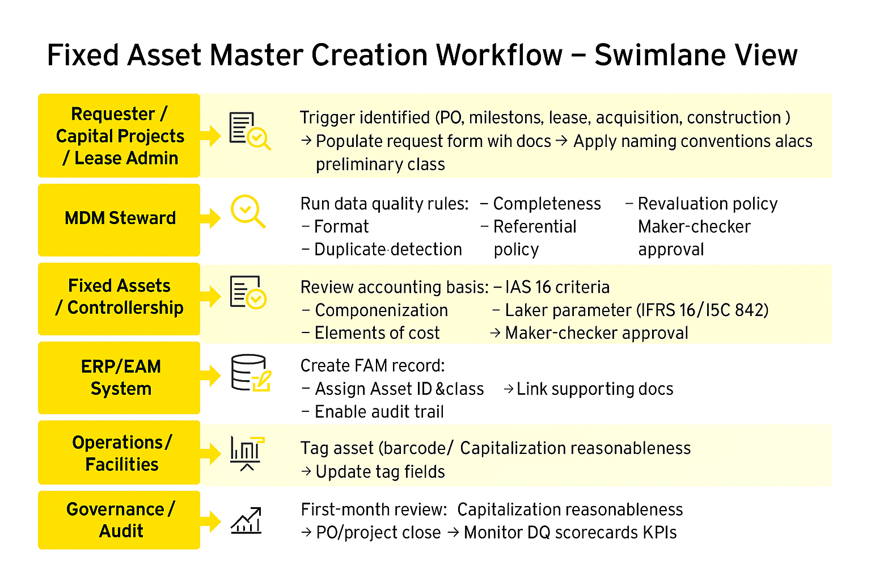
Fixed Asset- Master Creation
Master Creation workflow – Swimlane View
KPIs & SLAs for FAM creation (run monthly)
Right‑first‑time rate (% new assets with zero post‑creation corrections): target ≥ 95%.
Cycle time (trigger→ approved FAM): stratify by source (PO/CIP/Lease).
% of automatic asset master creations- Auto‑created via integration
Master records created per FTE (throughput) - Completed master creations per period ÷ FTEs dedicated to asset master work.
Physical reconcile delta (% assets not found/extra): target < 1%.
Source - EYQ

Slide 36
Lifecycle of Fixed Assets
 | Description | Detailed activities | Challenges | Strategic Approach | Outcome / Goal
Pre-Acquisition & Acquisition | Planning and procurement of assets based on operational needs | Identify asset requirement & Budget Approval | Budget overruns | ERP-integrated budgeting tools + Predictive analytics | Ensure assets are acquired timely and in compliance with procurement policies
 |  | Initiate procurement (PO, vendor selection) | Delays in procurement | Vendor performance dashboards
 |  | Asset delivery and inspection | Incomplete documentation | digital document management with version control
Asset Capitalization | Recording the asset in financial books and assigning relevant attributes | Asset tagging and classification | Incorrect classification | Use smart templates and rule-based validation engines | Accurate and compliant asset register and financial records
 |  | Transfer from CWIP to active asset | Missed capitalization | Automate CWIP-to-asset transfer schedule
 |  | Apply capitalization criteria (IAS 16 / IFRS 16) | Manual errors | Enable barcode/RFID tagging
Depreciation | Systematic allocation of asset cost over its useful life | Apply correct method (SLM, WDV) | Wrong depreciation method | validate during asset setup using rule-based logic. | Accurate expense recognition and financial reporting
 |  | Review useful life and residual value | Missed or duplicate postings | Automate reconciliation and exception reporting
 |  | Post depreciation to GL | Inconsistent useful life | ML models to adjust useful life on asset performance.
Maintenance, Enhancements & Impairment | Managing asset condition and value adjustments | Record maintenance activities | Misclassification of repairs vs enhancements | Define repair vs enhancement rules in CMMS workflows. | Maintain asset integrity and reflect true value
 |  | Perform impairment testing | Missed impairment triggers | Use IoT and AI to detect asset impairments.
 |  | Post impairment losses to GL | Lack of documentation | Maintain timestamped digital logs
Asset Transfer | Movement of assets across locations or entities | Initiate transfer request | Lack of audit trail | Automate transfers with GPS & blockchain | Accurate tracking of asset movement and ownership
 |  | Update asset location and ownership | Incorrect revaluation | Embed ERP revaluation logic with finance approval
 |  | Post transfer entries to GL | Compliance gaps | Standardize transfer protocols & automate entries.
Asset Disposal / Retirement | Removal of asset from books due to sale, scrapping, or obsolescence | Identify asset for disposal | Missed disposal entries | Automate disposal requests with aging prompts | Clean asset register and accurate financial impact
 |  | Derecognize from asset register | Incorrect gain/loss calculation | Configure ERP to auto-calculate disposal gain/loss.
 |  | Post disposal entries to GL | Incomplete audit trail | Enforce disposal workflows with approvals
Reporting & Reconciliation | Ensuring financial accuracy and audit readiness | Reconcile FA register with GL | Data mismatches | Automate FA-GL reconciliation with monthly reviews. | Transparent and compliant financial reporting
 |  | Prepare disclosures for financial statements | Incomplete disclosures | Use BI dashboards for disclosure tracking and reporting.
 |  | Support internal and external audits | Audit findings | Maintain audit trails with automated dashboards.

Slide 37
Revaluation & Impairment Automation Guide
Revaluation
Trigger Identification
Impairment
Trigger Identification
Fair Value Input
Revaluation Calculation
Accounting Entries
Audit Trail & Reporting
Recoverable Amount Calculation
Impairment Test
Accounting Entries
Reversal Logic
Audit Trail & Compliance
Scheduled revaluation (e.g., annually)
Market indicators or valuation reports
Automated feed from valuation systems or external sources
Manual override option for finance team
Increase → Credit Revaluation Reserve (OCI)
Decrease → Debit P&L (unless reversing previous revaluation surplus)
System generates journal entries
Maintain valuation source, date, and method
Automated reporting for auditors and compliance
Indicators of impairment (e.g., obsolescence, market decline)System flags based on KPIs or external feeds
Higher of:
Fair Value less Costs to Sell OR Value in Use (discounted cash flows)
Compare recoverable amount vs. carrying amount
If impaired → write down asset
System generates journal entries
If conditions improve, reversal allowed (except goodwill)
System checks periodically for reversal triggers
Document assumptions, inputs, and calculations
Automated logs for audit and SOX compliance

Slide 38
Depreciation
Validate Asset Master Data
Amortization
Identify and Classify
Configure Depreciation Rules
Automate Data Extraction
Depreciation Calculation Engine
Journal Entry Posting
Define Amortization Policy
Configure ERP/Automation Rules
Automate Data Integration
Amortization Calculation & Posting
Monitoring, Reporting & Compliance
Reporting & Controls
Depreciation & Amortization automation Guide
Ensure completeness and accuracy of: Acquisition, cost, Useful life, Residual value, Capitalization date
Standardize data formats and mapping for GL accounts.
Define depreciation methods (Straight-line, Declining Balance, etc.) in ERP.
Include logic for partial periods, additions, disposals, and impairments.
Schedule jobs or use RPA to pull asset data from ERP.
Validate extracted data against master records.
Prepare structured input for calculation engine.
Apply formula
Automate handling of: Mid-month acquisitionsTransfersRevaluations
Generate calculation logs for audit.
Automate GL postings
Ensure integration with ERP and reconciliation reports
.Implement error-handling for failed postings.
Automate Monthly depreciation reports & Exception logs
Implement controls
Use BI tools for visualization and trend analysis.
Gather all intangible assets (e.g., software licenses, patents, trademarks).
Classify them as finite life (amortizable) or indefinite life (not amortized, only impairment tested).
Validate supporting documentation for capitalization.
Amortization start date).Useful life based on contractual terms or expected economic benefit.
Document policy for: Method, Treatment of residual value,Handling of changes in useful life or impairments.
Set up amortization keys in ERP (SAP, Oracle, Dynamics).
Define: Frequency, Posting logic for expense and accumulated amortization.
Enable automated triggers for: New asset additions, Adjustments for impairments or write-offs.
Build automated workflows to Pull intangible asset data from sub -ledger.
Validate completeness and accuracy.
Ensure integration with General Ledger for postings & Reporting tools for schedules.
Automate calculation
Post entries automatically
Include logic for Mid-period acquisitions & Adjustments for impairments or revised useful life.
Generate Amortization schedules, Exception reports for changes in useful life or impairments.
Implement controls to Ensure NBV never goes negative.
Maintain audit trail for all automated postings.
Align with IAS 38 and local GAAP for compliance.

Slide 39
Inter-Entity Transfer
An inter-entity transfer occurs when a fixed asset is moved from one legal entity to another within the same corporate group. This process must comply with international accounting standards to ensure accurate financial reporting and consolidation.
Transfer Logic
IFRS 16
Leases: Applies if the asset is leased post-transfer or involves right-of-use assets.
IAS 16
IFRS 16 sets out principles for the recognition, measurement, presentation, and disclosure of leases. It aims to bring transparency by requiring lessees to recognize most leases on the balance sheet.
Property, Plant and Equipment: Governs recognition, measurement, and depreciation of fixed assets.
AS 16 governs the accounting treatment for tangible fixed assets (e.g., buildings, machinery, vehicles) that are held for use in production, supply of goods/services, rental, or administrative purposes.
Inter-Entity Transfer Process
Best Practices
Identify the Nature of Asset
Maintain audit trail of asset movement.
Use automated workflows for approvals and accounting entries.
Align with group accounting policies and ERP systems.
Determine the type of Transfer
IAS 16 (Owned Fixed Assets)
IFRS 16 – Leased Assets
Derecognize the asset, Transfer at NBV if under common control, No gain/loss recognized under common control
Transfer lease liability and ROU asset, Transfer at NBV (reassess ROU if needed), No gain/loss recognized under common control
Depreciation Continuity
Fair Value Reassessment
Lease Reclassification (IFRS 16)
Transfer Documentation
Elimination in Consolidation
Tax and Regulatory Compliance
Key Accounting Considerations
Intercompany Elimination (Consolidation Level)
Eliminate Intercompany balances & Ensure uniform policies

Slide 40
Intercompany Accounting
Source - EYQ

Slide 41
Intercompany matching logic
Attribute based matching
This is the most fundamental logic, where transactions are matched based on key fields:
Company Code / Entity
Counterparty Code
Document Number / Reference Number
Transaction Amount (with tolerance)
Currency
Transaction Date / Posting Date
GL Account / Intercompany Account
Invoice Number / PO Number
Rule- based matching
Tools allow users to define custom rules to handle exceptions and variations:
One-to-One Matching
One-to-Many Matching
Many-to-Many Matching
Tolerance Rules
Date Range Rules
Currency Conversion Rules
Automated Matching Engine
Tools like Black Line use automated matching engines that apply:
Exact match logic
Fuzzy match logic
Weighted matching
Example:
Match if Company A has a debit of ₹100,000 to Company B, and Company B has a credit of ₹100,000 to Company A, within ±₹500 tolerance and within 5 days of each other.
Example:
Match if Company A has a 1 debit of ₹100,000 to Company B, and Company B has a 3 credits of ₹50,000, 30,000 and 20,000 to Company A, within ±₹500 tolerance and within 5 days of each other.
Example:
Uses fuzzy matching to detect similar invoice numbers. Applies weighted scoring: 70% invoice match, 20% amount match, 10% date proximity. Match score = 92% → above threshold

Slide 42
Intercompany threshold configurations and escalation flows
Common Threshold Types
Escalation flows
When transactions fail to match or exceed thresholds, they follow an escalation path for resolution.
Threshold Type | Purpose | Typical Configuration
Amount Tolerance | Accept small differences in transaction amounts | ± ₹500 or ± 1% of transaction
Date Tolerance | Allow matching within a date range | ± 3 to 7 days
Currency Tolerance | Handle FX rate differences | ± 0.5% of converted amount
Invoice Number Variance | Allow fuzzy matching for typos | Levenshtein distance ≤ 2
GL Account Mapping | Accept mapped accounts across entities | Predefined account equivalence
Unmatched Transaction Identified
Flagged by the matching engine. Categorized by reason (amount mismatch, missing invoice, etc.)
First-Level Review
Assigned to Entity Accountant or Intercompany Analyst. Can resolve, comment, or reclassify
Second-Level Escalation
Routed to Manager . May involve dispute resolution or policy override
Third-Level Escalation
Sent to Skip Manager / Finance Controller. Final decision authority for write-offs or adjustments
Audit Trail & Certification
All actions logged. Certified for period-end close
Trigger | Escalates To | Timeframe
Amount mismatch > threshold | Manager | Within 2 days
Missing counterparty transaction | Analyst | Immediate
Repeated unmatched entries | Controller / Skip Manager | Monthly review
Dispute flagged by entity | Intercompany Lead | Case-by-case

Slide 43

Intercompany Entity pair matrix for high volume reconciliations
Escalation flows
Powerful tool for high-volume reconciliations, especially in financial operations, accounting, or data integration tasks where large datasets from different sources need to be matched and compared
What is an Entity-Pair Matrix?
- An entity-pair matrix is a structured table where:
Rows represent entities from Source A (e.g., internal records).
Columns represent entities from Source B (e.g., external records).
Cells contain a matching score or comparison result between the corresponding pair of entities.
Structure of the Matrix
How to Build One:
Extract entities from both sources.
Normalize data (e.g., trim spaces, unify formats).
Compare each entity from Source A with each from Source B.
Score each pair based on matching logic.
Populate the matrix.
Apply thresholds to classify matches (e.g., >0.95 = match, 0.7–0.95 = potential match).
 | Entity B1 | Entity B2 | Entity B3
Entity A1 | 0.98 | 0.10 | 0.00
Entity A2 | 0.05 | 0.95 | 0.20
Entity A3 | 0.00 | 0.15 | 0.99

Slide 44
Life Cycle of Intercompany Transaction During a Typical Business Period
Establish IC policies &
governance
Initiate IC transactions
Record IC transactions
Reconcile IC transactions
Net and settle IC transactions
Master Data integrated from ERP via established Connector/FTP integrations or flat file import
Intercompany trading relationships maintained in BlackLine
Transfer pricing and tax logic and/or tables input maintained in BlackLine
Intercompany Global Process Ownership and regional team oversight of ICH processes and maintenance and monitoring of KPIs
IC Goods (ERP Sourced)
Transactions Initiated by the businesses via PO/ Invoice
GR/IR transactions
GR/NI transactions
IC Goods (ERP Sourced)
Transactions booked to intercompany AR & AP accounts in ERP
Adjusting journal entries booked to GL
IC Goods and IC Services
Matching logic created according to business scenarios to match AP and AR transactions for goods and services
IC matching and reconciliation process can be run more frequently (and near real time) as transactions are imported to matching data source
Approval workflow for transactions with increased visibility to minimize disputes
Timely reporting to identify disputes earlier in the process rather than at period end (continuous accounting process)
IC Goods and IC Services
Netting and Settlement of payments in Quantum
Reconciled transactions can serve as a payment source for settlement in Quantum
IC Services (BlackLine Initiated)
Cost Pools sourced from ERP (or other identified sources)
Allocations Keys and bases created in supporting tables
Services transactions initiated in BlackLine specified Templates
IC Services (BlackLine initiated)
BlackLine controlled Approval Workflow
Auto-certification for established thresholds and IC relationships
Double sided JE postings to create balanced IC journals for entity and counter party
Period End
Financial Close
Substantiation of IC Trade accounts
Trading Partner Balancing Resolution
FX variances resolved and eliminations performed in consolidation tool
BlackLine
ERP or Formal Tool

Slide 45

Intercompany Process Flow
ERP(S) | Import Definition | Data Source(s) | Match Set | ICH Processes (AIT) | ICH Transaction | Actions | Journals | Reporting by Relationship or Actions
Match
IC Transactions (AR/AP)
BL Import
ICH Transaction Interim
Interim
ICH Transaction Interim
Book / Adj
Book or Adjust IP / IR
ICH Balancing Error Log (IR/IP)
Dispute, Investigate, TP to Resolve
ICH Balancing Stage (IR/IP)
ICH Balancing (IR/IP)
Match Rules
Month End
ICH Transaction Month End
Month End Accrual

Slide 46
Intercompany Balancing Data Flow
ERP(S) | Import Definition (BL) | Balancing Stage Table (BL) | Balancing tables (BL)
IC Transactions (AR/AP)
Non SAP
Import Definition Standard
ICH Balancing Stage (IR/IP)
ICH Balancing (IR/IP)
IC Transactions (AR/AP) SAP
Import Definition SAP
ICH Balancing Stage SAP (IR/IP)
ICH Balancing Error Log
(IR/IP)

Slide 47
ICH Balancing Automated Intercompany Transactions (AIT)
Automated Intercompany Transactions (AIT) serve as an engine to create Intercompany Transactions based on Matching or ICH data sources
These transactions can be set to auto-certify and facilitate the posting of both party journal entries or set to flow through a designed workflow
These can be cloned or created from scratch
Automated Intercompany Transaction (AIT) definitions to create ICH Transactions from the ICH-Balancing Data Source
ICH_Balancing_Interim – These transactions will be created at an interval defined (daily based on the data load in BL) for researching & taking appropriate resolution ‘Actions’
ICH_Balancing_Month End Accrual– These transactions will be timed to be the last ICH transaction for the period
AIT can be configured to group the transactions and create one single Intercompany transaction using any field from data source (e.g. trading relationship)
Balancing Stage Table (BL) | Automated Intercompany Transaction (AIT) | ICH Transaction (2.0 – Balancing)
ICH_Balancing Interim
ICH Balancing Transaction ‘Interim’
ICH Balancing (IR/IP)
ICH_Balancing_Month End Accrual
ICH Balancing Transaction ‘Month-End Accrual’

Slide 48
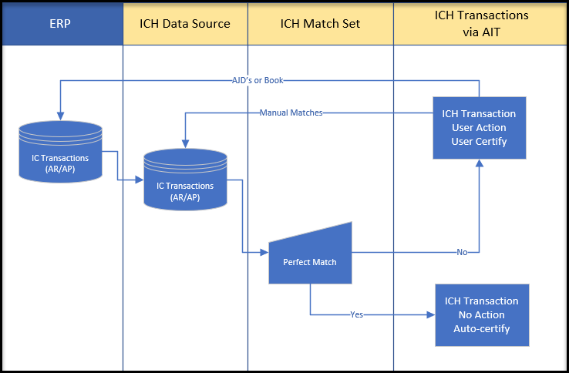
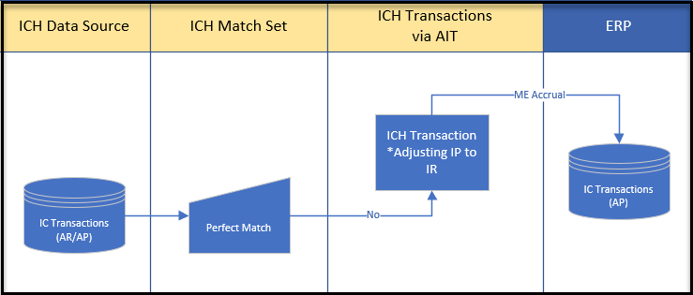
ICH Balancing Transactions
Interim Transactions
Month End Transactions
Interim Transactions
Interim Transactions
Month End Transactions
Each newly created relationship transaction will be the ‘active’ transaction
Any Action will move with the record until the record has been resolved
Prior created relationship transactions will be marked as ‘inactive’
Drop down list to select “Actions”
Should be the last transaction created to close out the month
Out-of-Balance Relationships will automatically book ‘IP’ Adjustment to equal ‘IR’ balances
Auto populate “Actions” to automate and accelerate the process

Slide 49
Best Practices of Managing Inter Company Processes in Distributed ERP Landscape
A combination of SAP and BlackLine capabilities can drive the best in class intercompany process
Establish IC Policies &
Data Setup
Initiate IC
Transactions
Book IC Transactions
Perform IC Matching and Reconciliation
Prepare Elimination Entries, Consolidate & Report
SAP:
Company Code = Legal Entity set up
Business Partner setup – Customer & Vendor
Establish relationships for dual posting
Setup VAT, WHT, other Indirect Taxes
COA – specific IC accounts
Material Master
SKU/Product cost
Transfer Pricing Markup
FX – can handle multiple currencies
Interfaces set-up
Policies – built into process
Revenue Recognition – PGI/GR/Other that aligns with Rev Rec pronouncements
SAP:
TRADE (i.e. Supply Chain impacts should be done in SAP). PO (ISTO) driven for goods & services including drop shipments
For service companies Project Systems provides IC functionality but it is complicated
External feeds (Banks, Vendors, Customers)
RPA
Blockchain
SAP:
Must update the book of record
Anything that requires payment/settlement must be booked to IC customer/vendor accounts
The timing of the ERP uploads & cut-off synchronized through policy & ERP.
SAP:
Currency conversion and intercompany elimination in Group Reporting
Gross Profit in Inventory/Transfer Pricing Markup can be calculated at the SKU level and summarized for booking purposes
Parallel valuations can help with reporting before month-end is completed
BlackLine:
Intercompany Matching can be configured to bring in data from other source ERPs and other instances of SAP
Transaction Matching capabilities with flexible search criteria and matching logic
Manage and Resolve IC Disputes
Settle IC Accounts
BlackLine:
Non-Trade (no PO) can be handled with dual posting with other automation capabilities across ERPs.
Non-PO can be driven by:
Manual input
Automated entries – one-time setup same amount OR different amounts
Excel Uploads
Approval workflow or driven by contract
BlackLine:
Governance process with thresholds
Automated corrections with booking to SAP
Can set up some workflow
BlackLine:
Multi-lateral settlement can be accomplished
Netting is calculated based on reconciled intercompany data
Clearing files and treasury instructions can be created
BlackLine:
Policies – built into agreements
Specific arrangements – built into contracts
Preventive or detective controls
SAP:
Open item clearing
Fund movements between bank accounts
Intercompany balances updated as the source to Group Reporting

Slide 50
Intercompany Process – Maturity Assessment model
Basic
Established
Leading
Policies, processes, and procedures documented but not consistently applied
Policies maintained offline and not integrated with transaction system(s)
Policies established and effective at a local level, but inconsistently applied across the organization
Global allocation methodology inconsistently applied
Standardized policies and procedures applied consistently across the organization
Global allocation methodology applied consistently
Policy
Processing is de-centralized
Intercompany entries reside within each business and are supported by multiple operation areas
All month-end processes are carried out at the local finance level
Limited regionalization of processing
Local finance teams still post a considerable volume of entries
Centralized month-end processing in place for some intercompany transaction processing
Majority of processing and allocations has been offshored or automated
Core month-end transaction processing is performed in an offshore shared service setting
Org/ People
No common G/L platform or subsidiary ledgers, creating inconsistent data definitions and inconsistencies in intercompany accounting
Multiple legacy systems require significant manual intervention to post to GL
Significant reliance on Legacy System( e.g,Excel)
Enterprise G/L interface for all business units; subsidiaries vary across business and region
Sub-ledger data is electronically interfaced but requires top-side adjustments
Lack of standard account and/or legal entity definitions
Enterprise G/L interface for all business units; region specific subsidiaries sync with G/L and Data Warehouse
Use of enterprise intercompany application
Use of automated overhead allocation tables
Reconciliations supported by integrated standard solution
Tech & Data
Manually and inconsistent
Prone to errors due to manual intervention.
Performed on ad hoc, irregular base
Most activity pushed to month-end
Mapping of intercompany accounting performed at period-end
Revaluation calculations are changed frequently and manually
Allocations calculated off-line and posted manually
Consistent, but ineffective across organization
Spreadsheet and/or manual uploads with some, inconsistent automation
Multiple repeats of intercompany clearing occur throughout the period
Significant activity performed during the close
Processing activity is streamlined during the month
Allocations calculated differently across business units and corporate
Revaluations (G/L) calculation automated offline
Automated system across organization
Highly automated with minimal intervention and minimal spreadsheet use
Automated intercompany clearing
Automated postings simultaneously to receivables/payables side
Intercompany clearing performed intra-month
Efficient transfer of intercompany documentation
Revaluations (G/L) calculations and posting handled automatically via application functionality
All enterprise statutory allocations processed simultaneously via enterprise allocations tool
Process

Slide 51
Intercompany Hub (ICH) Process flow
The BlackLine Intercompany hub is a solution that can address your intercompany process needs. The solution has a structured workflow capability and a central repository to handle large volume of transactions to build efficiency and cost saving into your organization.
Trading rules & agreements
Transaction & data management
Invoice & journals
Reconciliation & matching
Netting & settlement
Reporting & metrics
Legal agreement between countries and entities that establishes agreed upon price for goods/services.
Initiation of I/C transactions based on types. Management of data source( automated vs. manual)
Timely and accurate invoicing between entities and settling via netting and/or cash as well as dispute resolution
Balancing and matching Intercompany transactions feeding reconciliation processes.
Net and settle
intercompany transactions between related parties.
Monitoring of key metrics to inform and adjust the integrated Intercompany process that can be aligned to goals and key performance indicators
Define entity hierarchies & trading relationships
Enforce policies and agreements (transfer pricing rules, etc.)
Administer globally across platforms and regions
Handles currency & exchange rates
Import, schedule or manually create transactions
Streamline workflow with integrated transfer pricing, dynamic business rules and bulk certification
Attach supporting documentation, comments and hyperlinks for global visibility and audit support
Automatically generate invoices in compliance with policies and jurisdictional requirements
Automatically create journals across ERP platforms for both sides of the transaction (trading entities)
Automated scheduling & journals with bulk approval based on embedded validation rules
Integrate seamlessly with the account reconciliation product to substantiate balances with verified transactions
Match transactions globally across ERP platforms
Manage imbalances with exception handling and automated adjustments within tolerable thresholds
Attach supporting documentation
Bilateral netting and settlement matrix for global visibility across legal entities and ERP platforms
Dynamic filtering and drill-down capabilities to monitor and manage unsettled balances
Configurable dashboards
Dynamic reporting with drill-down capabilities to the transaction-level – e.g., disclosures, Intercompany out of balance, aging, internal audit
Helps comply with external regulations and audit requirements
Internal data sources (Excel, ERP, Sub-Ledger, Data Warehouse)

Slide 52
Key Drivers and Considerations during Intercompany Hub Implementation
Global organizations can significantly benefit from the automation of their Intercompany accounting processes. Companies will see a reduction in risk exposure, a more efficient and time-saving close and increased financial reporting integrity
Drivers & Considerations
The reconciliation and settlement of a company’s Intercompany trading balances is a challenge that grows significantly with the number of subsidiaries and systems.
As volume grows, the use of spreadsheets, email or verbal approvals or other work arounds exposes organizations to significant financial, compliance and reputational risk.
Standardization of Intercompany accounting processes
Central system to manage all transactions, documentation and journal entries.
Auto-generated alerts and standardized trading agreements
Cross-entity and multi-stakeholder approval workflows
Centralized Intercompany accounting across ERP systems
Integrated data repository and centralized document repository
Standardized data flows across multiple ERP systems
Familiar user experience with clear visibility of intercompany transactions
Automated Intercompany reconciliations
Automated reconciliation and transactions matching from multiple ERP systems
Centrally stored transaction level detail
Finance & accounting resources have additional time to focus on value-added activities – e.g., analytics.
Netting and settlement management
Automated invoice and journal entry process
Automated importing of foreign exchange rates
Reduced number of transactions required for settlement between entities

Slide 53
Intercompany Balancing & Resolve
This is a brief and detailed presentation of how the Intercompany Account receivable and Account payable transactions are brought into BlackLine via File Transfer Protocol (FTP) connections, where further these transactions are matched based on the various pass rules. If the match is approved, the transactions are matched and are further processed for settlements.
Intercompany Account receivable Line Items queried from Invoice data tables in ERPs
Automated matches identified
Automated Intercompany transaction template created
Match Approved?
Data Enrichment Process in BlackLine combines ERP Queries to creates 1 Match Set
Suggested matches reviewed by Accounting Team
Yes
Intercompany Accounts payables Line Items Queried from Purchase order data Sources In ERPs
Pre-defined Pass Rules applied to Match Set
Suggested matches Identified
Data Tables sent to Blackline Intercompany Hub via FTP Site
Additional Intercompany Trade Data (Chargebacks, Rebates) queried from ERP Data Sources1
No
Match Identified?
Unmatched transactions Identified
Unmatched matches reviewed by Accounting Team
Yes
No
Unmatched Transaction Handling

Slide 54
Intercompany Balancing & Resolve
Timing Issue?
Item left unmatched and matched off in subsequent period
Unmatched Transactions Identified
Accounting Team Researches utilizing Line-Item Detail
Reason Code Applied
Automated Intercompany transaction template Created
Yes
No
Missing AP Document?
AR Reconciling Item Created
After the intercompany matching process is closed at period end and cut-off is established, the remaining unmatched transactions are matched off in subsequent periods due to timing issues, or are routed as reconciling items to substantiate the applicable general ledger account
Yes
Automated AP Accrual created
No
Alternative handling as deemed appropriate by Business

Slide 55



Intercompany Transaction flow types
Trade Transactions
Recharge Transactions
Trade Transactions
Initiation
Entities Involved: Two or more legal entities within the same corporate group (e.g., Entity A and Entity B). Nature: Sale or purchase of goods/services between these entities.
Order & Delivery
Entity A (Seller) receives a purchase order from Entity B (Buyer). Goods or services are delivered from Entity A to Entity B.
Invoicing
Entity A raises an intercompany invoice to Entity B for the goods/services provided. The invoice includes details like quantity, price, and applicable taxes (if any).
Accounting Entries
Settlement
Entity A (Seller): Debit Intercompany Receivable (amount due from Entity B) Credit: Revenue (for the sale) Credit: Inventory (if goods are sold) Entity B (Buyer):Debit: Inventory or Expense (for goods/services received) Credit: Intercompany Payable (amount owed to Entity A)
Month end Reconciliation
Consolidation & Elimination
Entity B settles the invoice by making a payment to Entity A. Both entities update their books to reflect the payment.
Both entities reconcile intercompany balances to ensure amounts match. Any discrepancies are investigated and resolved.
During group financial consolidation, these intercompany sales and purchases are eliminated to avoid double-counting revenue and expenses at the group level.
Cost Incurred
Entity A incurs a cost on behalf of Entity B (e.g., software license, travel expense, shared service). The cost is initially recorded in Entity A’s books.
Recharge Decision
Entity A determines that the cost (fully or partially) should be recharged to Entity B. The basis for recharge is usually actual cost, with no profit margin (unlike trade transactions).
Raising the Recharge Invoice
Entity A raises an intercompany invoice to Entity B for the amount to be recharged. The invoice includes supporting documentation (e.g., vendor invoice, allocation basis).
Accounting Entries
Settlement
Entity A (Recharging Entity):Debit: Intercompany Receivable (amount due from Entity B)Credit: Expense (to remove the cost from its own books) or Intercompany Revenue (if required by policy) Entity B (Receiving Entity):Debit: Expense (to record the cost in its books)Credit: Intercompany Payable (amount owed to Entity A)
Reconciliation
Entity B settles the invoice by making a payment to Entity A. Both entities update their books to reflect the payment.
Both entities reconcile intercompany balances to ensure the recharge is matched and settled. Any discrepancies are investigated and resolved.
Order Placement
Entity B (Buyer) places a purchase order for goods/services with Entity A (Seller), both part of the same corporate group.
Goods/Services Delivery
Entity A delivers the goods or services to Entity B. A delivery note or service completion confirmation is generated.
Invoicing
Entity A issues an intercompany invoice to Entity B for the goods/services provided. The invoice includes details such as quantity, price, and any applicable taxes.
Accounting Entries
Payment & Settlement
Entity A (Seller):Debit: Intercompany Receivable (amount due from Entity B)Credit: Revenue (for the sale)Credit: Inventory (if goods are sold) Entity B (Buyer):Debit: Inventory or Expense (for goods/services received)Credit: Intercompany Payable (amount owed to Entity A)
Month end Reconciliation
Consolidation & Elimination
Entity B settles the invoice by making a payment to Entity A. Both entities update their books to reflect the payment.
Both entities reconcile intercompany balances to ensure amounts match. Any discrepancies are investigated and resolved.
During group financial consolidation, these intercompany sales and purchases are eliminated to avoid double-counting revenue and expenses at the group level.

Slide 56

Intercompany Journal Logic Builder
What initiates the journal? (e.g., intercompany invoice, cost allocation, recharge, trade transaction)
IC Journal Logic
Trigger/Event
Transaction type
Source Entity & Counterparty
Account Mapping
Amount & Currency Logic
Validation & Approval
Attach invoice, allocation logic, or supporting documentation.
Automated checks (e.g., both sides match, correct accounts used)
Workflow for approval if needed
Post journals in both entities’ ledgers
Reconcile intercompany balances
Trade, Recharge, or Allocation (as discussed earlier)
How is the transaction amount determined?
Is currency conversion required?
Which entity is the initiator (seller/allocator/recharger)?
Which entity is the counterparty (buyer/receiver)?
Define which GL accounts to debit/credit for each entity. Example: Seller: Debit Intercompany Receivable, Credit Revenue Buyer: Debit Expense/Inventory, Credit Intercompany Payable

Slide 57
Order Creation
Source - EYQ

Slide 58
Transfer Pricing & Markup Calculator
Markup Calculator
Common Transfer Pricing Methods
Comparable Uncontrolled Price (CUP)
Compares the price of a controlled transaction to a similar transaction between independent entities.
Input
Total Cost (e.g., manufacturing or service cost)
Markup % (based on industry benchmarks or comparable transactions)
Output
Arm’s-Length Transfer Price
How does it work?
Application: When reliable market data is available for identical or similar transactions.
Resale Price Method
Starts with the resale price to a third party, then subtracts a gross margin. Ideal for distributors.
Application: Common in distribution businesses where resale prices are known.
What is Transfer pricing? Transfer pricing refers to the price charged for goods, services, or intellectual property exchanged between related entities within a multinational group.
These prices must reflect arm’s-length principles, meaning they should be similar to what unrelated parties would charge in the open market.
Cost Plus Method
Adds a markup to the cost incurred by the supplier. Common in manufacturing and services.
Why Use a Markup Calculator? A Transfer Pricing Markup Calculator helps determine the correct markup to apply on intercompany transactions to ensure compliance with tax regulations and avoid penalties.It ensures that the selling entity earns a fair profit and the buying entity pays a fair price, based on global standards.
Application: Ideal for service entities where cost structures are well documented.
Why It Matters in R2R?
Ensures accurate intercompany accounting.
Supports tax compliance and avoids double taxation.
Facilitates audit readiness with documented rationale for pricing.
Transactional Net Margin Method (TNMM)
Compares net profit margins of controlled transactions to those of independent entities.
FAQs
Application: Most widely used method when gross margins are hard to compare.
Profit Split Method
Allocates combined profits based on each entity’s contribution. Used in highly integrated operations.
Application: Used in highly integrated operations like R&D or IP development.

Slide 59
Balance Sheet Reconciliation
Source - EYQ

Slide 60
Account Reconciliation
It is the process that makes sure financial records match external financial statements such as bank statements, invoices, or credit card bills.
Reconciliations should provide detail on
When
Timing
What
Description
Why
Purpose
Who
Responsibility
How
Much
Amounts
When did the item appear in the General Ledger?
When will the adjustment no longer be included in that account?
Does the items have a specific “Close Date” or an “activity trigger”?
Account Description: Explanation of what the purpose of the account is and how the balance should be calculated and evaluated
Reconciling Items: Explanation for each individual item. What is it?
Proposed action plan for remediation
Reconciliation should comply with company policy, often this may be partly explained in the policy and procedure section of the reconciliation
Reconciliation Criticality or Risk Rating
Further explanation should be made when necessary for an individual item
Who else is involved in the account or the specific item and may be required to take action in the future?
Operations
Local Country Team
Other Internal departments
Who else has governance responsibilities “Needs to Know”:
LE Controller
Business Unit
Other
Sub-ledger balance
Additional calculations / support for certain accounts:
Allowance
Reserves
Accruals
Require adjustment due to reconciling items recorded in the General Ledger
Timing
Errors
Account Reconciliation template and tracker

Slide 61






Reconciliation Methodology
Balance & Reconciling Items
Reconciliation Templates
Supporting Documentation
Provide a clear explanation of balance components and reconciling items
Define all item classes available in EPM tool
Include examples for each item class to guide correct classification
Establish guidelines for creating clear narrations/descriptions for open items
Specify the date criteria to be used for calculating aged items
Clearly map template types to the nature of accounts (e.g., accruals, clearing, suspense)
Ensure consistent usage across teams and entities
Define what constitutes adequate support (e.g., invoices, bank statements, journal entries)
List acceptable formats (e.g., PDF, Excel, system screenshots)
Include data confidentiality guidelines for handling sensitive information

Slide 62
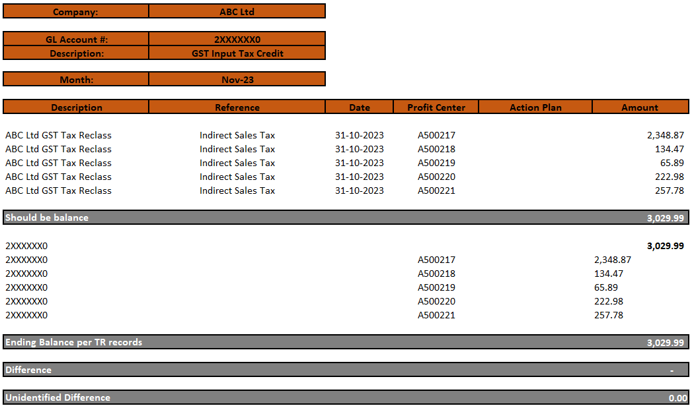

Best Practices for reconciliation
To ensure standardization, consistency, and audit readiness, the reconciliation process must follow some of the best practices which includes
All items are properly classified as List Component, Timing Item or Required Adjustment
Any unidentified difference that cannot be substantiated has been appropriately marked as a Required Adjustment
All reported items have attached proper documentation and third-party documentation, if available, which supports the balances
Aged Required Adjustments and Timing Items are resolved timely per policy
Required Adjustments have a proper impact type identified and Action Plan defined for resolution
Purpose & procedures were reviewed and properly updated
Requirements for control evidence
Control evidence should contain adequate supporting documentation to show all items were included
Form of system reports, electronic email, meeting minutes, etc.
Exceptions should be documented, explained, and tracked for appropriate and timely resolution
Tracking including escalation as needed and documentation on procedures and information received
Resolution should be completed timely and documented

Slide 63
Account reconciliation tool comparison
 | ERP Integration | Automation (%) | Cycle Time Reduction | Exception Reporting | Scalability | Performance | Matching Logic | Flexibility
HighRadius | SAP, Oracle, NetSuite | 90% | Up to 40% faster | AI-driven anomaly detection | Highly scalable across global entities | High-speed processing with AI | AI/ML-based intelligent matching | Custom workflows and anomaly engine
BlackLine | SAP, Oracle, NetSuite | 85% | 30–40% faster | Built-in audit trails | Enterprise-grade scalability | Reliable under high transaction volumes | Rule-based and AI-enhanced | Configurable templates and workflows
FloQast | QuickBooks, NetSuite | 70% | 25–30% faster | Audit-ready workflows | Scales well for mid-sized teams | Optimized for monthly close cycles | Auto-recognition of reconciled entries | Easy integration with cloud tools
Trintech Cadency | Oracle, SAP, Dynamics | 80% | 35–45% faster | Risk-based exception handling | Supports large multi-entity setups | Efficient for high-volume reconciliations | Risk-based auto-matching | Customizable approval and certification
OneStream | Multi-ERP support | 85% | 30–40% faster | Real-time dashboards | Designed for multinational organizations | Real-time performance analytics | Drill-to-reconciliation logic | Extensible platform with modular features
Tools
Parameters

Slide 64
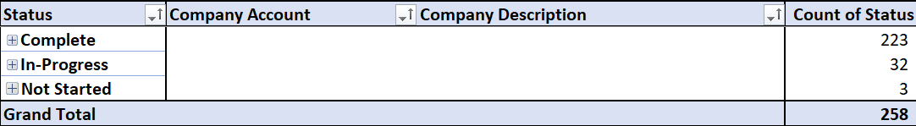
Account reconciliation Template – How to use it
Variance in accounts extracted and recorded for the company B
Color coding helps tracking the status
Description of the line items
Variance in accounts extracted and recorded for the company A
Progress Tracker
Account Reconciliation template and tracker

Slide 65
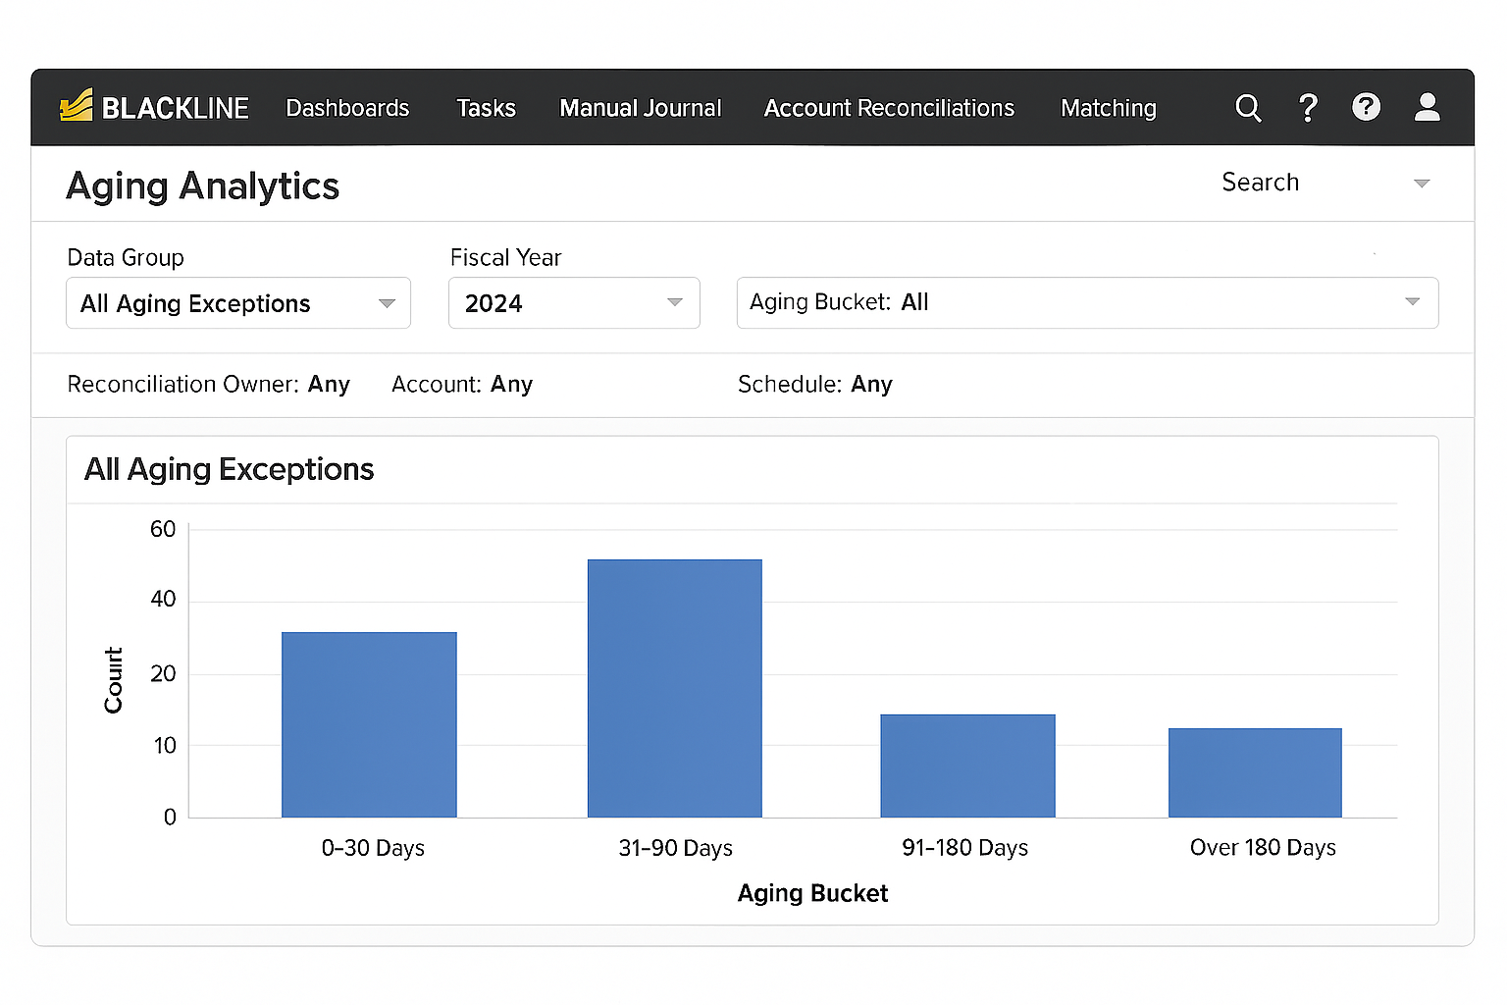
Visibility best practices
Best Practices
Aging Analytics Dashboard
Entity Wise
% of Reconciliation on time per entity
% of exceptions per entity
Average time to resolve exceptions
Segment reconciliations by legal entity or business unit, Unique identifiers
Tag accounts or reconciliations with region or geography codes (e.g., APAC, EMEA, NA). Align reconciliation calendars with regional close cycles. Use regional filters in dashboards and reports.
Implement entity-level dashboards Reconciliation status, Exception volume, SLA compliance
Metrics
Region Wise
Regional reconciliation completion rates
Exception trends by region
Regional compliance with global policies
Best Practices
Metrics
Track aging of unreconciled items (e.g., 0–30, 31–90, 91–180, 180+ days)
Use aging buckets in exception logs and dashboards.
Set escalation rules for aging thresholds (e.g., >60 days triggers manager review).

Slide 66


Tool specific Account reconciliation Best Practices
Tool agnostic Best Practices
BlackLine offers best-practice-based templates for different account types (e.g., prepaid expenses, accruals). These templates ensure consistency, reduce manual effort, and improve auditability. [How to Per...BlackLine] Templates can be customized and reused across periods, with automatic roll-forward of balances.
Use BlackLine’s Journal Entry module to automate recurring entries like amortizations. Reconciliations can be auto-certified when balances match the GL within a defined threshold. Set up scheduled GL balance feeds (e.g., every 10 minutes or hourly) to keep reconciliations current.
BlackLine supports Excel imports for GL detail reports. The system can parse and map fields automatically, remembering previous mappings for faster future imports. Spot-check imported data to ensure accuracy before certification.
Define thresholds (e.g., ₹0, ₹500, ₹1,000) for acceptable variances. Reconciliations outside these limits are flagged and cannot be certified, adding a layer of control.
Reconciliation Status Dashboard
Display color-coded status (e.g., green/yellow/red) based on defined tolerances. Shows Leading Unit vs. Partner Unit balances.
Highlights discrepancies and their impact.
Operations View KPIs & Metrics:
KPIs are calculated using weighted metrics. Performance KPI: Combines average and max response times.KPIs are color-coded: Green: >85% Orange: 70–85% Red: <70%
Automate Account Determination:
Configure automatic account determination for processes like MM, SD, and FI to reduce manual errors.
Use SAP’s configuration paths to set up rules that map transactions to correct G/L accounts.
Integration Methods:
File-Based Integration: Use structured formats (CSV/XML) via SFTP. Best for batch processing but lacks real-time capabilities. SAP-Certified Connector: Supports real-time and scheduled syncs with minimal manual effort.
Standardize Reconciliation Templates
Use consistent formats for all accounts. Include fields for account number, description, balance, supporting documentation, and preparer/reviewer notes.
Set Materiality Thresholds
Define thresholds for acceptable variances (e.g., ₹500 or ₹1,000). Focus efforts on high-risk or high-value accounts. Avoid wasting time reconciling immaterial differences.
Maintain Supporting Documentation
Attach backup files (invoices, bank statements, journal entries). Ensure documentation is accessible and audit-ready. Use cloud storage or centralized repositories.
Track Exceptions Separately
Maintain a log of unreconciled items with reason codes. Monitor aging of exceptions and escalate overdue items. Use dashboards or trackers to visualize exception trends.
Ensure Audit Trail & Compliance
Log all actions with timestamps and user IDs. Maintain version history of reconciliations. Align with standards like SOX, GAAP, or IFRS.
Review & Improve Regularly
Conduct periodic reviews of reconciliation processes. Solicit feedback from users. Update templates, rules, and workflows based on learnings.

Slide 67
Compliance
Source - EYQ

Slide 68
Exception management workflow with rules-based clearing
Auto-clearing logic (e.g., tolerance rules, recurring patterns)
Exception Categorization
By type (timing, amount mismatch, missing data)
Assignment & Workflow
Exception Identification
Data Ingestion
Rules Based Clearing
Matching engine flags unmatched transactions
Manual resolution or auto-clear post-validation
Routed to responsible teams/entities
Resolution & Resolute
Audit trail & Reporting
Logged for compliance and analytics
Source systems (ERP, bank feeds, subledgers
Data Ingestion
Financial data is pulled from various systems: ERP (SAP, Oracle), bank feeds, subledgers, etc. This includes journal entries, payments, invoices, receipts, and other transactional records.
Exception Identification
The system compares transactions across sources (e.g., bank vs GL) and flags mismatches. Exceptions are created when transactions don’t meet matching criteria.
Rules Based Clearing
Tolerance rules (e.g., clear if amount difference < ₹100) Recurring patterns (e.g., monthly rent payments) Date proximity (e.g., within 3 days) Reference matching (e.g., invoice number matches)
Every action (auto-clear, manual resolution, reassignment) is logged. Reports and dashboards show: Exception aging Auto-cleared vs manual resolutions Entity-wise exception trends SLA compliance
Assignment & Workflow
Exception Categorization
Exceptions are tagged based on their nature: Timing differences Amount mismatches Missing data Duplicate entries
Exceptions are assigned based on: Entity (e.g., business unit) Region (e.g., APAC, EMEA) Exception type
Resolution & Resolute
Users investigate and resolve exceptions that couldn’t be auto-cleared. Once resolved, the status is updated to “Closed” or “Resolved”. Some exceptions may be cleared after delayed matching or external validation.
Audit trail & Reporting

Slide 69
GPO Governance Playbook
The Global Process Owner (GPO) Governance Playbook provides a structured framework for managing processes across an organization
Advantages
Consistency
Efficiency
Compliance
Challenges
Lack of Flexibility
Overburdened GPO
The GPO has full authority and control over process design, implementation, and compliance across the organization. All decisions are made centrally, ensuring consistency and standardization.
Key Features
Unified Decision-Making
Standardization
Centralized Oversight
Centralized Model
Advantages
Flexibility
Empowerment
Scalability:
Challenges
Inconsistency
Complexity
The GPO provides overarching guidelines and frameworks, while local process owners (LPOs) have the autonomy to adapt processes to their specific needs. Decision-making is distributed across the organization.
Key Features
Shared Authority
Flexibility
Collaborative Oversight
Federated Model

Slide 70
Record to Report : Target Operating Model (part1)
Organizational Structure: A clear definition of roles and responsibilities, process ownership, and reporting relationships to ensure accountability and efficiency.
RECORD TO REPORT OPERATING MODEL
Organizational structure
Process design
Technology infrastructure
Data management
Continuous improvement
Governance and control
Governance and Control: Establishment of robust internal controls and governance frameworks to ensure the integrity and reliability of financial information and compliance with regulatory requirements.
Process Design: Standardized, streamlined and automated processes for R2R that minimize manual interventions and ensure compliance with accounting standards.
Continuous Improvement: Regular review and refinement of R2R processes to drive continuous improvement and respond to changes in business needs and regulatory requirements.
Technology Infrastructure: Use of modern technologies, such as cloud computing and robotic process automation, to automate manual processes, improve data quality and processing speed, and reduce costs.
Data Management: Adoption of an integrated data management strategy to ensure timely, accurate, and consistent data inputs from various sources.
Page 70

Slide 71
Record to Report : Target Operating Model (part 2)
Organization structure
Process design
R2R Team Lead
A senior finance professional who oversees the entire R2R process, ensuring alignment with corporate goals and regulatory requirements.
R2R Specialists
Dedicated professionals who perform day-to-day R2R tasks, such as data entry, reconciliation, and financial reporting.
Data collection
from various sources, such as ERP systems, banks, and other transaction system
Roles
Data validation
for completeness, accuracy, and consistency.
Record of transactions
in the general ledger, including accruals, adjustments, and reclassifications.
General Ledger Team
maintaining the accuracy of the general ledger, reconciling accounts, and preparing financial reports.
Intercompany Team
managing I/C transactions, reconciling intercompany accounts, and preparing intercompany billing and settlement.
Reporting Team
preparing financial statements, management reports, and regulatory filings.
Sub-ledger reconciliation
such as accounts receivable, accounts payable, and inventory, to the general ledger.
Team
Financial reporting
preparation of financial statements in accordance with accounting standards.
Statutory reporting
preparation of regulatory filings, such as tax returns and financial reports.

Slide 72
Record to Report : RACI methodology (part1)
RACI Methodology
R
Determine who will execute activity in the future (R= Responsible)
Result in an activity split between BPO and retained organization
Sign off from GPOs for current RACI (and handover of ownership)
A
Determine who is accountable for correct execution of activity (A= Accountable)
C
Determine who must be consulted, e.g. stakeholder or subject matter expert (C=Consulted)
I
Determine who must be informed about activity (I=Informed)
Working sessions exclusively focused on “R’s”
Complemented with “C” and “I” on some processes
Multiple “R’s” are possible
Added “A” for accountability; where no A is recorded, R=A applies

Slide 73
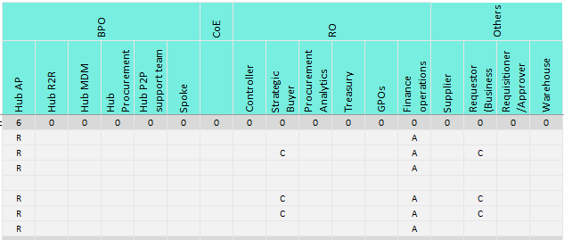
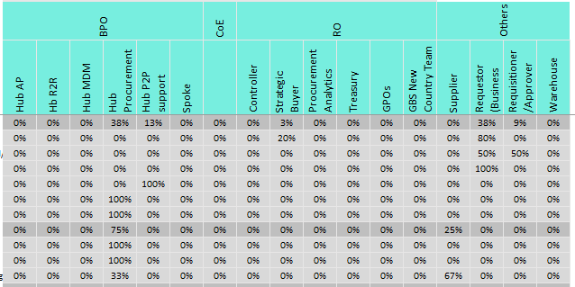
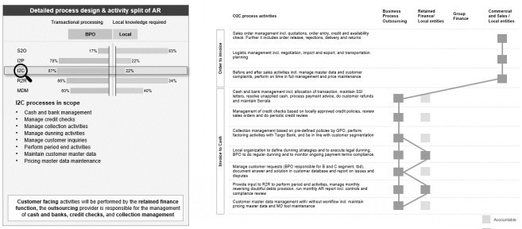
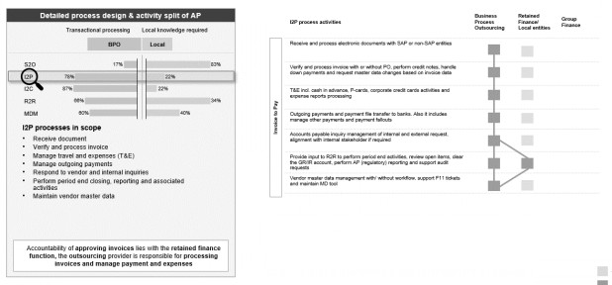
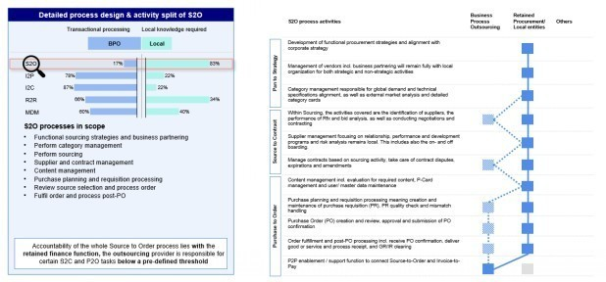
Record to Report : RACI methodology (part 2)
1
2
3
Determine RACI on process level 4
Develop process activity split
Validate and update TOM
Assign “R”, indicating the responsible person to do the job, to each activity
Illustrate the interfaces, stakeholder involvement and hand-overs between tasks
Consider stakeholders group such as the BPO provider, local finance organization and external parties
Calculate of the arithmetic split (distribution of “R”s)
Aggregate the “R”s on process level 3 and 2 for gaining visibility on overarching processes
Develop the activity split by translating qualitative information into quantitative data → each “R” is weighted 100%
Compare and validate the responsibilities/ activity split with Target Operating Model assumptions
Set up a regular review cycle to keep activity split updated based on future process adjustments
73

Slide 74
Record to Report : Governance model (part2)
Reconciled accounts
Tasks & checklists
Task Management
Accounts Reconciliation
Completed financial close activities
Report creation & notifications
Reconciliation items from other sources
Create reconciling Items
ERP
Transaction Matching
Journal Entry
Auto-matched
transactions
Real time Account Monitoring
Payment gateways
Posted to GL or Subledgers
Bank statements
Automate period / flux comparison
Reports from internal & external systems
Unmatched
transactions
Other data sources

Slide 75
Accelerator Generator- Custom Workflows
Master Data & Governance (MDG
Intake & completeness check (R→A)
Create/Change in MDM/ERP
Downstream sync & smoke tests
Evidence & monitoring
Close Preparation
Publish close calendar & period status
Subledger readiness
IC pre‑recon & accrual pipeline
Readiness approval
Fixed Asset Accounting
Capitalization (R→A) → Lease updates
Depreciation simulate
Disposals/
retirements
ARO changes → Reconciliation
General Accounting
Publish close calendar & period status
Subledger readiness
IC pre‑recon & accrual pipeline
Readiness approval
** MDG – Master Data & Governance , MDM – Master Data Management , ERP – Enterprise Resource Planning , R→A – Review to Approve (workflow status) ,FS – Financial Statements , TB – Trial Balance , JE – Journal Entry , IC – Intercompany

Slide 76
Accelerator Generator- Custom Workflows
Intercompany Accounting
IC capture & propose
Counterparty confirm (R→A) → Dispute management
Netting/settlement & posting
IC reconciliation
Order Creation (O2C entry control)
Order entry & validation
Credit check (R→A) → Tax determination
Tax determination → Non‑standard terms
Release to fulfilment & AR link
Balance Sheet Reconciliation
Assign accounts & thresholds
Prepare recon (R→A)
Exception handling
Certification & monitoring. Additions/CIP review
Consolidation & Reporting
Load & validate entity TB
Currency translation → IC eliminations & group adjustments
Consolidated FS & flux
Management/
statutory release
Compliance (SOX/ICFR & Close Controls)
Plan & scope controls
Operate controls & collect evidence
Certifications → GITC reviews
IA testing & management responses.
** AR – Accounts Receivable , O2C – Order to Cash , CIP – Construction in Progress , FX – Foreign Exchange , ARO – Asset Retirement Obligation, SOX – Sarbanes-Oxley Act , ICFR – Internal Controls over Financial Reporting , GITC – General IT Controls , IA – Internal Audit

Slide 77
Transformation Playbook: Blackline Use Cases
Link between Recs & Variance + Single Source GL Data
Dependency Integration b/w Close Tasks, Rec’s & JE’s
GL
GL
GL
GL
Transaction Matching
Data Warehouse
(PoS Systems, GL Detail, Bank trans., Payroll processor, HR Detail, 3rd party info)
Account Reconciliations Account substantiation (GLB/S Balances, Sub-ledgers, Bank Statements, Schedules, Open / Unmatched Items)
Variance Analysis
(I/S & B/S Period over Period, Budget to Actual)
Task Management Month-End Checklist (Close Calendars, Critical Path, Administrative Tasks, Audit PBC Lists)
Consolidation
Integrity Manager
(CIM)
Intercompany Hub (ICH)
(Intercompany transaction creation, invoicing, posting, reconciliation, and netting & settlement)
Journal Entry
Manual JE Entry and Approval
Solution Suite
Capabilities
Create JE from
reconciling item
Create & automate reconciling items
Automatically create journal entry from Matching & perform calculations
Rules Based Transaction Matching
High volume, high frequency reconciliation
Multiple data sources and matching criteria
Exception Handling & Workflow
Automated workflow & Segregation of Duties
Auto-certification opportunities
Integration of data sources
Centralized repository for supporting documentation
Manual Creation
Workflow after sub-system creation
Recurring & automated
Predefined Journal templates
Journal Workflow
Rules based variance definitions
Flexible Grouping
Automated data feed
Alignment to underlying reconciliations
Standardized task templates & dependencies
Role Based Workflow
Integrated workflow for deadlines, status, approvals, accountability and tracking
Critical path & bottleneck
Automation of SAP activities via SMART Close
Automated SAP integration
Reconciliation of consolidated balances back to underlying GL reconciliations / balances
Role based workflow
Import or create Intercompany transactions
Invoice approval
Journal creation & posting
Netting & settlement
Process
Automation
Cash
Clearing
Intercompany
GR / IR
Inventory
Credit Card
Customer data
Account balance substantiation
Monthly / Quarterly Balance Sheet Certification / Attestation
Risk Methodology enablement
Write-offs
Bank Fees
AR Clearing
Credit Card Fees
Allocations & Accruals
Automating Manual JE’s
Recurring Journals
Period over period Flux
Activity or Balance based
Budget to Actual
Close Monitoring
PBC Lists
Ad-hoc activity management / requests
Multiple close calendars (divisional, GAAP, IFRS, Local, Corporate)
Balance to Balance tie out
Reporting to GL reconciliation (Consolidation, Regulatory, Management, Financial)
Due to / Due from
Payables / receivables
Affiliate transactions
Trade & non-trade
Typical
Use-Cases
77

