Slide 1
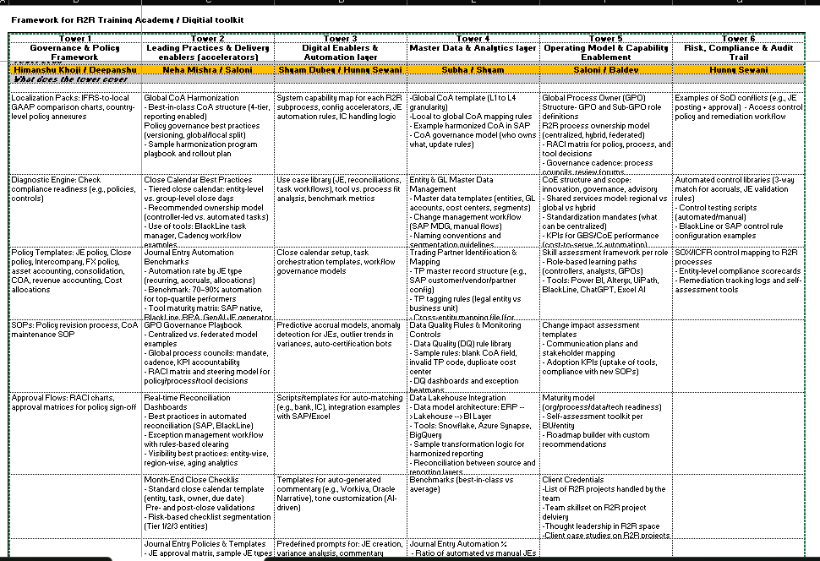
Record-to-Report | Operating Model and Capability Enablement
GPO
R2R Ownership Model
RACI Matrix
Governance
Summary
We have structured the content according to the operating model chevrons – including process, technology, organization, location, people, data, governance, policies and controls. Additionally, we have incorporated other essential capabilities such as personas, change management, and client credentials.
Gaps Identified
The structured content primarily focuses on overall Finance process and requires customization for the R2R context
Governance cadence
Role-based skill development and learning pathways
Comprehensive communication strategy and stakeholder mapping
Self-assessment toolkit
Next Steps
Build R2R GPO structure, establish skill enhancement learning pathways, and create a governance schedule from the ground up.
Design a tailored organizational framework for R2R, along with sourcing and transition strategies, and comprehensive communication plan.
Framework of the operating model encompassing both upstream and downstream activities within the comprehensive Finance process.
CoE Structure
Shared Service Model
Performance Mgmt.
Processes overview
Service delivery framework (GBS, CoE, Local, Corp.)
Contextual framework
Performance metrics
R2R transformation and automation heatmap
Sourcing strategy
Transition strategy
Maturity model assessment
Organizational framework and hierarchy
Standardization and placement of L3 activities
RACI matrix
Change Impact analysis
Communication strategy
Accountability framework (Governance / Decision-making)
Technology solutions (BlackLine, Trintech, ARCS)
R2R user personas
Client credentials and case study
GPO structure – roles and definitions
Skill Assessment Personas
Technology and Platforms
Change Impact
Governance
Maturity Model
Client Credentials

Slide 2
Review Slides – slides created from scratch
Section | Sub-Section | Pages | Comments | Review Status | Reviewer’s Name
Global Process Owners | RACI matrix for policy, process, etc. | 58 – 61
COE structure and scope | Standardization mandates (what can be centralized) | 16 – 17
 | KPIs for GBS / COEs | 35 – 38
Skill assessment per role | R2R personas | 28 – 30 | Built 3 in this template. If good, we can build couple more
Maturity Model | Roadmap builder with custom recommendations | 32 – 33 | Built couple of frameworks on determining sequencing of improvement opportunities

Slide 3
Contents
1 | Introduction and Summary
2 | Operating Model and Service Delivery
3 | Organizational Structure and Transition
4 | Personas and Skills (People)
5 | Performance Management
6 | Technology and Platforms
7 | Governance and Change Management
8 | Client Credentials and Case Studies

Slide 4
Introduction and Summary

Slide 5
Executive Summary
The Record-to-Report (R2R) operating model is designed to deliver accurate, timely, and insightful financial reporting while enabling business decision-making. At the center sits the Global Process Owner (GPO), who ensures end-to-end process standardization, governance, and compliance across regions. The interaction model connects the CFO organization, Global Business Services (GBS) or Centers of Excellence (CoEs), and the GPO office, with clear accountabilities, escalation paths, and service-level agreements. The process scope covers general accounting, reconciliations, intercompany, fixed assets, financial consolidation, and both regulatory and management reporting.
The model is enabled by a strong talent and technology backbone. R2R roles span from transaction specialists and reconciliation analysts to reporting and insights partners, with skillsets in accounting, analytics, automation, and stakeholder management. Technologies such as ERP platforms, RPA, AI/ML, advanced analytics, and visualization tools drive efficiency, accuracy, and predictive insights. A robust governance framework ensures risk management, KPI tracking, and process compliance, while GBS/CoEs focus on efficiency, scale, and innovation.
Finally, the model embeds innovation and change management as critical levers for value creation. Real-time close, AI-enabled reconciliations, and process mining are used to streamline operations, while structured change programs ensure adoption and business alignment. Client case studies highlight tangible outcomes, such as reduced close timelines, effort elimination, and improved stakeholder satisfaction. Looking ahead, success in R2R will depend on blending finance expertise with digital acumen and business partnering skills, positioning the function as a strategic enabler of growth and decision-making.

Slide 6
Objectives and Scope
Operating Model and Service Delivery | Organizational Structure and Transition | Personas and Skills (People) | Performance Management | Technology and Platforms | Governance and Change Management | Client Credentials and Case Studies
Global Process Ownership (GPO) – Structure, roles, and definitions R2R interaction model and process maps and overview Placement of L3 activities R2R service delivery | R2R process ownership model Organizational framework and hierarchy Transition strategy Sourcing strategy | Record-to-Report personas Skill assessment toolkit Roadmap builder Role-based learning pathways | Performance metrics and management: GBS CoE | R2R technology overview Different platforms and tools: BlackLine Trintech ARCS Financial Consolidation Systems | Governance model and accountability framework (Decision-making, policies and controls) RACI matrix Change impact analysis Communication strategy | Client credentials and case studies Team skillset on R2R project delivery

Slide 7
Operating Model and Service Delivery

Slide 8
Global Process Ownership (GPO) Structure
A comprehensive GPO model comprises responsibility for process design, delivery & IT solution design. GPO’s responsibilities for Global will evolve from advanced model to comprehensive E2E responsibility.
GPO Light Model
Design responsibilities for GBS processes
*GPO Advanced Model
E2E design and build responsibilities
GBS Comprehensive Model
Full fledged E2E responsibility (GSO*)
GPO
SSC/BPO Org.
Retained Org.
GPO
SSC/BPO Org.
Retained Org.
GPO
SSC/BPO Org.
Retained Org.
Design
Design
Design
Build
Build
Operate
IT
GBS Process Governance
GBS Process Governance
GBS Process Governance
Retained Process Governance
Retained Process Governance
Retained Process Governance
Process Design
Currently the Global GPO is operating in a GPO Light Model
Process Design
Process Execution is assumed to be the responsibility of the Tower Lead, with IT Solution Design being the responsibility of IT
Process Design
Process Build
Process Build
Process Build
Process Execution
Process Execution
Process Execution
IT Solution Design
IT Solution Design
IT Solution Design
Outcome/Demand Steering
Outcome/Demand Steering
Outcome/Demand Steering
Focus on process governance and process design. GPO light model is a common starting point to setup process in a GBS or SSC/BPO environment.
The GPO has full responsibility for process governance in regards to design and build on a global scale including process governance for retained and local functions.
GPO focuses on E2E process responsibility for design, build, and execute. The governance embraces also IT solution design and driving of new technologies.

Slide 9
Responsibilities of Global Process Owners (GPO)
Global Process Owners are executives who owns the end-to-end processes of their assigned workstreams across functions, geographic locations or business units. They are the overall accountable for the business process on a global scale and will be accountable for all process design and build activities as well as continuous improvement across the full solution including technology enablement.
Responsibilities | Description
Solution performance and improvement | Development of global process blueprint and standardisation across functions and ensure end-to-end process/solution adherence to implemented global standards across GBS centres and all sites
 | Identify and propagate process/solution improvements and scope enhancements, ensuring proper controls are in place to mitigate any risks associated with the process (e.g. SOD)
 | Identification of the key process owners and the skills required for a specific activity within their workstream
 | Decide on the functional SLA/KPI targets that will measure the process’s efficiency and effectiveness, in alignment with functions/divisions; Analyse and review the performance of their workstream
 | Take ownership of improvement projects (including budgets), along with scope and roadmap in alignment with functions/divisions
 | Monitor market trends, learn new technologies and understand the disruptions affecting their processes, and adopt them to the company if useful
People Management | Define talent development goals and hire key solution leadership positions
 | Own and update the training agenda, cultivate digital competencies and leadership by coaching and guiding others
 | Perform goal setting and performance review
Governance and Stakeholder Management | Align solution scoping, design and SLA topics with the leadership and with functions/divisions in governance committees
 | Represent and discuss solution with other major stakeholder groups, e.g. site, regional or global functional/divisional representatives
 | Closely coordinate all aspects of designing and operating of the solution with heads of functions and ensure all process related decision are aligned with the strategy and business objectives.

Slide 10
GPO Responsibilities | Interaction Model
Business Requirements/Direction
Global Process Owner
GBS Interaction
Leadership Team
Process Transformation: Establish a clear guiding vision that directs and aligns all process transformation efforts across the organization.
GBS Process Governance: Define and manage the oversight structures for Global Business Services to ensure consistency and accountability.
Retained Process Governance: Maintain internal control over key processes that remain within the organization rather than being outsourced.
Process Design: Develop structured workflows and procedures that support operational efficiency and strategic goals.
Process Implementation: Roll out newly designed processes into the organization with appropriate planning and stakeholder engagement.
Process Execution and Performance Measurement: Operate business processes while tracking performance metrics to ensure they meet desired outcomes.
Service Delivery Model: Structure how services are delivered to customers or internal teams to ensure quality and efficiency.
Technology Architecture and Roadmap: Define the IT infrastructure and create a strategic plan for its evolution to support business needs.
Sourcing Model: Determine how goods and services are acquired, balancing internal capabilities with external partnerships.
Continuous Improvements: Drive ongoing enhancements to processes and services through iterative changes and feedback loops.
Captive Teams
Business leadership requests the use of new emerging technology
Vendors may have questions on current tech stack/payment terms
Execute standardized processes and escalate exceptions to GPOs
Provide feedback on process pain points and improvement opportunities
Process Improvement Team
Collaborates with GPOs to identify, design, and pilot process enhancements
Supports change management and adoption of new practices
Internal Stakeholders
Compliance & Controls Leader
Controller prioritizes financial accuracy and compliance
Planning & Business Partnering needs to obtain accurate forecasts & working day metrics
Ensures financial processes adhere to internal controls and regulatory compliance standards
Finance Operation Leads
Manage day-to-day finance operations and ensure compliance with GPO policy and process, acting as the liaison between local teams and GPOs for alignment
External Stakeholders
Customers may raise questions around billing/service delivery
Vendors request reliable payment processes and communication on invoice status
Service Delivery Leader/Managers
Oversee service performance and ensure KPI/SLAs are met
Coordinate with GPOs on escalations and service delivery improvements
BPO Operations
Captive Teams
Execute outsourced processes according to defined SLAs and KPIs
Provide regular performance reporting and participate in governance reviews
Execute standardized processes and provide operational insights and feedback to support continuous improvement and alignment with GPO strategy

Slide 11
Role Summaries and Description
Director of GBS
Role Description:
The Director of GBS will oversee the inception of the GBS organisation and steer the organisation through a period of high growth to maturity. The role will be responsible for the ramp-up of services for existing functions as well as developing new capabilities, internal controls and service agreements and performance management. Line management responsibilities for the GBS management team, including: Head of Service Delivery – Overall leadership of GBS RDC Service Delivery centres including MDM, S2P, R2D, P2P, Q2C, P2R and H2R. Head of Reporting & Analytics – Responsible for GBS foundational insight & reporting, predictive analytics, and data visualisation team. Head of Service Management & Transformation – Responsible for process performance, transformational projects, continuous improvement, automation opportunity identification, third party contract management and performance management (internal GBS/third party), including key KPIs, SLAs/OLAs. Head of Risk Management & Controls – Responsible for controls design & oversight, risk management, and control governance. GPO Team – Executive team who owns the end-to-end processes of their assigned workstreams across functions, geographic locations or business units. They are the overall accountable for the business process on a global scale and will be accountable for all process design and build activities and overall governance.
Global Process Owner (GPO)
Role Description:
GPO will serve as the global process owner (GPO) for their respective process tower working with Functional Leaders, Head of Service Management and Transformation, Director of Global Business Services (GBS) and Service Delivery Tower Leads in the future to support process delivery, continuous improvement, transformation and a positive user/employee experience. Key accountabilities are: Designs, develops, and implements enterprise-wide Process and Services Delivery initiatives. Performs needs assessment and solution development. Initiates change requests and is responsible for demand management. Works with the relevant functional and business stakeholders to drive future focussed and appropriate policy development. Drives process development, automation, simplification and continuous improvement. Demonstrates knowledge of One “Company” strategic direction and is proficient in managing senior / executive level stakeholder relationships. Provides consulting and expertise through effective communication. Leads large scale change implementations and projects focussed on the improvement of services.
RTR/Controllership CoE
Role Description:
Assemble and support the facilitation of all necessary components of the financial statements, which includes items such as the Balance Sheet, Profit & Loss Statement, and Cash Flow Statement. Support the preparation and submission of Tax filings in adherence to the required timeframe. Develop internal reporting packages and other necessary financial reporting documents in a timely and accurate manner. Provide necessary support in preparing documentation and information for any audit requests related to legal entities. Ensure thorough completion of both sub-ledger and general ledger closures. Responsible for the preparation of legal entity actuals variance analysis to track and explain any fluctuation in financial numbers. Support the preparation of any tax-related calculations. Take charge of completing any remaining or stranded transactional activities that relate to the legal entities, ensuring no tasks are left unattended. Escalate any issues or potential complications concerning complex accounting matters to the attention of the Controller for prompt and effective resolution.

Slide 12
Record-to-Report Process Maps

Slide 13
Record-to-Report Process Overview

Slide 14
Placement of RTR L3 Activities – Current State (Accounting)
Taxonomy (L3) | EBS |  | Controllership |  | BUF | CII
 | Prepare | Review | Prepare | Review
Consolidation Period-End Close |  |  | Global | Global
Financial & External SEC Reporting |  |  | Global | Global
Financial Reporting | Non-standard | Non-standard |  | Global
Governmental / Regulatory Reporting | Non-standard |  |  | Global
Intercompany | Non-standard | Non-standard
Internal Reporting and Analysis | Global |  |  | Global
Inventory Costing (PIC) |  |  |  |  | Non-standard
Legal Entity Accounting | Non-standard | Non-standard
Operational Controllership Activities³ |  |  |  | Non-standard
Policies and Procedures |  |  | Global | Global |  | Non-standard
Reconciliations | Non-standard | Non-standard
Topsides |  |  | Global | Global
Transactional Accounting¹ ⁴ | Non-standard | Non-standard |  |  | Non-standard
Trial balances² | Non-standard | Non-standard
Note:
¹ Transactional accounting includes Cash, Bank, Currency, & Hedging; Inventory & COGS; Procurement Accounting; Revenue Accounting; General Accounting; Lease Accounting; Fixed Assets; Comp & Benefits Accounting
² Trial balances includes trial balance submission to OneStream; Trial balance submission
³ Operational Controllership Activities includes Master Data Maintenance – LE & Account Only; Business Partnering; Other – Special Projects; Responding to Escalations
⁴ Transactional accounting is non-standard, except for Fixed Assets
Key: Process
Global
Regional
Non-standard

Slide 15
Placement of RTR L3 Activities – Future State (Accounting)
Taxonomy (L3) | EBS |  | Controllership |  | BUF | CII
 | Prepare | Review | Prepare | Review
Consolidation Period-End Close |  |  | Global | Global
Financial & External SEC Reporting |  |  | Global | Global
Financial Reporting | Global | Non-standard |  | Global
Governmental / Regulatory Reporting | Global |  |  | Global
Intercompany | Global | Global
Internal Reporting and Analysis | Regional |  |  | Regional
Inventory Costing (PIC) | Regional | Regional
Legal Entity Accounting | Regional | Regional
Operational Controllership Activities³ |  |  | Non-standard | Non-standard
Policies and Procedures |  |  | Global | Global
Reconciliations | Non-standard | Non-standard
Topsides |  |  | Global | Global
Transactional Accounting¹ ⁴ | Global | Global
Trial balances² | Regional | Regional
Note:
¹ Transactional accounting includes Cash, Bank, Currency, & Hedging; Inventory & COGS; Procurement Accounting; Revenue Accounting; General Accounting; Lease Accounting; Fixed Assets; Comp & Benefits Accounting
² Trial balances includes trial balance submission to OneStream; Trial balance submission
³ Operational Controllership Activities includes Master Data Maintenance – LE & Account Only; Business Partnering; Other – Special Projects; Responding to Escalations
⁴ Transactional accounting is non-standard, except for Fixed Assets
Key: Process
Global
Regional
Non-standard

Slide 16
Record-to-Report Service Delivery (1/2)
9.3 Perform General Accounting and Reporting
9.3.1 Manage financial policies & procedures
9.3.2 Perform general accounting
9.3.3 Perform fixed-asset accounting
9.3.4 Perform financial reporting
Negotiate service-level agreements Establish accounting policies Publish accounting policies Set and enforce approval limits Establish common financial systems
100%
Maintain chart of accounts Process journal entries Process allocations Process period end adjustments Post and reconcile intercompany transactions Reconcile general ledger accounts Perform consolidations and process eliminations Prepare trial balance
Maintain chart of accounts Process period end adjustments Prepare and post management adjustments
75%
Maintain fixed-asset master data files Process and record fixed-asset additions and retires Process and record fixed-asset adjustments, enhancements, revaluations, and transfers Calculate and record depreciation expense Reconcile fixed-asset ledger Track fixed-assets including physical inventory Provide fixed-asset data to support tax, statutory, and regulatory reporting
Establish fixed-asset policies & procedures
Maintain fixed-asset master data files Process & record fixed-asset additions & retires Process & record fixed-asset adjustments, enhancements, revaluations, & transfers Process and record fixed-asset maintenance & repair expenses
55%
Prepare business unit financial statements Prepare consolidated financial statements Perform business unit reporting/review management reports Perform consolidated reporting/review of cost management reports Prepare statements for board review Produce quarterly/annual filings and shareholder reports Produce regulatory reports
Prepare business unit financial statements Prepare consolidated financial statements Prepare statements for board review Produce quarterly/annual filings and shareholder reports Produce regulatory reports Perform legal and management consolidation
55%
10%
45%
35%
25%
Transactional Services
Value-Added Services
 | Local |  | Corporate |  | GBS |  | CoE

Slide 17
Record-to-Report Service Delivery (2/2)
9.4 Manage Fixed-asset Project Accounting
9.4.1 Perform capital planning and project approval
9.4.2 Perform capital project accounting
80%
Develop capital investment policies and procedures Develop and approve capital expenditure plans and budgets Review and approve capital projects and fixed-asset acquisitions Conduct financial justification for project approval
Conduct financial justification for project approval
Create project account codes Record project-related transactions Monitor and track capital projects and budget spending Close/capitalize projects Measure financial returns on completed capital projects
100%
20%
Transactional Services
Value-Added Services
 | Local |  | Corporate |  | GBS |  | CoE

Slide 18
Organizational Structure and Transition

Slide 19
Record-to-Report Process Ownership Model
Business Engagement Flow
Support accurate external reporting and disclosures.
Ensure financial narratives tie back to audited results.
FP&A and Business Unit Finance
(Regional / Global)
Investor Relations
Local BU Leadership
(BoD / MD / FD / CFO)
Align on financial results, variance analysis, & business performance drivers.
Provide accurate, timely accounting close outputs for planning and forecasting.
Provide financial stewardship, governance, and controllership oversight.
Support decision-making with financial accuracy and risk management.
CCR
Consolidation, Close, and Reporting
Lead end-to-end monthly/quarterly/annual close governance.
Validate intercompany eliminations, consolidation adjustments, and reporting accuracy.
HR Operations (Acquire-to-Retire)
CONTROLLER
(Regional / Global)
Accounts Payable & Receivables
Core Flow (Close-to-Report Cycle)
Validate payroll, benefits, and employee costs postings.
Support accounting for restructuring, severance, and workforce changes.
Ensure correct cut-off, accruals, and cash flow reporting.
Oversee policy compliance (payment terms, credit management).
Operations /
Supply Chain
Enterprise Business Services
Coordinate on tax provisions, transfer pricing, and statutory reporting.
Align on cash flow forecasts, hedging, and intercompany settlements.
Own accuracy and completeness of journal entries and reconciliations.
Monitor accounting policies, capitalization rules, and project spend alignment.
Others
(Tax and Treasury)
Own accuracy and completeness of journal entries and reconciliations.
Monitor accounting policies, capitalization rules, and project spend alignment.
Act as primary liaison with internal and external auditors.
Ensure compliance with SOX, IFRS/GAAP, and internal control framework.
Audit & Compliance
IT / ERP / Analytics
Drive ERP integrity, chart of accounts governance, and system controls.
Partner on automation, reporting dashboards, and data accuracy.
Governance & Compliance Flow

Slide 20
R2R Organizational Framework | Revenue Recognition Accounting
 | HC: 7.0 | FTE: 6.5 | Open Role: 1
James Austin
Head, Controller
Process | Employee FTEs | Contractor FTEs
Contract-to-Cash | 4.7 | 0.8
Source-to-Pay | - | -
Record-to-Report | 0.9 | 0.2
Planning & Analysis | - | -
Other Finance | - | -
Total Finance | 5.6 | 1.0
Non-Finance | 0.4 | -
Total | 6.0 | 1.0
45%
15%
40%
Emily Dickens
Revenue Acct. Director
85%
15%
Steven Jacks
Contractor
50%
Open Role
Manager, Accounting
Roy Livingstone
Manager, Accounting
80%
20%
85%
15%
85%
15%
Location
Bangalore
Hyderabad
Manila
Jessica Park
Senior Accountant
John Faulkner
Senior Accountant
Houston, TX
Dallas, TX
Mexico City
85%
15%
85%
15%
%
Part-Time Efforts
Role Interviewed / Open

Slide 21
R2R Organizational Framework | Technical Accounting & Reporting
 | HC: 7.0 | FTE: 7.0 | Open Role: 1
Mark Johnson
Head, Tech. Acct., CAO, SIG
Process | Employee FTEs | Contractor FTEs
Contract-to-Cash | 1.0 | -
Source-to-Pay | - | -
Record-to-Report | 6.0 | -
Planning & Analysis | - | -
Other Finance | - | -
Total Finance | 6.0 | 0.0
Non-Finance | - | -
Total | 6.0 | 0.0
10%
90%
Ruth Capri
Principal Director, Financial Reporting
Jack Wilder
Principal Director, Technical Reporting
100%
30%
70%
Joy Simpson
Financial Reporting Lead
Sussane Moss
Technical Accounting Director
100%
30%
70%
Location
Bangalore
Hyderabad
Manila
Open Role
Senior Analyst
Charles Black
Technical Accounting Director
Houston, TX
Dallas, TX
Mexico City
100%
30%
70%
%
Part-Time Efforts
Role Interviewed / Open

Slide 22
R2R Organizational Framework | SSC General Ledger (GL)
 | HC: 17.0 | FTE: 16.0 | Open Role: 2
James Bond
Head, Finance Shared Services (FSS)
Process | Employee FTEs | Contractor FTEs
Contract-to-Cash | - | -
Source-to-Pay | - | -
Record-to-Report | 11.2 | 2.0
Planning & Analysis | - | -
Other Finance | 2.8 | -
Total Finance | 14.0 | 2.0
Non-Finance | - | -
Total | 14.0 | 2.0
Kate Russo
Principal Director, FSS
90%
10%
Open Role
Director
Erica Morse
Director, Accounting
Frankie Cowan
Director, Accounting
Aditya Rathore
Director, FSS
100%
100%
30%
70%
100%
Kirk Maxwell
Contractor
Kenneth Baldwin
Senior Accountant
Ted Simms
Senior Accountant
Anaya Bansal
Accountant III
100%
100%
100%
100%
Location
Joni Jennings
Senior Accountant
Shelly Bradford
Senior Accountant
Rajesh Chopra
Accountant II
Bangalore
Hyderabad
Manila
100%
100%
100%
50%
Houston, TX
Dallas, TX
Mexico City
Kay Arroyo
Contractor
Open Role
Accountant
Tanushree Joshi
Accountant II
%
Part-Time Efforts
Role Interviewed / Open
100%
100%
100%
Irene Meyer
Accountant
50%
Luke Ashley
Contractor
100%
100%

Slide 23
Transition Strategy – 1

Slide 24
Transition Strategy – 2

Slide 25
Sourcing Strategy – 1

Slide 26
Sourcing Strategy – 2

Slide 27
Personas and Skills
(People)

Slide 28







Persona Capability Summary – General Ledger (GL) Accountant
Role and Responsibilities Summary
Record | Reconcile | Close | Consolidate | Report
Post journal entries (accruals, prepayments, intercompany, etc.) | Perform GL account reconciliations (bank, intercompany, sub-ledgers) | Support monthly/quarterly/year-end close processes | Assist in preparing data for group-level consolidation | Generate internal financial reports (trial balances, P&L, balance sheets)
Ensure accurate GL coding and documentation | Investigate discrepancies and ensure timely resolution | Ensure completeness and accuracy of GL entries | Support intercompany eliminations and group adjustments | Provide supporting documentation for audit or management review
Maintain master data integrity (e.g., chart of accounts, cost centres) | Adhere to internal controls and reconciliation policies | Coordinate with AP, AR, and other functions to validate balances | Liaise with corporate finance on local entity results | Assist in regulatory / statutory financial reporting where applicable
Stakeholder Interaction
Accounts Payable (AP)
Accounts Receivable (AR)
FP&A and Payroll Teams
Tax and Treasury Teams
Controllers / Finance Business Partners
IT / ERP Support Teams
Motivations Summary
Questions and Concerns Summary
Team Structure*
Deliver timely and accurate financial data for decision-making.
Maintain compliance with accounting standards and internal controls.
Ensure smooth period-end processes with minimal adjustments or rework.
Streamline processes through automation and standardization.
Foster strong relationships with cross-functional teams and auditors.
Are all journal entries recorded accurately and in a timely manner?
Are GL accounts reconciled and discrepancies resolved before deadlines?
Is the data prepared in a format suitable for consolidation?
Are financial reports compliant with internal and external requirements?
Do upstream/downstream data sources impact the accuracy of the GL?
GL Accountants | 6 – 10
GL Lead / Supervisor | 1 – 2
R2R Process Manager | 1
Transaction Processing Staff (Shared Services) | 3 – 6
Finance Transformation Specialist | 1 – 2
Process Understanding
Record | 9/10
Reconcile | 9/10
Close | 8/10
Consolidate | 5/10
Report | 6/10
Color Key
1 | 2 | 3 | 4 | 5 | 6 | 7 | 8 | 9 | 10
*Team structure may vary based on business size, number of entities, transaction volume, and tool maturity

Slide 29
Persona Capability Summary – Intercompany Accountant
Role and Responsibilities Summary
Record | Reconcile | Close | Consolidate | Report
Record intercompany transactions (sales, services, charges, cost allocations) | Match intercompany balances between entities | Coordinate with counterparties to ensure balances align pre-close | Provide accurate intercompany data for elimination during consolidation | Prepare intercompany balance reports and aging schedules
Ensure accurate and timely posting across entities | Investigate and resolve mismatches in timing, currency, and amounts | Book necessary accruals or adjustments to align intercompany positions | Ensure proper tagging of intercompany transactions for reporting tools | Report unresolved mismatches and reconciliation items
Apply correct intercompany pricing and terms (as per transfer pricing policy) | Maintain audit trail and documentation for eliminations | Support timely completion of period-end tasks related to intercompany activity | Collaborate with group consolidation teams to resolve discrepancies | Support audit and compliance reporting with intercompany data
Stakeholder Interaction
GL Accountants
AP and AR Teams
Corporate Finance (FP&A)
Tax and Treasury Teams
Entity Controllers / Local Finance Teams
IT / ERP Support Teams
Motivations Summary
Questions and Concerns Summary
Team Structure*
Ensure all intercompany transactions are accurately recorded and reconciled.
Meet internal deadlines for reconciliation and close.
Maintain clean audit trails and documentation for compliance (e.g., SOX, statutory).
Foster smooth collaboration with intercompany counterparties.
Support end-to-end process automation and efficiency improvements.
Are all intercompany transactions recorded by both entities, on time and accurately?
Are exchange rate differences and timing mismatches properly accounted for?
Are outstanding intercompany balances justified or actionable?
Are all intercompany eliminations reflected correctly in consolidation?
Is the ERP or reconciliation tool providing sufficient visibility and automation?
Intercompany Accountants | 4 – 6
Intercompany Lead / Senior Accountant | 1 – 2
R2R Process Manager (Intercompany Focus) | 1
Reconciliation Tool Specialist (example: BlackLine, Trintech) | 1
Process Understanding
Record | 8/10
Reconcile | 10/10
Close | 9/10
Consolidate | 7/10
Report | 7/10
Color Key
1 | 2 | 3 | 4 | 5 | 6 | 7 | 8 | 9 | 10
*Team structure may vary based on business size, number of entities, transaction volume, and tool maturity

Slide 30
Persona Capability Summary – Consolidation & Reporting Specialist
Role and Responsibilities Summary
Record | Reconcile | Close | Consolidate | Report
Ensure accuracy of GL, sub-ledgers, and intercompany postings | Review reconciliations of intercompany balances and key GL accounts | Validate trial balances for month-end/quarter-end close activities | Execute consolidation processes using HFM/OneStream/SAP Group Reporting | Prepare and deliver consolidated financial statements for reporting
Validate chart of accounts for consolidation | Identify and resolve mismatches with entity controllers | Monitor close calendars and escalate delays affecting consolidation | Post top-side adjustments (eliminations, minority interest, etc.) | Support management reporting and regulatory filings
Collaborate with local entities on standard templates and accounting principles | Oversee foreign currency translation accuracy per group policies | Conduct preliminary variance analysis for unusual trends | Validate accuracy of consolidated P&L, BS, and CF | Liaise with auditors on consolidation queries and provide analysis on financial results and KPIs
Stakeholder Interaction
Country Finance Teams
Regional Finance Leads
Corporate Finance (FP&A)
Tax & Treasury Teams
GL and Intercompany Accountants
IT / System Admin
Motivations Summary
Questions and Concerns Summary
Team Structure*
Delivering accurate and timely consolidated financials to meet statutory, regulatory, and management expectations.
Driving standardization and automation in consolidation & reporting processes.
Ensuring compliance with IFRS/US GAAP/local GAAP and internal policies.
Supporting management with data-driven insights to improve decision-making.
Building a reputation for being a trusted advisor within finance.
Are all local entities aligned with accounting policies, timelines, and reporting standards?
Are intercompany mismatches and FX translation issues resolved on time?
Is there full visibility of adjustments and eliminations across the group?
Are the tools/systems reliable and automated enough to minimize manual interventions?
Can I trust the data quality being submitted by local and regional teams?
Consolidation and Reporting Specialists | 3 – 5
Senior Consolidation Financial Analyst / Lead | 2 – 3
Consolidation and Reporting Manager | 1
Systems Administrator / Consolidation Tool Expert | 1 – 2
Process Understanding
Record | 6/10
Reconcile | 7/10
Close | 8/10
Consolidate | 10/10
Report | 9/10
Color Key
1 | 2 | 3 | 4 | 5 | 6 | 7 | 8 | 9 | 10
*Team structure may vary based on business size, number of entities, transaction volume, and tool maturity

Slide 31
Skill Assessment Toolkit
Focus on People aspect – Skill gap assessment
Focus on Tool aspect – Like the survey EY Pulse roll out
Based on the current KPIs – Identify the current STAGE of the maturity model

Slide 32
Roadmap Builder (Method 1 – Generic)
Opportunities have been divided into tranches to stagger activity to manage the time requirements and resource constraints across the R2R Team. Tranches indicate start times of initiatives – activities may extend beyond a single tranche timeline.
Overarching Principles | R2R Resources will need to be dedicated to support the delivery of selected initiatives Roadmap is initially for the next 12 months – activities for some initiatives may extend beyond 12 months Show benefit quickly to maintain momentum – prioritize delivery over assessments Complete pre-requisites to enable longer term initiatives
Tranche 1 – Short Term “Start to see immediate benefit and relief” | Communication of the go-forward plan to the executive and business teams starts in Tranche 1 Focus on what can completed within the “walls of R2R” Allow time for hiring resource backfills and R2R headcount needs Include initiatives which both benefit wider stakeholders and the R2R team Lay the foundation for future Tranches – e.g., R2R Roles and Responsibility Matrix
Tranche 2 – Medium Term “Continue to build on the foundation” | Mobilize more complicated initiatives which will require heavier R2R resource commitment Work with IT and data team to tackle the wider enterprise data strategy design and roll out Begin more complex process redesign and tool capability design before busy monthly and annual Process starts Activities from Tranche 1 may continue during Tranche 2
Tranche 3 – Long Term ”Start fundamental process redesign” | Continue and implementation of more complex initiatives (reimagine of the R2R processes, EPM tool, etc.) Balance process redesign with the resource intensive close processes starting now Activities from Tranche 1 and 2 may continue during Tranche 3

Slide 33
Roadmap Builder (Method 2 – Scoring Based)
1. Identify improvement opportunities
2. Conduct roadmap development working session with client to get consolidated results on ranking of importance vs feasibility for each opportunity
3. Create a scorecard and determine sequencing of opportunities in roadmap builder
Importance Ranking
Feasibility Ranking
Roadmap Prioritization
Initiative 3
1st
2nd
Immediate Focus
Initiative 1
2nd
1st
Immediate Focus
Initiative 2
3rd
5th
Immediate Focus
Initiative 5
4th
9th
Immediate Focus
Initiative 6
5th
4th
Immediate Focus
Initiative 10
6th
8th
Future Focus
Initiative 4
7th
3rd
Future Focus
Initiative 8
8th
10th
Future Focus
Initiative 9
9th
6th
Future Focus
Initiative 7
10th
7th
Future Focus

Slide 34
Performance Management

Slide 35


KPIs for GBS performance (1/2)
GBS KPIs are more execution-focused, targeting operational efficiency, transactional accuracy, and cost-effectiveness
Operational Efficiency KPIs
Quality & Accuracy KPIs
KPI | Description | Benchmark | Notes
Days to Close (Month-End Close Cycle Time) | Number of calendar days to complete the monthly closing process | 3–5 days | World-class organizations target ≤5 days
Cost per Transaction / per Report | Total cost to perform an RTR transaction or generate a financial report | $1–$3 per transaction | Varies based on labor arbitrage and automation
Journal Entry Processing Time | Average time taken to process journal entries | <4 hours per entry | Includes validation and posting
Automated vs. Manual Journal Entry Ratio | Proportion of journal entries posted automatically versus manually | >70% automated | RPA and ERP rules help increase this
Standardization Rate | % of RTR processes standardized across regions or BUs | >85% | High-performing GBS strive for global standardization
Process Automation Level | Extent of RPA or AI integration in RTR activities | 40–70% | Depends on maturity of RPA/AI initiatives
KPI | Description | Benchmark | Notes
Journal Entry Accuracy Rate | % of journal entries posted without errors or rework | >98% | Less than 2% error rate is best practice
Rework Rate | % of RTR transactions that require correction | <2% | Indicates strong process control
Intercompany Reconciliation Accuracy | % of matched vs. unmatched intercompany transactions | >95% matched at close | Faster close cycles demand better reconciliation
First Pass Yield (FPY) | % of RTR outputs completed correctly the first time | >95% | Shows transaction quality and process effectiveness

Slide 36




KPIs for GBS performance (2/2)
Timeliness KPIs
Compliance & Control KPIs
KPI | Description | Benchmark | Notes
On-Time Delivery of Reports | % of reports delivered on or before due dates | >98% | Critical for leadership decision-making
Compliance with Reporting Calendars | Adherence to internal and external reporting timelines | 100% | Reporting timelines should be strictly met
Audit Request Turnaround Time | Time taken to respond to internal/external audit queries | <48 hours | Best-in-class organizations aim for ≤2 days
KPI | Description | Benchmark | Notes
Number of Control Failures | Count of failed internal controls related to RTR | 0–1 per quarter | Zero tolerance is ideal, but occasional issues may occur
Policy Adherence Rate | Compliance with global RTR policies and procedures | >98% | Ensures global consistency and risk mitigation
Number of Audit Findings | Audit exceptions specific to RTR processes | ≤2 minor findings/year | Minimal and non-critical findings show strong governance
Value-Added & Strategic KPIs
Talent & Capability KPIs
KPI | Description | Benchmark | Notes
Continuous Improvement Initiatives Implemented | Count of Lean, Six Sigma, or transformation projects completed | 5–10 initiatives/year | Active Kaizen or Lean projects across RTR
Business Partner Satisfaction Score | Survey-based feedback from internal stakeholders | >85% satisfaction | Usually measured via surveys (CSAT or NPS)
KPI | Description | Benchmark | Notes
Training Hours per FTE | Average hours of training per RTR staff member | 20–40 hours/year | Includes compliance, tools, and soft skills
Attrition Rate | % of RTR staff turnover within a period | <10% annually | Lower attrition indicates a healthy GBS environment

Slide 37
KPIs for CoE performance (1/2)
CoE KPIs are more value-driven, focusing on analytics, compliance, standardization, and strategic impact
Operational Efficiency KPIs
Talent & Capability KPIs
KPI | Description | Benchmark | Notes
Automated vs. Manual Journal Entry Ratio | Proportion of journal entries posted automatically versus manually | >70% automated | RPA and ERP rules help increase this
Standardization Rate | % of RTR processes standardized across regions or BUs | >85% | High-performing GBS strive for global standardization
Process Automation Level | Extent of RPA or AI integration in RTR activities | 40–70% | Depends on maturity of RPA/AI initiatives
KPI | Description | Benchmark | Notes
Training Hours per FTE | Average hours of training per RTR staff member | 20–40 hours/year | Includes compliance, tools, and soft skills
Attrition Rate | % of RTR staff turnover within a period | <10% annually | Lower attrition indicates a healthy GBS environment
Skill Readiness Score | Assessment of employee skills vs. RTR role requirements | >90% | Based on skills mapping and training completion
Quality & Accuracy KPIs
KPI | Description | Benchmark | Notes
Variance Analysis Timeliness | Time taken to provide meaningful analysis on financial variances | <2 business days | After close, analysis should be prompt

Slide 38
KPIs for CoE performance (2/2)
Value-Added & Strategic KPIs
Compliance & Control KPIs
KPI | Description | Benchmark | Notes
Insight-to-Action Ratio | % of analytics reports that led to business action or decision | >60% | More than half of insights should drive real decisions
Continuous Improvement Initiatives Implemented | Count of Lean, Six Sigma, or transformation projects completed | 5–10 initiatives/year | Active Kaizen or Lean projects across RTR
Business Partner Satisfaction Score | Survey-based feedback from internal stakeholders | >85% satisfaction | Usually measured via surveys (CSAT or NPS)
Forecast Accuracy | Accuracy of financial forecasting versus actuals | ± 5–10% variance | Depends on volatility in the business environment
KPI | Description | Benchmark | Notes
Number of Control Failures | Count of failed internal controls related to RTR | 0–1 per quarter | Zero tolerance is ideal, but occasional issues may occur
SOX Compliance Rate | % compliance with SOX-relevant RTR controls | 100% | Non-negotiable for publicly listed companies
Policy Adherence Rate | Compliance with global RTR policies and procedures | >98% | Ensures global consistency and risk mitigation
Number of Audit Findings | Audit exceptions specific to RTR processes | ≤2 minor findings/year | Minimal and non-critical findings show strong governance
KPI | Description | Benchmark | Notes
On-Time Delivery of Reports | % of reports delivered on or before due dates | >98% | Critical for leadership decision-making
Compliance with Reporting Calendars | Adherence to internal and external reporting timelines | 100% | Reporting timelines should be strictly met
Timeliness KPIs

Slide 39
Technology and Platforms

Slide 40
Record-to-Report Technology | Cloud Interface

Slide 41
Record-to-Report Technology Landscape

Slide 42
BlackLine | 1

Slide 43
BlackLine | 2

Slide 44
BlackLine | 3

Slide 45
Trintech | 1

Slide 46
Trintech | 2

Slide 47
Trintech | 3

Slide 48
ARCS | 1

Slide 49
ARCS | 2

Slide 50
ARCS | 3

Slide 51
Financial Consolidation & Close | 1

Slide 52
Financial Consolidation & Close | 2

Slide 53
Financial Consolidation & Close | 3

Slide 54
Governance and Change Management

Slide 55
GBS Governance Models
Many companies have shifted to an integrated GBS Governance model
Regional SSCs
Divisional SSCs
Functional SSCs
Global Business Services
Functional Steering
Global Business Services
Central Steering
CEO
CEO
CEO
CEO
CEO
EU
NA
APAC
Business Unit 1
Business Unit 2
Group Function
Business Unit 1
Business Unit 2
Group Function
Business Units
Group Functions
GBS
Business Units
Group Functions
GBS
SSC
SSC
SSC
SSC
SSC
SSC
SSC
SSC
Governance – Option 1:
GBS with independent functions based on a harmonized shared services foundation.
Key aspects:
One common GBS strategy with a harmonized shared services foundation and a global service delivery model
Global steering board with functional owners and board representatives to leader global strategic priorities and execute GBS strategy
Functional steering by functional owners to remain functional autonomy
GBS organization as foundation (“Global service delivery network”)
Governance – Option 2:
Fully integrated end-to-end global business services steered by a single head of GBS.
Key aspects:
End-to-end global business services bundled within one organization as a foundation for strong governance
One common GBS strategy with global process owners, a global service delivery setup, and a global service management
The organization is headed by a single head of global business services, who reports to the C-suite or may be a member of it
Single global shared services organization operating through regional centers.
Full integration of enterprise processes and complete end-to-end process integration throughout the company due to concentrating on service products instead of functions

Slide 56
GBS Governance Layers
Baldev
GBS governance layers need to have clearly define governance objectives, participants, and frequency of meeting
GBS Governance Layers
Frequency/Participants
Governance Objective
Customer Board (representing functions/divisions)
E.g., quarterly during implementation, semi-annually in steady-state
Division/functions: Key representatives to ensure full mandate for strategic oversight
GBS: Head of GBS, heads of solution and delivery excellence, head of customer excellence, GBS center heads
Determine overall strategy and provide management oversight
Conduct periodic review of performance
Resolve key issues and disputes
Approve increases in scope of operations/services
Approve cost center expenditure plans
Approve functional SLA targets
Corporate
Head of GBS
Participation
Division/Functional Governance Committee (e.g., GHR)
E.g., monthly during implementation, bi-monthly in steady-state
Regular participants of Divisional/functional committee
GBS: GSO, likely global and/or regional functional delivery Lead(s) optional head of solution excellence
Establish functional SLA targets
Review functional performance against SLAs
Regularly review scope and prepare scope extension proposals for customer board
Identify, develop and leader business process improvement initiatives
Identify specific service or process issues
Monitor process compliance
Functional
GSO
Operational Lead Division/Function
Monthly
By region or local?
Division/functions: Regional / local / operations / commercial / functional head
GBS: Head of DC; functional leader; head of service mgmt.
Monitor the in-scope process execution
Monitor local/regional performance, service quality and cost
Discuss and manage operational issues
Analyze root causes of service issues or below target SLA performance
Entry door for new requests (e.g. new entity)
Operational
HFD
Service Management Lead
Service Management Channels
Daily, operational
Service request and delivery
Incident management
Proactive and reactive problem management
Service level management
Service
Mgmt.
F&F
F&F: Full and Final Settlement; GSO: Global Solution Owners; SLA: Service Level Agreement

Slide 57
Governance & Accountability Framework
Stakeholder Value & Communication
Reporting & Steering
Data Model & Analytics
Customer
Product Labels
Operative Steering Model
Integrated Data & Analytics Layer
Financial Data Sources
Data Model
Investors
Marketing Campaigns
Real Time
Information Portal
LTV
Value Narrative
Activists
Apps
Financial Statement
Consolidation Engine
Business Data Sources
Talent
YouTube
Regulator
Website
ESG
External Data Sources
Alliances
API
Other
….
….
Value to Stakeholder
High number of external reports can lead to inconsistent information and has limited value impact
Translating the different reports into one integrated value narrative ensures consistent information sharing along core value driver
Communication channels change from classic reports to apps, digital tagging and modern forms of content visualization.
Insights to Value
Corporate steering models translate the value narrative into key performance indicator
KPI & Analytics needs to be structured along value flows to create impact and support business in decision taking
Simulation and prediction models will enable business to see the impact of their decision on the consolidated long term value report
Data to Insights
Data to insights will require analytics capabilities enabled by artificial intelligence
Multiple data sources will be utilized to fulfill the new reporting requirements. ERP, Blockchain, IoT etc. will play a more important role in creating real time data.
Integration of the various data resources requires a data model and technology solutions, that provide the necessary flexibility

Slide 58
RACI Definitions and Rules
SHORT
LONG
R
Responsible
Does the work
Stakeholders who do the work – either complete the task or make the decision
A
Accountable
Is accountable for outcomes
Stakeholders who is the ‘owner’ of the work – signs off or approves when the task, objective or decision is complete
C
Consulted
Gives input and influences the output
Stakeholders who need to give input before the work can be done and signed-off on. They are active participants.
I
Informed
Receives the output
They receive information, but neither need to be formally consulted, nor contribute to or influence the step
RULES
A can only be used once (ultimate owner of the step)
A and R can be the same on a function level, on a person level it would usually be different
R/C/I can be used several times per step
Role Mapping Assumptions
GBS → Primary executor for operational accounting steps (journal entries, reconciliations, MDM, etc.)
Corp Finance → Accountable for policy, governance, and consolidated group reporting
Regional Finance → Accountable for regional adjustments, reporting, and allocations
Commercial Finance → Responsible/Consulted for business insights, project financials
CoE → Accountable for technical/specialized areas (e.g., fixed assets, cost management)
Sales → Consulted/Informed for data inputs, rarely accountable

Slide 59
Record-to-Report | RACI Matrix (1/3)
Process Step | Sales | GBS | Regional Finance | Commercial Finance | Corporate Finance | CoE
Maintain accounting master data
Design accounting master data structure | I | C | C | I | A | C
Establish, maintain, and communicate accounting master data policies & procedures | I | R | C | I | A | C
Update / maintain accounting master data | I | A/R | I | I | C | I
Manage policy & procedures
Negotiate service-level agreements | I | A/R | C | I | C | I
Establish accounting policies | I | C | C | I | A | C
Publish accounting policies | I | R | I | I | A | I
Set and enforce approval limits | I | R | C | C | A | I
Establish common financial systems | I | R | C | I | A | C
Perform general accounting
Maintain chart of accounts | I | A/R | I | I | C | C
Process journal entries | I | A/R | I | I | C | I
Provide inputs for updating allocations | C | R | A | R | I | I
Process allocations | I | R | A | I | I | I
Provide inputs for period-end adjustments | C | R | A | R | I | I
Process period-end adjustments | I | R | A | I | I | I
Post & reconcile intercompany transactions | I | A/R | C | I | I | I
Reconcile general ledger accounts | I | A/R | I | I | I | I
Perform consolidations and process eliminations | I | R | C | I | A | I

Slide 60
Record-to-Report | RACI Matrix (2/3)
Process Step | Sales | GBS | Regional Finance | Commercial Finance | Corporate Finance | CoE
Perform general accounting
Prepare trial balance | I | A/R | I | I | C | I
Prepare and post management adjustments | I | R | A | C | I | I
Perform fixed asset accounting
Establish fixed-asset policies & procedures | I | C | C | I | I | A
Establish (tax and book) depreciation policies | I | C | I | I | I | A
Maintain fixed-asset master data files | I | A/R | I | I | C | R
Process and record fixed-asset additions and retires | I | R | I | I | I | A
Process and record fixed-asset adjustments/enhancements/revaluations/transfers | I | R | I | I | I | A
Process and record fixed-asset maintenance & repair expenses | I | R | I | I | I | A
Calculate and record depreciation expense | I | R | I | I | I | A
Reconcile fixed-asset ledger | I | R | I | I | I | A
Track fixed assets incl. physical inventory | I | R | I | I | I | A
Provide fixed-asset data for reporting | I | R | I | I | I | A
Perform cost management & control
Determine key cost drivers | C | C | R | A | I | C
Measure cost drivers for non-recurring activities | C | C | R | A | I | C
Measure cost drivers for recurring activities | C | C | R | A | I | C
Determine non-recurring critical activities | C | I | R | A | I | C
Manage asset resource deployment & utilization | C | I | R | A | I | C

Slide 61
Record-to-Report | RACI Matrix (3/3)
Process Step | Sales | GBS | Regional Finance | Commercial Finance | Corporate Finance | CoE
Perform financial reporting
Prepare business unit financial statements | I | R | A | C | I | I
Prepare consolidated financial statements | I | C | I | I | A | I
Perform business unit reporting/review | I | R | A | C | I | I
Perform consolidated reporting/review of cost management reports | I | C | I | C | A | I
Prepare statements for board review | I | I | C | C | A | I
Produce quarterly/annual filings & shareholder reports | I | I | C | I | A | I
Produce regulatory reports | I | I | C | I | A | I
Perform legal and management consolidation | I | C | I | I | A | I
Manage project accounting
Develop capital investment policies & procedures | I | C | I | I | I | A
Develop & approve capital expenditure plans & budgets | C | I | C | A | I | C
Review & approve capital projects and acquisitions | C | I | C | A | I | C
Conduct financial justification for project approval | C | I | C | A | I | C
Create project account codes | I | A/R | I | I | I | I
Record project-related transactions | I | A/R | I | I | I | I
Monitor & track capital projects and budget spending | C | R | R | A | I | C
Close/capitalize projects | I | A/R | I | I | I | I
Measure financial returns on completed projects | C | I | R | A | I | C

Slide 62
Change Impact Analysis (1/2)

Slide 63
Change Impact Analysis (2/2)

Slide 64
Client Credentials and Case Studies

Slide 65
Client Credentials

Slide 66
Key decisions will need to be addressed to determine the appropriate service delivery model
Current State
Service Delivery Model Selection
Selected Service Delivery Model
Processes
Decision Criteria
Models / Options
Finance
Current operating model and shared services locations
Local practices and business requirements
Response time requirements of work
Degree of management control
Scalability requirements
Cost considerations
Speed to implementation and degree of change required
Acceptable level of risk
Complexity vs. standardization
Tools and application enablers
Governance model
Local / Region / Global
Procurement
Centralized Services
Global Service Delivery Model
Identification of processes and activities to be retained vs. in the center – process, activity splits
Number of centers
Processes by location – what goes where
HR
Captive Cent. Services
Onshore vs. Offshore
Sites / Locations
IT
CoE
Onshore vs. Offshore
Locations
Specialized Capabilities
Activity Automation Assessment
Activity Assessment
Key Outputs of Analysis
Marketing
Sales & Commercial
Hybrid
(a combination of local in country, captive and outsourcing)
Supply Chain
Governance
Key processes
Organizational alternatives
R&D
Program Management
High level approach to evaluating and developing the appropriate Operating Model.
Based on decisions made by the client, we would develop an appropriate service delivery model and transition plan

Slide 67
RTR Process Taxonomy
L3
Maintain accounting master data | Manage policy & procedures | Perform general accounting | Perform fixed asset accounting | Perform cost management & control | Perform financial reporting | Manage project accounting
L4
Design accounting master data structure
Negotiate service-level agreements
Maintain chart of accounts
Establish fixed-asset policies and procedures
Determine key cost drivers (capacity planning , labor, energy, raw materials etc. )
Prepare business unit financial statements
Develop capital investment policies and procedures
Establish, maintain, and communicate accounting master data policies and procedures
Establish accounting policies
Process journal entries
Establish (tax and book) depreciation policies
Measure cost drivers for non-recurring activities
Prepare consolidated financial statements
Develop and approve capital expenditure plans and budgets
Update / maintain accounting master data
Publish accounting policies
Provide inputs for updating allocations
Maintain fixed-asset master data files
Measure cost drivers for recurring activities
Perform business unit reporting/review management reports
Review and approve capital projects and fixed-asset acquisitions
Set and enforce approval limits
Process allocations
Process and record fixed-asset additions and retires
Determine non- recurring critical activities
Perform consolidated reporting/review of cost management reports
Conduct financial justification for project approval
Establish common financial systems
Provide inputs for appropriate period end adjustments needed
Process and record fixed-asset adjustments, enhancements, revaluations, and transfers
Determine critical recurring activities
Prepare statements for board review
Create project account codes
Process period end adjustments
Process and record fixed-asset maintenance and repair expenses
Manage asset resource deployment and utilization
Produce quarterly/annual filings and shareholder reports
Record project-related transactions
Post and reconcile intercompany transactions
Calculate and record depreciation expense
Produce regulatory reports
Monitor and track capital projects and budget spending
Reconcile general ledger accounts
Reconcile fixed-asset ledger
Perform legal and management consolidation
Close/capitalize projects
Perform consolidations and process eliminations
Track fixed-assets including physical inventory
Measure financial returns on completed capital projects
Prepare trial balance
Provide fixed-asset data to support tax, statutory, and regulatory reporting
Prepare and post management adjustments

Slide 68
RTR Contextual Models (1/2)
Maintain account. master data | Manage policy & procedures | Perform general accounting | Perform fixed asset accounting | Manage capital accounting | Perform plant cost accounting | Perform cost mgmt. & control | Perform financial reporting
Systems
Various ERPs (Netsuite, SAP, Oracle, NAV, AX09)
Planful
SharePoint
IDT SharePoint
Virtual Lease
Anvil (Simms)
Data Cubes (each brand)
Alteryx (Simms)
BlackLine Acct Recs
BNA
OMB (Eagle)
Planful
Commission Calc
(H/S/G)
Excel (Royalties, etc.)
Vertex/Avalara
Teams
Various Platform/Brand Acct Teams (incl. AP & AR accruals, and GL)
Corporate Team (H/S/G, Eagle, Camp Chef, Adv Sport)
Corp Acct
FP&A
FP&A
External Reporting
IT Team
FP&A (alloc/accruals)
FP&A
Pain Pts
Manual updates and corporate approvals across multiple systems, along with an outdated legacy chart of accounts and lack of seamless ERP integration, create inefficiencies.
Lack of automation for JE creation including reversal of accruals and automated calcs
Volume of passed adjustments
Iterative IDT requires multiple cycles from acct teams
Most brands do not have direct integration with BlackLine
Payroll automated reporting broken
Lack of standardized cost allocation for overseas assets
Absence of automated postings to ERPs in asset accounting
Asset management delays arise from reliance on specific project owners for BNA data inputs.
Manual capital closeout process with multiple approvals and no real-time tracking
Lack of a dedicated system for capitalized invoices and manual amortization management
Timing variations in asset service initiation across businesses
Onerous std cost revaluation process
Inconsistent in transit inventory tracking across ERP systems
Overlooked initial freight costs for new SKUs(valuation gaps)
Absence of automated cost management reports
Month-end delays in receiving load files from BUs
Manual data upload of financials to Planful
Planful Trading Partner config
GL rec. issues with HighJump & corp sales tax
¹ Does not include employees outside of Acct functions supporting RTR activities, based on EY analysis of org chart
Legend
Est. effort
Est. effort
high opportunity
System supported
Offline Process

Slide 69
RTR Key Process Changes
Process Steps
Maintain accounting master data
Manage policy and procedures
Perform general accounting
Perform fixed asset accounting
Perform cost management & control
Perform financial reporting
Perform project accounting
Systems / Tech.
Oracle
Blackline
Archer
Blackline
Excel
Oracle EPM
JIRA / Workday
RPA-enabled JE prep and upload integrated with Oracle for recurring manual JEs (e.g., compensation, IDS, re-class etc.)
Improved JE details (description, support, documentation) through enforcement of standard and required fields
Enhanced GL policies to optimize materiality thresholds for posting and approval and frequency (e.g. monthly posting with quarterly true ups)
Standardized JE templates for ad hoc / remaining manual JEs
Simplified, exception-based approval matrix based on category, amount.
Exception report to monitor the JE posting timeliness and integrity
Rationalized reporting package with pre-defined templates across Finance and operation teams
RPA solution data gathering and consolidation for report generation
System enabled capabilities (e.g. BI publisher) for self-service reporting
RPA-enabled IDS JE prep data collection (monthly timesheets, salary, stock compensation) and upload integrated with Oracle
RPA-enabled monthly fluctuation analysis for IDS capitalized costs
Recommended Changes
Associated Initiatives:
Systems:
+
New technology implemented
To be sunsetted
-

Slide 70
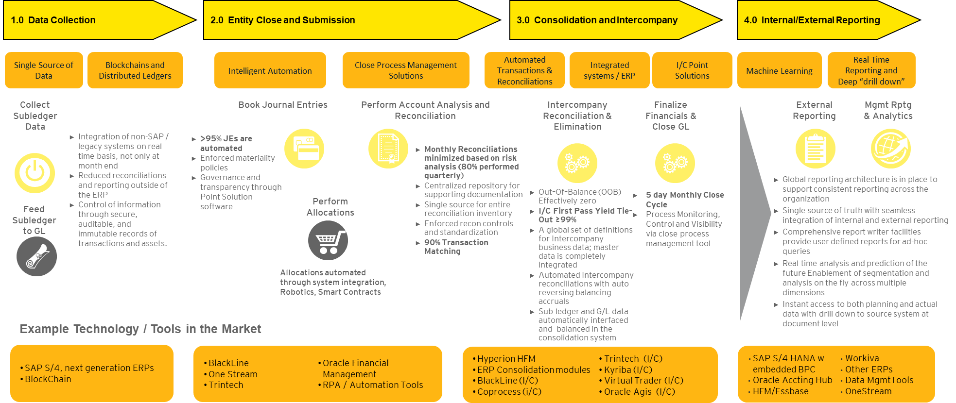
Record to Report Process Overview and leading practice performance metrics
1.0 Data Collection
2.0 Entity Close and Submission
3.0 Consolidation and Intercompany
4.0 Internal / External Reporting

Slide 71
Finance Transformation – R2R
Includes Processes and sub-processes that can be targeted for Automation and AI+RPA
Knowledge Based
Business Impact
Cognitive (AI)
Cognitive Operations (AI+RPA)
Robotic Assist
Asset
Structured
Unstructured
Patterns
Intelligence
Prepaid Recon.
Client Reference
Account Recon.
Policy Guideline Search/Comp
Treasury Report Extraction
GL Close: Roll fw. Scheduling
Daily Bank Recon.
Accounting
Analysis
GL Close: Account Recon.
GL Close: Allocations
Forecast Revenue Growth
Planning Analytics
Gross to Net
Accruals
General Ledger posting
Journal Entry Processing
PA: Update Project Process
Master Data: COA
Structured
Rule Based
FA: Unclaimed Property
FA: Upload budget
Cost Centre Reporting
Inter company -Recon
Rule Based
Low
Assisted RPA
Unassisted RPA
High

Slide 72




Strategy: Sourcing Model
High-level Section Overview
Sourcing options
Build-Operate Transfer (“B-O-T”)
Outsourcing
Hybrid/Co-source (“Joint ventures”)
Retain and improve (“Captive”)
Captive GBS value proposition vs. BPO
Options for BPO economic model
Transaction-based
Output-based (Performance based/managed service)
Outcome-based
Considerations to select suitable model for the BPO journey
Strategies to drive cost optimization
Lift and shift (then fix)
Fix (transform) then shift
Hybrid
Transform
Sourcing Model
Governance
Location Model
Service delivery
Target Operating Model
Strategy
Operations
Human Capital
Purpose, Vision & Values
Service Scope
Enabling Technology
Risk Management
Controls & Measurement
Financial Management
Talent Management
Operational Performance & Partner Mgmt.

Slide 73
Sourcing Options
Continuum of sourcing options is assessed against capital Intensity, financial return and risk. The service delivery model dependent on business criticality, timing and trust between organizations to drive the change.
.
Build-Operate Transfer (“B-O-T”)
Outsourcing of transactional and non-transactional processes.
Contracting and leveraging external provider capacity to fully run an outsourced operation; managing results and outputs rather than inputs.
High
Outsourcing
Fast way to establish a multifunctional center and allows both directions to transfer operations: Back to the company or to BPO.
Engaging expert service provider to design, set-up, and run an outsourced operation; with a plan/option to take-over outsourced operations at a pre-agreed “Transfer price”.
Low
Financial Return
Capital Investment
Selective outsourcing for transactional and captive GBS for non-transactional processes.
Engaging expert service provider to partner on the design, set-up, and run operations (may involve transfer staff and/or systems); maintaining initial/ongoing ownership.
Hybrid/Co-Source (“Joint Ventures”)
Highly automated global (nearby) center or simplified near and offshore hub structure.
Designing, financing, building, operating, and improving systems, organizations, facilities, and methods in-house.
Retain and Improve (“Captive”)
Risk
Low
High

Slide 74
Options for BPO Economic Model
The relationship model you choose, and the behaviors you will want to drive in the BPO, will determine the most appropriate way to commercially contract with the supplier.
Options for BPO economic model:
1. Relationship Model
Transactional Contract (Power Based)
Relationship Contract (Trust Based)
Investment/Vertical Integration
 | Transaction-based | Output-based (Performance based/Managed Service) | Outcome-based
Examples | Fixed price FTE driven Volume driven | Performance based - SLAs: Throughput Timeliness Accuracy Quality | Risk/reward Gain/share
Pros | Very simple to set-up and manage. Allows easy comparison between service providers. | Fairly simple to set-up and manage. Encourages the right behaviors-to take end-to-end view on performance. with the client to ensure Service-Level Agreement (SLAs) are met. | Incentives the BPO to work with the client to transform. Fosters an environment for continuous improvement. Improves relationship between the BPO and retained organization.
Cons | Does not incentivize efficiency. Does not facilitate collaborative working - allows the BPO to make savings whilst maintaining the same pricing structure to the client. | Does not incentivize transformation (BPO will do the minimum to meet the SLAs). SLAs can be harder to define for non transactional areas. | More complex to set-up and manage. Can be difficult to compare service vendor pricing.
2. Economic Model
SLA: Service-Level Agreement, FTE: Full-Time Equivalent.

Slide 75
Considerations for Suitable Model
Key considerations to select suitable model for the BPO journey.
Suitable model for clients with low risk appetite and low propensity to make heavy upfront investments.
8
1
High volume, transactional, rules based repetitive tasks.
Outsourcing model is better equipped to handle rapid increase or reduction in size and scope of GBS.
7
2
Processes with relatively higher potential for standardization across regions and technology enablement/automation.
BPO considerations
Clients with low maturity or experience with GBS tend to start with the outsourcing model to minimise risks.
Preferred model for clients looking for rapid ROI and efficiency/arbitrage benefits rather than building long term capability.
6
3
Suitable model for clients which do not have inhouse talent with right skillset and enabling technologies to manage large GBS set ups.
5
4
Processes which have fewer handoffs/touch points across different functions in the retained organization or third parties.

Slide 76
Sourcing Models
 | Outsource Model | Build-Operate-Transfer (“B-O-T”) | Captive Model
Speed to Value | Higher near-term cost savings, but ongoing monitoring required to maintain long-term cost-effectiveness | Higher near-term cost savings, while long-term cost effectiveness offset by transition cost of operations | Higher potential for long-term savings, near term savings offset by initial set up
Investment | Limited investment with no outlay on facilities & IT infrastructure | Limited investment with no outlay on facilities & IT infrastructure | Limited investment in facilities (Trivandrum), however significant Oracle investment
Control | With proper governance, control & visibility on operations & execution can be achieved | With proper governance, control & visibility on operations & execution can be achieved | Control remains with the organization during all phases
Management effort | Limited effort required to govern operations | Minimal effort due to service provider governance in the set-up of outsourced operations | Maximum effort
Operations risk | Medium risk with operations governed by third party provider | Low risk with an opportunity to govern with third party provider | Low risk with established offshore operations existing and inherent business knowledge
Scalability | Scalability limited by outsourcer capabilities for value added services | Scalability somewhat limited by outsourcer capabilities for value added services | Highly scalable platform for offshoring other functions & value-adding services
+
+
+
-
+
+
-
+
+
-
+
-
+
Other factors includes Talent Management, quality of delivery, operative focus, process knowledge etc.
Cons
Neutral
Pros

Slide 77
Transition Strategy
A
B
C
D
“Move then Improve”
“Transform”
“Improve then Move”
“Move and Improve”
Shift
Shift
Shift
Shift
End
End
End
End
Start
Transform
Transform
Transform
Transform
Start
Start
Start
Start
Onshore
Offshore
Onshore
Offshore
Onshore
Offshore
Onshore
Offshore
Approach | Implements improvements to transform processes & system capabilities Set up adequate governance structure in place to oversee transformation Efforts and activities remain onshore | Implements improvements to transform processes & system capabilities Define standardized global process designs based upon improvements Migrate to new operating model after existing operations are optimized | Define standardized global process designs based upon improvements Build out infrastructure to support new operating model Implement improved processes, organization and technology into new operating structure | Immediately implement organizational changes ahead of technology and process build-out Define standardized global process designs Implements improvements to transform processes & system capabilities
Impact | Greater control and oversight to transform the process Process knowledge and control is retained locally Delivers process optimization and greater agility | Delays the realization of benefits More difficult to implement new designs into decentralized organization | Balances operational risk and desire to achieve savings Easier to implement new designs into centralized locations | Quickly achieves benefits from labor arbitrage and organizational restructuring Increases transition complexity and operational risk Moves organization into suboptimized process and technology
Transition Risk¹

Slide 78
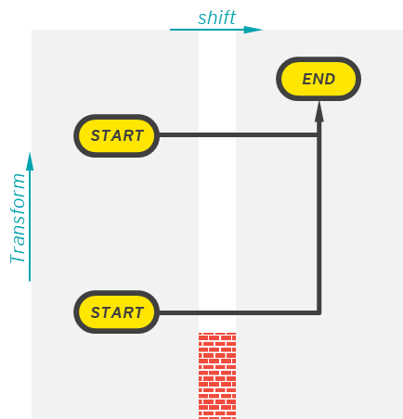
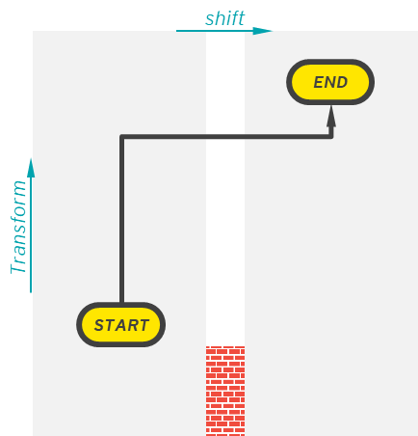
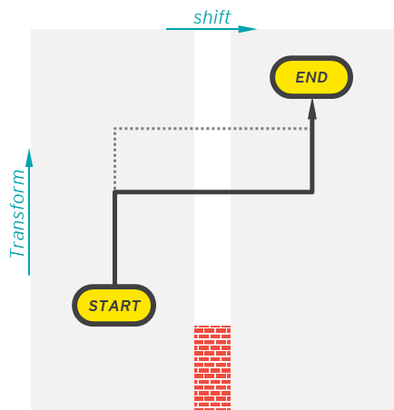
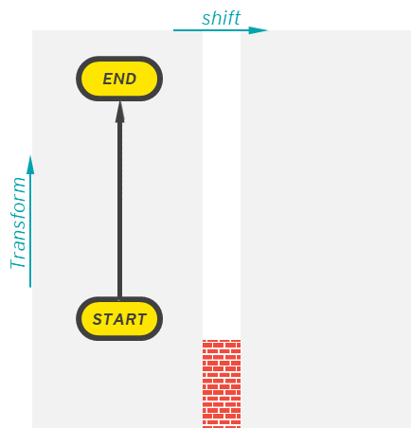
Cost Optimization Strategies
There are four basic strategies to drive rapid and sustainable cost optimization; presenting different pros and cons across: Cost, effort, risk, pace and benefits.
Process maturity
 | 1. Lift and shift (then fix) | 2. Fix (Transform) then shift | 3. Hybrid | 4. Transform (only)
Pros | Drives immediate labor arbitrage. Requires less time investment. Shifts the transformation target over to the vendor. Removes the need to transform the process (shifts the task to vendor). Utilizes the BPO providers ability to automate and improve the process. | Improves service quality and efficiency before it is transferred. Provides ability to change the process upfront. Avoids paying for services which are not required/eliminated through optimization. Enhances: Business As Usual (BAU) transparency of BPO performance and coordination of handoffs. | Delivers compounding process quality and cost benefit. Avoids paying of services which are not required/eliminated through optimization. Drives immediate labor arbitrage in priority areas. Potential to utilize BPO vendor to undertake transformation pre, during and/or post transition. Rapid approach to standardize and consolidate activities. | Greater control and oversight to transform the process. Process knowledge and control is retained within the business. Delivers process optimization and continuous improvement in the process. Greater agility (ability to respond to change).
Cons | Existing inefficient processes continue in offshore location. Process redesign becomes harder to control once transitioned. Requires commercial due diligence to embed continuous improvement and automation. Requires innovation support from the business to advise the vendor. Benefits are shared with the vendor. | Requires greater time and financial investment upfront to improve process prior to transition. Delays labor arbitrage benefit achieved through lift and shift. Requires greater stakeholder engagement/management. | Additional time required compared to lift and shift (priority required). Introduces another dependency to be achieved prior to the go-live date of the BPO process. Not all activities can be optimized prior to transition. | Requires in-house capability and maturity to drive optimization. Labor arbitrage not achieved. Not suitable for all process, e.g., sub-optimal to have low value, non time-sensitive transactional activity remaining in high-cost locations.
BAU: Business As Usual.

Slide 79
Accountability & Interaction Model for New Controllership
CCR
Consolidation
Corporate results, reporting and filings
Technical Accounting
External Reporting
Global close coordination calls
Global audit coordination
Region controller serves as POC for entity questions during consolidation
Serve as POC for Entity Close, for Accounting treatment questions from EBS
Coordinate on implementation of policy updates, process harmonization, accounting process changes, strategy for upskilling of A2R team
Serve as POC for BU leadership regarding filings, signoffs, audit, controls, etc.
EBS A2R
Country / Region Controller
FP&A / BUF (regional / global)
Coordinate with sub-ledger teams to close SLs
GL / Close execution (regionally coordinated)
Prepare and review GL entries for low/mid-complexity accounts and below materiality thresholds
Intercompany & Fixed Assets (global / centralized)
Inventory Costing transactions (from SCF)
Perform reconciliations
Process harmonization (+DTP/WI updates)
Global process ownership, continuous improvement and standardization, with controls & compliance improvement
High materiality / high complexity JE preparation and/or review during entity close
Sign off on Legal Entity results (BS, PL)
BS review & accountability
PL review & accountability (aligned to Inventory / Costing in EBS)
Communication with local BU leaders
Hosts entity close calls
Triage and address entity close issues
Reconciliation and controls oversight
Legal Entity Audit coordination
Bridge to mgmt reporting / internal reporting
Forecasting, planning budgeting (financial, cash, tax, etc.)
Price and cost analysis
Review business results vs plan / budget / fcst
Local BU Leadership (BoD / MD / FD)
Review local business results
Sign off on Statutory & Tax Filings (not Finance unless required)
Liaise with Tax team to understand relevant accounting changes and reporting needs
Other (e.g., Tax, Treasury)
Key
Interaction between teams
Responsibilities / accountabilities
Note: Current close is operated according to MRC; LE-based close to be implemented with OneStream go-live; migration path TBD. In this diagram, use MRC and LE interchangeably.

Slide 80

CFM vs. Regional / Country Controller
Cluster Finance Manager (CFM) – Current State
Required Skillset
Activity
Description
Examples
CPA or equivalency in region
Local / Regional Tax regulatory expertise
Budgeting/Forecasting expertise
1
Accuracy validation & controlling | Accountability for the completeness and validity of actuals | Reviews BVA (e.g., PNL, Capex, CF/BS) for errors and completeness Executes Bravo approvals for actuals submissions Owns healthiness of LE trial balance
Stakeholder orchestration & navigation | Coordination across stakeholders to drive financial reporting and close | Acts as liaison between BUF / COE teams and GS Finance Organizes processes & leads meetings in preparation for closing Coordinates and consolidates inputs from LE
First-level analysis | Leveraging technical accounting knowledge to provide interpretation of results | Uses technical accounting & business acumen to add first-level commentary and analysis Provides review and ensures commentary appropriately reflects results for BUFs
Process improvement & finance projects | Seeking opportunities to enhance operations | Identifies & documents ways to improve closing processes Manages IT implementation projects
Ad hoc & stranded | Activities beyond the scope of the core CFM role, often as a result of legacy processes | Assists with legal entity accounting issues Manages T&E on Concur Acts as 'messenger' for BUF & teams on out-of-scope inquiries
Country / Region Controller Activities
1
Signoff on Legal Entity Balance results (BS review & accountability; PL review & accountability - aligned to Inventory / Costing in EBS; Communication with local BU leaders)
Bridge to management reporting / internal reporting; Triage and address entity close issues; Coordinate with teams as needed (CCR, EBS A2R, FP&A / BUF, Local BU Leadership, Tax, and Treasury)
Signoff on Legal Entity Balance results (BS review & accountability; PL review & accountability - aligned to Inventory / Costing in EBS; Communication with local BU leaders)
Activities related to the Country / Regional Controller’s responsibilities (indirect tax, activities impacting Legal Entity BS, P&L, etc.)
2
2
3
3
5
4
Other Teams’ Activities
4
Identification & documentation of close processes improvements and manage IT implementation projects (EBS)
Activities related to preparation or transactional in nature (ownership of these activities is TBD)
5
5

Slide 81
Current State Taxonomy & Activity Placement - Accounting
Taxonomy (L3) | EBS |  | Controllership |  | BUF | CII
 | Prepare | Review | Prepare | Review
Consolidation Period end close
Financial & External SEC Reporting
Financial Reporting
Governmental/Regulatory Reporting
Intercompany
Internal Reporting and Analysis
Inventory Costing (PIC)
Legal Entity Accounting
Operational Controllership Activities³
Policies and Procedures
Reconciliations
Topsides
Transactional Accounting¹ ⁴
Trial balances²
Global
Global
Global
Global
Non-standard
Non-standard
Global
Non-standard
Global
Non-standard
Non-standard
Global
Global
Non-standard
Non-standard
Non-standard
Non-standard
Non-standard
Global
Global
Non-standard
Non-standard
Non-standard
Global
Global
Non-standard
Non-standard
Non-standard
Non-standard
Non-standard
Note:
¹Transactional accounting includes Cash, Bank, Currency, & Hedging; Inventory & COGS; Procurement Accounting; Revenue Accounting; General Accounting; Lease Accounting; Fixed Assets; Comp & Benefits Accounting
²Trial balances includes trial balance submission to OneStream; Trial balance submission
³Operational Controllership Activities includes Master Data Maintenance – LE & Account Only; Business Partnering; Other – Special Projects; Responding to Escalations
⁴Transactional accounting is non-standard, except for Fixed Assets.
Global
Regional
Non-standard
Key: Process

Slide 82
Future State Taxonomy & Activity Placement - Accounting
Taxonomy (L3) | EBS |  | Controllership |  | BUF | CII
 | Prepare | Review | Prepare | Review
Consolidation Period end close
Financial & External SEC Reporting
Financial Reporting
Governmental/Regulatory Reporting
Intercompany
Internal Reporting and Analysis
Inventory Costing (PIC)
Legal Entity Accounting
Operational Controllership Activities³
Policies and Procedures
Reconciliations
Topsides
Transactional Accounting¹ ⁴
Trial balances²
Global
Global
Global
Global
Global
Non-standard
Global
Global
Global
Global
Global
Regional
Regional
Regional
Regional
Regional
Regional
Non-standard
Non-standard
Global
Global
Non-standard
Non-standard
Global
Global
Global
Global
Regional
Regional
Note:
¹Transactional accounting includes Cash, Bank, Currency, & Hedging; Inventory & COGS; Procurement Accounting; Revenue Accounting; General Accounting; Lease Accounting; Fixed Assets; Comp & Benefits Accounting
²Trial balances includes trial balance submission to OneStream; Trial balance submission
³Operational Controllership Activities includes Master Data Maintenance – LE & Account Only; Business Partnering; Other – Special Projects; Responding to Escalations
⁴Transactional accounting is non-standard, except for Fixed Assets.
Global
Regional
Non-standard
Key: Process

Slide 83
GPO Structure
A comprehensive GPO model comprises responsibility for process design, delivery & IT solution design. GPO’s responsibilities for Global will evolve from advanced model to comprehensive E2E responsibility.
GPO light model
Design responsibilities for GBS processes
*GPO advanced model
E2E design and build responsibilities
GBS comprehensive model
Full fledged E2E responsibility (GSO*)
GPO
SSC/BPO Org.
Retained Org.
GPO
GBS
Retained Org.
GSO*
GBS
Retained Org.
Design
Design
Design
Build
Build
Operate
IT
GBS process governance
GBS process governance
GBS process governance
Retained process governance
Retained process governance
Retained process governance
Currently the Global GPO is operating in a GPO Light Model
Process Execution is assumed to be the responsibility of the Tower Lead, with IT Solution Design being the responsibility of IT
Process design
Process design
Process design
Process build
Process build
Process build
Process execution
Process execution
Process execution
IT solution design
IT solution design
IT solution design
Outcome/Demand steering
Outcome/Demand steering
Outcome/Demand steering
Focus on process governance and process design. GPO light model is a common starting point to setup process in a GBS or SSC/BPO environment.
The GPO has full responsibility for process governance in regards to design and build on a global scale incl. process governance for retained/local functions.
GPO focuses on E2E process responsibility for design, build, and execute. The governance embraces also IT solution design and driving of new technologies.

Slide 84
Responsibilities of Global Process Owners (GPO)
Global Process Owners are executives who owns the end-to-end processes of their assigned workstreams across functions, geographic locations or business units. They are the overall accountable for the business process on a global scale and will be accountable for all process design and build activities as well as continuous improvement across the full solution including technology enablement.
Responsibilities | Description
Solution performance and improvement | Development of global process blueprint and standardisation across functions and ensure end-to-end process/solution adherence to implemented global standards across GBS centres and all sites
 | Identify and propagate process/solution improvements and scope enhancements, ensuring proper controls are in place to mitigate any risks associated with the process (e.g. SOD)
 | Identification of the key process owners and the skills required for a specific activity within their workstream
 | Decide on the functional SLA/KPI targets that will measure the process’s efficiency and effectiveness, in alignment with functions/divisions; Analyse and review the performance of their workstream
 | Take ownership of improvement projects (including budgets), along with scope and roadmap in alignment with functions/divisions
 | Monitor market trends, learn new technologies and understand the disruptions affecting their processes, and adopt them to the company if useful
People Management | Define talent development goals and hire key solution leadership positions
 | Own and update the training agenda, cultivate digital competencies and leadership by coaching and guiding others
 | Perform goal setting and performance review
Governance and Stakeholder Management | Align solution scoping, design and SLA topics with the leadership and with functions/divisions in governance committees
 | Represent and discuss solution with other major stakeholder groups, e.g. site, regional or global functional/divisional representatives
 | Closely coordinate all aspects of designing and operating of the solution with heads of functions and ensure all process related decision are aligned with the strategy and business objectives.

Slide 85
GPO responsibilities | Interaction model
Business Requirements/Direction
Global Process Owner
GBS Interaction
Leadership Team
Process transformation: Establish a clear guiding vision that directs and aligns all process transformation efforts across the organisation.
GBS process governance: Define and manage the oversight structures for Global Business Services to ensure consistency and accountability.
Retained process governance: Maintain internal control over key processes that remain within the organisation rather than being outsourced.
Process design: Develop structured workflows and procedures that support operational efficiency and strategic goals.
Process implementation: Roll out newly designed processes into the organisation with appropriate planning and stakeholder engagement.
Process eeecution and performance measurement: Operate business processes while tracking performance metrics to ensure they meet desired outcomes.
Service delivery model: Structure how services are delivered to customers or internal teams to ensure quality and efficiency.
Technology architecture and roadmap: Define the IT infrastructure and create a strategic plan for its evolution to support business needs.
Sourcing model: Determine how goods and services are acquired, balancing internal capabilities with external partnerships.
Continuous improvements: Drive ongoing enhancements to processes and services through iterative changes and feedback loops.
Captive teams
Business leadership requests the use of new emerging technology
Vendors may have questions on current tech stack/payment terms
Execute standardized processes and escalate exceptions to GPOs.
Provide feedback on process pain points and improvement opportunities.
Process Improvement Team
Collaborates with GPOs to identify, design, and pilot process enhancements.
Supports change management and adoption of new practices.
Internal Stakeholders
Controller prioritizes financial accuracy and compliance
Planning & Business Partnering needs to obtain accurate forecasts & working day metrics
Compliance & Controls Leader
Ensures financial processes adhere to internal controls and regulatory compliance standards.
Finance Operation Leads
Manage day-to-day finance operations and ensure compliance with GPO policy and process, acting as the liaison between local teams and GPOs for alignment.
External Stakeholders
Customers may raise questions around billing/service delivery
Vendors request reliable payment processes and communication on invoice status
Service Delivery Leader/Managers
Oversee service performance and ensure KPI/SLAs are met.
Coordinate with GPOs on escalations and service delivery improvements.
Captive Teams
BPO Operations
Execute standardized processes and provide operational insights and feedback to support continuous improvement and alignment with GPO strategy
Execute outsourced processes according to defined SLAs and KPIs.
Provide regular performance reporting and participate in governance reviews.

Slide 86
Role Summaries
Director of GBS
Role description:
The Director of GBS will oversee the inception of the GBS organisation and steer the organisation through a period of high growth to maturity. The role will be responsible for the ramp-up of services for existing functions as well as developing new capabilities, internal controls and service agreements and performance management. Line management responsibilities for the GBS management team, including Head of Service Delivery – Overall leadership of GBS RDC Service Delivery centres including MDM, S2P, R2D, P2P, Q2C, P2R and H2R Head of Reporting & Analytics – responsible for GBS Foundational insight & reporting, Predictive analytics and Data visualisation team Head of Service Management & Transformation – responsible for process performance, transformational projects, continuous improvement, automation opportunity identification, third party contract management and performance management (internal GBS/third party), including key KPIs, SLAs/OLAs Head of Risk Management & Controls – responsible for Controls design & oversight, Risk Management & Control governance GPO Team – Executive team who owns the end-to-end processes of their assigned workstreams across functions, geographic locations or business units. They are the overall accountable for the business process on a global scale and will be accountable for all process design and build activities and overall governance
Detailed job description:
Embed full word doc profile
GPO
Role description:
GPO will serve as the global process owner (GPO) for their respective process tower working with Functional Leaders, Head of Service Management and Transformation, Director of Global Business Services (GBS) and Service Delivery Tower Leads in the future to support process delivery, continuous improvement, transformation and a positive user/employee experience. Key accountabilities are: Designs, develops, and implements enterprise-wide Process and Services Delivery initiatives. Performs needs assessment and solution development. Initiates change requests and is responsible for demand management Works with the relevant functional and business stakeholders to drive future focussed and appropriate policy development Drives process development, automation, simplification and continuous improvement. Demonstrates knowledge of One “Company” strategic direction and is proficient in managing senior / executive level stakeholder relationships Provides consulting and expertise through effective communication. Leads large scale change implementations and projects focussed on the improvement of services
Detailed job description:
Embed full word doc profile

Slide 87
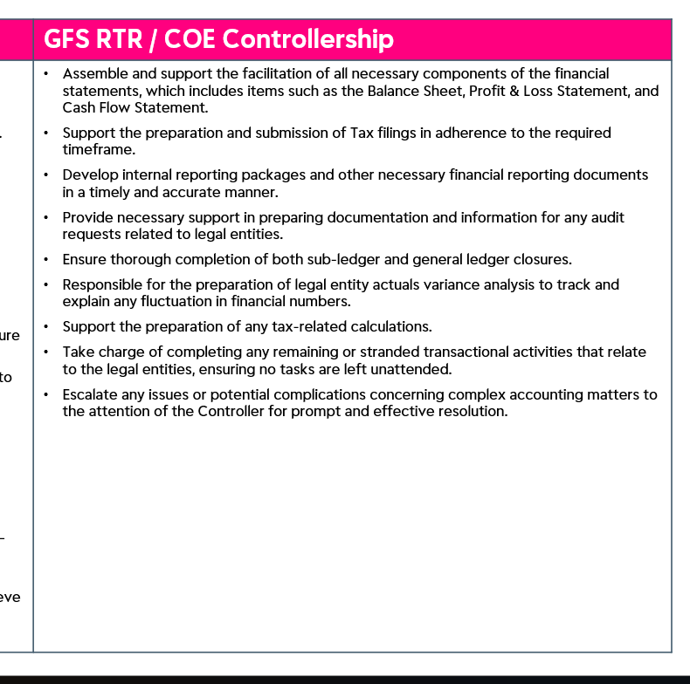

Slide 88
Revenue Recognition Accounting
40%
Focused on overseeing and managing Wealth’s revenue recognitionon, deferred revenue, sales commissions and related accounting processes.
 | HC: 7 | FTE: 7 | Open Role: 1
Brian Paula^{1,2}
Head, Controller
Process | Employee FTEs | Contractor FTEs
Contract-to-Cash | 4.7 | 0.8
Source-to-Pay | - | -
Record-to-Report | 0.9 | 0.2
Planning & Analysis | - | -
Other Finance | - | -
Total Finance | 5.6 | 1.0
Non-Finance² | 0.4 | -
Total | 6.0 | 1.0
45%
15%
40%
Emily David
Revenue Acct. Director
Oversees entire revenue close process, manages day to day operations / provides oversight of team, acting as conduit between Brian and rest of team. Focused on revenue accounting / revenue recognition for UMP and Wheelhouse
85%
15%
Stephanie Bondar
Contractor
Manager, Accounting Open Role
Once open role is filled, the current proposal is to eliminate contractor role and have the manager take over Contractor’s responsibilities
Andrew LaCour
Manager, Accounting
80%
20%
85%
15%
85%
15%
Focused on revenue accounting / recognition for TAM Portfolio Center, MoneyGuide, and EFT/Redi2. Main activities include pulling billing details from NetSuite, determine revenue recognition method and calculate revenue, create manual JE and upload to Oracle Cloud
Sandra Frazier
Senior Accountant
Alexander Phillips
Senior Accountant
Location
85%
15%
Berwyn
Denver
Raleigh
Trivandrum
85%
15%
Bangalore
Field (US)
Field (IN)
Focused on revenue accounting / recognition for UMP (majority of efforts), Wheelhouse, ERS and Folio/FDX. Main activities include pulling billing files (created by the billing team) from SharePoint, determining revenue recognition method, determine if amortization or period revenue is required, reviewing contracts from Spring CM, pulling billing data into Excel workbook to manually calculate revenue, and creating manual JEs and uploading to Oracle Cloud
#%
Part-Time Efforts
#%
Yodlee Efforts
Role interviewed
Source – Stakeholder interviews and Envestnet data collection - org charts, FTE time allocation, HR data.
¹ Brian Paula additionally oversees Yodlee accounting function (dotted-line reporting, not including in org. charts). Brian spends 60% of time on Wealth activities
² Includes Brian’s non-Wealth efforts
Note - this is the proposed / target team structure pending approvals

Slide 89
Technical Accounting & Reporting
Matthew Majoros
Head, Tech. Acct., CAO, SIG
Oversees reporting and technical accounting activities and efforts, including all consolidation, ownership of fees function as well as reporting
 | HC: 7 | FTE: 7 | Open Role: 1
Process | Employee FTEs | Contractor FTEs
Contract-to-Cash | 1.0 | -
Source-to-Pay | - | -
Record-to-Report | 6.0 | -
Planning & Analysis | - | -
Other Finance | - | -
Total Finance | 7.0 | -
Non-Finance | - | -
Total | 7.0 | -
10%
90%
Focuses on generating and approving internal reporting (monthly), management reporting (monthly), and consolidation. Coordinates with FP&A team for budget-to-actuals data
Devon Niebur
Principal Director, Financial
Reporting
Hongying Sun
Principal Director, Technical
Accounting
100%
30%
70%
Jeff Hurda
Financial Reporting Lead
Kelly Collard
Technical Accounting Director
Focuses on acquisition accounting and investment accounting, including debt, hedging, and supports highly technical accounting issues. Also assists in revenue recognition guidance and contract reviews and impacts from technical accounting perspective.
Focuses on preparing internal reporting (management and internal)
100%
30%
70%
Location
Open Role
Marc Furton
Technical Accounting Director
Berwyn
Denver
Raleigh
Trivandrum
Bangalore
Field (US)
Field (IN)
100%
30%
70%
#%
Part-Time Efforts
#%
Yodlee Efforts
Role interviewed
Source – Stakeholder interviews and Envestnet data collection - org charts, FTE time allocation, HR data.

Slide 90
SSC GL
 | HC: 16¹ | FTE: 15.5^{1.3} | Open Role: 2¹
Lisa Lindsay
Head, Finance Shared
Services
Process | Employee FTEs | Contractor FTEs
Contract-to-Cash | - | -
Source-to-Pay | - | -
Record-to-Report | 11.2 | 1.5
Planning & Analysis | - | -
Other Finance | 2.8 | -
Total Finance | 14.0 | 1.5
Non-Finance | - | -
Total | 14.0 | 1.5
 |  | .0
Chris Levy
Principal Director, Finance
Shared Services
Oversees the GL accounting activitiess, including close, analysis (flux, trending), and quarterly balance sheet reporting (reconciliations, accounting issues), management reporting, PBCs, SEC reporting and debt covenant reporting
90%
10%
Open Role²
Director
Dominic Rivera
Director, Accounting
Tish Bender
Director, Accounting
Mark Holmes
Director, Finance
Shared Services
100%
100%
30%
70%
100%
John Bugni
Senior Accountant
Chloe Pionek
Senior Accountant
Ben Hester
Accountant II
100%
100%
Focuses on compensation accounting for severance, retention, bonus plans, etc. and all reconciliations for accrued vacation, accrued payroll taxes, withholdings, etc.
100%
Focuses on capital accounting for PP&E, intangibles, IDS, prepaid assets, leases. Also assist in reconciliations and GL close, flux analysis
Matt Thompson
Senior Accountant
Erin Stangoni
Senior Accountant
Open Role
Senior Accountant
100%
100%
100%
Location
Quinn Ambrose
Senior Accountant
Open Role¹
Accountant II
Stephen Neumann
Senior Accountant
Berwyn
Denver
Raleigh
Trivandrum
Focuses on cash accounting
Bangalore
Field (US)
Field (IN)
100%
100%
100%
#%
#%
Focus on lease accounting, OPEX, accrued liabilities, including related reconciliations for to manager and advisor payments (and any other 3rd party payments) coming out of UMP platform, and other balance sheet reconciliations
50%
Supports team across processes with a focus on lease accounting preparation
Part-Time Efforts
Yodlee Efforts
Christopher Schnur¹
Contractor
Kyle Jester
Contractor
Role interviewed
100%
100%
Stephanie Catoggio
Contractor
Supports team across processes with current focus on supporting purchasing accounting (new joiner)
100%
Source – Stakeholder interviews and Envestnet data collection - org charts, FTE time allocation, HR data.
¹ Role to be onboarded mid-February. Christopher Schnur, contractor, to roll off subsequently. Excluded from HC and FTEs.
² This position may be eliminated
³ Delta (0.5 FTEs) between HC and total FTEs is due to single part-time contractor with just 0.5 FTE allocation

Slide 91
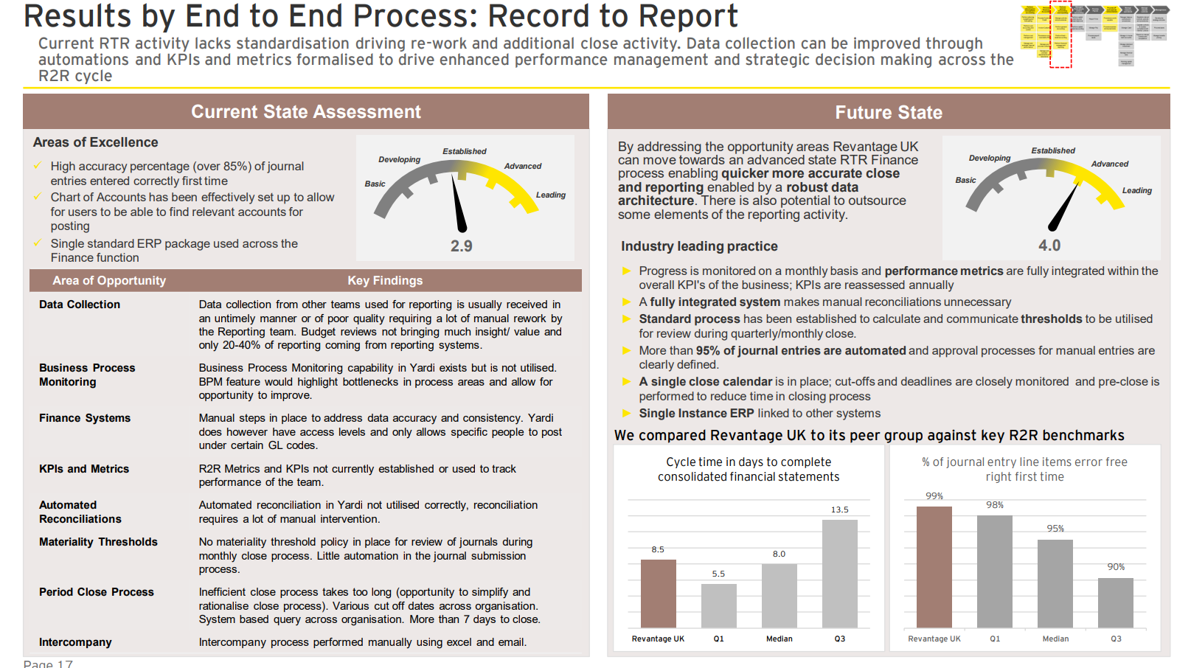
Maturity Assessment (1/2)

Slide 92
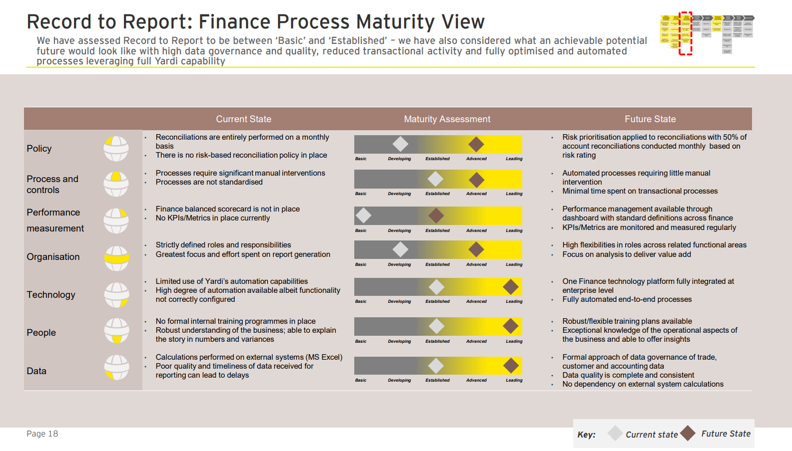
Maturity Assessment (2/2)

Slide 93
A maturity assessment can be done for RTR as an EY differentiator around various operational levers
 | Basic | Developing | Established | Advanced | Leading
Process & Controls | No formal close calendar(s) or cut-offs Processes are inconsistent and undocumented Financial Statements are prepared in Excel | Multiple close calendars and cut-offs in place monitored locally Processes are documented but not consistently applied | Multiple close calendars, but cut-offs/deadlines are standardized System runs Financial Statements, but manual adjustments are required | A common close calendar is in place Processes are adhered to consistently and monitored Some Financial Statement preparation is automated | A single, closely monitored, close calendar with close is in use All Financial Statement preparation and distribution is automated
Policy | Set at local level for local business need; no central oversight and no or limited monitoring | Set at local level with some consistency due to informal networking or divisional alignment; limited monitoring | Set at division level and applied consistently at division level with policies monitored regularly | Defined centrally and mandated / applied consistently at all divisions; Each policy is monitored regularly with key controls | Common policies that are understood, enforced and aligned to overall strategy Robust account risk assessment policy
Data | Multiple COAs in use with inconsistent definition | Multiple COAs in use with consistent definitions | Single master data systems within business units; some manual procedures to interface Common COA in use but limited rationalization of number of accounts | Standard, appropriately structured COA and governance process in place | Single, rationalized COA that optimizes module/sub-ledger functionality and strong governance process
Performance Measurement | Performance measures not used substantially; no central oversight of local performance measures | Performance measures around process performance used; there is informal review of local performance measures | Performance measures including process measures, customer service measures, financial and non finance measures within BU; | Performance is managed using measurement and KP Standard global management information for performance is available for central view | Defined process KPIs to manage the process Aligned operational and financial metrics to monitor achievement of business objectives
Organization | Few transactional activities are outsourced or centralized; no global centralization or outsourcing Roles and responsibilities are not clear | Some outsourcing or centralization, but not country or world-wide Roles and responsibilities are assigned, but confusion and overlap exists | Partial outsourcing or centralization by country Roles and responsibilities understood, but not documented | Majority of transactions are centralized by country and recorded consistently across the region Roles and responsibilities are clearly documented | All transactional activity is outsourced or handled in shared services center environment Deep technical skills and business understanding
Technology | Fragmented systems with redundant and inconsistent data and extensive Excel-based reporting Sub-ledger data is reformatted and manually entered/uploaded | Fragmented systems with manual steps in place to address data consistency and accuracy Manual reconciliations | Semi-automated reconciliations Consolidation done primarily in ledger with some Excel reporting Sub-ledger data is transferred to the GL electronically; top-side adjustments are required | Best of breed automated systems are interfaced to general ledger; workflow approvals for journal entries Streamlined consolidation using a dedicated consolidation tool Automated reconciliations | Integrated ERP platform Fully integrated system makes manual GL reconciliations unnecessary Automated consolidation and elimination entries for legal, statutory and management books

Slide 94
Record-to-Report | Maturity Model
 | Stage 1 Basic | Stage 2 Developing | Stage 3 Established | Stage 4 Advanced | Stage 5 Leading
Process | No formal close calendar(s) or cut-offs | Multiple close calendars and cut-offs in place monitored locally | Multiple close calendars, but cut-offs/deadlines are standardized | A common close calendar is in place | A single, closely monitored, close calendar with soft close is in use
 | Policies, processes, and procedures are inconsistent and undocumented | Policies, processes, and procedures are documented, but not consistently applied in practice | Standardized policies, processes, and procedures are documented, and adhered to | Policies, processes, and procedures are standardized, documented, adhered to, and monitored regularly | Policies, processes, and procedures are standardized, documented, adhered to, enforced by the system, and monitored by a center of excellence (COE)
 | Financial Statements are prepared in Excel | System runs Financial Statements, but manual adjustments are required | Preparation of the BS and P&L is automated; Cash Flow is manual | All Financial Statement preparation is automated | All Financial Statement preparation and distribution is automated
 | Accounts are not analyzed | Limited account analysis | Account analysis is common, limited forward-looking analysis | Account analysis is performed regularly with some forward-looking analysis | Comprehensive account analysis is performed
People | Few transactional activities are outsourced or centralized; no global centralization or outsourcing | Some outsourcing or centralization, but not country or world-wide | Partial outsourcing or centralization by country | Majority of transactions are centralized by country and recorded consistently across the region | All transactional activity is outsourced or handled in shared services center environment
 | Roles and responsibilities are not clear | Roles and responsibilities are assigned, but confusion and overlap exists | Roles and responsibilities understood, but not documented | Roles and responsibilities are clearly understood and documented | Roles and responsibilities are understood, documented, and monitored by the COE
 | Limited business/finance understanding | Uneven technical skills and business acumen | Adequate and consistent finance technical skills, but uneven business acumen within finance | Adequate and consistent technical skills and business understanding within finance | Deep technical skills and business understanding of business and finance
 | No development or training is available to employees | Limited development and ad hoc training | Functional training and development programs are in place | Rotation programs and leadership training is available for select individuals | Finance staff rotations and leadership programs are in place
Technology | Fragmented systems with redundant and inconsistent data and extensive Excel-based reporting | Fragmented systems with manual steps in place to address data consistency and accuracy | Single master data systems within business units; some manual procedures to interface | Best of breed automated systems are interfaced to general ledger; workflow approvals for journal entries | Integrated ERP platform and common COA BPM platform interfaced to GL and operational databases for reporting data
 | No reconciliations | Manual reconciliations | Semi-automated reconciliations | Automated reconciliations | Fully integrated system makes manual GL reconciliations unnecessary
 | Multiple COAs in use with inconsistent definitions | Multiple COAs in use with consistent definitions | Common COA in use but limited rationalization of number of accounts | Standard, appropriately structured COA and governance process in place | Single, rationalized COA that optimizes module/sub-ledger functionality and strong governance process
 | Close/consolidation process is complex and manual with high degree of adjustments and reconciliations | Infrequent feeds to reporting system with spreadsheet or manual consolidation and reporting process | Consolidation done primarily in ledger with some Excel reporting | Streamlined consolidation using a dedicated consolidation tool | Automated consolidation and elimination entries for legal, statutory and management books Workflow application in place to integrate 10Q/10K management discussion
 | Sub-ledger data is reformatted and manually entered/uploaded; adjusting entries are required | Sub-ledger data is interfaced with the GL but requires manual intervention and manual reconciliation to test data integrity and accuracy | Sub-ledger data is transferred to the GL electronically; top-side adjustments are required | Sub-ledger data is electronically transferred to the GL with web-enables interfaces and automatic data capture, few adjustments are needed | Sub-ledger data is automatically interfaced and balanced daily

Slide 95
Intercompany Accounting | Maturity Model
 | 1. Basic | 2. Developing | 3. Established | 4. Advanced | 5. Leading *
Strategic Direction | No leadership exposure/awareness of intercompany out of balance conditions | Limited leadership interest in out of balance conditions, unclear direction for clearing discrepancies/out of balance conditions | Moderate net intercompany out of balance amounts carried forward with basic tracking and resolution direction | Management focus on intercompany absolute gross amounts to avoid “netting”; management support to address all out of balance conditions promptly | Leadership focus on efficient intercompany processes and high levels of accuracy
Processes | No formal intercompany transaction and dispute resolution process definitions Routine charges to incorrect/inactive trading partners No formal intercompany policy definitions for required review/approvals or materiality levels Intercompany activities viewed as a month-end exercise Substantial historic and current imbalances exist | Standardized intercompany invoices with required intercompany elements incorporated Basic intercompany policy exists with limited compliance Relatively high error rates in intercompany processing Periodic review of intercompany discrepancies with limited follow up to address core issues Out of balance conditions reported with progress to resolution | Fully documented and deployed processes as well as expanded intercompany policy development with high levels of adherence Resolution process fully defined with tracking and reporting resolution transactions and timing Intercompany “adjustments” are reviewed to ensure true reconciliation at the transaction level Intercompany processing is treated with the same “rigor” as third-party transactions | Core intercompany activities require limited attention, focus on exception-based processing Periodic review of discrepancy volume and types with root cause analysis Very low error rates for intercompany activity Substantial reconciliation efforts are completed outside of the defined close cycle | Optimized processes with focus on key process measures and continuous improvement Fully adopted thresholds/materiality levels based upon transaction effort requirements, risk and financial impact All discrepancies tracked by defined type and root causes addressed on an immediate basis
People and Organization | Organization views intercompany problems as solely a finance issue People involved in intercompany processing do not understand downstream impacts No identified contacts to resolve intercompany transaction issues | Inconsistent training for personnel involved in intercompany processing Limited awareness of better intercompany processes Degrees of roles and responsibilities definitions deployed | Personnel empowered to take corrective action to address intercompany issue root causes Organization shares common understanding of intercompany significance | Measures set utilized support efficient intercompany processing Organization identifies and quickly adopts changes to improve intercompany activities Personnel thoroughly understand and apply intercompany leading practices | Intercompany personnel and organization structure aligned to focus on exception-based processing Fully coordinated intercompany account teams with explicit knowledge of all downstream impacts and upstream dependencies
Technology | Limited use of core systems to support intercompany processing No integration between related party systems Data model inconsistent from system to system | Technology in wider use across business but not integrated Supporting technology leveraged for validation of key intercompany elements Inconsistency in data cleansing activities and requirements to process intercompany transactions | Technology is being implemented to achieve fully integrated intercompany activities Key measures intercompany metrics are identified and partially deployed to incent improved intercompany processing Technology readily available to assist in detail analysis of intercompany discrepancies | Key intercompany information is accessible through technology enablement Technology leveraged to automate notification of intercompany issues and “pre-populate” resolution | Technology is fully integrated, information and drill down capabilities are optimized Technology automation leveraged to facilitate capture and delivery of intercompany performance measures

Slide 96
Revenue Recognition Model (1/3)
 | Stage 1 Basic | Stage 2 Developing | Stage 3 Established | Stage 4 Advanced | Stage 5 Leading
Business Principles and Policies | Finance systems organically grown with no reference to Finance strategy or business model A basic revenue recognition policy is in place in each business unit | Common Finance architecture at business unit level which allows strategic change with significant effort Revenue recognition policies aligned with local GAAP exist but are not systematically implemented and require manual monitoring procedures | Global finance architecture designed to support existing Finance needs, but requires major effort to support changes to strategy Company wide revenue recognition policy is in place that requires significant interpretation for application to local business unit transactions | Enterprise business architecture designed to support existing Finance needs and supports annual business plans and strategic change Enterprise-wide governance of revenue recognition policy in place providing detailed guidance on application of local GAAP | Dynamic global business architecture designed to support existing Finance needs and allow for business and strategic changes Substantially all major elements of enterprise revenue recognition policy are automated in a transaction processing application that provides compliance reporting
Performance Measurement | Revenue recognition process performance measurement defined only as variance of actual revenue against plan No GAAP revenue forecasting capability | Revenue recognition process performance measurement aligned to strategic objectives at a high level Limited GAAP revenue forecasting as an output of manual period close processes | Revenue recognition process performance measurements align process or transaction drivers that have a significant impact on outcome metrics which in turn provide a business service perspective on the achievement of strategic objectives Limited GAAP revenue forecasting as part of period close flash reporting process | Driver based performance measurement enabled through ERP custom reporting and data warehouse analysis GAAP revenue forecasting enabled through manual reporting for deals booked prior to current open accounting period | Revenue recognition performance measures and GAAP revenue forecasting available daily from stand alone revenue recognition application
Organization and People | Revenue recognition skillset undefined in standard finance roles No centralized revenue assurance function in finance No formal revenue recognition subject matter resources established | Revenue recognition skills defined in terms of control compliance in standard finance roles Business unit level revenue assurance function for only large or complex transactions Business unit level revenue recognition subject matter resources established | Specific revenue analyst skills defined for finance role Corporate level revenue assurance function for only large or complex transactions Corporate and Business unit level revenue recognition subject matter resources established | Revenue assurance function established with deal review, compliance monitoring, revenue forecasting, fair value, and period close roles Corporate level revenue assurance function for all transactions at quarter close and large deal review | Centralized revenue assurance function administers stand alone revenue recognition application Corporate level revenue assurance function provides daily deal review services, GAAP revenue forecasting, multi-dimensional revenue reporting for operations and compliance

Slide 97
Revenue Recognition Model (2/3)
 |  | Stage 1 Basic | Stage 2 Developing | Stage 3 Established | Stage 4 Advanced | Stage 5 Leading
PROCESS | Deal Review | Deal reviews completed at business unit level after being booked in ERP system | All deal reviews utilize revenue assurance checklist to ensure corporate policy compliance | All complex deal reviews consist of checklist and GAAP revenue waterfall forecast prior to being booked | Center of Excellence (COE) revenue assurance team reviews all deals over specific thresholds and/or by contract type | All deal reviews utilize revenue forecasting feature in stand alone revenue recognition application
 | Transaction Booking | Significant number of transactions require periodic manual entries in the GL to accurately record GAAP revenue | Complex revenue transactions require manual steps to record GAAP revenue: Date Based Event Based Percentage of Completion Multiple Elements | Non-standard contracts and revenue recognition models require manual procedures to record GAAP revenue | Transaction templates developed to support GAAP revenue recognition in ERP customizations Elements outside template parameters are booked as separate orders requiring manual adjustments to revenue | Nearly all revenue impacting events are recorded through automated processes Manual postings in revenue accounts limited to external audit adjustments and specific reserves
 | Revenue Leakage | No ongoing review and analysis of deal structure, fulfillment practices, and billing processes to identify potential revenue leakage issues | Terms and conditions used for booked deals are monitored to ensure they maximize recognition of GAAP revenue Transactions lacking standard data investigated for possible fraud | Unbilled items are reviewed on a periodic basis to ensure revenue can be recognized at the earliest point permissible under local GAAP | Systems used for provisioning, recording service time, and initiating transaction lifecycle events monitored to detect lost or corrupted data | Revenue analysis performed at customer, product, material, and transaction type level to determine revenue leakage issues
 | Compliance | Minimal attempt to calculate and applies Vendor Specific Objective Evidence (VSOE), Third Party Evidence (TPE), Selling Price principles to revenue recognition allocations | Business unit calculates, stores VSOE, TPE, Selling Price Business unit applies VSOE, TPE, Selling Price, and performs allocations manually | Center of Excellence (COE) calculates, stores VSOE, TPE, Selling Price Central revenue assurance team applies VSOE, TPE, Selling Price, and performs allocations manually | Revenue recognition customizations in ERP provides audit trail only for manual journals posted to the General Ledger Custom processing in ERP requires annual IT controls testing | Stand alone revenue recognition application stores and applies VSOE, TPE, Selling Price Revenue recognition application provides audit trail for changes to revenue related transactions
 | Period Close | Manual period cutoff procedures monitored for booking of new orders Preparation of manual adjusting entries for orders booked in previous periods with revenue recognition over multiple periods | Standard ERP reports and shipping confirmations monitored for period cutoff Revenue recognition spreadsheet updated throughout quarter close to produce adjusting entries | Transaction types known to cause revenue recognition irregularities monitored in last period of quarter to ensure they meet all revenue recognition criteria Manual adjustments made for new and existing deals | Revenue assurance close meetings conducted at quarter end to review new complex deals, revenue leakage issues, and performance of related internal controls | Stand alone revenue recognition application requires only quality assurance and internal control reviews of standard reports to perform period close for revenue accounts Revenue assurance close meetings held for all period closings
 | Reporting & Forecasting | Revenue reporting limited to standard financial statement reporting Revenue analysis performed manually utilizing limited data points No revenue forecasting capability | Revenue reporting limited to standard ERP reports Revenue analysis performed manually utilizing data from multiple sources Revenue forecasting limited to ERP treatment without GAAP adjustments | Revenue reporting and analysis supported by both ERP and data warehouse Revenue forecasting enabled only at period end through customization of data warehouse | Revenue reporting and analysis supported by customization of ERP Revenue forecasting enabled throughout period by customization of data warehouse | Stand alone revenue recognition application provides daily GAAP revenue forecasting capability and multi-dimensional revenue management reporting

Slide 98
Revenue Recognition Model (3/3)
 | Stage 1 Basic | Stage 2 Developing | Stage 3 Established | Stage 4 Advanced | Stage 5 Leading
Data Architecture | Basic data documentation maintained in desktop procedures of end-user Data is inconsistent and redundant with no formal data maintenance procedures in place No visibility to changes made to data elements in source systems | Data definition standards exist within business units but are not consistent across enterprise Limited visibility to changes made to data elements in source systems | Standard data definitions are used throughout the enterprise Most company wide revenue recognition information is captured in a central data warehouse or business service application Automated tools in use for data integrity and consistency checks | Standard data definitions used across the enterprise leveraging a common Master Data Management system based on ERP platform All company wide revenue recognition information is captured in a central data warehouse or business service application | Data entities and data components documented Data governance structure for enterprise encompasses Revenue Recognition processes and applications Conceptual and logical data diagrams maintained Data entity and business function matrix maintained
Application Architecture | Spreadsheets created each quarter to calculate revenue adjustments Data loaded manually into spreadsheet Limited to no end-user computing controls | Integrity of spreadsheet design and historical data maintained throughout the fiscal year to calculate revenue adjustments Data loaded manually into spreadsheet with basic quality controls in place End-user computing controls documented and reviewed periodically as part of a self-assessment of finance controls | Integrity of spreadsheet design and historical data maintained across multiple fiscal years to calculate revenue adjustment Data loaded to spreadsheet from standard or custom ERP reports Data upload application used to export calculation results to ERP journal entry End-user computing controls documented and tested periodically as part of a key internal controls | Primary ERP solution customized to support substantially all revenue recognition calculations and transaction lifecycle adjustments Revenue recognition solution outputs limited to adjusting journal entries and manual transaction audit reports Data warehouse provides limited revenue recognition management reporting after period close Business service level security maintained | Revenue Recognition application integrated into company ERP solution Process and application realization documented Standard design utilized by subsidiaries Interfaces documented and actively monitored Role level security maintained Application and business function matrix maintained Revenue Recognition application maintained as principle sub-ledger for deferred revenue
Technology Architecture | Technology solution maintained on end-user computer No documented technology architecture to support processes | Final version of spreadsheet calculations for revenue adjustments maintained on security enabled network shared folder Basic technology architecture documented for compliance with external reporting standards | All versions of spreadsheet calculations for revenue adjustments maintained on security enabled network shared folder Leading technology architecture standards used to store, distribute services and provide access security for revenue recognition spreadsheets | ERP customizations and testing documented to support future ERP upgrades Communications documented and monitored through custom reports in ERP solution | Application and multiple environments deployed centrally with network access Communications documented and actively monitored Technology standards to support revenue recognition documented Impact of network and platform changes and improvement initiatives assessed against revenue recognition standards

Slide 99
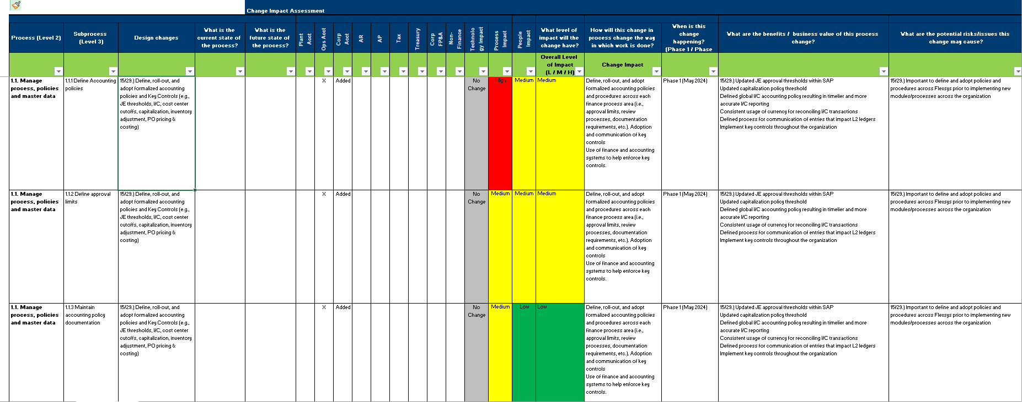
Change Impact Assessment (1/2)
https://eyus.sharepoint.com/sites/FlexsysOneRockproject/Shared%20Documents/General/FSCP%20Finance%20Transformation/5.%20People%20&%20Change/Change%20Impact/Flexsys%20Change%20Impact%20Assessment.xlsx?web=1
Design Change Initiative Charters
Impact Ratings
Change Impact Descriptions
Benefits / Risks
Process Flows
Stakeholder Roles
Timing
FSCP Taxonomy

Slide 100
Decision Making Roles and Responsibilities
Workstream
Leads
Workstream
Sponsors
Joe
Wilkins
Brian
Newman
Critical Enterprise wide, several workstreams or overall program impact External visibility and audience reach
High Will affect several workstreams or overall program Escalated visibility and audience reach
Medium Single workstream impact Multiple projects in a workstream Standard visibility and audience reach
Low Charter milestones and commitments Limited visibility and audience reach Affects project team stakeholders only
Escalate
Escalate
Recommend
Decide
Escalate
Recommend
Decide
Recommend
Decide
Decide

Slide 101
Templates
Templates: RACI
Template: Communication Plan
Template: RAID Log
Template: Project Charter
Template: Governance/ Decision Making: Accountability Matrix

Slide 102
Templates: RACI
 | Timing | Responsible | Accountable | Consulted | Informed
Milestone/ Phase | Time
Steps…. |  | Name or Role
Steps….
Milestone: Kick Off | June
Charter | 6/1 | Project Lead | Project Lead | Sponsor | Sponsor
Kick Off Project Team | 6/5 | Project Lead | Project Lead | Sponsor | Sponsor
Initial Project Plan | 6/15 | Project Lead | Project Lead | Sponsor | Sponsor
Milestone: Planning Complete | July
Project Plan Approved | 7/1 | Sponsor | Project Lead/PM | Project Team | Leadership
Charter Signed | 7/15 | Sponsor | Project Lead/PM | Stakeholders | Leadership
Project Schedule Complete | 7/15 | Project Lead/PM | Project Lead/PM | Project Team | Sponsor
Milestone: Design and Test | Aug – Nov
Key Decisions Document | 8/15 | Project Lead/PM | HREC | Project Team | Leadership
Design Estimated | 9/15 | Functional Lead | Project Lead | Leadership | Sponsor
Testing Complete | 11/1 | Functional Lead | Project Lead | Leadership | Sponsor

Slide 103
Templates: Communication Plan
Purpose of Template: To document the types of information to be distributed, the methods of distributing information, the frequency of distribution and the responsibilities of each person in the project team for distributing information.
Note: Please delete all instructions after filling out the form.
Project Identification
Project Name | Program Manager | Date Modified
Franchise / Brand / Department | Champion | Sponsor
Communication Matrix
Date | Communication Type | Objectives of Communication | Frequency | Audience | Responsible/ Delivered By | Resources Required
Communications Management Approach (Optional)
< Describe the general Communication Management Approach for this project. List the actions the team will take to ensure adequate communication. Identify the steps needed to create a communications message for distribution and describe the process for reviewing and distributing communications messages. Describe any guidelines for meetings. Describe any specific tools that will be used. >

Slide 104
Templates: RAID Log
Risk & Issue Log:
Risk / Issue # | Date Opened | Owner | Current Status | Risk Event / Description | Due Date | Mitigation Plan | Contingency Plan | Impact (Cost, Time, Capability) | Probability (1-5) | Impact (1-5) | Severity (C,H,M,L) | Escalated (Y, N & Who) | Comment
Assumptions Log:
Assumption # | Category Ex. Scope | Description of Assumption / Constraint | Owner | Due date | Actions to validate the assumption | Impact | Priority | Current Status | Comments | Escalated (Y, N & Who) | Comment
Dependency Log:
Dependency # | Date Opened | Owner/ This Workstream | Dependent on this Workstream, Person or Team | Description | Due Date / Date Needed | Implication if date is not met (Cost, Time, Capability) | Date Completed | Escalated (Y, N & Who) | Comment

Slide 105
Templates: Project Charter
Key Components:
Project Description Overview
Business Impact
Goal Statement
Completion Criteria
Scope Statement
Organizational Considerations
Milestones with target dates
Project Team Members
Additional Key Stakeholders

Slide 106
Templates: Governance / Decision Making – Accountability Matrix
 | Meeting Participants |  |  |  |  |  | Deliverables
Project Role | Sponsor Meeting | Blueprinting | Change Management Strategy | ….. | …. |  | Provide approval, guidance & resources | Test Functionality | Develop Change Communication | . . . | . . .
 | Legend: Green = Required Attendance Yellow = May Attend |  |  |  |  |  | Legend: A = Accountable/Owner, P = Participant, R = Review Required, I = Input Required, S = Signoff Required
1.Project Sponsor |  |  |  |  |  |  | A | A | A
2. Project Lead |  |  |  |  |  |  | P | P | P
3. Workstream Sponsor |  |  |  |  |  |  | A,I,S | A,I,S | A,I
4. Workstream Lead |  |  |  |  |  |  | A,I | A,I | A,I, S
5. Change Team Member

Slide 107
Oracle Cloud Interface Diagram
Avalara Tax
INT26
Avalara Tax Integration
FA
Oracle Cloud EPM
Tax
Oracle Cloud ERP
INT.31
GL Data Primary Ledger Balances
FCCS
INT08
EYCore Tax Only Invoice Import
EYCore
INT24
EYCore GL Details Extract
GL
INT11
Employee Import- Workforce structure
HCM
INT54
GL Extract to Adaptive
INT23
EYCore Invoice Extract
AR
INT09
Bank BAI Files
CM
INT03
Workday Payroll GL Data
BMO Harris Bank
AP
INT19, 27, 30
BMO Harris Bank Wire, ACH, Positive Pay
INT55
GL Extract to Blackline
Oracle Cloud
Infrastructure
(OCI)
INT07
UMP AP Invoices
INT12
Concur T&E GL Data import
Decoder Ring
Secondary or OOS for SOX
In-Scope for SOX
FCCS Process
Record to Report (R2R) Process
Order to Cash (O2C) Process
Procure to Pay (P2P) Process
UMP
INT14 UMP Billing (Other than Direct Debits)
INT47
MoneyGuide Customer Portal via Admin
Concur
Blackline ENV
Workday
Adaptive Planning
Money Guide/ Admin
INT48 MoneyGuide Intacct Admin
INT06
UMP GL JE Import

Slide 108
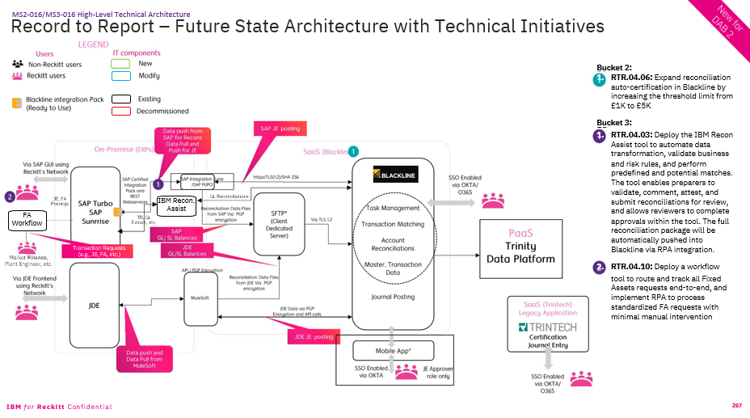
Technology Landscape

Slide 109
What is BlackLine?
BlackLine is a modular, cloud-based solution to automate and monitor critical month-end financial close processes. BlackLine modules help to automate and control the close process while providing visibility and risk mitigation. Each module can be used independently or can be integrated together for greater efficiencies and control.
Account
reconciliations
Intercompany
Task
management
Agile accounting
Data
Soft close and hard close
Maximum automation
Consistent, unified processes (R2R, P2P, O2C, H2R and intercompany)
Global visibility for all stakeholders
Data source for ERPs, subledgers and sub-systems
ERP(s)
Subledgers
Finance and accounting database
Banks
Transaction data
Reporting
Transaction
matching
Automation,
rules and
business logic
Data warehouse and analytics
Consolidation
integrity
Journal
entry
Standard
templates
Workflow and
documents
Variance
analysis
Automated
journals
Compliance

Slide 110

How do BlackLine and SAP work together?
DATA SOURCES
Unmatched items that require adj.
JOURNAL ENTRY
Product
Kyriba
BAI Files
Matched
Items
Summarize & send journal lines to JE
Bank Charges
AUTOMATED JOURNALS
Functionality
Check Registries
TRANSACTION MATCHING
Product
Differences within Threshold
Create Automated
Journal Entry
Integ. Layer
Matching Rules
Unmatched
Items
Manual
Journals
Cash escalation process req. write-off
Third Party Admins
Allocations &
Look-up Tables
SAP AP
EXCEPTION HANDLING
Functionality
ACCOUNT RECONCILIATIONS
Product
Journal Approval Process
Ability to handle exceptions and assign out open items across different work groups
Exceptions / Timing items
SAP AR
FS-CD
Cash Team / Accounting Ops
Clearing
Inter-company
Monthly BSC Reconciliations
SAP
SAP GL
GL Monthly Balances
Task Management
Product

Slide 111
Why use BlackLine with SAP?
SAP automates certain journal
entries and reduces overall volume.
SAP provides centralised monitoring of
close tasks, dashboards, and automated
execution of SAP programs.
SAP solution centers around cash
application and automates manual
matching of invoices with payments.
SAP automates posting of IC documents
and provides transparency of IC balances
leveraging Central Finance.
Journals
Reconciliations &
Close Calendar
Transaction Matching
Intercompany
BlackLine extends it by:
Flexible design of journal template
Centralised journals management across ERP systems
Control beyond SAP posting requirements with additional validations
Automated and recurring journals
Auditable workflow with alerts & sign-off
Department and entity based flexibility
Controlled document repository
Integration across BlackLine modules
BlackLine extends it by:
Replacing excel based reconciliations
Rules-based auto-certification of reconciliations, reducing overall manual effort
Real-time visibility and dashboards across single platform
Automated, dynamic workflow with built-in segregation of duties
Automate close calendar activities through integration across modules (i.e. task is marked as complete after reconciliation is completed)
Dependency hierarchy for close calendar activities
BlackLine extends it by:
Rules-based logic to automatically match high volumes of transactions, reducing time-consuming and manual effort
Expand data available through integration of SAP and non-SAP sources
Integration across modules (i.e. automatically create journal postings or add transactions as reconciliation support)
By leveraging SAP BlackLine connector, BlackLine automatically creates matches and sends clearing documents for posting in SAP
BlackLine extends it by:
Providing ability for end to-end automation and visibility of each transaction
Integrating with AR
Pro-active transaction management
Automated 2-sided journals
Global netting & settlement
Enabling exception tracking and visibility into settlements
Web Services
SAP purpose built API providing real-time validation and posting feedback
SAP Connector
Standard connector designed to enable seamless connection between SAP and BL for Balances, Currency Rates and Transactions
OIM Clearing Extract
Standard connection to generate clearing documents in BlackLine and send to SAP
Web Services & SAP Connector
SAP Purpose built API and standard Connector to provide smooth communication between SAP & BL

Slide 112
What is Trintech?
Trintech a modular, cloud-based solution to automate and monitor critical month-end financial close processes. Trintech modules help to automate and control the close process while providing visibility and risk mitigation. Each module can be used independently or can be integrated together for greater efficiencies and control.
Reconciliation
Match
Agile accounting
Data
Intercompany
Reconciliations
Certify
Confident and faster financial close
Maximum automation
Consistent and standardize processes
Global visibility for all stakeholders
Strong controls and effective audits
ERP(s)
Subledgers
Finance and accounting database
Banks
Transaction data
Automation,
rules and
business logic
Data warehouse and analytics
Reporting
Standard
templates
Workflow and
documents
Close
management
Journal
entry

Slide 113
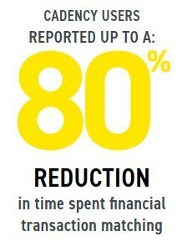
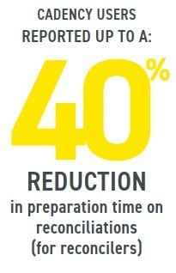
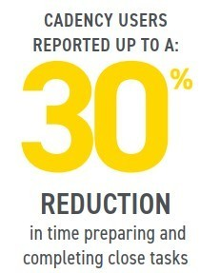
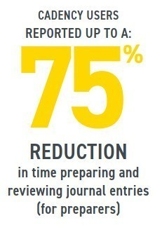
Trintech - Capabilities
Key Value Drivers
Process Standardization
Risk Mitigation
Audit Readiness
Clear Insights
Reduce Write- Offs
Key Value Drivers
Risk Mitigation
Process Standardization
Reduce Write- Offs
Audit Readiness
Clear Insights
Account Reconciliation
Transaction Matching
Module Capabilities
Smart Close & Compliance
Journal Entry
Key Value Drivers
Workflow Visibility
Dynamic Process
Audit Ease
ERP Integration
Process Clarity
Key Value Drivers
Less Preparation
Ease of Audit
Diminished Review Time
Key Controls
Automatic Routing

Slide 114
Account Reconciliation Cloud Service (ARCS) Overview
Application Integration
Easy Integration with Oracle & Other Source & Outbound Systems
Enterprise Awareness
Task-Driven Processing
Sign off’s and Approvals
Compliance – Leverage audit controls for all activities
Integration
Collaboration & Workflow
Intuitive, Role-Based User Interface
Role-Based Tasks and Work Areas
Interactive Dashboards - Real time analysis of reconciliation processes
User Experience
Reconciliations & Matching
Comprehensive Formats – Leverage prebuilt reconciliation formats
Automatic Reconciliations – Use flexible auto reconciliation routines
Compliance–Driven Framework – Utilize rule-based thresholds

Slide 115
Account Reconciliation Cloud Service (ARCS) Architecture
Account Reconciliation Cloud Service (ARCS) is a web-based, centralized reconciliation tool that allows controlled management of Balance Sheet GL account reconciliations with real-time access to status dashboards and reporting.
Control Points
Reject back to Preparer
Segregation of Duties
Alert notification for:
Upcoming due date
Balance changes
De-certifications
Action required
Certification & approval audit trail
Access managed by role & assignment
Preparer
Preparer
Preparer
Reviewer
Workflow
Prepare Recon
using standard web form templates
Attach supporting documentation and add comments
Complete reconciliation and certify
Review and Approve
Complete GL balance population
New & unassigned reconciliations identified
Daily load enables up to date data
Admin user access & profile maintenance
Audit trail
Standard templates
Automated data feeds
FDMEE Balances
ARCS
Administrators
Admin & Data Loads
Manage user security
Account Assignments
Account profiles & settings
Data Loads & Interfaces
Period Management
Currency/FX Rates
Supporting Data (e.g. AR, AP, FA subledger balances)
LE owners can provide comments and track status
Real time status tracking & dashboards
Consistent dashboard & reporting formats
Auditor access can be driven at recon level
All Users
Auditors
Governance
Governance & Reporting
Status reports, dashboards and filters
Centralized
audit and QA
Dashboards and Reporting
(Status Tracking, Analysis, etc)

Slide 116
FCPM leading vendors comparison
Module / Functionality | Account Rec’s | Close Management | Transaction Matching | Journals | Variance | Consolidated Balance Rec’s | Compliance | Other
BlackLine* | ✓ Accounts | ✓ Tasks | ✓ Transaction Matching | ✓ Journals (Manual, Recurring, Automated) | ✓ Variance | ✓ CIM | ✓/ - Tasks | Intercompany Hub COSO Enhanced Reporting BlackLine U Insights
Oracle* | ✓ ARM / ARCS | ✓ Close Manager / FCCS | ✓/ - New functionality within Cloud Solution (ARCS) only – not FCM (On-prem) | X (Not within FCM / ARM) *Roadmap Item | ✓ ARM / ARCS With Variance Template | ✓/ - *Can be built into ARM / ARCS | ✓ Fin Reporting Compliance Cloud Service | Supplemental Data Manager Reporting through BI Publisher / OBIEE
Trintech** | ✓ Certification (Cadency) | ✓ Close (Cadency) | ✓ ReconNet | ✓ Journal Entry (Cadency) | ✓/ - Certification (Cadency) | ✓/ - Certification (Cadency) *Not specific for Variance / Flux | ✓ Compliance (Cadency) | Reporting Solution Acquired Chesapeake w/ Treasury Management tools
AICO*** | ✓ Accounts | ✓ Tasks | X (No functionality) | ✓ Journals (Standard Templates - Automated, Manual, Recurring) | X (No functionality) | X (No functionality) | X (No functionality) | Journals Dashboard Live ERP data extract Manual Payments – Secures one-time payment
Redwood**** | ✓ Balance Sheet Reconciliation | ✓ Close | X (No functionality) | ✓ Journal Entry | X (No functionality) | ✓/ - *Can be built | ✓/ - Possible with audit trails | Intercompany Reconciliation Journals Insights Dashboard
* Gartner recognized “Leader” for Cloud Financial Close Solutions (source: Gartner 2018 FCPM report)
** Gartner recognized “Visionary” for Cloud Financial Close Solutions (source: Gartner 2018 FCPM report)
*** Ranked as No. 1 out of 24 Finance Close Software Tools (source: Peerspot)
**** Mentioned as Rising Star in Featured Customers Spring 2022 report on Financial Close Management software

Slide 117
FCPM Tool Analysis
Each of the solutions in the close / rec space have various modules that support different controls and pieces of the close process
The best fit of a tool is dependent on a company's requirements, primary focus and overall drivers
Each of the solutions can use its various components / modules to solution functionality that may assist with certain functions, but not all vendors have specific modules to support each
Module / Functionality | Account Recs | Close Management | Transaction Matching | Journals | Journal Automation | Variance | Consolidation Integrity | Compliance | Intercompany
BlackLine | ✓ Accounts | ✓ Tasks | ✓ Transaction matching | ✓ Journals | ✓ Journals (Auto) | ✓ Variance | ✓ CIM | ✓ Compliance | ✓ Intercompany Hub
Trintech | ✓ Certification (Cadency) | ✓ Close (Cadency) | ✓ Cadency / ReconNET | ✓ Journal entry (Cadency) | ✓/ - Journals for Recurring Journals | ✓/ - Certification (Cadency) *Not specific for Variance | ✓/ - Certification (Cadency) | ✓ Compliance (Cadency) | ✓/ - Not a specific solution – supports intercompany recon through Cert + Match modules
Oracle | ✓ ARM / ARCS | ✓ Close Manager / FCCS | ✓ ARCS | ✓ ARCS via FCCS | ✓ ARCS via FCCS( For Reconciliation Compliance) | ✓ Can be built into ARM / ARCS With Variance Template | ✓/ - Can be built into ARM / ARCS | ✓ Fin Reporting Compliance Cloud Service | ✓/ - Not a specific solution – supports intercompany recon through Recon + Match modules
OneStream | ✓ RCM (Marketplace Solution) | ✓ Task Manager (Marketplace Solution) | ✓ RCM (Marketplace Solution) | X Not available | X Not available | ✓ Consolidation application | ✓/ - RCM; Built through custom reporting | ✓ Compliance (Marketplace Solution) | ✓/ - Not a specific solution – supports intercompany recon through Recon + Match modules

Slide 118
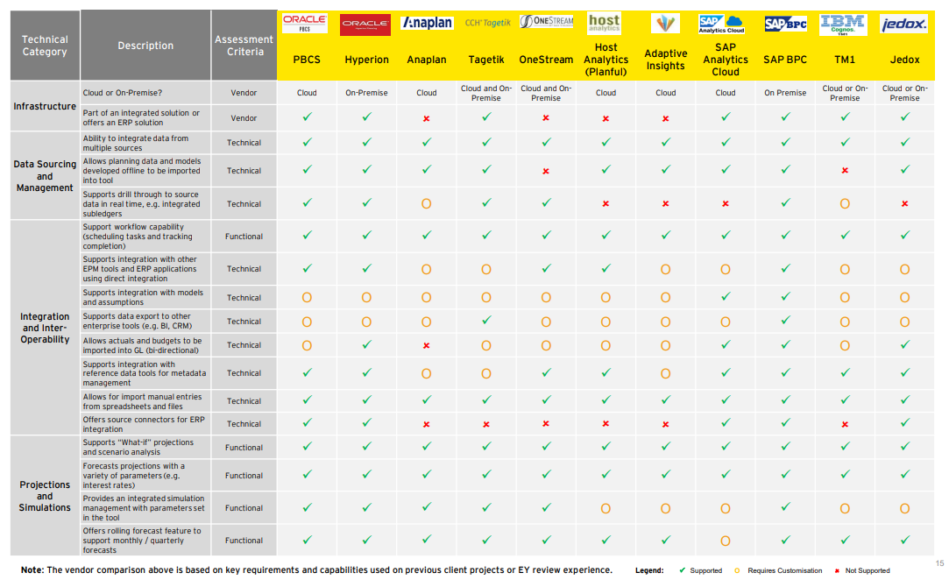
Financial Consolidation Solutions Assessment (1/3)

Slide 119
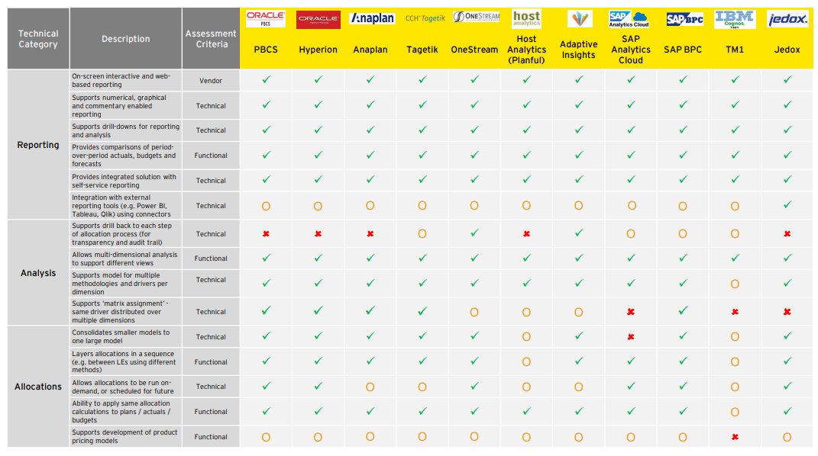
Financial Consolidation Solutions Assessment (2/3)

Slide 120
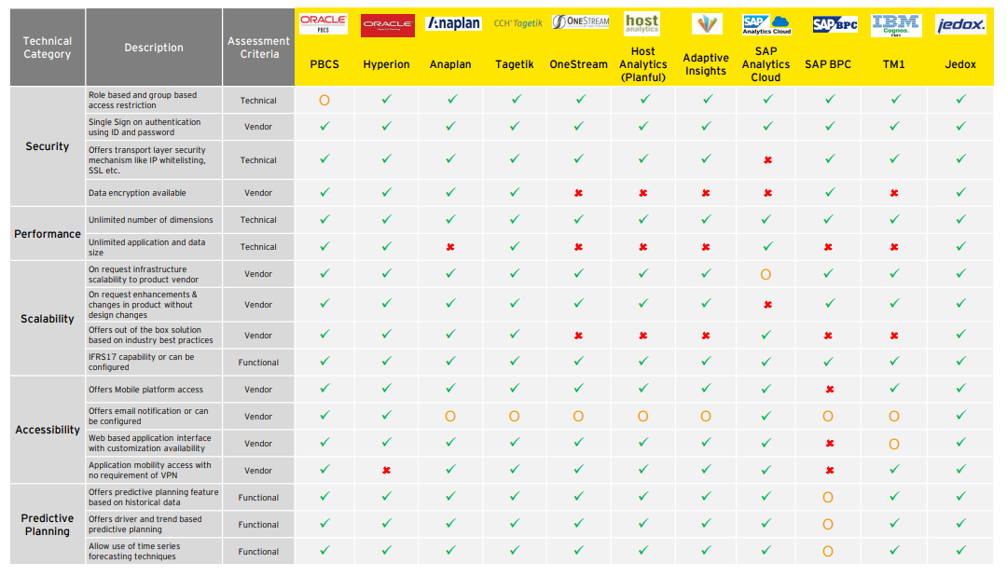
Financial Consolidation Solutions Assessment (3/3)

Slide 121
Companies need to rethink what information creates value and how they can set up an efficient structure to steer and report on it and provide real(er) time transparency to stakeholders.
Stakeholder Value & Communication
Reporting & Steering
Data Model & Analytics
Customer
Product Labels
Investors
Marketing Campaigns
Operative Steering Model
Integrated Data & Analytics Layer
Data Model
Financial Data Sources
Activists
Apps
Real Time
Information Portal
LTV
Value Narrative
Talent
YouTube
Financial Statement
Consoli-dation
Engine
Business Data Sources
Regulator
Website
ESG
Alliances
API
External Data Sources
Other
…
…
Value to Stakeholder
High number of external reports can lead to inconsistent information and has limited value impact
Translating the different reports into one integrated value narrative ensures consistent information sharing along core value driver
Communication channels change from classic reports to apps, digital tagging and modern forms of content visualization.
Insights to Value
Corporate steering models translate the value narrative into key performance indicator
KPI & Analytics needs to be structured along value flows to create impact and support business in decision taking
Simulation and prediction models will enable business to see the impact of their decision on the consolidated long term value report
Data to Insights
Data to insights will require analytics capabilities enabled by artificial intelligence
Multiple data sources will be utilized to fulfill the new reporting requirements. ERP, Blockchain, IoT etc. will play a more important role in creating real time data.
Integration of the various data resources requires a data model and technology solutions, that provide the necessary flexibility

Slide 122
Evolution of GBS governance models
Many companies have shifted to an integrated GBS Governance model
Regional SSCs
Divisional SSCs
Functional SSCs
Global Business services
Functional steering
Global Business services Central steering
CEO
CEO
CEO
CEO
CEO
EU
NA
APAC
Business Unit One
Business Unit Two
Group Function
Business Unit One
Business Unit Two
Group Function
Business Unit
Group Functions
GBS
Business Unit
Group Functions
GBS
SSC
SSC
SSC
SSC
SSC
SSC
SSC
SSC
Governance option one: GBS with independent functions based on a harmonized shared services foundation.
Key aspects:
One common GBS strategy with a harmonized shared services foundation and a global service delivery model.
Global steering board with functional owners and board representatives to leader global strategic priorities and execute GBS strategy.
Functional steering by functional owners to remain functional autonomy.
GBS organization as foundation (“Global service delivery network”).
Governance option two: Fully integrated end-to-end global business services steered by a single head of GBS.
Key aspects:
End-to-end global business services bundled within one organization as a foundation for strong governance.
One common GBS strategy with global process owners, a global service delivery setup, and a global service management.
The organization is headed by a single head of global business services, who reports to the C-suite or may be a member of it.
Single global shared services organization operating through regional centers.
Full integration of enterprise processes and complete end-to-end process integration throughout the company due to concentrating on service products instead of functions.

Slide 123
GBS Governance Layers
Baldev
GBS governance layers need to have clearly define governance objectives, participants, and frequency of meeting
GBS Governance Layers
Frequency/Participants
Governance Objective
Customer Board (representing functions/divisions)
E.g., quarterly during implementation, semi-annually in steady-state.
Division/functions: Key representatives to ensure full mandate for strategic oversight.
GBS: Head of GBS, heads of solution and delivery excellence, head of customer excellence, GBS center heads.
Determine overall strategy and provide management oversight.
Conduct periodic review of performance.
Resolve key issues and disputes.
Approve increases in scope of operations/services.
Approve cost center expenditure plans.
Approve functional SLA targets.
Corporate
Head of
GBS
Division/Functional Governance Committee (e.g., GHR)
E.g., monthly during implementation, bi-monthly in steady-state.
Regular participants of Divisional/functional committee.
GBS: GSO, likely global and/or regional functional delivery Lead(s) optional head of solution excellence.
Establish functional SLA targets.
Review functional performance against SLAs.
Regularly review scope and prepare scope extension proposals for customer board.
Identify, develop and leader business process improvement initiatives.
Identify specific service or process issues.
Monitor process compliance.
Participation
Functional
GSO
Operational Lead Division/Function
Monthly.
By region or local?
Division/functions: Regional/local operations/commercial/functional head.
GBS: Head of DC; functional leader; head of service mgmt.
Monitor the in-scope process execution.
Monitor local/regional performance, service quality and cost.
Discuss and manage operational issues.
Analyze root causes of service issues or below target SLA performance.
Entry door for new requests (e.g. new entity).
Operational
HFD
Service
Mgmt.
Service Management Lead
Service Management Channels
F&F
Daily, operational.
Service request and delivery.
Incident management.
Proactive and reactive problem management.
Service level management.
F&F: Full and Final Settlement, GSO: Global Solution Owners, SLA: Service Level Agreement.

Slide 124
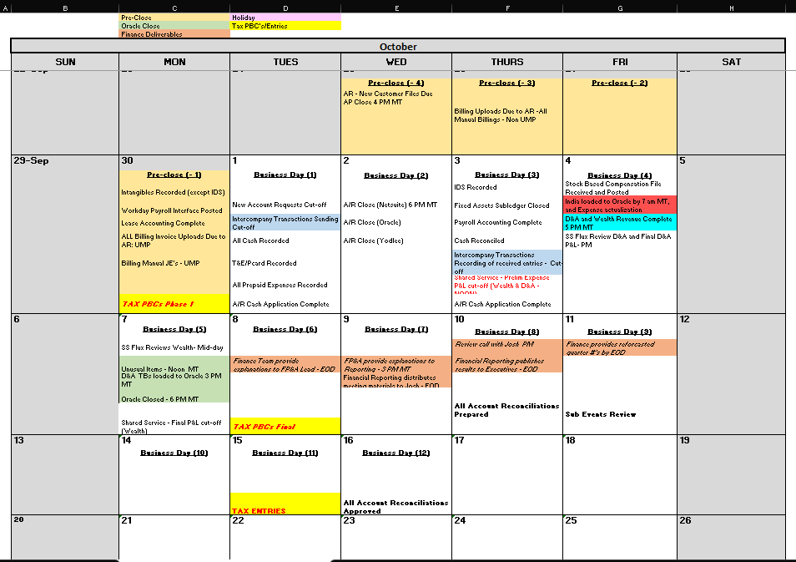
Close Calendar

Slide 125
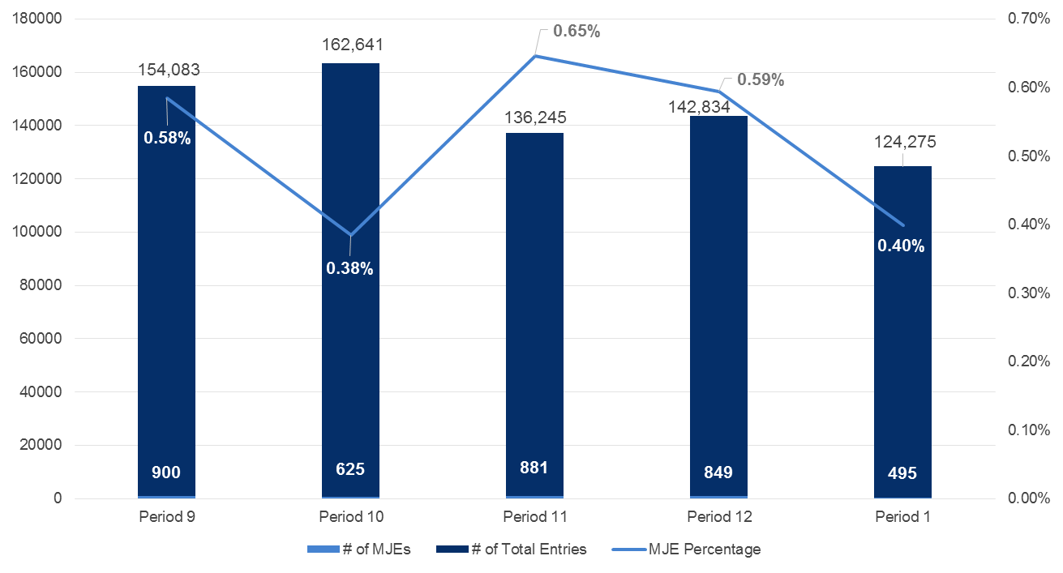
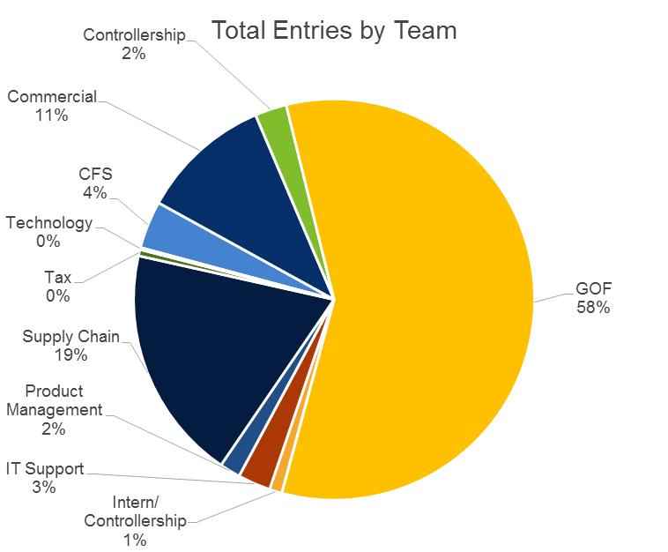
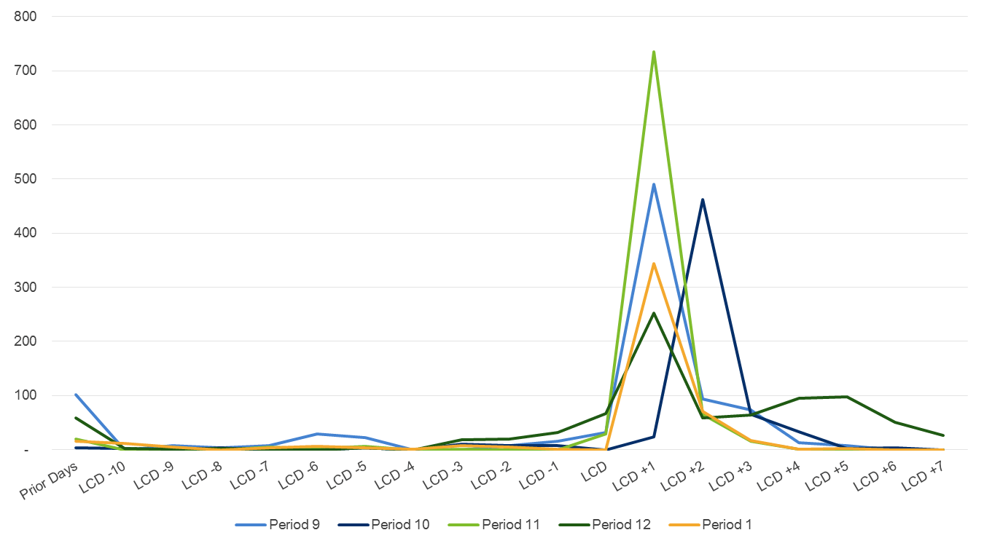
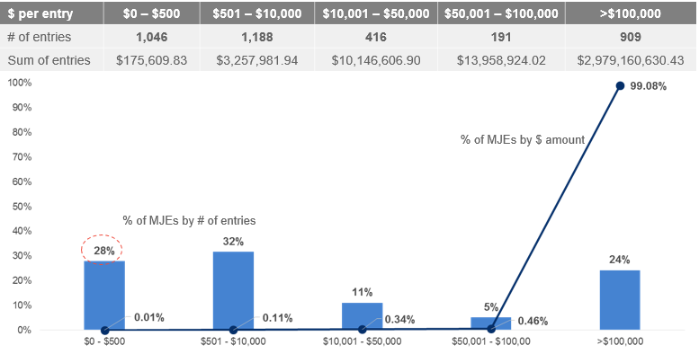
Case Study#1 Manual journal entry (MJE) analysis
EY was tasked with helping a large tech company to achieve a long term goal of getting to a one (1) day close.
Discoveries
Overall MJE % is low but volume is high
97% are made by the R2R team; PERSON A processes the most MJEs at 50%; others range from 3%–6%
Opportunities exist to begin activities earlier in the close cycle to create a more level loaded profile
More consistency needed in how entries are made and defined in SAP to drive visibility in 45% unknown bucket
IBS and Re-classes were the two largest known categories of entries; ripe opportunity to simplify
Approximately 30% of manual journal entries being made are $500 or less; implementing thresholds will reduce volume
Overall MJE %
MJE’s by team
MJE by close day
MJE threshold analysis

Slide 126
Case Study #2 Record to Report Assessment
EY was tasked with helping a Global Diversified Healthcare Company to assess the client’s Record to Report (R2R) processes across the client’s US finance centers
Value Delivered
Business Need | This global diversified healthcare client’s North American operations included three finance centers in the US, in addition to their corporate office. A previous finance benchmarking exercise identified that the finance centers were highly inefficient and leveraged disparate, manual processes – indicating there were significant opportunities to reduce costs as compared to their peers. Consolidating the finance centers represented one way to reduce costs and the client sought an objective assessment to better understand and capture the potential benefits in a business case and an improvement roadmap, which would be used to determine next steps.
Engagement Summary and Objectives | EY was engaged to assess the client’s Record to Report (R2R) processes across the client’s US finance centers. The scope of the assessment included general accounting, intercompany, fixed and leased assets, inventory, financial close and consolidations, etc. The output from the assessment was a detailed business case, as well as an implementation roadmap that sequenced key activities for transitioning from current to future state. Once completed with the assessment, the EY team anticipates being further engaged to assess the client’s other business, as well as to assist with implementing the recommended initiatives.
EY Role | Performed process owner interviews and documented current state process flows for each in-scope location Identified gaps between processes and developed a plan to standardize processes across the sites Conducted a survey to evaluate how FTEs spend their time (and how many) across the R2R processes Leveraged the results of the survey to benchmark against EY Benchmarking information for Finance and IT Conducted a second FTE survey to assess how much time is spent on certain close activities in order to identify dependencies and efficiency opportunities Developed comprehensive business case that summarized all inputs and highlighting the costs, benefits and level of effort in moving forward with select scenarios (e.g., consolidating finance centers, moving to shared services, implementing new technology or processes) Developed a roadmap that prioritizes key initiatives (both quick wins and longer term) required to transition from current to desired future state
Objective point of view on how their cost of finance compares with peers
Clear picture of current state finance processes, including gaps, and a path forward for standardization
A detailed business case providing scenario and sensitivity analysis which captures the cost benefit of moving forward with recommendations
An actionable roadmap to implement their future state vision once a path is selected

Slide 127
Case Study #3 Close Optimization
Business Need | Migrate from unsupported close management tool Define task parameters/ granularity. Develop review workflow and support repository around month-end tasks Reconciliation processes were manually intensive and decentralized Account ownership unclear, out of balance amounts remained stagnant due to lack of visibility Reconciliation policy not set, lacking procedures & support Lack of controls around inactive account population prevented reporting for process tracking
Engagement Summary and Objectives | Develop financial close task definitions to operationalize close management tool Enable standardization, visibility, reporting, consistency and set process efficiencies across account reconciliation processes Create a framework of controls, ownership and workflow around account balances and associated clearing process Tool Implemented: BlackLine Task and Reconciliations Modules
EY Role | Configured, implemented and operationalized Task and Reconciliation BlackLine modules Implemented operational model, including account and entity governance and controls across the distributed organization Set and aligned account reconciliation standards and policies to industry standards Developed and provided training and change management to user base, managers and BlackLine admins Aligned reconciliation templates and reporting categories to accounting hierarchy for transparency and efficiency Automated feed of General Ledger to BlackLine reconciliation tool and enabled auto-certification policy Identified and configured automated solution for complex intercompany and variable interest / equity reconciliations Developed an organizational hierarchy within the tool to enable real time reporting around status, close process tracking and out of balance clearing at multi-tiered organizational view
Value Delivered
Configured, implemented and operationalized Task and Reconciliation BlackLine modules
Implemented operational model for account governance & controls across the distributed organization
Developed training framework and change management to user base and BlackLine admins
Aligned recon templates and reporting categories to account hierarchy for transparency and efficiency
Automated GL feed to BlackLine reconciliation tool and enabled auto-certification policy
Identified and configured automated solution for complex intercompany and variable interest recons

Slide 128





Top 20 US Pharma Company – Fast Close Project
What we have done
Identified and designed processes to improve the financial statement close process
Held 30 interviews with key close process stakeholders, collecting 125 process challenges and mapped them to 13 key improvement initiatives
Built dependency-driven critical path summaries, detailing the current state close and the acceleration required to reach desired future state
Assessed and provided recommendations to standardize the close process globally
Compiled close checklists into a global close tracking tool for monitoring key close activities, including owners and due dates for each activity
Analyzed MJE’s using SOX, PwC and SAP reporting data and tested thresholds for overall MJE dataset. Recommended changes in current thresholds, which resulted in 35% reduction in overall entries and immaterial P&L impact
Evaluated and recommended the use of automation to increase the efficiency and accuracy of closing activities
Recommended implementation of BlackLine JE module for further streamlining of MJE and as governance for new MJE threshold policies
Recommended implementation of RPA bots for selected processes to reduce manual effort and improve efficiency of calculation and reporting steps
Value for the client
Provided a clear, actionable path to reach a 4 day close in 2019 and 3 day close in 2020 (prelim, pre-tax, non-GAAP consolidated P&L)
Developed an initiative roadmap focused on minimizing non-value added activities, and replacing them with robust processes enhanced through automation
Calculated and socialized optimal thresholds for MJEs globally, including validation with international accounting leads
John Hatcher
Executive Director US Engagement Lead
Heidi Taradash-Destino
Senior Manager Project Manager
“With this credential we demonstrated that EY understands the key facets of the financial statement close processes and provide clients with actionable improvement initiative to increase efficiency and effectiveness of the overall process.” John Hatcher
Scope
Financial Close Process & Controls
MJE Assessment & Rationalization
Global Process Alignment
Technology Enablement Assessment
✓
Objective
Accelerate the financial close process from 5 to 4 days in 2019 and to 3 days in first quarter 2020, through standardization of processes, deployment of leading-practice tools and increased governance
✓
✓
✓
✓
✓
✓
✓
The challenge
The client had an aggressive timeline for the reduction of the financial statement close process from a 5 day close to 4 days by end of 2019 and then to 3 days by the end of 2020
The client was in the final stages of integrating an acquisition and As-Is processes were not fully standardized at the inception of the acceleration effort
Increased Automation
Global Close Calendar
Faster Close

Slide 129

FTSE 100 Global Pharma Company – Fast Close Project
What we have done
Design the future state global close calendar
Defined a harmonized close calendar for all countries and functions (R&D, IT, Sales, etc.) based on leading practice and the art of the possible for the client
Designed the future state process through a series of regional workshops with functional teams
Implement the future state calendar
Conducted gap assessment per country with a remedial action plan to close the gaps
Managed the remedial actions and drove compliance leveraging our global network of professionals
Set up a governance framework
Deployed a robust governance structure to challenge any possible exceptions raised and leveraged local experts from across our service lines to stress test any country legal / regulatory requirements – this minimized the exceptions that were put in place
Implemented a global close calendar dashboard which tracked the compliance of all countries
Value for the client
Standardization enabled:
Accounting automation technology to be deployed thereafter, reducing the level of manual work
Results to be reported faster
Greater control and visibility by central finance
Greater willingness to share good practice across the company
Note: The programme won a “CFO award” at the client – a prestigious internal award that is given by their CFO to a team or project that has significantly contributed to their success
Ben Castell
Partner Senior Advisory Partner
“For [CLIENT]’s Fast Close project we can leverage experience and material from this project to speed up project results and reduce involvement of the [CLIENT] team.” Ben Castell
Objective
A FTSE 100 global pharmaceutical company needed support to achieve scalable and sustainable Record To Report process excellence
A key enabler was to design and implement a standardized global close calendar, to enable and deploy automation technology for a faster close
Increased Automation
Global Close Calendar
Faster Close
The challenge
Every country worked with a different timetable (e.g., when they closed subledgers)
The headquarter had only limited control and visibility on the Record to Report process

Slide 130









Finance integration of multinational Swiss group into global life sciences company
What we have done
Finance integration support on new chart of account and currency conversion
Assistance for all currency conversion and technical accounting related matters under US GAAP considering SEC requirements
ERP architecture design. Complete Finance Conceptual Design and Integration including technical implementation. Design and Implementation of Organizational Structure and reporting requirements into SAP (Functional Area, Cost centers, Profit Centers, etc.)
Chart of Account design, incl. account determination and P2P process design (indirect/direct)
Design and Integration of end-to-end process values flows from SD, FI to MM into BI for commercial and R&D entities
Overall project support on PMO, data conversion and migration
Data migration support including object list, concept & protocol, project plan and compliance documentation
In charge of the overall project plan including resource planning for the finance integration
Compliance support on project and migration matters
Deployment of a robust governance structure to challenge any possible exceptions raised
Developing a finance compliance plan and business logic concepts together with the client as well as designing a data migration concept
Value for the client
Successful finance integration of operations into the global life sciences company, incl. a harmonized financial reporting structure, close processes and internal controls (SOX)
On-time migration and deployment of SAP
Frederik Schmachtenberg
Partner Engagement Partner
Markus Wüest
Senior Manager Engagement Manager
“Each project on top of ongoing merger and integration initiatives adds more complexity. With this credential we have demonstrated that EY successfully manages Finance transformation and integration projects at the same time.” Frederik Schmachtenberg
Scope
Design and Integration of E2E process flows from SD, FI to MM into BI
Chart of Account design
Functional Currency Assessment
Financial Close Process & SOX Controls
✓
✓
✓
✓
Objective
Integration of the USD 30 billion acquisition into a global life sciences company, both from a financial reporting and internal control (SOX) perspective
✓
✓
✓
✓
The challenge
The project lasted close to two years with the main challenges around the fact that the acquired group had a completely different financial reporting structure and setup, both from an accounting and tax perspective
$30 Bn. acquisition
2 Years
Financial reporting structure

Slide 131


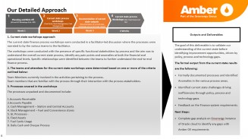
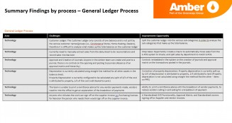
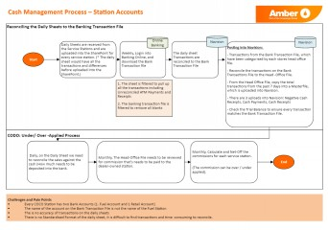
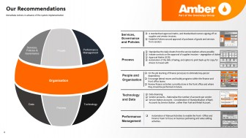
Finance Process Standardization & Documentation
1. Business background:
2. Solution:
3. Value Delivered:
Client background and problem statement:
Amber Oil is a Fuel Company part of the Greenergy group which offers oil and fuel for various types of clients at competitive pricing.
Amber Oil will be implementing Oracle Fusion Cloud in 2022 and there was a requirement to document the ‘As-Is’ Finance processes in advance of this migration.
EY role:
EY was engaged by Amber Oil to perform a four-week review of Amber Oil’s current Finance processes
Collect and analyse documentation on the current Finance processes across Fuel (Commercial and Consumer) and Retail business of Amber Oil
Carry out workshops and in-person reviews / work shadowing for each Finance Process Area (Payables, Receivables, Assets, Cash Management, General Ledger)
Document ‘as is’ processes (Process Maps) and outline data sources, anomalies, challenges and improvement opportunities.
Scope:
EY was engaged to perform a four-week review of Amber Oil’s existing Finance processes. Amber Oil will be implementing Oracle Fusion Cloud in 2022 and there was a requirement to document the ‘As-Is’ Finance processes in advance of this migration. We documented ‘As-Is’ process flows for the areas in scope below including identifying key pain points and challenges in the process with suggested opportunities for improvement / automation.
The main finance processes included in the review were:
General Ledger Process
Account Receivables
Account Payables
Cash Management (Bank Accounts)
Value delivered:
Identified key challenges and improvement areas in the current Finance Processes, Systems and Resourcing.
Identified areas based from the EY Operating Model to identify key improvements in the overall performance of the Function.
The key improvement areas identified in the Operating Model included:
Services, Governance and Policies
Processes
Cash Management (Bank Accounts)
General Ledger Process
Key Outputs:

Slide 132
Dairy Farm: BlackLine Transaction Matching & Journal Implementation
1. Business background:
2. Solution:
3. Value Delivered
Client background:
Dairy Farm is a leading pan-Asian retailer. Dairy Farm International Holdings Limited is incorporated in Bermuda and has a standard listing on the London Stock Exchange, with secondary listings in Bermuda and Singapore
Client was looking for:
The elimination of manual excel based reconciliation of the sales data.
Automated Journals workflow for variance postings.
Analysing the financial data & current ERP systems
Configurable dashboards and reporting
GDS role:
Configured BlackLine instance for Matching Module & global settings.
Development of Business rules to define matching criteria.
Prepared workshop decks, admin guides, training guide to drive the workshops and training session with the client.
Scope:
Dairy Farm required a cloud based system to help in sales reconciliation and automated journals workflow for variance.
GDS Team:
GDS team size: 1 FTE (Offshore); 2 months
Value delivered:
Built and update BlackLine module for quick matching results with interface through static data source.
Documented Key Design Decision for Implementation
Standardised and streamlined cash matching process with defined pass rules for all payment banners.
Documented comprehensive training material & work instructions for all modules
Streamlined financial process related to match transaction requirement for multiple countries to avoid duplicity.
Configured exhaustive reporting suite for all MIS reporting pertaining to FCMP
A team of certified Black Line professionals with complete knowledge on implementation with a blend of RPA experience.
Elite combination of technical and functional skills which enabled timely execution and high-quality deliverables
Deep understanding of financial close process, accounting policies and procedures
Page 132

Slide 133
Coupang: BlackLine Account Reconciliation Implementation
Partner: Ronald Wong
Sector: E-Commerce, South Korea
1. Business Background
2. Solution
3. Key Success Factors
Client background:
Coupang, Inc. (Korean: 쿠팡) is a U.S.-based e-commerce company headquartered in Seattle, WA. The company expanded to become the largest online marketplace in South Korea. Coupang services are Rocket Delivery, Rocket Wow, Rocket Fresh, Rocket Direct Purchasing of foreign goods, Coupang Eats, Coupang Flex, Coupang Play & Coupang Pay
Client was looking for:
The client was looking for an efficient and automated financial reconciliation solution for balance sheet reconciliation
Design and build BlackLine functions as per client's reconciliation processes
Subledger Automation for Customer, Vendor and Asset subledger accounts.
GDS role:
GDS contributed in assessing reconciliation requirements and designing & updating the BlackLine to match client needs
Setup Global Settings/design decisions as per client’s reconciliation process; Application setting, Accounts details, Org Structure, Certifications requirements etc
Built prototypes in client’s sandbox to coach on BlackLine functionalities
Prepared workshop decks, admin guides, training guide to drive the workshops and training sessions
Scope:
Implementation of BlackLine modules (Account Reconciliation) for 21entities; streamlining the Subledger, Bank/cash and other B/S line item’s reconciliation process.
Train the admin on the Task management module.
GDS Team:
GDS team size: 1 FTE (Offshore); 3 months
Value delivered:
Built and updated BlackLine functions to eliminate unnecessary manual efforts with respect to ongoing reconciliation process followed by client.
Improved reconciliation process and close cycle times
Better governance around the close process
Streamlined the close processes and communication via BlackLine for account certifications, unidentified details between the specific data owners.
Experienced team of professionals with past experience in BlackLine
Expertise in reconciliation process across Cash and balance sheet line items
The mix of technical and functional knowledge that GDS brought to the engagement enabled timely execution and high quality deliverables
Page 133

Slide 134
Marathon Petroleum Corporation: BlackLine Journal Module Implementation
Partner: David Adler
Sector: Oil & Gas, US
1. Business Background
2. Solution
3. Key Success Factors
Client background:
Marathon Petroleum Corporation is an American company specializing in petroleum refining, marketing, and transportation, with its headquarters in Findlay, Ohio. US
Client was looking for:
Implementing BlackLine Journal module
Standardization of manual journal entry process by streamline the Journal posting and approval process with standardized templates and workflow for preparing and approving
Improved Governance & Visibility by increasing Control, transparency with enhanced accountability along with Monitoring completion of journal posting process within set timelines.
Optimization and automation of closing processes
GDS role:
Re-defined the journal entry process in BlackLIne
Support in day-to-day BlackLine Journals Implementation activities and contribute to the preparation of deliverables
Scope:
Implementation of the BlackLine Journal Module includes a Global Configuration review, creation and configuration of up to 4 Journal Templates, BlackLine and SAP integration, enablement of journal workflow within the journal templates
GDS Team:
GDS team size: 1 FTEs (Offshore) for 4 months, 27% GDS Integration
Value delivered:
Documented Key Design Decisions for implementation
Designed and Configured 4 Journal Entry Templates including 1 reversal Template
Prepared SIT and UAT Scripts for 4 Journal templates and Approval Workflow and User roles.
Documented comprehensive training collaterals and instruction for MPC end users.
Streamlined the Journal Entry Approval process for Standard and Cross Company journals with 6+ approval workflow scenario
Certified BlackLine professionals with complete knowledge of BlackLine Journal module
R2R domain expertise and deep understanding of financial close processes, accounting policies and procedures
Elite combination of technical and functional skills which enabled timely execution and quality deliverables
Documented the current state by creating a survey with more than 20+ questions.
Adapted Complex Validation rules in the Journal Templates for Tax Relevant journal entries.
Page 134

Slide 135
GDS Projects (1/x)
Client – Project Name | Description | Region | Sector
SAS: IFRS 17 - “Sub Ledger Accounting Module” (SLAM) development | Identification of Accounting Events missing in the current SLAM module based on disclosure requirements and linkage to business events and COA structure & hierarchy. | APAC | Technology
IFRS17: Transamerica COA Design and Disclosure Mapping | Client was looking for: 1) IFRS 17 Implementation gap assessment 2) New IFRS17 Chart of Account Design 3) IFRS-17 reporting and disclosure mapping with COA 4) Management Internal Reporting with IFRS-17 | Americas | Insurance
AIS: IFRS15 Revenue Recognition Implementation | End to end IFRS 15 implementation using Aptitude ARRE calculation engine | APAC | Telecom
Mondelez: IFRS16 Lease Accounting Implementation | Modifying their existing Slan system to include Lease Accounting calculations and algorithms via excel based Model | Americas | FMCG
Bridgestone: IFRS16 Lease Accounting Reporting | Modifying their existing Lease management reporting to include Lease Accounting reporting and analysis via excel based Model for effective management decisions | Americas | Automotive
Aegon Asia: IFRS17 MI reporting Impact assessment and Gap analysis | IFRS 17 impact on their current MI reporting and new IFRS 17 KPIs to be included going forward | Asia | Insurance
Great Eastern: IFRS17 Data Gap Assessment | Preparation of business requirement document and gap assessment for IFRS 17 using Aptitude modules like AICE and AAH | APAC | Insurance
De Lage Landen (DLL): Banking licence structure – Accounting policy memo | Client was looking for: 1) The client wanted a transformation plan detailing the necessary steps to optimise its banking licence structure to increase strategic flexibility and lower regulatory vulnerability 2) Assessment of accounting impact of applicable standards during and post restructure of the group and identifying disclosure requirements for the existing and new entities | Netherlands | Banking
SAP: IFRS15 Revenue Recognition | Client was looking for: 1) Implementation of US GAAP ASC 606 for their revenue recognition process 2) Process modification and establishment of SAP RAR as ‘Accelerated go to market’ program 3) Design a model for reconciliation between the revenue recognition as per US GAAP ASC 605 and ASC 606 can be performed 4) Evaluation of data flow and additional data requirement to comply with US GAAP ASC 606 | EMEA | IT

Slide 136
GDS Projects (2/x)
Client – Project Name | Description | Region | Sector
Moody’s: Revenue Recognition | Client was looking for: 1) Implementation of RevPro to comply with ASC 606 as per US GAAP for their Revenue Recognition process 2) Design, build and deliver the test scripts for RevPro 3) Provide assistance to Revenue Accounting team in resolving RevPro issues 4) Provide support to Moody’s to operationalize the future state processes defined during Revenue Management program | Americas | FS
Mondelez: IFRS16 Implementation – SQL DBMS | Reconciliation of changes done in SLAN system for lease accounting through excel based models and reports generated out of SLAN model to ensure all changes have been correctly captured in SLAN system | Americas | FMGC
Moffitt Cancer Centre & Research Institute – Account Receivable Reconciliation | Accounts Receivable Reconciliation for their trials from various payers | Americas | Healthcare
New Relic: IFRS 15 – Zuora RevPro Implementation & Data Migration | Implementation of Zuora RevPro - Revenue Recognition tool baselined on IFRS 15 accounting. In addition, client also required migration of the financial data in their existing accounting tool – NetSuite to Zuora-Revenue tool | Americas | Technology
Boots : BlackLine Account Reconciliations, Task Management and Journals Implementation | Client was looking for: 1) Client was migrating from SAP ECC to SAP S4 HANA (Project Orion) and wanted to redesign there already existing Blackline instance for configuration with S4 2) As part of project Orion Client was planning to migrate Boots , No7 and Opticians from ECC to S4. 3)Implementing Account Reconciliation, Task Management and Journals Modules with new Chart of Accounts developed for S4. | UKI | Healthcare
AstraZeneca: BlackLine Remediation (S4 Migration) – Account Reconciliations & Journals | Client was looking for: 1) As the client was moving its SAP ECC systems to S4HANA instance, it was looking for BlackLine workstream transition within this larger transformation initiative (Project Axial) 2) Assist AstraZeneca in migrating the BlackLine system to the new S/4 HANA environment 3) Establish new BlackLine integrations compatible with S/4 HANA 4) Assessing the current design to determine necessary areas of impact and solution updates required to keep the processes aligned in the new SAP environment 5) Meet agreed milestones and deliverables in line with APICOM and Mexico entity deployment schedule | UKI | Health Sciences and Wellness
Coupang: BlackLine Account Reconciliation Implementation | Client was looking for: 1) The client was looking for an efficient and automated financial reconciliation solution for balance sheet reconciliation 2) Design and build BlackLine functions as per client's reconciliation processes 3) Subledger Automation for Customer, Vendor and Asset subledger accounts. | South Korea | E-Commercie

Slide 137
GDS Projects (3/x)
Client – Project Name | Description | Region | Sector
Grifols S.A. : BlackLine Journals Creation Implementation | Client was looking for: 1) Streamline approval process on the journal entries by automated approval workflow, centralized repository of documents & also eliminate unorganized SAP controls by levering BlackLine Journal entries 2) Enable Internal and external controls on MJE’s by adapting to FCPM technology – BlackLine | EMEA | Bio Pharma & Healthcare
Marathon Petroleum Corporation : BlackLine Journal Module Implementation | Client was looking for: 1) Implementing BlackLine Journal module 2) Standardization of manual journal entry process by streamline the Journal posting and approval process with standardized templates and workflow for preparing and approving 3) Improved Governance & Visibility by increasing Control, transparency with enhanced accountability along with Monitoring completion of journal posting process within set timelines. 4) Optimization and automation of closing processes | Americas | Oil & Gas
Fresenius Kabi: BlackLine ICH Balance & Resolve | Client was looking for: 1) A standard Global ICO reconciliation process supported by the adequate technology 2) Implement new intercompany reconciliation process based on BlackLine Balance & Resolve 3) Bring ICO Master data in a state that will enable BlackLine B&R effectiveness4) Prepare the organization and steer it throughout the change journey | - | Pharma
Viatris : BlackLine ICH Balance & Resolve | Client was looking for: 1) Automation major part of the intercompany reconciliation process in an efficient manner by levering BlackLine ICH B&R Module. 2) Create and post month end SIT Accruals by integration of BlackLine Journals Module. | Americas | Pharma
Reckitt Benckiser : BlackLine Journals, Task, Variance and Account Reconciliations Implementation | Client was looking for: 1) Implementing a global best in class digital R2R process that is standardized, simplified, automated and UK Sox compliant 2) Eliminate manual effort, design automated month end process by levering multiple BlackLine modules that provides a single version of truth | UKI | Consumer Products
Asahi: BlackLine Account Reconciliations, Task Management, Journals and Transaction Matching Implementation | Client was looking for: 1) To reimagine and transform RTR processes enabled by a modern platform like BlackLine to improve visibility, control and to analyse and report on data in a consistent way 2) Eliminate manual effort, design automated month end process and bring in data from multiple sources by leveraging multiple BlackLine modules that provides a single version of truth | UKI | Consumer Products
CoStarwood Capital: BlackLine Account Reconciliation, Transaction Matching and Tasks Implementation | Support the additional rollouts of BlackLine for remaining functions (Property, Fund) and provide administrative support to maintain the BlackLine activities | Americas | Real Estate

Slide 138
GDS Projects (4/x)
Client – Project Name | Description | Region | Sector
Partners Group : BlackLine Account Reconciliation, Tasks, Financial Reporting Analytics & Transaction Matching Implementation | Client was looking for: 1) To incorporate automation while strengthening their month-end processes and centralized tracking. 2) Detailed insight of overall performance and financials of the organization 3) Automated reconciliation in fit-for-purpose tool, increasing efficiency and reducing control risk 4) Standardized global design that will enable scalability when rolled out to other entities of Partners Group | EMEA | Private Equity
Getinge AB : BlackLine Account Reconciliation, Journals & Smart Close Implementation | Client was looking for: 1) Automation to refine their reconciliation processes, enhance efficiency, and reduce control risks 2) Automating journal entries to minimize manual errors, establish a robust approval workflow, and maintain a comprehensive audit trail 3) Moving away from individual local close calendars for each entity in favour of a unified, harmonized global calendar | - | Healthcare & Life Sciences
BP International: BlackLine Account Reconciliation, and Transaction Matching | Client was looking for: 1) Moving from only a 8% non-standard BSA process to a 100% standardized & centralised BSA process as per leading practices 2) Design a standard process across client’s complex financial structure spanning across 15+ ERP instances, Finance Business Warehouse (FBW), Other Systems 3) Develop a reconciliation handbook for 50+ type of account types defining underlying procedures as per best practises to support first time reconciliations for 90% of the balance sheet accounts |  | Oli & Gas
Athene : BlackLine Account Reconciliation, Transaction Matching, Journals & Task Implementation | Client was looking for: 1) To move from their legacy system due to stability issues which in turn posed Operational risk 2) BlackLine provided further automation opportunities and ease of implementation due to flexibility of tool 3) Automated reconciliation in fit-for-purpose tool, increasing efficiency and reducing control risk 4) Mapping tables to automatically create journals based on data input 5) Automated certification, substantiated by matching results | Amercias | FS
Diageo : BlackLine Account Reconciliations and Transaction Matching Implementation | Client was looking for: 1) Initially used Trintech for their digital close transformation however the said tool was not able to deliver as per the expectations 2) Moved to BlackLine modules to enhance flexibility for Diageo in terms of maintenance and focus on key activities such as analysis to improve accuracy 3) Implementing Account Reconciliation & Transaction Matching Modules with new Reporting currency | UKI | Consumer Products
Nike: BlackLine Transaction Matching Implementation | Client was looking for: 1) Implementing BlackLine Transaction Matching for cash, gift cards and digital sales transaction 2) Replace Trintech which is currently being utilized for transaction matching, but would be retired in Dec 21 3) Process optimisation, increased matching results, process change and match results to integrate with reconciliations 4) Build templates for each reconciliations& Build reports | Americas | AM&M

Slide 139
GDS Projects (4/x)
Client – Project Name | Description | Region | Sector
Thermo Fisher Scientific : BlackLine Journal Module Implementation | Client was looking for: 1) Implementing BlackLine Journal module 2) Standardization across their global manual journal entry process regardless of region / ERP. 3) Increase efficiency of their journal posting processes. 4) SOX Reporting | - | Health Sciences & Wellness

Slide 140
Record-to-Report Process Ownership Model
CCR
Consolidation
Corporate results, reporting and filings
Technical Accounting
External Reporting
Global close coordination calls
Global audit coordination
Region controller serves as POC for entity questions during consolidation
Serve as POC for Entity Close, for Accounting treatment questions from EBS
Coordinate on implementation of policy updates, process harmonization, accounting process changes, strategy for upskilling of A2R team
Serve as POC for BU leadership regarding filings, signoffs, audit, controls, etc.
EBS A2R
Country / Region Controller
FP&A / BUF (regional / global)
Coordinate with sub-ledger teams to close SLs
GL / Close execution (regionally coordinated)
Prepare and review GL entries for low/mid-complexity accounts and below materiality thresholds
Intercompany & Fixed Assets (global / centralized)
Inventory Costing transactions (from SCF)
Perform reconciliations
Process harmonization (+DTP/WI updates)
Global process ownership, continuous improvement and standardization, with controls & compliance improvement
High materiality / high complexity JE preparation and/or review during entity close
Sign off on Legal Entity results (BS, PL)
BS review & accountability
PL review & accountability (aligned to Inventory / Costing in EBS)
Communication with local BU leaders
Hosts entity close calls
Triage and address entity close issues
Reconciliation and controls oversight
Legal Entity Audit coordination
Bridge to mgmt reporting / internal reporting
Forecasting, planning budgeting (financial, cash, tax, etc.)
Price and cost analysis
Review business results vs plan / budget / fcst
Local BU Leadership (BoD / MD / FD)
Review local business results
Sign off on Statutory & Tax Filings (not Finance unless required)
Liaise with Tax team to understand relevant accounting changes and reporting needs
Other (e.g., Tax, Treasury)
Key
Interaction between teams
Responsibilities / accountabilities
Note: Current close is operated according to MRC; LE-based close to be implemented with OneStream go-live; migration path TBD. In this diagram, use MRC and LE interchangeably.

Slide 141
RTR Service Delivery (1/2)
9.3 Perform general accounting and reporting
9.3.2 Perform general accounting
9.3.3 Perform fixed-asset accounting
9.3.3 Perform financial reporting
9.3.1 Manage financial policies & procedures
100
75%
Maintain fixed-asset master data files Process and record fixed-asset additions and retires Process and record fixed-asset adjustments, enhancements, revaluations, and transfers Calculate and record depreciation expense Reconcile fixed-asset ledger Track fixed-assets including physical inventory Provide fixed-asset data to support tax, statutory, and regulatory reporting
Establish fixed-asset policies & procedures
Maintain fixed-asset master data files Process & record fixed-asset additions & retires Process & record fixed-asset adjustments, enhancements, revaluations, & transfers Process and record fixed-asset maintenance & repair expenses
55%
Negotiate service-level agreements Establish accounting policies Publish accounting policies Set and enforce approval limits Establish common financial systems
Maintain chart of accounts Process journal entries Process allocations Process period end adjustments Post and reconcile intercompany transactions Reconcile general ledger accounts Perform consolidations and process eliminations Prepare trial balance
Maintain chart of accounts Process period end adjustments Prepare and post management adjustments
55%
Prepare business unit financial statements Prepare consolidated financial statements Perform business unit reporting/review management reports Perform consolidated reporting/review of cost management reports Prepare statements for board review Produce quarterly/annual filings and shareholder reports Produce regulatory reports
Prepare business unit financial statements Prepare consolidated financial statements Prepare statements for board review Produce quarterly/annual filings and shareholder reports Produce regulatory reports Perform legal and management consolidation
10%
45%
35%
25%
Transactional Services
Value-Added Services
 | Local |  | Corporate |  | GBS |  | CoE

Slide 142
RTR Service Delivery (2/2)
9.4 Manage fixed-asset project accounting
9.4.2 Perform capital project accounting
9.4.1 Perform capital planning and project approval
80%
100
Develop capital investment policies and procedures Develop and approve capital expenditure plans and budgets Review and approve capital projects and fixed-asset acquisitions Conduct financial justification for project approval
Conduct financial justification for project approval
Create project account codes Record project-related transactions Monitor and track capital projects and budget spending Close/capitalize projects Measure financial returns on completed capital projects
20%
Transactional Services
Value-Added Services
 | Local |  | Corporate |  | GBS |  | CoE

Slide 143
GPO Responsibilities | Interaction Model
Business Requirements/Direction
Global Process Owner
GBS Interaction
Leadership Team
Process transformation: Establish a clear guiding vision that directs and aligns all process transformation efforts across the organization.
GBS process governance: Define and manage the oversight structures for Global Business Services to ensure consistency and accountability.
Retained process governance: Maintain internal control over key processes that remain within the organization rather than being outsourced.
Process design: Develop structured workflows and procedures that support operational efficiency and strategic goals.
Process implementation: Roll out newly designed processes into the organization with appropriate planning and stakeholder engagement.
Process execution and performance measurement: Operate business processes while tracking performance metrics to ensure they meet desired outcomes.
Service delivery model: Structure how services are delivered to customers or internal teams to ensure quality and efficiency.
Technology architecture and roadmap: Define the IT infrastructure and create a strategic plan for its evolution to support business needs.
Sourcing model: Determine how goods and services are acquired, balancing internal capabilities with external partnerships.
Continuous improvements: Drive ongoing enhancements to processes and services through iterative changes and feedback loops.
Captive teams
Business leadership requests the use of new emerging technology
Vendors may have questions on current tech stack/payment terms
Execute standardized processes and escalate exceptions to GPOs.
Provide feedback on process pain points and improvement opportunities.
Process Improvement Team
Collaborates with GPOs to identify, design, and pilot process enhancements.
Supports change management and adoption of new practices.
Internal Stakeholders
Controller prioritizes financial accuracy and compliance
Planning & Business Partnering needs to obtain accurate forecasts & working day metrics
Compliance & Controls Leader
Ensures financial processes adhere to internal controls and regulatory compliance standards.
Finance Operation Leads
Manage day-to-day finance operations and ensure compliance with GPO policy and process, acting as the liaison between local teams and GPOs for alignment.
External Stakeholders
Customers may raise questions around billing/service delivery
Vendors request reliable payment processes and communication on invoice status
Service Delivery Leader/Managers
Oversee service performance and ensure KPI/SLAs are met.
Coordinate with GPOs on escalations and service delivery improvements.
Captive Teams
BPO Operations
Execute standardized processes and provide operational insights and feedback to support continuous improvement and alignment with GPO strategy
Execute outsourced processes according to defined SLAs and KPIs.
Provide regular performance reporting and participate in governance reviews.

Slide 144
Record-to-Report Personas (1/2)
Global Process Owner (GPO)
Regional Finance Controller
General Ledger (GL) Accountant
Intercompany Accountant
Profile
Senior leader responsible for end-to-end R2R process standardization, governance, and transformation.
Key Responsibilities
Define global R2R strategy and policies
Drive process standardization and automation
Monitor process KPIs across regions
Needs & Pain Points
Visibility into global performance
Balancing local compliance vs. global standards
Typical Metrics
Close cycle time
Compliance rates
Standardization levels
Profile
Oversees R2R execution within a region, ensuring compliance with local laws and corporate policies.
Key Responsibilities
Review regional trial balance and adjustments
Liaise between local entities and GBS/CoE
Approve journal entries for accuracy
Needs & Pain Points
Timely, accurate data from GBS
Clear escalation paths
Typical Metrics
Adjustments accuracy
On-time close
Profile
Executes day-to-day GL accounting activities in the GBS or local finance team.
Key Responsibilities
Post journal entries
Maintain reconciliations
Ensure correct coding and compliance with chart of accounts
Needs & Pain Points
Clear posting guidelines
Minimized last-minute changes
Typical Metrics
Journal entry error rate
Reconciliation completion timeliness
Profile
Manages intercompany transactions, reconciliations, and eliminations.
Key Responsibilities
Record intercompany transactions
Resolve mismatches with counterparties
Support consolidation process
Needs & Pain Points
Timely responses from other entities
Automated matching tools
Typical Metrics
Number of unmatched transactions
Resolution time

Slide 145
Record-to-Report Personas (2/2)
Fixed Assets Accountant
Consolidation & Reporting Specialist
Management Reporting Analyst
R2R Automation / Systems Analyst
Profile
Manages capitalization, depreciation, and asset disposal processes.
Key Responsibilities
Record asset acquisitions and retirements
Calculate depreciation and impairment
Maintain fixed asset register
Needs & Pain Points
Timely asset documentation from business
Integration between asset and GL systems
Typical Metrics
Accuracy of FA register
On-time capitalization
Profile
Prepares consolidated financial statements for management and external reporting.
Key Responsibilities
Perform group-level consolidations
Adjust for currency translations, eliminations
Prepare statutory and management reports
Needs & Pain Points
Reliable data from all entities
Compliance with IFRS/GAAP
Typical Metrics
Reporting accuracy
Audit adjustments
Profile
Delivers performance insights through management reports and analysis.
Key Responsibilities
Prepare variance analysis
Support budgeting & forecasting teams with actuals
Highlight risks and trends
Needs & Pain Points
Access to BI tools and real-time data
Aligned definitions between finance & operations
Typical Metrics
Report delivery timeliness
Stakeholder satisfaction
Profile
Manages R2R ERP systems, reporting tools, and automation solutions.
Key Responsibilities
Configure GL modules in ERP
Support RPA and workflow tools
Troubleshoot data and system issues
Needs & Pain Points
Stable system performance
Alignment between IT and Finance timelines
Typical Metrics
System downtime
Automation adoption rate

