Slide 1

#GoodVibesOnly

Slide 2
Intro
Understand your Health Insurance with plain English
Find relevant doctors without having to search the internet

Slide 3
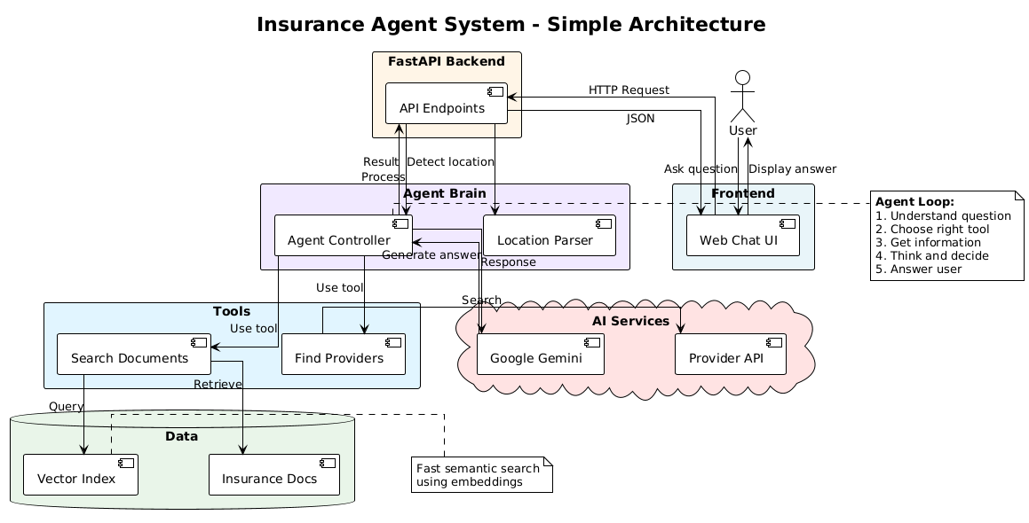

Slide 4
DEMO!!

Slide 5
Future Scope
Partner with Insurance Provider APIs to fetch even more relevant data
Allow users to list out their insurance plans from the UI

Slide 6
Thank You

