Slide 1
Angular
A platform that makes it easy to build applications with the web.
It combines declarative templates, dependency injection, end to end tooling
Integrated best practices to solve development challenges.
Empowers developers to build applications that live on the web, mobile, or the desktop

Slide 2
Angular1.X vs Angular 2
Angular 2 shares some concepts with its predecessor
the special HTML templating syntax,
directives/components to modify the DOM
Has Introduced better strategies and concepts to improve the performance
By updating data binding concept.
Angular 1 may not be deprecated or will not lack support
It will be there to stay
Angular 2 is Well designed and its is mobile oriented.
Need for Iconic framework is minimized
Component based without any controllers or scopes.

Slide 3
Single Page Application
HTML is a great declarative language for static documents.
It does not contain much in the way of creating applications,
One "real" HTML page whose content can be changed in Javascript without having to download a new page.
The new content is created programmatically using templates.
Server sends an application engine along with the HTML page
The engine controls the entire application including processing, input, output, painting, and loading of the HTML pages.
Server is used when there is a need for new data or must perform secured operations such as authentication.

Slide 4
MVC on Client Side
Client side MVC
MVC framework is built entirely on the client side.
Server only delivers data to the application.
The binding of the data to the models happens client side.
Need for client-side MVC
operations are not only with HTML but with data on the page.
when data is collection of JSON
Process data, perform all required calculations, render HTML and put that into page.
CRUD actions , over REST API.
adding or deleting should not make page to reload
can update page according to current data state.

Slide 5
Webpack Dev Server
The Webpack also comes with a development server.
Can be used run application as we are developing the application.
The Development server uses the Webpack’s watch mode.
Any changes made to our application are instantly updated.
Configured by using the webpack.config.js. Configuration file

Slide 6
Angular Development Environment
Installing Angular CLI Done by using the following command.
npm install -g @angular/cli
npm install -g @angular/cli@6.1.1
ng -version
Creating the Project
Created by executing the following command from the Prompt
ng new “gettingstarted” –routing
To Skip creating test artificats --skip-tests
Creates a folder gettingstarted and copies all the required files and configuration settings.

Slide 7
Angular 17
Standalone Mode:
Angular Applications are created without requiring a serverside
Used when Applications are being developed , tested or executed in a contexts where serve side rendering is not necessary.
create project with modules
ng new demo –no-standalone

Slide 8
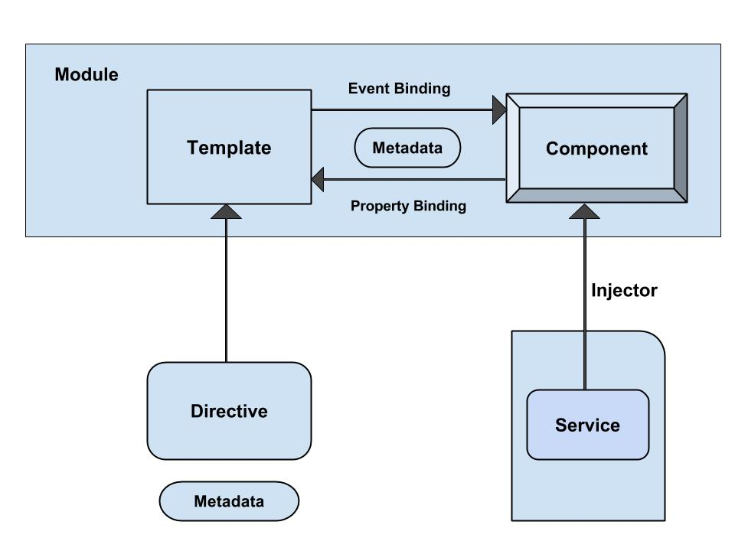
Angular - Architecture

Slide 9
Angular Application Folder structure
Creates a Sample Angular Application
It contains the subfolders node_modules and src.
It also contains the few configuration files
Angular.json
This is the configuration file for Angular CLI

Slide 10
package.json
It also creates a package.json which contains dependencies
{
"name": "quickstart",
"version": "0.0.0",
"scripts": {
},
"dependencies": {
},
"devDependencies": {
}
}

Slide 11
Packages.json
Script Section
This Script section contains many of the most useful commands
Ng,start,test etc
devDependencies Section
This section contains the entries required for application development
Typescript,karma,jasmine,protractor etc.,

Slide 12
Updating package.json
Can also add in Project’s package.json and run update
"dependencies": {
"bootstrap": "^5.3.2",
"jquery": "^3.7.1",
"popper.js": "^1.16.1",
}
npm install jquery --save
npm install popper.js --save

Slide 13
Adding to angular.json
"styles": [
"src/styles.css",
"node_modules/bootstrap/dist/css/bootstrap.min.css",
],
"scripts": [
"node_modules/jquery/dist/jquery.min.js",
"node_modules/bootstrap/dist/js/bootstrap.min.js"
]

Slide 14
Sample Application
app/app.component.ts
where root component is defined
app/app.component.css
where Css Styles are defined
app/app.component.html
where HTML templates are defined
app/app.component.spec.ts
where Test Specification are defined
index.html
this is the page the component will be rendered in
app/main.ts
- is the glue that combines the component and page together

Slide 15
@Component decorator
Components are decorated with @Component decorator.
Provides Metadata about component
It consists of three main parts
@Component({
selector: 'app-root',
templateUrl: './app.component.html',
styleUrls: ['./app.component.css']
})

Slide 16
Scoped Package
import { Component } from '@angular/core’;
Package names also have a scope.
Scopes are preceded by an @ symbol and followed by a slash
Scopes are a way of grouping related packages together
Each npm user/organization has their own scope
A way to signal official packages for organizations.

Slide 17
Export and Import Component
@Component({
selector: 'app-root',
templateUrl: './app.component.html',
styleUrls: ['./app.component.css']
})
export class AppComponent {
title = 'app';
}

Slide 18
app/app.component.html
<div style="text-align:center">
<h1>
Welcome to {{title}}!!
</h1>
</div>

Slide 19
app/main.ts
Makes angular to load the Application and controls the start up of the application
import { bootstrapApplication } from '@angular/platform-browser';
import { appConfig } from './app/app.config';
import { AppComponent } from './app/app.component’;
bootstrapApplication(AppComponent, appConfig)
.catch((err) => console.error(err));

Slide 20
index.html
<html>
<head>
<link rel="icon" type="image/x-icon" href="favicon.ico">
</head>
<body>
<app-root></app-root>
</body>
</html>
The selector “app-root”, defined in component metadata is used as HTML tag.
Angular scans the HTML page for <app-root>
replaces the entire content with content of app.component.html

Slide 21
Running an Angular Application
ng serve
command launches the server,
Watches files, and rebuilds the app
serves an Angular project via a development server
Using the --open or -o option
will automatically open browser on http://localhost:4200/.
ng serve --port 5050
Will change the default port to 5050

Slide 22
Generating Components
ng generate or ng g
Ng generate component footer
ng g component my-new-component
ng g component feature/new-cmp
Creating a new component, generates the following files
component.html (View)
component.ts (Controller)
ng generate --help
To View all available options Angular CLI.

Slide 23
Component Class
The basic building block of an UI
An application is a tree of components.
Component decorator marks a class as an Angular component
A component must belong to an NgModule in order for it to be usable by another component or application.
Component Class has a constructor() to setup Dependency Injection
Components can control their runtime behavior by implementing various Life-Cycle hooks.

Slide 24
Header Component
import { Component, OnInit } from '@angular/core';
@Component({
selector: 'app-header',
templateUrl: './header.component.html',
styleUrls: ['./header.component.css']
})
export class HeaderComponent {
banner: string;
constructor() {
this.banner = 'assets/images/Banner.jpg';
}
}

Slide 25
Data Binding - Interpolation
communication between a component and it’s Template
{{ expression }} to render the bound value to the component’s template.
To weave calculated strings into the text between
HTML element tags and within attribute assignments.
Replaces the name with the string value of the corresponding component property
<img src={{banner}} class='banner' />

Slide 26
Add Component
@Component({
selector: 'app-root',
standalone: true,
imports: [RouterOutlet,HeaderComponent],
templateUrl: './app.component.html',
styleUrl: './app.component.css'
})
export class AppComponent {
title = 'ang17demo';
}

Slide 27
app.component. html
<app-header> </app-header>
<router-outlet />

Slide 28
templates

Slide 29
Angular Templates
Templates mix native HTML with custom elements.
Inline Templates
Specified directly in the component decorator
Template literals with back-ticks allow multi-line strings.
@Component({
selector: 'inline-template',
template: ` <h2>Inline Template</h2>
<p> Multi-line inline template using back-ticks </p>`
})
export class InlineComponent {}

Slide 30
Angular Templates
External Templates
Defined in a separate HTML file
Referenced with templateUrl.
Recommended to use if the template contains more than 3 lines.
@Component({
selector: 'external-template',
templateUrl: 'app/templates/external-template.html'
})
export class ExternalComponent {}

Slide 31
Built-in Directives -ngFor
Part of core directive to build data presentation lists and tables
Takes an iteration expression
A loop variable defined using the keyword let
From Angular -17 it should be added to the components import
@Component({
imports: [NgFor]
}
<tr *ngFor="let medicine of medicineList">
<td>{{medicine.medicineName}}</td>
<td>{{medicine.price}}</td>
<td>{{medicine.unit}}</td>
</tr>
<tr *ngFor="let medicine of medicineList let i=index">
<td>{{i+1}}</td>
</tr>

Slide 32
@For
A built-in for loop got introduced
Improves Angular’s rendering speed
Replace the structural directives ngFor
Advantages :
No need to import the directive in standalone components
Generate a bit less code in the final bundle
<ol>
@for (student of studentNames; track $index) {
<li> {{ student }}</li>
}
</ol>

Slide 33
Why do we Need -@for track
Used for Performance optimization
Angular re-renders the entire list whenever a change is detected, which can be inefficient and impact performance.
Assigns a unique id to items in a collection, allowing to track changes more efficiently and re-render only the elements that have been modified.
track
Can Define a custom function to return unique Id

Slide 34
@for track with function Declaration
<ul>
@for (name of names; track trackByIdx()) {
<li>{{name}}</li>
}
</ul>
Defined in the component class
trackByIdx():number {
return ++this.index;
}

Slide 35
Property binding

Slide 36
Types of Property Binding
Element property binding
works within HTML element
binds a component property to a DOM property.
<img [src]=" imageUrl ">
Component property binding
works within component element
binds parent component property into child component property.
<app-child [info]=‘data’></app-child>
Directive property binding
Works within HTML element with angular directives such as NgClass and NgStyle.
Component property or any angular expression is bound to angular directive.

Slide 37
Element property binding

Slide 38
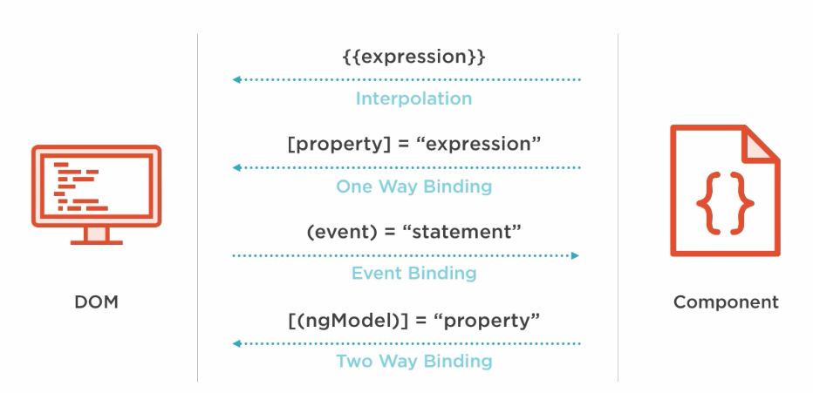
Element Property Binding

Slide 39
Property Binding
A One way Binding
from the component class, to the component’s template.
sets an element property to a component property value.
Can be Used for non-string data value.
Done by wrapping brackets around an element
<img [src]=" imageUrl ">
<button [disabled]='isDisabled'>Try Me</button> // in the template
isDisabled: boolean = true; // in the component class

Slide 40
Event Binding
Event handler are is specified inside the template using ()
Event handler is then coded in the class to process the event.
Can take the same property that is on the HTML element wrap it in parenthesis.
template: `
<h1>My First Angular App</h1>
<img [src]="imageUrl" (click)='myMethod()'> `
imageUrl =‘’assets/images/idly.jpg'
myMethod() {
console.log('Hello);
}

Slide 41
Event Binding
Can also pass information about the event to the component class:
` <img src=“{{imageUrl}}" (click)='myMethod($event)'> `
myMethod(event:any) {
console.log(event);
}

Slide 42
Two Way Binding
Combines the input and output binding into a single notation
Done by using a special directive called ngModel.
<input [(ngModel)]="name" >
<input [ngModel]="name" (ngModelChange)="name=$event">
square braces [..] refers property binding.
circle braces (..) refers to the event binding.
Together as [(..)] refers two way binding
This syntax is called Banana in a Box ([()]).

Slide 43
Two Way Binding- App Module
import { FormsModule } from '@angular/forms';
@NgModule({
declarations: [
AppComponent,
],
imports: [
BrowserModule,FormsModule
],
providers: [],
bootstrap: [AppComponent]
})

Slide 44
Angular 17 Update
import { FormsModule } from '@angular/forms’;
@Component({
imports: [FormsModule]
})

Slide 45
Two Way Binding
<div> <label>Name:</label>
<input type="text" [(ngModel)]="name">
<h1>Hello {{name}}!</h1> </div>
export class AppModule {
private name:string='World';
}

Slide 46
directives

Slide 47
Directives
Used to attach behavior to DOM elements.
Built-in directives to the framework
NgFor, NgIf, NgModel, NgClass
There are three kinds of directives:
Components
@Component(): Is also a directive with a template.
Structural Directives
Can change the DOM layout by adding and removing DOM elements
Attribute Directives
doesn’t change the DOM but can change the appearance or behavior of an element such as NgStyle.

Slide 48
Attribute Directives
These directives change the appearance or behavior of a component.
They work in a way that is component agnostic and not bound to implementation details.
Example:
ngClass and ngStyle work on any component or element.

Slide 49
NgStyle Directive
[ngStyle]
Takes an object with CSS property names as keys and values as values.
Can be used to set multiple styles at once.
Supports property binding, allowing for dynamic style updates.
<div [ngStyle]="{'background-color': 'blue', 'color': 'white'}"> test text </div>
<div [ngStyle]="{'color': item.status === 'active' ? 'green' : 'red'}">
Item status: {{ item.status }}
</div>
[style.<attr>]
Takes a single CSS property value.
Can be used to set a single style attribute.
Supports property binding for dynamic updates.
<div [style.background-color]="'blue'" [style.color]="'white'"> test text </div>

Slide 50
Differences-ngStyle vs style
Multiple styles:
[ngStyle] allows setting multiple styles at once,
[style.<attr>] requires separate bindings for each style attribute.
Object vs. single value:
[ngStyle] expects an object,
[style.<attr>] expects a single value.
Readability and maintainability:
single-style attributes, [style.<attr>] more readable.
Multiple styles or more complex scenarios, [ngStyle]

Slide 51
[ngClass]
Used to add and remove CSS classes on an HTML element.
The CSS classes are updated based on the type of the expression evaluation.
<div [ngClass]=”’border margin’”></div>
Will Apply both the class border and margin to the div tag
<div [ngClass]="{ ‘border': true, ‘margin': false }"></div>
Will Apply only the class border and NOT margin to the div tag
<div [ngClass]="[ 'first', 'second' ]"></div>
Will Apply both the class border and margin to the div tag

Slide 52
Structural Directives
It’s a "syntactic sugar" for tasks that’s done Internally,
* Means angular should create a template element
Expression passed will be bound to the outer <ng-template>
Template will be rendered related to variable passed to the directive
It might add /remove/manipulate the host element and its descendants.
ngIf , ngFor , and ngSwitch .

Slide 53
Built-in Directives –ngIf
*ngif="condition“
<div>
<button (click) =“clicked()”>Toggle</button>
<div *ngIf=“show”>
<p> see Image</p>
</div>
</div>
export class AppComponent{
show:boolean =true;
Clicked (){
this.show=!this.show;
}
}

Slide 54
Build in Directive - ngIf
<button (click)="toggle()">Hide/Show Child </button>
<app-child [image]="selectedImage" *ngIf="showChild"></app-child>
export class ParentComponent {
showChild: boolean = true;
toggle() {
this.showChild = !this.showChild;
}
}

Slide 55
@If
Block conditionally displays its content when its condition expression is truthy:
@if (a > b) {
{{a}} is greater than {{b}}
}
@if (a > b) {
{{a}} is greater than {{b}}
} @else if (b > a) {
{{a}} is less than {{b}}
} @else {
{{a}} is equal to {{b}}
}

Slide 56
@Switch
@switch (color) {
@case ("red") {
<div>Red</div>
}
@case ("blue") {
<div>Blue</div>
}
@default {
<div>Default</div>
}
}
ng generate @angular/core:control-flow

Slide 57
Type of Selectors
Selector type | Description | Examples
Type selector | Matches elements based on their HTML tag name, or node name. | app-profile-photo
Attribute selector | Matches elements based on the presence of an HTML attribute and, optionally, an exact value for that attribute. | [app-table-head ]
Class selector | Matches elements based on the presence of a CSS class. | .app-menu-item

Slide 58
Types of Selector
@Component({ selector: '[app-element]', template: './element.component.html', styleUrls: ['./element.component.css'] })
<div app-element></div>
@Component({ selector: '.app-element', template: './element.component.html', styleUrls: ['./element.component.css'] })
<div class="app-element"></div>

Slide 59
Nesting components

Slide 60
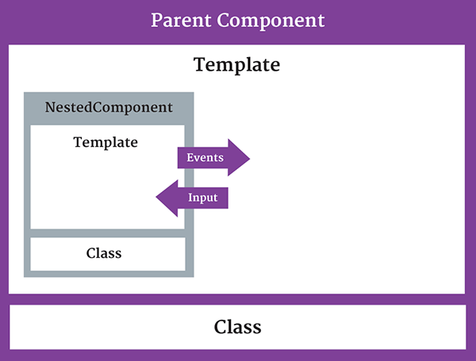
Nested Component
The component being used inside another component is known as the child component
and the enclosing component is known as the parent component.

Slide 61
Nested Component -Child
import { Component } from '@angular/core';
@Component({
selector: 'appchild',
template: `<h2>Hi {{greetMessage}}</h2>` })
export class AppChildComponent {
greetMessage: string = "I am Child";
}

Slide 62
Nested Component- Parent
import {Component } from '@angular/core';
import {AppChildComponent} from './appchild.component';
@Component({
selector: 'my-app',
template: `<h1>Hello {{message}}</h1>
<appchild></appchild> `,
})
export class AppComponent {
message : string = "I am Parent";
}

Slide 63
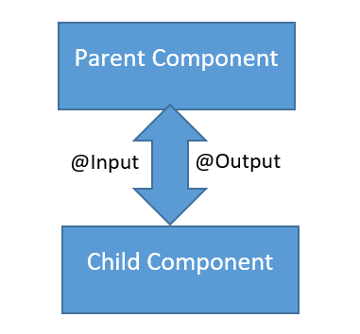
Communication Between Components
Can share data and information with another component by passing data or events.
Components can communicate to each other in different ways:
Using @Input()
Using @Output()
Using Services
Parent component calling ViewChild

Slide 64
PASSING DATA USING @Input
To pass data into components from template and to dynamically configure them.
Supports change tracking.
Can NOT pass @Input() to a bootstraped component.
Binds a property within one component (child component) to receive a value from another component (parent component).
One way communication from parent to child.
Component property should be annotated to act as input property.

Slide 65
Child Component
import { Component,Input,Output,EventEmitter, OnInit } from '@angular/core';
@Component({
selector: 'review-food',
templateUrl:'reviews.component.html',
styleUrls: ['../food-items/food/food.component.css']
})
export class ReviewsComponent {
@Input() reviewedby:string=‘’;
details='Reviewed by 200 peoples';
}

Slide 66
Parent Component-One Way Component Property Binding
import { ReviewsComponent } from '../../reviews/reviews.component';
@Component({
selector: 'app-food',
templateUrl: './food.component.html',
styleUrls: ['./food.component.css'],
})
export class FoodComponent {
reviewer:string = 'Zomoto';
}
Reviwed by <review-food [reviewedby]='reviewer'></review-food>
Parent component sets the value of the child component’s property
Input Property as defined in Child
Bound property in Parent

Slide 67
@Input Required
@Input({required:true}) heading :string=‘’
@Input({alias:'customprop',required:true}) heading :string=‘’
@Input alias
Don’t want let use the same property name outside the component to bind to that property.
<app-showproduct [customprop]='majHeading'></app-showproduct>
<h1>{{heading}}</h1>

Slide 68
@output
One way communication from child to parent component
Uses events
binds a property of a component to send data from one component (child component) to calling component (parent component).
The child component exposes an EventEmitter property
It emits events when something happens.
The parent binds to that event property and reacts to those events.
The child's EventEmitter property is an output property,
Its adorned with an @Output decoration
@Output()
sendMsgEvent = new EventEmitter<string>();
sendMsgEvent will be custom event name.

Slide 69
Child Component
import { Component,Input, Output,EventEmitter,OnInit } from '@angular/core';
export class ChildComponent implements OnInit {
@Input() childName: string;
@Output() result: EventEmitter<string> = new EventEmitter<string>();
constructor() { }
ngOnInit() { }
addData(){
this.result.emit(this.childName + 'Added');
}
}
Property placeholder to receive from parent
Property To Parent

Slide 70
Emit
emit()
emit a change to (change) listener in the parent
Which will invoke the onchange($event) callback
The data associated with the event will be given via the $event property.
Child-Component.html
<p>
<button (click)="addData()">Add Medicine</button>
</p>

Slide 71
Parent-component.html
<input type="text" name='user' [(ngModel)]='name'>
<p>
<app-child [childName] ={{name}} (result)="onChange($event)"></app-child>
{{msg}}
</p>
childName : refers to @Input Property in to Child Component
name : refers to property in the Parent Component
Result : refers to @output Property in Child Component

Slide 72
Parent Compnent
import { Component, OnInit, SimpleChanges } from '@angular/core';
@Component({
})
export class ParentComponent implements OnInit {
msg: string;
name: string;
constructor() { }
ngOnInit() {
}
onChange(val) {
this.msg = val;
}
}

Slide 73
Child Components
export class GuestPhotosComponent implements OnInit {
guestPhoto: string;
constructor() {
this.guestPhoto = 'assets/images/frntView.jpg';
}
}
export class HotelPhotosComponent implements OnInit {
hotelPhoto: string;
constructor() {
this.hotelPhoto = 'assets/images/rearView2.jpg';
}
}

Slide 74
Parent Template
<app-guest-photos></app-guest-photos>
<app-hotel-photos></app-hotel-photos>
<img src={{gp}} alt='hello'>
<img src={{hp}} alt='style'>

Slide 75
Life Cycle hooks

Slide 76
Lifecycle Hooks
Components have lifecycle managed by Angular.
Provide visibility into life moments
Can act when they occur.
Represented by interfaces which is optional .
Hook methods are called if they are defined.
Life Cycle Hooks are Called
When Angular Creates ,renders its children,
While checking its data-bound properties change,
While destroying and before removing from the DOM.

Slide 77
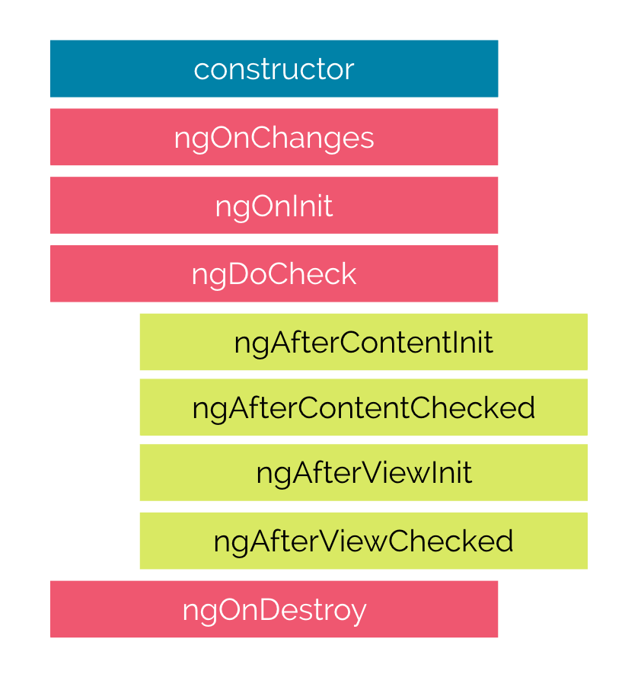
Lifecycle Hooks

Slide 78
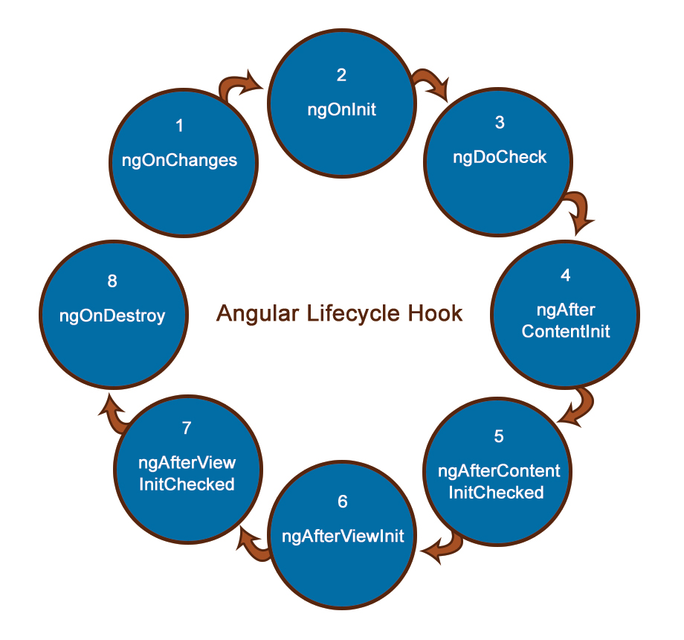
Life cycle Sequence

Slide 79
Constructors
Invoked when a component or directive are created by calling new on the class.
A typescript feature and used only for a class instantiations
Has nothing to do with Angular
JavaScript engine calls the constructor, and not directly by Angular
Its called first time before the ngOnInit().
Dependencies Required for the Component are Injected through Constructor

Slide 80
ngOnInit()
Called after the first ngOnChanges, but only once.
Fires when the component is ready for use when all queries (content child and view child queries) and inputs have been resolved.
It’s the place to perform complex initializations shortly after construction;
Can fetch or set initial data
@Input() properties are available inside ngOnInit
Added to every component by default by the Angular CLI.

Slide 81
ngOnDestroy()
ngAfterContentInit:
Content is what is passed as children
Its projected at some <ng-content> element of a component.
Its called after external content has been projected into the component.
ngOnDestroy
Used to clean up any necessary code when a component is removed from the DOM.
Used to unsubscribe from things like services.

Slide 82
Services

Slide 83
Dependency Injection
The ability to add functionality to components at runtime.
Simplify dependency management in software components.
Done by reducing the amount of information a component needs to know about its dependencies,
unit testing can be made easier and code is more likely to be flexible.

Slide 84
Services
A service is used when a common functionality needs to be provided to various modules.
Eg: A database functionality that could be reused among various modules.
A separate class which has the injectable decorator
ng g service my-new-service
Can also be added to the module to use the service as a provider in the @Component decorator.
Services are singleton objects.
Services are capable of returning the data in the form promises or observables.

Slide 85
@Injectable
@Injectable()
Let know a class can be used with the dependency injector.
Not strictly required if the class has other Angular decorators on it.
Best practice is to decorate injectables with @Injectable(), as it is makes more sense to the reader.
providedIn: 'root‘
Indicates that the root injector is responsible for creating an instance
These are automatically made available to the entire application
Don't need to be listed in any module.

Slide 86
Service
import { Injectable } from '@angular/core';
@Injectable({
providedIn: 'root'
})
export class MedicineService {
medicines: Medicine[] = [{id:101, medicineName : ‘crocin'}, {id:102, medicineName : metacin'}];
constructor() { }
getMedicines(){
return this. medicines
}
}

Slide 87
Injecting the Service
Register Has a provider in app-module.ts
providers: [MedicineService],
Injected into the Component through Constructor
export class ShowComponent {
details:Medicine [];
constructor(medicineService : MedicineService) {
this.details = medicineService. getMedicines();
}
Access it in the template <li *ngFor="let eachDetail of details">{{eachDetail. medicineName}}</li>

Slide 88
pipes

Slide 89
Pipes
“Pipes transform displayed values within a template.”
A pipe takes in data as input and transforms it to a desired output.
Used in any template.
Inside the interpolation expression, pipe operator ( | ) is used
Expression | pipeOperator[:pipeArguments]

Slide 90
Passing arguments
Can pass optional arguments to the pipe.
Arguments are added to the pipe using a colon (:) sign followed by the value of the argument.
Multiple arguments can be separated colon (:).
Date pipe accepts one optional argument called “format”.
{{toDate | date:'medium'}}
Nov 22, 2016, 10:04:10 PM
Pipes can be chained together with useful combinations.
{{ birthday | date:'fullDate' | uppercase}}

Slide 91
Built In Pipes
DatePipe,
UpperCasePipe, LowerCasePipe,
CurrencyPipe,
PercentPipe,
JsonPipe,
Some of pipes not supported in New versions of Angular 2
orderBy and filter
Can by achieved by using “custom pipes”.

Slide 92
Date Pipe
date_expression | date[:format]
format indicates which date/time components to include.
'medium': equivalent to 'yMMMdjms' (e.g. Sep 3, 2010, 12:05:08 PM for en-US)
'fullDate': equivalent to 'yMMMMEEEEd' (e.g. Friday, September 3, 2010 for en-US)
'mediumDate': equivalent to 'yMMMd' (e.g. Sep 3, 2010 for en-US)
'mediumTime': equivalent to 'jms' (e.g. 12:05:08 PM for en-US)
'shortTime': equivalent to 'jm' (e.g. 12:05 PM for en-US)

Slide 93
Decimal Pipe
To format a number as decimal number according to locale rules.
It uses number keyword with pipe operator.
number_expression | number[:digitInfo]
number_expression:
An angular expression that will give output a number.
number :
A pipe keyword that is used with pipe operator.
digitInfo :
Defines number format. {minIntegerDigits}.{minFractionDigits}-{maxFractionDigits}
{{450.997 | number:'3.2-2'}} // 451.00
{{450.992 | number:'3.2-2'}} // 450.99

Slide 94
Currency Pipe
currency [ : currencyCode [ : display [ : digitsInfo [ : locale ] ] ] ] }}
currencyCode is the ISO 4217 currency code,
USD for the US dollar and EUR for the euro.
display
code: Show the code (such as USD).
symbol(default): Show the symbol (such as $)
String: Use the given string value instead of a code or a symbol.
digitInfo
<p> {{salary | currency:‘USD':'symbol':'4.2-2‘ : ‘fr’}}</p>

Slide 95
Percentage Pipe
Formats a number as a percentage according to locale rules.
number_expression | percent[:digitInfo]
number_expression:
An angular expression that will give output a number.
percent :
A pipe keyword that is used with pipe operator and it converts number into percent
digitInfo:
defines a percentage format.
{minIntegerDigits}.{minFractionDigits}-{maxFractionDigits}

Slide 96
Customizing angular

Slide 97
Decorator
A decorator is a programming design pattern in which wrap to change its behaviour.
Decorators are used to annotate and modify class declarations, methods, properties, accessors, and parameters.
TypeScript 5.0 introduces the new implementation of decorator support, which aligns with the ECMAScript stage three proposal.
The second important difference between decorators in JavaScript and TypeScript is type checking.

Slide 98
Types of Decorator
Class Decorator:
Receives the class constructor.
Property Decorator:
Receives the prototype and property name. Cannot modify descriptor directly.
Method Decorator:
Receives the prototype, method name, and descriptor (lets you override/wrap the method).
Parameter Decorator:
Receives the prototype, method name, and parameter index.

Slide 99
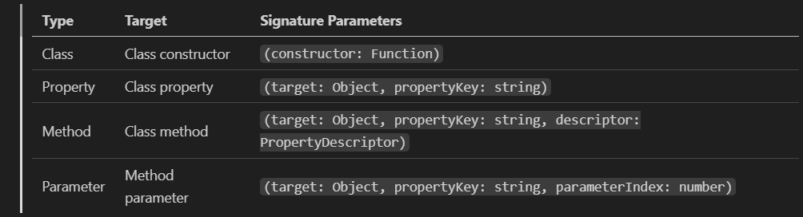
Type of Decorators

Slide 100
Class Decorator
Applied to the constructor of the class
Used to observe, modify, or replace a class definition.
export function LogClass(constructor: Function) {
console.log('Class created: ========', constructor.name);
}
@LogClass
class User{. }

Slide 101
Method Decorator
export function MyMethodDecorator(target: Object, propertyKey: string, descriptor: PropertyDescriptor) {
const original = descriptor.value;
descriptor.value = function (...args: any[]) {
console.log(`Calling ${propertyKey}`, args);
return original.apply(this, args);
};
return descriptor;
}

Slide 102
Decorator Factories
TypeScript function that returns a decorator.
Used to parameterize decorator
Pass arguments to customize its behavior.
Function that returns a function:
A decorator factory is a function that, when called, returns the actual decorator function.
Parameterization:
The outer function (the factory) can accept parameters, which are then used by the inner function (the decorator) to modify its behavior.
Customization and Reusability:
This allows for highly customizable and reusable decorators, as the same decorator logic can be applied with different configurations.

Slide 103
Field Decorator
export function DefaultValue(val: any) {
return function (target: any, propertyKey: string) {
let value = val;
Object.defineProperty(target, propertyKey, {
get: () => value,
set: v => (value = v),
});
};
}
@DefaultValue("Default Message")
info!: string;

Slide 104
Parameter Decorator
export function MyParamDecorator(target: Object, propertyKey: string, parameterIndex: number) {
console.log(` *****. ***** Parameter ${parameterIndex} in method ${propertyKey.valueOf}`);
}

Slide 105
Debounce Decorator
export function Debounce(ms: number) {
return function (target: any, propertyKey: string, descriptor: PropertyDescriptor): PropertyDescriptor {
const original = descriptor.value;
let timeoutId: ReturnType<typeof setTimeout>;
descriptor.value = function (...args: any[]) {
timeoutId = setTimeout(() => {
original.apply(this, args);
}, ms);
};
return descriptor;
};
}

Slide 106
Adding Debounce Decorator
@Debounce(3000)
onSearch(query: string) {
console.log('I waited for 300 ms to do nothing.... !'+query);
}
display(firstName:string): string{
console.log("Hello from Trial Component"+firstName);
this.onSearch("Test");
return "Hello ${'firstName'} from Trial Component";
}

Slide 107
Decorator Evaluation
Order how decorators applied to various declarations inside of a class are applied:
Parameter Decorators, followed by Method, Accessor, or Property Decorators are applied for each instance member.
Parameter Decorators, followed by Method, Accessor, or Property Decorators are applied for each static member.
Parameter Decorators are applied for the constructor.
Class Decorators are applied for the class.

Slide 108
Directives
Directives are classes that add additional behavior to elements
Custom directives to enhance the functionality of HTML elements to build reusable components.
They are used to modify the behavior or change the characteristics of an elements in the application.
Reused throughout your angular application.
Three types of directives:
structural, attribute and components.

Slide 109
Custom Directives
ng generate directive [name]
The class is decorated with the Directive decorator
specifies a selector which will be looked up in views.
The Class has a constructor which takes two arguments
ElementRef and Renderer
constructor(private el: ElementRef, private renderer: Renderer2) {}

Slide 110
Element Reference
ElementRef
A wrapper for the actual DOM element
Can Uses its property nativeElement to access DOM Elements
el.nativeElement.style.backgroundColor = "gray";
Renderer2
A platform independent way of setting properties on elements
Can create element, provide a text and then it can be appended with any existing element at run time on any event of an element.
Can add and remove CSS classes, styles, HTML attributes

Slide 111
Renderer
Methods of Renderer2 service.
setStyle() :
To set a CSS style for an element in the DOM.
createElement():
Creates element such as <div>, <ul>, <li> etc.
createElement(name: string, namespace?: string|null): any
appendChild():
Appends new element to any existing
element.appendChild(parent: any, newChild: any): void

Slide 112
Simple Directive
@Directive({
selector: '[appRoundBorder]'
})
export class RoundBorderDirective {
@Input('appRoundBorder') borderRadius:string=‘’
constructor(private elementRef: ElementRef,private renderer:Renderer2){ }
ngOnInit(): void {
this.renderer.setStyle(this.elementRef.nativeElement, 'border-radius’, this.borderRadius);
}
}
<p appRoundBorder="10px" style="border:2px solid blue;">

Slide 113
Directives with Host Listeners
Used to specify the DOM events a directive listens
event:
DOM event that the directive listens to.
statement:
Statement to execute when the event occurs.

Slide 114
@HostListener
Used to Listen to the event emitted by host element in a Directive
Will the Invoke the decorated method when the host element emits the specified event.
@ HostListener('click') myClick(){ }
Equivalent to (click)="myClick()"

Slide 115
@HostListener
@HostListener('mouseover') over():void{
this.renderer.addClass(this.element.nativeElement, 'increase');
}
@HostListener('mouseout') out(){
this.renderer.removeClass(this.element.nativeElement, 'increase' );
}

Slide 116
Directive and Components
@Components
@Directive
To register the components.
To create UI widgets.
To split to application into smaller parts.
Only one component is used per DOM element.
template and templateUrl are mandatory in the components.
To register the directives.
To Change or add existing DOM elements.
To design a reusable components.
More than one directive are used per DOM element.

Slide 117
RXJs

Slide 118
*R*eactive E*x*tensions for *J*ava*S*cript
A stream in the RxJS represents values over time
A library for composing asynchronous and event-based programs by using observable sequences.
Observable
A function that produces a stream of values to an observer over time.
Observer
Observer is the one which subscribes to an observable
Read values coming from an observable.
An observer has three callbacks that accept notifications coming from the observer,
Next ,error,complete

Slide 119
RxJS
The create() method accepts a single argument subscribe function.
This subscribe function accepts an observer argument.
import {Observable} from 'rxjs';
ngOnInit(): void {
const obs = Observable.create((observer: any) => {
observer.next('Will be sent');
observer.next('This too will be sent');
observer.complete();
observer.next('Will not be sent');
});
obs.subscribe((x: any) => console.log(x));
}

Slide 120
HttpClient
Introduced in the Angular 4.3.
Available in package @angular/common/http
To replace the older HttpModule.
The Response returned from the HttpClient is an observable
Needs to be Subscribed.
The response can be converted to desired object

Slide 121
Http Client Module
import {HttpClientModule, HttpClient} from '@angular/common/http';
@NgModule({
declarations: [
AppComponent,
],
imports: [
BrowserModule ,HttpClientModule],
providers: [HttpClient],
bootstrap: [AppComponent]
})
export class AppModule { }

Slide 122
Angular 17 Update
HttpClient is provided using the provideHttpClient helper function
app.config.ts.
export const appConfig: ApplicationConfig = {
providers: [
provideHttpClient(),
]
};

Slide 123
HttpClient
get() :
parses the JSON server response into the anonymous Object type.
Can specify the type of response to make consuming the output easier and more obvious.
this.http.get<Medicine[]>(this.baseURL)

Slide 124
Get Method
@Injectable( { providedIn: 'root‘ }
)
export class MedicineApiService {
constructor(private http: HttpClient) { }
baseURL = 'http://localhost:3000/medicines';
findAll(): Observable<Medicine[]> {
return this.http.get<Medicine[]>(this.baseURL);
}
}

Slide 125
Subscribe()
.subscribe(success, failure, completed);
Success:
Whenever observable returns a value.
(response) => { this.repos=response; }
Failure:
When observable is failed to generate the expected data or has encountered some other error.
(error) => {this.errorMessage=error; this.loading=false; },
Completed:
When the observables complete its task.
() => {this.loading=false;})

Slide 126
Subscribing
@Component({
selector: 'app-crud',
templateUrl: './crud.component.html',
styleUrls: ['./crud.component.css']
})
export class CrudComponent implements OnInit {
medList: Medicine[]
constructor(private service: MedicineApiService) { }
ngOnInit() {
this.service.findAll()
.subscribe(data => this.medList = data, err => console.log(err));
}
}

Slide 127
Angular 17 Update
Angular uses the modern fetch Api over XHR
provideHttpClient(withFetch())
Inject using the inject method rather than Constructor
httpClient = inject(HttpClient);
Subscribe old version is deprecated
ngOnInit(){
this.service.getTasks().subscribe({ next: data => this.data=data,
error: err =>console.log(err),
complete:() =>console.log('completed')
}
)}

Slide 128
HttpResponse
Can provide observe option to specify return data type
By default, observe is set to body.
response which returns the full response
events which returns the full event stream
findAll(): Observable<HttpResponse<Object> {
return this.http.get<Object>(this.baseURL, {observe: 'response'});
}
this.service.findAll().subscribe(resp => {
this.weekEndTripList = <Weekendtrip[]> (resp.body);
console.log(resp.status);
console.log(resp.headers.get('content-type'));
});

Slide 129
Using Promise
findAllWithPromise(): Promise<Medicine[]> {
return this.http.get<Medicine []>(this.baseURL).toPromise();
}
Can use in the Component
this.service.findAllWithPromise().then(
res => this.medicineList = res ).catch(
err => console.log(err.error));

Slide 130
Post and Delete Method
add(medicine): Observable<Medicine> {
const headers =
new HttpHeaders().set('content-type', 'application/json');
return this.http.post<Medicine>(this.baseURL, medicine, {headers});
}
remove(codeNumber): Observable<Medicine> {
return this.http.delete<Medicine>(this.baseURL + '/' + codeNumber);
}

Slide 131
Delete Method
remove(loan: LoanCustomer): Observable<LoanCustomer> { const headers = new HttpHeaders().set('content-type', 'application/json'); return this.client.request<LoanCustomer>('Delete', this.baseURL, { body: loan, headers}); }

Slide 132
Making Multiple Calls
callMoreThanOneAPI(){
forkJoin({
callOne:this.http.get(""),
callTwo:this.http.get(""),
}).subscribe({
next:(data)=>{
this.first = data.callOne
this.second = data.callTwo
}
})
}

