Slide 1
FORM HANDLING

Slide 2
Forms
Simple Certain web applications
Can also become really complex.
  When it has to modify data, both on the page and the server
  Values Changes need to be reflected elsewhere on the page
  Need to validate values
  The UI needs to clearly state expectations and errors, if any
  Dependent fields can have complex logic
  To test forms, without relying on DOM selectors

Slide 3
Angular Forms
Need to import the following Modules
  ReactiveFormsModule
  FormsModule.
Reactive -Model Driven Forms
  Models are created on the component
  Then used in the directives to map elements in the template to form model.
Template Driven Forms
  A Special type of Model Driven Form
  Driven by directives in the template versus code in the component.
  Directives are used to create the model.

Slide 4
TEMPLATE DRIVEN FORMS

Slide 5
Template-driven forms
Created by placing HTML form controls in the component template
  Component are bound to data model properties using directives like ngModel and NgForm
The FormGroups and FormControls are created by directives added to the template.
The template does the work under the scenes.
No need push and pull data values.
  Handled with ngModel.
  Less code in the component class,

Slide 6
Binding Template to Model
Data binding is done by a domain model defined via a class,
  Its not done to a simple string or object on component
There are three different ways to use ngModel
Two Way Binding - [(ngModel)]
  Used for reading and writing input control values.
  The input field takes an initial value from the bound component class
    Updates it back whenever any change to value is detected
  Maintain the state in domain model as well as in the Form

Slide 7
Submitting the form
Done By using ngSubmit directive
  <form #f="ngForm"
  (ngSubmit)="onSubmit(f.value)"
The # to create a local variable for this view an alias to ngForm
Can revent the form being submitted when the form is invalid.
<button type="submit“ [disabled]="f.invalid">Submit</button>

Slide 8
Model
  export interface User{
  userName: string;
  password:string;
  }

Slide 9
Controller
  export class LoginComponent {
  user:User={userName:'',password:'',}
  constructor(private router:Router){ }
  onSubmit(){
  if (this.user.userName === 'india' && this.user.password === 'delhi') {
  sessionStorage.setItem('status', 'logged');
  this.router.navigate(['order']);
  }
  }
  }

Slide 10
Template Form
  <form method="post" (ngSubmit)="onSubmit()" #loginForm="ngForm">
    <label>UserName</label>
    <input type="text" [(ngModel)]="user.userName" required="required" name="userName">
    <label>Password</label>
    <input type="password" [(ngModel)]="user.password" required="required" name="password">
    <input type="submit" value="Login">
  </form>

Slide 11
Rendering Options in Template
Component Class
  langs: string[] = [ 'English', 'French', 'German', ]
Template :
  <select name=“lang">
    <option value="">Please select a language</option>
    <option *ngFor="let lang of langs" [value]="lang"> {{lang}} </option>
  </select>

Slide 12
Resetting the form
Forms Model is accessible in template and not in component.
ViewChild :
  Gives a reference to component for something in template.
  Components use this to get a reference of form
  import { ViewChild } from '@angular/core';
  @ViewChild('loginForm') form: any;
  reset(){
  this.form.reset();
  }

Slide 13
VALIDATION

Slide 14
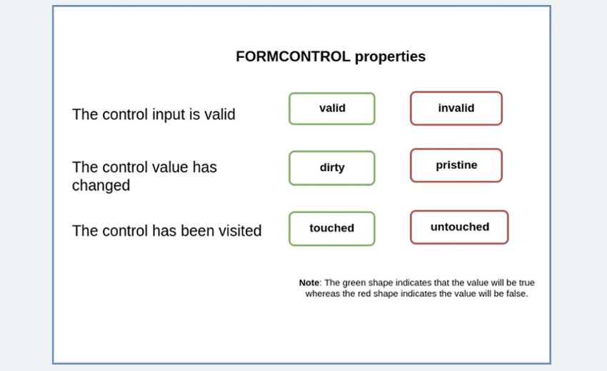
Validation
Angular tracks three form field states
  Applies CSS classes to both the form and its controls:
  touched or untouched
  valid or invalid
  pristine or dirty

Slide 15
Validation With Form and Two Way Binding
  <form #f="ngForm“ (ngSubmit)="save(f.value, f.valid)">
  <input type="text" name="name" [(ngModel)]="user.name"
  #name="ngModel" required minlength="5">
  <small [hidden]="name.valid || (name.pristine && !f.submitted)">
  Name is required (minimum 5 characters).
  </small>
  </form>

Slide 16
Update Mode Options for Template Driven forms
Can Define the event upon which the form control value and validity will update.
  Improves performance by delaying form control updates until the blur or the submit event.
    Updating on every keystroke can sometimes be too expensive.
  Can be set to blur , or submit
  Default is change
  Can be set for each Form control or for the whole form
  <input type="text" [(ngModel)]="user.userName" name='userName' required [ngModelOptions]="{ updateOn: 'blur' }">
  <form #newUserForm="ngForm" (ngSubmit)="onSubmit(newUserForm)" [ngFormOptions]="{updateOn: 'blur'}"> ... </form>

Slide 17
Template Driven Forms
  <form #frm='ngForm' (ngSubmit)='submit()' novalidate>
  <label for="">UserName</label>
  <input type="text" [(ngModel)]="user.userName" name='userName' required [ngModelOptions]="{ updateOn: 'blur' }">
  <pre>Valid? {{frm.controls.userName?.valid}}</pre>
  </form>
  {{user |json}}.

Slide 18
REACTIVE -MODEL DRIVEN FORM

Slide 19
Model Driven Forms
Forms are represented as a composed instances of FormGroups and FormControls.
FormControl
  Basic building blocks
  represents a single input field
  Encapsulate the field's value, and states such as if it is valid, dirty (changed), or has errors.
FormControls can be nested inside FormGroups

Slide 20
Form Group
FormGroup is a collection/group of FormControls.
  Api’s for tracking validity and values of the whole formGroup.
  Encapsulates the state of all of it’s inner controls
  Valid only if all of it’s inner controls are also valid.
Values are received as an object with key-value pairs.
  Eliminates the need to iterate over each FormControl

Slide 21
Model Driven Forms
class ModelFormComponent implements OnInit {
  myform: FormGroup;
  duration: string[];
  constructor() {
  this.duration = [ 'One Week','One Month','Six Month',];
  }
  onSubmit(){
  console.log(this.myform.value);
  }

Slide 22
Model Driven Forms
  ngOnInit() {
  this.myform = new FormGroup(
  { name: new FormGroup(
  {firstName: new FormControl(),
  lastName: new FormControl(),
  }),
  email: new FormControl(),
  duration: new FormControl(),
  password: new FormControl()
  });
  }

Slide 23
Mode Driven Template
  <form [formGroup]="myform" (ngSubmit)="onSubmit()">
  <fieldset formGroupName='name'>
  <input type="text" formControlName="firstName" required>
  <input type="text" formControlName="lastName" required>
  </fieldset>
  <input type="email" formControlName="email" required>
  <input type="password" formControlName="password" required>
  <select formControlName="duration">
    <option *ngFor="let eachEntry of duration"
    [value]="eachEntry">{{eachEntry}}
    </option>
  </select>
  <input type='submit' value="submit">
  </form>

Slide 24
Form Builder
A "factory" object.
Injected to the constructor of component class:
  Uses formGroup and formControl directives
FormGroups are created with a map of configuration.
  Valid keys can be the extra parameter

Slide 25
Form Array
Represents an array of FormControls.
It is used to manage a collection of similar form controls
  Used when number of controls is dynamic and can change at runtime.
Dynamic Forms:
  Used to add or remove form fields dynamically, such as a list of phone numbers, skills, or items in a shopping cart.
Collection of Controls:
  It aggregates the values and validity state of its child controls into an array.
  Each child control can be a FormControl, a FormGroup, or even another FormArray.

Slide 26
Form Array
Indexed Access:
  FormGroup uses key-value pairs,
  FormArray stores controls as elements in an array, can access by their index.
Manipulation Methods:
  Provides methods like push(), insert(), removeAt(), and at()
  For add, insert, remove, and retrieve controls within the array.
Template Integration:
formArrayName
  Directive on a container element
  Iterate over the controls property *ngFor to dynamically render the individual form elements.
  The formControlName directive on the input elements is set to the index of the control within the array.

Slide 27
Form Array Definition
  export class CustomerComponent {
  userForm!: FormGroup;
  phoneNumbers: this.formBuilder.array([
  this.formBuilder.control('', [
  Validators.required,
  Validators.pattern(/^\d{10}$/),
  ]),]),});
  }

Slide 28
Form Array Definition
  get phoneNumbers(): FormArray {
  return this.userForm.get('phoneNumbers') as FormArray;
  }
  addPhoneNumber() {
  this.phoneNumbers.push(
  this.formBuilder.control('', [
  Validators.required,
  ])
  );
  }
  removePhoneNumber(index: number) {
  this.phoneNumbers.removeAt(index);
  }

Slide 29
Form Array in Template
  <div formArrayName="phoneNumbers">
  <div *ngFor="let phoneNum of phoneNumbers.controls; let i = index">
  <label>Phone Number {{ i + 1 }}</label>
  <input type="text" [formControlName]="i" />
  <button type="button" (click)="removePhoneNumber(i)">Remove</button>
  </div>
  </div>
  <div>
  <button type="button" (click)="addPhoneNumber()">Add Phone Number</button>
  </div>
  <div>
  <button type="submit" [disabled]="!userForm.valid">Submit</button>
  </div>

Slide 30
Validators
Can be defined by directives and HTML5 attributes in template
  <input type="email“ name="email" [(ngModel)]="model.email" required>
Angular built-in validators.
  Validators.required
  Validators.minLength
  Validators.maxlength
  Validators.pattern
Assigned to the FormControl object
  Can Check the status of the validator in the view and take action accordingly

Slide 31
Custom Validator
Apart from the built-in validators can have custom validators too
Can access control’s value and validity
  import { AbstractControl } from '@angular/forms';
  export function hasExclamationMark(input: AbstractControl) {
  const hasExclamation = input.value.indexOf('!') >= 0;
  return hasExclamation ? null : { 'needsExclamation': true };
  }

Slide 32
Form Builder
  bookFrm: FormGroup;
  constructor(private frmBuilder: FormBuilder) {
  this.bookFrm = this.frmBuilder.group({
  'bookName': ['', Validators.required],
  'author': ['', Validators.required],
  'city': ['', [Validators.required , hasExclamationMark]]
  });
  }
  submit(){
  console.log(this.bookFrm.value);
  }
  First Argument is initial value which is empty and the second is the validation

Slide 33
Validation
  <form [formGroup]="bookFrm" (ngSubmit)='submit()' class="form" novalidate>
  <input type="text" formControlName="bookName" class="form-control">
  <div *ngIf="bookFrm.controls.bookName.invalid && bookFrm.controls.bookName.touched"> Book Name is Required </div>
  <input type="text" formControlName="author" class="form-control">
  <div *ngIf="bookFrm.controls.author.invalid">Error</div>
  <input type="text" formControlName="city" class="form-control">
  <div *ngIf="bookFrm.controls.city.invalid">city should have exclamation</div>
<input type="submit" value='submit' class="btn btn-info">
</form>
{{bookFrm.value | json}}.

Slide 34
Http with Authorization
import { HttpHeaders } from '@angular/common/http';
  const httpOptions = {
  headers: new HttpHeaders(
  {
  'Content-Type': 'application/json',
  'Authorization': 'Basic ' + btoa('username:password')
  }
  )
  };
return this.http.get<AObjects[]>(this.postsURL, httpOptions);

Slide 35
ROUTING

Slide 36
Routing
Used for navigation from one view to the next as users perform application tasks.
  The browser is a familiar model of application navigation:
A router is bound to links on a page and it will navigate to the appropriate application view when the user clicks a link.
  “router“ can interpret a browser URL to a client-generated view.
  Can pass optional parameters to display specific content
  Logs activity in the browser's history journal
  Back and forward buttons work
  Used to Implement modular applications
  Implement the application based on the roles

Slide 37
RouterModule
Router module must be specified in the list of imports of the app module.
  import { RouterModule, Routes } from '@angular/router';
Two Locations where Routing can be defined
  Main application module
  A separate module for routing alone
    Need to create a app.routing.ts file inside the src/app folder.
Separate Routing Module can be created by two ways
  ng new app-name –routing
  ng generate module –routing

Slide 38
Route Configuration -Attributes
path
  URL to be shown in the browser when application is on the specific route
component
  component to be rendered when the application is on the specific route
redirectTo
  redirect route
  Route can have either component or redirect attribute
pathMatch
  optional property that defaults to 'prefix'; determines whether to match full URLs or just the beginning.
  When defining a route with empty path string set to 'full',
    Else matches all paths.

Slide 39
Router Module
RouterModule.forRoot()
  A provider for registering routes.
  Creates a module with all the router directives
  enableTracing : makes the router log all its internal events to the console.
  useHash enables the location strategy that uses the URL fragment instead of the history API.
  RouterModule.forRoot([
  { path: '', redirectTo: 'home', pathMatch: 'full' },
  { path: 'home', component: HomeComponent },
  { path: 'login', component: LoginComponent },
  { path: 'registration', component: RegistrationComponent },
  { path: '**', redirectTo: 'home' }
  ])

Slide 40
Angular17 –Router Set up
The Angular CLI performs this step automatically.
It creates a file app.routes.ts, update the Route configuration
  const routes:Routes = [
  { path: '', redirectTo: 'home', pathMatch: 'full' },
  { path: 'home', component: HomeComponent },
  { path: 'login', component: LoginComponent },
  { path: 'registration', component: RegistrationComponent },
  { path: '**', redirectTo: 'home' }
  ]

Slide 41
Routing Order
Routes are configured in a correct order.
  There is no notion of route precision.
  When a match is found, stops processing the configuration.
  A wildcard route as the first route would always be matched.
  They need as the last route r configuration.

Slide 42
Router-link Directrive
Directive is use to declare link into view instead of href in the <a> tags,
Can pass an expression ,with an array containing URL path
Can contains optional parameters also.
  <a routerLink="">Home</a>
  <a [routerLink]="['lessons']">Lessons</a>
routerLinkActive:
  To add a CSS class to an element when the link's route becomes active.

Slide 43
Router-outlet directive:
To render the components for specific location of the applications.
Both the template and templateUrl render the components
  <router-outlet></router-outlet>

Slide 44
ROUTER GUARDS

Slide 45
Router Guards
Traditional server side applications would check permissions on the server
  if the user didn’t have permissions, and return a 403 error page
  May redirect to a login/register page.
Angular can implement the same functionality with Router Guards
Router Guards
  can prevent users from accessing areas that they’re not allowed to access,
  Can also ask them for confirmation when leaving a certain area.

Slide 46
Guard Types
User must login or authenticate
User has logged in but is not authorized to navigate to the target component.
User has to confirm if it’s OK to discard pending changes rather than save them.
For a given route we can implement zero or any number of Guards.

Slide 47
Types of Guards:
CanActivateChecks
  to see if a user can visit a route.
CanActivateChildChecks
  to see if a user can visit a routes children.
CanDeactivateChecks
  to see if a user can exit a route.
CanDeactivate() and CanActivateChild() guards are always checked first.
The checking starts from the deepest child route to the top.
If any one of the guards returns false, then the entire navigation is canceled.

Slide 48
Implementing a Guard
Ng g g universalGuard
Guards are implemented as services
  With @Injectable Decorator
  Return either true if the user can access a route or false if they can’t.
  Can also return an Observable or Promise that later on resolves to a boolean
Build the Guard as Service.
Implement the Guard Method in the Service
Register the Guard Service in the Root Module
Update the Routes to use the guards

Slide 49
Guard function parameters
The guard function takes arguments:
component: Component reference to the component
ActivatedRouteSnapshot
  url: UrlSegment[]
  params: Params
  queryParams: Params
RouterStateSnapshot
  Represents the state of the router at a moment in time.
  A tree of activated route snapshots.
  Node in the tree knows about the "consumed" URL segments,
  They also know the extracted parameters, and the resolved data.

Slide 50
Configuring Guards
  const routes: Routes = [
  {path: 'donor', component: DonarComponent, canActivate: [UniversalGuard]},
  {path: 'donor/:id', component: DonarComponent, canActivate: [UniversalGuard]},
  {path: 'request', component: BloodRequestComponent, canDeactivate: [UniversalGuard]},
  {path: '**', redirectTo: 'login'}
  ];

Slide 51
Auth Service
  @Injectable({
  providedIn: 'root'
  })
  export class AuthService {
  constructor() { }
  hasAccess():boolean {
  return sessionStorage.getItem('status')==='logged'?true:false;
  }
  }

Slide 52
Universal Guard
  import { ActivatedRouteSnapshot, CanActivateFn, RouterStateSnapshot } from '@angular/router';
  import { AuthServiceService } from './auth-service.service';
  import { inject } from '@angular/core';
  export const universalGuard: CanActivateFn =
  (route:ActivatedRouteSnapshot, state:RouterStateSnapshot) => {
  return inject(AuthService).hasAccess();
  };

Slide 53
Deactivate Guard
  export const canDeactivateGuard: CanDeactivateFn<LoginComponent> = (component: LoginComponent) => {
  if(component.form.dirty){
  return window.confirm('You have not submitted -Exit ? ');
  }
  return window.confirm('Are you Sure ...');
  }

Slide 54
ROUTING WITH PARAMETERS

Slide 55
Declaring Route Parameters
  const routes: Routes = [
  {path:'',redirectTo:'login',pathMatch:'full'},
  {path:'player',component:PlayersComponent},
  {path:'player/:name',component:PlayersComponent},
  {path:'login',component:LoginComponent},
  {path:'**',redirectTo:'sponsor'}
  ];

Slide 56
Linking to Routes with Parameters
RouterLink directive passes an array which specifies the path and the route parameter.
  <tr *ngFor="let eachPlayer of playerList">
  <td>{{eachPlayer.playerName}}</td>
  <td><a style="margin: 15px;“ [routerLink]="['/player',eachPlayer.playerName]“>View</a>
  </td>
  </tr>
  <p>{{data}}</p>
  localhost:3000/player/dravid

Slide 57
Reading Route Parameters
Params property on ActivatedRoute is an Observable
  The component must read the parameter
  By subscribed to get the route parameters
  router may not recreate the component when navigating to the same component.
Component will be notified, whenever the value of the parameter changes

Slide 58
Reading Route Parameters
  export class PlayersComponent {
  private sub: any;
  name: string;
constructor(private router:Router,private activeRoute:ActivatedRoute,private service:HttpOrderService){
this.name = activeRoute.snapshot.params[name]
}
  }

Slide 59
Linking to Routes with Parameters
  goToProductDetails(id) {
  this.router.navigate(['/product-details', id]);
  // this.router.navigateByUrl('/product-details/‘+id);
  }
Can navigate to the route programmatically:
  Need to inject the router into component,
  Can use navigate or navigateByUrl methods:
navigateByUrl
  need to provide the “whole” new URL.
navigate
  creates a new URL by applying an array of passed-in commands,
  A patch, to the current URL.

Slide 60
CUSTOMIZING ANGULAR

Slide 61
Directives
Directives are classes that add additional behavior to elements
Custom directives to enhance the functionality of HTML elements to build reusable components.
They are used to modify the behavior or change the characteristics of an elements in the application.
Reused throughout your angular application.
Three types of directives:
  structural, attribute and components.

Slide 62
Custom Directives
  ng generate directive [name]
The class is decorated with the Directive decorator
  specifies a selector which will be looked up in views.
The Class has a constructor which takes two arguments
  ElementRef and Renderer
  constructor(private el: ElementRef, private renderer: Renderer2) {}

Slide 63
Element Reference
ElementRef
  A wrapper for the actual DOM element
  Can Uses its property nativeElement to access DOM Elements
  el.nativeElement.style.backgroundColor = "gray";
Renderer2
  A platform independent way of setting properties on elements
  Can create element, provide a text and then it can be appended with any existing element at run time on any event of an element.
  Can add and remove CSS classes, styles, HTML attributes

Slide 64
Renderer
Methods of Renderer2 service.
setStyle() :
  To set a CSS style for an element in the DOM.
createElement():
  Creates element such as <div>, <ul>, <li> etc.
  createElement(name: string, namespace?: string|null): any
appendChild():
  Appends new element to any existing
  element.appendChild(parent: any, newChild: any): void

Slide 65
Simple Directive
  @Directive({
  selector: '[appRoundBorder]'
  })
  export class RoundBorderDirective {
  @Input('appRoundBorder') borderRadius:string=‘’
  constructor(private elementRef: ElementRef,private renderer:Renderer2){ }
  ngOnInit(): void {
  this.renderer.setStyle(this.elementRef.nativeElement, 'border-radius’, this.borderRadius);
  }
  }
  <p appRoundBorder="10px" style="border:2px solid blue;">

Slide 66
Directives with Host Listeners
Used to specify the DOM events a directive listens
event:
  DOM event that the directive listens to.
statement:
  Statement to execute when the event occurs.

Slide 67
@HostListener
Used to Listen to the event emitted by host element in a Directive
Will the Invoke the decorated method when the host element emits the specified event.
  @ HostListener('click') myClick(){ }
    Equivalent to (click)="myClick()"

Slide 68
@HostListener
  @HostListener('mouseover') over():void{
  this.renderer.addClass(this.element.nativeElement, 'increase');
  }
  @HostListener('mouseout') out(){
  this.renderer.removeClass(this.element.nativeElement, 'increase' );
  }

Slide 69
Directive and Components
@Components
@Directive
To register the components.
To create UI widgets.
To split to application into smaller parts.
Only one component is used per DOM element.
template and templateUrl are mandatory in the components.
To register the directives.
To Change or add existing DOM elements.
To design a reusable components.
More than one directive are used per DOM element.

Slide 70
PIPES

Slide 71
Creating a Custom Pipe
Ng g p pipeName
Class is Decorated with “@Pipe”
Pipes Implement the PipeTransform interface's
  transform method accepts an input value followed by optional parameters and returns the transformed value.
  Can have one additional argument to the transform method for each parameter passed to the pipe.

Slide 72
Custom Pipe
  @Pipe({
  name: 'filter'
  })
  export class FilterPipe implements PipeTransform {
  transform(values: any[], ...args:any): any[] {
  if (!values) {
  return [];
  }
  if (!args[1] || !values) {
  return values;
  }
  return values.filter(element => element[args[0]]===args[1]);
  }
  }

Slide 73
Template
  <input [(ngModel)]="srchCriteria">
  <table>
  <tr *ngFor="let course of courseList | filter: 'fees' : srchCriteria">
  <td>{{course.courseName}} </td>
  <td> {{course.fees}} </td>
  </tr>
  </table>

Slide 74
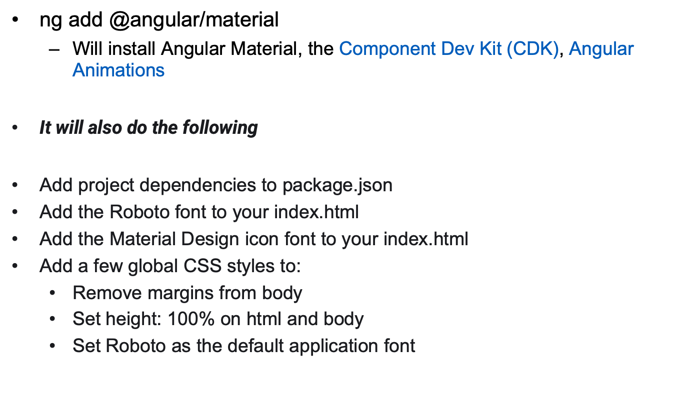
Install Angular Material

Slide 75
Adding Material Component
  import {MatMenuModule} from '@angular/material/menu';
  import {MatButtonModule} from '@angular/material/button';
  @Component({
  selector: 'menu-overview-example',
  templateUrl: 'menu-overview-example.html',
  standalone: true,
  imports: [MatButtonModule, MatMenuModule],
  })
  export class MenuOverviewExample {}

Slide 76
Add Menu
  <button mat-button [matMenuTriggerFor]="menu">Menu</button>
  <mat-menu #menu="matMenu">
  <button mat-menu-item>Item 1</button>
  <button mat-menu-item>Item 2</button>
  </mat-menu>

Slide 77
BUILDING APPLICATION

Slide 78
Ahead of Time compilation
Biggest change in Angular 4
In AoT mode, Angular compiles templates during the build, and generates JavaScript code
Just in Time mode, where this compilation is done at runtime, when the application starts
Application starts faster (as the code generation is already done).

Slide 79
Just-in-Time Compilation
Development of Angular application with TypeScript.
  Compilation of the application with tsc.
  Bundling.
  Minification.
  Deployment.
Once Application is deployed
User opens browser
  Download all the JavaScript assets.
  Angular bootstraps.
  Angular goes through the JiT compilation process,
    generation of JavaScript for each component in application.
  The application gets rendered.

Slide 80
Ahead-of-Time Compilation
Development of Angular application with TypeScript.
Compilation of the application
  Performs compilation of the templates with the Angular compiler and generates (usually) TypeScript.
  Compilation of the TypeScript code to JavaScript.
  Bundling.
  Minification.
  Deployment.
When the User Open on Browser
  Download all the assets.
  Angular bootstraps.
  The application gets rendered.

Slide 81
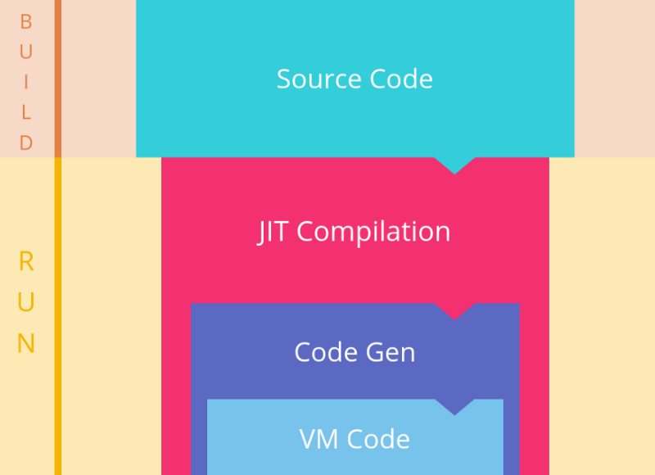
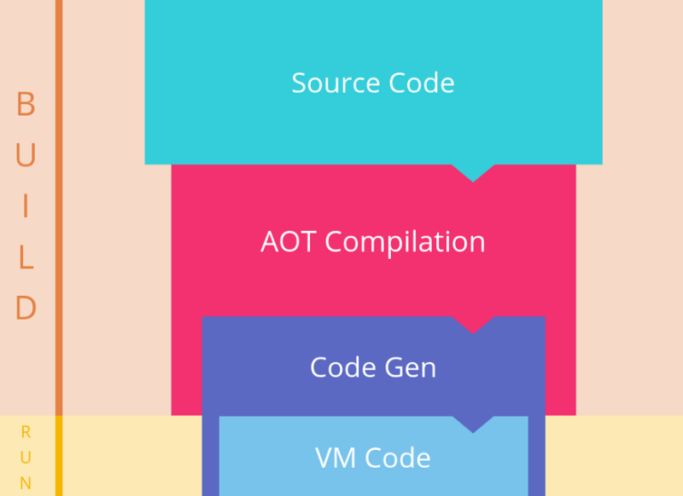
AOT and JIT

Slide 82
Configuring Environment
angular.json file
"environments": {
"dev": "environments/environment.ts",
"prod": "environments/environment.prod.ts"
}
ng serve --dev
ng serve –prod

Slide 83
Production Build Using AOT
AOT compiling is now the default compilation method with Angular CLI
To Build with AOT
  ng build --prod
To build with JIT
  ng build
  ng build --prod --no-aot
  npm install enhanced-resolve@3.3.0

Slide 84
Production Build
ng build
  creates a /dist folder.
vendor.bundle.js
polyfills.bundle.js
main.bundle.js
inline.bundle.js
styles.bundle.js

Slide 85
Production Build
ng build --prod flag
  Removes unwanted white space by minifying files.
  Uglifies files by renaming functions and variable names.
  AoT compilation, which removes the compilation process at runtime and instead performs compilation during the build process.
Can put the contents of the /dist folder and upload them to site.

Slide 86
LIFE CYCLE HOOKS

Slide 87
Lifecycle Hooks
Components have lifecycle managed by Angular.
  Provide visibility into life moments
  Can act when they occur.
  Represented by interfaces which is optional .
  Hook methods are called if they are defined.
Life Cycle Hooks are Called
  When Angular Creates ,renders its children,
  While checking its data-bound properties change,
  While destroying and before removing from the DOM.

Slide 88
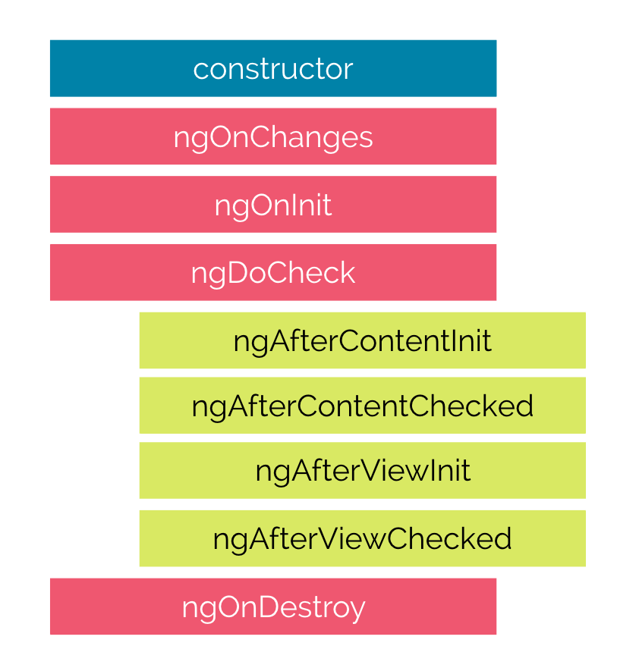
Lifecycle Hooks

Slide 89
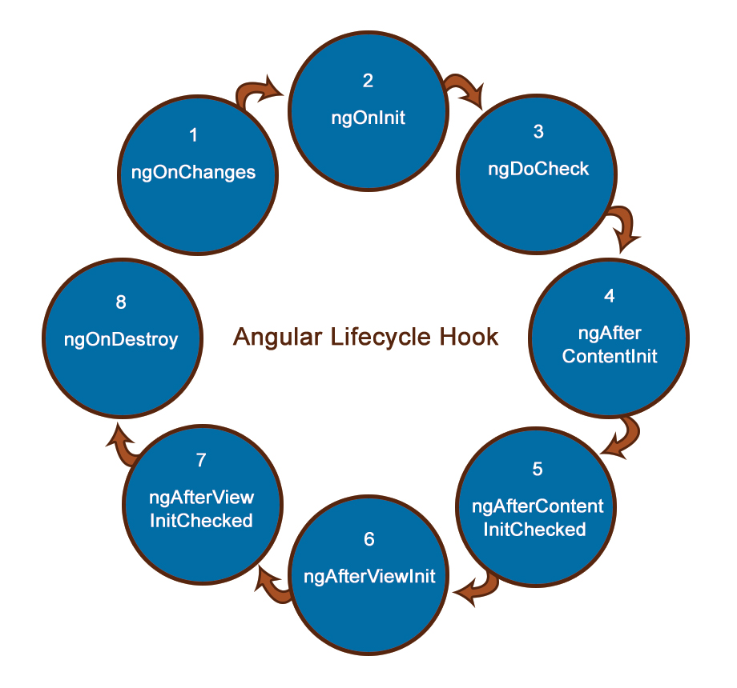
Life cycle Sequence

Slide 90
Constructors
Invoked when a component or directive are created by calling new on the class.
A typescript feature and used only for a class instantiations
  Has nothing to do with Angular
  JavaScript engine calls the constructor, and not directly by Angular
Its called first time before the ngOnInit().
Dependencies Required for the Component are Injected through Constructor

Slide 91
ngOnInit()
Called after the first ngOnChanges, but only once.
Fires when the component is ready for use when all queries (content child and view child queries) and inputs have been resolved.
It’s the place to perform complex initializations shortly after construction;
Can fetch or set initial data
@Input() properties are available inside ngOnInit
Added to every component by default by the Angular CLI.

Slide 92
ngOnChanges()
Fired when Angular sets and resets data-bound input properties.
The method receives a SimpleChanges object of current and previous property values.
Called when an input or output binding value changes.
  Is called the first time before ngOnInit

Slide 93
Simple Changes
  ngOnInit() {
  this.currentValue = 'Ramesh';
  this.previousValue = 'Kumar';
  }
  ngOnChanges(changes: SimpleChanges): void {
  for (const propertyName in changes) {
  if (propertyName) {
  const change = changes[propertyName];
  const current = JSON.stringify(change.currentValue);
  this.currentValue = change.currentValue;
  const previous = JSON.stringify(change.previousValue);
  this.previousValue = change.previousValue;
  }
  }

Slide 94
After View Init
View is the template of the current component.
  Triggered after all the child components that are directly used in the template of the component are finished initializing and their views updated with bindings.
  After this life cycle hook is called, there will be no additional change detection
  If the component has a reference to a view child and this reference is used within the components view, the component will become dirty
Can Invoke change detection mechanism.
  Done by Injecting ChangeDetectorRef to Constructor

Slide 95
Change Detection
Can Invoke change detection mechanism.
  Done by Injecting ChangeDetectorRef to Constructor
detectChanges()
  Method is called when ViewChild property is changed
  Can also use manual change detection
  Checks the view and its children
  Fixes the “Expression has changed after it was last checked,” error

Slide 96
ngAfterViewInit
  Import ChangeDetectorRef from @angular/core
  constructor(private cd: ChangeDetectorRef) {}
  ngAfterViewInit() {
  this.messageViewChild.message = 'Passed as View Child';
  this.cd.detectChanges();
  }

Slide 97
ngOnDestroy()
ngAfterContentInit:
  Content is what is passed as children
  Its projected at some <ng-content> element of a component.
  Its called after external content has been projected into the component.
ngOnDestroy
  Used to clean up any necessary code when a component is removed from the DOM.
  Used to unsubscribe from things like services.

Slide 98
Other Life Cycle Hooks
ngDoCheck:
  Fired each time anything that can trigger change detection has fired (e.g. click handlers, http requests, route changes, etc…).
  Used for debug purposes;
ngAfterContentChecked:
  called after every check of component content;
ngAfterViewChecked:
  called after every check of a component’s view(s);

Slide 99
Index.html
  <body>
  <h2>Using Angular Elements</h2>
  <my-button label='Login'></my-button>
  </body>

Slide 100
@ViewChild
  A variable is decorated with @ViewChild
  Returns the first element that matches the selector
  Can be used to access following from the Parent Component,
    Child Component by Component Name
    Directive by Directive Name
    DOM Element with template reference variable
    Can also Access the Services added as Provider in Child

Slide 101
Child Components
  export class GuestPhotosComponent implements OnInit {
  guestPhoto: string;
  constructor() {
  this.guestPhoto = 'assets/images/frntView.jpg';
  }
  }
  export class HotelPhotosComponent implements OnInit {
  hotelPhoto: string;
  constructor() {
  this.hotelPhoto = 'assets/images/rearView2.jpg';
  }
  }

Slide 102
Parent Component
  export class GalleryComponent implements OnInit, AfterViewInit
  {
  hp: string;
  gp: string;
  @ViewChild(GuestPhotosComponent) guestPhotos: GuestPhotosComponent;
  @ViewChild(HotelPhotosComponent) hotelPhotos: HotelPhotosComponent;
  ngAfterViewInit(): void {
  this.gp = this.guestPhotos.guestPhoto;
  this.hp = this.hotelPhotos.hotelPhoto;
  }
  }

Slide 103
Parent Template
  <app-guest-photos></app-guest-photos>
  <app-hotel-photos></app-hotel-photos>
    <img src={{gp}} alt='hello'>
    <img src={{hp}} alt='style'>

Slide 104
Passing Data Between Siblings
Data between siblings, grandchildren passed by a shared service.
RxJS BehaviorSubject
  Will return the current value on subscription
  A Service is injected into the constructor of one Component
  It then subscribe to an observable
  Set its value equal to a variable.

Slide 105
Behavior Subject
A special type of observable
  Needs an initial value
  Always return a value on subscription
On subscription
  Can Return the last value of the subject.
  Can also send values to a subject in addition to subscribing to it.
Returns an Observable using the asObservable()

Slide 106
BehaviorSubject
  let bSubject = new BehaviorSubject("a");
  bSubject.next("b");
  bSubject.subscribe(value => { console.log(“Got", value);
  // Got b,
  bSubject.next("c"); // Got c
  bSubject.next("d"); // Got d

Slide 107
Service
  export class DataService {
  private currentMessage =
  new BehaviorSubject<string>('My Desktop Suggestion');
  constructor() { }
  changeMessage(message: string) {
  this.currentMessage.next(message);
  }
  }

Slide 108
Component - 1
  export class ComputerComponent implements OnInit {
  suggestion: string;
  constructor(private service: DataService) { }
  ngOnInit() {
      this.service.currentMessage.subscribe(
      message => {
      console.log('Msg in Computer' + message);
      this.suggestion = message;
      });
  }
  }

Slide 109
Component 2 - Template
  {{response}}
  <button (click)="newMessage()">suggest </button>

Slide 110
Component -2
  export class PrinterComponent implements OnInit {
  response: string;
  constructor(private service: DataService) { }
  ngOnInit() {
    this.service.currentMessage.subscribe(message => {
    console.log('Msg in Printer' + message);
    this.response = message;
    });
  }
  newMessage() {
  console.log('Printer is changing message ');
  this.service.changeMessage(' Dell Desktop');
  } }

Slide 111
Component Interactions
Parent to Child
  Sharing Data via Input()
Child to Parent
  Sharing Data via ViewChild()
Child to Parent
  Sharing Data via Output() and EventEmitter
Unrelated Components
  Sharing Data with a Service

