Slide 1
Angular
A platform that makes it easy to build applications with the web.
It combines declarative templates, dependency injection, end to end tooling
Integrated best practices to solve development challenges.
Empowers developers to build applications that live on the web, mobile, or the desktop
_x000b_

Slide 2
Angular1.X vs Angular 2
Angular 2 shares some concepts with its predecessor
  the special HTML templating syntax,
  directives/components to modify the DOM
Has Introduced better strategies and concepts to improve the performance
  By updating data binding concept.
Angular 1 may not be deprecated or will not lack support
  It will be there to stay
Angular 2 is Well designed and its is mobile oriented.
  Need for Iconic framework is minimized
  Component based without any controllers or scopes.

Slide 3
Single Page Application
HTML is a great declarative language for static documents.
  It does not contain much in the way of creating applications,
One "real" HTML page whose content can be changed in Javascript without having to download a new page.
  The new content is created programmatically using templates.
  Server sends an application engine along with the HTML page
The engine controls the entire application including processing, input, output, painting, and loading of the HTML pages.
Server is used when there is a need for new data or must perform secured operations such as authentication.

Slide 4
MVC on Client Side
Client side MVC
  MVC framework is built entirely on the client side.
  Server only delivers data to the application.
  The binding of the data to the models happens client side.
Need for client-side MVC
  operations are not only with HTML but with data on the page.
  when data is collection of JSON
  Process data, perform all required calculations, render HTML and put that into page.
  CRUD actions , over REST API.
  adding or deleting should not make page to reload
  can update page according to current data state.

Slide 5
Webpack Dev Server
The Webpack also comes with a development server.
Can be used run application as we are developing the application.
The Development server uses the Webpack’s watch mode.
Any changes made to our application are instantly updated.
Configured by using the webpack.config.js. Configuration file

Slide 6
Angular Development Environment
Installing Angular CLI
Done by using the following command.
    npm install -g @angular/cli
    npm install -g @angular/cli@6.1.1
    ng -version
Creating the Project
  Created by executing the following command from the Prompt
  ng new “gettingstarted” –routing
  To Skip creating test artificats --skip-tests
  Creates a folder gettingstarted and copies all the required files and configuration settings.

Slide 7


Slide 8
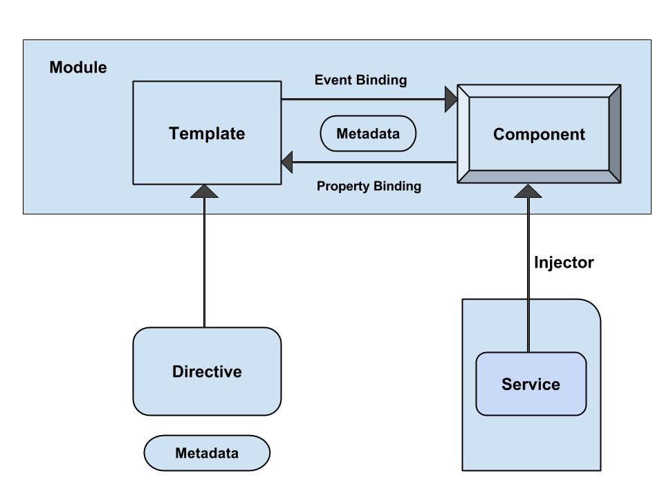
Angular - Architecture

Slide 9
Angular Application Folder structure
Creates a Sample Angular Application
It contains the subfolders node_modules and src.
It also contains the few configuration files
Angular.json
  This is the configuration file for Angular CLI

Slide 10
package.json
It also creates a package.json which contains dependencies
  {
  "name": "quickstart",
  "version": "0.0.0",
  "scripts": {
  },
  "dependencies": {
  },
  "devDependencies": {
  }
  }

Slide 11
Packages.json
Script Section
  This Script section contains many of the most useful commands
  Ng,start,test etc
devDependencies Section
  This section contains the entries required for application development
  Typescript,karma,jasmine,protractor etc.,

Slide 12
Updating package.json
Can also add in Project’s package.json and run update
  "dependencies": {
  "bootstrap": "^5.3.2",
  "jquery": "^3.7.1",
  "popper.js": "^1.16.1",
  }
  npm install jquery --save
  npm install popper.js --save

Slide 13
Adding to angular.json
  "styles": [
  "src/styles.css",
  "node_modules/bootstrap/dist/css/bootstrap.min.css",
  ],
  "scripts": [
  "node_modules/jquery/dist/jquery.min.js",
  "node_modules/bootstrap/dist/js/bootstrap.min.js"
  ]

Slide 14
Sample Application
app/app.component.ts
  where root component is defined
app/app.component.css
  where Css Styles are defined
app/app.component.html
  where HTML templates are defined
app/app.component.spec.ts
  where Test Specification are defined
app/app.module.ts
  - the entry Angular Module to be bootstrapped
index.html
  this is the page the component will be rendered in
app/main.ts
  - is the glue that combines the component and page together

Slide 15
@Component decorator
Components are decorated with @Component decorator.
Provides Metadata about component
It consists of three main parts
  @Component({
  selector: 'app-root',
  templateUrl: './app.component.html',
  styleUrls: ['./app.component.css']
  })

Slide 16
Scoped Package
  import { Component } from '@angular/core’;
  Package names also have a scope.
  Scopes are preceded by an @ symbol and followed by a slash
  Scopes are a way of grouping related packages together
  Each npm user/organization has their own scope
  A way to signal official packages for organizations.

Slide 17
Export and Import Component
  @Component({
  selector: 'app-root',
  templateUrl: './app.component.html',
  styleUrls: ['./app.component.css']
  })
  export class AppComponent {
  title = 'app';
  }

Slide 18
app/app.component.html
  <div style="text-align:center">
  <h1>
  Welcome to {{title}}!!
  </h1>
  </div>

Slide 19
app/app.module.ts
The Angular applications are organized as modules.
  application must have at least one module.
  root Module is loaded first
  Reference of root component type is passed as argument
  Its called as root module
Application routes declarations should be done here

Slide 20
NgModule
Modules are class decorated with the @NgModule
Decorator function which has one argument
  A metadata object with properties describing the module.
Some of its important properties are:
Bootstrap Array
Export Array
Import Array
Provider Array.

Slide 21
Modules
Bootstrap array
  Used to inform which components need to be loaded, so that its functionality can be accessed in the application.
Export array
  Used to export components, directives, and pipes which can then be used in other modules.
Import array
  Used to import the functionality from other modules.
Providers array
  Used to provide the services by the module

Slide 22
Modules
  import { NgModule } from '@angular/core';
  import { BrowserModule } from '@angular/platform-browser';
  import { CreditCardModule } from '../credit-card/credit-card.module';
  import { AppComponent } from './app.component';
  @NgModule({
  imports: [ BrowserModule, CreditCardModule ],
  declarations: [AppComponent],
  bootstrap: [AppComponent] })
  export class AppModule { }

Slide 23
Built in Modules
BrowserModule from @angular/platform-browser
  Used to run application in a browser.
CommonModule from @angular/common
  Used for directives - NgIf, NgFor and so on.
FormsModule from @angular/forms
  Used when to build template driven forms.
RouterModule from @angular/router
  Used for routing RouterLink, forRoot, and forChild.
HttpClientModule from @angular/common/http
  Used to initiate HTTP request and responses

Slide 24
app/main.ts
Makes angular to load the AppModule and controls the start up of the application
bootstrapModule method of platformBrowserDynamic library
  to bootstrap AppModule
  import { platformBrowserDynamic } from '@angular/platform-browser-dynamic';
  import { AppModule } from './app/app.module';
  platformBrowserDynamic().bootstrapModule(AppModule) .catch(err => console.error(err));

Slide 25
index.html
  <html>
  <head>
  <link rel="icon" type="image/x-icon" href="favicon.ico">
  </head>
  <body>
  <app-root></app-root>
  </body>
  </html>
The selector “app-root”, defined in component metadata is used as HTML tag.
Angular scans the HTML page for <app-root>
  replaces the entire content with content of app.component.html

Slide 26
Running an Angular Application
ng serve
  command launches the server,
  Watches files, and rebuilds the app
  serves an Angular project via a development server
Using the --open or -o option
  will automatically open browser on http://localhost:4200/.
ng serve --port 5050
  Will change the default port to 5050

Slide 27
Generating Components
ng generate or ng g
Ng generate component footer
ng g component my-new-component
ng g component feature/new-cmp
Creating a new component, generates the following files
  component.html (View)
  component.ts (Controller)
ng generate --help
  To View all available options Angular CLI.

Slide 28
Component Class
The basic building block of an UI
  An application is a tree of components.
Component decorator marks a class as an Angular component
A component must belong to an NgModule in order for it to be usable by another component or application.
Component Class has a constructor() to setup Dependency Injection
Components can control their runtime behavior by implementing various Life-Cycle hooks.

Slide 29
Configuring More than One Bootstrap Component
  Done in the app.module.ts
  import { AppComponent } from './app.component';
  import { HeaderComponent } from './app.headercomponent';
  @NgModule({
  declarations: [
  AppComponent,
  HeaderComponent,
  ],
  imports: [
  BrowserModule
  ],
  providers: [],
  bootstrap: [AppComponent,HeaderComponent]
  })
  export class AppModule { }

Slide 30
Header Component
  import { Component, OnInit } from '@angular/core';
  @Component({
  selector: 'app-header',
  templateUrl: './header.component.html',
  styleUrls: ['./header.component.css']
  })
  export class HeaderComponent {
  banner: string;
  constructor() {
  this.banner = 'assets/images/Banner.jpg';
  }
  }

Slide 31
Data Binding - Interpolation
communication between a component and it’s Template
  {{ expression }} to render the bound value to the component’s template.
  To weave calculated strings into the text between
    HTML element tags and within attribute assignments.
  Replaces the name with the string value of the corresponding component property
  <img src={{banner}} class='banner' />

Slide 32
Index.html
  <!doctype html>
  <html lang="en">
  <head>
    <base href="/">
    <meta name="viewport" content="width=device-width, initial-scale=1">
    <link rel="icon" type="image/x-icon" href="favicon.ico">
  </head>
  <body>
      <app-header> </app-header>
      <app-root> </app-root>
  </body>
  </html>

Slide 33
TEMPLATES

Slide 34
Angular Templates
Templates mix native HTML with custom elements.
Inline Templates
  Specified directly in the component decorator
  Template literals with back-ticks allow multi-line strings.
  @Component({
  selector: 'inline-template',
  template: ` <h2>Inline Template</h2>
  <p> Multi-line inline template using back-ticks </p>`
  })
  export class InlineComponent {}

Slide 35
Angular Templates
External Templates
  Defined in a separate HTML file
  Referenced with templateUrl.
  Recommended to use if the template contains more than 3 lines.
  @Component({
  selector: 'external-template',
  templateUrl: 'app/templates/external-template.html'
  })
  export class ExternalComponent {}

Slide 36
Built-in Directives -ngFor
Part of core directive to build data presentation lists and tables
Takes an iteration expression
A loop variable defined using the keyword let
  <tr *ngFor="let medicine of medicineList">
    <td>{{medicine.medicineName}}</td>
    <td>{{medicine.price}}</td>
    <td>{{medicine.unit}}</td>
  </tr>
  <tr *ngFor="let medicine of medicineList let i=index">
  <td>{{i+1}}</td>
  </tr>

Slide 37
SERVICES

Slide 38
Dependency Injection
The ability to add functionality to components at runtime.
  Simplify dependency management in software components.
Done by reducing the amount of information a component needs to know about its dependencies,
  unit testing can be made easier and code is more likely to be flexible.

Slide 39
Services
A service is used when a common functionality needs to be provided to various modules.
  Eg: A database functionality that could be reused among various modules.
A separate class which has the injectable decorator
  ng g service my-new-service
Can also be added to the module to use the service as a provider in the @Component decorator.
Services are singleton objects.
Services are capable of returning the data in the form promises or observables.

Slide 40
@Injectable
@Injectable()
  Let know a class can be used with the dependency injector.
  Not strictly required if the class has other Angular decorators on it.
  Best practice is to decorate injectables with @Injectable(), as it is makes more sense to the reader.
providedIn: 'root‘
  Indicates that the root injector is responsible for creating an instance
  These are automatically made available to the entire application
  Don't need to be listed in any module.

Slide 41
Service
  import { Injectable } from '@angular/core';
  @Injectable({
  providedIn: 'root'
  })
  export class MedicineService {
  medicines: Medicine[] = [{id:101, medicineName : ‘crocin'}, {id:102, medicineName : metacin'}];
  constructor() { }
  getMedicines(){
  return this. medicines
  }
  }

Slide 42
Injecting the Service
Register Has a provider in app-module.ts
  providers: [MedicineService],
Injected into the Component through Constructor
  export class ShowComponent {
  details:Medicine [];
  constructor(medicineService : MedicineService) {
  this.details = medicineService. getMedicines();
  }
Access it in the template
<li *ngFor="let eachDetail of details">{{eachDetail. medicineName}}</li>

Slide 43
PROPERTY BINDING

Slide 44
Types of Property Binding
Element property binding
  works within HTML element
  binds a component property to a DOM property.
    <img [src]=" imageUrl ">
Component property binding
  works within component element
  binds parent component property into child component property.
  <app-child [info]=‘data’></app-child>
Directive property binding
  Works within HTML element with angular directives such as NgClass and NgStyle.
  Component property or any angular expression is bound to angular directive.

Slide 45
ELEMENT PROPERTY BINDING

Slide 46
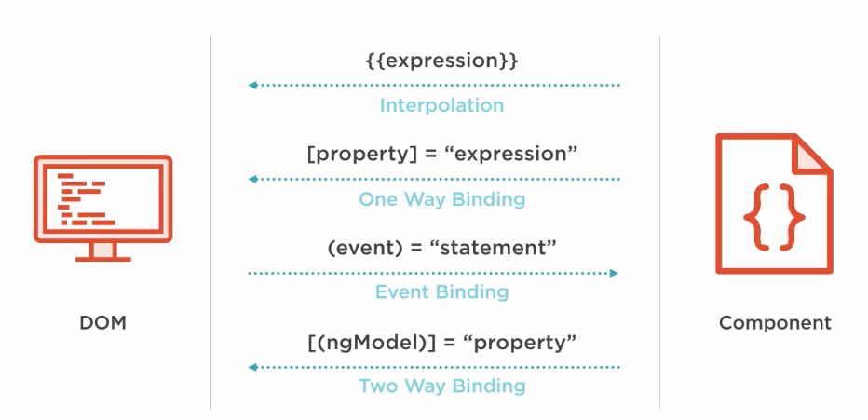
Element Property Binding

Slide 47
Property Binding
  A One way Binding
    from the component class, to the component’s template.
  sets an element property to a component property value.
  Can be Used for non-string data value.
Done by wrapping brackets around an element
  <img [src]=" imageUrl ">
  <button [disabled]='isDisabled'>Try Me</button> // in the template
  isDisabled: boolean = true; // in the component class

Slide 48
Event Binding
Event handler are is specified inside the template using ()
  Event handler is then coded in the class to process the event.
Can take the same property that is on the HTML element wrap it in parenthesis.
  template: `
  <h1>My First Angular App</h1>
  <img [src]="imageUrl" (click)='myMethod()'> `
      imageUrl =‘’assets/images/idly.jpg'
  myMethod() {
  console.log('Hello);
  }

Slide 49
Event Binding
Can also pass information about the event to the component class:
  ` <img src=“{{imageUrl}}" (click)='myMethod($event)'> `
  myMethod(event:any) {
  console.log(event);
  }

Slide 50
Two Way Binding
Combines the input and output binding into a single notation
Done by using a special directive called ngModel.
<input [(ngModel)]="name" >
  <input [ngModel]="name" (ngModelChange)="name=$event">
square braces [..] refers property binding.
circle braces (..) refers to the event binding.
  Together as [(..)] refers two way binding
This syntax is called Banana in a Box ([()]).

Slide 51
Two Way Binding- App Module
  import { FormsModule } from '@angular/forms';
  @NgModule({
  declarations: [
  AppComponent,
  ],
  imports: [
  BrowserModule,FormsModule
  ],
  providers: [],
  bootstrap: [AppComponent]
  })

Slide 52
Two Way Binding
  <div> <label>Name:</label>
  <input type="text" [(ngModel)]="name">
  <h1>Hello {{name}}!</h1> </div>
  export class AppModule {
  private name:string='World';
  }

Slide 53
DIRECTIVES

Slide 54
Directives
Used to attach behavior to DOM elements.
Built-in directives to the framework
  NgFor, NgIf, NgModel, NgClass
There are three kinds of directives:
Components
  @Component(): Is also a directive with a template.
Structural Directives
  Can change the DOM layout by adding and removing DOM elements
Attribute Directives
  doesn’t change the DOM but can change the appearance or behavior of an element such as NgStyle.

Slide 55
Attribute Directives
These directives change the appearance or behavior of a component.
They work in a way that is component agnostic and not bound to implementation details.
Example:
  ngClass and ngStyle work on any component or element.

Slide 56
NgStyle Directive
To modify a component or element's style attribute.
  @Component({
  selector: 'style-example',
  template: `
  <p [ngStyle]="{'background-color':messageStyle}">
  `
  })
  export class StyleExampleComponent {
  messageStyle:string='yellow';
  }

Slide 57
NgClass Directive
Directive changes the class attribute that is bound to the component or element it's attached
Binding a string
  Can bind a string directly to the attribute.
  @Component({
  selector: 'class-as-string',
  template: `
  <p [ngClass]='centerText'>Page Designed by Ramesh</p>
  `,
  Binding an Array : A list of applicable class names defined in css
  <p [ngClass]="['centerText','highLight']">Page Designed by Ramesh</p>

Slide 58
[ngClass] - Binding an object
Object can also be bound to the directive.
Template
  <button (click)='change()' class="fa fa-2x"
  [ngClass]="{'fa-toggle-up':showup,'fa-toggle-down':showdown}">
  </button>
  Component.ts
  showup =true;
  showdown =false;
  change(){
  this.showup = !this.showup;
  this.showdown = !this.showdown;
  }

Slide 59
Structural Directives
It’s a "syntactic sugar" for tasks that’s done Internally,
  * Means angular should create a template element
  Expression passed will be bound to the outer <ng-template>
  Template will be rendered related to variable passed to the directive
  It might add /remove/manipulate the host element and its descendants.
ngIf , ngFor , and ngSwitch .

Slide 60
Built-in Directives -ngFor
Part of core directive to build data presentation lists and tables
Takes an iteration expression
A loop variable defined using the keyword let
  <tr *ngFor="let medicine of medicineList">
    <td>{{medicine.medicineName}}</td>
    <td>{{medicine.price}}</td>
    <td>{{medicine.unit}}</td>
  </tr>
  <tr *ngFor="let medicine of medicineList let i=index">
  <td>{{i+1}}</td>
  </tr>

Slide 61
ngFor
ngFor also provides some other values that can be bound to:
  index - position of the current item in the iterable starting at 0
  first - true if the current item is the first item in the iterable
  last - true if the current item is the last item in the iterable
  even - true if the current index is an even number
  odd - true if the current index is an odd number
  *ngFor="let emp of employees;
  let even = even; let odd = odd"
  [ngClass]="{ odd: odd, even: even }"> {{emp.name}}

Slide 62
Built-in Directives –ngIf
*ngif="condition“
  <div>
  <button (click) =“clicked()”>Toggle</button>
    <div *ngIf=“show”>
    <p> see Image</p>
    </div>
  </div>
  export class AppComponent{
  show:boolean =true;
  Clicked (){
  this.show=!this.show;
  }
  }

Slide 63
ngIf
<h2 *ngIf="condition">Hello {{name}}</h2>
<button (click)="condition = !condition">Click</button>
// When the above code is Rendered
  <ng-template [ngIf]=“condition">
  <h2 >Hello {{name}}</div>
  </ng-template>
  <!--bindings={
  "ng-reflect-ng-if": "true"
  }-->
  <h2 _ngcontent-c0="">Hello Angular5</h2>

Slide 64
NESTING COMPONENTS

Slide 65
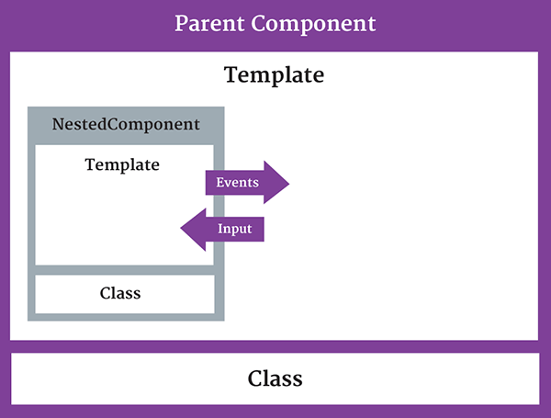
Nested Component
The component being used inside another component is known as the child component
  and the enclosing component is known as the parent component.

Slide 66
Nested Component -Child
  import { Component } from '@angular/core';
  @Component({
  selector: 'appchild',
  template: `<h2>Hi {{greetMessage}}</h2>` })
  export class AppChildComponent {
  greetMessage: string = "I am Child";
  }

Slide 67
Nested Component- Parent
  import {Component } from '@angular/core';
  import {AppChildComponent} from './appchild.component';
  @Component({
  selector: 'my-app',
  template: `<h1>Hello {{message}}</h1>
  <appchild></appchild> `,
  })
  export class AppComponent {
  message : string = "I am Parent";
  }

Slide 68
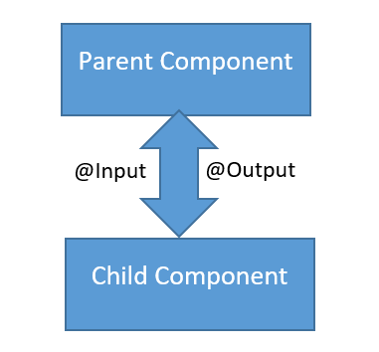
Communication Between Components
Can share data and information with another component by passing data or events.
Components can communicate to each other in different ways:
  Using @Input()
  Using @Output()
  Using Services
  Parent component calling ViewChild

Slide 69
PASSING DATA USING @INPUT
  To pass data into components from template and to dynamically configure them.
  Supports change tracking.
  Can NOT pass @Input() to a bootstraped component.
Binds a property within one component (child component) to receive a value from another component (parent component).
  One way communication from parent to child.
Component property should be annotated to act as input property.

Slide 70
Child Component
  import { Component,Input,Output,EventEmitter, OnInit } from '@angular/core';
  @Component({
  selector: 'review-food',
  templateUrl:'reviews.component.html',
  styleUrls: ['../food-items/food/food.component.css']
  })
  export class ReviewsComponent {
  @Input() reviewedby:string=‘’;
  details='Reviewed by 200 peoples';
  }

Slide 71
Parent Component-One Way Component Property Binding
  import { ReviewsComponent } from '../../reviews/reviews.component';
  @Component({
  selector: 'app-food',
  templateUrl: './food.component.html',
  styleUrls: ['./food.component.css'],
  })
  export class FoodComponent {
  reviewer:string = 'Zomoto';
  }
Reviwed by <review-food [reviewedby]='reviewer'></review-food>
Parent component sets the value of the child component’s property
Input Property as defined in Child
Bound property in Parent

Slide 72
@Input Required
@Input({required:true}) heading :string=‘’
@Input({alias:'customprop',required:true}) heading :string=‘’
@Input alias
  Don’t want let use the same property name outside the component to bind to that property.
<app-showproduct [customprop]='majHeading'></app-showproduct>
<h1>{{heading}}</h1>

Slide 73
@output
One way communication from child to parent component
Uses events
  binds a property of a component to send data from one component (child component) to calling component (parent component).
The child component exposes an EventEmitter property
  It emits events when something happens.
  The parent binds to that event property and reacts to those events.
The child's EventEmitter property is an output property,
  Its adorned with an @Output decoration
  @Output()
  sendMsgEvent = new EventEmitter<string>();
  sendMsgEvent will be custom event name.

Slide 74
Child Component
  import { Component,Input, Output,EventEmitter,OnInit } from '@angular/core';
  export class ChildComponent implements OnInit {
  @Input() childName: string;
  @Output() result: EventEmitter<string> = new EventEmitter<string>();
  constructor() { }
  ngOnInit() { }
  addData(){
  this.result.emit(this.childName + 'Added');
  }
  }
Property placeholder to receive from parent
Property To Parent

Slide 75
Emit
emit()
  emit a change to (change) listener in the parent
  Which will invoke the onchange($event) callback
  The data associated with the event will be given via the $event property.
Child-Component.html
  <p>
  <button (click)="addData()">Add Medicine</button>
  </p>

Slide 76
Parent-component.html
  <input type="text" name='user' [(ngModel)]='name'>
  <p>
  <app-child [childName] ={{name}} (result)="onChange($event)"></app-child>
  {{msg}}
  </p>
  childName : refers to @Input Property in to Child Component
  name : refers to property in the Parent Component
  Result : refers to @output Property in Child Component

Slide 77
Parent Compnent
  import { Component, OnInit, SimpleChanges } from '@angular/core';
  @Component({
  })
  export class ParentComponent implements OnInit {
  msg: string;
  name: string;
  constructor() { }
  ngOnInit() {
  }
  onChange(val) {
  this.msg = val;
  }
  }

Slide 78
Child Components
  export class GuestPhotosComponent implements OnInit {
  guestPhoto: string;
  constructor() {
  this.guestPhoto = 'assets/images/frntView.jpg';
  }
  }
  export class HotelPhotosComponent implements OnInit {
  hotelPhoto: string;
  constructor() {
  this.hotelPhoto = 'assets/images/rearView2.jpg';
  }
  }

Slide 79
Parent Template
  <app-guest-photos></app-guest-photos>
  <app-hotel-photos></app-hotel-photos>
    <img src={{gp}} alt='hello'>
    <img src={{hp}} alt='style'>

Slide 80
PIPES

Slide 81
Pipes
“Pipes transform displayed values within a template.”
  A pipe takes in data as input and transforms it to a desired output.
Used in any template.
Inside the interpolation expression, pipe operator ( | ) is used
Expression | pipeOperator[:pipeArguments]

Slide 82
Passing arguments
Can pass optional arguments to the pipe.
  Arguments are added to the pipe using a colon (:) sign followed by the value of the argument.
  Multiple arguments can be separated colon (:).
Date pipe accepts one optional argument called “format”.
  {{toDate | date:'medium'}}
  Nov 22, 2016, 10:04:10 PM
  Pipes can be chained together with useful combinations.
    {{ birthday | date:'fullDate' | uppercase}}

Slide 83
Built In Pipes
  DatePipe,
  UpperCasePipe, LowerCasePipe,
  CurrencyPipe,
  PercentPipe,
  JsonPipe,
Some of pipes not supported in New versions of Angular 2
  orderBy and filter
Can by achieved by using “custom pipes”.

Slide 84
Date Pipe
date_expression | date[:format]
format indicates which date/time components to include.
  'medium': equivalent to 'yMMMdjms' (e.g. Sep 3, 2010, 12:05:08 PM for en-US)
  'fullDate': equivalent to 'yMMMMEEEEd' (e.g. Friday, September 3, 2010 for en-US)
  'mediumDate': equivalent to 'yMMMd' (e.g. Sep 3, 2010 for en-US)
  'mediumTime': equivalent to 'jms' (e.g. 12:05:08 PM for en-US)
  'shortTime': equivalent to 'jm' (e.g. 12:05 PM for en-US)

Slide 85
Decimal Pipe
To format a number as decimal number according to locale rules.
It uses number keyword with pipe operator.
number_expression | number[:digitInfo]
number_expression:
  An angular expression that will give output a number.
number :
  A pipe keyword that is used with pipe operator.
digitInfo :
  Defines number format.
  {minIntegerDigits}.{minFractionDigits}-{maxFractionDigits}
  {{450.997 | number:'3.2-2'}} // 451.00
  {{450.992 | number:'3.2-2'}} // 450.99

Slide 86
Currency Pipe
currency [ : currencyCode [ : display [ : digitsInfo [ : locale ] ] ] ] }}
currencyCode is the ISO 4217 currency code,
  USD for the US dollar and EUR for the euro.
display
  code: Show the code (such as USD).
  symbol(default): Show the symbol (such as $)
  String: Use the given string value instead of a code or a symbol.
digitInfo
  <p> {{salary | currency:‘USD':'symbol':'4.2-2‘ : ‘fr’}}</p>

Slide 87
Percentage Pipe
Formats a number as a percentage according to locale rules.
number_expression | percent[:digitInfo]
number_expression:
  An angular expression that will give output a number.
percent :
  A pipe keyword that is used with pipe operator and it converts number into percent
digitInfo:
  defines a percentage format.
  {minIntegerDigits}.{minFractionDigits}-{maxFractionDigits}

Slide 88
*R*eactive E*x*tensions for *J*ava*S*cript
A stream in the RxJS represents values over time
  A library for composing asynchronous and event-based programs by using observable sequences.
Observable
  A function that produces a stream of values to an observer over time.
Observer
  Observer is the one which subscribes to an observable
  Read values coming from an observable.
  An observer has three callbacks that accept notifications coming from the observer,
    Next ,error,complete

Slide 89
RxJS
The create() method accepts a single argument subscribe function.
This subscribe function accepts an observer argument.
  import {Observable} from 'rxjs';
  ngOnInit(): void {
  const obs = Observable.create((observer: any) => {
    observer.next('Will be sent');
    observer.next('This too will be sent');
    observer.complete();
    observer.next('Will not be sent');
  });
  obs.subscribe((x: any) => console.log(x));
  }

Slide 90
HttpClient
Introduced in the Angular 4.3.
Available in package @angular/common/http
  To replace the older HttpModule.
The Response returned from the HttpClient is an observable
  Needs to be Subscribed.
  The response can be converted to desired object

Slide 91
Http Client Module
  import {HttpClientModule, HttpClient} from '@angular/common/http';
  @NgModule({
  declarations: [
  AppComponent,
  ],
  imports: [
  BrowserModule ,HttpClientModule],
  providers: [HttpClient],
  bootstrap: [AppComponent]
  })
  export class AppModule { }

Slide 92
HttpClient
get() :
  parses the JSON server response into the anonymous Object type.
  Can specify the type of response to make consuming the output easier and more obvious.
  this.http.get<Medicine[]>(this.baseURL)

Slide 93
Get Method
  @Injectable( { providedIn: 'root‘ }
  )
  export class MedicineApiService {
  constructor(private http: HttpClient) { }
  baseURL = 'http://localhost:3000/medicines';
  findAll(): Observable<Medicine[]> {
  return this.http.get<Medicine[]>(this.baseURL);
  }
  }

Slide 94
Subscribe()
.subscribe(success, failure, completed);
Success:
  Whenever observable returns a value.
  (response) => { this.repos=response; }
Failure:
  When observable is failed to generate the expected data or has encountered some other error.
  (error) => {this.errorMessage=error; this.loading=false; },
Completed:
  When the observables complete its task.
  () => {this.loading=false;})

Slide 95
Subscribing
  @Component({
  selector: 'app-crud',
  templateUrl: './crud.component.html',
  styleUrls: ['./crud.component.css']
  })
  export class CrudComponent implements OnInit {
  medList: Medicine[]
  constructor(private service: MedicineApiService) { }
  ngOnInit() {
  this.service.findAll()
  .subscribe(data => this.medList = data, err => console.log(err));
  }
  }

Slide 96
HttpResponse
Can provide observe option to specify return data type
  By default, observe is set to body.
  response which returns the full response
  events which returns the full event stream
  findAll(): Observable<HttpResponse<Object> {
  return this.http.get<Object>(this.baseURL, {observe: 'response'});
  }
  this.service.findAll().subscribe(resp => {
  this.weekEndTripList = <Weekendtrip[]> (resp.body);
  console.log(resp.status);
  console.log(resp.headers.get('content-type'));
  });

Slide 97
Using Promise
    findAllWithPromise(): Promise<Medicine[]> {
  return this.http.get<Medicine []>(this.baseURL).toPromise();
  }
Can use in the Component
this.service.findAllWithPromise().then(
res => this.medicineList = res ).catch(
err => console.log(err.error));

Slide 98
Post and Delete Method
  add(medicine): Observable<Medicine> {
  const headers =
  new HttpHeaders().set('content-type', 'application/json');
  return this.http.post<Medicine>(this.baseURL, medicine, {headers});
  }
  remove(codeNumber): Observable<Medicine> {
  return this.http.delete<Medicine>(this.baseURL + '/' + codeNumber);
  }

Slide 99
Delete Method
remove(loan: LoanCustomer): Observable<LoanCustomer> {
const headers =
new HttpHeaders().set('content-type', 'application/json');
return this.client.request<LoanCustomer>('Delete',
this.baseURL, { body: loan, headers});
}

