Slide 1

Spring Framework
Rod Johnson

Slide 2
IoC Container
Introduction
Basic Containers and Beans
Dependencies
Bean Scope
The Application Context
Quick Start Spring Application Using Eclipse IDE

Slide 3
Spring Framework
Light-weight comprehensive framework for building Java SE and Java EE applications
Created by Rod Johnson
Java Bean-based configuration management,
Uses Inversion-of-Control principles, specifically using the Dependency Injection technique

Slide 4
Key Features
Suite for Both Java SE and EE
IoC Container
Integration with persistence frameworks.
MVC web application framework
Java Transaction API and a single JDBC Data Source
  This removes the dependency on a Java EE environment for transaction support.
Aspect-oriented programming (AOP) framework

Slide 5
History of Spring Framework
The Spring Framework was first released in 2004
Spring 2.0
  provided XML namespaces and AspectJ support;
Spring 2.5
  embraced annotation-driven configuration;
Spring 3.0
  Support for Java 5+ across the framework codebase,
  Java-based @Configuration model.
Spring 4.0
  Fully support Java 8 features.
  The minimum requirement is Java SE 6

Slide 6
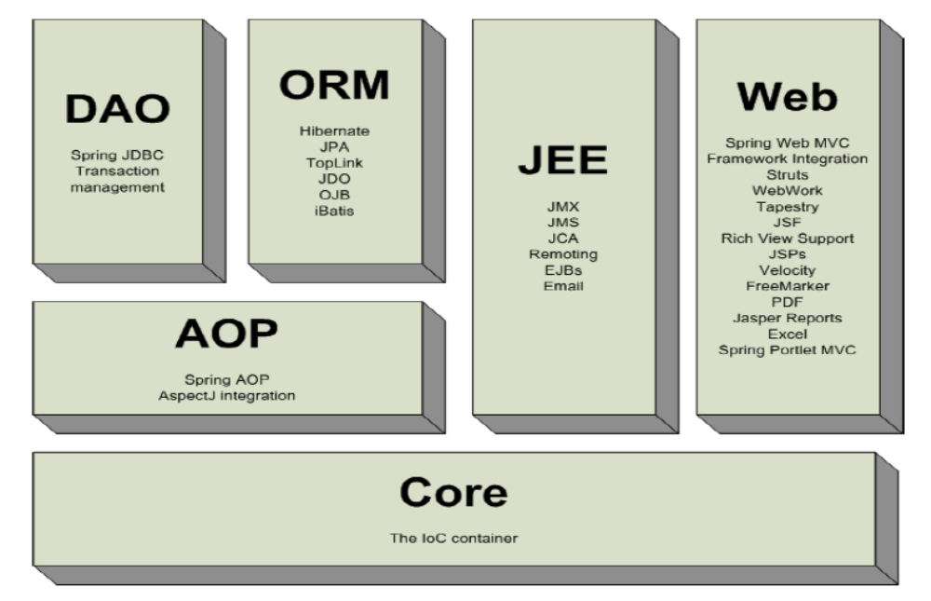
Spring Framework

Slide 7
IoC Container
Introduction
Basic Containers and Beans
Dependencies
Bean Scope
The Application Context
Quick Start Spring Application Using Eclipse IDE

Slide 8
Dependency Injection
A pattern of injecting a class’s dependencies into it at runtime.
Achieved by defining the dependencies and then injecting in a concrete class
Can swap in different implementations without having to modify the main class.
Promotes high cohesion by promoting the Single Responsibility Principle (SRP)

Slide 9
Dependency Inversion Principle
public class Messaging {
MessageService service;
public void sendMssage(){
service.sendMessage();
} }
public interface MessageService {
public String sendMessage();
}
public class Email implements MessageService {
public String sendMessage() { }
}
High-level modules should not depend on low-level modules.
Both should depend on abstractions.
High Level Module
Abstraction
Low Level Module

Slide 10
Inversion of Control Container(IoC)
A container that supports Dependency Injection.
No Need to create objects but describe how they should be created.
Describe which services are needed by which components in a configuration file.
Objects are given their dependencies at creation time by the IoC
IoC - inversion of responsibility with regard to how an object obtains references to collaborating objects.

Slide 11
Container and Beans
org.springframework.beans.factory.BeanFactory is the representation of the Spring IoC container
  containing and managing beans,
  instantiating or sourcing application objects
  configuring such objects
  assembling the dependencies between objects.
A bean is an object that is instantiated, assembled, and otherwise managed by a Spring IoC container.
Beans, and the dependencies among them, are reflected in the configuration metadata used by a container

Slide 12

The Container
There are more than one implementations of the BeanFactory interface
The most commonly used BeanFactory implementation is the XmlBeanFactory class.
The XmlBeanFactory takes the XML configuration metadata and uses it to create a fully configured system or application.

Slide 13
Beans
The term “bean” is used to refer any component managed by the BeanFactory
The “beans” are in the form of JavaBeans (in most cases)
  Present in a Named Package
  No Argument constructor
  getter and setter methods for the properties
  Can be controlled for scope, life cycle and callbacks.
Beans are singletons by default
Properties the beans may be simple values or references to other beans

Slide 14
The Bean – A Java Class
  public class Customer {
  private int customerNumber;
  private String customerName;
  private long handPhone;
  public Customer() {
  super();
  }
    //SET/GET Methods
    }

Slide 15
Simple XML Configuration
  <?xml version="1.0" encoding="UTF-8"?>
  <beans xmlns="http://www.springframework.org/schema/beans"
  xmlns:xsi="http://www.w3.org/2001/XMLSchema-instance"
  xsi:schemaLocation="http://www.springframework.org/schema/beans
  http://www.springframework.org/schema/beans/spring-beans-2.5.xsd">
  <bean id="..." class="...">
  <!-- collaborators and configuration for this bean go here -->
  </bean>
  <bean id="..." class="...">
  <!-- collaborators and configuration for this bean go here -->
  </bean>
  <!-- more bean definitions go here -->
  </beans>

Slide 16
Configuration Meta-Data
Spring Container uses the meta-data to instantiate, configure, and assemble the objects of the Application
XML-based metadata and Annotation Based metadata can be used to form configuration metadata.
Configuration consists of one or more bean definition.
Beans are configured as <bean/> elements inside a top-level <beans/> element.

Slide 17
Setter Injection
All dependencies injected via setter methods
  No need for constructors
Allows flexible initialization
  Any set of properties can be initialized
Named properties allow for readable configuration data
  Clear what is being injected
Requires Java Bean conventions to be followed
  Non standard method names are problematic
Can result in invalid object configurations
  Need post initialization checking methods

Slide 18
Setter Dependency Injection
  <?xml version="1.0" encoding="UTF-8"?>
  <beans xmlns="http://www.springframework.org/schema/beans"
  xmlns:xsi="http://www.w3.org/2001/XMLSchema-instance"
  xsi:schemaLocation="http://www.springframework.org/schema/beans http://www.springframework.org/schema/beans/spring-beans.xsd">
  <bean id="custBean" class="com.training.domains.Customer">
  <property name="customerNumber" value="1010“/> <property name="customerName" value="Ramesh“/> <property name="handPhone" value="90898989“/>
  </bean>
</beans>

Slide 19
Bean Lookup
To interact directly with the bean Container to get a specific bean according to its name, type, or both.
This is done with overloaded methods getBean() defined in interface FactoryBean.
This interface is implemented by ApplicationContext classes.
ApplicationContext ctx = ...
  MyBean beanRef = (Bean) ctx. getBean (" beanID");
  MyBean beanRef = ctx. getBean (" beanID ", MyBean. class );
  MyBean a = ctx. getBean (MyBean. class );

Slide 20
Spring Application
package com.training.applications;
import org.springframework.beans.factory.BeanFactory;
Import org.springframework.context.support.FileSystemXmlApplicationContext;
import com.training.domains.Customer;
public class QuickStart {
  public static void main(String[] args) {
BeanFactory fact =new FileSystemXmlApplicationContext("bean.xml");
Customer cust =(Customer)fact.getBean("custBean2");
System.out.println(cust);
  }
  }

Slide 21
Application Context
ClassPathXmlApplicationContext:
  Loads a context definition from an XML file located in the classpath,
  context definition files as classpath resources.
FileSystemXmlApplicationContext
  Loads a context definition from an XML file in the file system.
XmlWebApplicationContext
  Loads context definitions from an XML file contained within a web application.

Slide 22
Bean Factory and Application Context
Application Context
Bean Factory
Can have more than one config files
Publish events to beans that are registered as listeners
Support internationalization (I18N) messages
Support application lifecycle events, and validation.
Support for JNDI , EJB, remoting
In this only one config file or .xml file
Doesn’t support.
Doesn’t support
Doesn’t support.
Doesn’t support.

Slide 23
Constructor-based or setter-based DI?
Constructor arguments for mandatory dependencies and setters for optional dependencies.
Constructor dependency , disadvantage is that the object becomes less amenable to reconfiguration and re-injection.
A legacy class may not expose any setter methods, and so constructor injection is the only available DI.

Slide 24
Bean.xml
  <beans xmlns="http://www.springframework.org/schema/beans"
  xmlns:xsi="http://www.w3.org/2001/XMLSchema-instance"
  xmlns:aop="http://www.springframework.org/schema/aop"
  xmlns:context="http://www.springframework.org/schema/context"
  xsi:schemaLocation="http://www.springframework.org/schema/beans
  http://www.springframework.org/schema/beans/spring-beans.xsd
  http://www.springframework.org/schema/context
  http://www.springframework.org/schema/context/spring-context.xsd">
  </beans>

Slide 25
Pom.xml
  <dependency>
  <groupId>org.springframework</groupId>
  <artifactId>spring-core</artifactId>
  <version>4.2.5.RELEASE</version>
  </dependency>
  <dependency>
  <groupId>org.springframework</groupId>
  <artifactId>spring-context</artifactId>
  <version>4.2.5.RELEASE</version>
  </dependency>
  <dependency>
  <groupId>org.springframework</groupId>
  <artifactId>spring-beans</artifactId>
  <version>4.2.5.RELEASE</version>
  </dependency>

