Slide 1

INTRODUCTION TO SPRING BOOT

Slide 2
Introduction
Spring
  An application development framework and inversion of control container for Java
Spring Boot
  Makes it easy to create stand-alone, production-grade Spring Applications and expose them as services

Slide 3
DEPENDENCY INJECTION

Slide 4
Dependency Injection
Dependencies between the beans can be Injected by following ways
  Setter Injection (Using Setter Methods)
  Constructor Injection (Using the Constructors)
  Field Injection (@Autowired at field)
  Method Injection ( A Special type)

Slide 5
Setter Injection
All dependencies injected via setter methods
  No need for constructors
Allows flexible initialization
  Any set of properties can be initialized
Named properties allow for readable configuration data
  Clear what is being injected
Requires Java Bean conventions to be followed
  Non standard method names are problematic
Can result in invalid object configurations
  Need post initialization checking methods

Slide 6
Constructor Dependency Injection
Container invokes a class constructor with a number of arguments, each representing a dependency on the other class
Dependency can be one of the following
  primitive and String-based values
  Dependent object (contained object)
  Collection values

Slide 7
Constructor-based or setter-based DI?
Constructor arguments for mandatory dependencies
  Object becomes less amenable to reconfiguration and re-injection.
Setters for optional dependencies.
  Legacy class may not expose any setter methods

Slide 8
REGISTERING BEANS

Slide 9
@ Component
Bean are Managed by IoC Container.
@Component
  Spring can scan all the beans through auto scan if the class has this or similar annotation
By default the First character of the component is lower Cased
  ‘CustomerService’ to ‘customerService’.
CustomerService cust = (CustomerService)context.getBean("customerService");

Slide 10
@ComponentScan
  @Configuration
  @ComponentScan("com.training")
  public class Config {
  }
Class with @Component are candidates for component scanning.
If required during component scanning dependent components will be autowired together.

Slide 11
Java Based Configuration
XML is orthogonal to Java
Configuration is centralized
  It Could also also be split
Simplified autowiring.
A Java Class analogous to bean.xml is created it will be annotated with @Configuration
  To indicate that the class can be used as a source of bean definitions.

Slide 12
Java Based Configurtion
@Bean
  Method with this annotation will return an object that should be registered as a bean in the Spring application context.
@Configuration
public class EmployeeConfig {
@Bean
public Employee employee(){
return new Employee();
}
}
ID of the Bean

Slide 13
@Bean
Method-level annotation
Supports following attributes
  init-method
  destroy-method
  autowiring
Can be used in Class annotated with
  @Configuration
By default, the bean name is the same as the method name.

Slide 14
Customizing Bean Naming
@Bean method’s name is the name of the resulting bean.
It Can be overridden with the name attribute
  @Bean(name = “malar")
  public Hospital hospital() {
  return new Hospital();
  }
  }

Slide 15
Bean Dependencies
Bean-annotated method can have an arbitrary number of parameters
  Each Parameter describe the dependencies required to build that bean.
  @Bean()
  public Catalog catalog() {
  return new Catalog(101,"Classical Menu",address());
  }
  @Bean
  public Address address() {
  return new Address("Gandhi Street","behru Nagar","chennai",600040);
  }

Slide 16
Spring Boot
Extension of the Spring framework
  A faster and more efficient development
Eliminates the boilerplate configurations required for setting up a Spring application.
  Opinionated ‘starter’ dependencies to simplify build and application configuration
  Embedded server to avoid complexity in application deployment
  Metrics, Health check, and externalized configuration
  Automatic configuration whenever possible

Slide 17
Spring Initializr
https://start.spring.io/
  A web-based UI tool provided by the Pivotal
  Used to generate the structure of the Spring Boot Project.
  Can configure the list of dependencies
  Package downloaded as Jar or War file
  Import as a Maven Project into STS

Slide 18
Spring Boot Starters
Set of convenient dependency descriptors
Eliminates the need to hunt through sample code
No need to copy-paste loads of dependency descriptors.
Contains lot of the dependencies that are required to get a project up and running
Also has support of managed transitive dependencies.

Slide 19
Creating a Spring Boot Project
In the Eclipse IDE Right-click in the package explorer and select New -> Spring Starter Project
A screen opens with some details which can be changed or can accept the default values for a simple project
The entry point of a Spring Boot application is the class which is annotated with @SpringBootApplication:
Uses this class with public static void main entry-point to launch an embedded web server.

Slide 20
Spring Boot Bootstrap
  @SpringBootApplication
  public class Application {
  public static void main(String[] args) {
  SpringApplication.run(Application.class, args);
  }
  }
Spring Boot can scan all the classes in the same package or sub packages of Main-class for components.
Equivalent to using @Configuration, @EnableAutoConfiguration, and @ComponentScan with their default attributes,

Slide 21
LOMBOK

Slide 22
Introduction
A java library that automatically plugs into editor and build tools
Helps reduce the boiler plate code.
Has various annotations which can be used within our code that is be processed during the compile time and appropriate code expansion would take place based on the annotation used.
Does the code reduction in view time, after the compiling the byte code is injected with all the boiler plate.
This helps keeping our codebase small, clean and easy to read and maintain.

Slide 23
Adding Lombok to Eclipse
Downloaded from https://projectlombok.org/download
Execute command in terminal: java -jar lombok.jar
Will Open a window requesting Eclipse Destination
Copy lombok.jar into Eclipse Parent Directory directory.
Add the following command to end of Eclipse..ini
  -javaagent:lombok.jar .
Restart Eclipse and enable “Annotation Processing”

Slide 24
Lombok Annotation
To generate Setters and Getters
  @Getter
  @Setter
To generate constructors,
  @NoArgsConstructor
  @RequiredArgsConstructor
Other Annotations
  @ToString
  @EqualsAndHashCode
  @Data
  @Slf4j

Slide 25
DEMO

Slide 26
Tourist Guide
  @Data
  @AllArgsConstructor
  @NoArgsConstructor
  public class TouristGuide {
  private long id;
  private String guideName;
  private long mobileNumber;
  }

Slide 27
Tour
  @Data
  @AllArgsConstructor
  @NoArgsConstructor
  public class Tour {
  private long tourId;
  private String tourName;
  private int duration;
  private double price;
  private TouristGuide guide;
  }

Slide 28
Configuration
  @Configuration
  public class AppConfig {
  // Setter DI
  @Bean
  public Tour lanka() {
  Tour lanka = new Tour();
  lanka.setTourId(101);
  lanka.setPrice(23000);
  lanka.setTourName("Superb Srilanka");
  lanka.setDuration(12);
  return lanka;
  }

Slide 29
Configuration
  // Constructor DI
  @Bean
  public Tour thailand() {
  // Passing Reference of One Bean to Another Bean - Done Using ref in earlier Versions
  return new Tour(102,"Beautiful Bali",5,52000,swapnil());
  }
  @Bean
  public TouristGuide swapnil() {
  return new TouristGuide(101,"Swapnil Sawant",98495952);
  }
  }

Slide 30
Spring Application
  public static void main(String[] args) {
  ConfigurableApplicationContext ctx = SpringApplication.run(BootIocApplication.class, args);
  Tour lankaTour = ctx.getBean("lanka",Tour.class);
  System.out.println(lankaTour);
  System.out.println(ctx.getBean("thailand",Tour.class));
  ctx.close();
  }

Slide 31
SpringApplication
SpringApplication
  Class to bootstrap a Spring application from a Java main method.
  Creates an appropriate ApplicationContext instance
  Registers a CommandLinePropertySource to expose command line arguments as Spring properties,
  Refreshes the application context, loading all singleton beans, and triggers any CommandLineRunner beans.

Slide 32
Spring Boot Bootstrap
  @SpringBootApplication
  public class Application {
  public static void main(String[] args) {
  SpringApplication.run(Application.class, args);
  }
  }
  @SpringBootApplication
  Equivalent to using following with their default attributes
    @Configuration,
    @EnableAutoConfiguration,
    @ComponentScan

Slide 33
SPRING STEREOTYPES

Slide 34
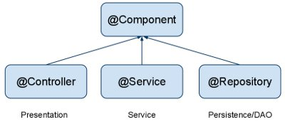
Auto Component Scan Types
@Component
  Indicates a auto scan component.
@Repository
  Indicates DAO component in the persistence layer.
@Service
  Indicates a Service component in the business layer.
@Controller
  Indicates a controller component in the presentation layer.

Slide 35
Auto Wiring of Bean
@autowired :
  Used to auto wire bean on the setter method, constructor or a field.
  It uses auto wire bean by matching data type.
  @autowired(required =false)
  Exception will be thrown when matching bean is not found
  required attribute is used to disable this checking
  Will leave the property unset.
@qualifier
  Used to control which bean should be autowired on a field.
  If there are two similar beans, can specify the bean name to wire

Slide 36
Disambuguation options
getBean()
  accepts both a class and a bean name
  bean ids must be unique, this call guarantees that the ambiguity cannot occur.
Service service = context.getBean(Service.class, "myService");

Slide 37
Lazy-initialized beans
  @Bean()
  @Lazy(value=true)
  public Employee myBean() {
  System.out.println("Loading LazyBean bean");
  return new Employee(employee_Id,employee_Name);
  }

Slide 38
Life Cycle Methods
  @Component
  public class Invoice {
  @PostConstruct
  public void myInit()
  {
  System.out.println("Inside init Method");
  }
  @PreDestroy
  public void myDestroy()
  {
  System.out.println("Inside Destroy Method");
  }
  }

Slide 39
SPRING BEAN SCOPES

Slide 40
Bean Scope
The Bean Scope for Standard Java SE Beans are singleton:
@Scope(scopeName=ConfigurableBeanFactory.SCOPE_SINGLETON)
  Scopes a single bean definition to a single object instance per Spring IoC container, per container and per bean.
  Single instance will be stored in a cache and all subsequent requests and references will result in cached object being returned.
@Scope(value=ConfigurableBeanFactory.SCOPE_PROTOTYPE)

Slide 41
Bean Scope
The Bean Score for Standard Java SE Beans are singleton:
Scopes a single bean definition to a single object instance per Spring IoC container, per container and per bean.
prototype:
  Prototype results in the creation of a new bean instance every time a request for that specific bean is made
  Can change the Scope by
@Scope(value=ConfigurableBeanFactory.SCOPE_PROTOTYPE)

Slide 42
SPRING AOP

Slide 43
Aspect Oriented Programming
It’s a Programming technique that promotes separation of concerns within a software system
It is not a replacement for Object Oriented Programming.
AOP is another way of organizing Program Structure
An aspect of a program which affect (crosscut) other concerns.
Cross Cutting Concerns
  Transaction management
  Security
  Auditing
  Event handling

Slide 44
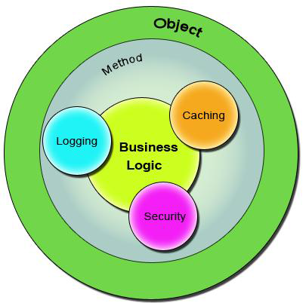
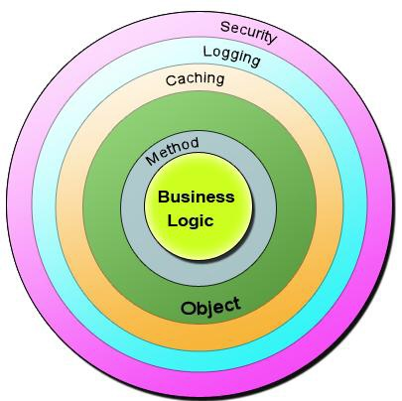
Bean in Spring container

Slide 45
Sample Code
  public class Account {
  public long deposit(long depositAmount){
  newAmount = existingAccount + depositAccount;
  currentAmount = newAmount;
  return currentAmount;
  }
  public long withdraw(long withdrawalAmount){
  if (withdrawalAmount <= currentAmount){
  currentAmount = currentAmount – withdrawalAmount;
  }
  return currentAmount;
  }
  }

Slide 46
The Challenge ?
Requirment -1
  Add security to the Account class - only users with BankAdmin privilege is allowed to do the operations.
Requirement-2
  Account class is to provide some kind of Logging
Requirement-3
Account class need to provide Transaction Management Facility.
New requirements forces the methods and the logic to change a lot which is against the Software Design.
The code has to undergo the Software Development Lifecycle of Development, Testing, Bug Fixing, Development, Testing,

Slide 47
The Solution !
public void deposit(){
// Transaction Management
// Logging
// Checking for the Privileged User
// Actual Deposit Logic comes here
}
public void withdraw(){
// Transaction Management
// Logging
// Checking for the Privileged User
// Actual Withdraw Logic comes here
}
The above logic that cross-cuts or overlaps the existing business logic as Concerns or Cross-Cutting Concerns.
These cross-cutting concerns from the application code can be modularized as different entities.

Slide 48
AOP Terminologies-Aspect
An Aspect is a functionality or a feature that cross-cuts over objects.
Logging and Transaction Management are the aspects.
public void businessOperation(BusinessData data)
{
// Logging logger.info("Business Method Called");
// Transaction Management Begin transaction.begin();
// Do the original business operation here transaction.end();
}

Slide 49
AOP Terminologies-Joint Point
Join Points defines the various Execution Points where an Aspect can be applied.
In Spring AOP, a join point always represents a method execution.
  public void someBusinessOperation(BusinessData data){
  //Method Start - > Possible aspect code here like logging.
  try{
  // Original Business Logic here.
  } catch(Exception exception) {
  // Exception -> Aspect code here when some exception is raised. }
  finally{
  // Finally -> Even possible to have aspect code at this point too.
  }
  // Method End -> Aspect code here in the end of a method.
  }

Slide 50
AOP Terminologies-JoinPoints
Points in the execution of the program
  Start of the Method,
  End of the Method,
  Exception Block,
  Finally Block
In these points an Aspect can be made to execute.
These Execution Points embedding Aspects are called Join Points.
An Aspect need not be applied to all the possible Join Points.

Slide 51
AOP Terminologies-Pointcut
Join Points refer to the Logical Points wherein a particular Aspect or a Set of Aspects can be applied.
A Pointcut or a Pointcut Definition will exactly tell on which Join Points the Aspects will be applied.
Advice
  Advice is the code that implements the Aspect.
  Aspect defines the functionality in a more abstract manner.
  Advice provides a Concrete code Implementation for the Aspect.

Slide 52
Advices
  Before advice :@Before
  Executes before a join point,
  Does not have the ability to prevent execution flow proceeding to the join point (unless it throws an exception).
After returning advice : @AfterReturning
  Executed after a join point completes normally:

Slide 53
Advices
After throwing advice : @AfterThrowing
  Executed if a method exits by throwing an exception.
  After advice :@After
  Executed when normal or exceptional return by which a join point exits
  Around advice : @Around
  Advice that surrounds a join point

Slide 54

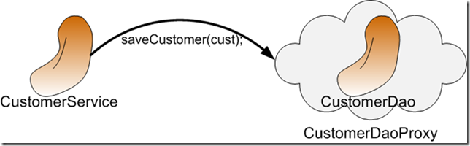
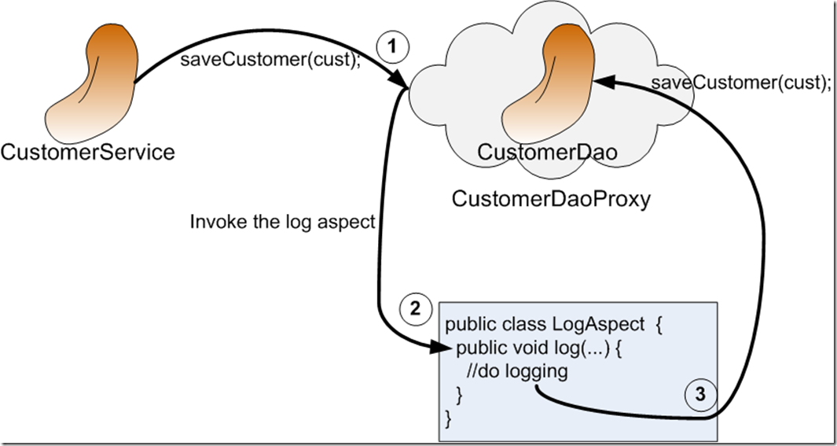
AOP Proxy Mechanism

Slide 55
Using Auto Proxy
Can create proxies automatically for selected bean definitions.
Built on Spring "bean post processor" infrastructure,
Need for ProxyFactoryBean is eliminated
  @Configuration
  @EnableAspectJAutoProxy
  public class AppConfig { }

Slide 56
Pointcut Designators
execution
  Primary designator Spring AOP
  Matching method execution join points
Within
  Matching to join points within certain types

Slide 57
Pointcut Designators
args
  Matching to join points where the arguments are instances of the given types
@args
  Matching to join points where the runtime type of the actual arguments passed have annotations of the given type(s)
@annotation
  Matching to join points where the subject of the join point has the given annotation

Slide 58
Format of an execution expression
executor(modifier? return-type class-path? method-name(parameters?) throws exception-type?)
  execution(
    modifiers-pattern
    returning-type-pattern
    declaring-type-pattern
    name-pattern(param-pattern)
    throws-pattern
  )

Slide 59
Spring Boot Dependency
  <dependency>
    <groupId>org.springframework.boot</groupId>
    <artifactId>spring-boot-starter-aop</artifactId>
  </dependency>

Slide 60
DEMO

Slide 61
Defining Pointcuts
  @Component
  public class CommonPointCutConfigs {
  @Pointcut(
  value = "execution(* com.example.demo.services.*.*(..))")
  public void dataExecution(){}
  }

Slide 62
Using Pointcuts
  @Aspect
  @Configuration
  @EnableAspectJAutoProxy(proxyTargetClass = true)
  public class CustomAspect {
  @Around("com.example.demo.config.CommonPointCutConfigs.dataExecution()")
  public Object around(ProceedingJoinPoint joinPoint) throws Throwable {
  long startTime = System.currentTimeMillis();
  Object obj =joinPoint.proceed();
  long timeTaken = System.currentTimeMillis() - startTime;
  System.out.println(timeTaken);
  return obj;
  } }

Slide 63
PROFILES

Slide 64
Profiles
A way to segregate parts of application configuration and make it only available in certain environments.
Used to load different types or sets of classes
Spring profiles are Created with @Profile annotation.
Profile-specific variants of can be set in the application.properties
By Setting a property value
  spring.profiles.active=test1

Slide 65
Profiles-Cont
application.properties
  spring.profiles.active=prod
  server.port=4040
  spring.application.name=Default
application-dev.properties
  server.port=5050
  spring.application.name=Development
  logging.level.org.springframework=TRACE
  application-prod.properties
  server.port=6060
  spring.application.name=Production
  logging.level.org.springframework=INFO

Slide 66
Profiles -Example
  @Data
  @NoArgsConstructor
  @AllArgsConstructor
  public class UseProfile {
  @Value("${server.port}")
  private int id;
  @Value("${spring.application.name}")
  private String application;

Slide 67
Profiles -Example
  @Autowired
  private Environment env;
  public void init() {
  log.info("Init Method called");
  Arrays.asList(env.getActiveProfiles()).forEach(System.out::println);
  Arrays.asList(env.getDefaultProfiles()).forEach(System.out::println);
  }
  }

Slide 68
Profiles- Contd
  @Bean(initMethod = "init")
  @Profile("dev")
  public UseProfile devProfileBean() {
  return new UseProfile();
  }
  @Bean(initMethod = "init")
  @Profile("prod")
  public UseProfile prodProfileBean() {
  return new UseProfile();
  }

Slide 69
Logging
  public static void main(String[] args) {
  ConfigurableApplicationContext ctx =SpringApplication.run(UsingProfilesApplication.class, args);
  UseProfile bean = ctx.getBean(UseProfile.class);
  log.info(bean.toString());
  ctx.close();
  }

Slide 70
Building Application
Using the Pom.xml
mvn package
Can Use the Generated jar to Execute the application.
$ java -jar target/mymodule-0.0.1-SNAPSHOT.jar

Slide 71
Profiles
A way to segregate parts of application configuration and make it only available in certain environments.
Used to load different types or sets of classes
Spring profiles are Created with @Profile annotation.
  attach a profile name to an @Configuration annotation.
Profile-specific variants of can be set in the application.properties
Profile control two things:
  Influence the application properties
  Which beans are loaded into the application context.

Slide 72
Defining Profiles
  @Bean(initMethod = "init")
  @Profile(Profiles.DEVELOPMENT)
  public UseProfile devProfileBean() {
  return new UseProfile();
  }
  @Bean(initMethod = "init")
  @Profile(Profiles.PRODUCTION)
  public UseProfile prodProfileBean() {
  return new UseProfile();
  }

Slide 73
Profiles -Example
  public class MyDataSource {
  private String driverClass;
  private String jdbcURL;
  return jdbcURL;
  }

Slide 74
Profiles-Cont
  @Configuration
  @Profile("deve")
  public class DevelopmentDataBase {
  @Bean
  public MyDataSource dataBase() {
  return new MyDataSource("OracleDriver", "localHost");
  }
  }

Slide 75
Profiles- Contd
  @Configuration
  @Profile("prod")
  public class ProductionDataBase {
  @Bean
  public MyDataSource dataBase() {
  return new MyDataSource("SqlDriver", "192.100.10");
  }
  }
Application.properties
  spring.profiles.active=prod
  server.port=4040

Slide 76
Activate Profiles
Spring only acts on a profile if it’s activated.
spring.profiles.active
  Not recommended
java -Dspring.profiles.active=foo -jar profiles-0.0.1-SNAPSHOT.jar
spring-boot:run -Dspring-boot.run.profiles=dev

Slide 77
Find the Current Profile
  private Environment environment;
  @PostConstruct
  void postConstruct(){
  String[] activeProfiles = environment.getActiveProfiles();
  logger.info("active profiles: {}", Arrays.toString(activeProfiles));
  }
  }

Slide 78
Command Line Runner
A Functional Interface
A special bean that execute some logic after the application context is loaded and started.
  They are Created within the same application context
  Can create Multiple CommandLineRunner beans
  It can be ordered using the Ordered interface or @Order annotation.
  Has a run() method that accepts array of String as an argument

Slide 79
Building Application
Using the Pom.xml
mvn package
Can Use the Generated jar to Execute the application.
$ java -jar target/mymodule-0.0.1-SNAPSHOT.jar

Slide 80

Spring JDBC

Slide 81
Spring JDBC
Spring Task
  Connection Management
  Statement Management
  ResultSet Management
  Transaction Management
  Exception Handling
Developer Task
  SQL
  Row Data Retrieval
  Parameter Setting

Slide 82
DataBase Access
Two different approaches
  use native resource API only
  or use Spring's DAO implementation helpers
Pre-built integration classes for different APIs
  JDBC: JdbcTemplate
  Hibernate: HibernateTemplate

Slide 83
DAO Layer
Service Layer
DAO Interfaces
DAO Implementations
DB

Slide 84
Spring JDBC – Template pattern
Defines the skeleton of an algorithm in an operation, deferring some steps to subclasses.
Template Method lets subclasses redefine certain steps of an algorithm without letting them to change the algorithms structure.
Register the Dao Implementation class and add the JdbcTemplate as Dependency

Slide 85
Spring JDBC Template
Has many helpful methods for performing CRUD operations
execute(String sql)
  To Issue a single SQL execute, typically a DDL statement.
queryForList(String sql, Object[] args)
  Query given SQL to create a prepared statement from SQL and a list of arguments to bind to the query, expecting a result list.
update(String sql)
  Issue a single SQL update operation (such as an insert, update or delete statement).

Slide 86
Repository Interface
  public interface MyRepository<T> {
  public int add(T t); //create
  public List<Map<String,Object>> findAll(); //read
  public T findById(long id); // read
  public T update(T t); // update
  public T remove(T t); // delete
  }

Slide 87
Entity Class
  @Data
  @AllArgsConstructor
  @NoArgsConstructor
  public class Doctor {
  private long doctorCode;
  private String doctorName;
  private long phoneNumber;
  private String specialization;
  }

Slide 88
Repository Implementation
  @Repository
  public class DoctorRepository implements MyRepository<Doctor> {
  @Autowired
  private JdbcTemplate template;
  @Override
  public int add(Doctor t) {
  String sql = "insert into Doctor values(?,?,?,?)";
  int rowAdded =template.update(sql,t.getDoctorCode(),
  t.getDoctorName(),t.getPhoneNumber(),
  t.getSpecialization());
  return rowAdded;
  }

Slide 89
Repository Implementation
  @Override
  public List<Map<String, Object>> findAll() {
  String sql = "select * from Doctor";
  return template.queryForList(sql);
  }

Slide 90
Repository Implementation
  @Override
  public Doctor findById(long id) {
  String sql = "select doctorCode,doctorName,phoneNumber,Specialization from Doctor where doctorCode=?";
  return this.template.queryForObject(sql,
  new BeanPropertyRowMapper<Doctor>(Doctor.class),id);
  }

Slide 91
Repository Implementation
  @Override
  public Doctor update(Doctor t) {
  Doctor updated = null;
  String sql = "update Doctor set doctorName=? , phoneNumber=?,Specialization=? where doctorCode=?";
  int rowUpdated =this.template.update(sql,t.getDoctorName(),
  t.getPhoneNumber(),
  t.getSpecialization(),
  t.getDoctorCode());
  if(rowUpdated ==1) {
  updated = t;
  }
  return updated;
  }

Slide 92
Repository Implementation
  @Override
  public Doctor remove(Doctor t) {
  Doctor deleted = null;
  String sql = "delete from Doctor where doctorCode =?";
  int rowDeleted = this.template.update(sql,t.getDoctorCode());
  if(rowDeleted ==1) {
  deleted = t;
  }
  return deleted;
  }

Slide 93
Bean Definitions
  @Bean
  public JdbcTemplate template() {
  return new JdbcTemplate(dataSource());
  }
  @Bean
  public DataSource dataSource() {
  DriverManagerDataSource dataSource = new DriverManagerDataSource();
  dataSource.setDriverClassName("com.mysql.jdbc.Driver");
  dataSource.setUrl("jdbc:mysql://localhost:3306/test");
  dataSource.setUsername("root");
  dataSource.setPassword("srivatsan");
  return dataSource;
  }

Slide 94
Client Jar POM
  <dependency>
  <groupId>org.apache.derby</groupId>
  <artifactId>derbyclient</artifactId>
  <version>10.14.2.0</version>
  </dependency>

Slide 95
Derby Bean Definitions
  @Bean
  public JdbcTemplate template() {
  return new JdbcTemplate(dataSource());
  }
  @Bean
  public SimpleDriverDataSource dataSource() {
  SimpleDriverDataSource datasource = new SimpleDriverDataSource();
  datasource.setUrl("jdbc:derby://localhost:1527/SampleDB");
  datasource.setDriver(new org.apache.derby.jdbc.ClientDriver());
  return datasource ;
  }

Slide 96
Invoking Find All Method
  List<BloodDonor> doorList= new ArrayList<>();
  List<Map<String, Object>> rows =
  template.queryForList("SELECT * FROM BloodDonor");
  for (Map < String, Object > row: rows) {
  BloodDonor donor= new BloodDonor();
  donor.setMobileNumber((int) row.get("phoneNumber"));
  donor.setBloodDonarName((String) row.get("donorName"));
  donor.setBloodGroup((String) row.get("bloodGroup"));
  donorList.add(donor);
  }
  return donorList;
  } }

Slide 97
SPRING BOOT MVC

Slide 98
Spring MVC
Web application framework that takes advantage of design principles of Spring framework
  Dependency Injection – Simplified Testing
  Interface-driven design
  POJO without being tied up with a framework
Flexible and extensible via component’s interfaces
Simplifies form handling through its parameter binding, validation and error handling
Abstracts view technology (JSP, Velocity, FreeMarker Excel , PDF)

Slide 99
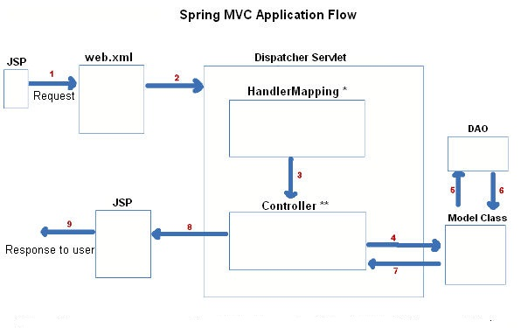
The requesting processing workflow

Slide 100
@Controller
Indicates that a particular class serves the role of a controller.
The dispatcher scans such annotated classes
  Detects and maps Methods with @RequestMapping annotations
  @Controller
  public class WelcomeController {
  @RequestMapping(value="/")
  public String init() {
  return "index";
  }
  }

Slide 101
@RequestMapping
Used to map URLs onto an entire or a class or a particular handler method.
Class-level annotation maps a specific request path or pattern to a controller
Method-level annotations are used to narrow the primary mapping or HTTP request ("GET"/"POST") or to HTTP request parameters.

Slide 102
Model
A map object used to store attribute value pairs
Its created before invoking a handler method if the method has an argument type Model.
  The handler uses the model to store attribute values that convey information to render dynamic views such as JSP.
addAttribute(String name, Object obj)
  Used to map attribute names to object as attribute vales.

Slide 103
Model
  @RequestMapping(value="/")
  public String init(Model model) {
  model.addAttribute("majHeading", "Jeevan Blood Bank");
  return "index";
  }

Slide 104
JSP View
Default embedded servlet container for Spring Boot Starter Web is tomcat.
To enable support for JSP’s, need to add dependencies
  <dependency>
  <groupId>org.apache.tomcat.embed</groupId>
  <artifactId>tomcat-embed-jasper</artifactId>
  </dependency>
  <dependency>
  <groupId>javax.servlet</groupId>
  <artifactId>jstl</artifactId>
  </dependency>

Slide 105
JSP View
tomcat-embed-jasper
  JSP Engine for Tomcat, required to enable JSP with Spring Boot.
  JSP pages are looked up inside /webapp directory.
  webapp directory is Created under the src/main directory,
  Need to configure the view resolver with the prefix and suffix.
  spring.mvc.view.prefix=/WEB-INF/jsp/
  spring.mvc.view.suffix=.jsp

Slide 106
Custom Error Page
To display a custom HTML error page for a given status code,
Can add a file to an /error folder.
Error pages can either be static HTML or built using templates.
The name of the file should be the exact status code
  src/ main//esources/ public/error/ 404.html

Slide 107
Logging and Static Resources
src/main/resources/static
  Folder used to place the css,js and images while using ThymeLeaf
src/main/webapp/styles
  Folder and Subfolder created in webapp while using JSP.
Logging
  In the application.properties file add the entries like below
  logging.level.org.springframework=TRACE
  logging.level.org.springframework.web=TRACE

Slide 108
ModelAndView object
Encapsulates both model and view that is to be used to render model
Model is represented as a java.util.Map
Objects can be added to without name:
  addObject(String, Object) – added with explicit name
  addObject(Object) – added using name generation (Convention over Configuration)
View is represented by String or View object
Analogous to Struts Action

Slide 109
@ModelAttribute
When Used as method parameter, maps a model attribute to the specific, annotated method parameter
The controller gets a reference to the object holding the data entered in the form.
When used at method level provides reference data for the model
The @ModelAttribute annotated methods are executed before the chosen @RequestMapping annotated handler method.
This helps in pre-populating the implicit model with specific attributes,

Slide 110
Spring Validation
JSR-303 Bean Validation API is used by Spring.
The standardized validation constraint declaration and metadata
Annotate domain model properties with declarative validation constraints and the runtime enforces them.
Can define own custom constraints.

Slide 111
Hibernate inbuilt Validation
  <dependency>
  <groupId>org.hibernate.validator</groupId>
  <artifactId>hibernate-validator</artifactId>
  </dependency>
@AssertFalse
@Email
@Length
@Range

Slide 112
Validation - @Valid
To trigger validation of a @Controller input,
  Input arguments are annotated with @Valid
  @PostMapping(path="/donors")
  public String greetingSubmit(@Valid @ModelAttribute("command") BloodDonor donor, BindingResult result) {
  if(result.hasErrors()) {
  return "addDonor";
  } else {
  return "result";
  }
  }

Slide 113
Model
  public class BloodDonor {
  private int id;
  @Length(min = 3,max = 8)
  private String name;
  @DateTimeFormat(pattern = "yyyy-MM-dd")
  private LocalDate dateOfBirth;
  private String bloodGroup;
  }

Slide 114
Controller
  @Controller
  public class WelcomeController {
  @RequestMapping(value="/")
  public String init(Model model) {
  model.addAttribute("majHeading", "Jeevan Blood Bank");
  return "index";
  }
  }

Slide 115
Controller - @Valid annotation
  @RequestMapping(“/donors")
  public String initAddDonorForm(Model model) {
  model.addAttribute("command",donor);
  return "addDonor";
  }
  @PostMapping(path="/donors")
  public String greetingSubmit(@Valid @ModelAttribute("command") BloodDonor donor, BindingResult result) {
  if(result.hasErrors()) {
  return "addDonor";
  } else {
  return "result";
  }
  }

Slide 116
@RequestParam
Use to bind request parameters to a method parameter in the controller.
  @RequestMapping(value="/find",method=RequestMethod.GET)
  public String findSupplier(@RequestParam("phoneNumber") long number,Model model)
  {
  Supplier found= dao.find(number);
  model.addAttribute("foundSupplier",found);
  return "ShowSupplier";
  }

Slide 117
SpringBootServletInitializer
Used to run a SpringApplication from a WAR on a web container.
  Binds the following beans from application context to the server
  Servlet, Filter and ServletContextInitializer
Done by extending SpringBootServletInitializer
  overriding the configure() method.
configure()
  Uses SpringApplicationBuilder to simply register as a configuration class of the application
  Method to point to itself, to make Spring find the main configuration.

Slide 118
ServletInitializer
  @SpringBootApplication
  public class WarInitializerApplication extends SpringBootServletInitializer {
  @Override
  protected SpringApplicationBuilder configure(
  SpringApplicationBuilder builder) {
  return builder.sources(WarInitializerApplication.class);
  }
  public static void main(String[] args) {
  SpringApplication sa = new SpringApplication(
  WarInitializerApplication.class);
  sa.run(args);
  } }

